Slide 1
Input for NA2 Service evolution after the end of EGI-InSPIRE
Gergely Sipos
gergely.sipos@egi.eu
EGI-InSPIRE TNA2.5 leader

Slide 2
Global services in NA2
TNA2.5 – Technical Outreach to New Communities:
Training Marketplace (TMP)
Since December 2010 (variant of the EGEE Training services)
Client Relationship Management system (CRM)
Since May 2012 (for the request of the NGI Council)
Applications Database (AppDB)
Continuation of an EGEE service

Slide 3
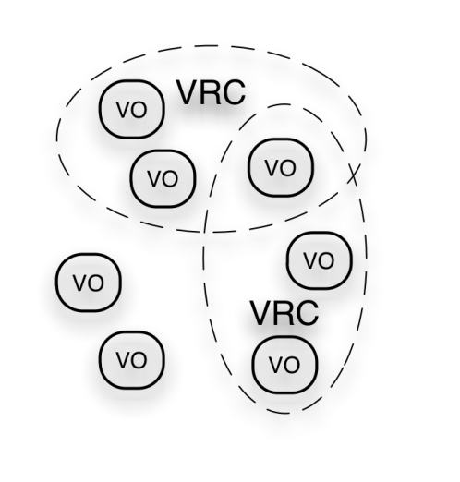
NA2 services in context
User Community
Policies + Funding
Requirements + Feedback
Services + Support
EGI-InSPIRE
NA2 services
Service & Resource Providers
Requirements + Feedback
Public Funding Bodies
Policies + Funding
Requirements + Feedback
European Commission
EGI.eu
Technology Providers
NA2 services
Open Source Providers
National Research Councils
Resource Infrastructure Providers
Strategic Feedback
Technology + Support
Commercial Providers
Policies + Funding

Slide 4
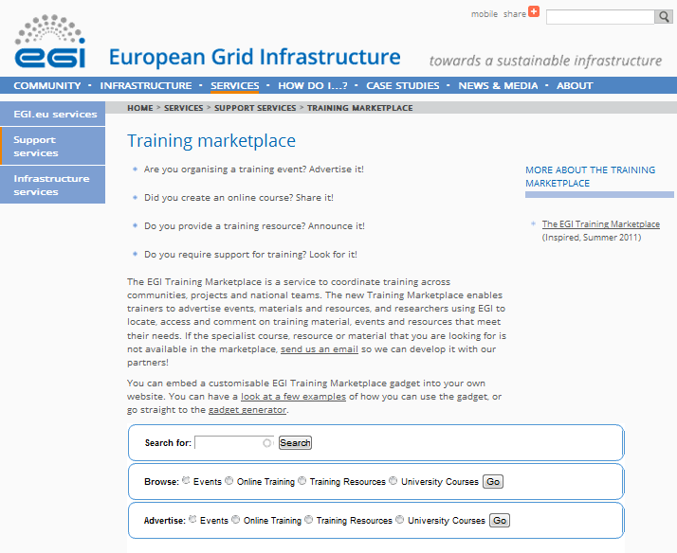
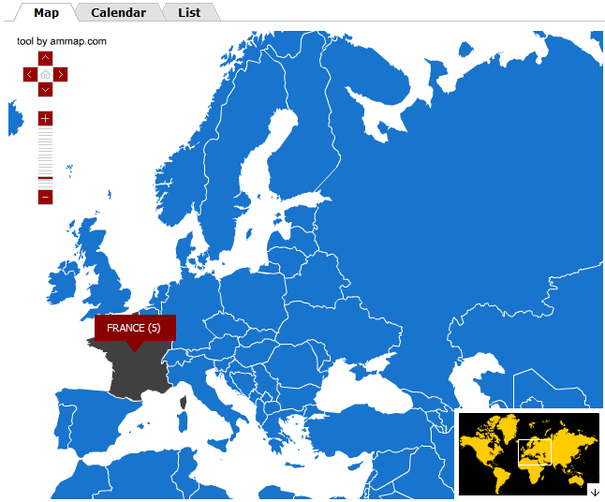
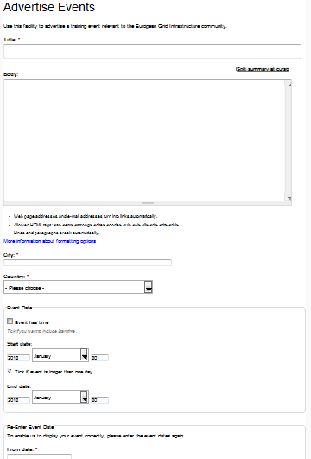
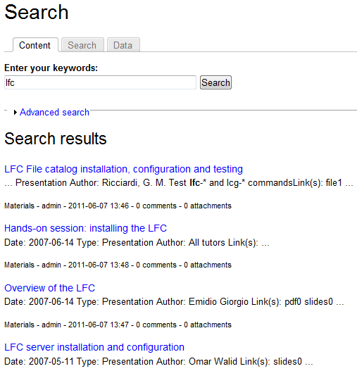
Training Marketplace (TMP)
Benefits:
Advertise
training events, online materials, training resources, university courses
Browse and search
Community features such as commenting, rating
Access through web page and web gadget
http://training.egi.eu

Slide 5
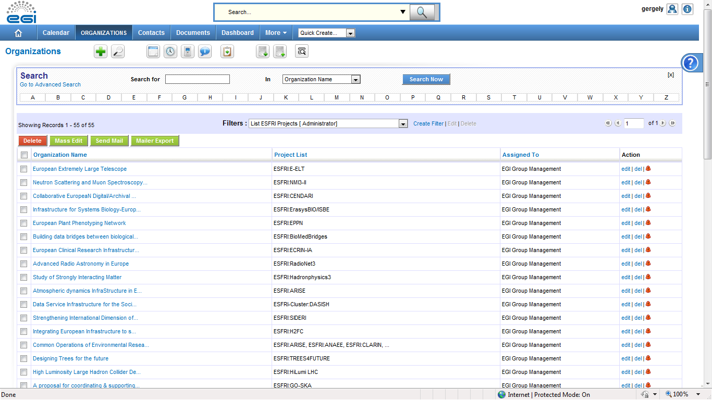
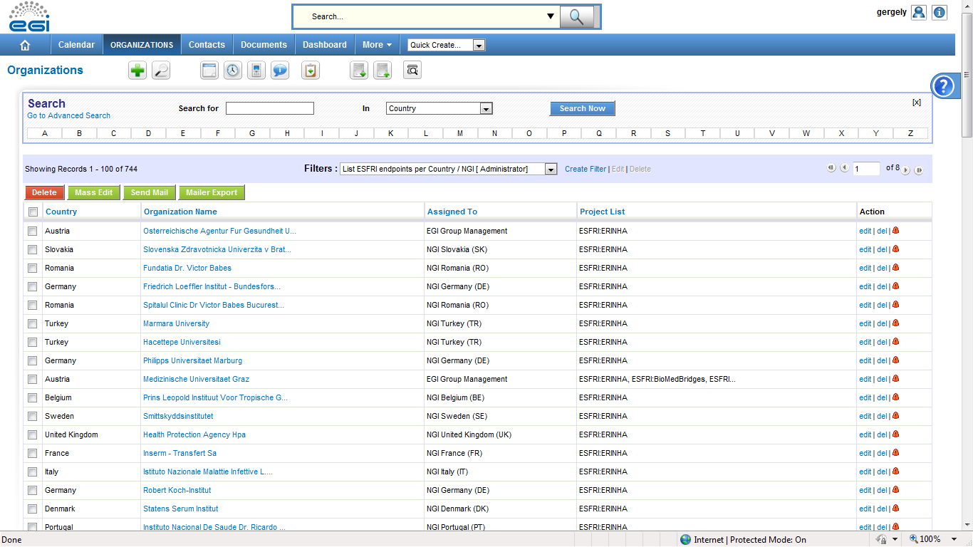
Client Management System (CRM)
To capture leads and needs of scientists & scientific communities – EGI’s clients
EGI CRM – main capabilities (based on vTiger CRM):
Register projects/communities
Register personal contacts
Register details about ‘Potential for EGI use’ and ‘Interest in e-infrastructures’
Generate reports
Available to NGI International Liaisons and their collaborators at http://crm.egi.eu

Slide 6
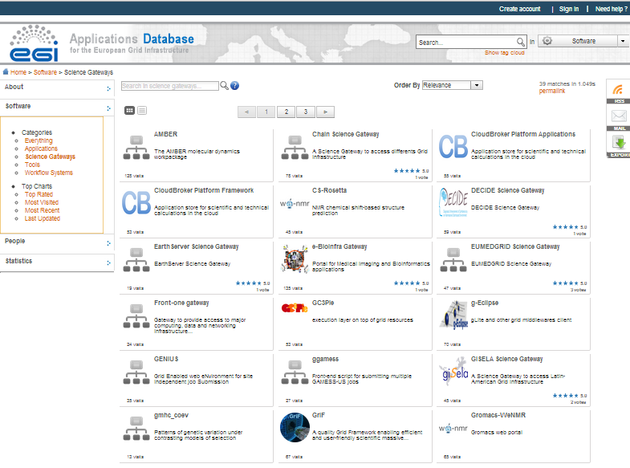
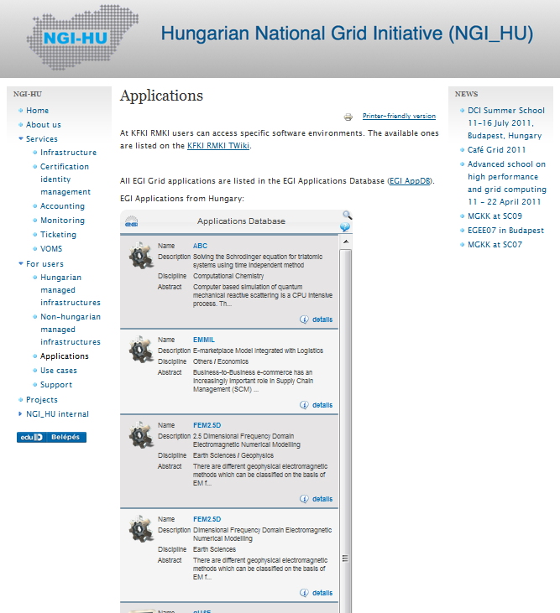
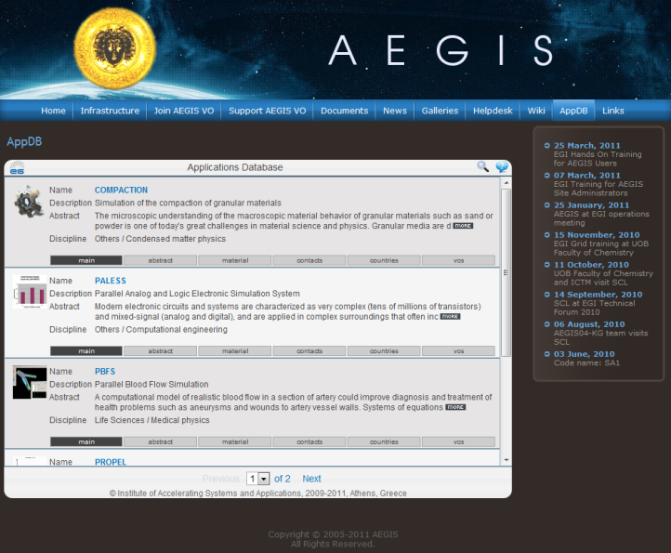
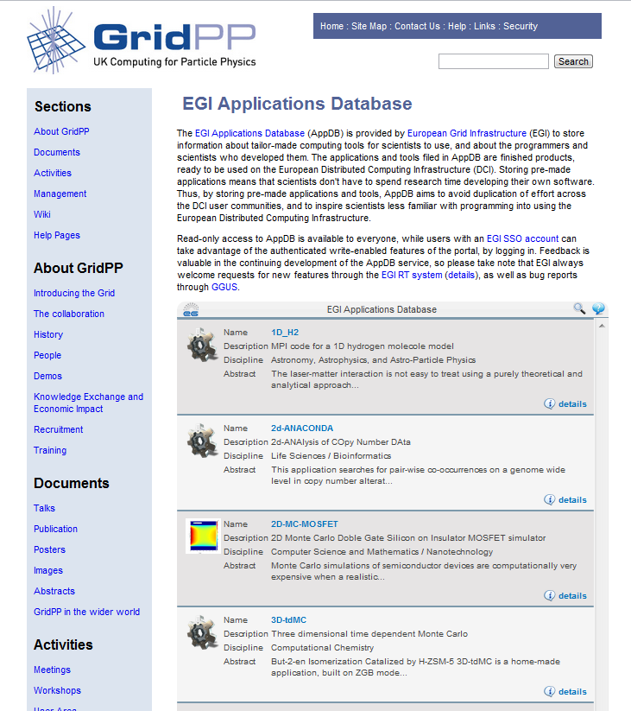
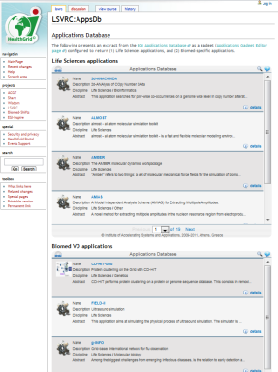
Applications Database (AppDB)
Benefits:
Gives recognition to reusable scientific applications, application developer tools, portals, workflow systems, etc.
Gives recognition to application developers (people profiles)
Access through web page AND web gadget
Community features such as commenting, rating, tag-based groupings
http://appdb.egi.eu

Slide 7
Presentation outline
Use until now – basis for impact assessment
TMP / 0.5 FTE
CRM / 0.5 FTE
AppDB / 1 FTE
My impact assessment
Expected use (until May 2014)
Future (after EGI-InSPIRE)
2 FTE out of 192 in EGI-InSPIRE.
~24 PM out of 574 PM in Global PY2.
25% (0.5 FTE) is Ops. + Maintenance.
75% (1.5 FTE) is development.

Slide 8
Use
Until now

Slide 9
Training Marketplace: Items registered since May 2010
Online training,
Training resources,
University courses
Mostly pointers for third party, project specific repositories. >400 items in total in those.
In the second year of EGEE-III: 48 events
Notes:
Make more clear which resources and events.

Slide 10
CRM: Data structure and use cases
Summarise key findings about clusters of projects
MAY 2012
Register projects and communities
Projects (ESFRI & non-ESFRI; National & International)
Summarise key findings about each project
Register institutes
Member institutes (universities, research labs, etc.)
NOW
Register people
People (researchers, developers, spokepersons, etc.)
Interview people & register key findings

Slide 11
CRM: Items registered since April 2012
As a single batch in May 2012.

Slide 12
AppDB: Registered software by country

Slide 13
AppDB web visits from Europe (without Greece, which is 6804)
EGI.eu’s dominance

Slide 14
My impact assessment based on the presented data
TMP
Mostly events are registered in TMP by the community. Could this use case more-or-less served by the EGI website CMS? Would that be cheaper?
My assessment: If usage patter does not change, then – with a sufficient replacement strategy – the removal would have no impact on EGI.
CRM
After 8 month there is still very little use within the NGIs.
My assessment: If use does not increase, then the removal would have no impact on EGI - Except that we would loose our ability for coordinated outreach.
AppDB
Balanced and increasing use.
Unique service – there is no alternative that EGI could use.
My assessment: Removal would cause the degradation of EGI

Slide 15
Expected use
Until May 2014

Slide 16
Plan until May 2014: Increase use!
Champions for the tools in each country:
Using the tools; Demonstrating and promoting usage
Primarily the NGI International Liaisons:
There is effort for this in EGI-InSPIRE (TNA2.1N, TNA2.6N)
Monthly email digest
Training and demos @ EGI Community Forum
Online Webinars, 1-on-1 trainings/interviews
Projects as users:
Project specific features and gadgets in TMP
Virtual Team projects (CTA, ELIXIR, V&E → CRM)
Technology providers after May 2013 (AppDB)
Mini-project on Massive Open Online Course

Slide 17
Future
After EGI-InSPIRE

Slide 18
After EGI-InSPIRE
We need the critical mass for communuity support and VRE support services (EGI Strategy)
For the development (Huge diff. between 0.5 and 1 FTE in NA2!)
For the use (Project champions or NILs?)
Horizon2020 project: Integrated EGI Collaboration Platform
AppDB + TMP + CRM + Nanohub + EGI platform (VO/cloud) specific functions + Portal toolkit (e.g. FIM support) + Helpdesk?
Productizing services – so third parties (e.g. ESFRIs) can have and control their own virtual instances provided by EGI
Related EGI-InSPIRE mini-project
Liferay tools as integrated environment for community support services

Slide 19
Conclusions
Good uptake for AppDB. Growing, but still unsatisfactory uptake of TMP and CRM
Use the services that You already paid for!
Improvement is expected during EGI-InSPIRE
Deciding about the future now is probably too early
Communities and Virtual Research Environments are the Raison d'être of the Production Infrastructure
What services will we need in 2 years from now to implement Our strategy?
Planning for a Horizon2020 project started
Covering, and broadening the user-facing EGI software services?
EGI Global services as an insurance?

Slide 20
Questions, discussion

