Slide 1
Defining the EGI service portfolio: the approach
Owen Appleton
Emergence Tech Ltd – FedSM

Slide 2
Overview
What is a service?
What is a service portfolio?
Challenges for EGI
Conclusions

Slide 3
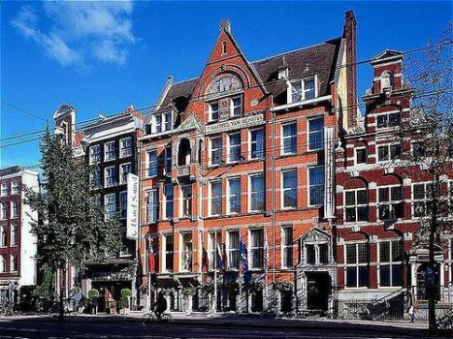
What is a "Service”
Wireless Internet
Pool
Fitness
Congress rooms
Limousine
Hotel website
Safety facilities
Room lights
Room heating
Room air conditioning
Room furniture
Bathroom facilities
Room decoration
Cleaning
Car park
Illuminated hotel sign
Room reservation system
Invoice system
Music in the lobby
Music in the elevator
Room locks / key card readers
"Do not disturb" sign
Coat hook in room
Accommodation
Concierge
Escalators
Elevators
Restaurant
In-room dining
Front desk
Housekeeping
Laundry
Free TV
Pay TV
Minibar
Telephone
Wired Internet
Example: Hotel

Slide 4
What is a "Service”
Car park
Illuminated hotel sign
Room reservation system
Invoice system
Music in the lobby
Music in the elevator
Room locks / key card readers
"Do not disturb" sign
Coat hook in room
Wireless Internet
Pool
Fitness
Congress rooms
Limousine
Hotel website
Safety facilities
Room lights
Room heating
Room air conditioning
Room furniture
Bathroom facilities
Room decoration
Cleaning
Car park
Illuminated hotel sign
Room reservation system
Invoice system
Music in the lobby
Music in the elevator
Room locks / key card readers
"Do not disturb" sign
Coat hook in room
Accommodation
Concierge
Escalators
Elevators
Restaurant
In-room dining
Front desk
Housekeeping
Laundry
Free TV
Pay TV
Minibar
Telephone
Wired Internet
Example: Hotel

Slide 5
What is a "Service”
Car park
Illuminated hotel sign
Room reservation system
Invoice system
Music in the lobby
Music in the elevator
Room locks / key card readers
"Do not disturb" sign
Coat hook in room
Wireless Internet
Pool
Fitness
Hold a conference
Limousine
Hotel website
Safety facilities
Room lights
Room heating
Room air conditioning
Room furniture
Bathroom facilities
Room decoration
Cleaning
Car park
Illuminated hotel sign
Room reservation system
Invoice system
Music in the lobby
Music in the elevator
Room locks / key card readers
"Do not disturb" sign
Coat hook in room
Stay and sleep
Concierge
Escalators
Elevators
Eat and drink
In-room dining
Front desk
Housekeeping
Laundry
Free TV
Pay TV
Minibar
Telephone
Wired Internet
Example: Hotel

Slide 6
What is a service
A service is something that provides value (that they recognise) to customer
  On its own!
Can include service components!
  Room includes cleaning
  Restaurant includes chairs!
In ITSM terms:
  For customers, compute is a service, CREAM isn’t
  CREAM is a service for another provider
    Porsche designs cars for VW, car design is not an end user service

Slide 7

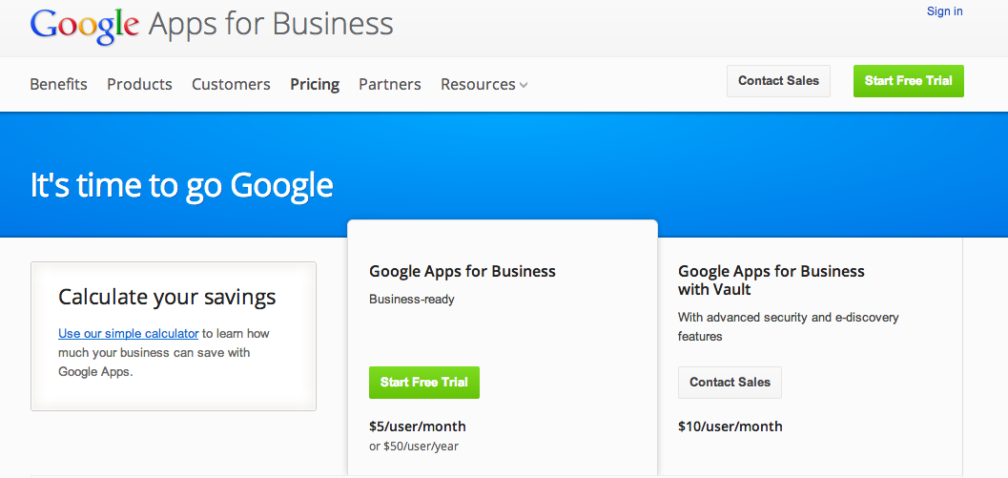
What is a service portfolio?
What can you do?
What should you do?
What have you decided to do?
What do you tell people you do?
Service portfolio
Service catalogue
Internal list
List of dishes the chef knows
Internal list
List of dishes the chef knows of the right cuisine
Internal list
‘Pre-menu’
Chef’s list of dishes he can make, prices , requirements

Slide 8
Challenges for EGI
“Why are you going backwards?”
  Because e-Infra stated providing services before it decided what the services were!
EGI inherited this problem
  From EGEE
  From DataGrid
  From Ian Foster…

Slide 9
Challenges for EGI
Work backwards
  EGI.eu started with a list of activities & components
  Filter down to services
    Value network to ~50 proposed services down to ~10
Look at what makes sense
  EGI.eu as a commercial conference organizer?
  EGI.eu as an advisor to user communities on who can provide them compute services?
Create a coherent offering in parallel to already providing services for ‘free’

Slide 10
Conclusions
Who are you serving? Who do you want to serve?
  Other providers? Integrators?
  Researchers who want to store data or run simulations?
To serve end users…
  Portfolio (and catalogue) make clear what value is, easier to get them or other funders to pay
To serve other providers…
  Less work for you (maybe) but major risk these integrators don’t appear
Decide what you want to do and for whom
  Then build business & funding models…

Slide 11
Questions?
Owen Appleton
www.fedsm.eu - owen@emergence-tech.com

