Slide 1
Business models for federated infrastructures
Owen Appleton
Emergence Tech Limited
e-FISCAL & FedSM projects

Slide 2
Overview
What is a business model and why do we need them
Mapping federation types
Deriving business models
Business models and costs

Slide 3
What is a business model
A business model defined:
The content, structure and governance of transactions designed so as to create value through the exploitation of business opportunities*
Value not be limited to economic
social, cultural or other forms of value may also be taken into account.
Not just a financial structure
Complex in federated environment
Limit ourselves to federator models
* Amit, R., and Zott, C.,(2001), “Value creation in e-business,” Strategic Management Journal, 22, pp. 493-520

Slide 4
FedSM Business model definition
A business model should…
…provide a clear idea of the value that is created by a federator in its specific federation context.
…draw a clear picture of the stakeholders involved besides the federator; this shall include any types of relevant partners contributing to the value proposition as well as “consumers”.
…highlight the most important relationships in the regarded federation context, i.e. relationships and dependencies between the involved parties.
…cover information about resources required to deliver value as well as the (physical or logical) channels through which service and value is delivered.
Any business model should be clearly defined in scope distinguished from other business models.

Slide 5
Why is this helpful
e-Infrastructures grew organically
Start in research groups
Grow though state funded projects
Only became cohesive landscape more recently
Need to demonstrate sustainability
Set out clear roles, relationships, activities, benefits
Create sustainable governance structures
Define realistic management processes
Provide cost estimates allow for pricing or funding

Slide 6
Establish context
Can’t jump directly to business models
BM dependent on structure of federation, many options
Can create broad ‘types’ of federation and look at resultant BMs
Need a structure for showing different federations
Show relationships
Show activities
Show locations of IT Service Management responsibility

Slide 7
Federation types
Customer
Customer
Federator (integrator)
Federator (Broker)
Resource provider
Resource provider
Resource provider
Resource provider

Slide 8
Federation Responsibility model
Customer
Design & transition of new or changed services
Service Level management (SLAs, OLAs)
Service reporting
Service continuity & availability management
Financial management (budgeting, accounting, charging) for services
Capacity management
Information security management
Incident & service request management
Problem management
Configuration management
Change management
Release & deployment management
Continual service improvement
Federator
ITSM processes
Federation members
ITSM processes
Provision of main technical service
Advice
Assignment of resources
Legal contracts
Billing and payments
Platform for using service
Internal communication
Collective bargaining
Internal mediation
Promotion
Validation
Facilitate technical interoperation
Technical components that support the overall service.
Central AAI system from federator
Portal provided by one federation member to the whole federation
Customer-facing services / components
Customer-facing services / components
Federation facing services/components
Federation facing services/components
Supporting service components
Supporting service components

Slide 12
From responsibilities to business models

Slide 13
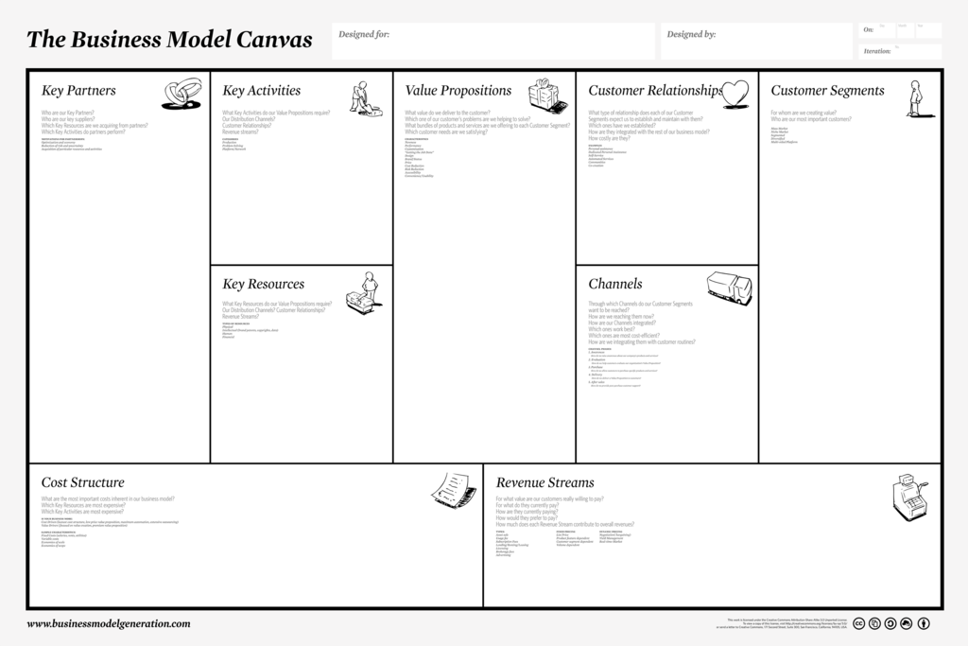
Business model canvas
To each customer type
Cost and resource use models
Support (revenue streams and other support)
See http://fedsm.eu/downloads

Slide 14
BM canvas: one stop shop

Slide 15
Conclusions
Business models are needed in the progress toward sustainability
First need to decide what you do!
A model to understand federation types helps with many areas
Define activities, relationships, simplify structures
Allow description of Business models, management processes and procedures
From this we can understand business models, e.g. via a business model canvas
Business models will vary widely

Slide 16
Thanks for listening!
Owen Appleton
owen@emergence-tech.com
www.emergence-tech.com - www.fedsm.eu

