Slide 1
e-FISCAL Final Workshop
Amsterdam, 28 January 2013
Introduction and key findings
Fotis Karagiannis, Sandra Cohen,
Athens University of Economics and Business-Research Center (AUEB-RC)

Slide 2



It’s all about knowing the costs..
Financial Study for Sustainable Computing e-Infrastructures
…their composition..
…and putting them in context!

Slide 3





Consortium
AUEB-RC
EGI.eu
NUIG*
(ICHEC)
Letter of Support received
ETL
* National University of Ireland, Galway / Irish Centre for High End Computing (ICHEC)

Slide 4
Main objectives
Analyse the costs of the current European dedicated High Throughput and High Performance Computing (HTC/HPC) e-Infrastructures for research
Compare them with the closest equivalent commercial leased or on-demand offerings
  Cloud computing!
Evaluate the findings through a report

Slide 5

Background
First in-depth study at European scale
  Significant sample of participants, HTC/HPC, comparisons with Clouds, innovative methodology!
Builds on previous financial exercise
  e-IRGSP2 project, focusing on HTC/NGIs only
  More at http://www.efiscal.eu/state-of-the-art
Notes:
e-IRGSP2 findings
EGI Capex: 93 – 230 M Euros, Capex per year: 19-62M per year, Opex 36 – 56M per year, Opex-Capex ratio: 1.90-0,90 (1 rule of thumb)
Total per year: 55 – 118M, Cost per core hour: 90% utilisation, without storage: 90%: 0,0521-0,0680, 80%: 0,0586-0,0765, 60%: 0,0782-0,1020
With storage: 0,0569-0,09 E, 80%: 0,0641-0,1017, 60%: 0,0854-0,1356

Slide 6
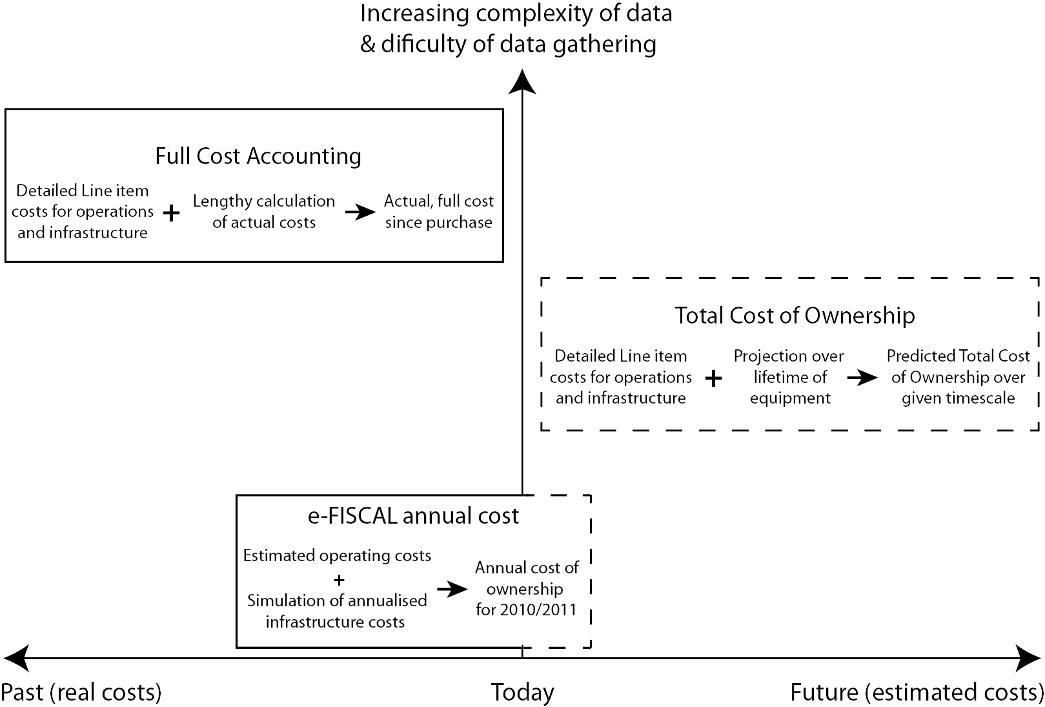
Basis of costing exercise
Full Data
Analysis
Detailed input
Forward looking
considerations
Full Data
Analysis
Several sources
of funding
Necessary access to
accounting books
6

Slide 7
Methodology overview
State-of-the-art
review in costing
issues
Collection of data,
Cross-checks
Benchmarking
Conclusions-findings
Development of a
cost model
Sample
identification
Questionnaire
development
Questionnaire
dissemination,
follow up
We have gone through the first full cycle of the methodology and we are about to start
again by capitalizing on the feedback and experience gained
7

Slide 8
Methodology
Logical CPUs, storage devices,
auxiliary equipment, connectivity devices
X
Prices per logical CPU, for storage, etc.
retrieved by
questionnaires
Approximation of the physical
infrastructure investment cost
Development of the financial model
Yearly Operational Expenditures
(OPEX)
Software, Personnel, Electricity,
Premises, Network connectivity,
Other operating costs
(questionnaire)
Yearly Capital Expenditures
(CAPEX)
Depreciation of
the physical infrastructure
costs
(questionnaire)
Total yearly cost of ownership
8

Slide 9
Not trivial….
Careful in estimating e-Infrastructure costs and comparing with Cloud prices!
  Cross-checks/validation with market or other prices
  Benchmarking comparisons to optimise results
  Profit-margin possible
  Moving to the cloud a different exercise!
Confidentiality/Anonymity of data!
  No identifiable data related to an individual site or national HPC/HTC entity are presented
  Some “big” sites (mainly PRACE Tier-0s) not ready to provide data
    Still PRACE Tier-1s and other EGI big sites participating
Cost is different from value!

Slide 10
Countries contributing
We would like to
thank all contributors!
Belgium (5), Bulgaria, Cyprus, Finland, Germany, Greece (4), Hungary, Ireland, Italy, Latvia,
Norway, Poland, Romania, Spain (6), Turkey, UK
10

Slide 11
Sample/Respondents
We have gathered information from:
  28 respondents – 16 countries
  The vast majority of respondents provide both computing and coordination
  Most of the data from HTC or mixed HTC/HPC centres
11

Slide 12
Review the state-of-the-art
All studies perform a case study or multiple case analysis. e-FISCAL is the first to provide an extended synthesis
http://www.efiscal.eu/state-of-the-art

Slide 13
e-FISCAL main findings
In-house HPC/HTC e-Infrastructures are cost-effective
  With high utilisation rates & depreciation rates (as reported)
  However per application cost analysis is needed
Personnel ~50% of total costs; CAPEX/OPEX=30/70%
Larger sites have in general less FTEs/core
Small-scale benchmarking efforts between in-house HPC and Amazon Compute Cluster instance:
  A ~40% performance degradation of the latter for HPC, a bit better for HTC (more on next presentation!)
Modest size HPC centres similar to state-of-the-art HTC ones

Slide 14
More details (1)
Average - Median
CAPEX / OPEX ratio in 2011: 27/73% - 31/69%
Personnel / Total costs in 2011: 50% !
Cost per core hour in € in 2011: 0,072 - 0,031
Median for minimum utilisation rate: 75%
Likely underestimated, at 80% rate, the cost drops to : €0,029
Depreciation rate: 5 years
For a value of 3 years it goes up to € 0,037

Slide 15
More details (2)
Average - Median
Cost per core in € in 2011: 390 204
CPU useful lives: 5 5
Interconnect equipment: 10% 10% of CPUs hw costs
Software costs: 4% 2% of CPUs hw costs
Average salary in € in 2011: 53k 49k
Power Usage Effectiveness: 1,55 1,49

Slide 16
Costs breakdown
(2011-median)

Slide 17
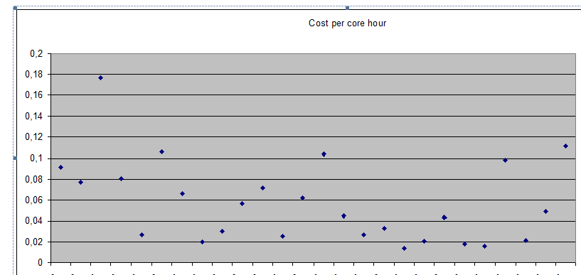
Cost per core hour in € / no of cores*
Cost per core hour in Euros
No of cores
* Dots are sites
Larger sites are in general more cost effective – however outliers exist

Slide 18
e-FISCAL vs. Amazon EC2
NO PERFORMANCE ADJUSTMENTS
e-FISCAL results compared with EC2 reserved instances (all amounts in €)
Costs refer to 2011 – Prices refer to 1/2013
Standard Reserved
Instances (L-XL)*
Cluster Compute
Quadruple XL**
e-FISCAL findings (median-avg)
0.031
0.072
0.026
0.029
0.082
0.10
*Price for 3-year reserved instances/hour transformed in €/core hour
(equivalence based on instance characteristics)
Based on Linux 60% (red) -80% (yellow) usage of reserved instances.
Amazon site accessed on 15/1/2013, 1 € = $ 1.3327
** Price for 1-year reserved instances/hour
Notes: a. No performance adjustment has been performed
b. Networking costs have been excluded in both cases
c. Storage costs have been excluded

Slide 19
e-FISCAL vs. Amazon EC2
PERFORMANCE DEGRADATION INCLUDED
e-FISCAL results compared with EC2 reserved instances (all amounts in €)
Costs refer to 2011 – Prices refer to 1/2013
Standard Reserved
Instances (L-XL)*
Cluster Compute
Quadruple XL**
e-FISCAL findings (median-avg.)
0.031
0.072
0.033
0.037
0.117
0.143
*Price for 3-year reserved instances/hour transformed in €/core hour
equivalence based on instance characteristics)
Based on Linux/60% (red) -80% (yellow) usage of reserved instances.
Amazon site accessed on 15/1/2013, 1 € = $ 1.3327
** Price for 1-year reserved instances/hour
Notes: a. Performance adjustment has been performed
(Standard L-XL 27% / Cluster Compute Quadruple XL 43%)
b. Networking costs have been excluded in both cases
c. Storage costs have been excluded also

Slide 20
e-FISCAL vs. Amazon EC2 (2)
NO PERFORMANCE ADJUSTMENTS
e-FISCAL results compared with EC2 on-demand instances (all amounts in €)
Costs refer to 2011 – Prices refer to 1/2013
Standard on demand
Instances (L-XL)*
Cluster Compute
Quadruple XL
e-FISCAL findings (median-avg.)
0.031
0.072
0.064
0.122
*Price for instances/hour transformed in €/core hour
(equivalence based on instance characteristics)
Based on Linux
Amazon site accessed on 15/1/2013, $ 1.3327
Notes: a. No performance adjustment has been performed
b. Networking costs have been excluded in both cases
c. Storage costs have been excluded also
20

Slide 21
e-FISCAL vs. Amazon EC2 (2)
PERFORMANCE DEGRADATION INCLUDED
e-FISCAL results compared with EC2 on-demand instances (all amounts in €)
Costs refer to 2011 – Prices refer to 1/2013
Standard Reserved
Instances (L-XL)*
Cluster Compute
Quadruple XL**
e-FISCAL findings (median-avg.)
0.031
0.072
0.081
0.174
*Price for instances/hour transformed in €/core hour
(equivalence based on instance characteristics)
Based on Linux
Amazon site accessed on 15/1/2013, $ 1.3327
Notes: a. Performance adjustment has been performed
(Standard L-XL 27% / Cluster Compute Quadruple XL 43%)
b. Networking costs have been excluded in both cases
c. Storage costs have been excluded also
21

Slide 22
In-house utilization vs. Amazon (1)
e-FISCAL median at 30%=EC2 on demand
e-FISCAL median at 40%=1year EC2@60%
e-FISCAL median at 50%=1year EC2@80%
e-FISCAL average at 55%=EC2 on demand
e-FISCAL average at 75%=1year EC2@60%
e-FISCAL average at 90%=1year EC2@80%

Slide 23
In-house utilization vs. Amazon (2)
e-FISCAL median at 60%~3year EC2@60%
e-FISCAL median at 70%=3year EC2@80%
e-FISCAL average @100% always >
3year EC2@60% or 80%

Slide 24
In-house utilization vs. Amazon (3)
e-FISCAL median at 15%=EC2 on demand
e-FISCAL median at 18%~1year EC2@60%
e-FISCAL median at 20%=1year EC2@80%
e-FISCAL average at 27%~EC2 on demand
e-FISCAL average at 30%=1year EC2@60%
e-FISCAL average at 40%=1year EC2@80%

Slide 25
Conclusions
e-FISCAL pioneer in costing computing e-Infrastructures :
  Assessing costs in a highly distributed-heterogeneous environment!
Our results are inline with literature
  Cost per logical CPU/hour € 0.031 (median 2011 whole sample)
  Costs show decreasing trends - not only for CAPEX but also for OPEX
Nevertheless some interesting issues emerged:
  Divergence in cost structures
  High Useful lives
  FTEs/core and personnel costs
  Non- unanimous economies of scale existence
  Moving to the cloud will not certainly reduce much on FTEs
  Indifference points for in-house utilisation vary a lot:
    30-55% compared to EC2 standard on-demand instances, reserved ones competitive
    15-27% compared to cluster compute on demand, 18-40% for reserved ones
25

Slide 26




Thanks!
All material to be available in www.efiscal.eu
  e-mail us at info @ efiscal.eu to and keep up with the project (update list)
Project acronym: e-FISCAL
Contract n°: RI-283449
Project type: CSA-SA
Start date: 01/08/2011
Duration: 18 months (end 31/1/2013)
Total budget: 392.523 €
Funding from the EC: 349 999 €
Total funded effort in PMs: 33.75
Web site: www.efiscal.eu

Slide 27
Transforming instances into number of cores
Type of Instances | Number of cores
M1 Medium | 2
M1 Large | 4
M1 Extra Large | 8
M3 Extra Large | 13
M3 Double X Large | 26
Cluster Compute
Quadruple Extra Large | 8
Eight X-Large | 16
High-CPU Instances
Extra Large | 20
Sources: Berriman, B. and Deelman, E. “How To Use Cloud Computing To Do Astronomy”,
IPAC, May 9, 2012, p. 8; plus e-FISCAL estimations

Slide 28
Hardware
Median mitigates the effect of outliers that influence average metrics
Decreasing trends in costs per logical CPU and Storage per TB
Reluctance to disclose information regarding acquisition costs
28

Slide 29
Useful lives
Prolongation of the useful life of computing and storage infrastructure
Most commonly encountered useful lives in literature for computing between 3-4 years
Depreciation period influences yearly CAPEX.
The longer the depreciation period the lower the yearly CAPEX
Less straightforward - obvious effect: Old machines consume more electricity
29

Slide 30
Other infra costs and software
Important
Cost
Difficult to distinguish from acquisition cost
Very Important Cost difficult to capture
Software enigma
CAPEX or OPEX
30

Slide 31
Personnel costs - FTEs
The salary range is
very wide
Plotting 1,000 Logical CPUs and number of FTEs per 1,000 Logical CPUs
Generally, no of FTEs/1,000 cores decreases as site size increases
30,00
25,00
20,00
15,00
1000/cores
FTEs/1,000 cores
10,00
5,00
Questionnaires
1 to 24
0,00
1
2
3
5
6
7
8
9
10
11
12
13
14
15
16
17
18
19
20
21
22
23
24
4
31

Slide 32
Power Usage Effectiveness
Improvement from 2010 to 2011
Our respondents were very active in Green IT initiatives (Examples)
Buying energy efficient servers (improve performance per Watt).
Reusing heat from servers to warm water for nearby buildings.
Buying new hardware to replace old hardware.
Building new datacentres.
Appling efficient cooling systems.
Exploitation of external temperature in order to use free cooling, fully or partially, during the whole year.
Machine rooms in the national infrastructure capture/recycle heat from the compute systems.
Reallocation of HPC systems.
Improvement on airflow management
Implementation of environment monitoring systems
32

