Slide 1
LifeWatch, costing and funding
The LifeWatch e-infrastructure financial construction

Slide 2
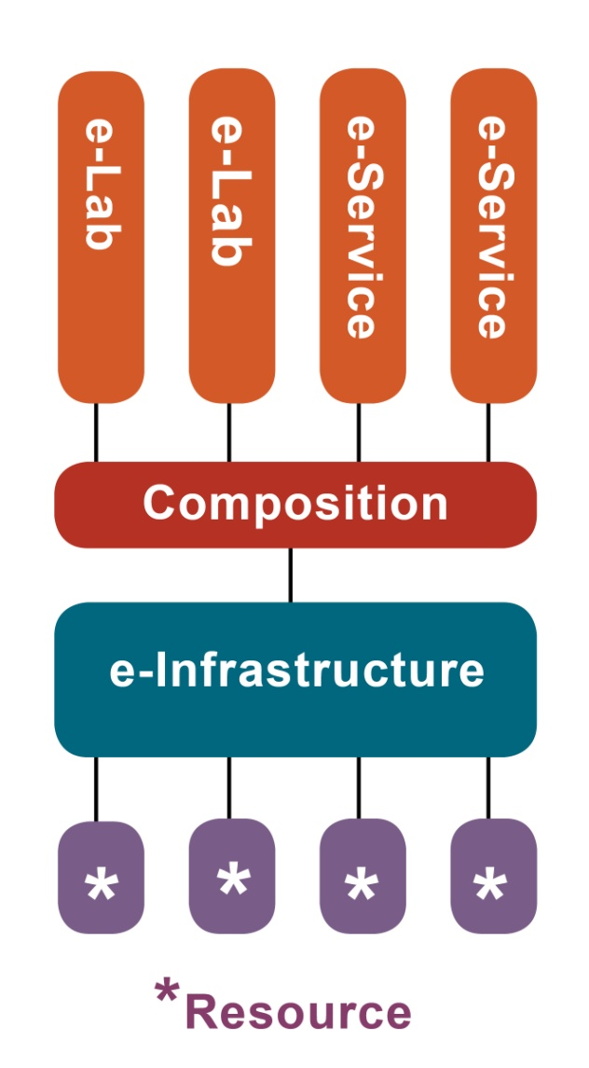
LIFEWATCH architecture providing infrastructure services to users
User groups can create their own e-laboratories or e-services within a common architecture of the infrastructure
The e-laboratories are the ‘community driven’ infrastructure, which promotes innovation.
Sharing data and algorithms,
scientists can address questions not
otherwise accessible
Notes:
2
2

Slide 3
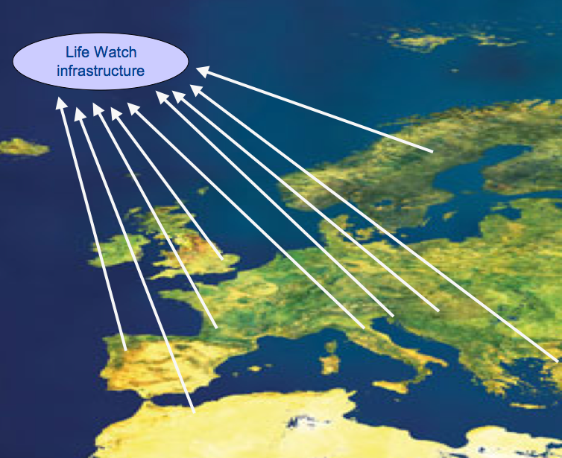
LifeWatch as a distributed research infrastructure
Data grid
monitoring sites
sensors
collections
Soft/Middleware grid
Computing grid
Part of an international infrastructure grid

Slide 4
LifeWatch vs. a single sited R.I.
No large capital investments
Not in one place, mainly virtual
Can operate on partial construction
Number of users is ‘infinite’
Decommissioning not a major issue
Make use of existing e-infrastructure (EGI, PRACE, GEANT

Slide 5
Costs - Considerations
Development of software etc. as main task
Mainly personnel costs
Like software, operate with releases. software requires maintenance, updates and upgrades
Operations already start with partial construction
Number of users is ‘infinite’
Decommissioning is minor
Notes:
Outsourcing important. Only limitation to users is special needs or heavy computing requirements. Decommissioning mainly buy off of contracts and some IPR issues.

Slide 6
Cost categories | 14 construction projects | 73 construction components | 203 construction items
Capital costs
Major third party costs
Running costs
Specialist staff costs
Service staff costs
Other costs
Depreciation costs
Each described and
associated costs calculated.
In total € 220 mln.

Slide 7
Capital costs | Equipment, floor space (m2)
Major third party costs | Data, Computation, Algorithms
Specialist staff | € 200.000 per f.t.e. Full Cost (for staff and associated secr/adm and m2)
Service staff | € 100.000 per f.t.e. Full Cost (for staff and associated secr/adm and m2)
Running costs | Travel, materials, etc
Other costs | Any other costs not fitting in the other categories
Depreciation costs | Mostly for relocating staff and services

Slide 8
Operational costs
Software based, so developments move fast
High level of uncertainty about future beyond 5 years
'Rule of Thumb': operational costs are about 15% of total construction
Critical mass and economies of scale to be taken into consideration!

Slide 9
Spending pattern

Slide 10
LifeWatch architecture
Virtual Labs
Optional
in-kind construction
Virtual laboratories for scientific cooperation
Select the data, software and computing power for your project
Integrate resources
Linking to resources (databases, sensors, software, computing power)
Common Facilities
Compulsory construction
Third party
contributions
Notes:
10
Data, tools, services and facilities are dispersed across the participating countries. While the infrastructure scale is European, its architecture is distributed, integrating local components that can be easily accessed through a single portal by researchers anywhere in Europe and beyond.
The governance model is both top-down for financial and political control and bottom-up for community involvement and influence. Development and operations of LifeWatch will be driven by the individual users. It’s based on the Apache model.
Deployment revolves around the idea of centres offering services to users. Such centres can offer services that have a predominantly ICT oriented focus – for example, data repositories and computational model capabilities, or they can be predominantly human oriented. That is to say, they can offer human services like a helpdesk or a partner matching service. Combinations are also possible, and expected.
With assistance from LifeWatch, user projects create their own e-Laboratories or e-Services.

Slide 11
LifeWatch Funding
Considerations on the funding of the RI:
ESFRI process requires us to convince individual countries to invest
Completely new concept, difficult to understand for countries
Virtual, distributed, so lots of investment possible accross Europe, and not in one place
No need for the full amount of construction costs to start operating

Slide 12
Funding mechanism
Countries contribute 15% of their funding in cash to the central operations of the ERIC
Countries invest 85% of their contribution as in-kind investments/projects in their own countries
the 85% in-kind has to match the identified construction items in the cost-book (which add up to 220 M€)

Slide 13
Advantages of this mechanism
A relatively small percentage of the contribution is 'leaving the country'
Countries have a big influence on prioritizing the needs of their scientific community (through the 85% national projects)
The ERIC can coordinate the construction through Service Level Agreements with the countries

Slide 14
Determining Country contributions
Based on GDP of all 27 EU countries
Considering that only if all EU countries contribute, the 220 M€ is needed
Minimal threshold of 2.5 M€ per country (for less one cannot really do relevant work)
Little discount for the 5 largest countries in Europe, to facilitate their entrance

Slide 15
National contributions
Size of national
contribution
(in cash + in kind)
National GDP
of the country

Slide 16
Valuation of in-kind contributions: Message for further exploration

