Slide 1
HPC Trends
Addison Snell, addison@Intersect360.com
Actionable Market Intelligence for High Performance Computing
January 2013

Slide 2
Future-Looking Trends (Tuesday a.m.)
Multi-core, and its implications for:
Memory usage
Power consumption
System utilization
Accelerators (e.g. GPU computing)
Programming models
System efficiency
Big Data
Adoption of HPC

Slide 3
From “HPC User Site Census Report”
The primary challenges for users are:
How to plan the balance between processors per node, cores per processor, memory per node, I/O and interconnect on node, total nodes, etc.
How to adapt applications for node parallelism and on-chip (i.e., multi-core) parallelism.
How to organize the overall job mix. Smaller nodes may be a better fit for processing large numbers of small jobs or large set of jobs with a broad range of requirements. Larger nodes may work best with a job mix skewed to larger problems.

Slide 4
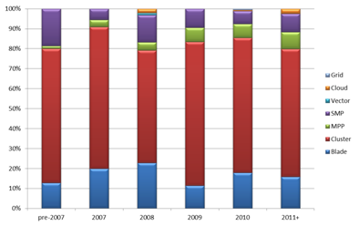
HPC System Architectures by Year
Sockets (CPUs) per node in clusters:
2, 66%
4, 14%
1, 9%
8, 6%
Other, 5%

Slide 5
Cores per Processor
Cores per Processor | pre-2007 | 2007 | 2008 | 2009 | 2010 | 2011+
1 | 36% | 12% | 11% | 4% | 5% | 3%
2 | 41% | 48% | 25% | 22% | 11% | 6%
3-4 | 20% | 34% | 55% | 66% | 54% | 32%
5-6 | 3% | 0% | 0% | 3% | 15% | 30%
7-8 | 0% | 6% | 6% | 2% | 8% | 12%
9-12 | 0% | 0% | 0% | 1% | 4% | 8%
13-16 | 0% | 0% | 2% | 0% | 1% | 6%
17-32 | 0% | 0% | 0% | 0% | 1% | 1%
>32 | 0% | 0% | 0% | 1% | 0% | 2%
Total Systems | 59 | 50 | 83 | 122 | 178 | 155
Avg Core/Processor | 2.2 | 2.9 | 3.7 | 5.7 | 4.9 | 11.8
Source: Intersect360 Research, 2012

Slide 6
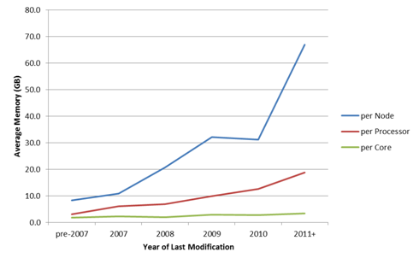
Memory Configuration

Slide 7
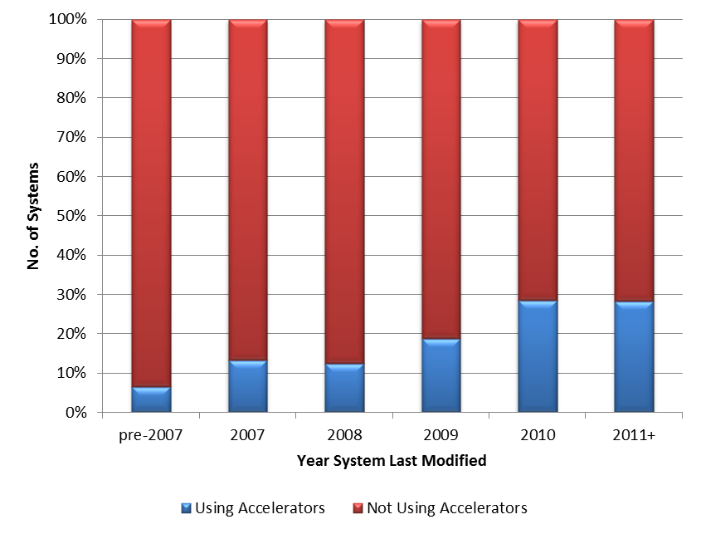
Accelerators (Mostly NVIDIA GPUs)

Slide 8
Challenges of Architecture Trends
Power consumption
Cost of memory
New models of parallelization
Languages and programming models
System efficiency
Personnel for administration, optimization, programming services, etc.

Slide 9
Where Big Data Comes From
“Big Data” is not a specific application type, but rather a trend – or even a collection of trends – spanning multiple application types
Data growing in multiple ways:
More data (volume of data)
More types of data (variety of data)
Faster ingest of data (velocity of data)
More accessibility of data (internet, instrumentation, …)
Data growth and availability exceeds organizational ability to make intelligent decisions based on it

Slide 10
Different Types of Big Data
“Big” in Big Data is a relative term, like “High” in High Performance Computing, not absolute TB or IOPS
Different types of challenges:
Large files
Large numbers of files
Many users of files (concurrent access, copies)
Fast rate of ingest
Long lifespan of data
Short lifespan of data

Slide 11
Important Insights on Big Data
It is much broader than Hadoop – many different types of users and applications.
Money is being spent on it now – often 25% of the annual IT budget.
Performance matters – even enterprise users are buying based on performance.
Big Data trends will lead to the adoption of HPC technologies in more areas.

Slide 12
Actionable Market Intelligence for High Productivity Computing

