Slide 1
Classifying Scientific Disciplines for EGI
Sy Holsinger
Strategy and Policy Officer, EGI.eu
Leader, SDC VT
sy.holsinger@egi.eu

Slide 2
Content
Context
Virtual Team Overview
EGI Uses and Public Classifications
Open Issues/Actions
Next steps
Summary/Conclusions

Slide 3
Context
EGI is a multidisciplinary e-Infrastructure where users belong to a variety of different scientific disciplines
EGI needs to categorise these users by disciplines through a number tools (e.g. AppDB, operations portal, training marketplace, CRM).
Legacy classification inherited from EGEE
Different tools have adopted different classifications
Need to remove the current inconsistencies and inflexibility
As EGI now operates within an open ICT ecosystem, it has become essential to agree on a common, coherent classification that is not only consistent across all tools, but allows for smooth inclusion of future user communities as well
The established VT is an implementation of a recommendation from the Scientific Publications Repository VT adopted by the Council
https://documents.egi.eu/document/1369

Slide 4
Virtual Team Overview
Status: Started 12 Dec 2012 running until Feb 2013 (3 months)
Objectives
Identify all possible uses of disciplines across EGI
Define an aggregation of scientific disciplines
Present the proposed list for comments and recommendation by VO Managers, tool operators and NILs
Output
A proposal for a new classification of scientific disciplines for EGI that is verified with the VO managers, EGI tools operators and NILs, which is open for the inclusion of new communities in the future.
Members
Sy Holsinger, EGI.eu / VT Leader
Sergio Andreozzi, EGI.eu
Gonçalo Borges, CRM
Marios Chatziangelou, AppDB
Claire Devereux, UK NIL /TMP
Iván Díaz, Accounting Portal
Maciej Filocha, PL NGI
Cyril L'Orphelin, Operations Portal
Geneviève Romier, FR NIL
Alvaro Simon, Accounting Portal
Jelena Tamulienė, LT NIL

Slide 5
Uses of Disciplines in EGI
Uses across EGI channels (38 total disciplines – varying in use)
Only 3 the same (9 + others)
Operations Portal
AppDB (+300 sub-disciplines)
Compendium
CRM (12 + other)
EGI Presentations (13)
EGI Strategic Plan (15)
VRCs (5)
Use Cases (6)
Majority tools are very specific with many following into the “other” category (e.g. Operations Portal)
Makes it difficult to:
Understand where the actual users are coming from
Provide consistent communication and accurate statistics
Easily account/integrate new user communities

Slide 6
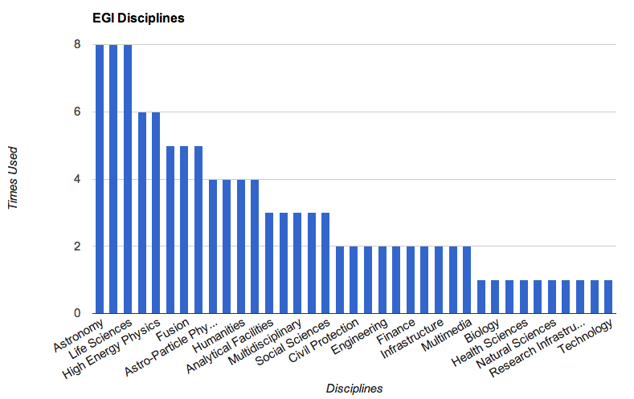
EGI Discipline Usage Stats

Slide 7
Public Classifications
12 Public Classifications Analysed
EuroStat
Cordis
ESFRI
Wikipedia
Google Scholar
SourceForge
Organisation for Economic Co-operation and Development
Dewey Decimal
Library of Congress
Universal Decimal Classification
Australian Bureau of Statistics
Dutch Basic Classification
OECD currently best for providing a scaling level of detail

Slide 8
Issues/Actions
3 Levels of detail being explored
Field of Science (e.g. natural, physical sciences)
Functional Field (e.g. Biological, Chemical, Earth sciences, Physics)
Sub-Functional Field (e.g. Structural, Comp Chem, High-energy physics)
Need to find a balance between all-encompassing and open/flexible
All tools can handle classification changes up to 2nd level
Key issue is accurate mapping from old to new
Users must be able to:
Select multiple disciplines
Select from any category level
Changes made must be “silent”
e.g. not affect having affect on anyone other than the tool operator making the changes

Slide 9
Next Steps
Members agree on Level 1 Classification
Continue to analyze proposed level 2
Integrate sub-disciplines into level 3
Start mapping current uses to new classification
Circulate draft version to NILs and VO managers for comments
Revise classification as necessary
Submit final report and proposal for EGI Mgt. approval
Integrate changes and promote

Slide 10
Summary/Conclusions
Identified there is an issue with the current way scientific disciplines are being classified and communicated across EGI
Brought together a representative from each EGI Tool
Engaged with NIL contacts for user community input
Following a step wise process to ensure this activity will not need to be repeated in the future (at least in the medium-term)
Complex issue that has been conducted by a number of organizations and governments with varying outputs
Not to re-invent the wheel, but needs to accurately reflect the research community
Ultimately, the result of the VT will unify the scientific disciplines making it easier to:
Accurately present usage statistics
Harmonize communication both internally and externally
Integrate and account for new communities in the future

Slide 11
Thank you!
sy.holsinger@egi.eu
policy@egi.eu

