Slide 1
e-FISCAL Final Workshop Panel Amsterdam, 29 January 2013
e-FISCAL: Sustainability and Business models - Lessons Learned and Way Forward
Fotis Karagiannis
Athens University of Economics and Business-Research Center (AUEB-RC)

Slide 2
e-FISCAL outputs
Pioneer costing federated computing e-Infrastructures
in a highly distributed-heterogeneous environment!
Estimation of several metrics
€ per core hour, CAPEX/OPEX ratio, depreciation rates, cost distribution, electricity/PUE, …
Comparisons with Clouds – Amazon EC2
State-of-the-art review (46 articles)
Hybrid methodology - Cost structures
Questionnaire: 28 high quality answers from 16 countries
Benchmarking efforts (HPC/HTC vs. Amazon EC2)

Slide 3
e-FISCAL outputs(2)
Appreciation of cost aspects: Nothing is free!
Understanding of e-Infrastructure cost ranges
Self-assessment tools www.efiscal.eu/tools
Excel based
On-line version
4 e-FISCAL workshops
Lyon, Samos, Prague, Asterdam
e-FISCAL outreach → community
~50 financial and overall 150 experts in ~ a year

Slide 4
e-FISCAL main findings
In-house HPC/HTC e-Infrastructures are cost-effective
With the high utilisation rates (75%) & depreciation rates (5 years)
Cost per core hour in € in 2011: 0,072 avg. - 0,031 median
However per application cost analysis is needed
Personnel ~50% of total costs; CAPEX/OPEX=30/70%
Average salary ~50K, PUE~1,5
Larger sites have in general less FTEs/core
Small-scale benchmarking efforts between in-house HPC and Amazon Compute Cluster instance:
A ~40% performance degradation
Modest size HPC centres similar to state-of-the-art HTC ones

Slide 5
Costs breakdown (2011-median)

Slide 6
Comparison with Amazon
PERFORMANCE DEGRADATION INCLUDED
EC2 “on-demand” instances always more expensive
Even standard ones
“Reserved” instances much more competitive
However EC2 “cluster compute” (HPC in the cloud) > 1,5-2 times more

Slide 7
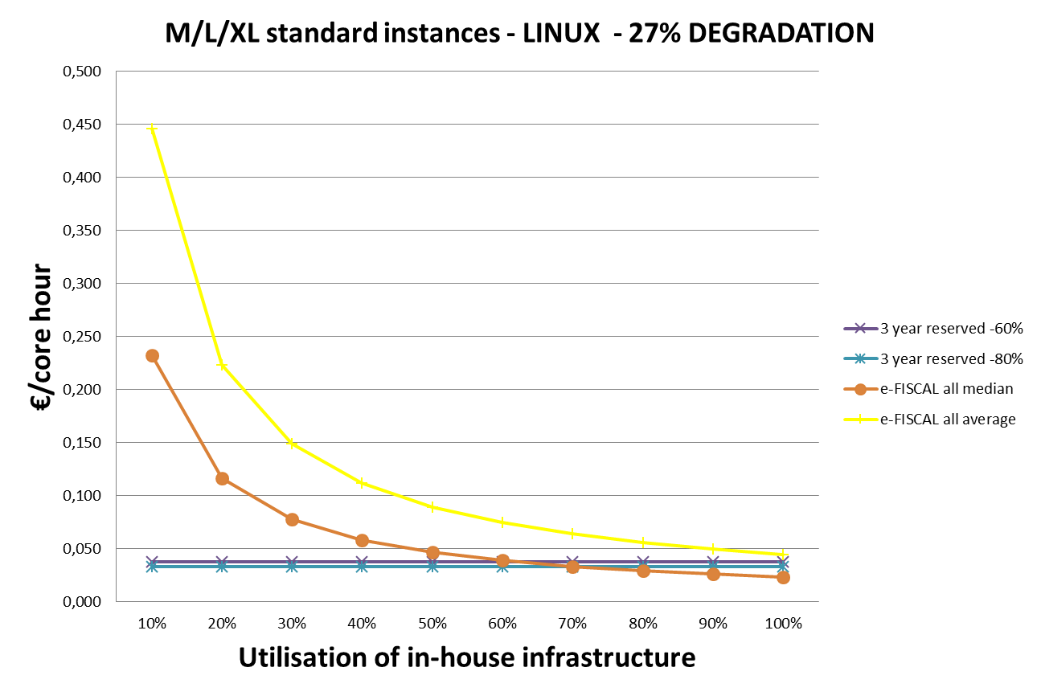
In-house utilization above which it is better to keep it in-house…
PERFORMANCE DEGRADATION INCLUDED
Again variation among the different instances:
>30-55% compared to EC2 “standard on-demand” instances
15-27% compared to “cluster compute”
40-90% compared to “standard reserved ones”
18-40% for reserved “cluster compute”

Slide 8
e-FISCAL sustainability
The tools will remain available on the website
State of the art repository also
LinkedIn group on ICT cost assessment linkd.in/VqEth0 continues discussions
Cost collection/estimation to continue in part through the EGI compendium (go.egi.eu/EGI-Compendium-2011)
Consortium members can provide consultancy

Slide 9
Lessons learned
Not trivial gathering-estimating costs in a highly heterogeneous-federated environment!
Anonymity, confidentiality, overload, ..
And comparing with cloud prices
profit-margin, like-with-like comparisons -performance…
Cost ≠ price and cost ≠ value
Moving the cloud a different exercise
Focus on avoidable costs – some evidence that personnel costs want decrease so much
e-FISCAL with cost know-how acts as a consultant for policy makers and strategists
9

Slide 10
Business models
High utilization key to maintain economic efficiency
A broker role is essential to facilitate demand meeting the right suppliers
Need to evolve funding streams and new pricing models

Slide 11
Way forward is…open!
Probably a mix of several e-infrastructure service components
In-house HPC/HTC, Hybrid clouds: In-house Cloud+ Commercial HTC/HPC clouds, networking, data,…
Service-Oriented e-Infrastructure (SOI) to provide e-Science as a Service….
Efficient integration will be key for researchers accessing one-stop-shop services by 2020
Again broker role important!
Again need to evolve funding streams and pricing models!

Slide 12
Thanks!
All material to be available in www.efiscal.eu
e-mail us at info @ efiscal.eu to and keep up with the project (update list)
Project acronym: e-FISCAL
Contract n°: RI-283449
Project type: CSA-SA
Start date: 01/08/2011
Duration: 18 months (end 31/1/2013)
Total budget: 392.523 €
Funding from the EC: 349 999 €
Total funded effort in PMs: 33.75
Web site: www.efiscal.eu

