Slide 1
Federated Resource Allocation Objectives and activity roadmap
Tiziana Ferrari/EGI.eu
Evolving EGI Workshop, 29-01-2013

Slide 2
Outline
Motivation
Current status
EGI Council
Activities

Slide 3
Motivation
Support of excellent European science
Acknowledgement of resource utilization → demonstration of EGI impact → funding
Raising of resource offering (let offer meet demand) → attract new users
Improvement of existing processes for resource allocation and capacity management
Heterogeneous site-specific resource allocation policies
Support of multiple resource provisioning models from high-priority usage of owned resources to opportunistic usage

Slide 4
Resource ownership
RCs and/or user communities (majority)
All large NGIs (IberGrid, NGI_DE, NGI_FRANCE, NGI_IT, NGI_UK)
Major fraction of resources is contributed by user communities, with unprivileged access to resources by other VOs with different fair shares (1%, 10%, 20%), typically with no enforcement of the policy (with the exception of IberGrid for national VOs)
RC ownership with NGI coordination (IberGrid, NGI_PL)
NGI offering of seed resources for new VOs and core VO services
NGI (NGI_GE, NGI_HR, NGI_MD)
National funding ensuring the NGI to be the resource provider
Small-scale NGIs where RCs and the NGI are the same organization
NGI and RCs (NGI_GR, NGI_NL)
Mixed scenario with NGI focusing offering of resources to national VOs

Slide 5
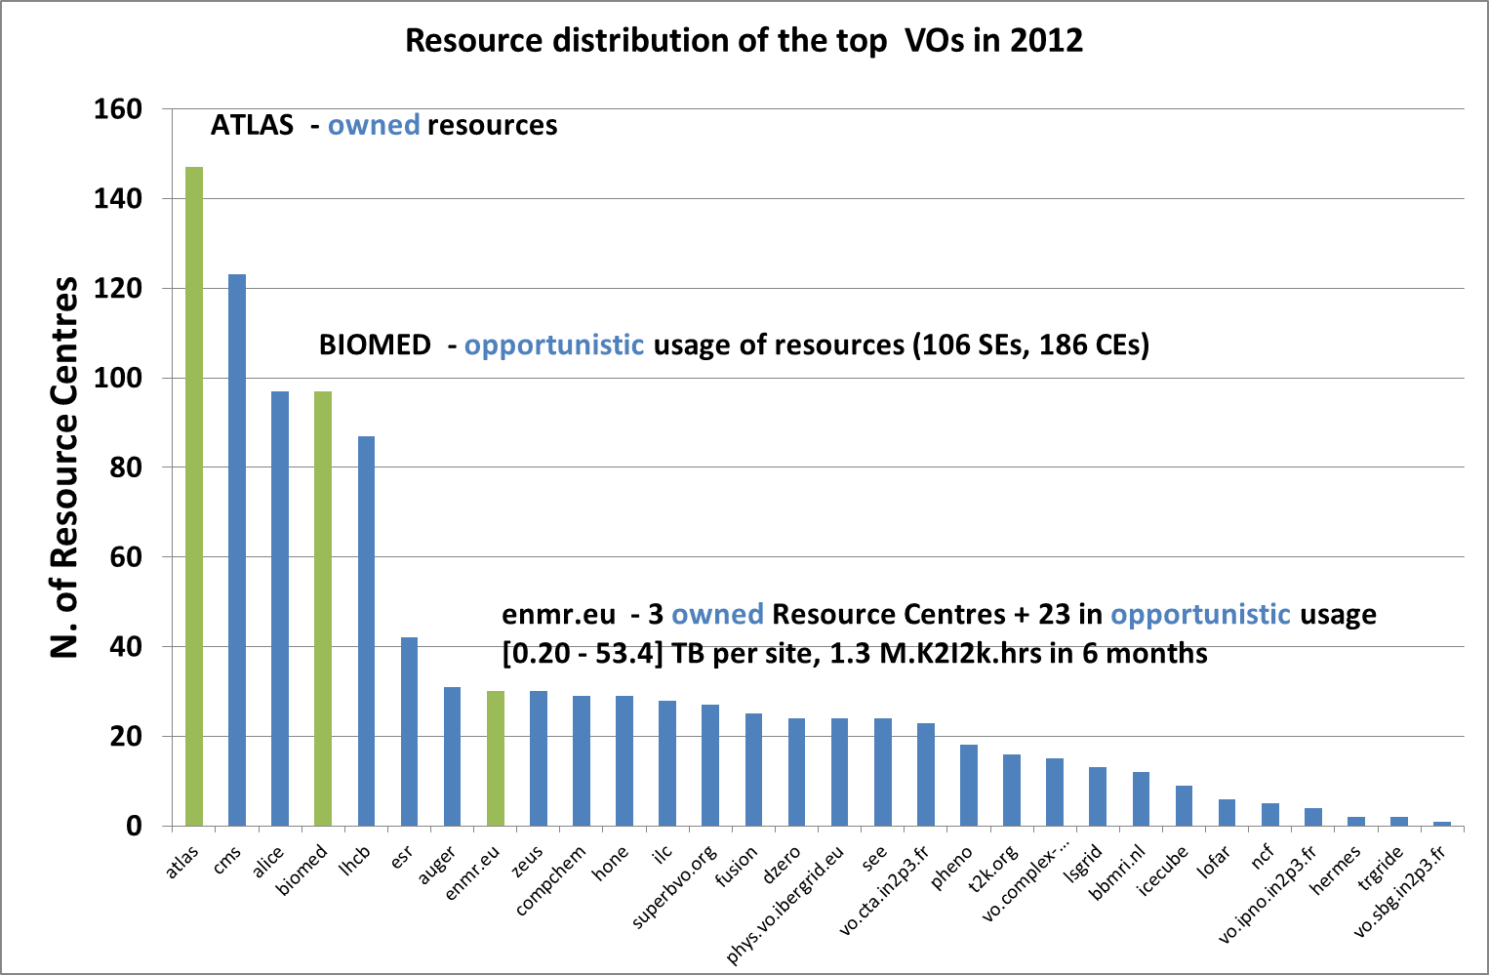
Resource Distribution - Examples

Slide 6
Current policies
Heterogeneous and defined by autonomously by the resource owners ~80%
NGI coordination of resource allocation within the country ~20%
VO ← NGI → RCs
NGI Review process of demand at a national level NGIs (NGI_NL and NGI_PL), SLAs with Resource Centres

Slide 7
Current allocation model
Freedom of choice
SUPPORTERs
Support
NGI
Support
Interaction
VO
Resource Centre

Slide 8
EGI Council Policy – Nov 2012
The EGI Council has adopted a policy to explore how Excellent European Science can be supported through a European level review and resource allocation process of pooled NGI resources (Nov 2012)
https://documents.egi.eu/document/1415

Slide 9
Federated resource pooling?
Resource Centres (RCs) and/or NGIs contribute a fraction of resources to constitute a physically distributed pool of resources available for allocation
EGI.eu collects demand from international VOs (NGI at a national level) and offer from Resource Providers (RPs)
Need of better incentives for RPs
From acknowledgement of usage to pay-per-use (e.g. WeNMR current best practice http://www.wenmr.eu/wenmr/publications-acknowledging-wenmr)
Demand is peer reviewed (if required)

Slide 10
Activities – Jan 2013
Scientific review process/EGI.eu Strategy and Policy Team
Resource application and allocation/OMB task force
User and RP requirements
Resource allocation models
Processes and activities
Testbed
Discussion

