Slide 1
The OpenAIRE Infrastructure: on measuring research impact
Evolving EGI Workshop – 29 January 2013
Pasquale Pagano
CNR-ISTI
Paolo Manghi
CNR - ISTI

Slide 2
OpenAIRE objectives
European data infra for scholarly communication
  Promoting Open Access: best practices and business models for articles and datasets
  Providing services: aggregation and linking (by inference) of articles, datasets, projects, funding schemes (EC and National), access rights (OA, non-OA), and research initiatives (e.g. EGI)
  Measuring impact: research funding, EC SC39 Open Access policy, research initiatives, any entity

Slide 3
OpenAIRE Data Infrastructure
Human Infrastructure
Networking for Open Access
Community building,
dissemination, liasons, studies
Data Infrastructure
Research and Services
Data collection, aggregation,
curation, enrichment, provision

Slide 4







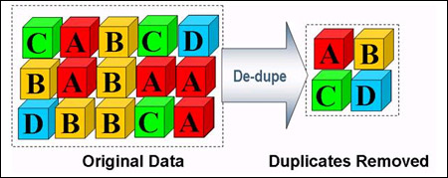


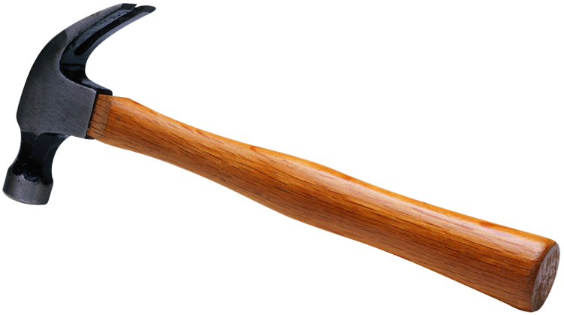
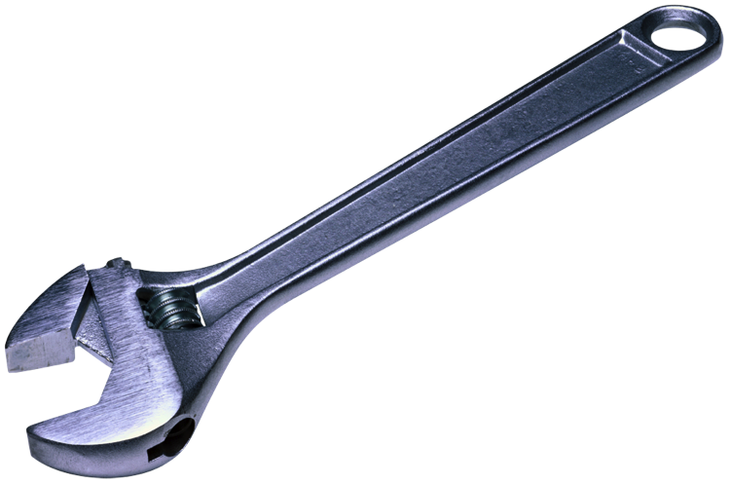


OpenAIRE Data Infrastructure
Curate &
collaborate
(feedbacks
from coordinators)
Deposit/
Ingest (claim)
Publications
Access for Third-party Service
Providers
Search &
Browse
Get support
Statistics
Usage policies
Information Inference by
Data Mining
Publications
De-duplication
Cleansing &
Transforming
Projects
Data Source Validation
OpenAIRE guidelines
Dublin Core metadata + FP7 project + license info + registered in OpenDOAR+
Orphan
Repository
FP7 publications
Institutional & Thematic repositories, OA Journals
Entity Registries
(OpenDOAR, EC-CORDA)
4

Slide 5
Human Infrastructure

Slide 6
Main Goals and Activities
OA Helpdesk for European researchers
  Dissemination, liaison, community building
National and European scholarly publication and data infrastructure initiatives alignment on OA
  DataCite, ESFRI infra projects (CLARIN, DARIAH), EuroCRIS (CERIF), EUDAT, Europeana, ORCID, …
Guidelines for content providers
IPR issues for pubs and research data
Feasibility/financing models for OA
Notes:
Bringing together representatives from all 27 European member states plus Norway, Switzerland, Croatia, Iceland and Turkey
Aligning national and European scholarly publication and data infrastructural initiatives on topics related to Open Access
Studying IPR issues and their specific applications on publications and research data
Identifying feasibility/financing OA models that will allow the envisioned expansion of Open Access to all European funded rogrammes

Slide 7
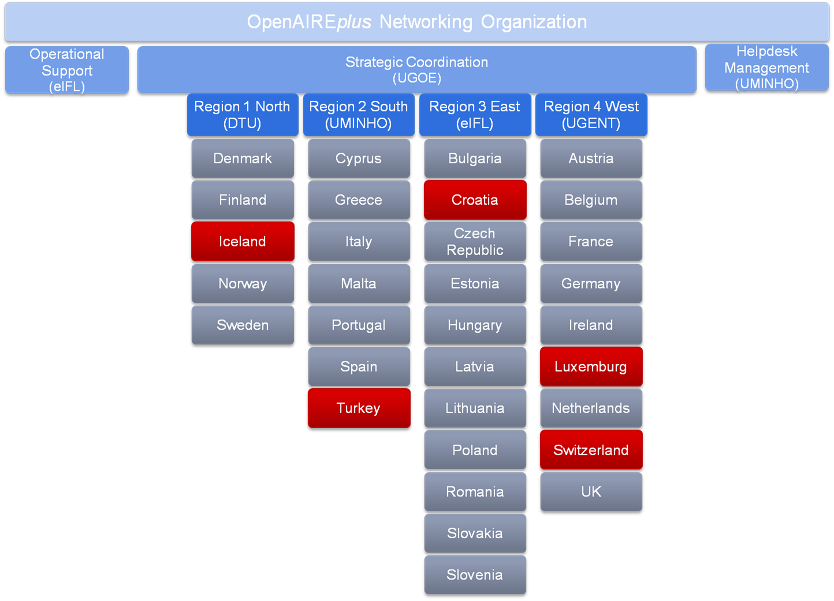

National Open Access Desks
Building on Confederation of Open Access Repositories (COAR)
Human Network

Slide 8



Guidelines for Content Providers
Repositories
  Extending OpenAIRE Guidelines for repository managers: OAI-PMH protocol: DC + project encoding + license encoding
  Data archives
  DataCite metadata
  CRIS systems
  CERIF metadata
  Entity registries
  Ad-hoc solutions (e.g., OpenDOAR, CORDA, ORCID, Wellcome Trust)

Slide 9
Data Infrastructure

Slide 10
OpenAIRE Data Model
CERIF & DataCite inspiration

Slide 11
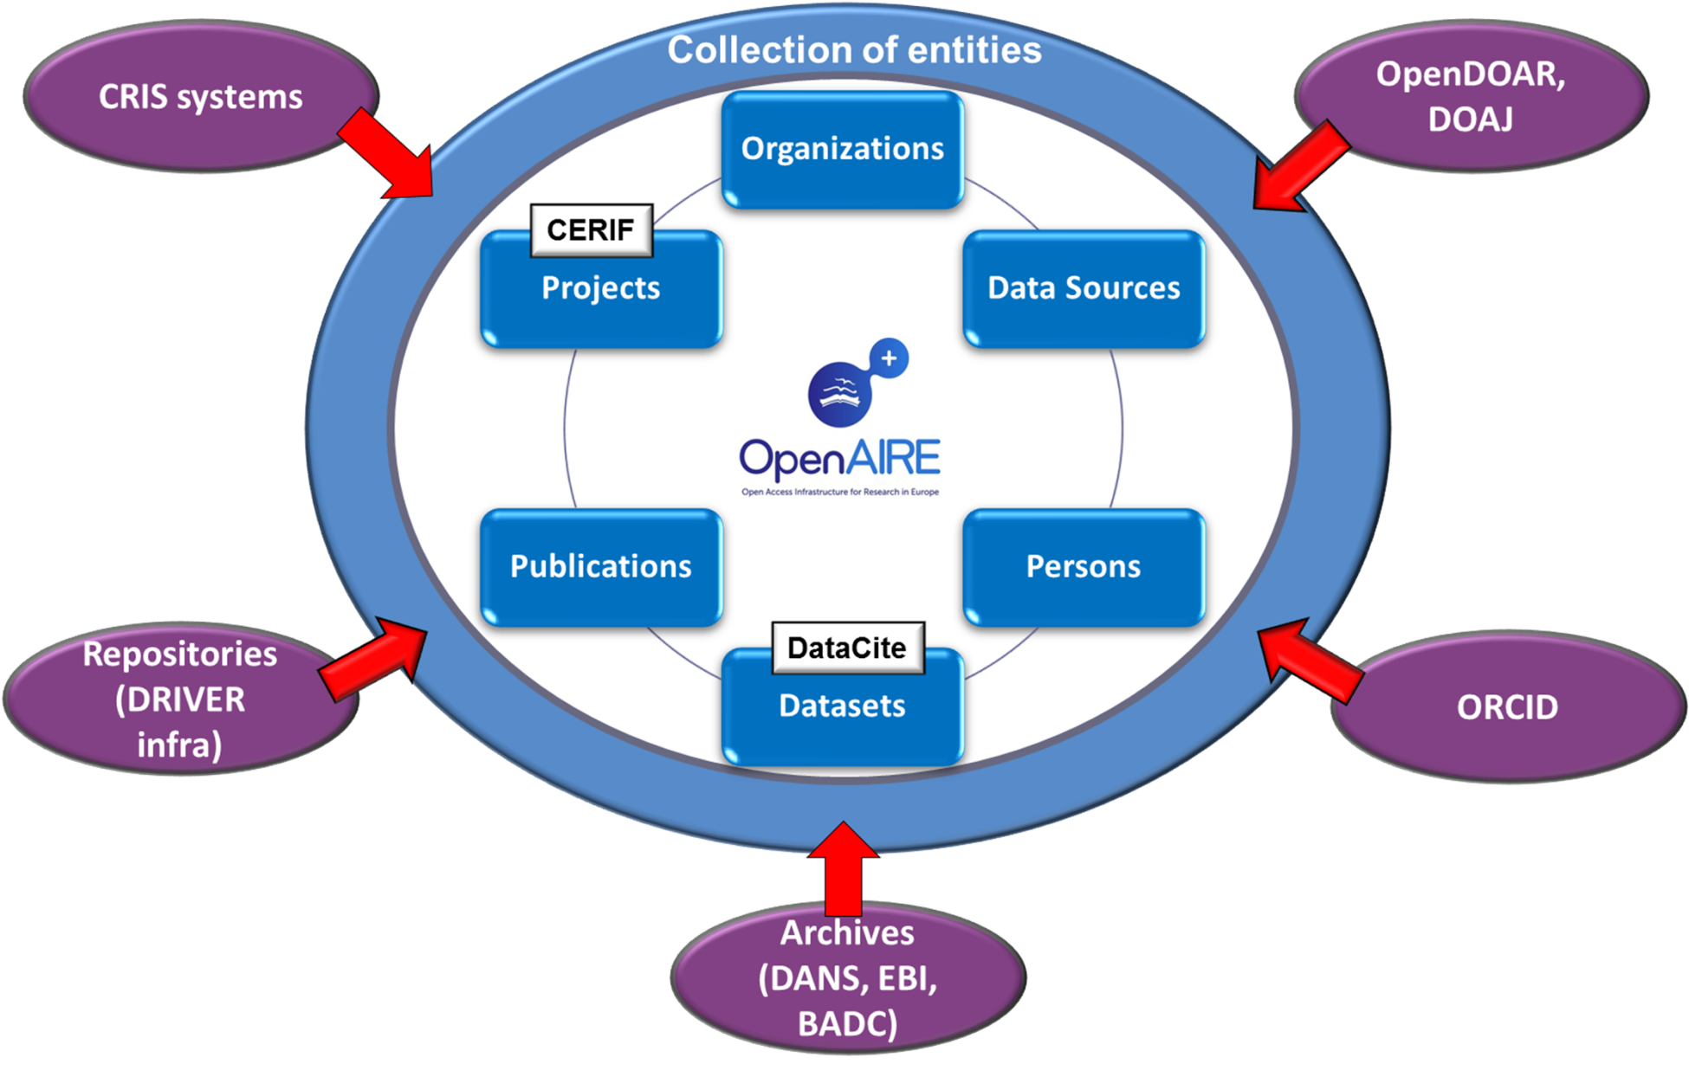
Data sources

Slide 12
Data flow
Information Space
Objects
Deduplicated
Objects
Inferred Objects
Relationships
Data inference
Original
Objects
OpenAIREplus
Data Sources:
Repositories, CRISs,
Data archives,
entity registries
Data collection
Orphan
Repository
Expert-validated
Objects

Slide 13


Enabling Technology
D-NET Software toolkit
  Service-oriented data infrastructure enabling technology
  Adoption: Projects (DRIVER, OpenAIRE, EFG, HOPE, EFG1914) and nations (Spain-Recolecta, Poland, Belgium, Argentina (in progress))
  By: CNR-ISTI (IT), U Athens (GR) , ICM (PL), U Bielefeld (GE)
  INVENIO Repository
  Customizable repository platform: workflows and data models
  Adoption: CERN digital library and 30+ institutions world-wide
  By: CERN (Switzerland), collaboration from DESY, EPFL, FNAL, SLAC

Slide 14

End-user claiming
articles and datasets
User feedback
Classification
OpenAIREplus
portal
OAI-PMH
Publisher
Similarity
Identification
Project-Article
Inference
OAI-ORE
Publisher
SRW/CQL
Publisher
Data Curation
and Enrichment
Deduplication
Citation
Identification
Data Provision
Statistics
Browse
Full-Text Index
Data Storage
and Indexing
Metadata Store
File Store
HBASE/Hadoop
Storage
Database
Metadata
Transformation
Metadata
Cleaner
Data mapping
FTP Import
OAI-PMH
Harvester
Data Sources
Man
Data Source
Validator
Data mediation
Repositories
Registries
CRIS
Data archives

Slide 15

Measuring research impact
“Research initiatives” (e.g., e-IRG infra)
Manual provision:
applications to (i) link metadata
to projects (ii) correct/enrich
information space
publication/dataset &
research initiative
Data model
represents
the concept of
“research initiative”
“Claim”
Any relationships &
entities
End-user
Feedback
Any relationships &
entities
Automated provision:
Supported by compliance
to “Guidelines
for Content
Providers”
Any relationships &
entities
Inference by mining
Collection
(Semi-)Automated provision:
facilitated by “mandates” typically
issued by funding agencies
(e.g., reference to initiative embedded in publication text)
Repositories, archives,
entity registries and CRISs

Slide 16
Ongoing and under discussion Liaisons
DataCite
OAJ
e-IRG
CORDA
REIsearch.eu
CERIF
OpenDOAR
Mendeley
ORCID
EUDAT
RepositoryNET+
Copernicus
…

Slide 17
OpenAIREplus project
Partners and Roles: Factsheet
Coordination
  University of Athens - GR
  Goettingen University Library - DE
  CNR-ISTI - IT
Technical production & operation
  5 partners with expertise in technologies for Digital Libraries and Data Infrastructures
General
  Starting date: Dec 1, 2011
  Duration: 30 months
  Total budget: 5.2 Mi
Scientific communities
  EBI – biology
  DANS – social sciences
  STFC/BADC – climate
Networking Organization
  5 libraries, active in OA movement
National Open Access Desks
  All member states
  Norway, Switzerland, Turkey, Iceland

Slide 18
Questions?
For more:
OpenAIRE infrastructure: http://www.openaire.eu
DRIVER infrastructure: http://www.driver-community.eu
D-NET Software toolkit: http://www.d-net.research-infrastructures.eu
INVENIO Repository: http://invenio-software.org

Slide 19
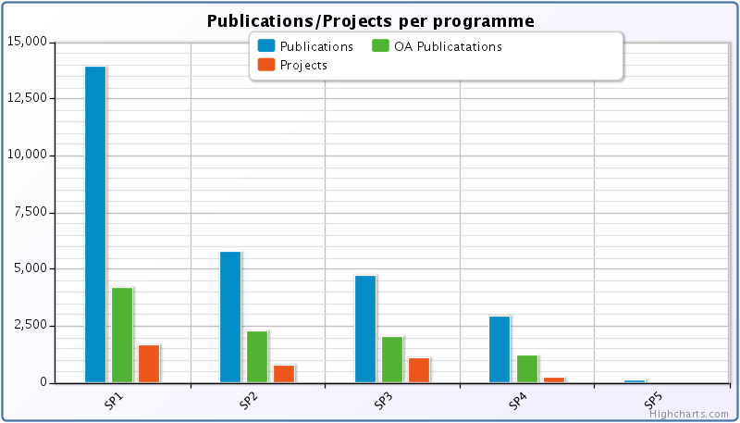
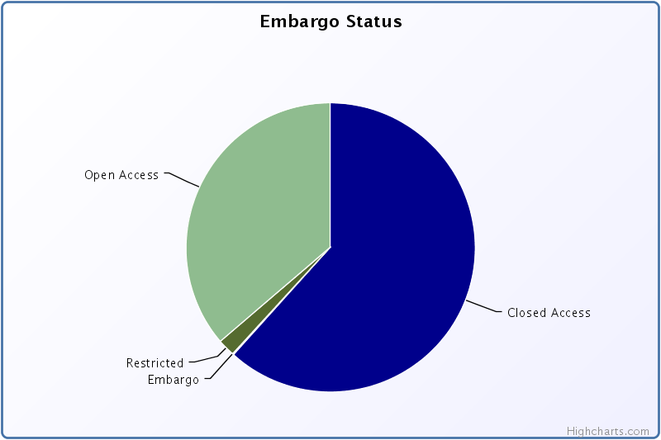
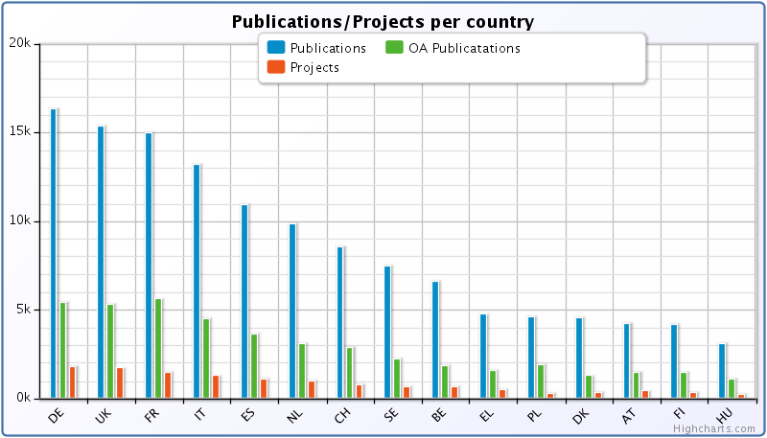
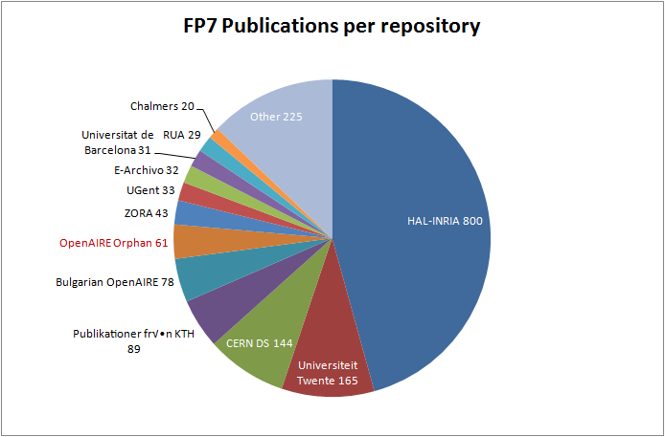
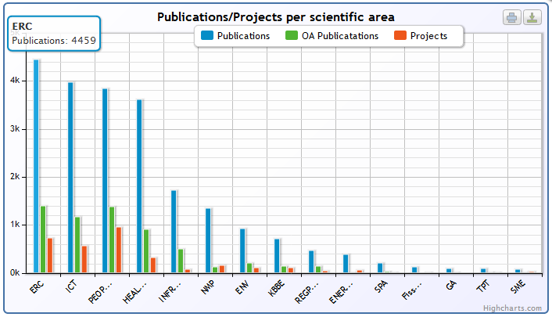
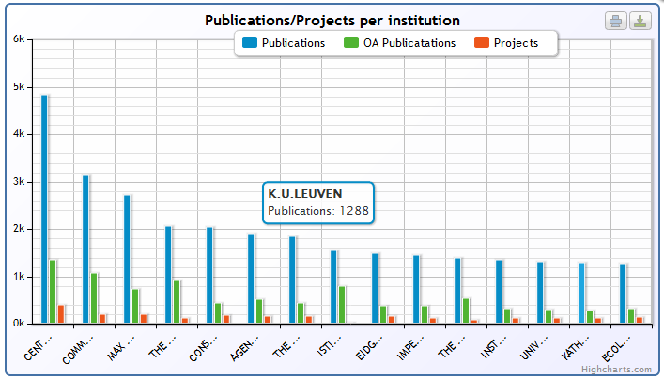
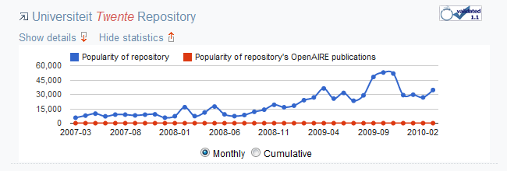
Services for research administrators

Slide 20
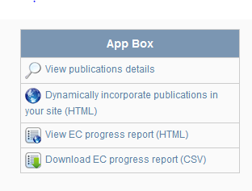
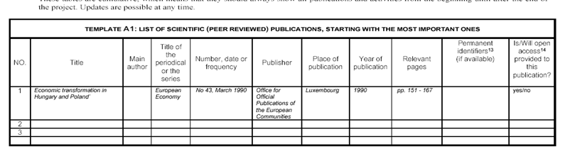
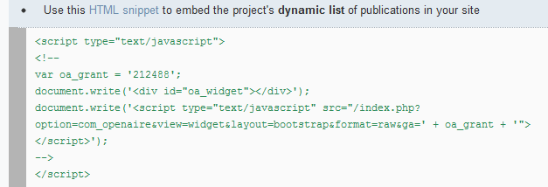
Services for Project coordinators
One click from the project’s publications
Assist in progress reporting
  Create HTML, csv files to use in EC templates
Provide code snippets to embed dynamic list of project publications in project site

