Slide 1
ELIXIR UK Node and UK NGI

Slide 2
Organisations involved
Core
University of Oxford
University of Manchester
NERC Environmental Omics Synthesis Centre (Centre for Ecology and Hydrology and
University of Cardiff)
The Wellcome Trust Sanger Institute
University of Liverpool
The Genome Analysis Centre, Norwich
University College London
University of Birmingham
University of Edinburgh
Other
Software Sustainability Institute UK
The Hartree Centre
University of Dundee

Slide 3
Focus is Training
Delivered in specialised centres, in courses, and through e-learning, in partnership with other ELIXIR Nodes and agencies.
Initially train postgraduate, postdoctoral and mid-career scientists
Focusing on research-intensive bioscience and environment industries.

Slide 4
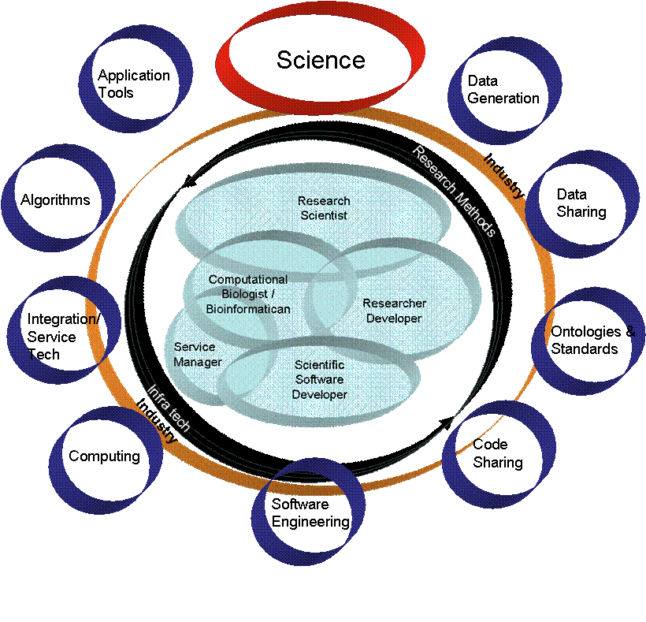

Slide 5
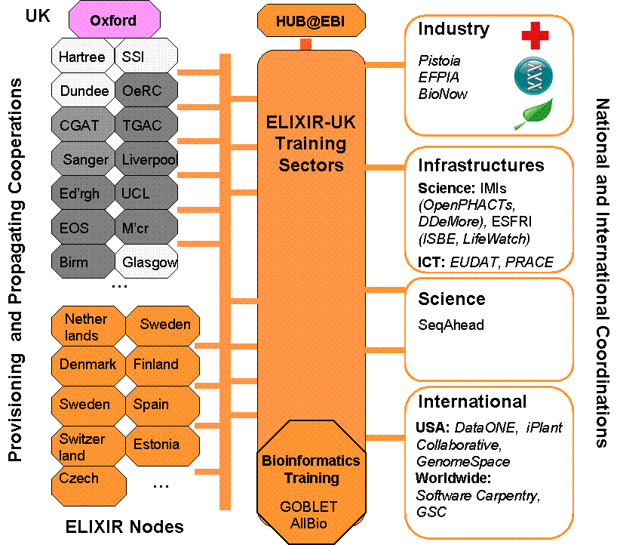

Slide 7
Connections between ELIXIR UK & UK NGI

Slide 8
UK NGI & ELIXIR
Sustained contact between UK NGI and ELIXIR hub
Discussion w.r.t Core Services, particularly monitoring
Participation in UK NGI technical roadmapping workshop

