Slide 1
SAML and eduGAIN for CTA
Brook Schofield
eduGAIN Task Leader, GN3 Project schofield@terena.org
18 January 2013
CTA WebEx

Slide 2
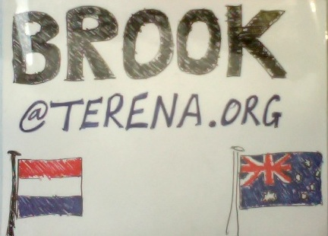
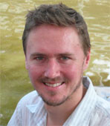
About me…
Brook Schofield
mailto:schofield@terena.org
skype://brookschofield
tel:+31651553991
http://terena.org/~schofield
linkedin.com/in/brookschofield
Australian living in The Netherlands. Grew up on the island state of Tasmania.
Task Leader in the GN3 Project for eduGAIN.

Slide 3
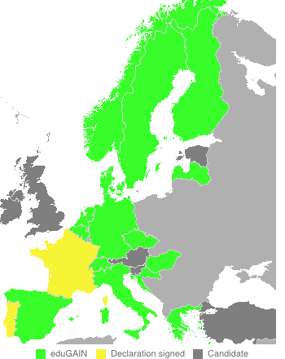
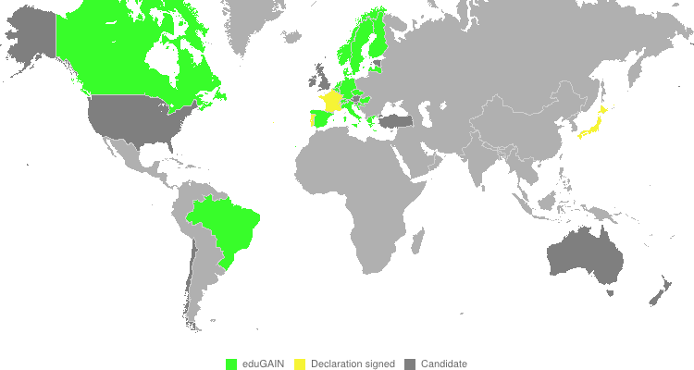
eduGAIN status (in numbers)
17 active participant federations
3 joining federations
6 European federations not participating
AT, EE, IE, TR, SI, UK
7 federations not participating
AU, CL, CN, IN, NZ, OM, US
18 GN3 Partners without a federation (23 GN3+)
Notes:
17 participant federations
3 candidate federations (FÉR, RCTSaai, GakuNin)
6 European federations not participating (Edugate, UKFederation, ArnesAAI, ACOnet, /CONFIA/, TAAT)
7 other federations not participating (AAF, Tuakiri, InCommon, CARSI, OMAN KID, INFED, COFRE)
18 GN3 Partners without a federation (BG BY CY IL LT LU MD ME MK MT RO RU SK UA)

Slide 4
eduGAIN status

Slide 5
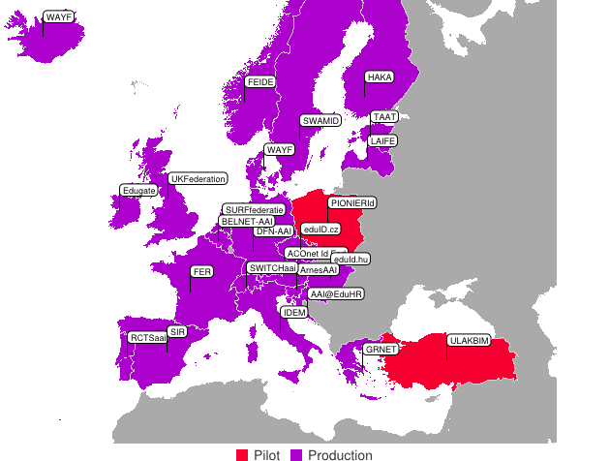
European Identity Federations
Notes:
REFEDS tracks identity federations globally and particularly in Europe (where there is a higher concentration of federations)

Slide 6
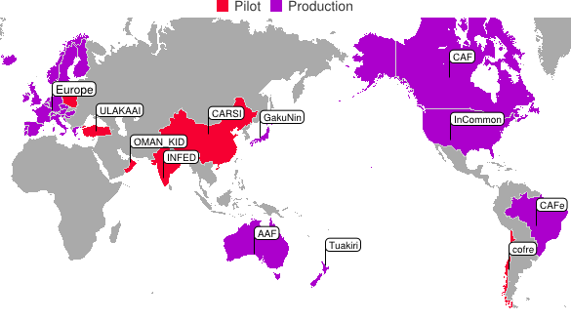
Identity Federations

Slide 7
Federations Required
Argentina, Armenia, Austria, Brazil, Bulgaria, Croatia, Czech Republic, Finland, France, Germany, Greece, India, Ireland, Italy, Japan, Mexico, Namibia, Netherlands, Norway, Poland, Slovenia, South Africa, Spain, Sweden, Switzerland, the UK & the USA.
Notes:
All are CTA countries, the one that are crossed out have ID federations. These are listed on the next slide.
The one without ID federations are on slide 9

Slide 8
CTA Federations Existing (20/27)
Austria, Brazil, Croatia, Czech Republic, Finland, France, Germany, Greece, India, Ireland, Italy, Japan, Netherlands, Norway, Slovenia, Spain, Sweden, Switzerland, the UK & the USA.

Slide 9
CTA Federations Required (7/27)
Argentina, Armenia, Bulgaria, Mexico, Namibia, Poland, South Africa
GÉANT Project (http://eduGAIN.org)
Support for Armenia, Bulgaria, Poland
ELCIRA Project (http://elcira.eu)
Support for Argentina, Mexico
Africa
No Project Known (Namibia, South Africa)

Slide 10
Federation Coverage
Austria (1/1), Brazil (1/3), Croatia (3/3), Czech Republic (1/1), Finland (1/1), France (7/10), Germany (7/12), Greece (3/3), India (0/4), Ireland (0/1), Italy (1/18), Japan (5/22), Netherlands (3/3), Norway (1/1), Slovenia (1/1), Spain (8/8), Sweden (4/4), Switzerland (4/4), the UK (12/12) & the USA (17/23).
Notes:
Those CTA countries that already have an ID federation.
Because of the hierarchical institutional setup in some of the countries (e.g. Italy) more institutes may be alrady covered in those.

Slide 11
Federations with 100% coverage
All members are federated…
12 federations
42 members
Austria (1), Croatia (3), Czech Republic (1), Finland (1), Greece (3), Netherlands (3), Norway (1), Slovenia (1), Spain (8), Sweden (4), Switzerland (4), the UK (12)

Slide 12
Mixed Federation Coverage
Mixed coverage (improvement needed)
8 federations
38 federated members
55 members need federating
Brazil (1/3), France (7/10), Germany (7/12), India (0/4), Ireland (0/1), Italy (1/18), Japan (5/22) & the USA (17/23).
Notes:
These are the countries with less than 100% coverage.

Slide 13
Recommendations
TODO…
…but:
SAML is deployed by 51% of consortia
eduGAIN offers an interfederation solution
Encouraging additional investment in SAML by other members looks promising
Investigate CTA Consortia account service as a temporary measure until National and Institutional service is deployed

Slide 14
Federations Required
Who is federated?
http://www.terena.org/~schofield/servicecatalogue/vo.html?fed=CTA

