Slide 1
Evolving the TCB
Technology coordination in a Platform based e-Infrastructure

Slide 2
IT Service (Management)
Software support
Expert level support in help desk
Requests for information, incidents, enhancements
Software maintenance
Fix software problems
Refactoring, etc.
Software development
Include new features (typically functional)
Requirements engineering
Service management
Service levels
Procedures
Contacts

Slide 3
EGI service suppliers
Different in size & organisation
Platform providers/integrators
Product Teams
Small team/Individuals
Different EGI commitment levels
Integrated
Contributing
Community

Slide 4
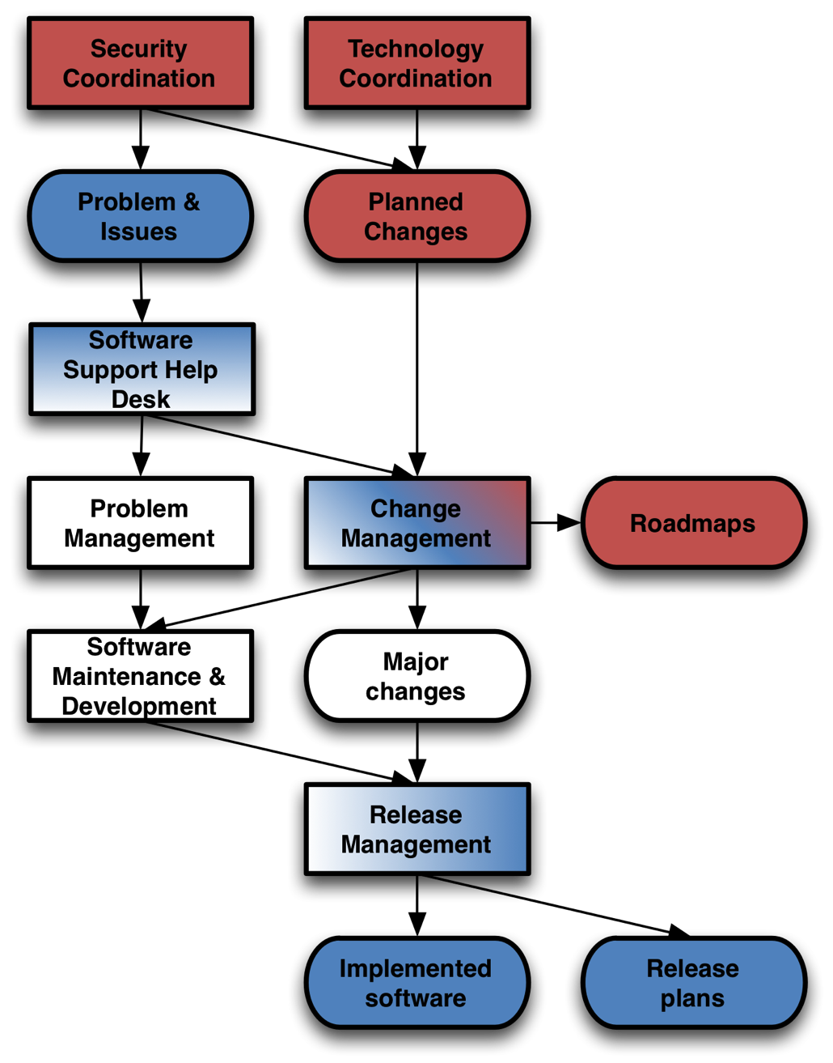
ITSM activities
Strategic ITSM activities
Security coordination
Technology coordination
Change management
Tactic ITSM activities
Software support (Help desk)
Change management
Release Management
Technical ITSM activities
Software Support (Help desk)
Problem management
SW maintenance
Release management

Slide 5
ITSM activities
Strategic ITSM activities
Security coordination
Technology coordination
Change management
Tactic ITSM activities
Software support (Help desk)
Change management
Release Management
Technical ITSM activities
Software Support (Help desk)
Problem management
SW maintenance
Release management
TCB
URT
Technology
supplier

Slide 6
Scope of the TCB
Strategic ITSM activities
Enabling/invasive technologies
E-Infrastructure capabilities
Requirements on European level
Inter-platform interface coordination
Roadmap harmonisation & publication
Framework for release planning & schedules
IT supplier service management (SLA)
Activity authority & delegation
Board of arbitration for URT
Appointing & closing down Task Forces
Budget authority (if awarded)

Slide 7
Scope of the TCB (2)
Participants
Chair & Secretary
Product Managers (and deputies)
1 per EGI platform (from EGI.eu)
1 per Community Platform (from Platform Integrators)
Attendance
Meeting frequency: 6 weeks – 3 months
Required in person, by deputy, or remotely
Flagged up if missing attendance level
2 consecutive F2F, or
3 consecutive meetings

Slide 8
Scope of the URT
Tactical ITSM activities
Monitoring the Help desk (incl. follow-up)
Monitoring SVG/RAT issues
Requirements on service/component level
Release schedules harmonisation
Within the roadmap timelines
Coordinates software provisioning
Direct EGI Software provisioning
Assess and accept (or deny) IT supplier process
IT Service Management
Provide and/or ensure metrication for KPIs

Slide 9
Scope of the URT (2)
Participants
URT Chair (from EGI.eu)
Release managers (and deputies)
1 per EGI platform (from with EGI)
1 per Community Platform (from Platform Integrator)
Attendance
Monthly conference calls
F2F when required & requested
Pre-meeting roundtable reports

Slide 10
Dealing with suppliers
Assumptions/expectations
Commitment level correlates to combination of supplier size & organisation
Commitment level correlates to ITSM activity coverage
Modular SLA reflects ITSM activity coverage
Fine-tuning through differentiation in SLA service levels
Commitment level | Strategic/ TCB | Tactical/ URT | Software delivery
Integrated | required | required | required
Contributing |  | required | required
Community |  |  | required

