Slide 1
Configuration management tools used at EGI (overview of survey)
EGI.eu Operations

Slide 2
Why the survey?
Yaim configuration of grid services for an homogeneous set of variables
Future support of Yaim core is uncertain…
Some EMI services are moving away from yaim to specific configuration files/scripts
Uniform configuration parameters across services are desirable
Configuration management templates can re-use parameters, which are shared between services

Slide 3
Survey summary
Survey opened: Jan 28th, closed: Mar 24th
Circulated directly among sites
87 answers
Questions:
Size of the sites: number of services / number of worker nodes
Configuration management tools used (or evaluated)
Pros and cons
Modules used for grid services and OS
Developed by the site/NGI/others

Slide 4
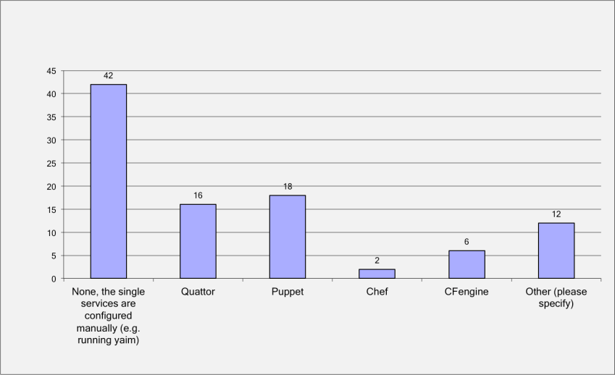
Is the site using configuration management tools?
Evaluating?
- 18 not yet chosen
- 6 Puppet
3 - Home made solutions
2 – Ansible
1 - cobbler
1 - xcat
54

Slide 5
Number of services deployed vs conf. tool used
# of services deployed | Quattor | Puppet | Chef | CFengine | Total sites
Less than 10 | 8 | 8 | 0 | 3 | 59
Less than 30 | 5 | 7 | 1 | 3 | 29
Less than 50 | 0 | 0 | 0 | 0 | 1
More than 50 | 3 | 3 | 1 | 0 | 8

Slide 6
Pros and cons
Quattor (15)
grid services templates available, knowledge base in the grid community (QWG)
Small community, steep learning curve, complicated to update
Puppet (16)
Huge community, well documented, many plugins available
Lack of grid modules, initial configuration takes time
Chef (2)
Reliable, mainstream, cloud interfaces available
Not widely used in the infrastructure, doesn’t configure O.S.
CFEngine (4)
Flexible, easy alteration of config files
CFv2 →CFv3 difficult migration

Slide 7
Custom modules for Grid 1/2
Do you use specific modules developed for the grid services?

Slide 8
Custom modules for Grid 2/2
Quattor: generally calling Yaim
Customizations for local monitoring, bugs workaround and fine tuning
Puppet: most of the sites are using modules calling Yaim
CERN is working on Yaim-free modules for: WN, CREAM, VOMS, MyProxy, BDII, DPM/LSF, Slurm, CVMFS, Argus, FTS, LFC
VU-MIF-LCG2, Yaim-free configuration for BDII
T3_CH_PSI, configuration modules for dCache and ARC
Chef: Using Yaim

Slide 9
Summary
No single configuration tool good for all the grid sites
Puppet is taking the lead
Growing user community within EGI
Already a big user community worldwide (true also for other tools)
Big site (CERN) working on a set of templates (master/masterless)
Lot of templates, but not all the products are covered
Coordination work starting within an Hepix working group

Slide 10
Future actions
Cooperate with the Hepix WG
Facilitate sharing of work done by site managers/NGIs → discussion forum
Re-use the modules already available (avoid duplication)
Collaboration on testing
Fill in the gaps, focusing on the missing services (yaim-free modules)

