Slide 1
The CTA Virtual Team in EGI
Authors
C. Vuerli (INAF), N. Neyroud (LAPP/IN2P3/CNRS),
G. Lamanna (LAPP/IN2P3/CNRS)
Contributions by
G. Sipos (EGI.eu), R. McLennan (EGI.eu),
B. Schofield (TERENA), L. Hämmerle (SWITCH)

Slide 2
EGI Virtual Teams
Virtual Team projects:
  https://wiki.egi.eu/wiki/Virtual_Team_Projects
  Short (1-6 months) project with multiple NGIs (National Grid Infrastructures) involved
  Setup through NILs – NGI International Liaisons
    Single point of contact in NGIs for various activities, including Technical Outreach
  Goal
    A flexible and dynamic means to rapidly bring together community members
    They have a well-defined series of tasks to meet a specific goal to be achieved in a relatively short period of time
  Focus
    Increase the number of EGI users
  Activity domains
    Marketing & Communication
    Strategic Planning and Policy Support
    Community outreach and events for new users
    Technical outreach and support to new communities

Slide 3
Why a VT for CTA in EGI
Interest by EGI to collaborate with one of the biggest astronomical ESFRI projects
  CTA is a flagship project for the whole astro particles physics community
CTA can leverage on the EGI ecosystem to find a solution to its challenges
Some of the CTA challenges
  Procurement of computing resources
    HPC, HTC, Clouds. This is matter of the CTA computing model definition which is underway in this phase
  Procurement of data storage resources
  Easy and user-friendly ways to get access to and use such resources
    A SSO (Single Sign On) authentication and authorization system
      The CTA community is wide and trans-national and this implies non trivial issues to solve for the SSO system
    Science Gateways

Slide 4
CTA VT Members
Project leader
  Claudio Vuerli – INAF, Italy
EGI.eu contacts
  Gergely Sipos – EGI.eu, Netherlands
  Richard McLennan – EGI.eu, Netherlands
Observers
  Brook Schofield, Licia Florio, Nadia Sluer – Terena institute, Netherlands
  Lukas Hämmerle – SWITCH, Switzerland
Armenia
  Hrachya Astsatryan – National Academy of Sciences of the Republic of Armenia
Bulgaria
  Aneta Karaivanova, Todor Gurov – Bulgarian Academy of Sciences, Institute of Information and Communication Technologies
France
  Giovanni Lamanna, Nadine Neyroud, Cecile Barbier, Nukri Komin – CNRS/IN2P3/LAPP, Annecy
  Genevieve Romier – CNRS/Institut des Grilles
Italy
  Claudio Vuerli, Ugo Becciani, Alessandro Costa, Fabio Vitello, Giuliano Castelli – INAF
  Daniele Cesini, Alessandro Costantini, Marco Bencivenni – IGI
Lithuania
  Viktor Kisko – Vilnius University, Faculty of Mathematics and Informatics
Poland
  Mariusz Sterzel – Cyfronet
Spain
  Ricardo Graciani – University of Barcelona/ICC, Barcelona
  Enol Fernandez, Isabel Campos – Ibergrid

Slide 5
Tasks of the EGI VT for CTA
N | Topic | Estimated Length
1 | Establish a social network between CTA and EGI through the support teams of the NGIs. | 0.5 months
2 | Use the social network to gather CTA user requirements concerning: a) Web based scientific gateways operated for the CTA community, making DCI resources and services from the NGIs accessible for CTA members; b) A SSO, internationally federated, authentication mechanism that would make web-based scientific gateways accessible for the CTA community. | 2.5 months
3 | Mapping the identified CTA requirements to solutions that exist within the EGI community and within its partners, such as the NRENs. | 2 months
4 | Document the findings and define a roadmap for implementing, deploying and operating an SSO solution and one or more scientific gateways for the CTA community. | 1 month

Slide 6
Expected Outcomes
 | Outcome | Means of delivery | Time of delivery (after VT start)
Task 1 | Social network between CTA members and EGI members (from EGI.eu and from NGIs) | The list of CTA – EGI connections are listed on the VT project Wiki page. Information about CTA members is recorded in the EGI CRM system. | 0.5 months
Task 2 | Documented CTA requirements concerning scientific gateways and an SSO system. | Document (approved by the CTA consortium) that is publicly accessible in the EGI Document Database. | 3 months

Slide 7
Expected Outcomes
 | Outcome | Means of delivery | Time of delivery (after VT start)
Task 3 | Most suitable solutions from EGI and its partners that are capable to address the CTA requirements. Identified gaps in the EGI science gateways and SSO offerings to address CTA requirements. | Document (approved by the CTA consortium) that is publicly accessible in the EGI Document Database. | 5 months
Task 4 | Final report that proposes a roadmap for CTA and EGI to setup scientific gateways and an SSO solution for the CTA community. | Document (approved by the CTA consortium) that is publicly accessible in the EGI Document Database. | 6 months

Slide 8
Current Status
Harvesting of end user requirements for Science Gateways and SSO systems (task 2)
  From existing CTA general user requirements documents
  Through brainstorming sessions with CTA end user communities
  Final user requirements document expected by end of April
Survey and discussions on the candidate technologies for Science Gateways and SSO already in progress (task 3)
  Formal documentation will be produced when the outcome of task 2 is available

Slide 9
T2 Outcome: UR Examples
Science Gateways
  UR-SG-0010 – The Science Gateway must be able to propose to each user its authorized applications associated with its authorized archive data
  UR-SG-0020 – The Science Gateway must provide access to the data collections (Archive) resulting from the Guest observers’ proposals, the MC simulation results through a data selection application
  UR-SG-0045 – Additional privileged applications must be integrated: Telescope monitoring, data processing management, …. and associated with specific privileged users (Archive scientists, on-site operator,…)
  UR-SG-0080 – The Science Gateway must allow a transfer of information from one application to another one (For example list of observation dataset references from data selection application to data analysis application).

Slide 10
T2 Outcome: UR Examples
Performance
  UR-SG-0100 – The Science Gateway must be able to manage about 1000 registered users and 100 simultaneous connections
Communication interfaces
  UR-SG-0200 – The Science Gateway must allow reasonable response time through an Internet standard Service Provider connection
Security
  UR-SG-0910 – A specific user can be simultaneously Privileged user, Principal Investigator or Guest observer for one or more specific subset of observation data, Archive user for all the public Archive data
  UR-SG-0915 – Any privileged application could restrict its access to a specific user connected on a specific Internet subnet
  UR-SG-0916 – The Science Gateway must be able to distinguish access rights between applications; a privileged user for one application could be a standard user for the other one
  UR-SG-0920 – All data obtained by CTA observatory must be made public (for Archive users?) through an archive following a period of proprietary use. The proprietary period could be different for each observation
  UR-SG-0940 – The Science Gateway must be able to provide a public access and public applications where the user is not identified

Slide 11
IdFs and IdPs for CTA
The identification/definition of IdFs (Identity Federations) and IdPs (Identity Providers) for CTA is a challenge
  The CTA collaboration is trans-national
  There are quite different scenarios for what concerns IdPs and IdFs in countries being part of the CTA collaboration
An IdF for CTA is mandatory to deploy a unique SSO system for the whole collaboration
Without a CTA SSO system relying on a unique IdF, there are no real advantages coming from DCIs and Science Gateways

Slide 12
IdFs and IdPs for CTA
Goal
  Allow CTA users to authenticate through credential issued by their own Institutes
  Credentials trusted within the whole CTA collaboration
Possible choices
  Create an ad-hoc Identity Federation for the CTA collaboration
    Hard to manage; useless effort: IdFs already exist in each country
  The plan then is to use those already in place
NGIs play a key role in defining the IdF for CTA
  IT, FR, PL and ES NGIs involved in the Virtual Team for CTA
The eduGAIN inter-federation service is able to ensure a good, although not full, coverage
  → eduGAIN + CTA IdP ?

Slide 13
SSO System for CTA
Closely related with the Identify Federation definition
Progressive approach for what concerns user’s credentials
  Classical username/password pairs at a first stage
  User Certificates and different ways of managing them at a later stage
To be integrated in all CTA Science Gateways

Slide 14
IdFs: European Landscape
Identity Federations (or simply federations) are being developed at national level by NRENs (National Research and Education Networks)
Different (open source) technologies are used but now they are interoperable
  They all recognize Security Assertion Markup Language (SAML) as “the standard” to transfer information (assertions) among each other
  Today converging towards SAML2.0. The open source software being used is:
    Shibboleth
    SimpleSAML PHP in the academic federations.
  Only SAML2 (vs. the old SAML1) provides good interoperability between different implementations
    SAML2 is a very broad standard
    SAML2int WebSSO profile (http://saml2int.org) is suggested by eduGAIN
eduGAIN: European project for interoperation between different Authentication and Authorization infrastructures
  eduGAIN is the way federations communicate in Europe

Slide 16
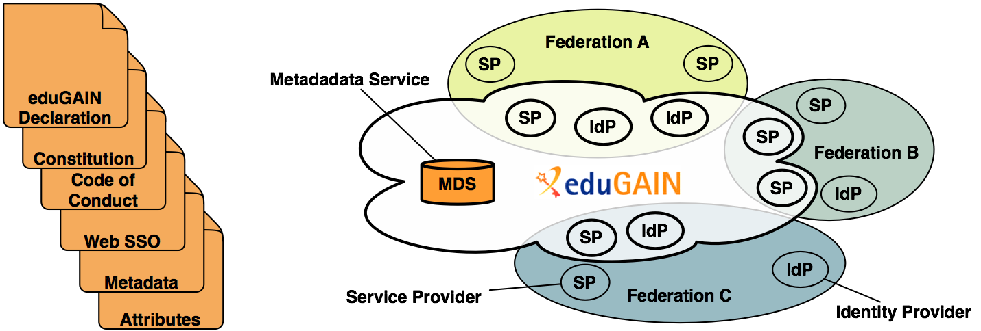

An inter-federation service and a framework (of legal document, policies and profiles) that allows interconnecting subsets of SPs/IdPs of the participating federations such that they can easier exchange identity information in form of (SAML) assertions

Slide 17
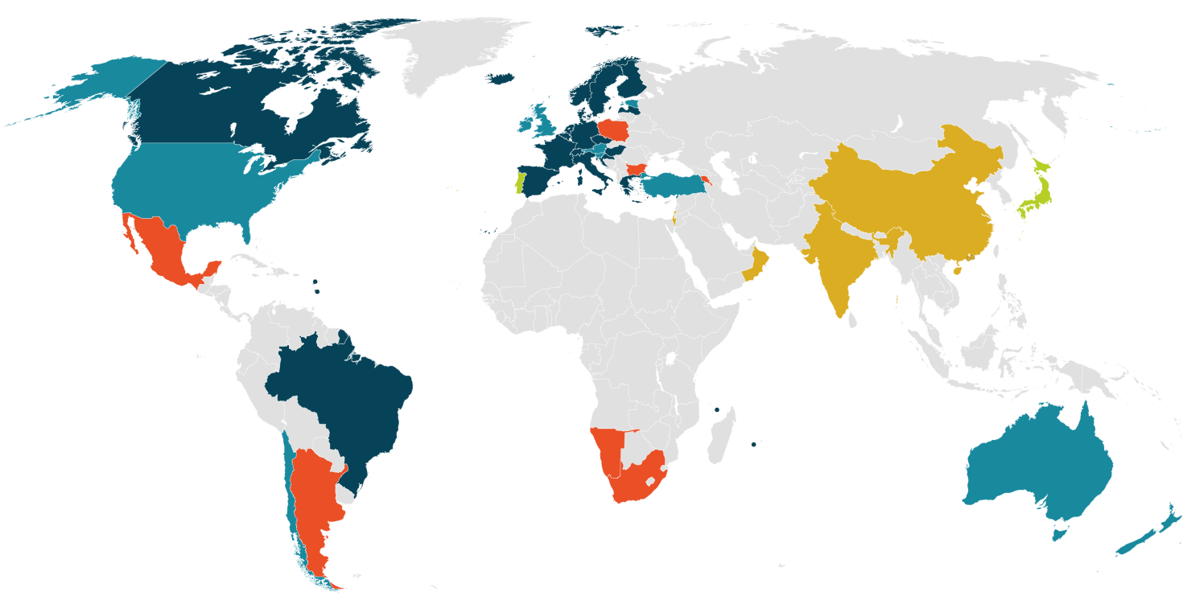
eduGAIN Member
Joining eduGAIN
Candidate Federation
Existing Federation
Missing Federation

Slide 18
17 → 18 active participant federations
3 → 2 joining federations
6 → 7 European federations not participating
  AT, EE, IE, IL, TR, SI, UK (Israel is new but not CTA relevant)
7 federations not participating
  AU, CL, CN, IN, NZ, OM, US
18 GN3 Partners without a federation (23 GN3+)
7 CTA participants without a federation

Slide 19
The CTA collaboration
Members of the CTA consortium
  https://portal.cta-observatory.org/Countries/Pages/default.aspx
Existing federations
  Austria, Brazil, Croatia, Czech Republic, Finland, France, Germany, Greece, India, Ireland, Italy, Japan, Netherlands, Norway, Slovenia, Spain, Sweden, Switzerland, the UK & the USA
Required federations
  Argentina, Armenia, Bulgaria, Mexico, Namibia, Poland, South Africa
  GÉANT Project (http://eduGAIN.org)
    Support for Armenia, Bulgaria, Poland
  ELCIRA Project (http://elcira.eu)
    Support for Argentina, Mexico
  Africa
    No Project Known (Namibia, South Africa)

Slide 20
Recommendations
Work to do … but:
  SAML is deployed by 51% of consortia, although:
    not all of them are part of eduGAIN yet
    as individual institutions they have to take technical and legal steps to opt-in for inter-federation (eduGAIN) support.
    an extra time (months to years) is necessary until all these institutions are actually fully supporting eduGAIN, but …
    … use cases like CTA will speed up the opt-in process
  eduGAIN offers an inter-federation solution
  Encouraging additional investment in SAML by other members looks promising
  Investigate CTA Consortium account service as a temporary measure until National and Institutional service is deployed

Slide 21
Closing remarks
Motivation for the VT under construction
  Triggered within the CTA collaboration but its deliveries impact wider aspects such as a broader identity federation for the Astro-Particle Astrophysics Community and the Virtual Observatory
CTA is now in its preparatory phase
  In this phase the activity for what concerns the SSO system and the Science Gateways aims at producing prototypes to be proposed to the CTA collaboration as possible solutions to be adopted during the operative phase of the project
  Whether to adopt such models/solutions or not is in charge of the CTA Consortium
  The prototypal models built in this phase do not represent any obligation for the CTA Consortium

Slide 22
Closing remarks
What produced during the CTA preparatory phase (including the deliveries of the VT) are issued in two directions:
  Towards EGI that can re-use them for the benefit of other User Communities interested in evaluating and exploiting solutions based on distributed e-Infrastructures
  Towards the CTA Consortium for an evaluation and a possible endorsement and usage after the end of the preparatory phase

