Slide 1
EGI: The Road Ahead
Steven Newhouse, EGI.eu
EGI-InSPIRE Project Director
EGI: The Road Ahead

Slide 2
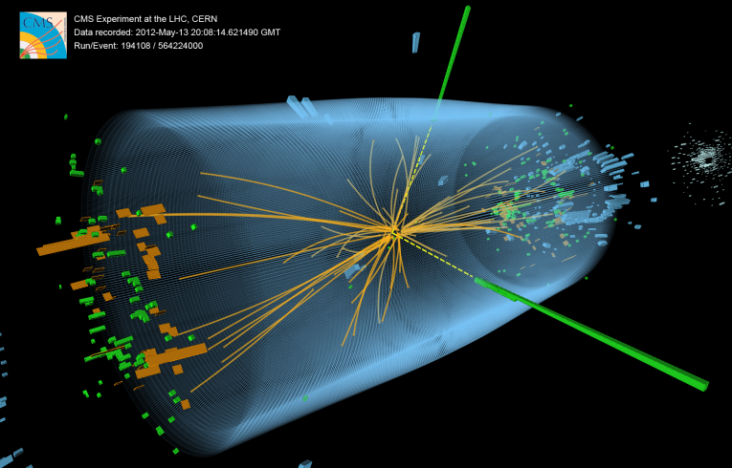
Where have we come from?
1990: The Web: Information Sharing
1998: The Grid: Resource Sharing
No centralised control
Open standards & protocols
Non-trivial quantities of service
2010: Establishment of EGI.eu & EGI
2012: Discover of a Higgs like particle
2013+: What’s next?
EGI: The Road Ahead

Slide 3
From EDG→EGEE→EGI
Sites 2004
CERN | 1
NGI_NL | 2
Sweden | 2
NGI_BG | 1
Canada | 1
NGI_FR | 1
NGI_DE | 3
Russia | 1
NGI_UK | 1
NGI_GR | 1
NGI_FI | 1
Taiwan | 1
Metrics March 2013 |  | Value
Capacity | CPU cores (EGI and integrated resource providers) Disk/Tape (PB) Countries | 372,612 (315 resource centres) 180/167 56
Jobs | Average Job/day (Million) | 1.67 (2.25 including local computation)
% of total norm. CPU wall time consumed | High-Energy Physics | 93.78%
 | Astronomy and Astrophysics | 2.78 %
 | Life Sciences | 1.31%
 | Remaining disciplines | 2.13%
CPU wall time | Integrated, Billion hours Jan 2004-Mar 2013 | 4.8 36.8 (normalized HEP-SPC06)
2001-2004 EDG Proof of Concept
2010-2014 EGI-InSPIRE Transition towards a sustainable infrastructure
2004-2010 EGEE-I/II/III From prototype to production
2007-2009 EGI Design Study Sustainability Model
EGI: The Road Ahead

Slide 4
EGI’s Vision for 2020
To support the digital European Research Area through a pan-European research infrastructure based on an open federation of reliable services that provide uniform access to national computing, storage and data resources.
EGI 2020 Strategy:
http://go.egi.eu/EGI2020
Virtual Research Environments
Operational Infrastructure
Community & Coordination
EGI: The Road Ahead

Slide 5
Sustainable Change
Who needs which services sustained?
Who uses the current services?
How long will this service be needed?
How can/should the continued operation be funded?
Who has new requirements for new services?
What should the new/changed service do?
Who will use this service?
How can the innovation be developed?
How will the innovation be brought into production?
EGI: The Road Ahead

Slide 6
The EGI Ecosystem
Participants & Associated Participants of EGI.eu
Through the EGI Council and the services they fund
The research communities & researchers
Feedback currrently through the EGI.eu participants
The large and diverse EGI Community
Technology Providers, Resource Providers, …
The European Commission & Member States
Through the projects and activities they fund
EGI: The Road Ahead

Slide 7
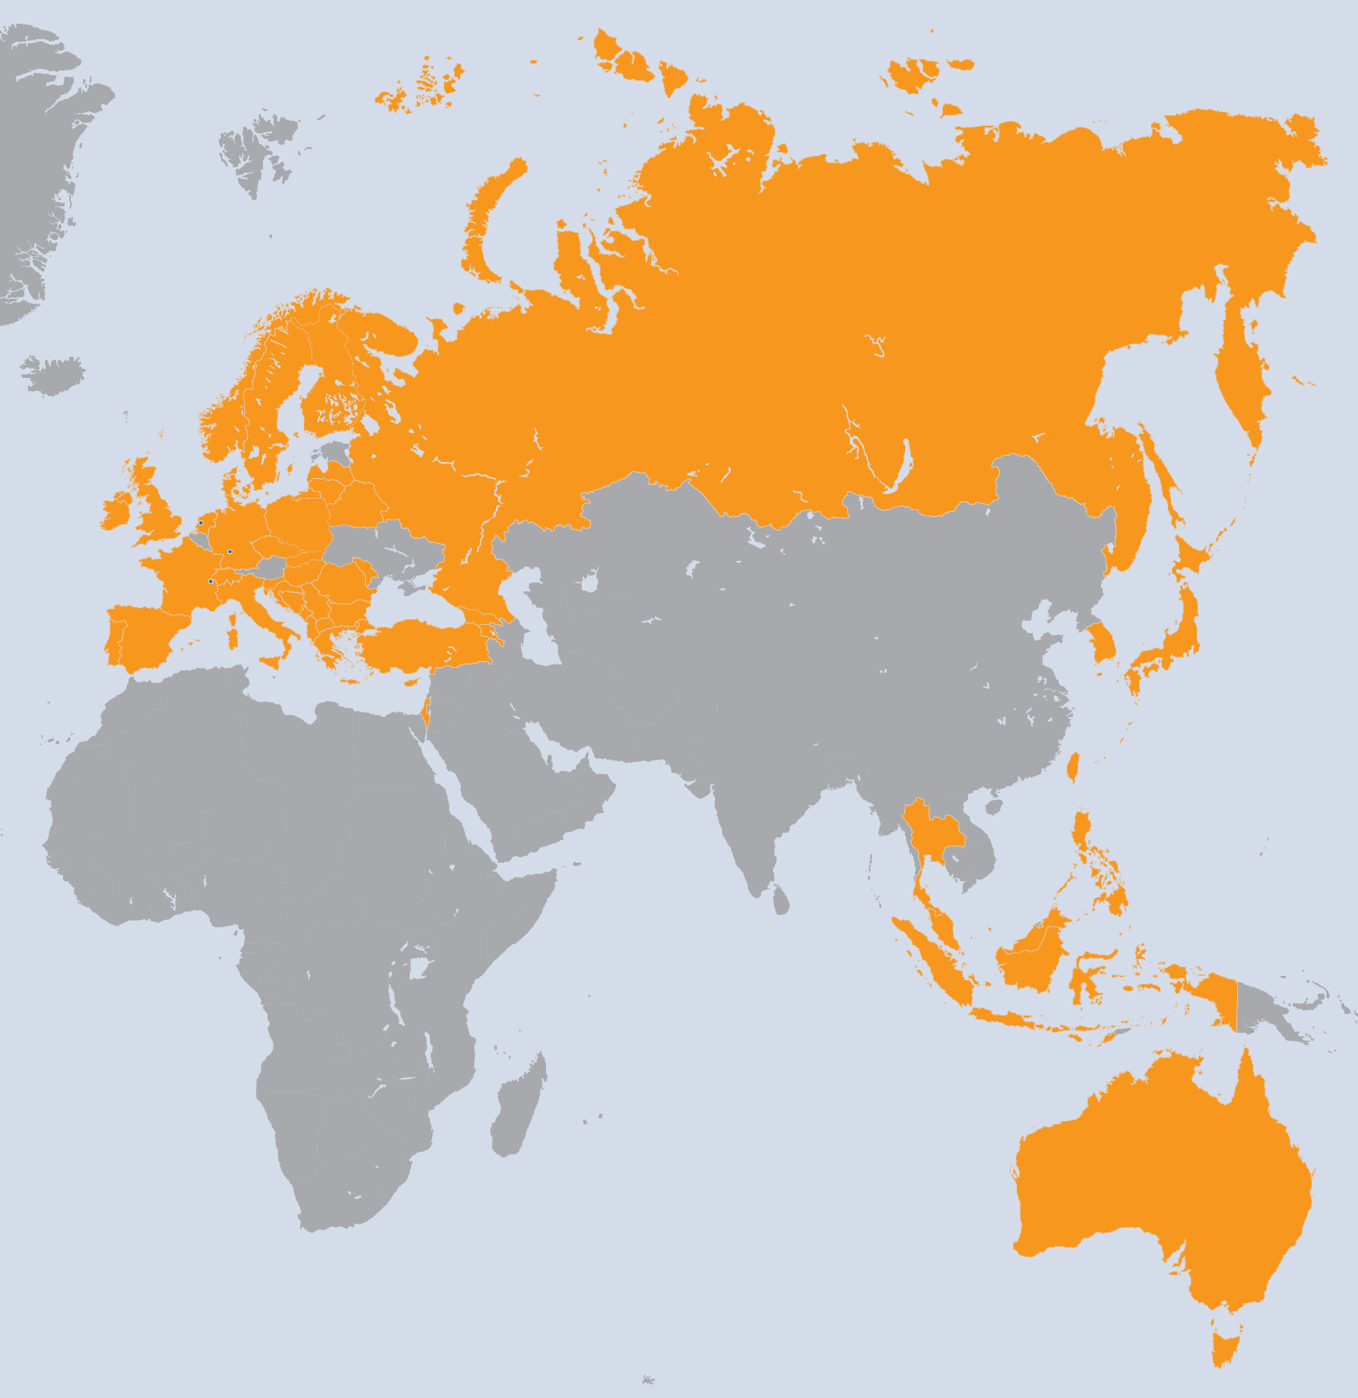
EGI-InSPIRE Project
Integrated Sustainable Pan-European Infrastructure for Researchers in Europe
A 4-year project with
€25M EC contribution
Project cost €72M
Total Effort ~€330M
Effort: 9261PMs
Project Partners (50)
EGI.eu, 38 NGIs, 2 EIROs
Asia Pacific (9 unfunded partners)
EGI: The Road Ahead

Slide 9
Research Infrastructures in H2020: Delivering Excellence in Science
Developing new world class infrastructures
Integrating and operating existing national RIs of pan-European interest
Development, deployment and operation of ICT based e-Infrastructures
Fostering the Innovation Potential or Research Infrastructures and their Human Capital
Reinforcing the European Research Infrastructure Policy and International Cooperation

Slide 10
Funding within EGI
Money
Develop innovate new services and integrate into EGI to grow and diversify the supported research community
Horizon 2020 Projects
(EC Funds)
6 month extension
EGI.eu fees
EGI.eu fees
?
EGI-InSPIRE: EC funds
EGI-InSPIRE: EC funds
Other EC
Project Funds
EGI.eu fees
EGI-InSPIRE:
Partner Contributions
EGI-InSPIRE:
Partner Contributions
EGI-InSPIRE: EC funds
EGI-InSPIRE:
Partner Contributions
Sustain EGI Services that are critical and prevent degradation
EGI.eu fees
EGI Community
Funds
EGI
Participant
Contributions
May
2010
May
2013
May
2014
Nov
2014
Time
EGI: The Road Ahead

Slide 11
EGI within Horizon 2020
Possible Project Concepts | Community & Coordination | Operational Infrastructure | Virtual Research Environments
Providing a Federated Cloud Infrastructure | XX | XXX | X
Innovation in EGI’s Operational Tools |  | XXX
Collaborative Data Infrastructure Platform | X | X | XXX
Promoting Research Results from DRIs | XX |  | XX
Ensuring Cohesion across Europe in EGI | XXX | X
Worldwide Integration | XXX | X
ERIC Design Study | XXX
XXX: Primary focus within the project
XX: Some focus within the project
X: Minor focus within the project
EGI: The Road Ahead

Slide 12
Building our Human Network
NGI Operations Coordination
National operational infrastructures
Existing user support activities
EGI Champions
Applied researchers using/developing on EGI
Support their promotion of EGI in their community
EGI: The Road Ahead

Slide 13
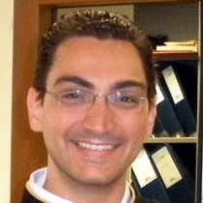
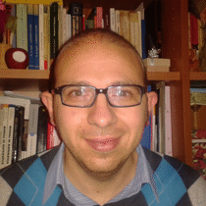
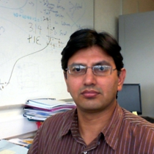
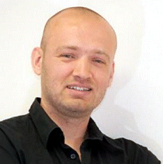
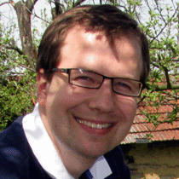
EGI Champions
http://go.egi.eu/champs
Afonso Duarte
Biophysics & Structural biology
Fotis Psomopoulos
Bioinformatics & Computer science
Silvio Pardi
Mathematics & Computer science
Ashiq Anjum
Biomedical sciences & Security
Joeri van Leeuwen
Astronomy
Stella Arnaouti
Civil engineering
Eleni Katragkou
Climatology & Climate science
Mark Santcroos
Biomedical sciences
Tomáš Kulhánek
Computational physiology
Keep the applications coming in!
EGI: The Road Ahead

Slide 14
Building our Human Network
NGI Operations Coordination
National operational infrastructures
Existing user support activities
EGI Champions
Applied researchers using/developing on EGI
Support their promotion of EGI in their community
NGI International Liaisons
Human network of national contact points
Virtual Team (VT) coordinators & participants
EGI: The Road Ahead

Slide 15
VTs: Bring Experts Together
Scientific Gateway Primer
Scientific Publications Repository
GPGPU Requirements within EGI
Inter NGI Usage reporting
Scientific Discipline Classification
ELIXIR and EGI
EGI: The Road Ahead

Slide 16
VTs: Funded Peer Reviewed
Virtual Research Environments
Massive Open Online Course Development
Evaluation of LifeRay Modules
Building and Using Operational Cloud Infrastructure
Providing OCCI support for arbitrary Cloud Management Frameworks
CDMI Support in Cloud Management Frameworks
Dynamic Deployment for OCCI Compliant Clouds
Automatic Deployment and Execution of Applications Using Clouds
Transforming Scientific Research Platforms to Exploit Cloud Capabilities
Operational Tools
VO Administration Portal
A new approach to computing Availability and Reliability Reports
GOCDB Scoping Extensions and Management Interface
Tools for automating applying for and allocating federated resources
Small projects lasting 6-12 months
EGI: The Road Ahead

Slide 17
EGI’s Platforms for H2020
ERA needs an open ecosystem of VREs & services
EGI Collaboration Platform
“Tools & Services enabling cross-community collaboration”
Community
Platform
(VRE)
Community
Platform
(VRE)
Community
Platform
(VRE)
EGI Cloud Infrastructure Platform
“A federated IaaS Cloud infrastructure”
EGI Core Infrastructure Platform
“Operational services necessary for the management of federated DCIs”
EGI: The Road Ahead

Slide 18
EGI’s Core Infrastructure
The services that federate and integrate the functional services deployed in the production infrastructure
EGI Core Infrastructure Platform
Information
Discovery
(BDII)
Federated AAI
Monitoring
Accounting
Metrics
Visualisation
(gstat)
Service
Catalogue
(GOCDB)
Messaging
Operations Portal
For e-Infrastructures, Research Infrastructures & Community Platforms
EGI: The Road Ahead

Slide 19
Why does EGI need Cloud?
Our User Communities are implicitly asking for it
Each user community has different needs
Every user community uses a different VRE (i.e. software)
Remove resource centres as deployment bottlenecks
Resources centres choose to join EGI’s Federated Cloud
Empowers others to deploy their VREs on their resources
Improve flexibility, efficiency and openness of EGI
Support the long-tail of researchers in new communities
Attract more of ERA’s 1.8M+ publicly funded researchers
EGI: The Road Ahead

Slide 20
EGI’s Cloud Infrastructure
Enable an open ecosystem of services
EGI Collaboration Platform
EGI Cloud Infrastructure Platform
VM
Mgmt
Storage
Mgmt
Information
Image Repository
Cloud Management Stacks
(OpenStack, OpenNebula, …)
Image Metadata Marketplace
EGI Core Infrastructure Platform
Federated AAI
Central Service
Registry
Monitoring
Accounting
EGI: The Road Ahead

Slide 21
Scientific Use Cases
Structural biology – We-NMR: Gromacs training environments.
Linguistics – CLARIN: scalable ‘British National Corpus’ service (BNCWeb).
Ecology – BioVel: remote hosting of OpenModeller service.
Software Engineering – SCI-BUS: simulated environments for portal testing.
Musicology – Peachnote project: music score search engine and analysis platform.
Space science – ASTRA-GAIA: data integration with scalable workflows.
Software Engineering – DIRAC: deploying ready-to-use distributed computing systems.
EGI: The Road Ahead

Slide 22
Virtual Research Environments
A VRE encompasses:
Site services for a community or communities
Services run for a single community
Shared Services run for all communities
More control & responsibility to researchers
On demand dynamic deployment of site services
Through EGI’s Federated Cloud
EGI Collaboration Platform: Shared services
People/Social Services
Technical/Infrastructure Services
EGI: The Road Ahead

Slide 23
Digital Research Infrastructure
For EU Researchers & Research Infrastructures
The EGI’s Collaboration, Cloud and Core Platforms
Stable and sustainable EGI Platforms
Baseline activity supported by their consumers
Project based funding for new innovation
Integrated e-Infrastructure Service Delivery
Across networking, HPC, clouds, grids, …
Driven by the needs of the researchers
Public and private sector demand & suppliers
EGI: The Road Ahead

Slide 24
Prof Stefan Soldner-Rembold
Head of the Particle Physics Group, University of Manchester
Dr John Brooke
Research Computing Services, University of Manchester
Dr Claire Devereux
e-Science Department, STFC, RAL

Slide 26
Buses to the Gala Dinner
7pm from the Conference Hotels
Ibis
Portland
Macdonald

Slide 27
CANCELLED

Slide 32
Enjoy Manchester!

