Slide 1
Adopting service management best practices for EGI.eu services
Małgorzata Krakowian
EGI.eu

Slide 2
EGI.eu Service Analysis
EGI.eu provides services known as “Global Tasks”
Directly by staff based in Amsterdam
Outsourced to EGI.eu Participants
FitSM
Global Task
Global Task
Global Task
EGI Service POrtfolio
Consultation and support by:
Global tasks have been evaluated and identified as a service or a supporting activity

Slide 3
EGI.eu within FedSM project works on improving service management in federated e-infrastructure (EGI)
Identify services provided by EGI.eu to the partners
Maturity (ability to provide service) self-assessment
Identify possible/needed improvement to achieve a given SM maturity in key areas
Goal: Implement structured processes for the improvement of service delivery to its customers
Service: way to provided value to customer

Slide 4
Tasks to Services
EGI-InSPIRE DoW
Council
EGI Service Portfolio
Project and Programme Management
Operations Coordination
Technology Coordination
Security Coordination
Specialized Consultancy Services
Strategy and Policy Decision Support
Policy Development
Technical Consultancy and Support
Helpdesk Support
Marketing
Outreach
Training Marketplace
Applications Database
Repository of Validated Software
Federated Operations
Executive Board
Strategic Planning and Policy
Finance and Secretary
Technical Coordination Board
Technology Roadmapping
Marketing and Communication
Community Outreach
Technical Outreach to New Communities
NGI Coordination
Software Accetance Criteria
Software Verification
Software Repository
Application Database
Training Marketplac
Core services
Message Broker Network
Service Availability Monitoring
Security Monitoring
Network Monitoring
Operations Portal
Accounting
Helpdesk
GOCDB
Metrics Portal
1st Level: TPM
2nd Level: DMSU
Network Support
Operations Coordination
Grid Oversight
Availability Reliability Management
Coordination of Operations Security
Coordination of Interoperation
Coordination of Staged Roolout and Related Support Tools
Coordination of Reuirement Gathering
Coordination of Documentation
36 Tasks ->
15 Services

Slide 5
EGI.eu Service Portfolio
Service Category | Service Name | Customer Type | Supporting Activities
Category of Services that have related scope | Service provided to a Customer | Target Customer(s) of the Service EGI.eu Members Resource Providers Reserchers | Activities provided to support part of a Service can be optional packaged
Global Task
Service
Global Task
Supporting Activity

Slide 6
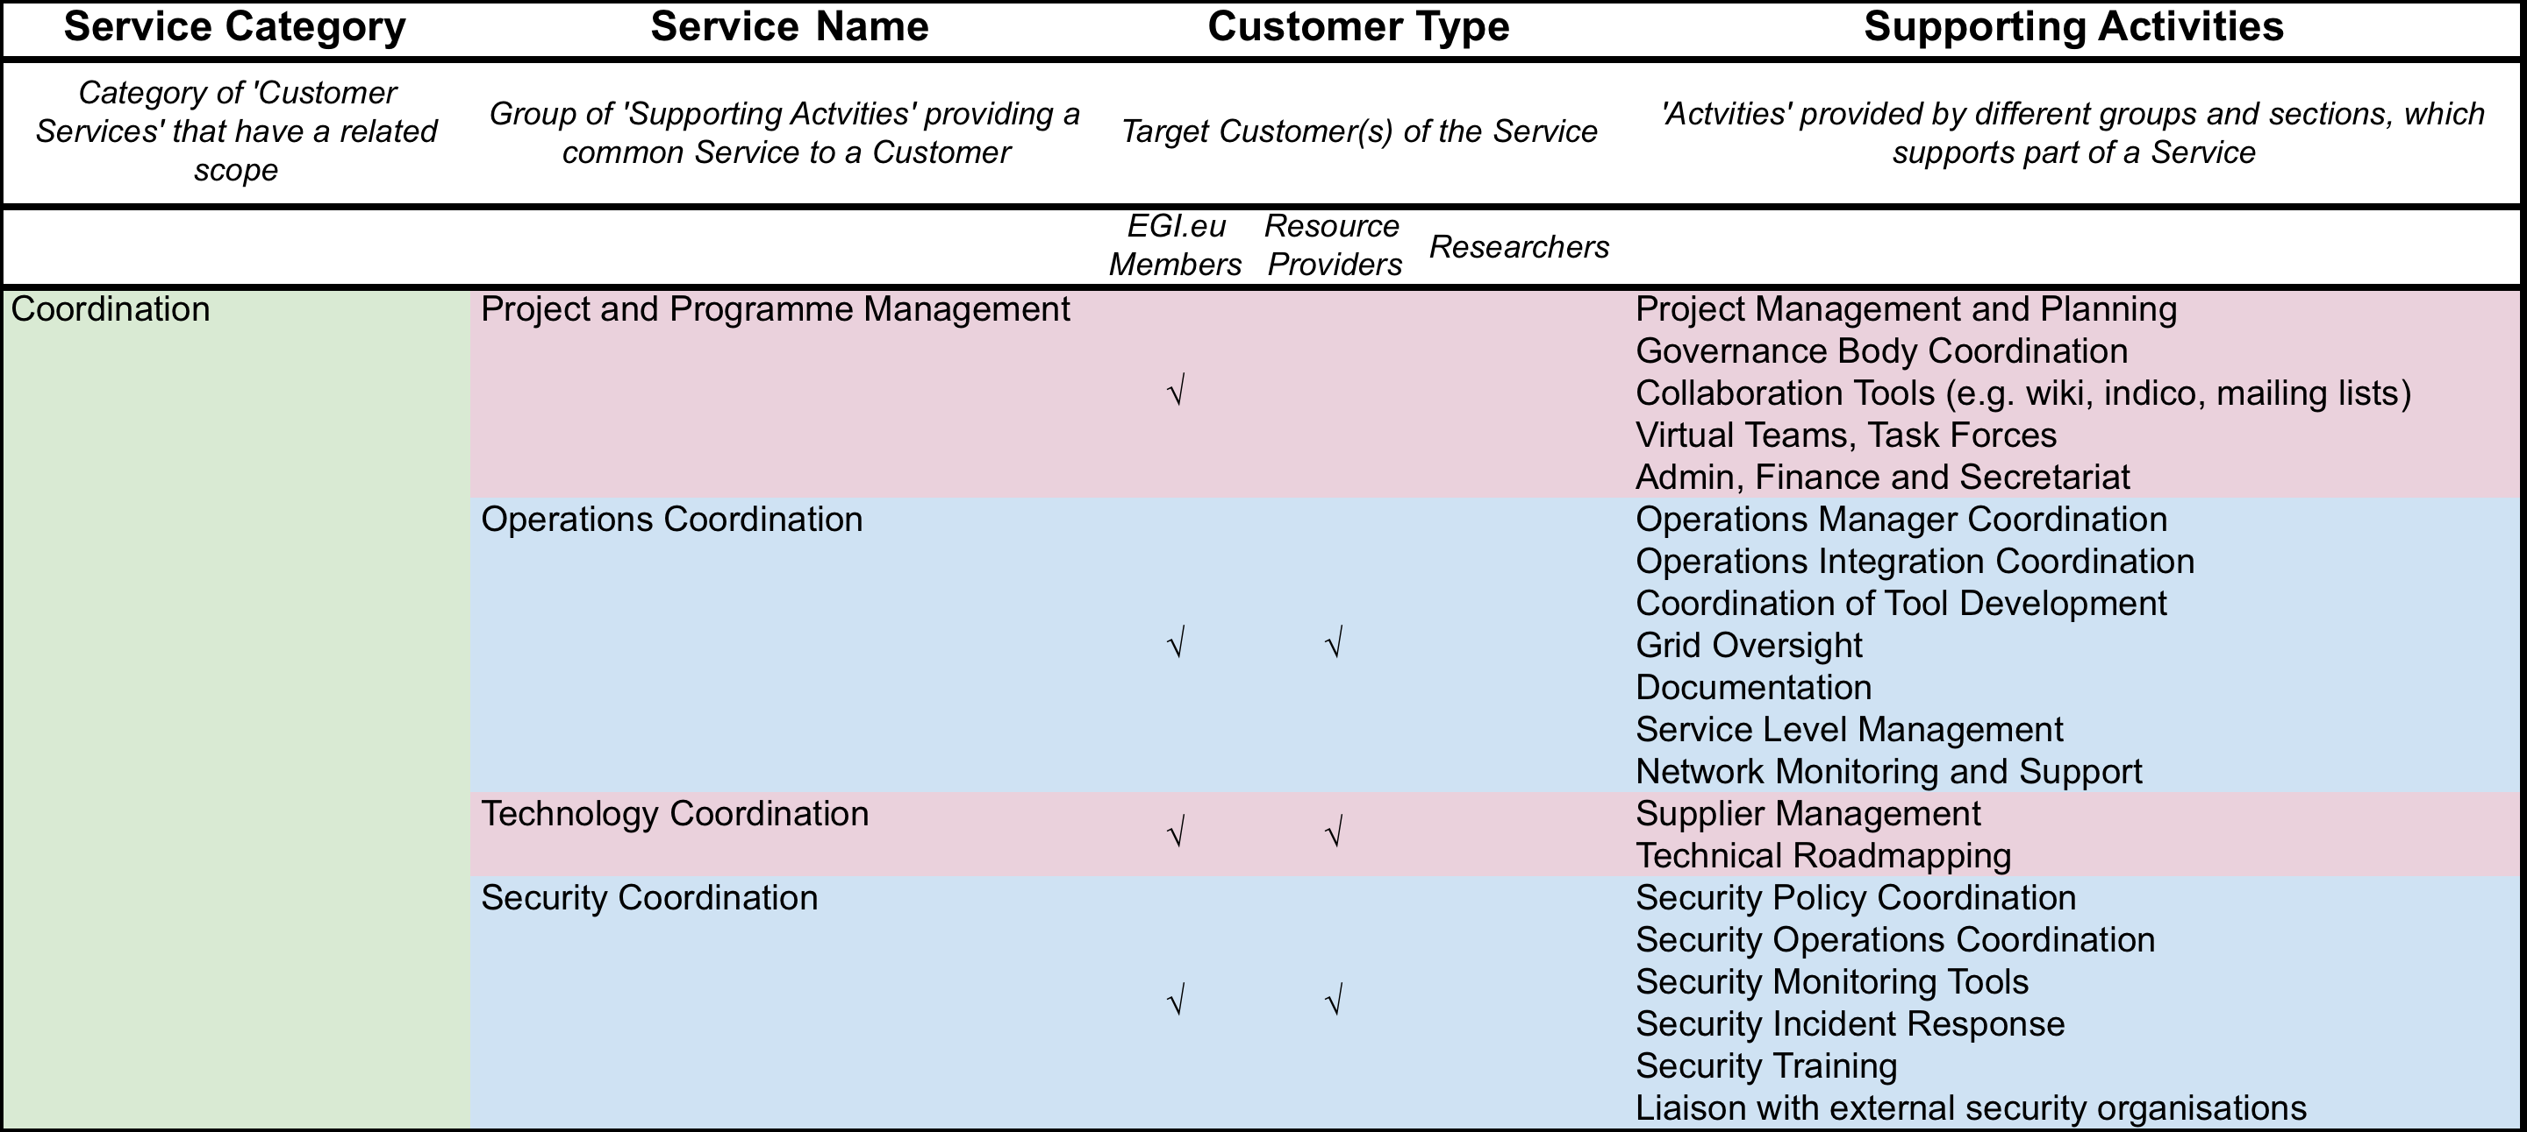
EGI.eu Service Portfolio

Slide 7
Scope
First Federated Operations - key service
Focus on 7 of the 14 total processes
the processes that others depend and to balance the effort required to implement ITSM processes overall
people (roles), procedures, policies and tools
Service Management Maturity Assessment
Assessment within FedSM project
2 NGIs also evaluating their services and management (FI, PL)
Identify areas of strength and areas of improvement for how services are being managed and processes and procedures defined

Slide 8
Federated Operations
Key areas - processes:
Service Portfolio Management
List of offered services - maintened, planned and communicated
Service Level Management
Services should be agreed, monitored
Service Reporting
Service reports should be defined and gathered
Customer Relationship Management
Customers should be identified and relationship properly managed

Slide 9
Federated Operations
Key areas - processes:
Supplier Relationship Management
Suppliers should be identified and relationship properly managed
Incident & Service Request Management
Incidents and requests should be recorded, classified and prioritized, managed
Continual Service Improvement Management
Improvements should be planned and implemented according to given procedures

Slide 10
General requirements
Top management commitment & responsiblity
Documentation
Scope of Service Management
Implementing Service Management
Monitoring and Reviewing Service Management
Continually Improving Service Management

Slide 11
FitSM Requirements
FitSM-1:2013: Standard requirements for lightweight service management in federated IT infrastructures
A set of requirements for effective service management based on ISO/IEC 20000. Includes general requirements and process-specific requirements.

Slide 12
Current improvement focus
General requirements
Processes:
Service level management
Service Reporting
Customer Relationship Management
Supplier Relationship Management
Incident & Service Request Management

Slide 13
EGI.eu Service Management Policy
https://documents.egi.eu/public/ShowDocument?docid=1895
Process Approach. To effectively manage all IT services and underlying components, a process-based approach to service management shall be adopted.
All required processes are defined, communicated and improved based on business needs and feedback from people and parties involved.
Roles and responsibilities are clearly defined.
Customer Alignment. The provision of IT services shall be aligned to customer and user needs.
IT Services are delivered in a defined quality sufficient to satisfy requirements identified from business processes.
For all IT services, a corporate level SLA and/or specific SLAs, which have been agreed with stakeholders, is in place.
Continual Improvement. IT Services and service management processes shall be continually improved.
Feedback from stakeholders is used to continually improve IT services and service quality. All proposals for improvements are recorded and evaluated.
IT Service management is improved based on continual monitoring of process performance and effectiveness.
Training & Awareness. Through trainings and awareness measures, it shall be ensured that staff involved in service management activities can effectively perform according to their roles.
Leadership. Senior management is committed to this policy and its implementation. It provides the resources required to implement and improve service management and enhance customer satisfaction with IT services.

