Slide 1
Quick overview of ENVRI
Yannick Legré – CNRS/IdGC
yannick.legre@idgrilles.fr
http://envri.eu

Slide 2
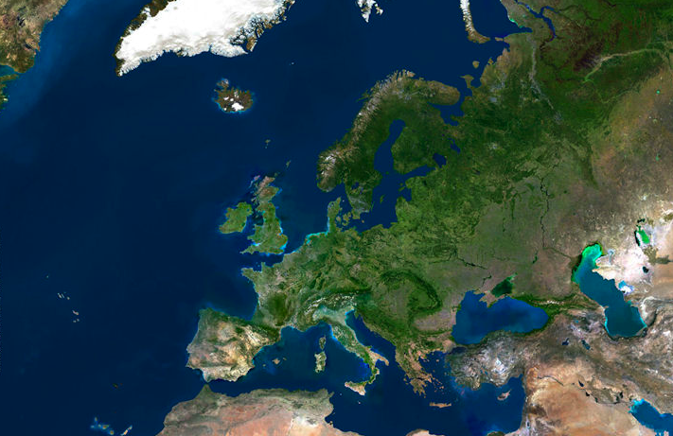
The laboratory of environmental
research infrastructures
Deep Earth, land and sea, the atmosphere
Living and dead environments

Slide 3
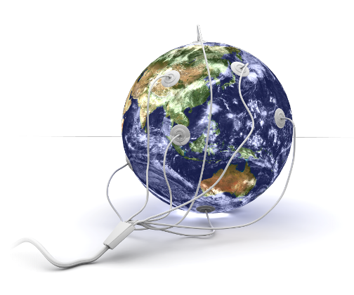
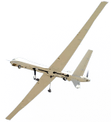
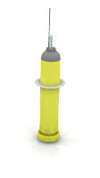
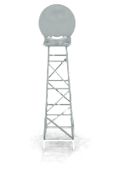
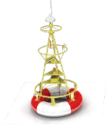
Goal
Enable multidisciplinary scientists to access and study data from multiple domains for “system level” research
by providing solutions and
guidelines for the ENV RIs
common needs
Multiple data producers
Multiple data consumers

Slide 4
ESFRI Environmental Research Infrastructures
COPAL
Tropospheric research aircraft
EISCAT-3D
Upgrade of incoherent SCATter facility
EMSO
Multidisciplinary seafloor observatory
EPOS
Plate observing system
EURO-ARGO
Global ocean observing infrastructure
IAGOS
Aircraft for global observing system
ICOS
Integrated carbon observation system
LIFEWATCH
Biodiversity and ecosystem research infra
SIOS
Svalbard arctic Earth observing system
Associated projects: ACTRIS, AnaEE, InGOS, IS-ENES …

Slide 5
Discover heterogeneous data at different places, in different catalogues
Distributed measurements and monitoring
• observatories, sensors, radars, human eyes . . .
• physical, chemical and biological parameters
Laboratories and experimental facilities
• in fixed monitoring stations
• on research vehicles, ships, floats and buoys
• from aircraft and satellites
A variety of data
• complex and sometimes fuzzy
• heterogeneous and distributed
• primary and processed data
Analytical and modeling platforms
• data exchange and integration
• high performance computing and Grid services
• e-Laboratories

Slide 6
Key Objectives
Develop and maintain a common policy for the (ESFRI) Environmental Research Infrastructures.
Design guidelines for a Common Reference Model (promote infrastructure interoperability).
Provide common ICT solutions for the ESFRI Environmental Research Infrastructures.

Slide 7
Key Objectives
Develop and maintain a common policy for the (ESFRI) Environmental Research Infrastructures.
Design guidelines for a Common Reference Model (promote infrastructure interoperability).
Provide common ICT solutions for the ESFRI Environmental Research Infrastructures.

Slide 8
Internal and External Liaisons
Technical background paper
Technical description of ENV Ris
A living document (first version ready)
Strategy paper
Vision of ENV RIs in 2030
Strategy for achieving the goals
Opinion paper
Explaining the need of strategic cooperation and funding in ENV Ris
Short comment to Nature
Longer document (journal not decided)
Capacity building, policies, training, Earth System Science
Under development
Commonalities and differences
Env RI cluster Position paper
Defining the common message of the cluster
Response to the COM Green paper (2011) 48 on ERA and research and innovations
A technical description analysing the commonalities and differences of the ESFRI ENV Ris needed to be developed -> the ENVRI Technical background paper (living document)
The SAB organized strategic discussions on future development of ENV RIs -> development of the Strategic paper (in process)
Opinion paper – the paper was written by the SAB members in order to express a common view on the future needs of the ENV RIs in Europe. This work is now concentrated on first writing a short commentary to Nature and finding a proper outlet for the longer document

Slide 9
Internal and External Liaisons
The communication and liaison has been established with the following project and initiatives: ESFRI, JRC, RDA, JPI Climate, Climate KIC, Copernicus, COOPEUS (EU-US cooperation on ENV Ris) and EUDAT. Specifically on future harmonization of data sharing among Research Infrastructures.
In cooperation with COOPEUS a joint informal working group has been established which is working on Persistent IDentifiers (PID) for RIs with special emphasis on the usage of PIDs for ‘open time series data’.

Slide 10
Key Objectives
Develop and maintain a common policy for the (ESFRI) Environmental Research Infrastructures.
Design guidelines for a Common Reference Model (promote infrastructure interoperability).
Provide common ICT solutions for the ESFRI Environmental Research Infrastructures.

Slide 11
Infrastructure Reference Model and system interoperability
Assess / analyse common requirements to grow a basis of common understanding among partners
Harmonise Reference Model approach and Standards basis for ICT solutions
Create frameworks of semantic relations between components to support interoperability

Slide 12
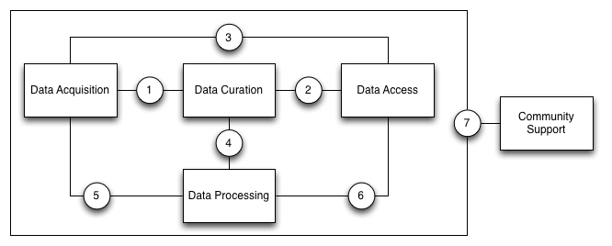
Analyse common requirements for data processing
5 common sub-systems identified:
data acquisition, data curation, data access, data processing and community support
List of 58 common functions shared by all/several RIs
Rising awareness of the value of our approach
Approval of RIs, positive comments, strengthening interest

Slide 13
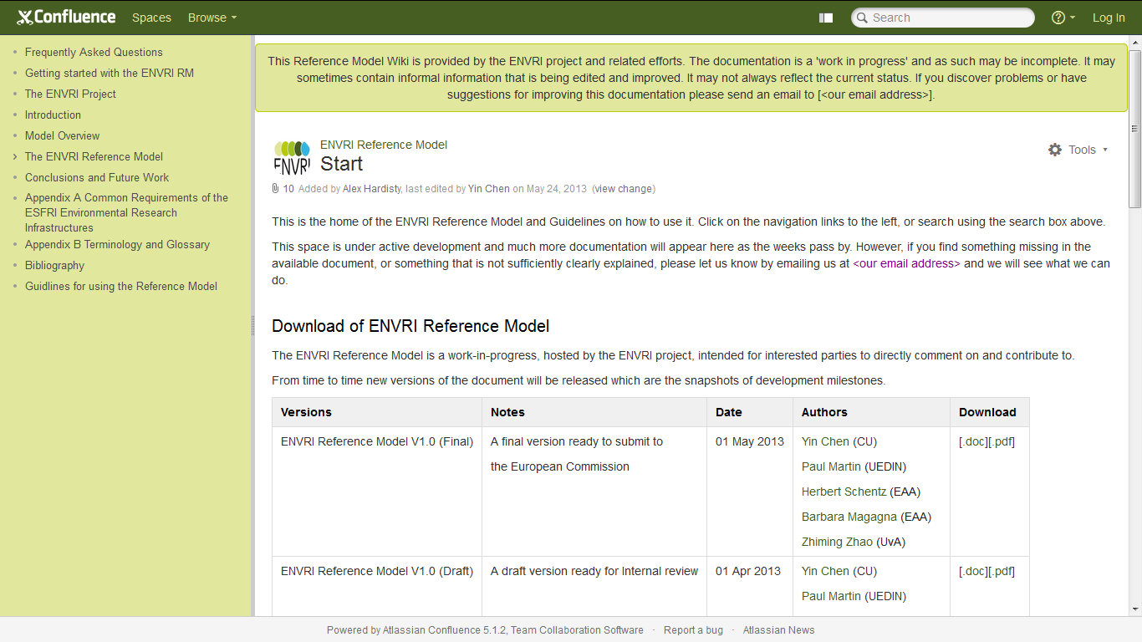
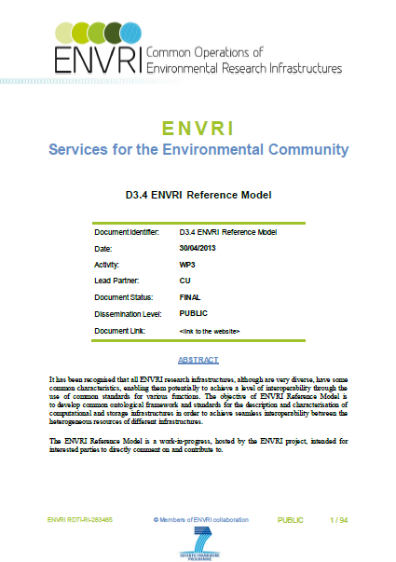
T3.3 Common Reference Model and guidelines
D3.4 ENVRI Reference Model
Version 1 published 1st May 2013
D3.5 Guidelines for use
Practical examples – a work in progress
http://envri.eu/rm

Slide 14
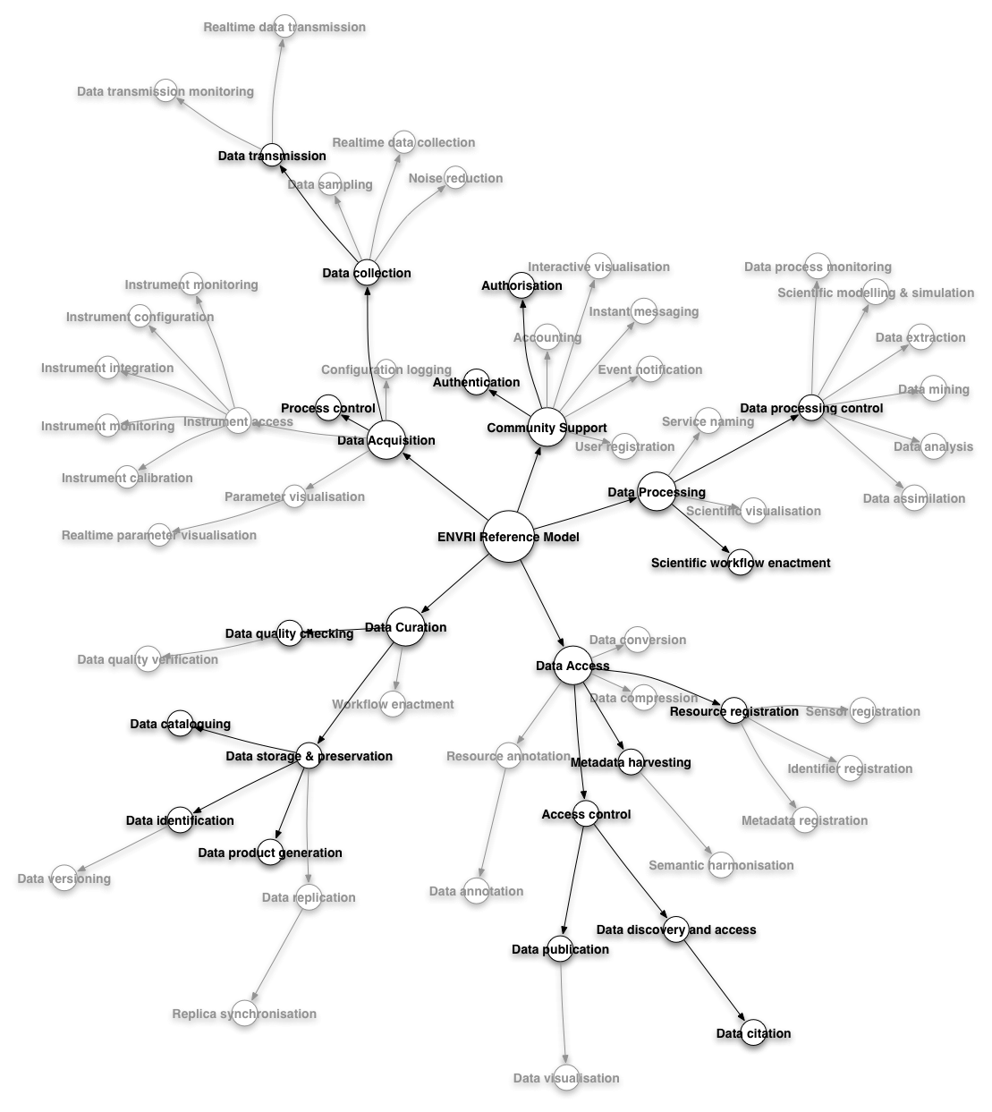
Minimum subset as basis for further expansion
3 viewpoints
Scientific (Enterprise), Information, Computational
Intended audience
Implementation teams
Architects, designers, integrators, Engineers
Operations teams
Third party solution / component providers
Positioning of other parts
ENVRI WP4, EGI.eu, EUDAT, GEOSS …

Slide 15
RM in brief - the 5 viewpoints and Data Acquisition
Communities: Acquisition, Curation, Publication, Service Provision, Data Usage
Roles in Acquisition: Scientist, Technician, Observer, Sensor, etc.
Behaviours in Acq.: Design of measurement model, Instrument configuration, calibration, data collection
Your science
Info objects:
Specification of measurements
Measurement result
Persistent data
Data state
Metadata
Persistent identifier
Action types (cause state change):
Perform measurement
Add metadata
Check quality
Store data
States:
Raw
Reviewed Published
Processed, etc.
Enterprise
Objects:
Instrument host
Acquisition service
Interfaces:
Configure instrument
Acquire data
Import data
Reference interactions:
Raw data collection coordinates above objects with the Import service object and the Raw data object in the Curation subsystem
Information
Computational
Your Research Infrastructure
Your information
Your software apps and processing
Your technology choices
Your disposition of functions
Technology
Engineering

Slide 16
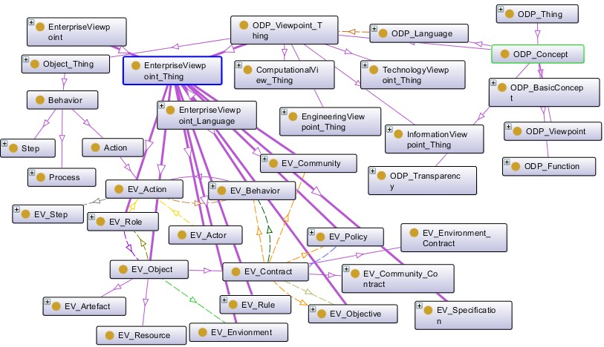
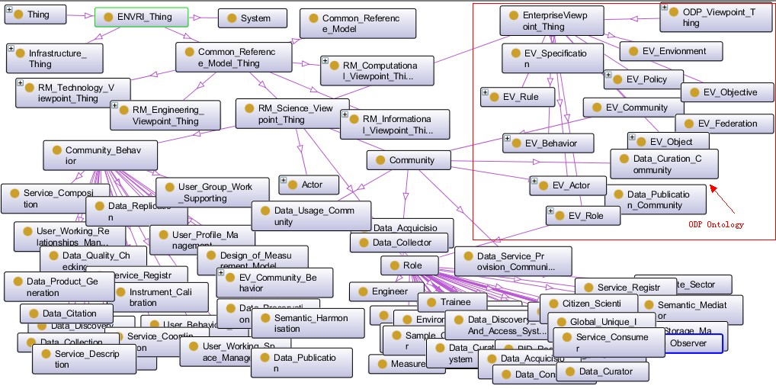
Progress so far: ODPont – in evaluation RMont – in evaluation
Linking model
- in development

Slide 17
Key Objectives
Develop and maintain a common policy for the (ESFRI) Environmental Research Infrastructures.
Design guidelines for a Common Reference Model (promote infrastructure interoperability).
Provide common ICT solutions for the ESFRI Environmental Research Infrastructures.

Slide 18
Overall Focus and Developments
Data discovery and access in distributed data archives
Data Discovery
Data Preservation
http://portal.envri.eu
Data integration, harmonisation and publication facilities
Standard-base Geospatial Data Access, Process, and Visualisation
Linked Data Publication
http://www.d4science.org/group/envri
Resources operation and GEOSS contribution
Facilities offered as-a-Service
GEO-GEOSS Compliancy

Slide 19
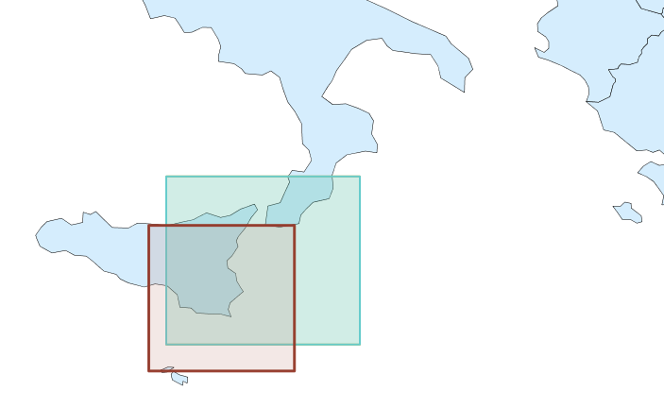
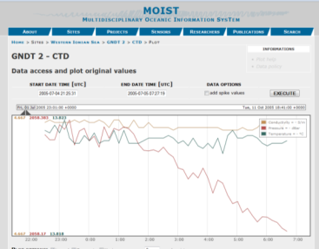
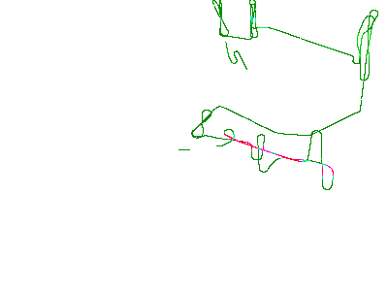
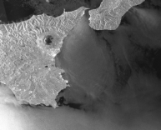
Data Discovery: focus and developments
Data from different ESFRI
Search of heterogeneous data based on geo-spatial and temporal criteria defined by the user
Satellite data
EMSO-MOIST data
Atmospheric measures from airborne sensors (IAGOS)
Interferograms computed from satellite data (EPOS)

Slide 20
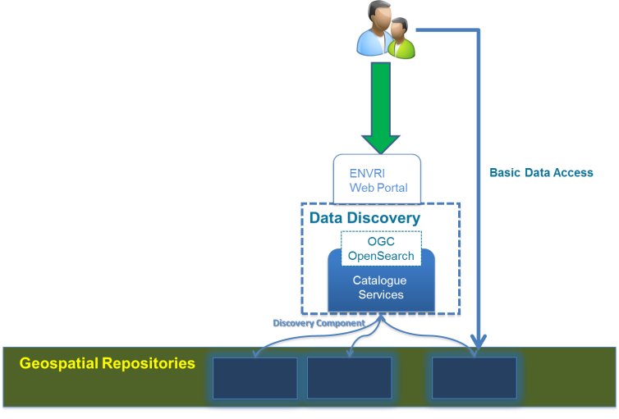
What after data discovery?
Different usage patterns according to user needs
Basic data access/download

Slide 21
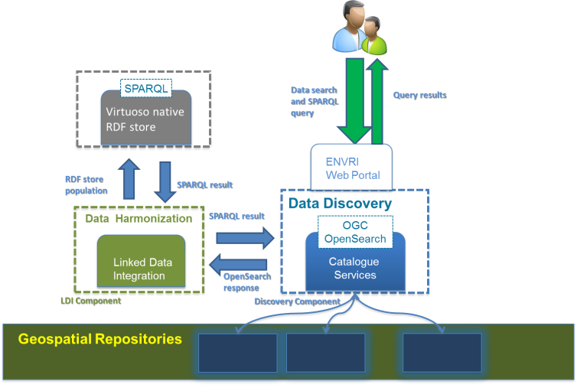
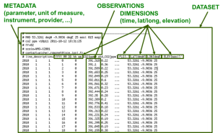
What after data discovery?
Different usage patterns according to user needs
Data Harmonization

Slide 22
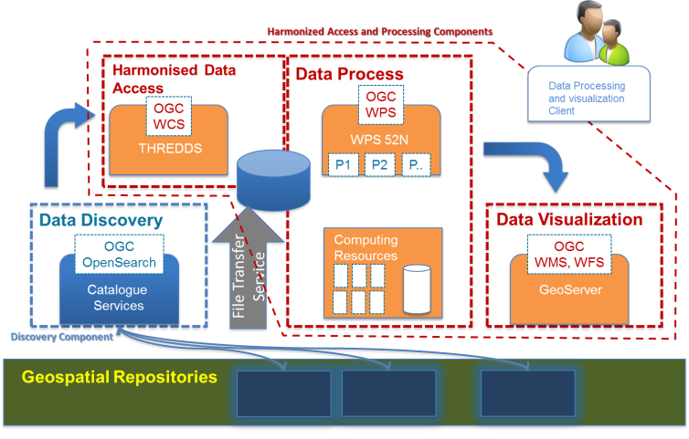
What after data discovery?
Different usage patterns according to user needs
Virtual Research Environment

Slide 23
Thank you!

