Slide 1
Brief introduction to the project
Rosa M. Badia
Barcelona Supercomputing Center | Reference Center on Environmental Information

Slide 2
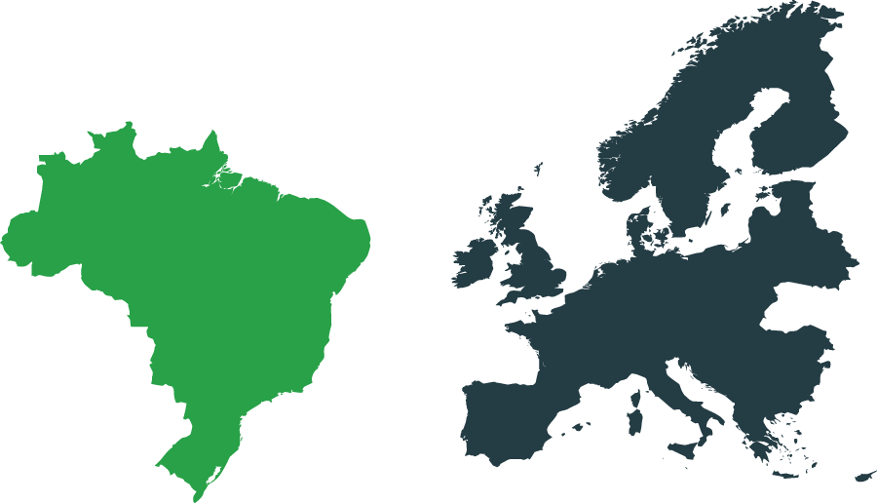




EU-Brazil OpenBio
EU-Brazil Open Data and Cloud Computing e-Infrastructure for Biodiversity
Combining Biodiversity Science and the Open Access Movement to deploy a joint European and Brazilian e-Infrastructure of open access resources supporting the needs of the
biodiversity scientific community.
Two biodiversity use cases
Who will benefit from
EUBrazilOpenBio?
Computing resources
& SW platforms
EU & Brazilian biodiversity scientific communities
Data and resource managers & Open Access community
European & Brazilian policy and funding bodies
Further EU-Brazil collaboration in support of the biodiversity area & infrastructures
Notes:
Reduce text -> enlarge font

Slide 3
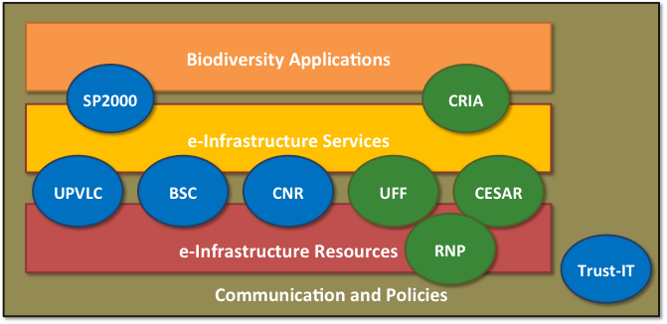









The Partnership
A well-balanced effort of
European and Brazilian organisations
BSC,
Spain
CRIA, SP
CNR-ISTI, Italy
UFF, RJ
UPVLC, Spain
CESAR, PE
SP2000, UK
RNP, RJ
Trust-IT, UK
Notes:
CRIA: Coordinator, application provider - openmodeller
UFF – technology provider – easygrid, condor, infrastructure provider
CESAR: technology provider
RNP: infrastructure provider
BSC – Coordinator, technology provider, infrastructure provider
CNR – technology provider, infrastructure provider
UPVLC – technology provider, use cases coordinator
Species 2000 – application provider
Trust-it – communication, policy oriented activities

Slide 4











EUBrazilOpenBio e-Infrastructure
The project puts together results from the federation and integration of existing EU and Brazilian infrastructures and resources
EUBrazilOpenBio integrates different technologies to make a large variety of services available
  for managing, manipulating and processing data and metadata within an autonomously-managed infrastructure
EUBrazilOpenBIo leverages on existing European, Brazilian and global data sources ranging from species data - species names, synonyms, taxonomical classifications - to literature, occurrence maps and images

Slide 5
An Hybrid Infrastructure
Integrating different technologies to make a large variety of services available for managing, manipulating and processing data and metadata within an autonomously-managed infrastructure: gCube system, openModeller, COMPSs, EasyGrid AMS, VENUS-C, HTCondor, u.store
Leveraging on existing European, Brazilian and global data sources ranging from species data - species names, synonyms, taxonomical classifications - to literature, occurrence maps and images: Catalogue of Life, List of Species of the Brazilian Flora, speciesLink, Biodiversity Heritage Library, Bioline International, Global Biodiversity Information Facility (GBIF).
Two use cases: Taxonomy Management and Ecological Niche Modelling

Slide 6
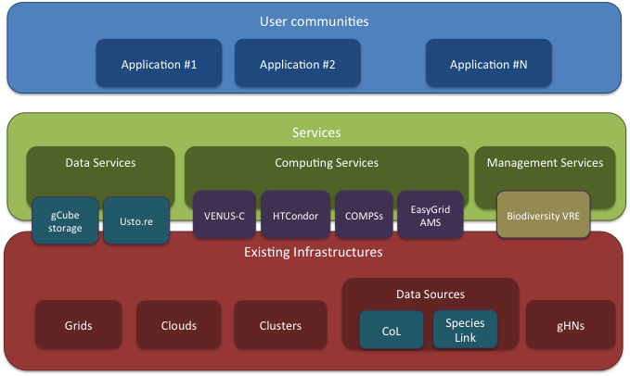
Infrastructure
EUBrazilOpenBio operates a Hybrid Data Infrastructure
Nicely integrates several technologies, infrastructures and information systems to enable a data-management-capability delivery model in which computing, storage, data and software are made available by the Infrastructure as-a-Service.

Slide 7
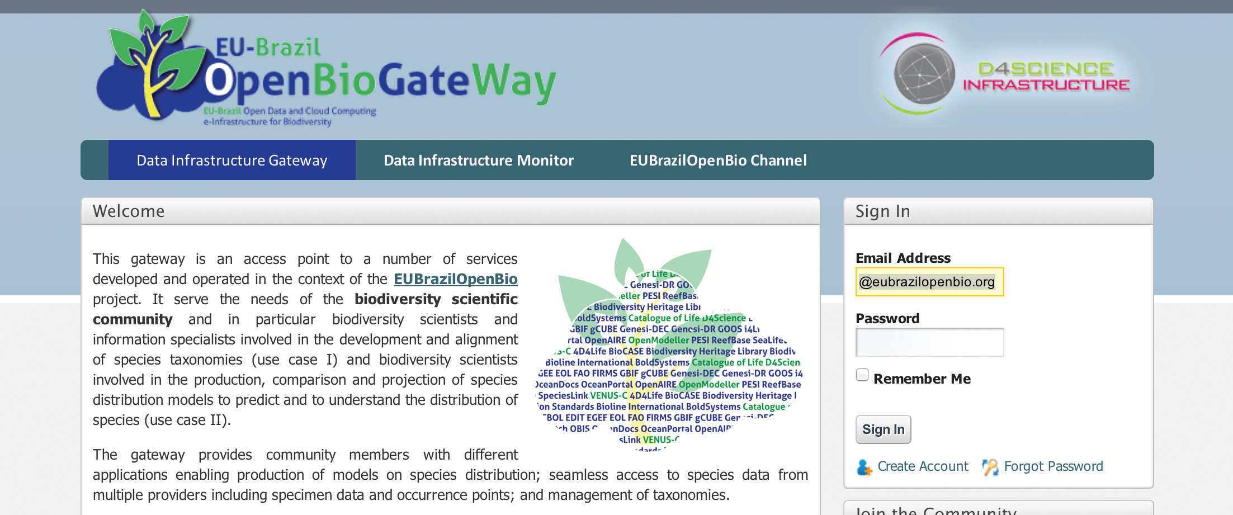
EUBrazilOpenBio Gateway
Access point to a number of resources operated by the EUBrazilOpenBio infrastructure.
It serves the needs of biodiversity scientists and information specialists
The gateway provides applications enhanced with seamless access to species, specimen, and complementary relevant data from multiple providers.

Slide 8
The training programme
Objective: guide users on the modules that should follow according to their profile and interests.
Describe units, timeline and targets.
Use links and nice drawings.
General Public
Biologists
Application developers
Infrastructure providers
OpenBio e-Infrastructure essentials
Biodiversity maps with the Ecological Niche Modelling in OpenBio
Biodiversity maps with openModeller in OpenBio
Accessing data from taxonomic checklists in OpenBio
Adapting applications to the OpenBio –data
Adapting applications to the OpenBio - processes
Deploying an OpenBio node

Slide 9
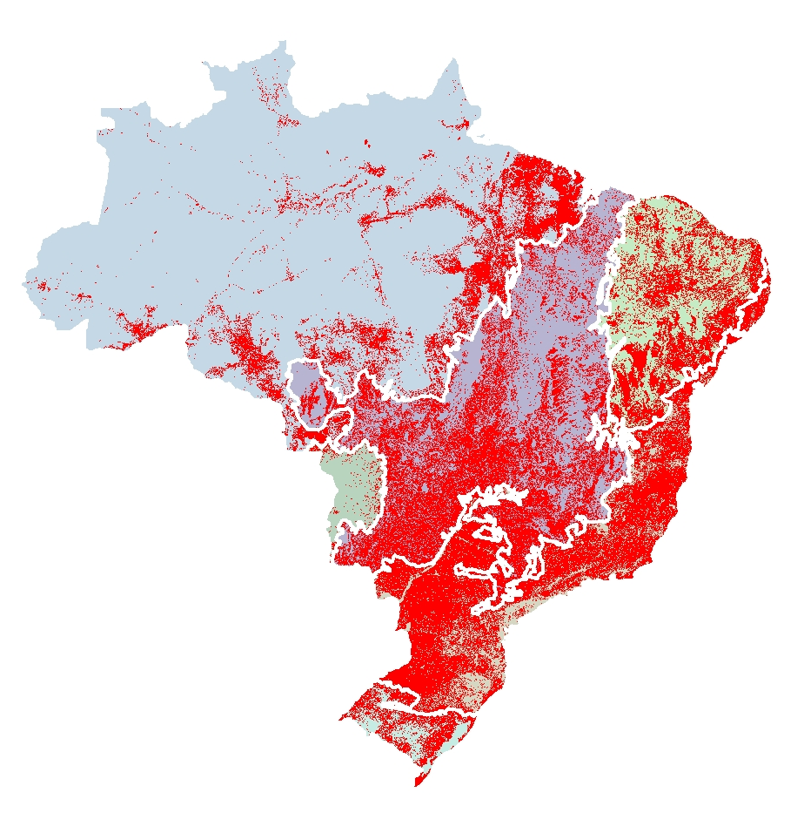
e-infrastructures for biodiversity analysis
Biodiversity crisis: at local and global levels.
The need for open access to data, tools & services.
Land use changes of Brazilian biomes are impacting the climate
Original area (km²) - IBGE | 8.570.112
Converted area (km²) | 3.030.460
Converted area (%) | 35%

Slide 10
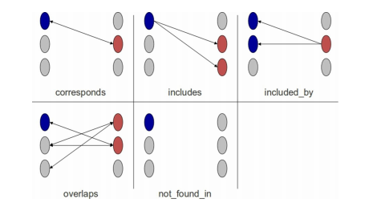
Use Case I
Integration between Regional & Global Taxonomies
Access to reliable taxonomic data is essential for environmental and biodiversity science.
Gap analysis of regional and global checklists and catalogues.
The cross-mapping tool enables taxonomists and data curators to find relationships between lists of species and higher taxa in two different species information systems.

Slide 11
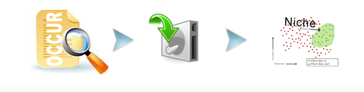
Use Case II
Data usability and use of ecological niche modelling
ENM has intensive computational requirements when models need to be generated for a large number of species using complex modelling strategies involving several algorithms and high-resolution environmental data
Exploitation of different computational resources available to the project.
Seamless access to different species and specimen data networks, such as GBIF, speciesLink and the Brazilian Virtual Herbarium.

Slide 12
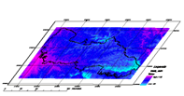
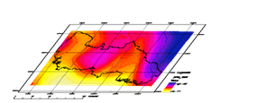
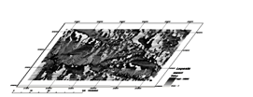

Use Case 2: Ecological
Niche Modelling
43203 species (18 Sept. 2012)
31 718 angiosperms (flowering plants)
Assuming that 30% will have enough points to generate models (~9 000 species):
  495k models, 540k tests, 90k projections
10 months to generate all models!
But what if we want to generate models for
  All ~43 thousand plant species from Brazil?
  Using more than one spatial resolution?
  Projecting into different environmental climatic scenarios?
  With global coverage?
Note: models may be regenerated every time new data is available for each species...

Slide 13
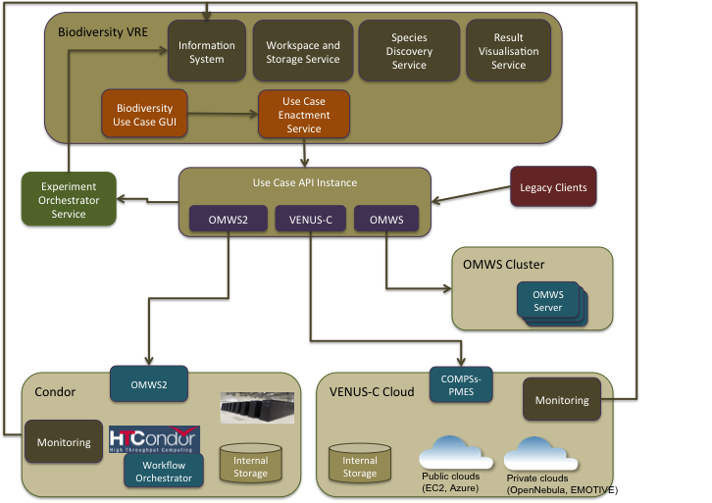

Use Case 2: Ecological
Niche Modelling
Multi-staging and multiparametric experiments implemented through COMPSs and the openModeller software and managed through a Virtual Research Environment (VRE) portal
COMPSs and the VENUS-C middleware middleware used to instantiate the workflows on cloud resources from different providers dynamically deployed by COMPSs

Slide 14

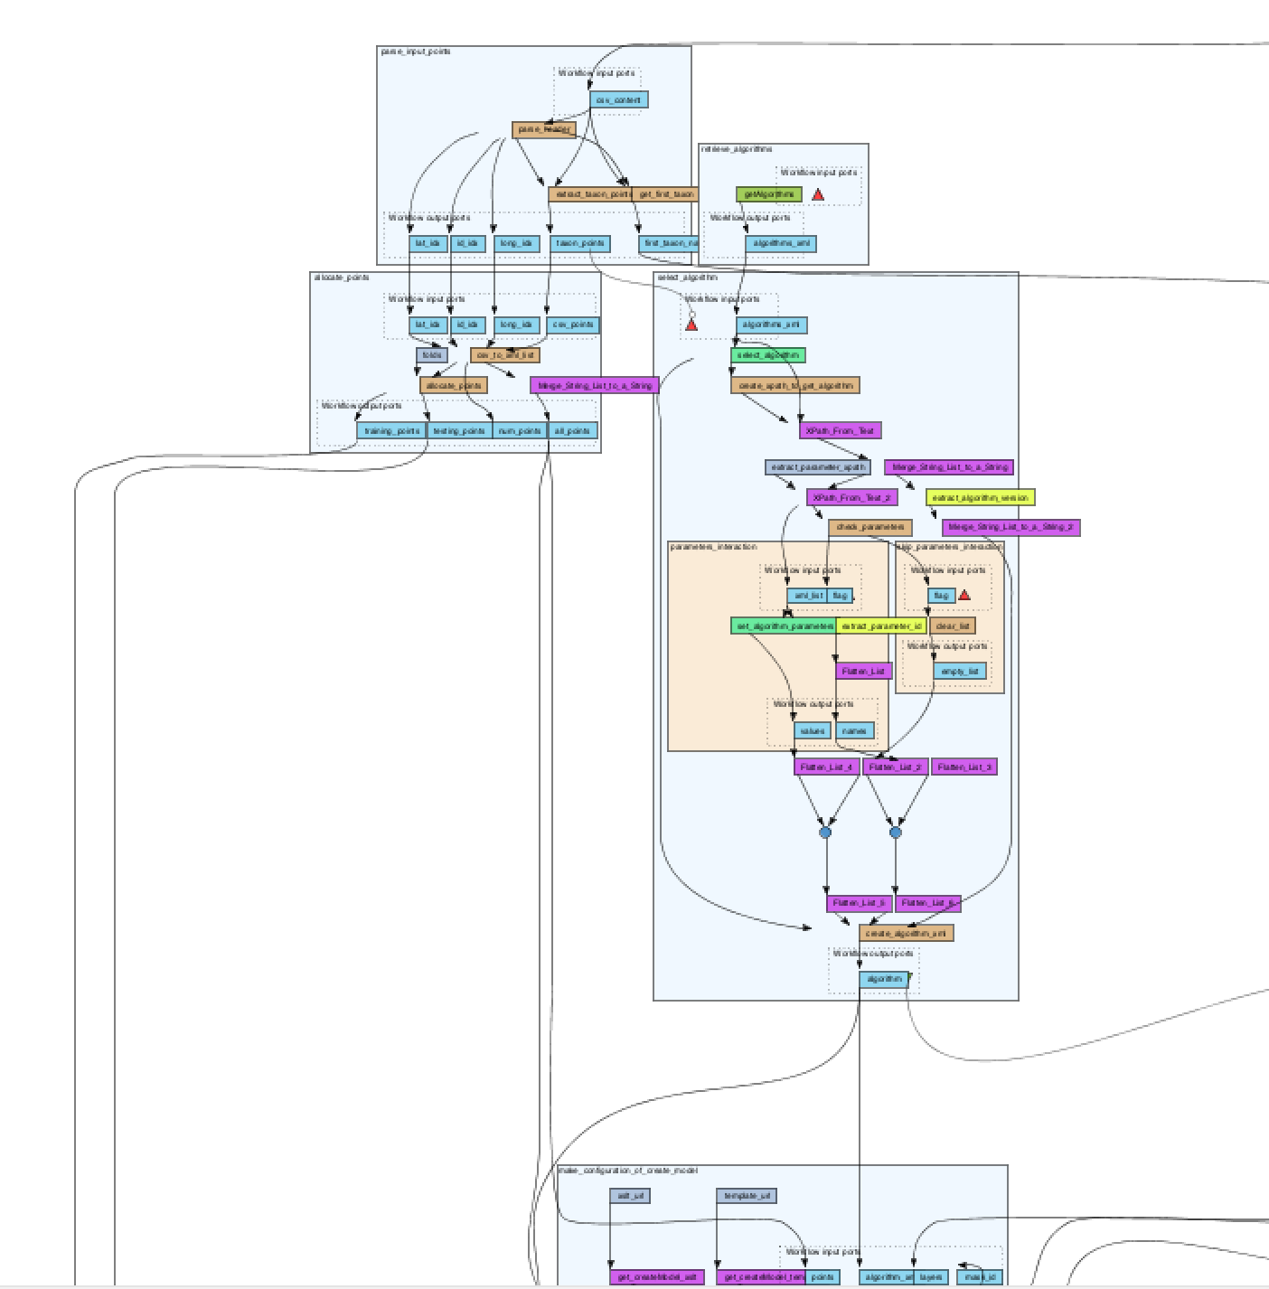
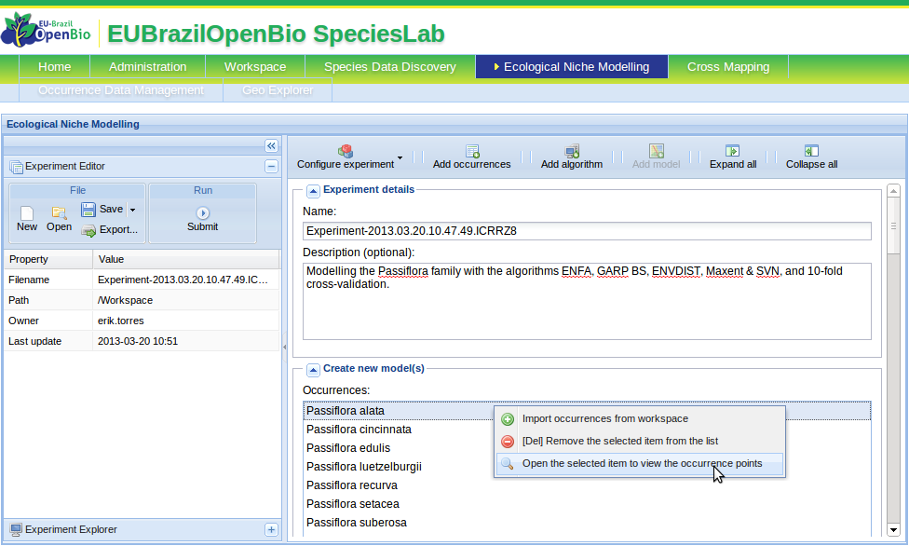

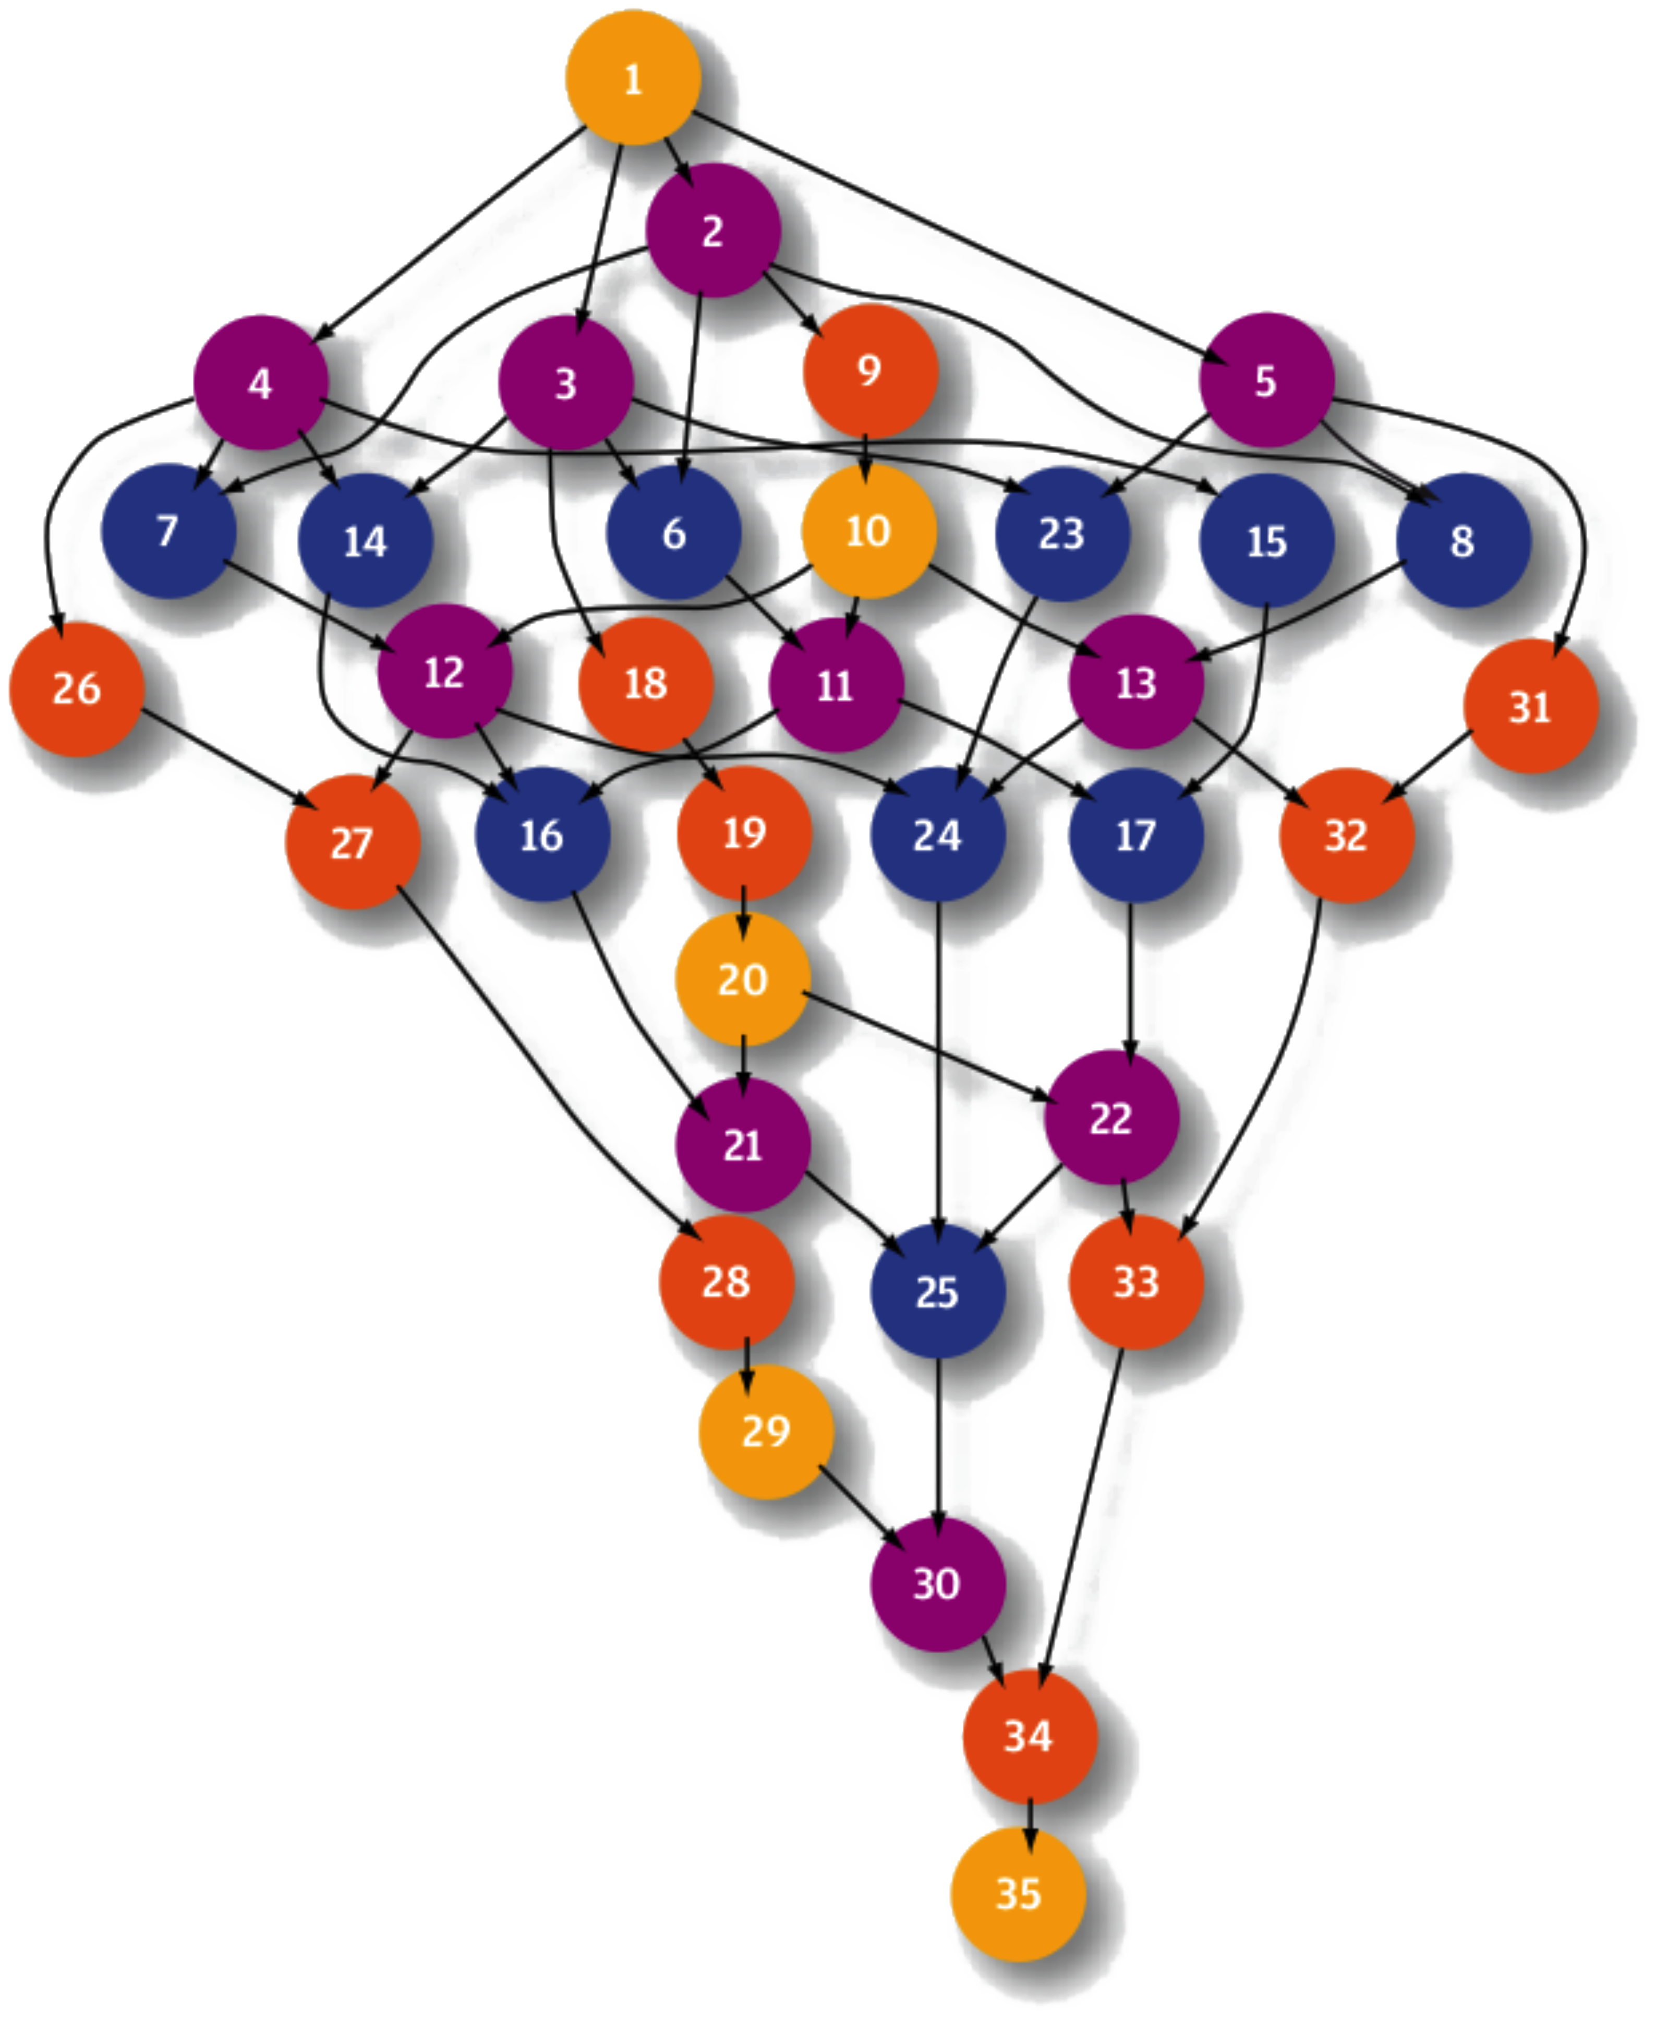


Support to biodiversity communities
Integration of the EUBrazilOpenBio solution in the EGI Federated Cloud
Shared requirements between EUBrazilOpenBio and BioVeL
The EUBrazilOpenBio ENM service is exposed through an extended openModeller Web Service interface (OMWS2 in the picture).
The OMWS extensions are backwards compatible with the original specification, allowing existing clients, as the Taverna Workflow Management System in BioVeL, to be fully supported in the new implementation
The EUBrazilOpenBio ENM Service is published in the BiodiversityCatalogue
ENM Service (OMWS2)
VENUS-C Cloud Middleware
COMPSs Workflow Orchestrator
OCCI
CDMI
EGI Federated Cloud

Slide 15
Conclusions
Project finishes this month…
… but we expect to continue our activities through other projects, i.e. EuBrazil Cloud Connect
  Continue support to biodiversity projects, i.e. BIOVEL
  Transfer technology and further develop it in LifeWatch
  Continue collaboration with infrastructure projects, i.e. EGI

Slide 16
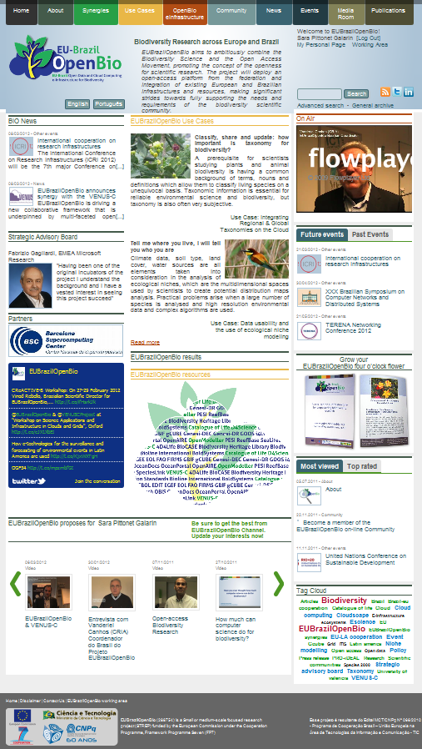
Further Information
Website http://www.eubrazilopenbio.org
Wiki http://wiki.eubrazilopenbio.eu
Coordinators:
  Rosa Badia (BSC)
  Vanderlei Canhos (CRIA)
Scientific Directors
  Donatella Castelli (ISTI-CNR)
  Vinod Rebello (UFF)
Contact Information
  contact@eubrazilopenbio.eu

