Slide 1




The WeNMR VRC: operating a worldwide e-Infrastructure for structural biology
EGI Technical Forum 2013
Madrid, Spain, 16-20 September 2013
Marco Verlato
INFN (National Institute of Nuclear Physics)
Division of Padova
Italy
marco.verlato@pd.infn.it
Notes:
1
1
1
1

Slide 2





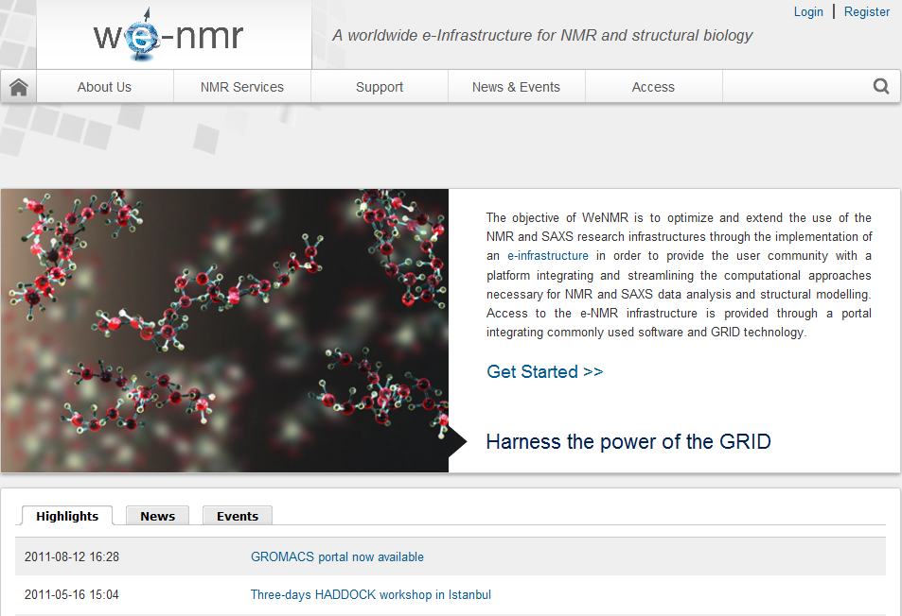




The Project
A Worldwide e-Infrastructure for NMR and structural biology
Contract n°: RI-261572
Project type: CP-CSA
Duration: 36 months (Oct.2013)
Total budget: 2’434’000 €
EC Funding: 2’150’000 €
Project Coordinator:
Prof. Alexandre M.J.J. Bonvin, Utrecht University, NL
The team
Utrecht University, Bijvoet Center for Biomolecular Research, NL
Johann Wolfgang Goethe Universität Frankfurt a.M., Center for Biomolecular Magnetic Resonance DE
University of Florence, Magnetic Resonance Center, IT
Istituto Nazionale di Fisica Nucleare , Padova, IT
Raboud University, Nijmegen, NL
University of Cambridge UK
European Molecular Biology Laboratory, Hamburg, DE
Spronk NMR Consultancy, LT
+ Academia Sinica,TW, since 2012
www.wenmr.eu
4
Linked with Bio-NMR and EAST-NMR EU projects and INSTRUCT ESFRI
1st VRC recognized by EGI
Notes:
2
2

Slide 3
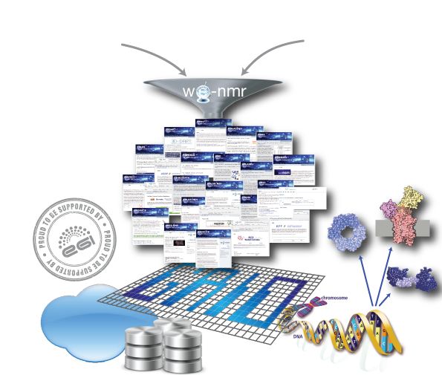
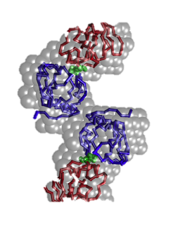

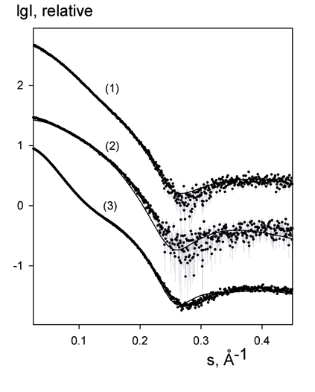
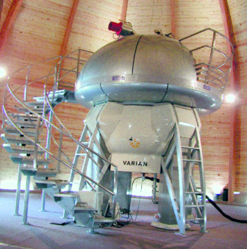



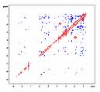
Exploiting grid resources in structural biology…
NMR SAXS
Structure, dynamics & interactions
➔ impact on research and health:
  - origin of disease
- design of new experiments
- drug design …

Slide 4
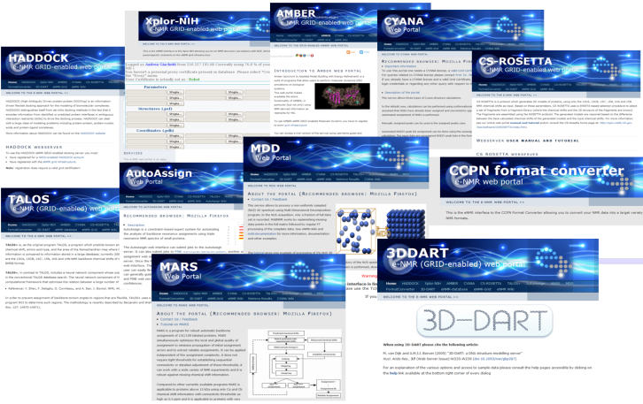
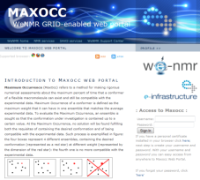
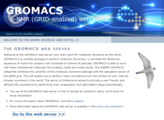
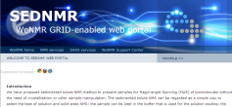
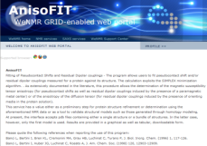
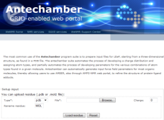
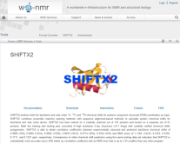
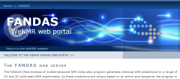
The WeNMR service portfolio
Our policy is to shield as much as possible the end user from the grid and all middleware related issues and commands
We chose to develop mainly web portal providing “protocolized” access to the grid
To facilitate operation, we use when possible robot certificates
33 portals (6 developed by external teams) are currently embedded in the WeNMR gateway and provide services for NMR and SAXS spectroscopists
11 of these run calculations on the grid

Slide 5
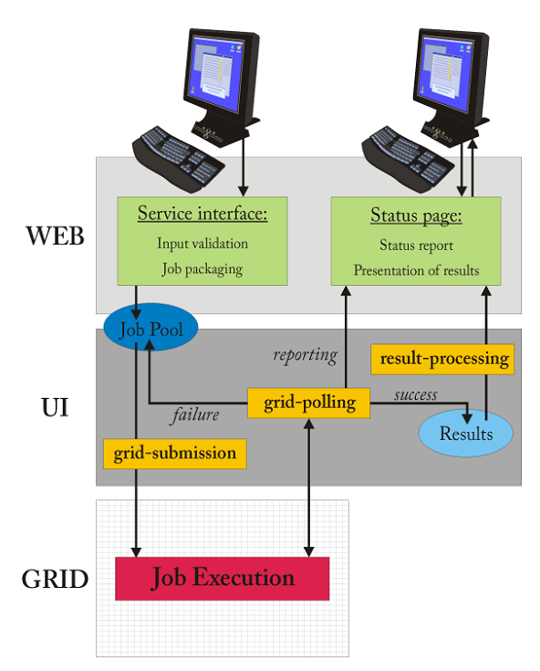
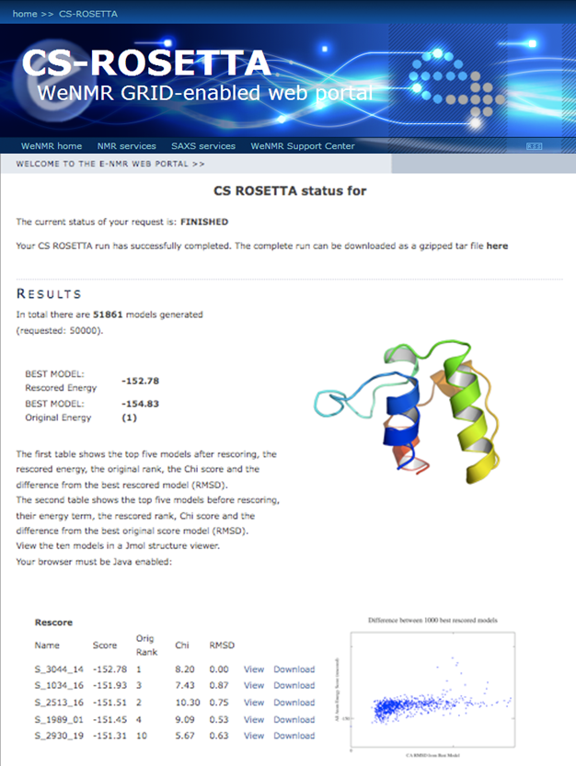


Grid daemon beyond a portal
5
Notes:
5
5

Slide 6
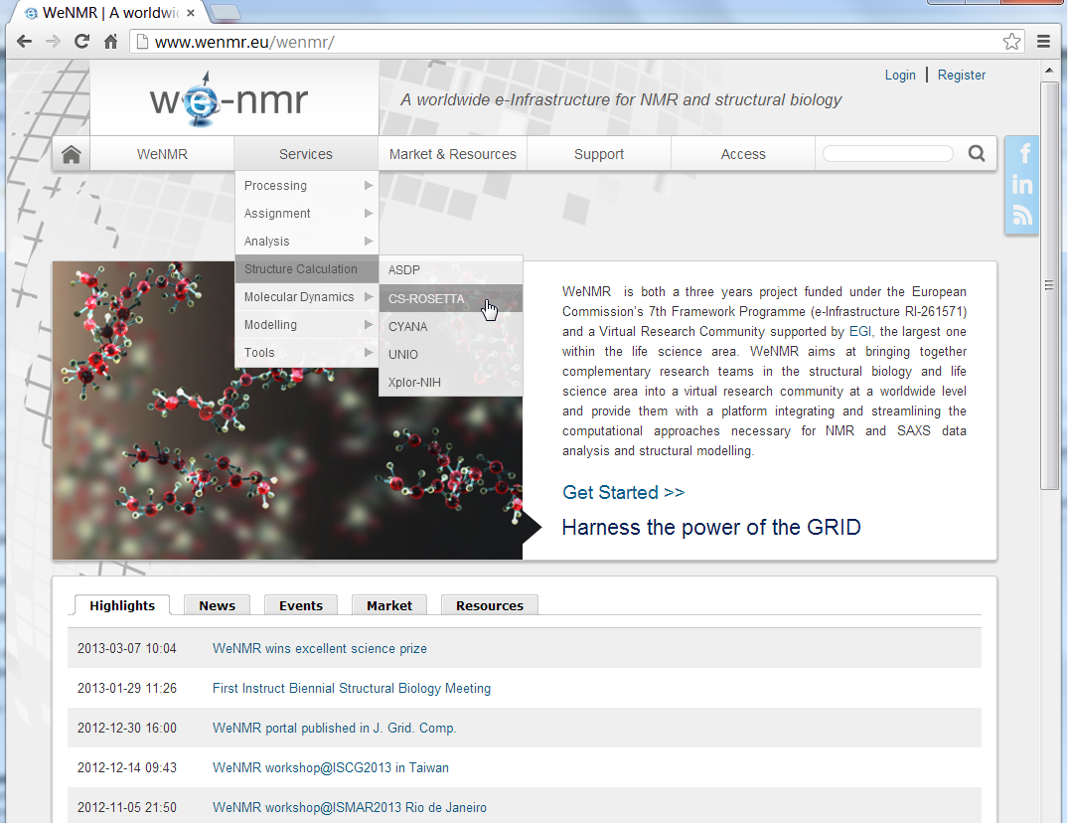
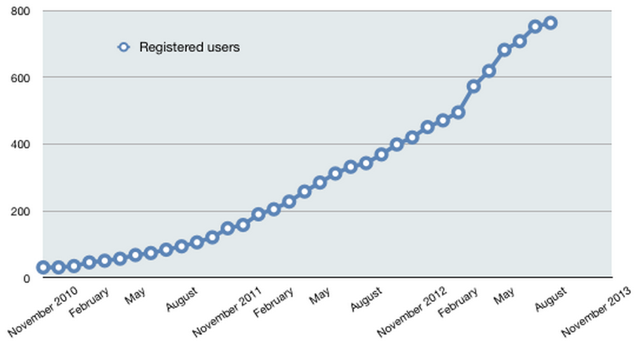
The VRC portal: www.wenmr.eu

Slide 7

The WeNMR VRC
Consultancy
Third-party aggregation
52 Tutorials
70 Wiki docs
20 Movies
Knowledge
Grid
Services
VRC
42 Help Centers
SSO
Marketplace
Portals
Blogs, news,
events…
(often picked up
from eScienceTalk/GridCast)
Exposure
Facebook,
Linkedin
Users
www.wenmr.eu
Notes:
Marketplace: community specific non-intrusive advertisement
The marketplace allows the members of the worldwide NMR community to list, advertise and search information about Events, Jobs, Products, Services and Training
Disperse and aggregates news; blogs, events.. Often picked up by eScience Talk and GridCast

Slide 8
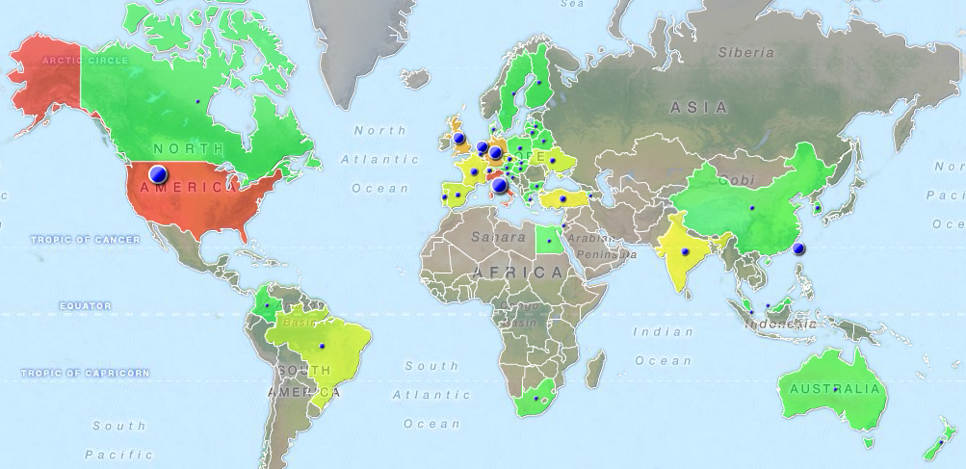
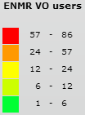
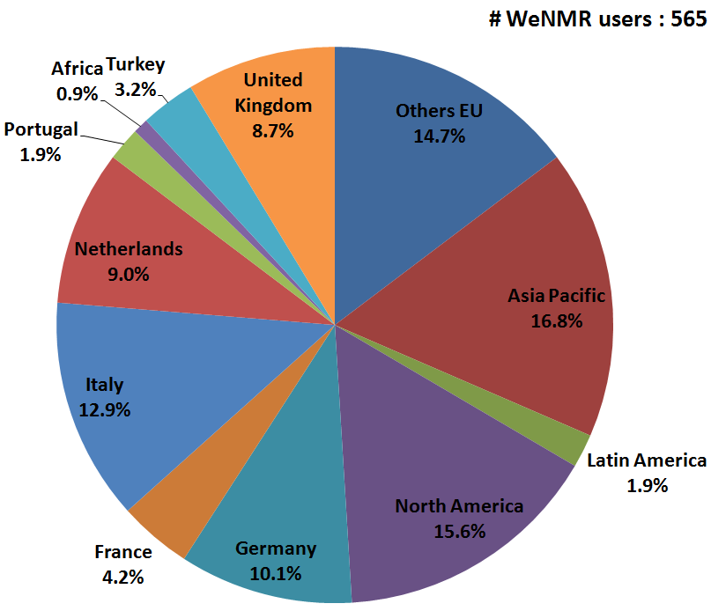
VO registered user distribution
>565 users from 52 countries
35% outside Europe
10 users/month steady growth
ENMR is the largest VO in Life Sciences
Notes:
8
8
8

Slide 9
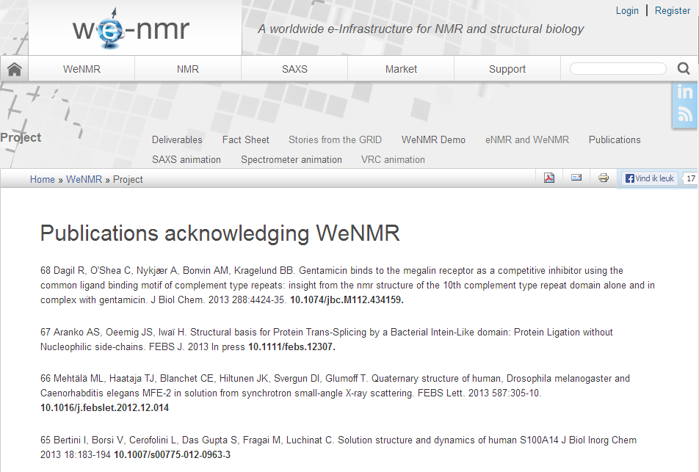
Output from users of the gateway
68 publications since 2011
acknowledging WeNMR (or eNMR)
Application of WeNMR services = collaborations between WeNMR staff and users

Slide 10
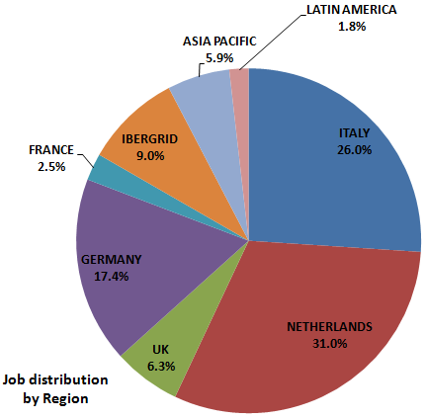
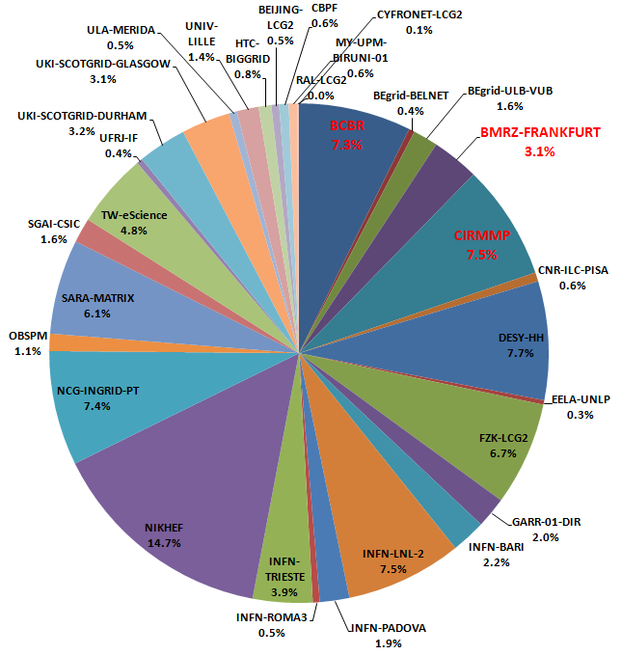
Distribution and usage of resources
Support from 8 European National Grid Initiatives:
  France, Germany, Italy, Poland, Netherlands, Portugal, Spain, UK
Support from Africa, Asia and Latin America:
  South Africa (SAGrid), Taiwan (TWGrid), Brazil, China, Malaysia
~90,000 CPU-cores (27 opportunistic sites) and 320 CPU-cores (3 owned sites)
18% of jobs (12% of CPU-time) provided by the owned sites

Slide 11
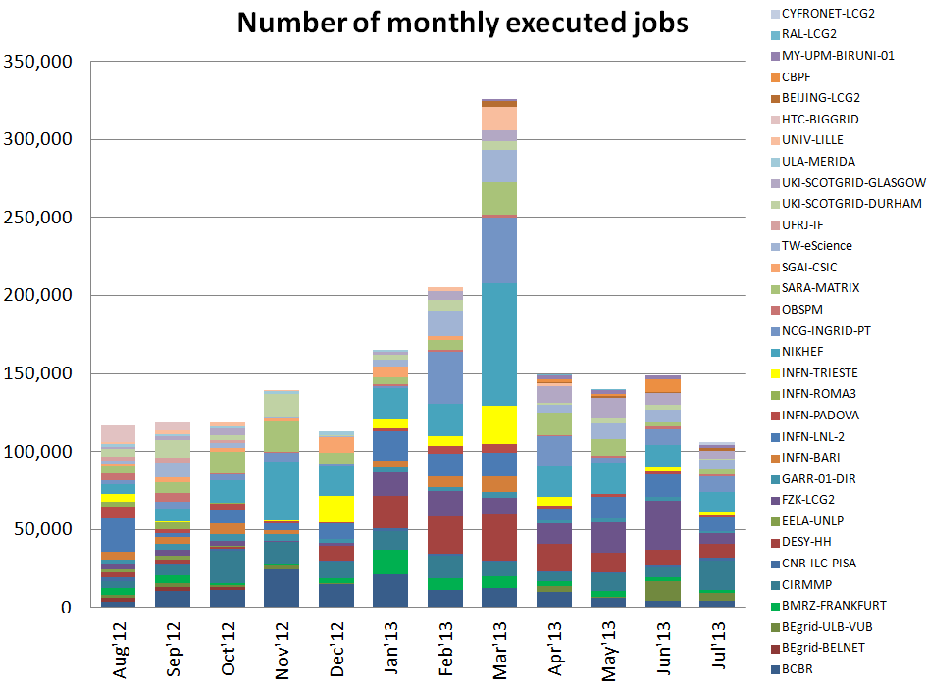
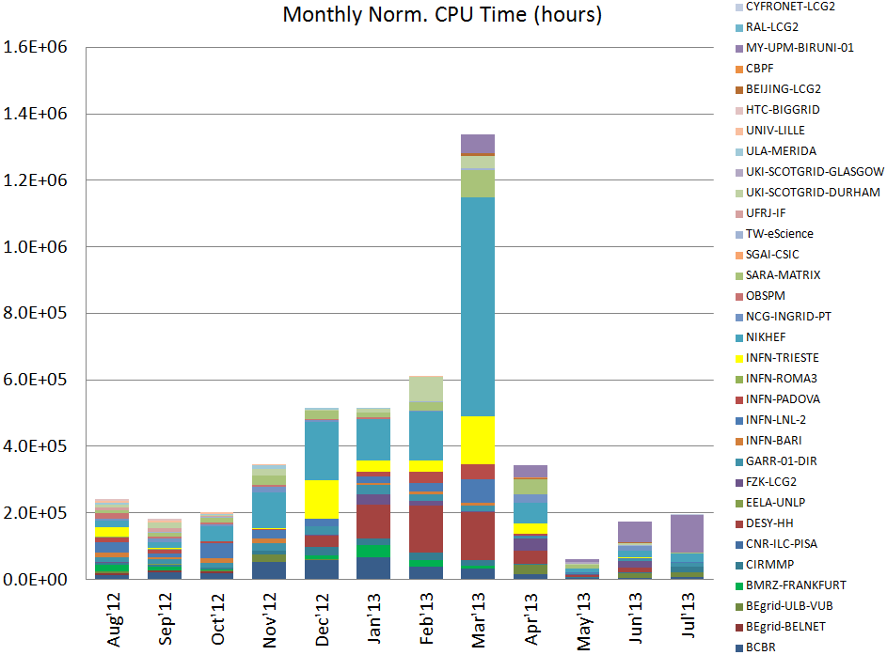
Distribution and usage of resources
154,000 jobs/month
1.8M jobs last year
393,000 CPU.hours/month
4.7M CPU.hours last year
Notes:
30,000 Euro/month cost of WP4+WP6 (estimated cost for maintaining WeNMR grid + portal operations) → 8.5 eurocent/CPU.hour
19,200 Euro/month cost of 353,000 CPU.hours with Amazon calculator → 5.5 Eurocent/CPU.hour

Slide 12
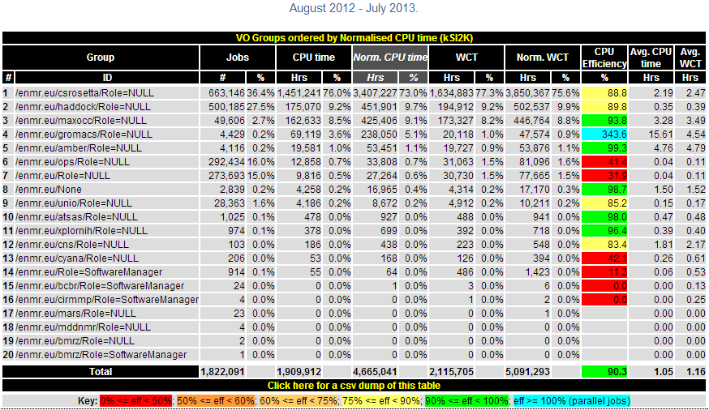
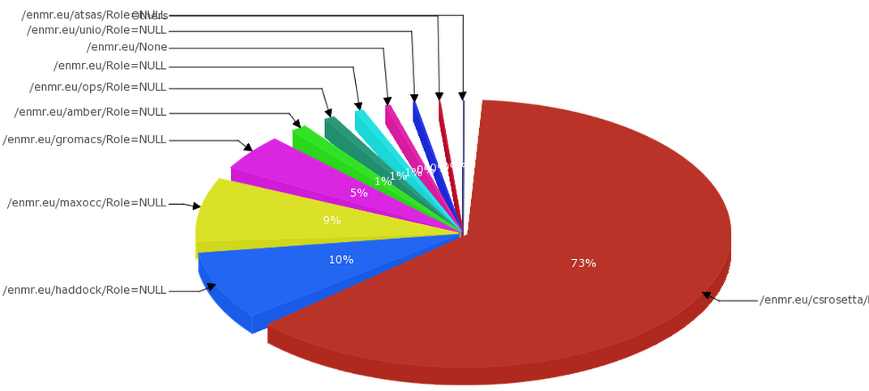
Application accounting
Implemented by exploiting the granularity made available by the VOMS service:
  a VOMS group defined for each application
  e.g.: voms-proxy-init –voms enmr.eu:/enmr.eu/haddock
  the user proxy carries the VOMS group info
Notes:
The usage records collected and stored by the grid accounting services have the VOMS group information and allow the aggregate usage of each application to be measured and shown through the accounting visualization tools

Slide 13
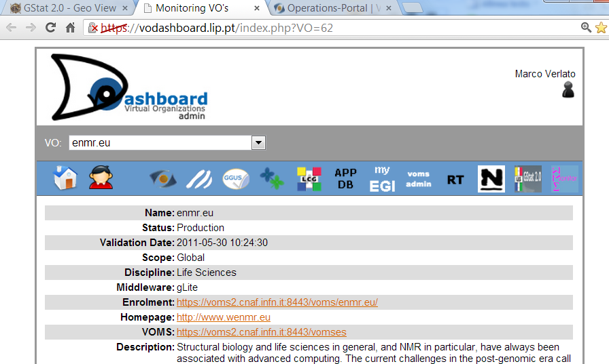
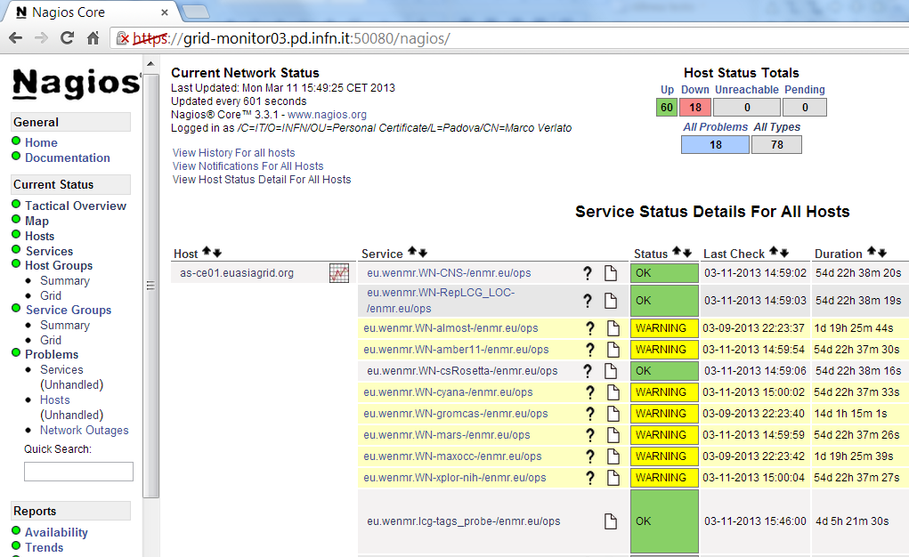
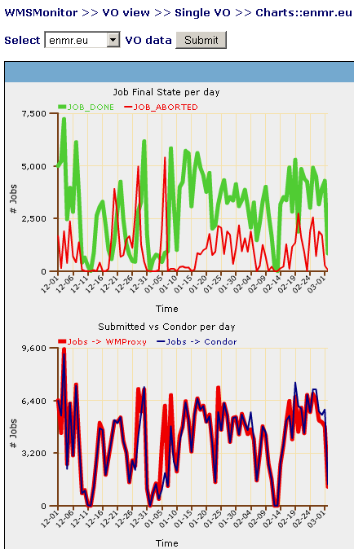
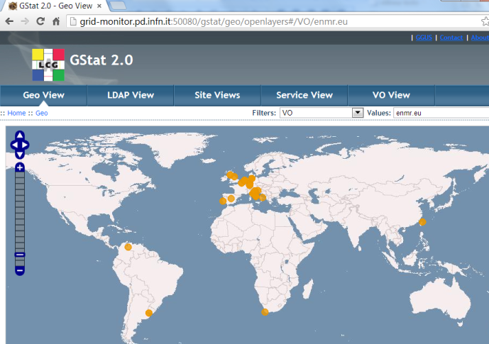
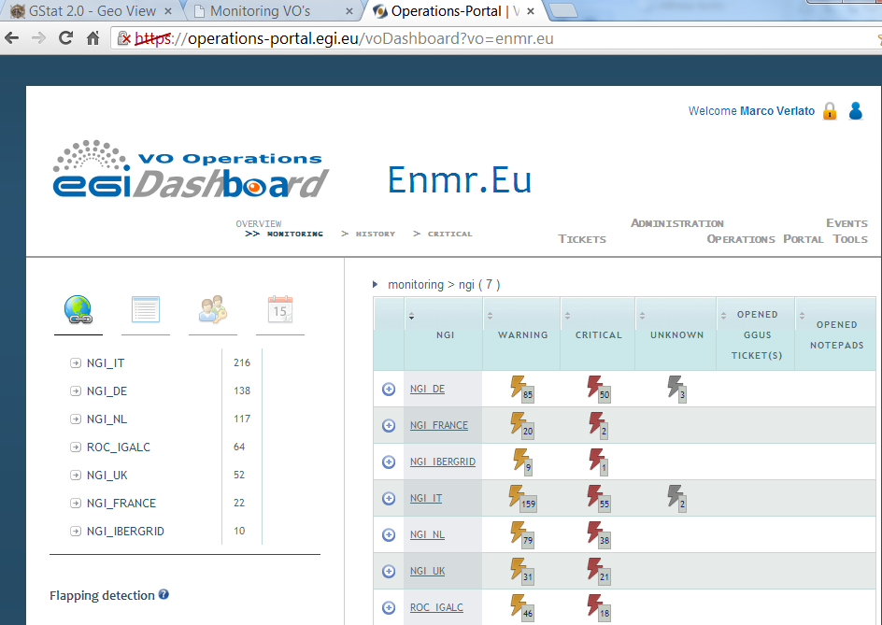
Grid operations monitoring
Wide use of the EGI/NGIs monitoring tools:
  Operating a dedicated instance of Gstat 2.0
  Operating a dedicated Nagios server with WeNMR specific Nagios probes
  Operating a dedicated WMSMonitor server
  Collaboration with EGI Operations team for integrating the dedicated services with:
    EGI VO Admin Dashboard
    EGI VO Operations Dashboard
  Providing input to VAPOR project

Slide 14
WeNMR and the clouds
For the majority of our applications, we are perfectly happy with the grid
Cloud not a replacement of the grid infrastructure for WeNMR
However, we have an application with a complex workflow that fits better with the cloud model:
  CING = Common Interface for NMR structure Generation
  Requires many programs that are impossible to install on traditional grid computing nodes → packaged into a VM image called VirtualCing
  NMR Protein DB with ~5000 entries needs validation/recalculation every two months → 1 M CPU.hours of a single-core machine in 3 years
  Prototype demonstrated the first time with the EMI-WNoDeS Cloud Framework at the EGI Technical Forum of Sep.12
  Recently demonstrated with the EGI Federated Clouds Infrastructure at Cloudscape V Workshop of Feb.13 and EGI Community Forum of Apr.13
Notes:
14
14
14

Slide 15
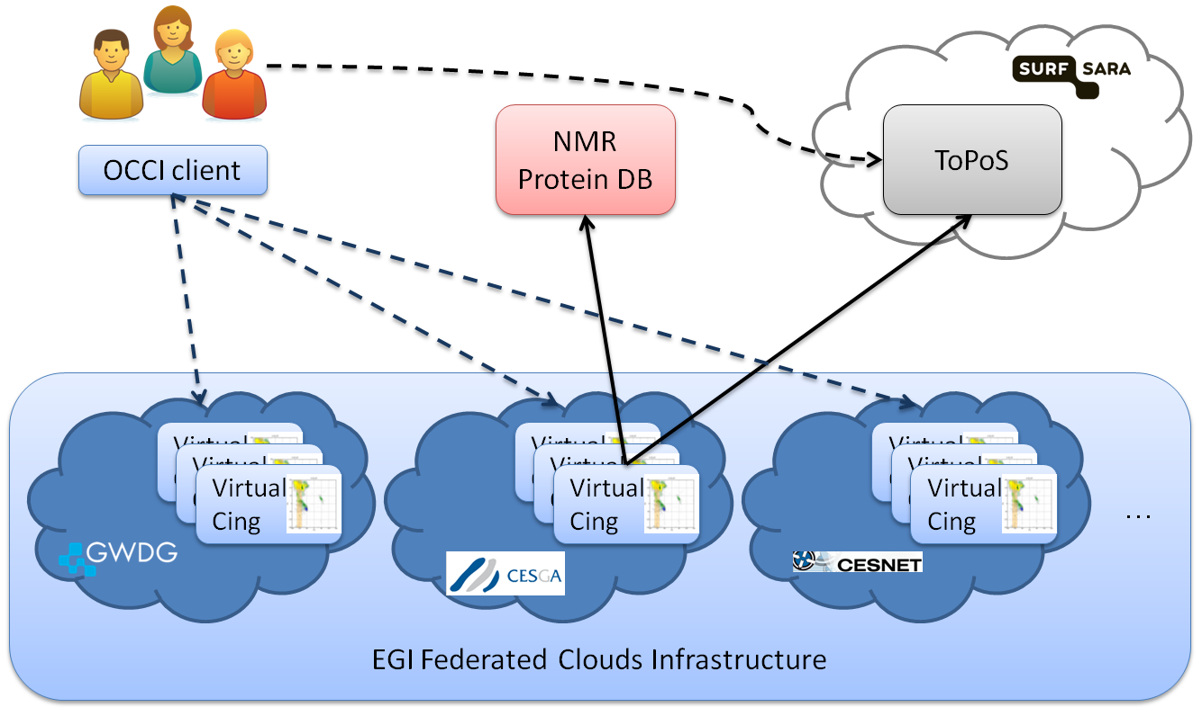
VirtualCing on EGI Federated Clouds
https://documents.egi.eu/public/ShowDocument?docid=1593
Notes:
15
15
15

Slide 16
Latest news
SSO implemented for all portals
CVMFS adopted for software deployment
ENMR VO enabled on OSG
WeNMR jobs on UNICORE-based resources
Notes:
16
16
16
16

Slide 17
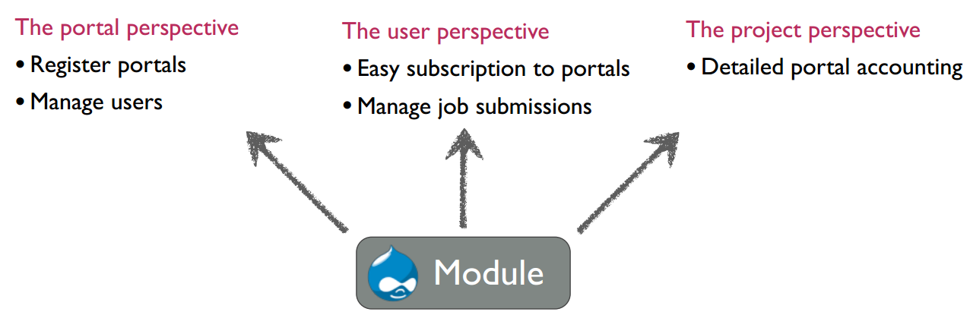
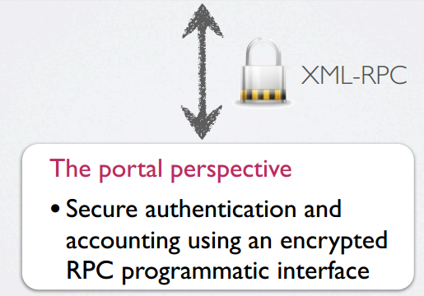
Drupal WeNMR SSO module overview
Notes:
17
17
17
17
The SSOXS (Single Sign-On for eXternal Services) Drupal module allows for a transparent, subscription based, use of external services by users of the WeNMR VRC.
From the user perspective this solution provides access to all services after authenticating once.
From the service perspective the solution provides a straight foreward way of linking the service to the VRC enabling at once, user authentication, authorization and management as well as a rich accounting platform.

Slide 18
Single Sign On implementation
Written as true Drupal module; PHP + JavaScript + CSS
Makes use of Drupal ‘hooks’ to extend Drupal Core functions
  authentication, permissions, user accounts
Stores data in a backup enabled, secure MySQL DB, local or remote
Use of BlowFish encrypted, XML-RPC function calls for communication between portals and VRC
Flexible authentication
Social media credentials Facebook, LinkedIn, Google, Twitter ...
SAML and Shibboleth authentication
phpCAS SSO, OAuth, OpenID
Flexible Framework
Allot of functionality for free in Drupal
XML-RPC enables a flexible API to expose functionality to the portals
Preparing SSOXS Drupal module for public release
  presented to FIM4R community
  with custom export of accounting reports
  integration with FIM initiatives (e.g. SURFConext platform)

Slide 19
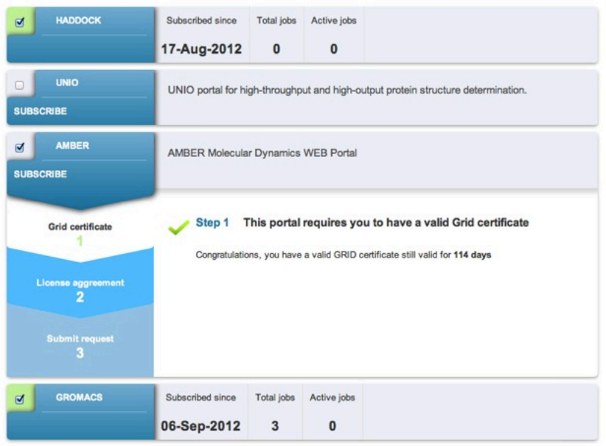
Subscribing and managing submission
  Access control list
  Portal specific
  step-by-step signup
  Grid X509 certificate
  validation
  Portal submission
  management

Slide 20
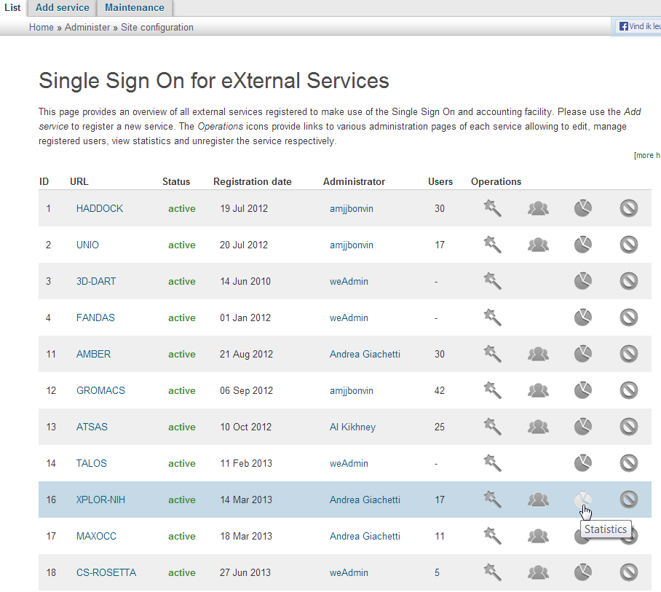
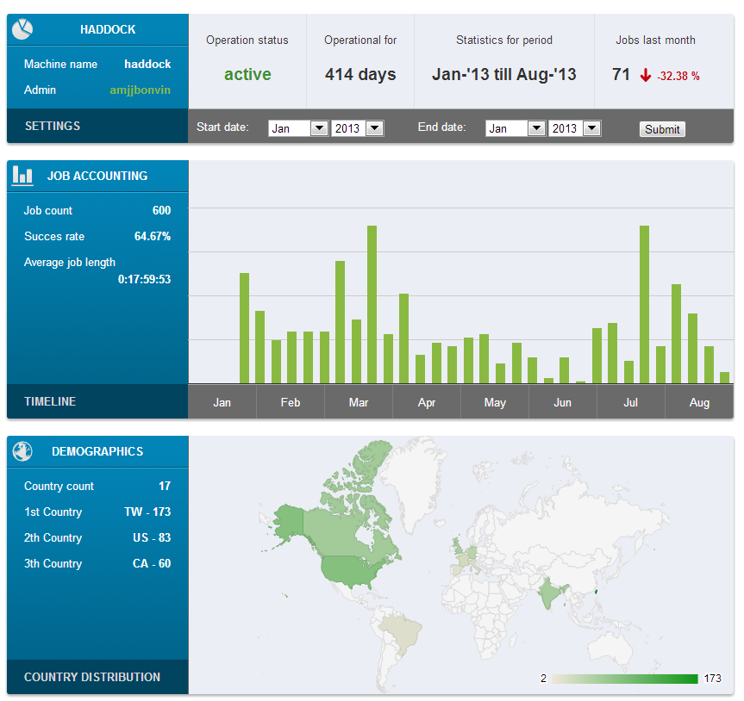
Portal registration, management and accounting

Slide 21
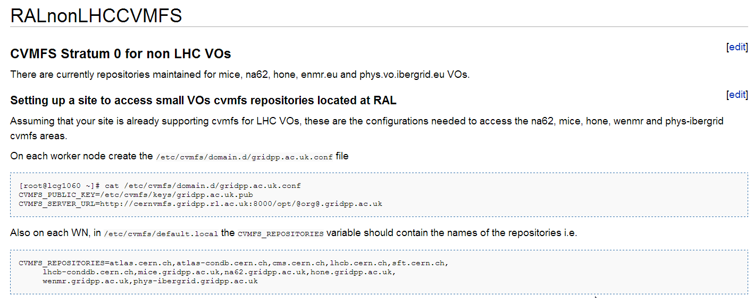
CVMFS for WeNMR
Support provided by RAL since April 2013
https://www.gridpp.ac.uk/wiki/RALnonLHCCVMFS
/cvmfs/wenmr.gridpp.ac.uk currently mounted at DESY-HH, INFN-PD, INFN-LNL, RAL-LCG2, CBPF and ZA-UJ sites
Synchronized with /cvmfs/oasis.opensciencegrid.org/enmr
Notes:
21
21
21

Slide 22
Extension towards Open Science Grid
A good collaboration with SBGrid Consortium and its VO already established more than 3 years ago during the previous e-NMR project
86 US users already registered with enmr.eu VO (15% or the total)
A joint OSG-SBGrid-WeNMR-EGI interoperability task force worked since March‘11 and its results were presented at EGI CF 2012 and published in PoS(EGICF12-EMITC2)040
In July 2013 the decision to enable the ENMR VO on OSG was taken
  OSG VOName “ENMR” vs EGI VOName “enmr.eu”
  It allows to see EGI and OSG as a single e-Infrastructure through the use of EMI-WMS
  Best effort resource allocation: potentially 25+ OSG sites with 70,000+ CPU-cores
  WeNMR application software deployed through CVMFS
  OSG accounting records exported to EGI Accounting Portal
Notes:
22
22
22

Slide 23
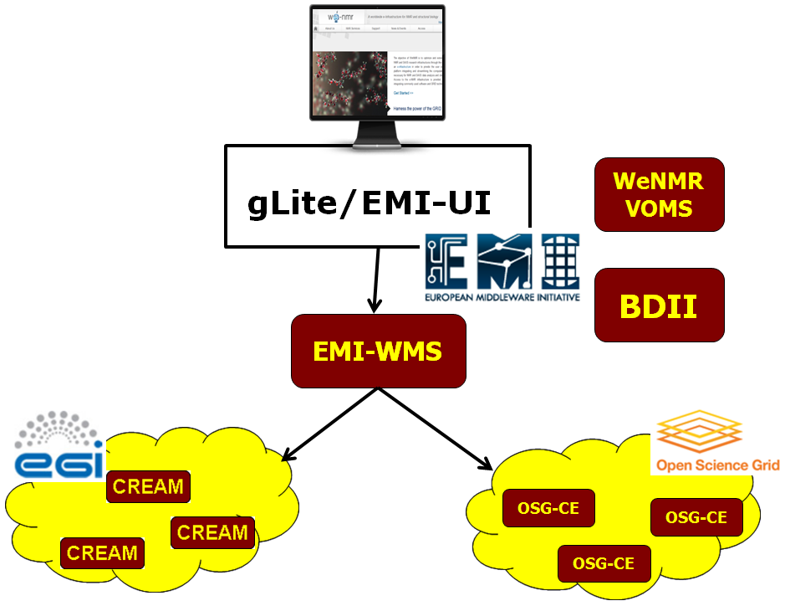
Extension towards Open Science Grid
Notes:
23
23
23

Slide 24
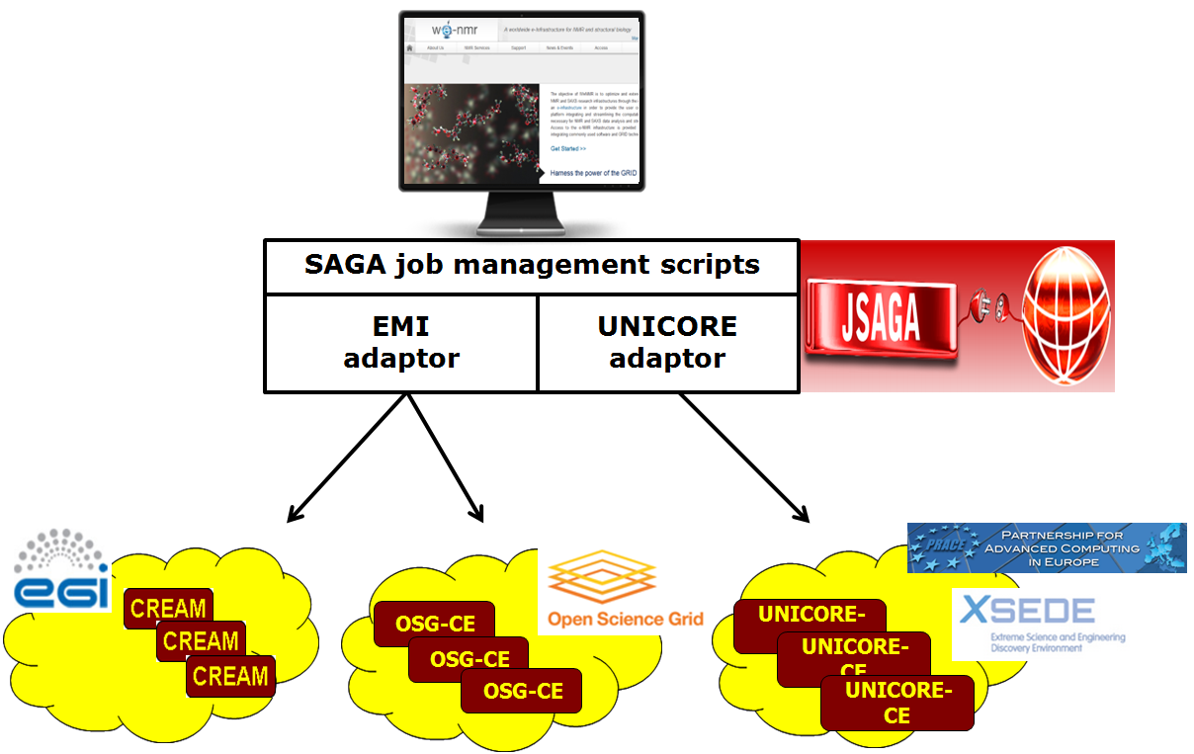
WeNMR jobs on UNICORE resources
Goal: to exploit HPC resources of PRACE and XSEDE for one WeNMR parallel application (Gromacs)
Successful testing of Gromacs jobs on UNICORE resource at Juelich through JSAGA adaptor (thanks to collaboration with the CHAIN project)
Notes:
24
24
24

Slide 25

Conclusion
Sustainability to be addressed at various levels:
  Infrastructure (hardware and resources)
  Grid services (middleware, VO services)
    Relying on EGI and NGIs
  Software (web-portals, software developers)
  Users (VRC portal, support)
  Training (workshops)
WeNMR professional structure calculation service recently launched by our commercial partner
Notes:
25
25
25
Maintaining the hardware will continue since NMR has always been associated with computing and running large facilities and laboratories will always require local computation resources (that were not funded by WeNMR)
To maintain a grid infrastructure requires quite some expertise and man power
We’ll rely on EGI/NGIs for most of the grid services
Only service required at a partner sites in order to keep our web portals active is a User Interface (UI), in combination with robot certificates.
We will however strive to keep all our grid services active after the end of the project, to bridge the gap until hopefully a follow-up project under the 2020 EU programme
Software is expected to be kept updated, as the software which is developed at the partner sites will be updated and further developed through National or European research funding obtained by these partners
New services might be added on the request of external developers and such portals will be offered for the time they are being used or supported by the developer
The VRC and WeNMR website will keep operating, provided that users, developers and ourselves keep using it by adding contents and answering requests
This is a standard task of software developers in general and the VRC site and its help center should facilitate this task
Costs for its operation and maintenance (i.e. mainly adding new features and dealing with Drupal issues) could be covered by including advertisements on the website or through the NMR marketplace that was introduced
Since most portals have a developer linked to the WeNMR help center, we expect that support will still be provided by the developers
Furthermore, with a "single sign on mechanism", we will be able to allow users without certificates to use our services in the future. This facilitation should lower the hesitation barrier for potential new users to using our services
Future workshops on the tools offered are expected to be either (semi-) commercially, or in joint efforts with other projects and organizations
We intend to ensure the user community keeps growing as usage is the key to sustainability. To reach that goal, we intend to keep participating in conferences and workshops to promote the services offered by WeNMR.

Slide 26
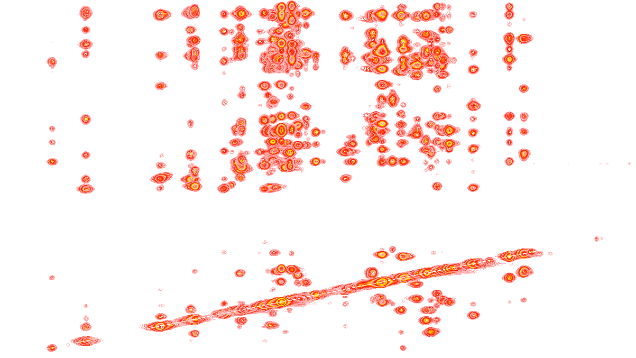
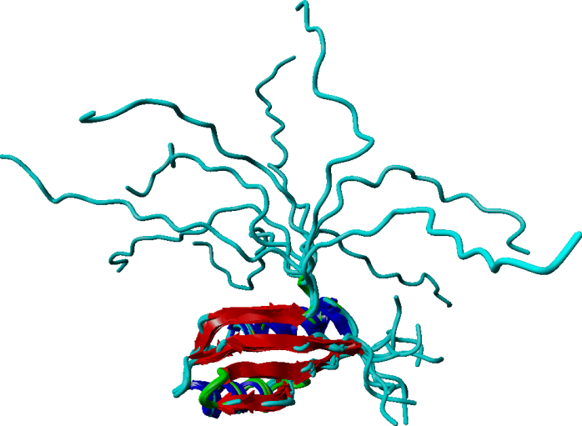
WeNMR professional structure calculation service
From assigned data to a publication ready structure within days to weeks, at special rates for the non-profit biomolecular NMR community
Includes free data check
Supports the WeNMR project after the funding ends
More information: WeNMR > NMR > Structure Service

Slide 27
Our 2020 vision
Provide off-the-shelves e-Science solutions to not only high profile projects but also the long tail of research with e-Infrastructure solutions for open data sharing, user-friendly access to complex software solutions and computational resources, all of which gathered into a virtual research environment, in order to boost the research output.

Slide 28




Acknowledgments
The team
Alexandre M.J.J. Bonvin
Andrea Giachetti
Antonio Rosato
Anurag Bagaria
Christophe Schmitz
Eric Frizziero
Gijs van der Schot
Harald Schwalbe
Hendrik R. A. Jonker
Ivano Bertini
Johan van der Zwan
Lucio Ferella
Marc van Dijk
Marco Verlato
Mikael Trellet
Mirco Mazzucato
Nuno Loureiro-Ferreira
Peter Güntert
Rolf Boelens
Sjoerd J. de Vries
Stefano Dal Pra
Torsten Herrmann
Tsjerk A. Wassenaar
Victor Jaravine
Wim F. Vranken
Danny Hsu
Simon Lin
The partners
Utrecht University, Bijvoet Center for Biomolecular Research, NL
Johann Wolfgang Goethe Universität Frankfurt a.M., Center for Biomolecular Magnetic Resonance DE
University of Florence, Magnetic Resonance Center, IT
Istituto Nazionale di Fisica Nucleare , Padova, IT
Raboud University, Nijmegen, NL
University of Cambridge UK
European Molecular Biology Laboratory, Hamburg, DE
Spronk NMR Consultancy, LT
Academia Sinica, TW

Slide 29
