Slide 1
FitSM: lightweight standards for service management in federated cloud
Owen Appleton
FedSM project / Emergence Tech Limited
HN Interoperability workshop, 17 Sept 2013

Slide 2
Content
Federated world
The federated management problem
“Why not ITIL”
FitSM: an ISO20k compliant solution
FitSM: a look inside
FitSM in practice
Training and support

Slide 3
Federated world
IT domain
People
ICT system
Federated domain
Org A
Org B
Physical domain
Paper
Org C
Org D

Slide 4
Federated world
Org A
Org B
Org C
OrgD
OrgA
Org B
Org C
Org D
Org E
Org G
Org F
Org H
Old world: Hierarchical
New world: Federated

Slide 5
The federated management problem
Org A
Org B
Org C
OrgD
Cohesive service for customers

Slide 6
The federated management problem
Some federation management issues:
Collaboration not hierarchy
Heterogeneous federation members, vary by:
Country
Sector
Org type (academic, commercial, public sector)
Lack of cohesive provider management
Some: lack of ITSM knowledge in general (new providers)
Others: ITSM varies across federation
Passive customers
Do not state or require specific service levels

Slide 7
Why a simple ITSM system
Helix Nebula providers (with mature ITSM)
Common ITSM format to expose to customers
Cooperate without exposing proprietary internal ITSM
Shared ‘language’ open to all participants
Helix Nebula customers
Simple enough for customers without ITSM understanding
‘Federation level view’ – they don’t have to care which provider is involved
Educate to make them better customers (clearer requirements etc. )

Slide 8
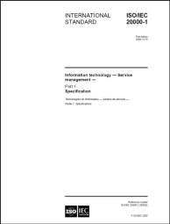
“Why not ITIL?”
IT Infrastructure Library Number of books with "Good Practice" in IT Service Management Slogan: "the key to managing IT services" Descriptions of key principles, concepts and processes in ITSM | Most popular and wide-spread framework Not a "real" standard, but often related to as "de-facto standard" 5 books edited and released by the British OGC
ISO/IEC 20000 International standard for managing and delivering IT services Defines the minimum requirements on ITSM | Developed by a joint committee of ISO and IEC Based on ITIL Auditable, certifiable
Control Objectives for Information and Related Technologies IT Governance framework Specifies control objectives, metrics, maturity models | Developed by ISACA can be combined with ITIL and ISO/IEC 20000
ISO/IEC 20000

Slide 9
“Why not ITIL?”
Existing standards / frameworks
To complex for complex federations
If new to ITSM: overwhelming
If experienced: not necessarily what your org chose
Needed:
Simple, achievable
Compatible with other standards/frameworks
Common ITSM baseline

Slide 10
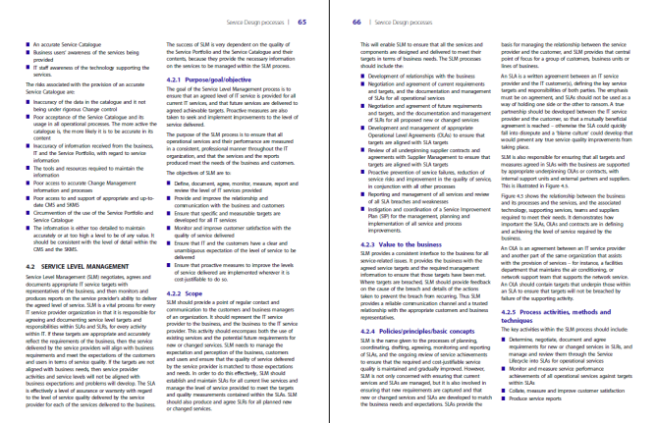
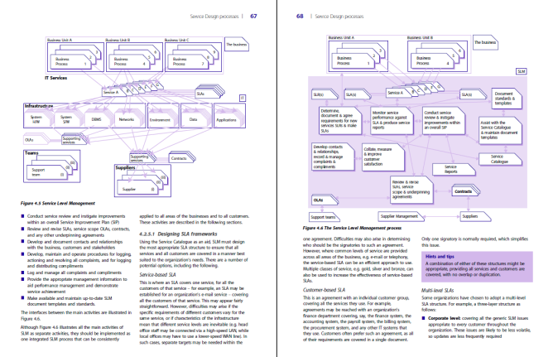
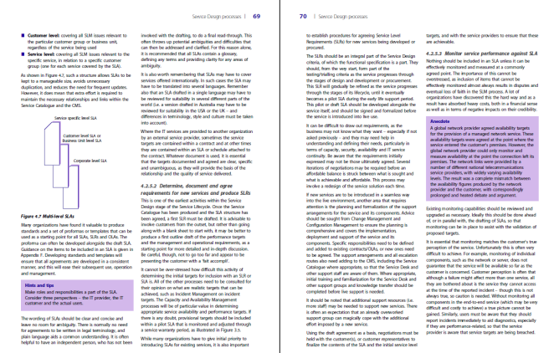
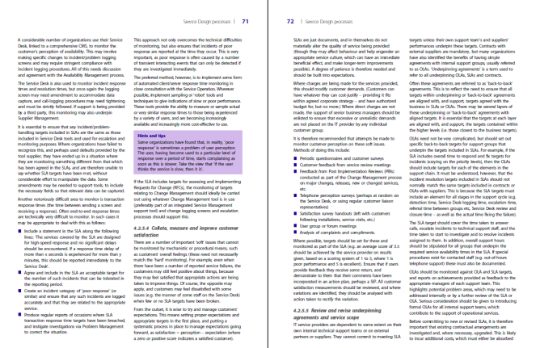
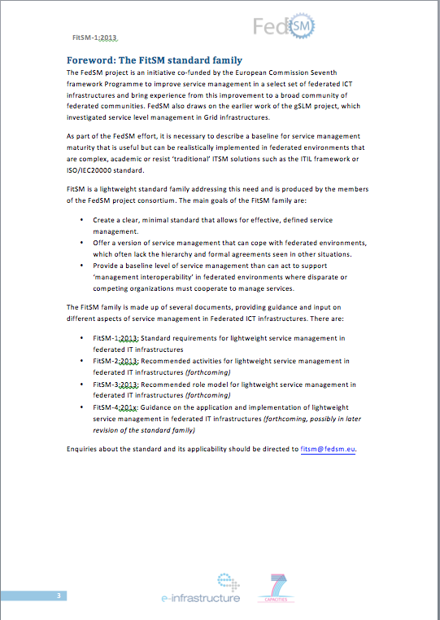
Why FitSM?
ITIL (good practice)
ISO/IEC 20000 (standard)
24 pages total (entire standard)
½ page per management process
FitSM-1
about 1,500 pages total (entire framework)
10-20 pages per management process
9 pages total
14 processes in 4 pages!

Slide 11
FitSM
Standard family
Requirements through to implementation guidance
Simple, achievable baseline for federated ITSM
Being deployed in grids, assessed in other communities
A baseline for service management
Enough to be effective
Basis for further development (ISO20k based)

Slide 12
FitSM - Structure
FitSM-1
Requirements
FitSM-0
Terms
FitSM-2
Activities
FitSM-3
Roles
FitSM-4
Supporting docs & templates
FitSM-5
Implementation guidance

Slide 13
FitSM - Structure
FitSM-1
Requirements
FitSM-0
Terms
FitSM-2
Activities
FitSM-3
Roles
FitSM-4
Supporting docs & templates
FitSM-5
Implementation guidance
Available now
www.fedsm.eu/fitsm
Oct 2013
ongoing
2015

Slide 14
Processes
We divide IT Service Management into 14 logical processes

Slide 15
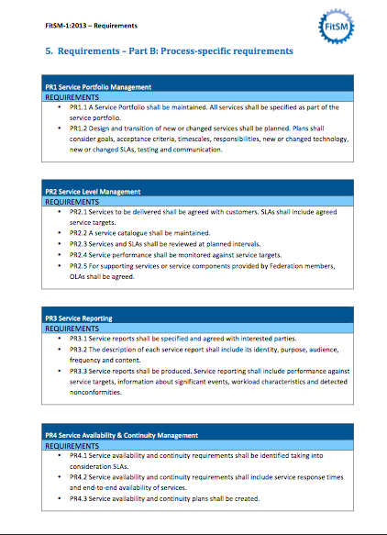
FitSM: a look inside

Slide 16
FitSM: a look inside
Link to other processes

Slide 17
FitSM in practice
Map processes
Compare your work to processes
Assess
How well do you meet each requirement?
Plan/achieve goal
Concrete list of actions / artifacts needed to meet
Set goal level

Slide 18
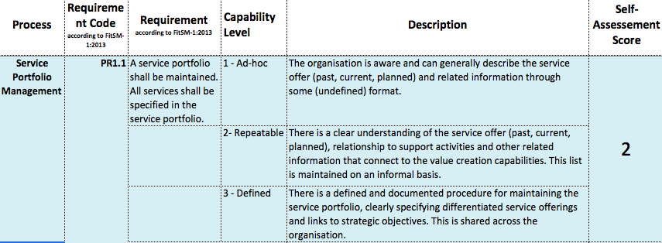
FitSM in practice

Slide 19
FitSM in practice
Raise PR1.1 to level 2
Target level: There is a clear understanding of the service offer (past, current, planned), relationship to support activities and other related information that connect to the value creation capabilities. This list is maintained on an informal basis.
Todos:
Discuss internally the services offered
Create a simple statement summarising the services offered (e.g. ”organization offers compute and storage to national researchers")
Fill/ Update the FedSM service portfolio template for each identified service
Put documents created in repository / Wiki / ...
Documents to be produced:
List of services provided
For each service, a service description following the FedSM template

Slide 20
Example: EGI portfolio

Slide 21
Example: EGI portfolio
EGI offers 5 Solutions
Federated Cloud
Federated Operations
High-Throughput Data Analysis
Community Networks and Support
Community-driven Innovation

Slide 22
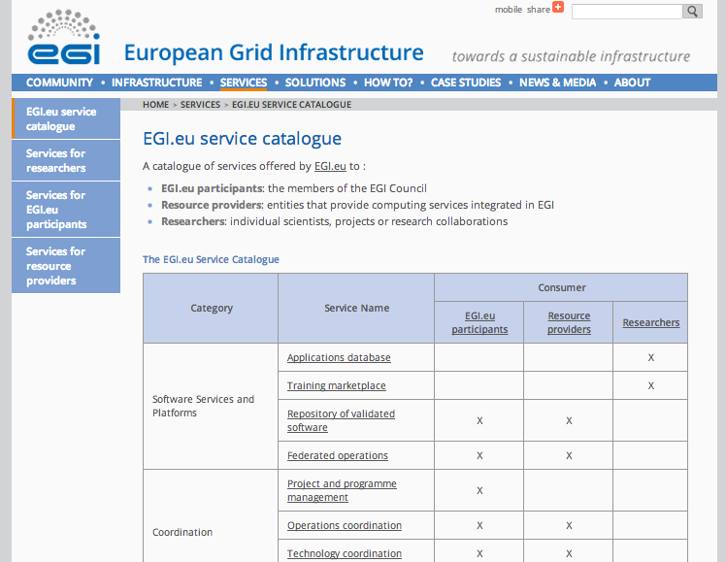
2. Defining the Service Portfolio

Slide 23
FitSM: training
FedSM provides training and certification on FitSM
Works with TÜV SÜD Academie to provide certified training for persons
Three levels, examined with TUV certificate
Mapped to different roles
Pilot Foundation training Thurs/Fri this week
More courses planned in Autumn/Winter and through to Spring 2015
First Advanced training spring 2014

Slide 24
FitSM: support
Clients within the project
Active consultancy and support
Co-design / testing of FitSM
All interested parties
Standard
Open, CC licensed
Supporting material
Assessment tools
Documents and templates
Implementation guidance
Best effort custom support / input to FitSM development

Slide 25
Conclusions
ITSM is complex in federations
Grid – excellence in technology not matched by ITSM experience
Helix Nebula – not synchronized among providers, need for clear offering to well informed users
FitSM
Real standard, backed by TUV, based on ISO20k
Simple and achievable but supports sufficient ITSM
Effective in improving communities new to ITSM
Provide service management ‘interoperability’ for providers

Slide 26
Thanks for listening!
Owen Appleton
owen@emergence-tech.com
www.emergence-tech.com - www.fedsm.eu

