Slide 1
WLCG Transfers monitoring EGI Technical Forum Madrid, 17 September 2013
Pablo Saiz on behalf of the Dashboard Team
CERN
IT/SDC

Slide 2
Monitoring
U
TODAY
Alexandre Beche
David Tuckett
Operation teams
Sites
\
Data management
Sites
Users
General
public
Data transfer
Data access
Publicity & Dissemination
Job
WLCG Google Earth Dashboard
Infrastructure
Opera- tion teams
Analysis
Production
Real time and historical views
Operation teams
Site Status Board
Site usability
SiteView
Sites
In AppDB Portal
https://appdb.egi.eu/store/software/dashboard
Sites

Slide 3
WLCG Transfers Monitoring
http://dashb-wlcg-transfers.cern.ch/

Slide 4
Steps to get there
Data acquisition
Storage
Statistics computation
Server side web API
User Interface rendering

Slide 5
Data flow
ALICE
(MonALISA)
Transport
AMQ
Apollo
HTTPD
+ Python
Web
Browser
Database
FTS
(FTS Servers)
RAW
AJAX
JSON
FAX
(ATLAS GLED)
STATS
AAA
(CMS GLED)

Slide 6
Collector
Stores messages in DB
Consumes using stompclt
Simplevisor to supervise
Only one component developed in-house
Simplevisor
cronjob
AMQ
Stompclt
collector
DB
Local file system

Slide 7
Database architecture
Keep it as simple as possible
Write to RAW
Generate statistics
10 minutes and daily bins
Read statistics through web API
Raw data kept for 3 months
Statistics kept indefinitely

Slide 8
Statistics
For each time bin
MERGE INTO <stats> USING (
select …
FROM <raw>
WHERE <time> between <time range>
)
Find last execution
Check touched bins
Recompute bins
[10am, 11am]
[9.00 am,
9.10, 9.20,
…, 11am]
Messages can be out of order
Transfer finishes → impact on multiple bins
Stored procedures in Oracle:
Run every 10 minutes
Use 10 min bin for daily
Full re-computation
Can be done at anytime

Slide 9
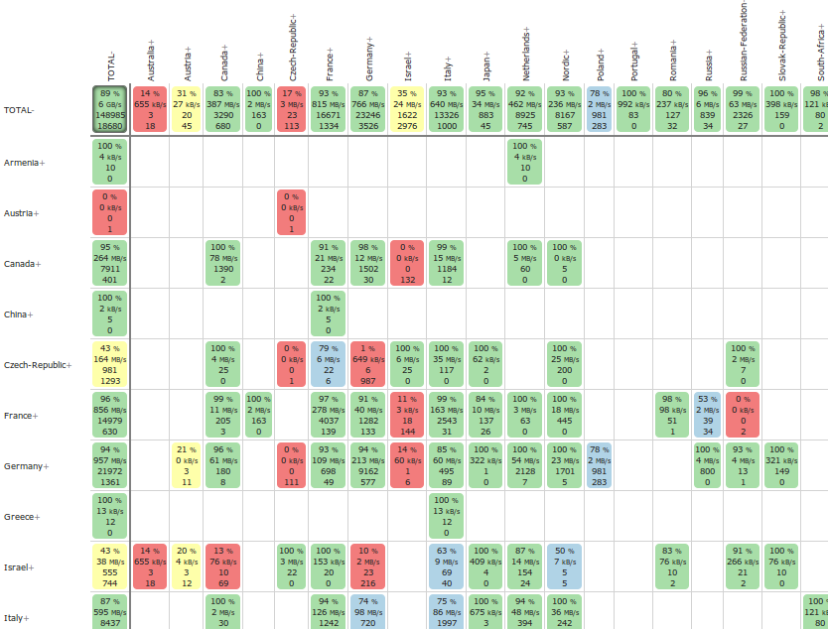
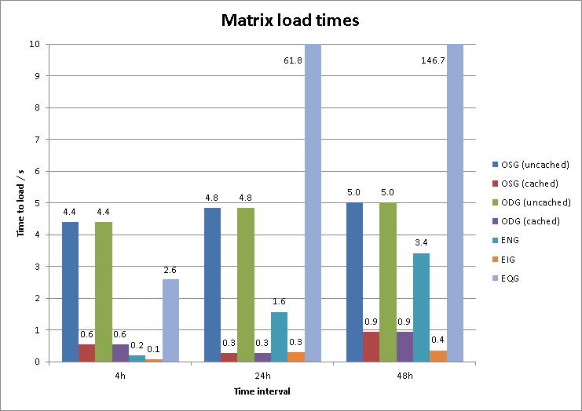
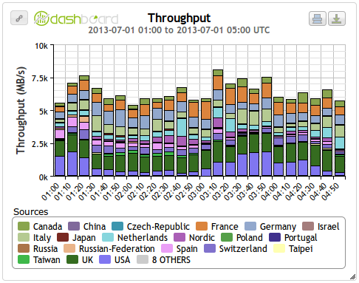
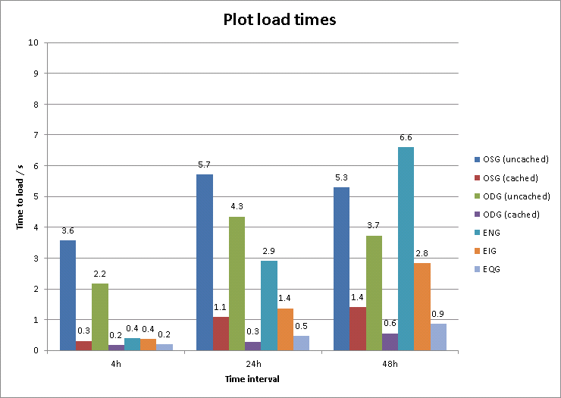
Other databases: ElasticSearch
For details on other layers, see:
http://cern.ch/go/pw7F

Slide 10
Web server
Use the MVC design pattern
Only Action, Configuration and DAO are application specific
Retrieve parameters from HTTP call, data from DAO and set a result dict
DB
Action
DAO
Controller
Collection of SQL queries
View
json, xml,…
Convert python dict into:
Json, xml, csv, html (xslt)
Configuration
Route url + mime to action + view

Slide 11
Web UI
In-house MVC javascript Framework
Xbrowse
Jquery, datatables, standard js libraries
Interact with the server through AJAX
Easy to add new views
Highly customizable

Slide 12
Putting it all together

Slide 13
WLCG Transfers Monitoring
Collects information from different sources:
FTS, xrootd federations, MonALISA
Presents it in a unified way
Very dynamic web interface
Multiple views:
Matrix, plots, world map
Multiple filters:
Source, target, site, country, time period, technology
Modular application
Collectors, transport, storage, web server, client
Same design principle used for all Dashboard Applications
http://dashboard.cern.ch

