Slide 1
INFN Product Teams Engaging with EGI
Cristina Aiftimiei, INFN
On behalf of INFN PTs
EGI TF 2013, Madrid, 16 – 20 Sept.2013

Slide 2
Overview
INFN PTs & their products
post-EMI governance model
Engaging with EGI
Sustainability

Slide 3
INFN PTs & products
CREAM
Development Areas: Compute & Infrastructure
products/services:
BLAH, CREAM & CEMon, CREAM [LSF|TORQUE|SLURM] modules, CREAM Client, Cluster
DGAS
Developemnt Areas: Infrastructure (Accounting)
Products/services: DGAS HLR server, DGAS sensors
STORM & VOMS
Developemnt Areas:: Data & Security
Products/services:
StoRM SE (backend, frontend, GridHTTPs Server)
VOMS server, Client tools & APIs
WMS
Developemnt Area: Compute
Products/services: WMS server & clients
WNoDeS
Development Area: Compute
Products/services: WNoDeS – bait, hypervisor, namespace, logwatch
Common
Products/services: UI, WN

Slide 4
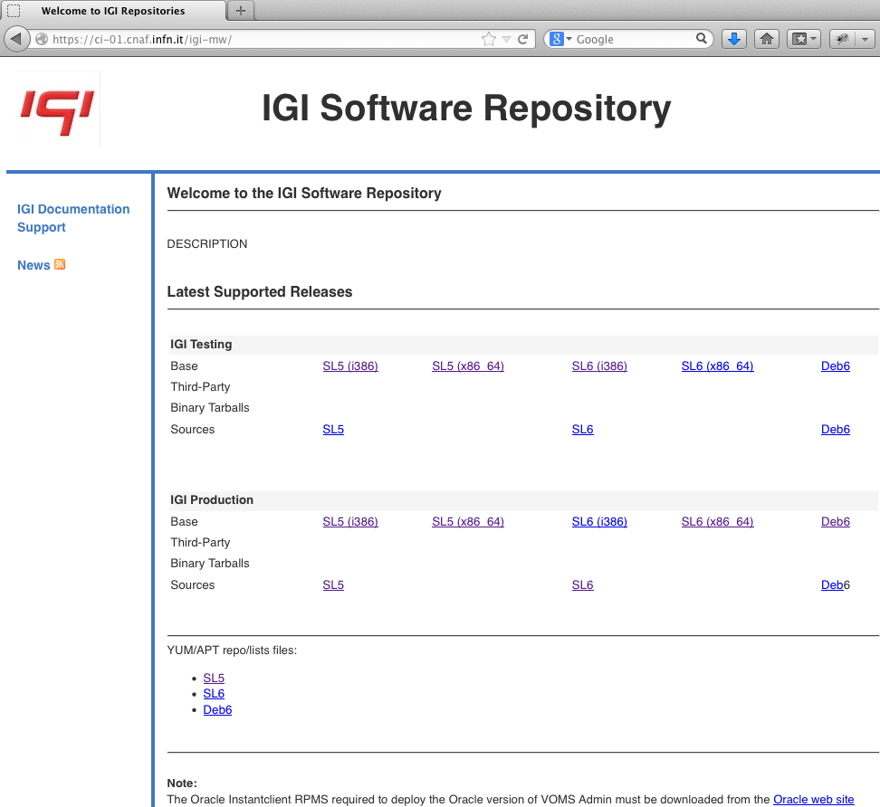
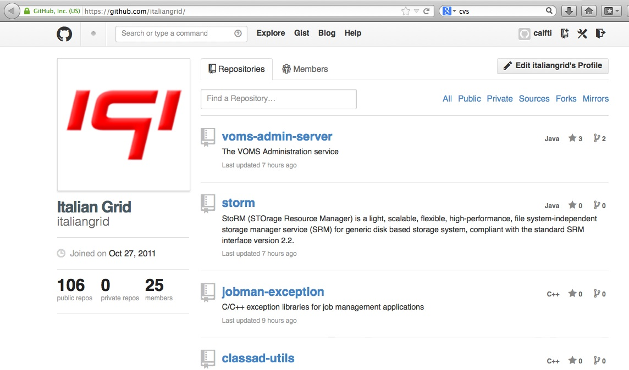
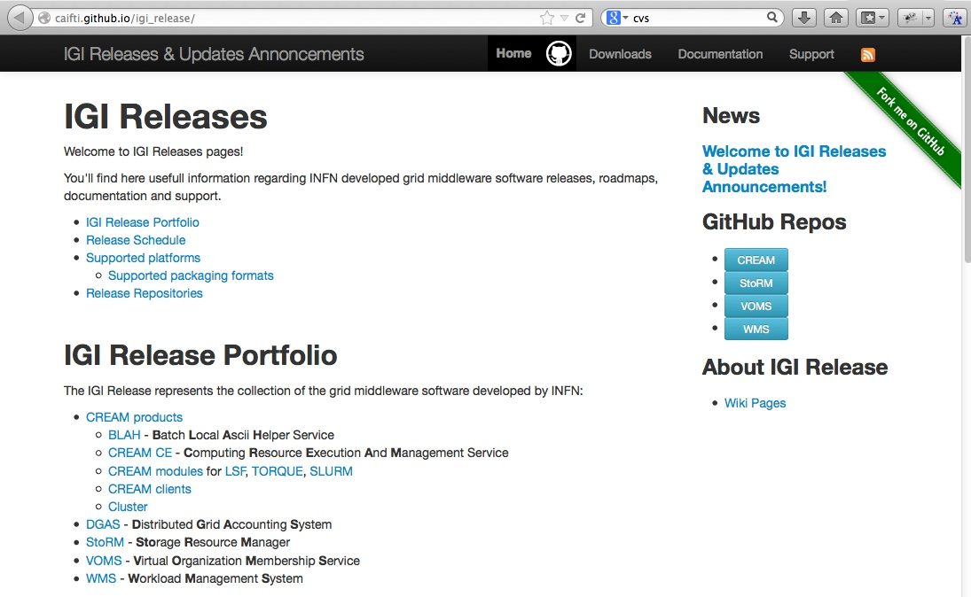
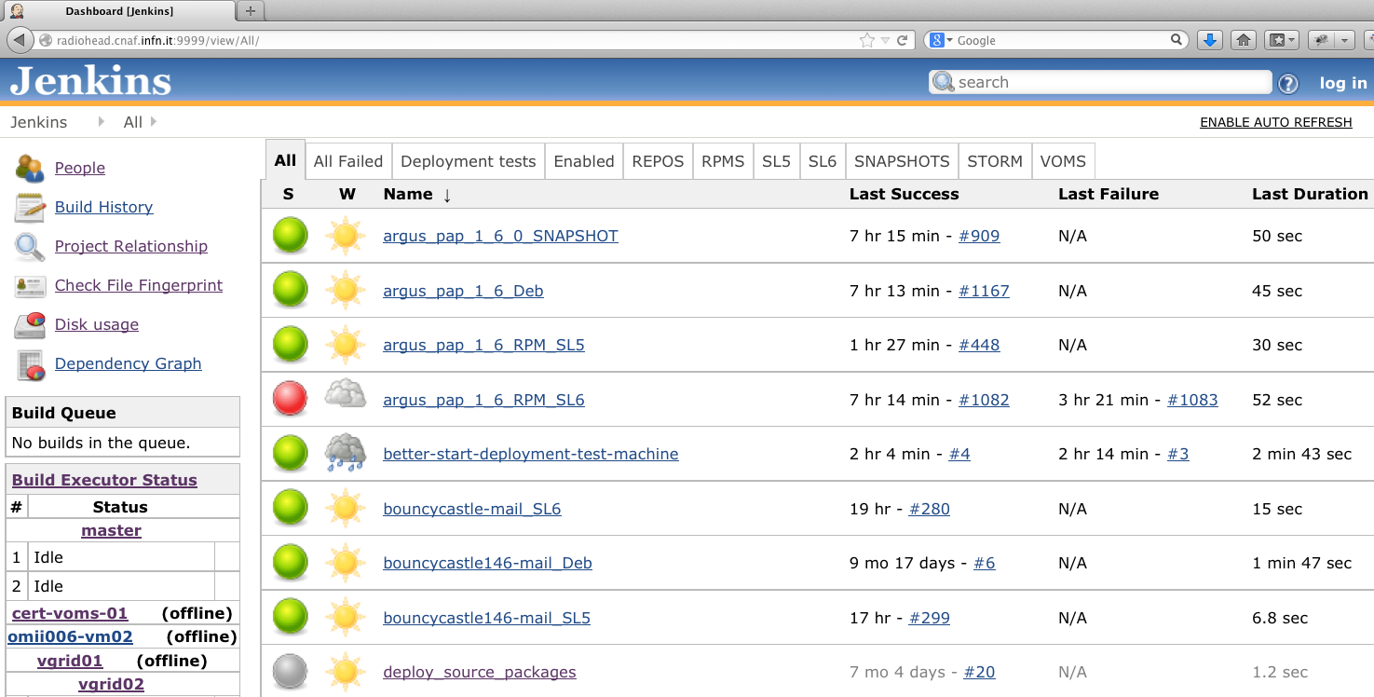
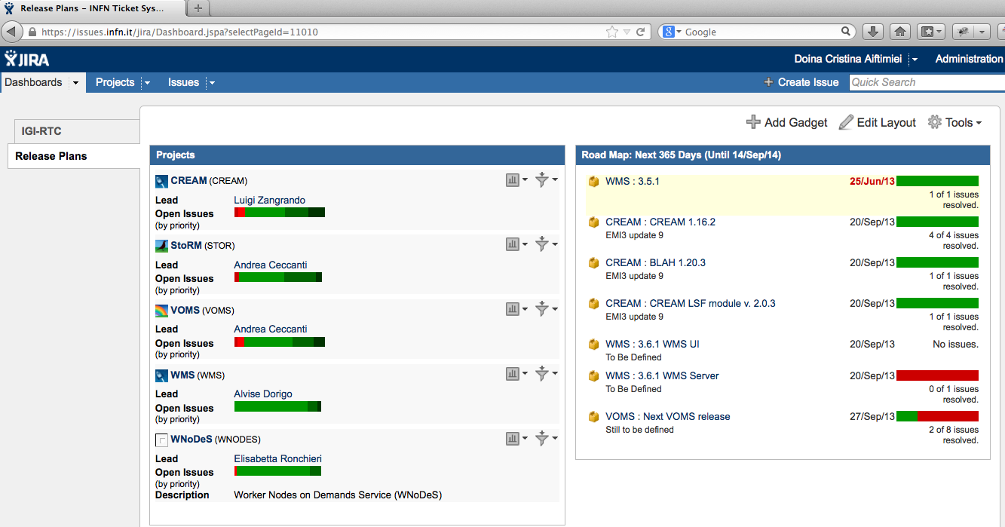
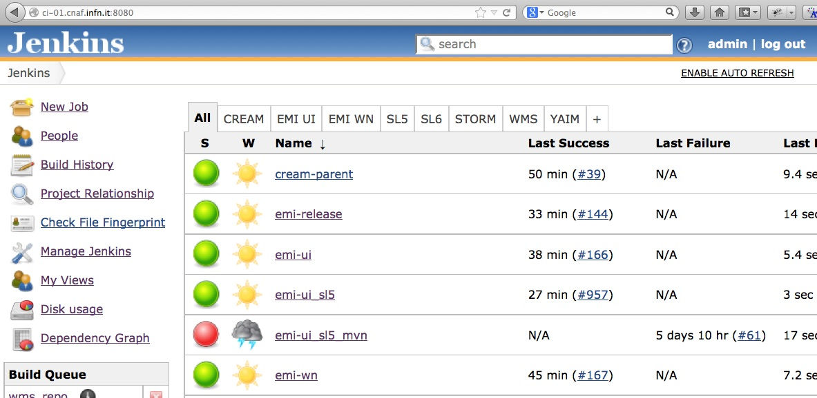
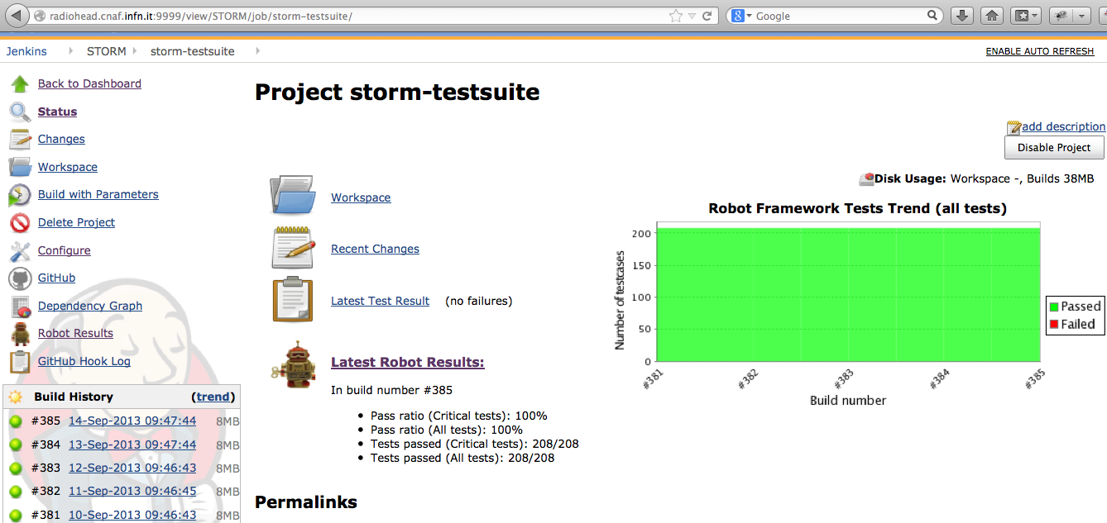
Governance model
Independent PTs
Common frameworks for:
Code Repositories – GitHUB
Distribution Repositories – per products & common INFN, redistributed through EMI/UMD
Continuous Integration – Jenkins
Issue Tracking – JIRA

Slide 5
Engaging with EGI
INFN will provide continued third-level, expert support for its products - until April 2014.
Support for these products will come into play only when a problem cannot be solved by the DMSU or a problem is identified in the code and expert feedback is needed.
Support will be provided through GGUS
Level of Support – Medium
4 working hours for top priority tickets
2 business days for very urgent tickets
5 business days for urgent and less urgent tickets
INFN is interested in receiving new requirements and contribute its expertise in discussing the adoption of new technologies – will participate to EGI TCB
INFN will provide new releases for its products through its own repository, but welcomes the distribution of the products through the UMD repository

Slide 6
Sustainability
Present funding (until 2014):
INFN internal funds, national projects
Future funding:
Through participation to national & international projects

