Slide 1
Standard-based Interoperability amongst HPC, Grid and Cloud Resources Distributed Worldwide with Catania Science Gateways SG Framework Session @ EGI TF 2013 – 17 Sep 2013
Roberto Barbera – University of Catania and INFN (roberto.barbera@ct.infn.it)

Slide 2
Outline
Introductory concepts and driving considerations
Vision and use cases
Current results
Summary and outlook
SG Framework Session @ EGI TF 2013 – 17 September 2013

Slide 3
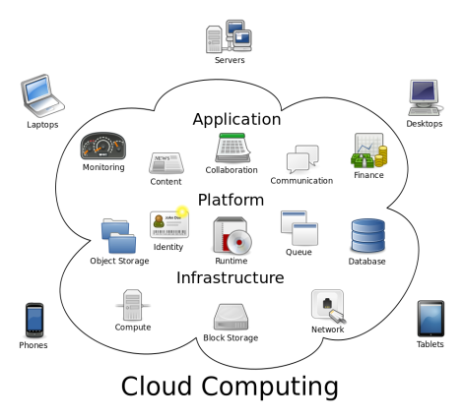
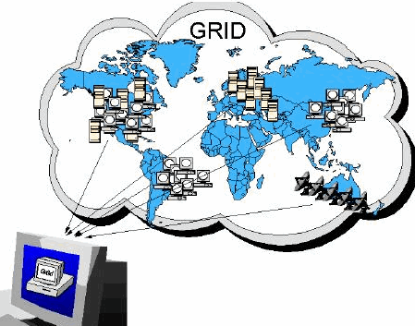
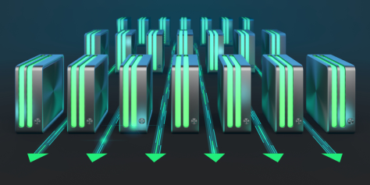
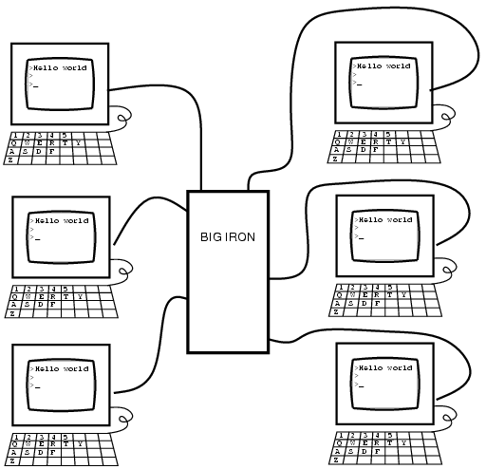
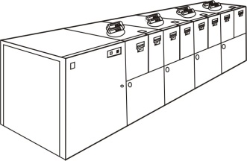
Evolution of distributed computing
Cost of hw
Cost of networks
Time
90’s-00’s
Grid
Computing
00’s-10’s
Cloud
Computing
80’s-90’s
Cluster
Computing
Mainframe
Computing
Power of COTS
WAN bandwidth

Slide 4
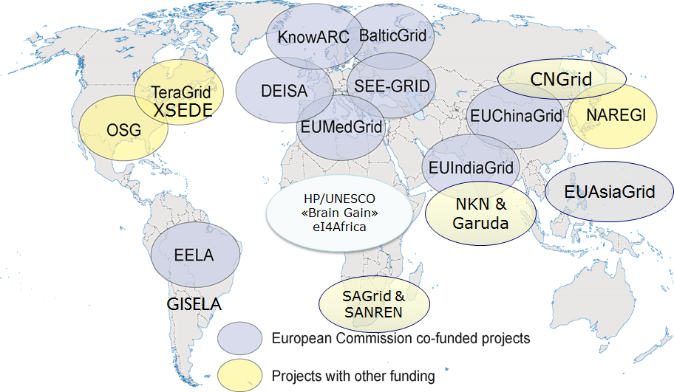
The “Global” Grid
SG Framework Session @ EGI TF 2013 – 17 September 2013

Slide 5
The “non-global” middleware
Genesis II
Interoperability and easiness of access are issues
SG Framework Session @ EGI TF 2013 – 17 September 2013

Slide 6
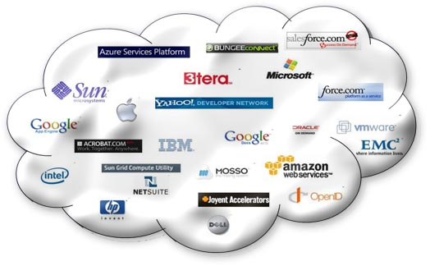
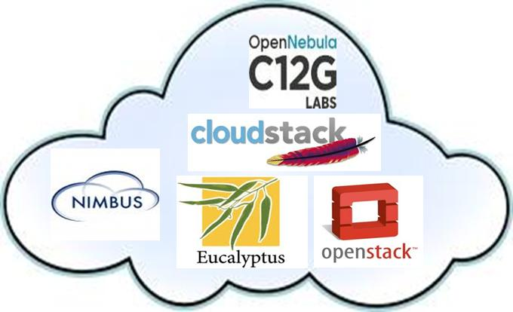
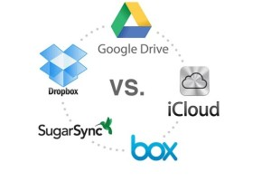
A very «cloudy» sky…
SG Framework Session @ EGI TF 2013 – 17 September 2013

Slide 7
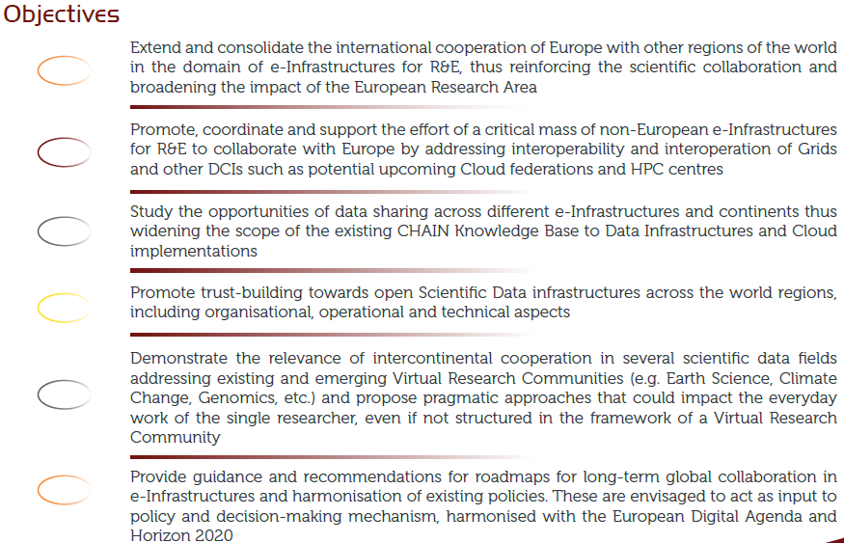
The CHAIN-REDS Project (www.chain-project.eu)
Started: 1 Dec 2012
Duration: 30 months
Targeted regions: Africa,
Arab Region, Latin America,
China, India, and
Far-East Asia

Slide 8
Interoperability and interoperation (source: Wikipedia)
According to ISO/IEC 2382-01 (Information Technology Vocabulary, Fundamental Terms), interoperability is "The capability to communicate, execute programs, or transfer data among various functional units in a manner that requires the user to have little or no knowledge of the unique characteristics of those units“
In engineering, interoperation is the setup of ad hoc components and methods to make two or more systems work together as a combined system
Adoption of standards is key
SG Framework Session @ EGI TF 2013 – 17 September 2013

Slide 9
Vision
A scientist can seamlessly run applications on HPC machines, Grids and Clouds based on different middleware
(→ to demonstrate interoperability → use case #1)
The cloud tenant of a real or virtual organisation can seamlessly and easily manage Cloud resources pledged by providers owning infrastructures based on different Cloud middleware stacks
(→ to demonstrate interoperation → use case #2 )
SG Framework Session @ EGI TF 2013 – 17 September 2013

Slide 10
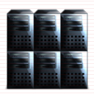
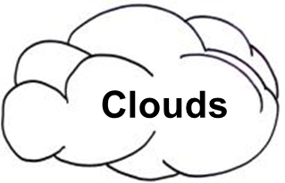
Updated Catania Science Gateway Framework architecture
Embedded Services
Administrator
Scientist
Cloud tenant
.......
App. 1
App. 2
MyCloud
Catania Science Gateway
Use case #1
Use case #2
Grid/Cloud Engine (based on SAGA)
CLEVER Orchestrator (based on OCCI)
Cloud #1
Users belonging
to Identity Federations
HPC
Clusters
Cloud #2
Cloud #n
Single logical domain

Slide 11
Use case #1 (scientist)
A user can sign in on a Catania Science Gateway using his/her federated credentials, select an application from a menu and seamlessly execute it on HPC machines, Grids and Clouds
The fractions of executions on the three different platforms can be adjusted to simulate the need to “boost” the resources in case of temporary peaks of activity
SG Framework Session @ EGI TF 2013 – 17 September 2013

Slide 12
Use case #1 implementation: JSAGA Adaptor for OCCI
Science Gateway
Catania Grid/Cloud Engine
Security context
Job management
Stage-in/out
Adaptor
SG
VM
robot certificate
start VM
SG
VM
1) stage-out
VM
SG
stage-in
& run app
2) kill VM

Slide 13
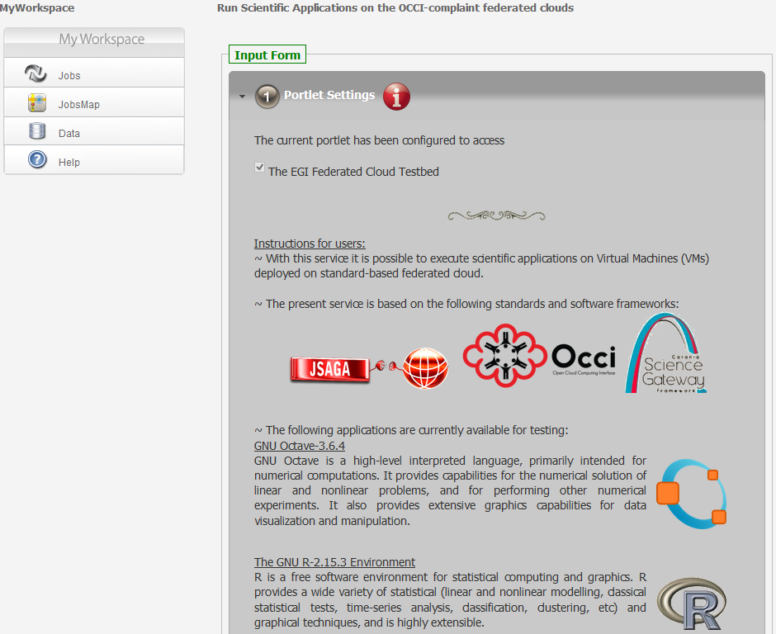
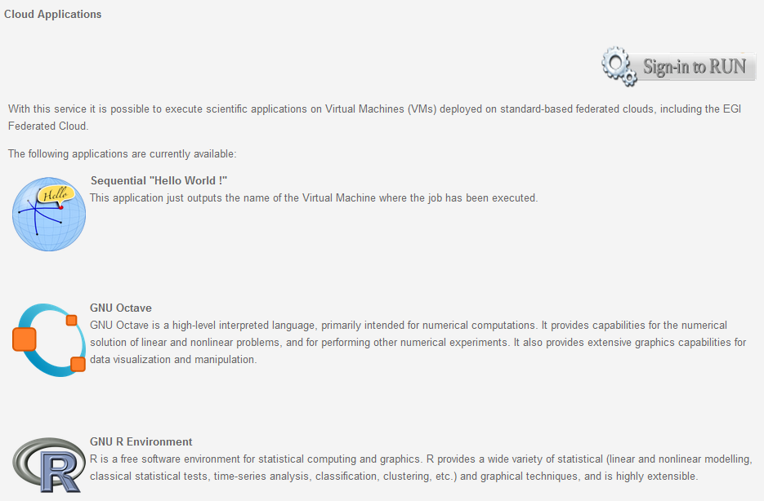
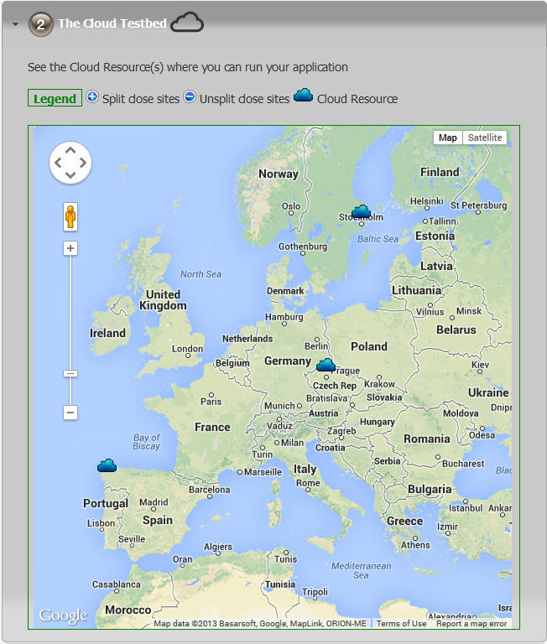
Running applications on the EGI FedCloud

Slide 14
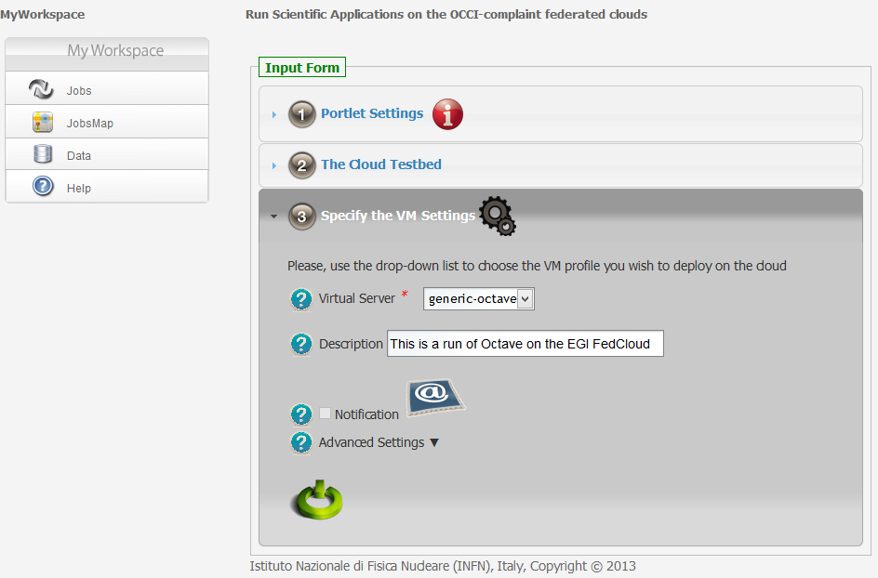
Running applications on the EGI FedCloud
SG Framework Session @ EGI TF 2013 – 17 September 2013

Slide 15
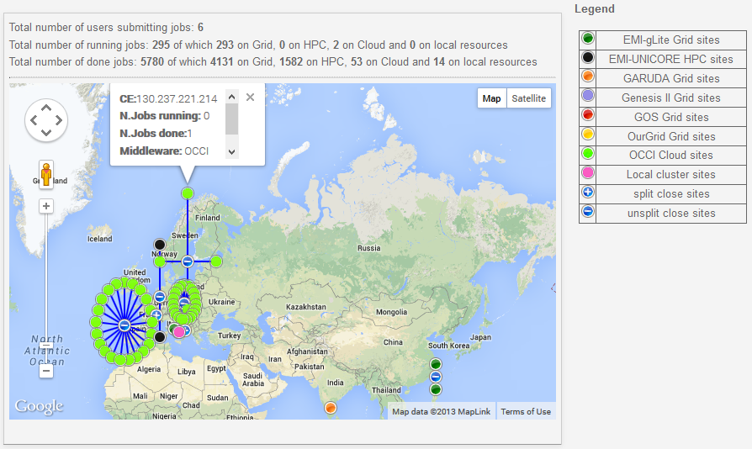
Running applications on various e-Infrastructures
See more tomorrow at the Demo Booth no. 1
SG Framework Session @ EGI TF 2013 – 17 September 2013

Slide 16
Use case #2 (cloud tenant)
The cloud tenant of a real or virtual organisation can sign in on a Catania Science Gateway using his/her federated credentials, select virtual machine(s) from a geographically shared repository and deploy/move/copy it/them across his/her personal cloud
The graphic user interface will be very intuitive including point & click and drag & drop functionalities
The virtual machine(s) will belong to the same domain name (chain-project.eu in the particular case) independently of the site where it/they will be instantiated and of the underlying Cloud middleware stack
SG Framework Session @ EGI TF 2013 – 17 September 2013

Slide 17
Scenario of use case #2
Cloud 1
M/W 1’
Cloud n
M/W n’
Cloud 2
M/W 2’
Cloud 7
M/W 7’
Cloud 3
M/W 3’
Cloud 6
M/W 6’
Cloud 4
M/W 4’
Cloud 5
M/W 5’
SG Framework Session @ EGI TF 2013 – 17 September 2013

Slide 18
Scenario of use case #2
Cloud 1
M/W 1’
Cloud n
M/W n’
Cloud 2
M/W 2’
Cloud 7
M/W 7’
MyCloud
Cloud 3
M/W 3’
Cloud 6
M/W 6’
Cloud 4
M/W 4’
Cloud 5
M/W 5’
SG Framework Session @ EGI TF 2013 – 17 September 2013

Slide 19
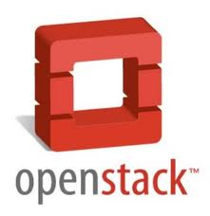
Actual testbed configuration for use case #2
8 clouds
6 countries
3 m/w stacks
1 SME
GR
IT
IT
CZ
Cloud
ES
ZA
FedCloud
EG
ES
SG Framework Session @ EGI TF 2013 – 17 September 2013

Slide 20
Use case #2 implementation: MyCloud functionalities
Services
MyCloud (orchestrated by )
Cloud 1 with m/w 1’
Basic
VM1
Basic
VM2
Cloud 2 with m/w 2’
VRC1
VM1
VRC1
VM2
Single domain (using dymanic DNS)
Cloud n with m/w n’
VRC2
VM1
VRC2
VM2
SG Framework Session @ EGI TF 2013 – 17 September 2013

Slide 21
MyCloud Architecture: the “big picture”
Cloud M/W X
CDMI
Object
Storage
CDMI
Cloud M/W Y
OCCI
OCCI
CDMI
OCCI
OCCI
orchestrator
CLEVER orchestrates
Storage
inter cloud migration
image management
Network
DNSmasq / OpenVSwitch
Computing
Stateful VM handling
MyCloud
CLEVER Client API
SG Framework Session @ EGI TF 2013 – 17 September 2013

Slide 22
MyCloud Architecture: current implementation
Cloud m/w X
Cloud m/w Y
Local
Storage
Local
Storage
OCCI
OCCI
sync
OCCI
OCCI
orchestrator
sync
CLEVER orchestrates
Computing
Stateless VM handling
MyCloud
CLEVER Client API
Local
Storage
SG Framework Session @ EGI TF 2013 – 17 September 2013

Slide 23
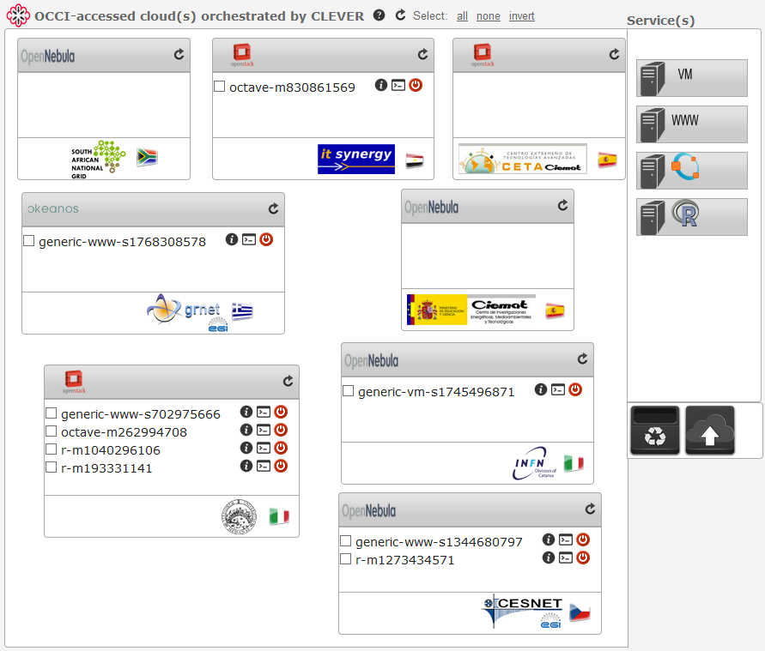
MyCloud @ the CHAIN-REDS Science Gateway
Current functionalities:
Federated authentication
Fine-grained authorisation
Single/multi-deployment of VMs on a cloud and across clouds
Single/multi-move of VMs across clouds
Single/multi-deletion of VMs on a cloud and across clouds
SSH connection to VMs
Direct web access to VMs hosting web services
See more tomorrow at the Demo Booth no. 1
SG Framework Session @ EGI TF 2013 – 17 September 2013

Slide 24
Summary and outlook
Catania Science Gateways successfully bridge e-Infrastructures built on different architectures (Grid, HPC, Cloud, local clusters, desktops, etc.) and make them interoperable at user application level thanks to standard adoption (SAGA, SAML, OCCI, etc.)
The MyCloud service allows seamless multi-cloud service operation across different OCCI-compliant middleware stacks
Next steps are:
Use the JSAGA adaptor for OCCI in other applications deployed in other Catania Science Gateways
Creation of the shared storage infrastructure to support stateful VMs
Allow deployed VMs to «find themselves» in MyCloud
Fostering the deployment of cloud infrastructures in the regions addressed by CHAIN-REDS to widen the testbed both in size and geographic coverage
Promotion of the EGI FedCloud model and possible extension of its infrastructure to other regions in order to support global VRCs (certificate-based authentication is the first issue to tackle)
SG Framework Session @ EGI TF 2013 – 17 September 2013

Slide 25
Contributors
Giuseppe Andronico (INFN Catania – Italy)
Nasia Asiki (GRNET – Greece)
Roberto Barbera (University of Catania and INFN – Italy) - corresponding author
Bruce Becker (Meraka – South Africa)
Federico Bitelli (University of Roma Tre and INFN - Italy)
Riccardo Bruno (INFN Catania – Italy)
Antonio Budano (INFN Roma Tre – Italy)
Ivan Diaz Alvarez (CESGA – Spain)
Miguel A. Díaz Corchero (CETA-CIEMAT – Spain)
Guillermo Díaz Herrero (CETA-CIEMAT – Spain)
Marco Fargetta (INFN Catania – Italy)
Esteban Freire (CESGA – Spain)
Marco Gallo (GARR – Italy)
Emidio Giorgio (INFN Catania – Italy)
Uli Horn (Meraka – South Africa)
Kostas Koumantaros (GRNET – Greece)
Giuseppe La Rocca (INFN Catania – Italy)
Ludek Matyska (CESNET – Czech Republic)
Rafael Mayo García (CIEMAT – Spain)
Salvatore Monforte (INFN Catania – Italy)
Maurizio Paone (INFN Catania – Italy)
Boris Parak (CESNET – Czech Republic)
Vanessa Privitera (GARR – Italy)
Vincenzo Puliatti (IT Synergy – Egypt)
Medhat Ramadan (IT Synergy – Egypt)
Rita Ricceri (INFN Catania – Italy)
Manuel A. Rodríguez Pascual (CIEMAT – Spain)
Riccardo Rotondo (GARR – Italy)
Antonio J. Rubio-Montero (CIEMAT – Spain)
Federico Ruggieri (INFN and GARR– Italy)
Davide Saitta (INFN Catania – Italy)
Diego Scardaci (INFN Catania – Italy)
Seeshan Ali Shas (KTH – Sweden)
Alvaro Simon (CESGA – Spain)
Giuseppe Tricomi (University of Messina – Italy)
Cristiano Valli (GARR – Italy)
Massimo Villari (University of Messina – Italy)
SG Framework Session @ EGI TF 2013 – 17 September 2013

Slide 26
Questions ?

