Slide 1



Business models for publicly funded e-Infrastructures in Helix Nebula
Julia Doll, SAP Project Lead
17 September 2013

Slide 2
Agenda
Motivation
Helix Nebula Business Models
Helix Nebula Broker Roles
(Integrating Publicly Funded e-Infrastructures)

Slide 3
Motivation:
Creating a sustainable Ecosystem
By leveraging ecosystems, companies can deliver complex solutions while maintaining corporate focus.
Exploit the strengths of each partner in an complementary way
Create a win-win situation for all involved
P.J. Williamson, A.D.Meyer: Ecosystem Advantage: how to successfully harness the power of partners, California Management Review, vol. 55, nr. 1, 2012.

Slide 4
Helix Nebula Business Models

Slide 5


HN Business Model Options
Information as a Service
The selling of aggregated and analyzed data in the cloud.
Generic Cloud Computing for European Big Science
Provision of data capture and processing that elastically meet the need of big science’s growing demand.
Versioned Cloud Computing for Science & Education
Addressing the entire world of science and education through explicit versioning of prices, revenue models, SLAs, and services.
Worldwide all-in-one enterprise cloud
Platform that offers a unique resource to governments, businesses and citizens.
Collaboration & Communication Platform for Science & Education
This BM combines social networking, collaboration, data interchange, and secure communication integrated in one web frontend.
Application Crowd
A marketplace where application users can outsource or “crowdsource” domain-specific development projects to thousands of developers from around the world.
Brand Management
Establishment of a brand to utilize advertising and franchising as a revenue model.

Slide 6








Information as a Service
Capturing, processing, analyzing and archiving of highly attractive data from ESA and EMBL occupies the potential to cooperate with further data providers in order to enrich the data in its context. The selling of resulting data sets and knowledge is evaluated as the most promising BM in terms of market need, impact on critical mass, differentiation, and thought leadership. Yet, the required time is high.
Who?
How?
What?
Who?
The confirmed customers‘ data (CERN, ESA, and EMBL) is context enriched with ...
... further providers‘ data sets (e. g. Unesco, World Bank, OECD) ...
... which is hosted on HN‘s cloud ...
... and acquired, standardized, and combined by a data broker role to be assigned.
Partner & Customer Expansion:
The finding an binding of further valuable data providers of e.g. financial data is a key success factor.
According to the expert evaluation extensive marketing is necessary and worthwhile as the “ingredient brands” ESA and EMBL are expected to raise high interest and attention.
Data Processing:
Selling enriched data requires huge efforts to ensure data quality for the intended use in commercial operations, decision making and planning.
The more profitable option of selling knowledge induces data mining involving methods at the intersection of artificial intelligence, machine learning, statistics, and database systems.
Double-Sided Improvements:
As data is accessible to a greater public, researchers’ problems of identifying missing research instrumentation and research questions can be mitigated.
Core business improvement is achieved by new data sets and knowledge concerning issues like urban development, disaster reduction research, teaching material, military movements, soil moisture etc.
Business Model Strengths:
Being evaluated with highest “impact on the market” among all BMs, the opportunity for a differentiated, thought-leading platform for data and knowledge sale truly exists.
Easy data and tool access yields in community growth.
Customers
Partners
Operations
Value Prop.
Business (B2B) including
Manufacturing
Strategy Consulting
Financial Sector
Health Sector
Oil Industry etc. and …
… Public (B2A) including
Universities
Military
Governments
Schools etc. …
… customers are evaluated to have a very high need.
Value Creation
Infrastructure cost (virtualization, servers, storage, networking, electricity, licensing) are extremely high recurring cost.
Staff costs for data standardization, context enrichment, and mining also appear recurrently.
Especially the exploitation of a first mover advantage causes high initial one time cost for marketing campaigns.
The role holder will receive a percentage of the revenues that are gained in this BM for lowering risks and cost and raising revenues.
Transaction-based services are of interest for one-time needs.
Preemium subscription ensures updates to follow latest data.
Crowdsourcing allows for data provisioning by anybody.
Data enrichment could be triggered by free or low price cloud access if data is made available to be aggregated and sold.
Costs
Revenue
Value Capture
Why?

Slide 7
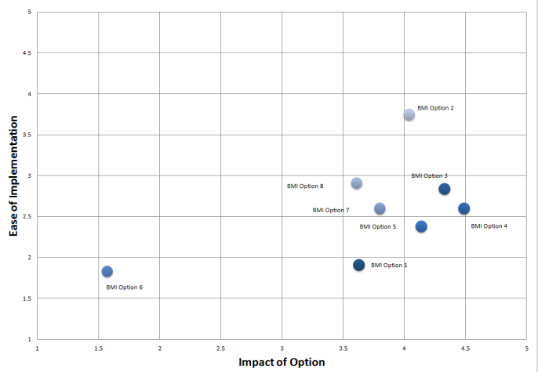
Evaluation Framework
We developed an evaluation framework that is based on two dimensions. The “impact” of the BM option to the market is described from the customers’ point of view, whereas the “ease of implementation” is seen from the suppliers’ point of view. The approach allows combining qualitative and quantitative criteria that were defined specifically for the project in collaboration with the HN suppliers.
Typical Criteria for “Impact of Option”’
Revenue Potential: Direct vs. Indirect (Influenced / Cross – Selling)
Typical Criteria for “Ease of Implementation’
Costs (One Time vs. Recurring)
Customer acceptance / Brand fit
Portfolio Fit / Impact on Portfolio
Impact on Visibility / Traffic
Impact on Differentiation / Thought Leadership
Impact on critical mass (network effect)
Risks (Technical, Financial, Legal etc.)
Time for Implementation
Organizational Fit
Synergies / Leverage of network
Privacy / Security Issues
1: very low / very critical 2: low / critical 3: medium / neutral 4: high / positive 5: very high / very positive

Slide 8
Consolidation Matrix
*Bubble size: Revenue Potential
1: very low / very critical 2: low / critical 3: medium / neutral 4: high / positive 5: very high / very positive

Slide 9
Information as a Service
Both HN supplier and SAP experts were enthusiastic about this BM which is depicted in its very high revenue potential and its very high customer need. Selling data and knowledge on this scale is a thought leading BM with a high differentiation and a very high revenue potential. Taking into account the feasibility and the required suppliers’ expertise, we clearly advise to strike up the critical one-time costs.
1: very low / very critical 2: low / critical 3: medium / neutral 4: high / positive 5: very high / very positive

Slide 10

Best Options
Short Term
Generic Cloud Computing for European Big Science
Objective of Helix Nebula. Further satisfying needs and requirements of CERN, EMBL and ESA
Information as a Service
Business model of interest to ESA and potentially other data intensive research organization.
Long Term
Versioned Cloud Computing for Science & Education
Addressing the entire world of science and education through explicit versioning of prices, revenue models, SLAs, and services.
Worldwide all-in-one enterprise cloud
The provision of resources to governments, businesses and citizens is a vision of Helix Nebula and hence, the extension of Helix Nebula to these customer segments could be incorporated as a long term strategy.

Slide 11
Helix Nebula Broker Roles
Integrating Publicly Funded e-Infrastructures

Slide 12

Broker Roles
A central shared service center can execute the tasks and coordinate results more efficiently and potentially achieve economies of scale
Lower risks and costs for all involved
Overcome challenges of D7.1

Slide 13
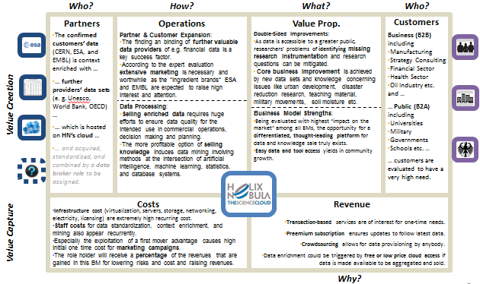
HN BM specific Broker Roles
Support Success of the Helix Nebula Business Model
Versioned Cloud Computing for Science & Education
  Market Research & Versioning
  Finds new partners and defines versions.
Worldwide all-in-one enterprise cloud
  International Strategy & Communications
  manages the choice of worldwide geographies where data centres are to be installed and customers addressed. Further, the international roll-out requires national law and language adaptions of the services
Application Crowd
  Appstore Provider
  provides the app store and tests, certifies, and customizes the apps. Establishing expert ecosystem.

Slide 14

HN Overarching Broker Roles
Lower Costs
Work Group Management
Assigns tasks and coordinates results between all HN partners’ individual work groups. For example the distribution of technical standards, central governance rules, definition of customer segments, service catalogue and a supply side expansion process for Europe and other continents, if approved.
The Up-/Cross-Seller
Exploits the up-/cross-selling potentials between the various services by finding suitable services based on customer’s data analysis.
Address D7.1 Challenges
Trading Role
A trading exchange platform that enables infrastructure provider to sell and buy computing capacity in order to better meet the customers’ needs and to earn money with unused resources
  Lowers investment risk
  Potential revenue increase
  Need neutral party
  Cloud provision and coordination expertise

Slide 15

Expertise of EGI
EGI knows the customer segment with their needs and requirements
Expertise in coordinating cloud providers and resources across countries
Knowledge in implementation of a cloud strategy for science
They know the products, services and value propositions needed to succeed
They can add valuable resources and services
Existing customer relationships

Slide 16
Rules – Level Playing Field
Segments | Public | Commercial
Research (open access results) | ✓ | ✓ (unfulfilled demand*)
Research (commercial results) | ✓ (for prototyping) | ✓
Business |  | ✓
Consumers |  | ✓
Administrations | ✓ (open research) | ✓
* Extra capacity, different resource types, different SLA’s
Ranking: potential options with price/performance ratio
Cooperation: trading exchange platform – sell/buy capacity

Slide 17







GÉANT’s Business Model in Helix Nebula
(Enterprise View)
Who?
How?
What?
Who?
Dante and Terena operate a premium broadband network
The Helix Nebula partner platform provides orchestration, value co-creation and future signal effects.
Commercial providers enrich the service porfolio of GÉANT.
Operational Network Management diagnoses network problems, organizes and oversees repairs and maintenance, and configures new services. It monitors basic network health and creates tickets for network incidents, planned maintenance and new service requests.
Network Security provides a mechanism to quickly and effectively inform affected users by allowing response teams to tailor how and for what type of incidents they want their notifications to be triggered for.
Research: In parallel with operating the existing network infrastructure, research is ongoing into those emerging technologies, standards and equipment that will be built into the GÉANT of tomorrow.
International Community:
The pan-European research and education network not only interconnects Europe's NRENs, but also has extensive links to networks in other world regions and thereby brings users worldwide seamlessly together to collaborate on research and education.
World’s Fastest Network:
It is now running at a basic level of 500Gbps (upgradeable to 2.5Tbps) with individual circuits running at up to 100Gbps. GÉANT is also looking to work with telecoms companies to trial 100Gbps circuits across the Atlantic, a feature which will particularly help US high energy physicists working with data from CERN's Large Hadron Collider.
Consulting & Services in the areas of connectivity, network performance, user access & applications, cloud, security, namespace registry, and training.
Customers
Partners
Operations
Value Prop.
NRENs (National Research and Education Networks)
Public Sector (e.g. administrations) ("Europe 2020")
Research & Education:
- Supranational Research (e.g. ESA)
- Commercial R&D
- Long Tail of Science
- Universities
Value Creation
  European Research & Education Network
TBD based on the following questions.
What are the most important costs inherent in our BM?
Which key resources are most expensive?
Which key activities are most expensive?
Commercial Partner-Sided Revenue Options:
Option 1: Commercial providers pay fees for network access and charge full ressource prices.
Option 2: Commercial providers pay no fees for network access and charge reduced ressource prices.
Customer-Sided Revenues:
TBD
Costs
Revenue
Value Capture
Why?
Challenge
Approach
Solution
Appendix

Slide 18
Win-Win Situation
Customer expertise and partner coordination
Valuable resources to tackle big science
Lower costs and risks
Value Proposition Extension
Customers get freedom of choice
Flexibility:
Expand publicly funded by commercial resources
Faster network
Better demand coverage for IaaS

Slide 19
Thank you.
Julia Doll
SAP Project Lead
T +41 58871 7722
ju.doll@sap.com

Slide 20
Appendix

Slide 21
HN Overarching Broker Roles
Trading Role
A trading exchange platform that enables infrastructure provider to sell and buy computing capacity in order to better meet the customers’ needs and to earn money with disused resources
Yellow Strom Role
Buys the offerings from HN providers to create frequently demanded bundles or single services ex ante and sells them to the end customer without making transparent from with provider the services come (reseller model).
Work Group Management
Assigns tasks and coordinates results between all HN partners’ individual work groups. For example the distribution of technical standards, central governance rules, definition of customer segments, service catalogue and a supply side expansion process for Europe and other continents, if approved.
The Up-/Cross-Seller
Exploits the up-/cross-selling potentials between the various services by finding suitable services based on customer’s data analysis.
Financial Broker
A financial broker integrates quotas/billings, passes through payments and splits revenues.
Law Broker
Legal operations concerning European and national antitrust policies, liability within the ecosystem, taxes and HN’s juridical status could be centrally managed for all providers.

Slide 22
HN BM specific Broker Roles
Information as a Service
acquires, standardises, and combines new structured, semi-structured, and unstructured data which is considered to be beneficial to the existing offerings
Generic Cloud Computing for European Big Science
Provision of data capture and processing that elastically meet the need of big science’s growing demand.
Versioned Cloud Computing for Science & Education
Finds new partners and defines versions.
Worldwide all-in-one enterprise cloud
manages the choice of worldwide geographies where data centres are to be installed and customers addressed. Further, the international roll-out requires national law and language adaptions of the services
Collaboration & Communication Platform for Science & Education
centrally ensures marketing, front-end deployment, tool integration communication, and quality assurance.
Application Crowd
provides the app store and tests, certifies, and customizes the apps. Establishing expert ecosystem.
Brand Management
Acquires franchisees, advertisers and donators. Further it manages established partner relationships.

Slide 23
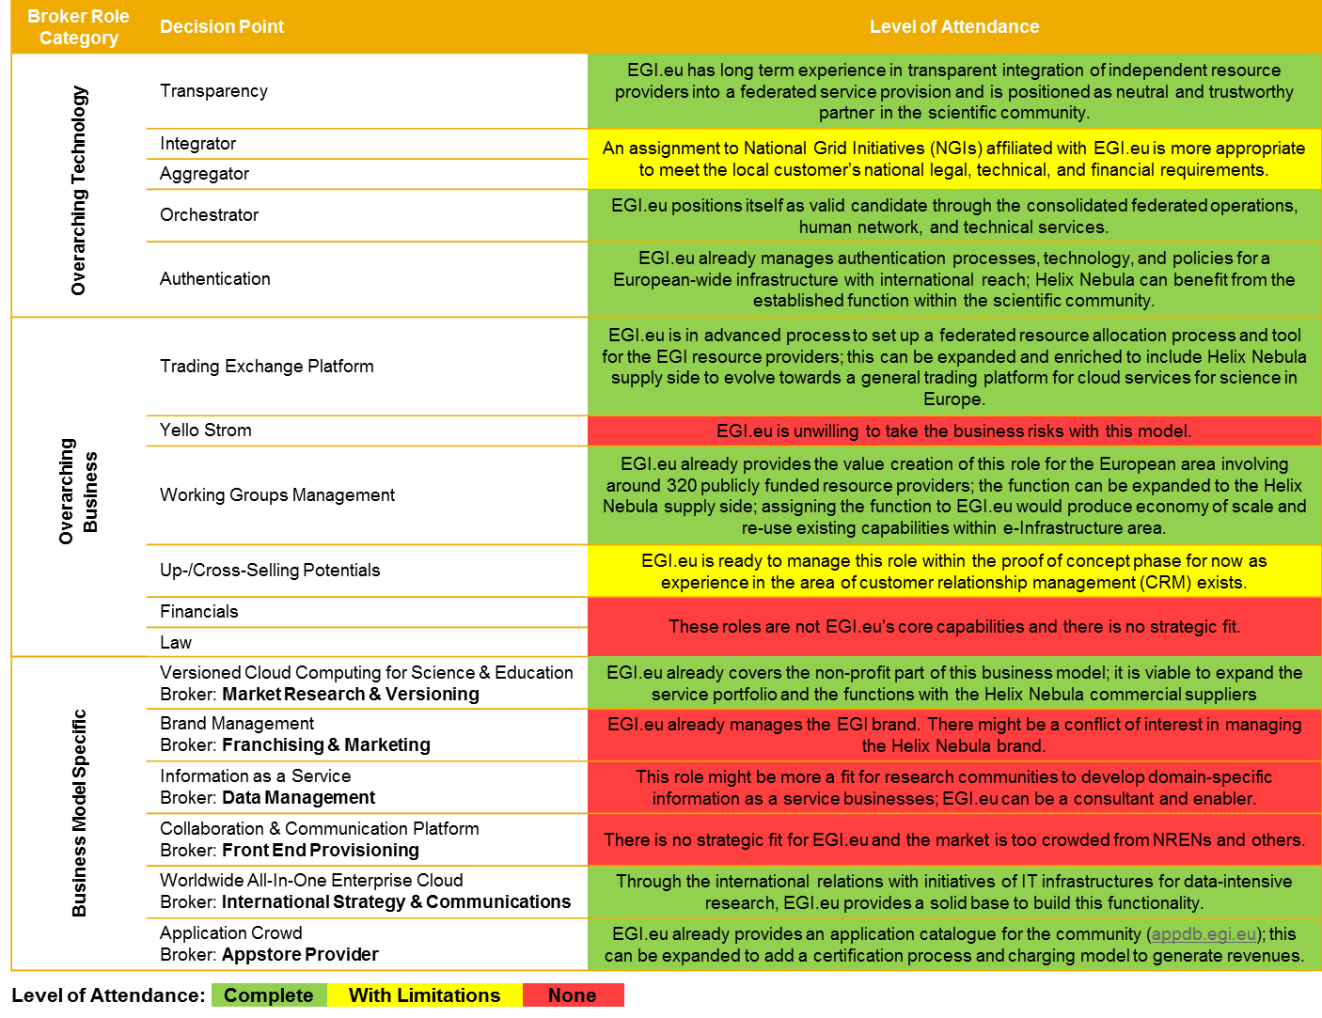

Slide 24
Evaluation Framework
We developed an evaluation framework that is based on two dimensions. The “impact” of the BM option to the market is described from the customers’ point of view, whereas the “ease of implementation” is seen from the suppliers’ point of view. The approach allows combining qualitative and quantitative criteria that were defined specifically for the project in collaboration with the HN suppliers.
Typical Criteria for “Impact of Option”’
Revenue Potential: Direct vs. Indirect (Influenced / Cross – Selling)
Typical Criteria for “Ease of Implementation’
Costs (One Time vs. Recurring)
Customer acceptance / Brand fit
Portfolio Fit / Impact on Portfolio
Impact on Visibility / Traffic
Impact on Differentiation / Thought Leadership
Impact on critical mass (network effect)
Risks (Technical, Financial, Legal etc.)
Time for Implementation
Organizational Fit
Synergies / Leverage of network
Privacy / Security Issues
1: very low / very critical 2: low / critical 3: medium / neutral 4: high / positive 5: very high / very positive

Slide 25
Criteria Comparison for “Impact of Option” (Table)
1: very low / very critical 2: low / critical 3: medium / neutral 4: high / positive 5: very high / very positive

Slide 26
Criteria Comparison for “Impact of Option” (Radar)
1: very low / very critical 2: low / critical 3: medium / neutral 4: high / positive 5: very high / very positive

Slide 27
Criteria Comparison for “Ease of Implementation” (Table)
1: very low / very critical 2: low / critical 3: medium / neutral 4: high / positive 5: very high / very positive

Slide 28
Criteria Comparison for “Ease of Implementation” (Radar)
1: very low / very critical 2: low / critical 3: medium / neutral 4: high / positive 5: very high / very positive

Slide 29




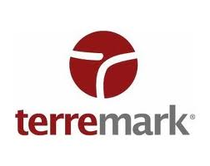


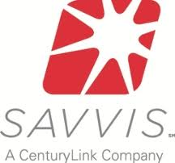


Generic Cloud Computing for European Big Science (Network View)
In its initial development phase, HN has started off as a M-to-N structure. On the costumer side there are three major research organisations that allow a cost-benefit analysis. The partners consist of IaaS providers supported by various other SMEs with specialist skills and knowledge. Overarching broker roles to be assigned act as a middle man to address costumers from a single source.
Partner Network
Customer Network
Competition
IaaS¹ Providers
Atlas Experiment
Processing & Storage
PaaS² & SaaS³ Prov.
Revenue
Proof of Concept
Governance & Infrastructure
Revenue
Genom Analysis
Plattform & Software
Processing & Storage
European Commission
European Cloud Computing
Proof of Concept
Funding
Middle Man
Processing & Storage
Revenue
Share
Proof of Concept
Overarching Broker Roles
Earth Observation
¹Infrastructure as a Service; ²Platform as a Service; ³Software as a Service
My Company My Customers My Partners My Competition

Slide 30
Generic Cloud Computing for European Big Science (Enterprise View)
This BM is the proof of concept on a long way to a worldwide wholesale cloud computing provider. It is based on the needs of European big-science and brings together leading IaaS providers and the three research centres CERN, EMBL, and ESA in order to provide data capture and processing that elastically meet big science’s growing demand for computing power.
Who?
How?
What?
Who?
A consortium of currently four sizable IaaS providers ...
... and 15 SMEs with specialist PaaS and SaaS skills brings diversity of experience/skills.
The EU DGC is giving €1.8 million in funding to this initiative.
Technology Requirements:
A multi-tenant, multi-provider cloud infrastructure with easy data access has to be established.
A growing infrastructure, services and user-base must be enabled.
Policies for trust, security and privacy are to be identified/adopted.
Business Requirements:
An extensible, lean governance structure that considers the customers‘ public status, their duty to follow public procurement processes has to be created.
Framework Programme 8 funding requires a definition of funding schemes to meet European level policies.
Future ICT Mastery:
The management of growing data volumes and more IT resource consumption is ensured on an ongoing basis.
A cooperation with European business ensures new storage and processor technologies on an ongoing basis resulting in more bytes/flops per euro and more energy efficiency.
Business & Research Improvement:
Cloud sourcing of data capture, processing, analysis and archiving using a high quality network allows for core research concentration with less IT and data management consideration.
Cost savings and better data exploitation will lead to recognition and support from Member States.
Customers
Partners
Operations
Value Prop.
The three flagship use cases…
… to support the computing capacity needs for CERN’s ATLAS experiment, …
… to simplify EMBL’s analysis of large genomes, and …
… to trigger ESA’s earth observation …
… will be used to enable a cost-benefit analysis.
Value Creation
The initial governance setup including policies, standards,
guidelines, and proceedings are high onetime cost.
Platform costs (libraries, languages) and infrastructure costs (virtualization, servers, storage, networking, electricity, licensing) are the main recurring costs.
The key activities R&D, marketing, tool development & integration, continuous technology updating are to be considered.
Potential contract models based on volume/time are a PPP, European Union Bilateral Framework Contracts (EU BFC), or a European Union Group Framework Contract (EU GFC).
Extensions are training fees, support charging, and crowd funding.
The EU, e.g., can invest a massive amount which is beneficial for projects requiring extensive R&D, resources and highly trained staff.
Costs
Revenue
Value Capture
Why?

Slide 31
Generic Cloud Computing for European Big Science
Although experts were worried about the little number of customers, the data volume and setting as proof of concept convinced them. The sheer data volume and a market niche of European big science was reason enough for experts to value its customer acceptance very high with the best value of all BMs. Basically, it has solid evaluation results in all criteria.
1: very low / very critical 2: low / critical 3: medium / neutral 4: high / positive 5: very high / very positive

Slide 32


Versioned Cloud Computing for Science & Education
Leaving the concentration on the core use cases at ESA, CERN, and EMBL, this BM addresses the entire world of science and education with all its customer groups. The consequence of including research, development & education from consumer, business, and public markets and the differentiation between profit and non-profit is an explicit versioning of prices, revenue models, SLAs, and services.
Who?
How?
What?
Who?
The initial consortium of I/P/SaaS remains at the core.
Further I/P/SaaS providers incl. ISVs and VARs provide tailored services.
SIs and MSPs design, architect, migrate, and build solutions.
A role to be assigned tailors offerings.
Requirements for Manifoldness:
The distribution channel requires
adapted front-ends with different service levels (e. g. access quality), prices, revenue models, and tailored products/services.
Setting up customer relationships induces acceptable terms and conditions for each segment.
Exploitation of Manifoldness:
Beyond up-/cross-selling between BMs by the overarching broker, up-/cross-selling potentials between different versions are to be exploited.
Manifoldness of customers allows for a cross-subsidisation between
different user types.
Impact of Differentiation:
If the ecosystem grows, a community will be built up and users don’t want to go elsewhere than to HN.
A differentiation between guaranteed (premium) access for profit organizations and an opportunistic (best effort) access for non-profit organizations is an option.
The market either offers generic low price or customized enterprise cloud services, but HN would offer tailored solutions for science and education.
Specific Software Versions:
To start with, the existing service portfolio including, e. g., Hadoop, ROOT, Office 365, and Matlab are to be versioned.
The support of administrative tasks (document handling) with several versions is
possible.
Customers
Partners
Operations
Value Prop.
Consumer (B2C):
“Long tail” of private research
Pupils & students
Business (B2B):
Manufacturing
Strategy Consulting
Financial Sector
Health Sector
Public (B2A):
Universities
Military Research
Schools
… are potential customer segments.
Value Creation
Versioning requires market research on an ongoing basis.
Platform cost (libraries, languages) and infrastructure cost (virtualization, servers, storage, networking, electricity, licensing) are extremely high recurring cost.
The key activities R&D, tool development & integration, continuous technology updating are to be considered.
The role holder will receive a percentage of the revenues that are gained in this BM for lowering risks and cost and raising revenues.
Initial non-profit customers may contribute scientific research results and pay-what-you-want revenues for unused capacity.
Common models are pay-per-use, subscription, and bidding.
Paying for data storage with free computing power for the first six months is an initial motivator for new customers.
Costs
Revenue
Value Capture
Why?

Slide 33
Versioned Cloud Computing for Science & Education
The technical and financial efforts for establishing versions were experts’ reason for lowering onetime costs to critical, which is the only worrying criterion. Yet, as HN is supposed to ultimately pave the way for a cloud computing platform for governments, businesses and citizens, experts acknowledged the inevitable requirement to broaden HN’s offerings step by step.
1: very low / very critical 2: low / critical 3: medium / neutral 4: high / positive 5: very high / very positive

Slide 34


Brand Management
With the first two BMs being successful, a brand may develop and be exploited. Above all, this is of great interest as the online advertising market for cloud computing is estimated to have a current volume of $65-billion (Hassan and Huh 2013). Further, other cloud computing providers might raise interest to participate on the HN marketplace and donators might be attracted by new science paths.
Who?
How?
What?
Who?
The core consortium of the inital HN phase may benefit from a developing brand.
A role to be assigned aquires franchisees and advertisers.
A professional brand management requires a partnership programme with logo management, codes of practice (CoP), codes of conduct (CoC), and marketing campaigns for brand awareness and perception
Supplier Onboarding:
A franchising option allows other cloud computing providers that want to address a market with similar requirements to build their own “HN” cloud and profit from the expertise and brand built up by the consortium.
New partners can still join the initial consortium by passing a qualification filter and following an explicit onboarding process.
Franchising & Joining:
The most important value delivered to franchisees and new arrivals is trust encompassing SLs, contract assurance, sustainability, fitness for purpose, and value for money.
Further triggers for EU franchisees and new arrivals are EU certifications / endorsements, access to funding bodies, and data protection assurance meaning no „Patriot Act“ as marketing argument.
Donation & Advertising:
The brand perception might be innovative, technically skilled, NOT American („Patriot Act“) for non
American markets, „Wow cool.“,
„We‘re different.“,
and easy to use.
Customers
Partners
Operations
Value Prop.
Cloud computing providers, not belonging to the core consortium, may want to join or franchise.
Advertisers may benefit from a cooperation.
Donators may want to support European Science.
Value Creation
Central cost are to be found in marketing, brand development and franchisee management.
The role holder will receive a percentage of the revenues that are gained in this BM for lowering risks and cost and raising revenues.
The online advertising market for cloud computing
is estimated to have a volume of $65-billion (Hassan and Huh 2013).
The pioneering character of large scale science may attract donators that want to contribute to science.
Further cloud computing providers franchise the HN brand and the strong logo by joining the core team of initial partners.
Costs
Revenue
Value Capture
Why?

Slide 35
Brand Management
This model was judged to have the lowest impact especially caused by the lowest customer need. It might be interesting for other cloud computing providers, advertisers, and donators to participate in this BM. As the brand exploitation is merely riskless and the enablement of a growing partner base is an explicit goal and rather an inherent criterion of a marketplace, this BM is both advisable and a must-have.
1: very low / very critical 2: low / critical 3: medium / neutral 4: high / positive 5: very high / very positive

Slide 36
Information as a Service
Capturing, processing, analyzing and archiving of highly attractive data from ESA and EMBL occupies the potential to cooperate with further data providers in order to enrich the data in its context. The selling of resulting data sets and knowledge is evaluated as the most promising BM in terms of market need, impact on critical mass, differentiation, and thought leadership. Yet, the required time is high.
Who?
How?
What?
Who?
The confirmed customers‘ data (CERN, ESA, and EMBL) is context enriched with ...
... further providers‘ data sets (e. g. Unesco, World Bank, OECD) ...
... which is hosted on HN‘s cloud ...
... and acquired, standardized, and combined by a data broker role to be assigned.
Partner & Customer Expansion:
The finding an binding of further valuable data providers of e.g. financial data is a key success factor.
According to the expert evaluation extensive marketing is necessary and worthwhile as the “ingredient brands” ESA and EMBL are expected to raise high interest and attention.
Data Processing:
Selling enriched data requires huge efforts to ensure data quality for the intended use in commercial operations, decision making and planning.
The more profitable option of selling knowledge induces data mining involving methods at the intersection of artificial intelligence, machine learning, statistics, and database systems.
Double-Sided Improvements:
As data is accessible to a greater public, researchers’ problems of identifying missing research instrumentation and research questions can be mitigated.
Core business improvement is achieved by new data sets and knowledge concerning issues like urban development, disaster reduction research, teaching material, military movements, soil moisture etc.
Business Model Strengths:
Being evaluated with highest “impact on the market” among all BMs, the opportunity for a differentiated, thought-leading platform for data and knowledge sale truly exists.
Easy data and tool access yields in community growth.
Customers
Partners
Operations
Value Prop.
Business (B2B) including
Manufacturing
Strategy Consulting
Financial Sector
Health Sector
Oil Industry etc. and …
… Public (B2A) including
Universities
Military
Governments
Schools etc. …
… customers are evaluated to have a very high need.
Value Creation
Infrastructure cost (virtualization, servers, storage, networking, electricity, licensing) are extremely high recurring cost.
Staff costs for data standardization, context enrichment, and mining also appear recurrently.
Especially the exploitation of a first mover advantage causes high initial one time cost for marketing campaigns.
The role holder will receive a percentage of the revenues that are gained in this BM for lowering risks and cost and raising revenues.
Transaction-based services are of interest for one-time needs.
Preemium subscription ensures updates to follow latest data.
Crowdsourcing allows for data provisioning by anybody.
Data enrichment could be triggered by free or low price cloud access if data is made available to be aggregated and sold.
Costs
Revenue
Value Capture
Why?

Slide 37
Information as a Service
Both HN supplier and SAP experts were enthusiastic about this BM which is depicted in its very high revenue potential and its very high customer need. Selling data and knowledge on this scale is a thought leading BM with a high differentiation and a very high revenue potential. Taking into account the feasibility and the required suppliers’ expertise, we clearly advise to strike up the critical one-time costs.
1: very low / very critical 2: low / critical 3: medium / neutral 4: high / positive 5: very high / very positive

Slide 38




Application Crowd
The basic idea of this BM is to establish a marketplace where application users can outsource or “crowdsource” domain-specific development projects to thousands of developers from around the world. Application Crowd fixes the problems with the traditional development process including a slow turnaround, expensive rates, limited application options, uncertain results, and high risk.
Who?
How?
What?
Who?
The HN infrastr. and platfrom providers deploy niche apps.
An appstore provider to be assigned tests, certifies, and customizes the apps in co-operation with ...
... a worldwide network of experts in all fields found by the the foregoing role.
Development Projects Process:
A web form enables the creation of a brief that describes the project requirements including the user’s or organization's name, project type, and the application specifications.
Basically, the customer decides what he wants to pay by stating a budget.
In order to browse and compare different ideas a mechanism to receive them directly in the inbox is necessary.
Appstore Mightiness:
Communication with friends, experts, and developers that simplifies feedback, adjustment messages, and app selection has to be easy.
Certification and quality
assurance allows to offer
apps in the marketplace.
Advantages for Users:
Users can discover, use, and adapt domain-specific apps in the marketplace or start an outsourced development project.
A development project is risk free for end customers because payment is done eventually.
The apps automatically deploy on the HN infrastructure and platform which allows users to benefit from cloud computing advantages.
The Crowd‘s Implication:
A worldwide crowd ensures diversity in all aspects and a higher creativity level.
Experts and developers get a new channel to share/develop applications
which ensures a fast turnaround for users.
Customers
Partners
Operations
Value Prop.
B2C, B2B, and B2A app users who need domain-specific apps but have no skill, time and/or money to develop them …
… find experts who have domain specific solutions to share or …
… developers who program or optionally customize the required domain-specific solutions.
Value Creation
Highest cost to be considered are recurring operational cost for running the appstore including IT infrastructure cost.
Offering apps programmed by unknown developers requires tests, certifications and quality assurances on an ongoing basis.
R&D to integrate these apps with HN‘s infrastructure and platform is obligatory and also causes recurring cost.
The role holder will receive a percentage of the revenues that are gained in this BM for lowering risks and cost and raising revenues.
Experts and developers recieve a bulk of the end customers‘ defined budgets for selling apps and optionally for consulting.
A percentage of the budgets end customers defined is given to the appstore provider for offering the channel and managing the end costumer relationships.
Users pay for the application deployment on HN infrastructure.
Costs
Revenue
Value Capture
Why?

Slide 39
Application Crowd
Experts highlighted the game changing and out of the box character of this BM off the record and in their evaluation of the differentiation and though leadership criterion which is high in average and second best of all. The visibility and traffic caused is high. As crowd sourcing in software development is new, the combination with cloud deployment and leader advantages makes a realisation very interesting.
1: very low / very critical 2: low / critical 3: medium / neutral 4: high / positive 5: very high / very positive

Slide 40
Collaboration & Communication Platform for Science & Education
This BM combines social networking, scheduling, data interchange, and secure communication integrated in one web frontend. Scientists and researchers can share papers, ask and answer questions, find collaborators, and schedule and organize events, from simple lectures to complex meetings, workshops and conferences with sessions and contributions. E-learning is offered to students, pupils, and teachers.
Who?
How?
What?
Who?
A front-end provider to be assigned manages, edits and integrates the enlisted services.
HN providers host the services.
Security & Privacy¹ :
Identity management controls access to information and computing resources.
Physical and personnel security ensures adequate security of physical machines.
Availability enables regular and predictable access.
Application security ensure that apps available via the cloud are secure.
Privacy efforts mask all critical data.
Legal issues consider related laws, which may vary by country.
Integration of new HN services^{2|3}:
User interface integration of the "content" of several apps is possible.
Code integration requires explicit "communications" via interfaces or messages.
Data storage integration requires
implicit "communication"
on a common data schema.
Communication:
A secure social networking site for scientists and researchers enables to share papers, ask/answer questions, and find collaborators.
Skype’s and Indico’s integration allows to manage complex conferences, workshops and meetings.
Collaboration:
A “Dropbox” or “Sharepoint” service enables file and data transfer between research labs.
E-learning is suited to distance learning and flexible learning, but it can also be used in conjunction with face-to-face teaching.
Customers
Partners
Operations
Value Prop.
Consumer (B2C) including
Pupils
Students
Business (B2B) including
Research
Academic and school book publishers
Public (B2A) including
Universities
Schools
… are expected customers.
Value Creation
Initial marketing is necessary to highlight the integration.
Platform and infrastructure cost are important recurring cost.
The key activities R&D, tool development & integration, continuous technology updating are to be considered.
The role holder will receive a percentage of the revenues that are gained in this BM for lowering risks and cost and raising revenues.
Transaction-based (pay-as-you-go) and subscription are revenue models, depending on the service.
The basic version of an offering is given away free in the hope of persuading the customers to pay for the premium version later on.
Costs
Revenue
Value Capture
Why?
Sources: ¹Chetal et al. 2011 | ²Meyer 2002 | ³Using existing services is an option

Slide 41
Collaboration & Communication Platform for Science & Education
Experts were worried about this BM’s impact as the market for e-collaboration and e-communication is mature. But if the integration of so far parallel used solutions and their adaption to science is successfully implemented, there will be a chance for this BM to be worth the effort. Experts think that its neutral to positive ease of implementation combined with the effects on awareness justify a realisation.
1: very low / very critical 2: low / critical 3: medium / neutral 4: high / positive 5: very high / very positive

Slide 42

Worldwide All-In-One Enterprise Cloud
The “Worldwide All-In-One Enterprise Cloud” eventually paves the way for a cloud computing platform that offers a unique resource to governments, businesses and citizens. It can be the ultimate BM for big players consolidating different business activities and strategies, including an ecosystem approach or comprehensive SaaS.
Who?
How?
What?
Who?
The initial consortium of I/P/SaaS remains at the core.
Further I/P/SaaS providers incl. ISVs and VARs enrich the portfolio.
SIs and MSPs design, architect, migrate, and build solutions.
A role to be assigned manages the intern. ecosystem & roll-out.
Expansion:
Further server plants must be added and existing ones expanded/improved.
Also the service catalogue ("Supermarket" & "Bundles") including partnerships & certifications must be expanded/improved.
Enterprise class cloud computing requires intensive auditing, risk & security certification management.
Comprehensiveness:
This aspiration requires availability from any device.
The usability should be improved on an ongoing basis.
A certified appstore should allow user reviews.
Flexibility:
T-shirt sized infrastructure is offered.
Migration from, and interoperability with, other cloud environments results in freedom of choice and prevents customer lock-in.
Addressing hybrid hosting use cases including “bare metal” physical servers on daily metering meets business needs.
Comfort:
One-stop-shop self-services, a large variety of products, bundles of services, and a deal of the week raises attention.
Keeping data in the EU bypasses FBI‘s misuse of the „Patriot Act“.
Optional managed services e.g. for onboarding simplifies the sourcing shift.
Offering co-location allows organizations to focus its IT staff on the actual IT work.
Customers
Partners
Operations
Value Prop.
Consumer (B2C):
Students/Pupils
Priv. Developer
Multimedia
Gaming
Business (B2B):
Start-ups
SMEs
Enterprises
Public (B2A):
Government
Military
Health
Justice
Value Creation
The alignment with different countries‘ languages and laws
followed by an initial worldwide marketing will be necessary.
Platform cost (libraries, languages) and infrastructure cost (virtualization, servers, storage, networking, electricity, licensing) are main recurring cost.
The key activities R&D, marketing, tool development & integration, continuous technology updating are also to be considered.
The role holder will receive a percentage of the revenues that are gained in this BM for lowering risks and cost and raising revenues.
A “Freemium”-Strategy with the three pricing models on-demand (linear) for high flexibility, subscription (hyperbola) with defined length, and spotting for batch computing (lowest bidding wins)
Training & support charging and crowd funding state revenue that might follow.
Costs
Revenue
Value Capture
Why?
Sources: ¹Chetal et al. 2011 | ² Meyer 2002

Slide 43
Worldwide All-In-One Enterprise Cloud
As the EU has the vision of a cloud computing platform for governments, businesses and citizens worldwide, this BM has to be included. HN supplier experts are attracted by its high revenue potential being the second best of all BMs. SAP experts were more reserved because the expansion to enterprise level cloud services worldwide causes high onetime costs and takes very long.
1: very low / very critical 2: low / critical 3: medium / neutral 4: high / positive 5: very high / very positive

Slide 44
Thank you.
Julia Doll
SAP Project Lead
T +41 58871 7722
ju.doll@sap.com
Michael Blaschke
T +41 58871 7745 michael.blaschke@sap.com

