Slide 1
Security Monitoring
Daniel Kouril
EGI TF 2013, Madrid

Slide 2
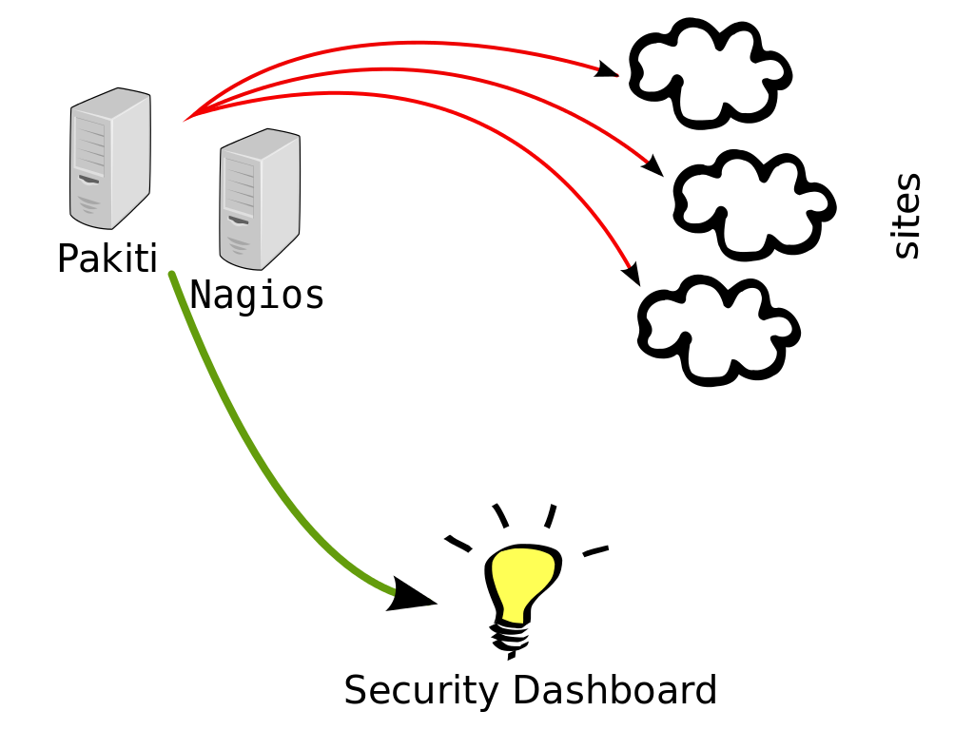
Security Monitoring of EGI
Detection of weaknesses or vulnerabilities
Done by CSIRT, alarms raised when necessary
Monitoring reactions to CSIRT advisories, alerts
Run in parallel to other monitoring, following the same principles and tools
Only public interfaces utilized
“non-intrusive” monitoring, e.g. no exploitation
false-positives may appear

Slide 3
Nagios
Single dedicated box, secmon.egi.eu
No NGI/site levels, however tools are the same
Operated by EGI CSIRT
Several security probes
File permissions, mitigations of vulnerabilities, …
Security probes sent several times a day
Result consumed by the security dashboard

Slide 4
Pakiti
Monitoring of patch status
Preventing attackers from abusing known vulnerabilities
Client submitted as Nagios probe
Server collects information
https://pakiti.egi.eu/
Alarms raised if tagged vulnerability detected
Results sent to Security Dashboard

Slide 5
Security Dashboard
Collects information from monitoring services
Part of EGI operational dashboard
Ongoing work on improved reporting
Access control based on GOC DB and SSO roles/groups
Current views and history

Slide 6
CVE-2013-2094 (mitigations not detected here)

