Slide 1
GBIF: An infrastructure for infrastructures
Francisco Pando
-GBIF Spain-CSIC
e‐Infrastructures & Biodiversity Workshop
Madrid, September 19, 2013
WP6 Related Sessions

Slide 2
GBIF in one slide
Inter-governmental organization
Mission: ”To facilitate free and open access to biodiversity data worldwide, via the Internet, to underpin scientific research, conservation and sustainable development.”
416,242,316 data records
10,140 datasets
Since 2001

Slide 3
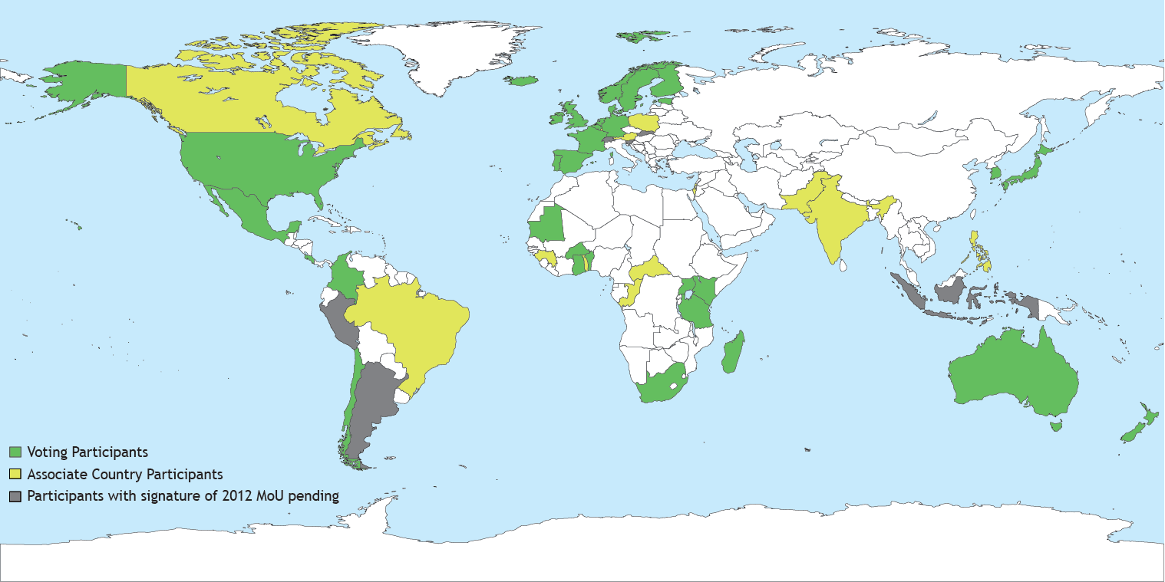
GBIF: an intergovernmental initiative to share biodiversity information
Currently 52 countries; 36 International Organisations…

Slide 4
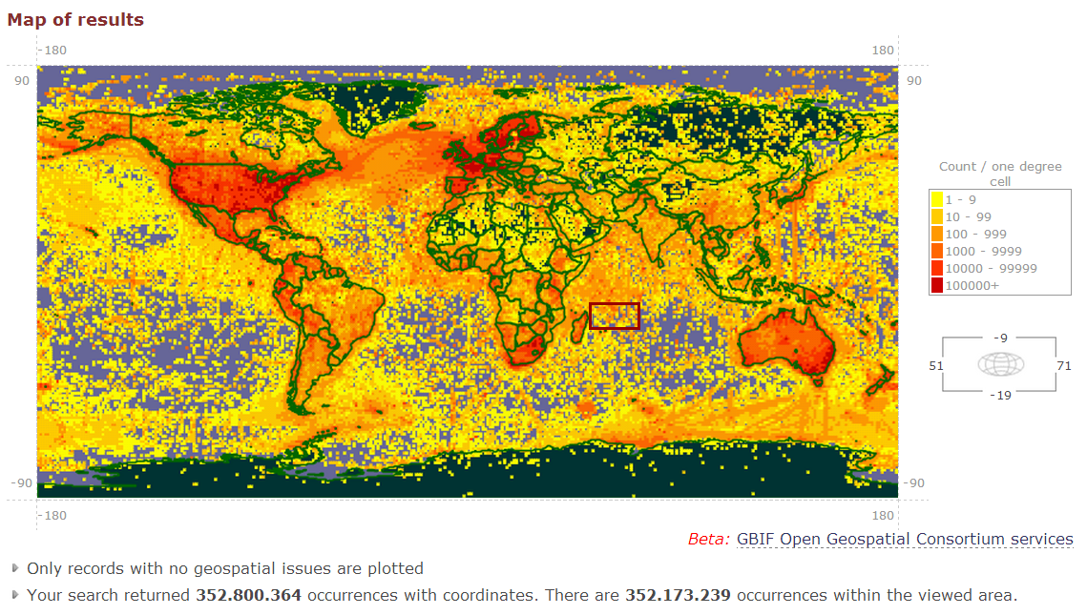
free and open data under a common standard

Slide 5
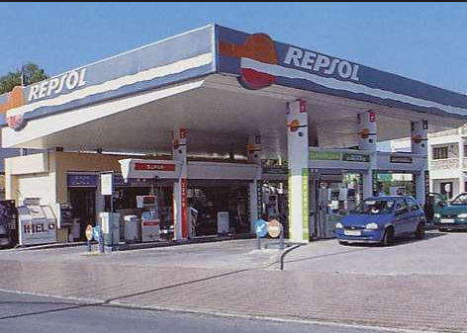
How GBIF is perceived

Slide 6
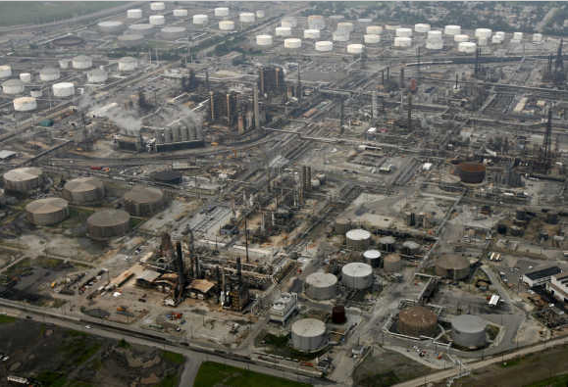
But indeed
Do You Think data Grows On Trees?
…and produced

Slide 7
Where is the infrastructure in GBIF?
”The lack of comprehensive information about the world’s biological resources continues to undermine the efforts of policymakers and managers to set priorities, elaborate strategies and assess the effectiveness of their actions.”
“There are known knowns; there are things we know that we know. There are known unknowns; that is to say, there are things that we now know we don't know.
But there are also unknown unknowns – there are things we do not know we don't know”

Slide 8
Where is the infrastructure in GBIF?
Physical infrastructure
Physical infrastructure, cyberinfrastructure, human resources, and expertise, and program management and coordination.
Information infrastructure
Data workflows
Datasets
Data openness
Data products
Capability infrastructure
Knowledage base and management, training
Standard development
Data gateways development

Slide 9
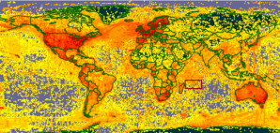
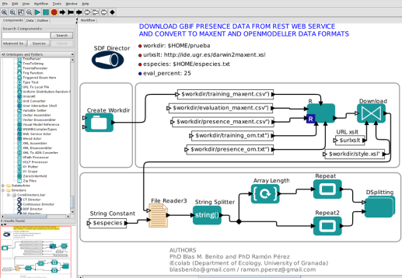
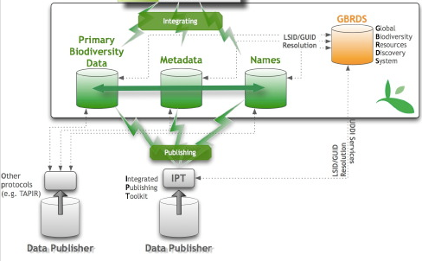
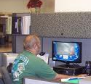
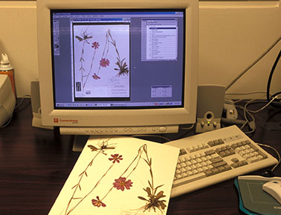
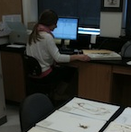
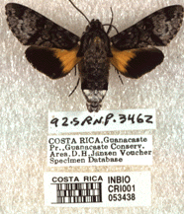
Physical infrastructure
http://data.gbif.org

Slide 10
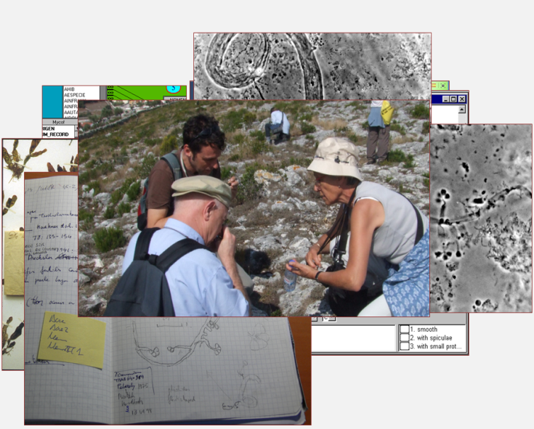
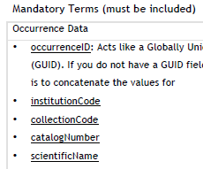
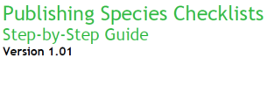
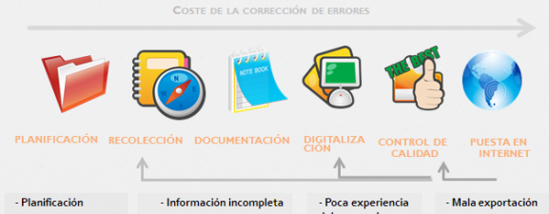
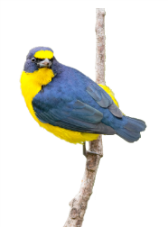
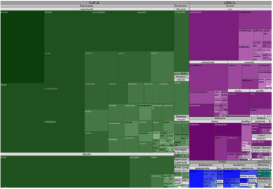
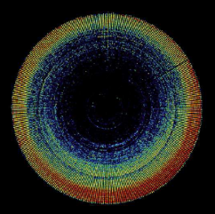
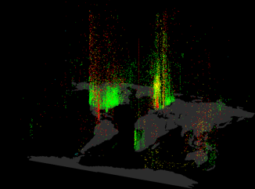
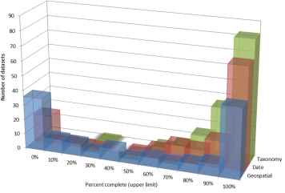
Data workflows
Information infrastructure
Data acquisition
Field sampling
Digitalization
collections
literature
Other sources
(citizen science, IAs,…
GBIF is data from everyone to everyone ... this includes LTER
and other observatory-based data
Data processing
Protocols
Standards
QA/QC
Documentation/Metadata
Datasets
Publication
Archival
usage
Avoid duplication > first, knowing what we know,…
Culture change > data for the imediate ends, also to be reusable

Slide 11
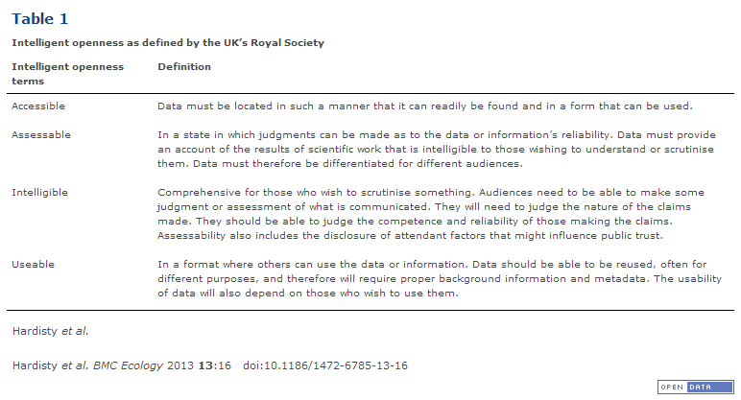
http://www.biomedcentral.com/1472-6785/13/16
BMC Ecology 2013, 13:16 doi:10.1186/1472-6785-13-16

Slide 12
Data openness in GBIF
Information infrastructure
Accesible | One entry point: data.gbif.org; all data queryable using a single interface; under a common data profile: Darwin Core. Other ways to access data avaliable; moving into Semantic Web
Assessable | Each dataset is made available along its corresponding metadata set; following the Ecological metadata language (EML) Standard describing
Intelligible | GBIF is focused on “primary data” not in summarized data or results. So analyses can be replicated and conclusions claimed, evaluated.
Usable | All data downloadable; a common data sharing framework (GBIF’s data use agreement; specific data set use conditions, moving into a standard, Open Database License framework)

Slide 13
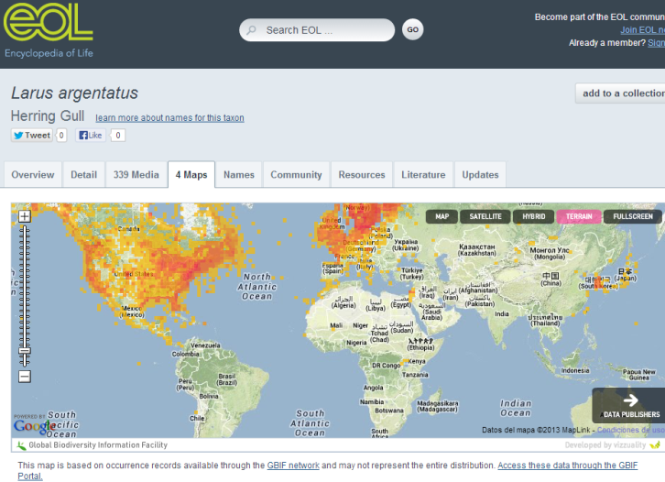
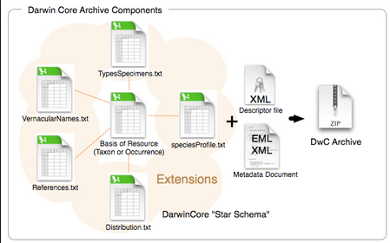
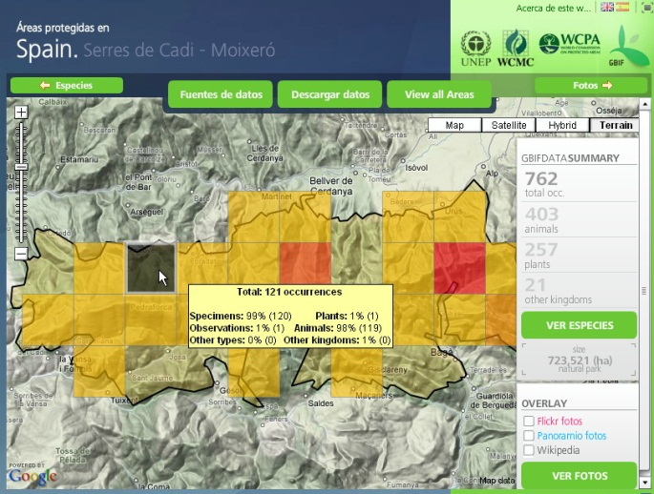
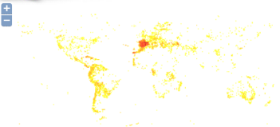
Data Products
Information infrastructure
Darwin Core Archives (inc. downloads)
Maps
GBIF Open Geospatial Consortium services
http://data.gbif.org/countries/gbifWMSMap?wmsFilter=%3CFilter%3E%3CAnd%3E%3CPropertyIsEqualTo%3E%3CPropertyName%3Etype%3C/PropertyName%3E%3CLiteral%3E4%3C/Literal%3E%3C/PropertyIsEqualTo%3E%3CPropertyIsEqualTo%3E%3CPropertyName%3Econcept%3C/PropertyName%3E%3CLiteral%3E252%3C/Literal%3E%3C/PropertyIsEqualTo%3E%3C/And%3E%3C/Filter%3E
Combined data

Slide 14
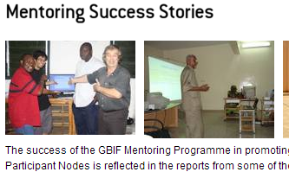
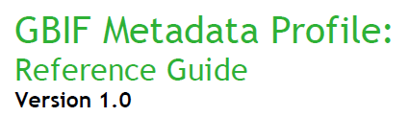
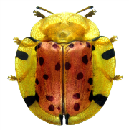
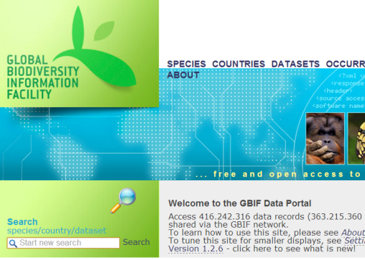
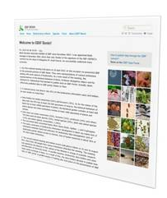
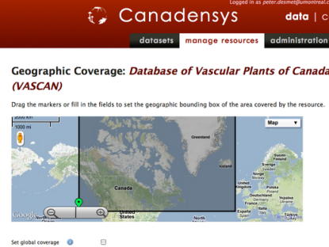
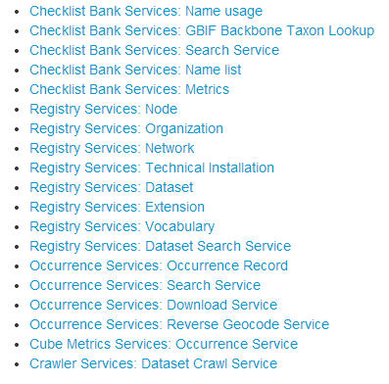
Capability infrastructure
Knowledge base and management, training
workshops, manuals
e-Learning, repositories
Standard development
Darwin Core
GMP
Data gateways development

Slide 15
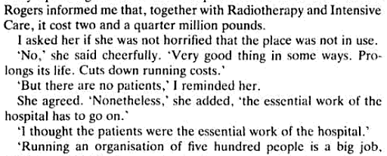
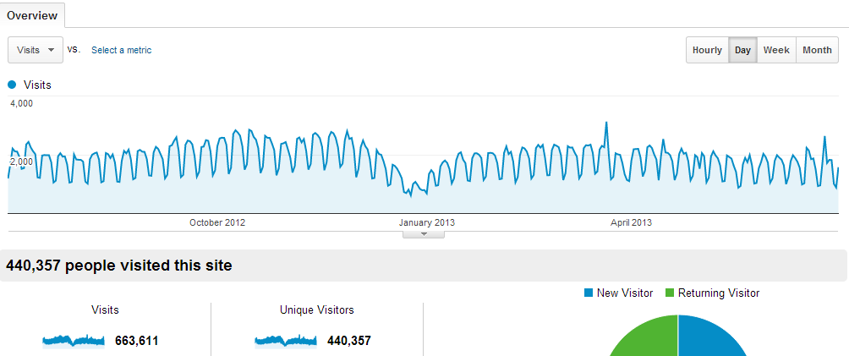
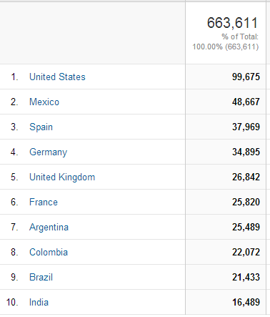
Infrastructure usage

Slide 16
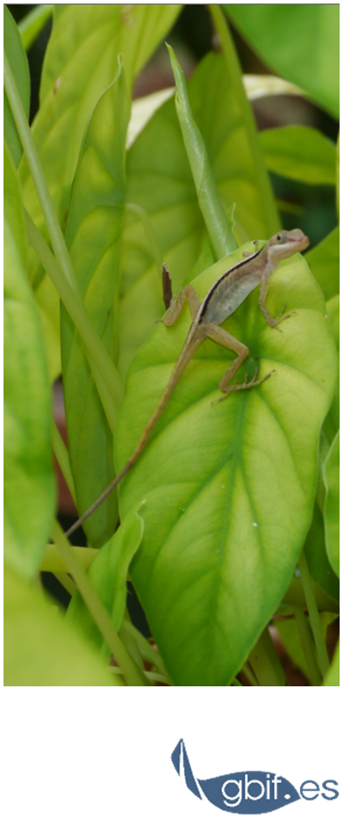
http://data.gbif.org
http://www.gbif.org/
> 400M data records
> 10K datasets
> 50 country members
> 700K visits/yr. + Ms-Ks APIs requests/yr
100s of people working on it around the globe
Francisco Pando
Unidad de coordinación, GBIF España
Real Jardín Botánico - CSIC
Claudio Moyano 1, 28014 Madrid
pando@gbif.es
www.gbif.es
http://creativecommons.org/licenses/by-sa/3.0/es/

Slide 18
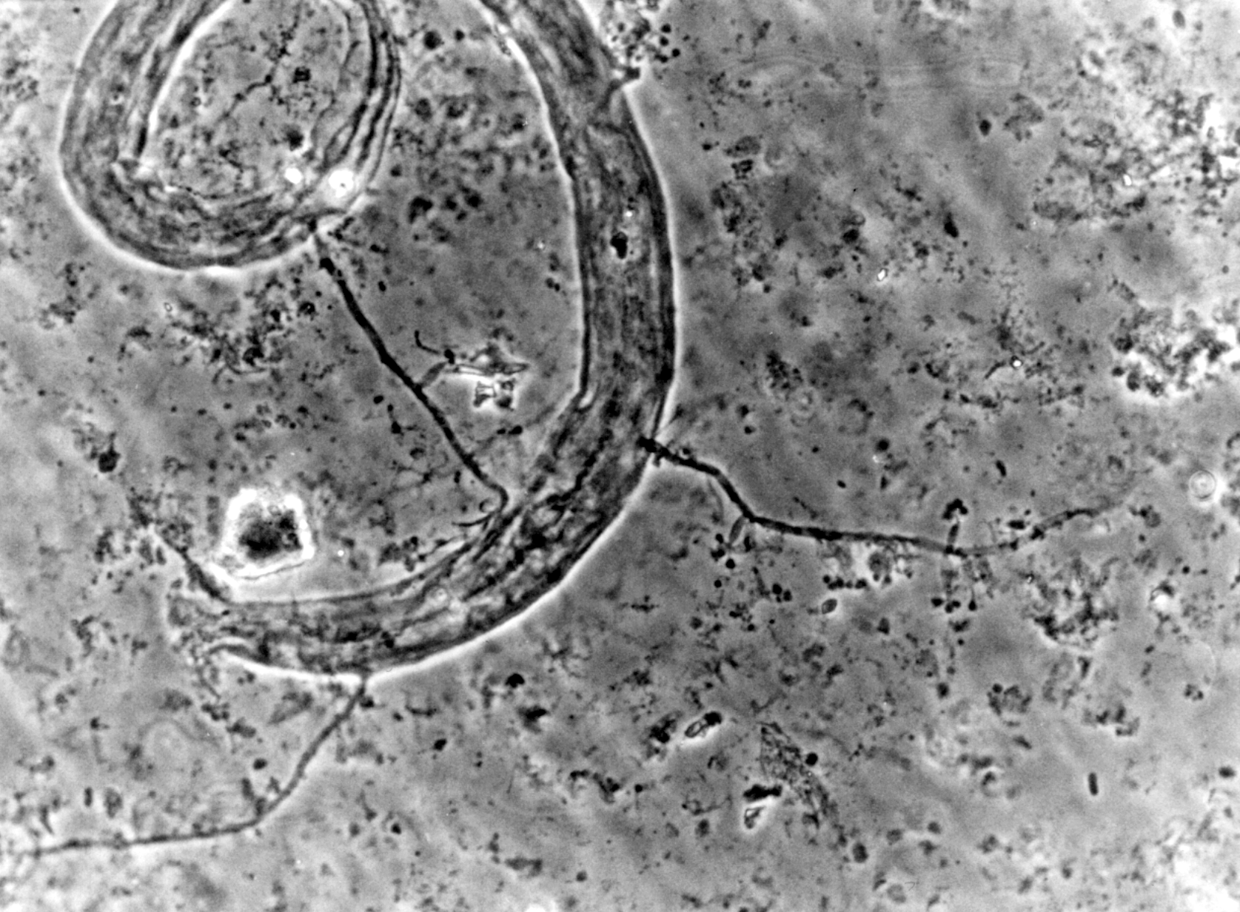
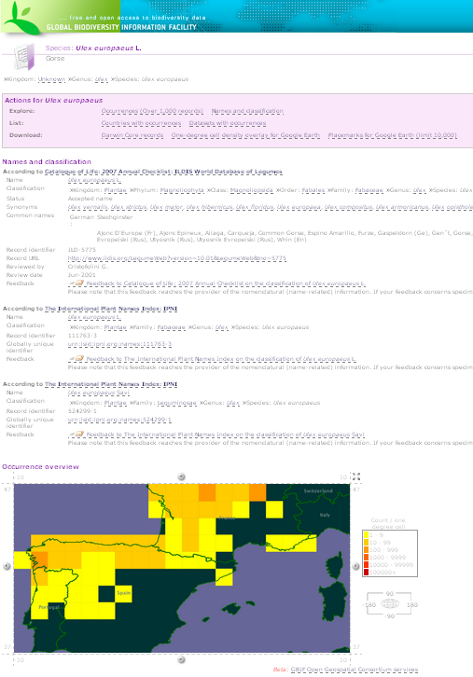
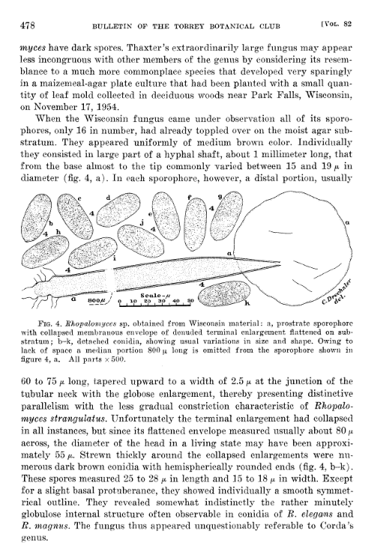
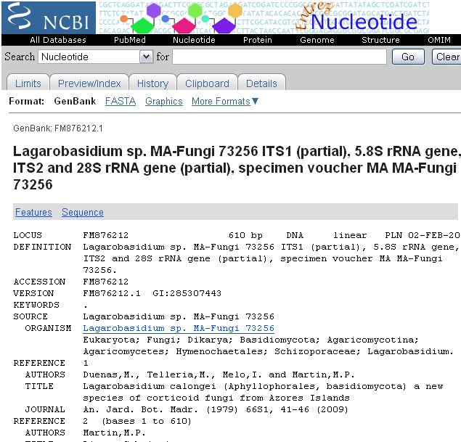
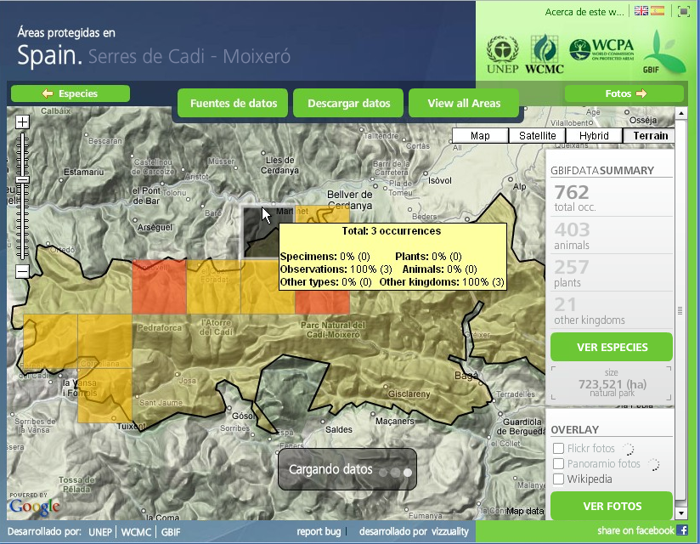
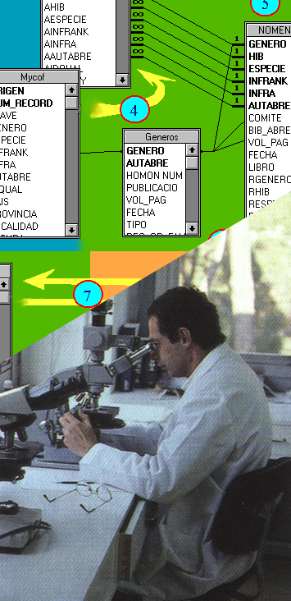
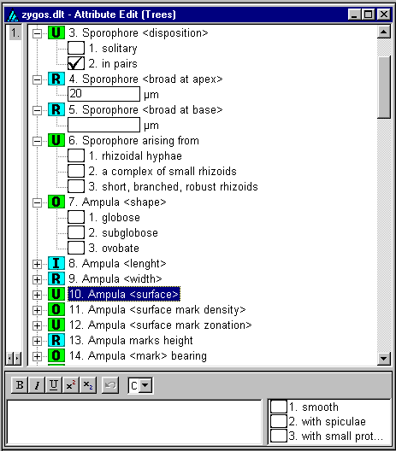
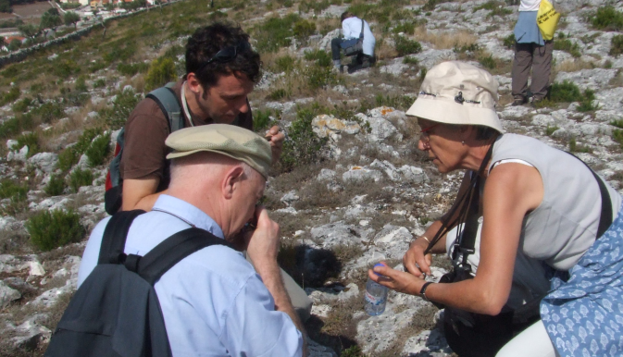
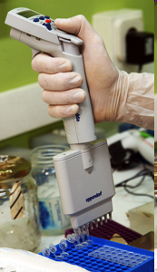
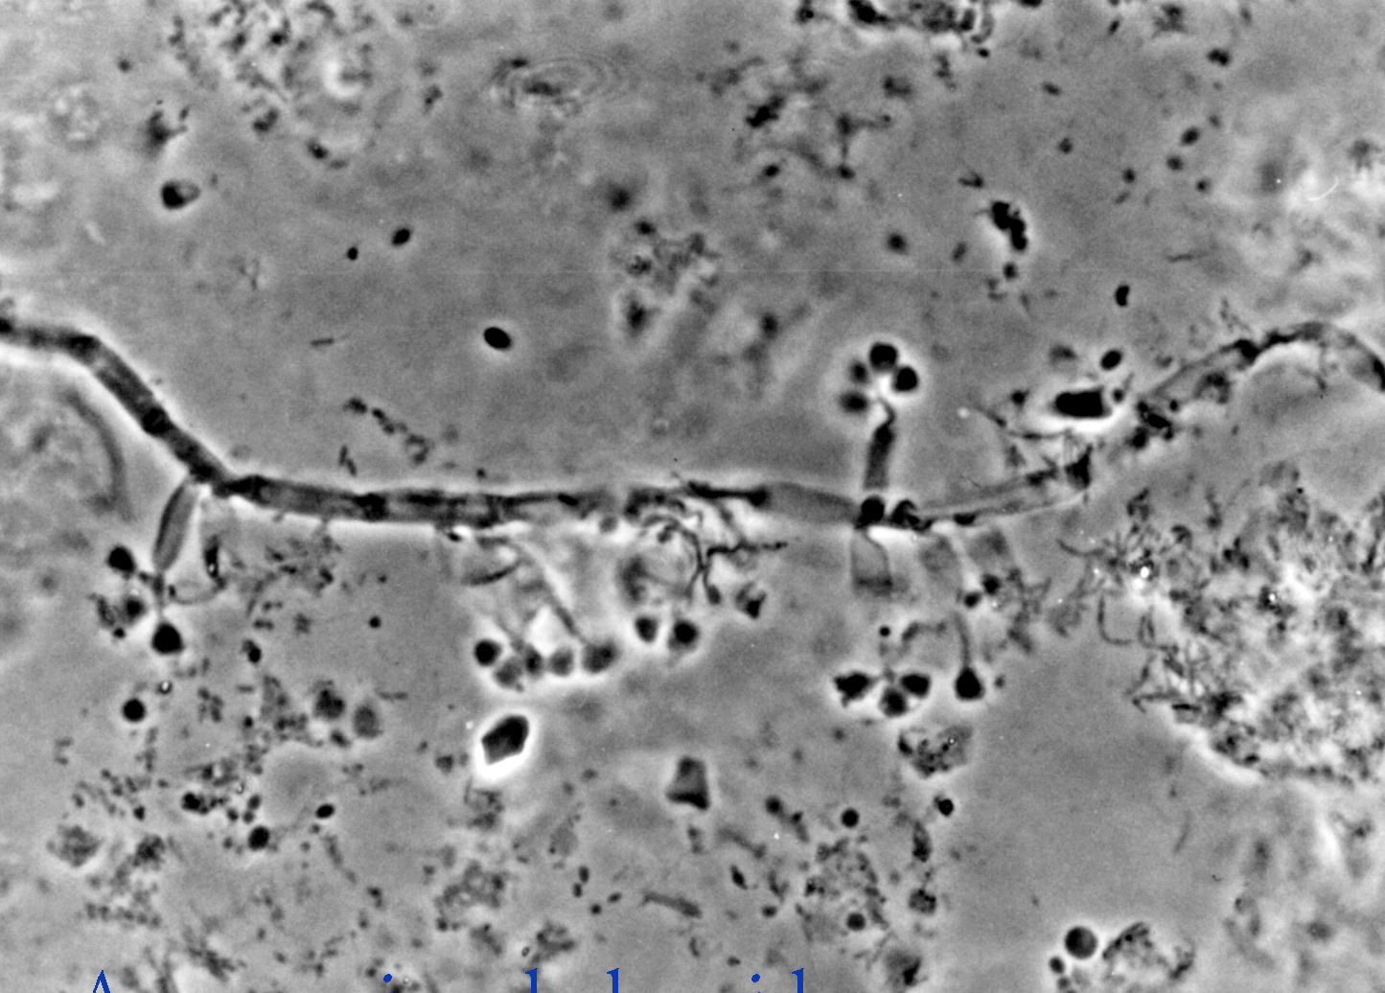
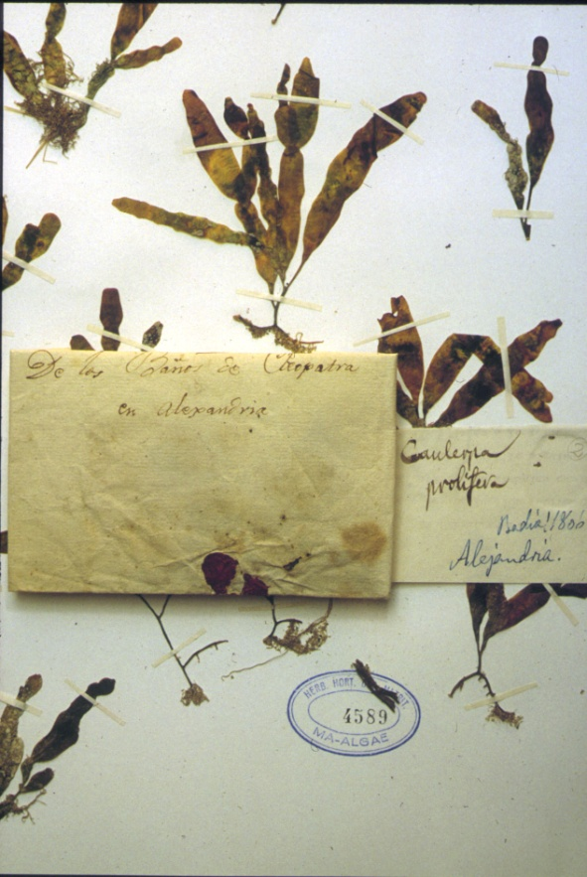
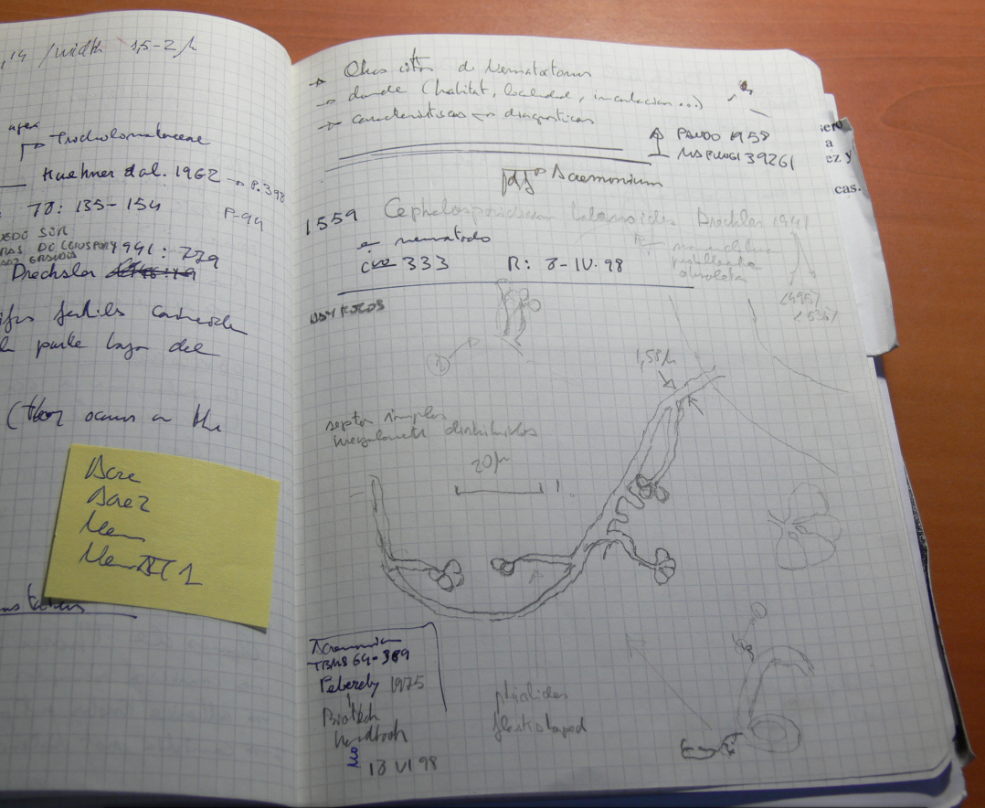
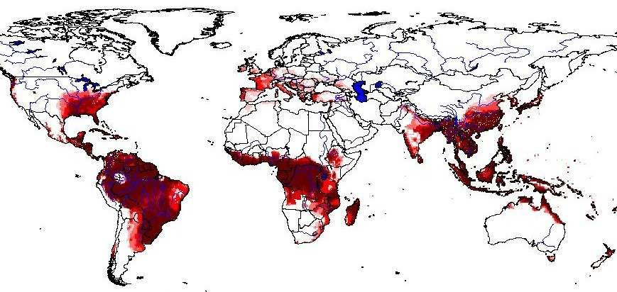
No olvidemos…

