Slide 1
Support for VRCs outside of Europe - services by the CHAIN-REDS project
Manuel Rodríguez-Pascual, CIEMAT
Madrid / 18 Sep 2013

Slide 2





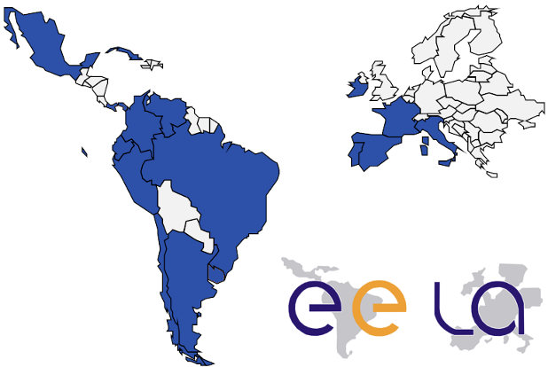
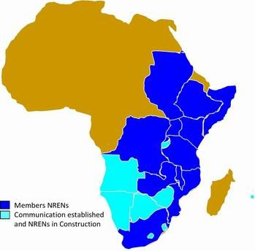
CHAIN-REDS: A legacy from CHAIN
Coordination & Harmonisation of Advanced eINfrastructures
CHAIN

Slide 3

WP4 in CHAIN-REDS
CHAIN-REDS is an EC (306819) funded project
  ~ 2.1 M€
  1 December 2012 – 30 months
Structured in
  WP 1 Project Management
  WP 2 Dissemination, Training and Outreach
  WP 3 Interoperation and coordination of e-Infrastructures
  WP 4 Data Infrastructures
  WP 5 Support to small groups and emerging communities

Slide 4
WP4 in CHAIN-REDS
CHAIN-REDS is an EC (306819) funded project
  ~ 2.1 M€
  1 December 2012 – 30 months
Structured in
  WP 1 Project Management
  WP 2 Dissemination, Training and Outreach
  WP 3 Interoperation and coordination of e-Infrastructures
  WP 4 Data Infrastructures
  WP 5 Support to small groups and emerging communities

Slide 5









WP4 ‘Data infrastructures’
Partners
  INFN
  CIEMAT
  GRNET
  CESNET
  UBUNTUNET
  CLARA
  IHEP
  ASREN
  SIGMA ORIONIS
  C-DAC

Slide 6
WP4 ‘Data infrastructures’
Partners
  INFN
  CIEMAT
  GRNET
  CESNET
  UBUNTUNET
  CLARA
  IHEP
  ASREN
  SIGMA ORIONIS
  C-DAC
Europe
Europe

Slide 7
WP4 ‘Data infrastructures’
  INFN
  CIEMAT
  GRNET
  CESNET
  UBUNTUNET
  CLARA
  IHEP
  ASREN
  SIGMA ORIONIS
  C-DAC
Europe
Africa
Europe

Slide 8
WP4 ‘Data infrastructures’
  INFN
  CIEMAT
  GRNET
  CESNET
  UBUNTUNET
  CLARA
  IHEP
  ASREN
  SIGMA ORIONIS
  C-DAC
Africa
Latin America

Slide 9
WP4 ‘Data infrastructures’
  INFN
  CIEMAT
  GRNET
  CESNET
  UBUNTUNET
  CLARA
  IHEP
  ASREN
  SIGMA ORIONIS
  C-DAC
Latin America
Asia
Asia

Slide 10
WP4 ‘Data infrastructures’
  INFN
  CIEMAT
  GRNET
  CESNET
  UBUNTUNET
  CLARA
  IHEP
  ASREN
  SIGMA ORIONIS
  C-DAC
Asia
Middle East
Asia

Slide 11
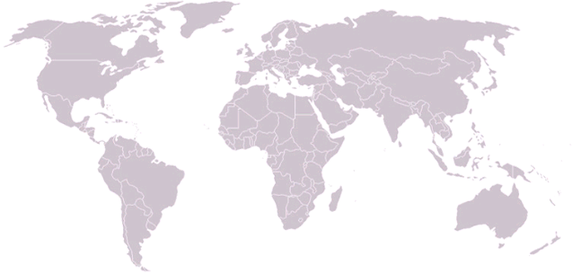
WP4 ‘Data infrastructures’
  INFN
  CIEMAT
  GRNET
  CESNET
  UBUNTUNET
  CLARA
  IHEP
  ASREN
  SIGMA ORIONIS
  C-DAC
Middle East

Slide 12
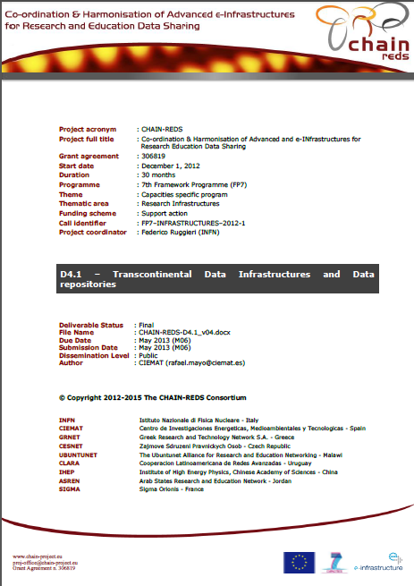
WP4 ‘Data infrastructures’
Public outreach and dissemination is focused on reporting on Trans-continental Data Infrastructures and Data repositories and on several Use Cases
  D4.1 Trans-continental Data Infrastructures and Data repositories available at http://www.chain-project.eu/deliverables

Slide 13
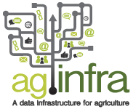


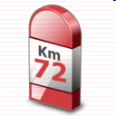
WP4 ‘Data infrastructures’
CHAIN-REDS has established official collaborations (MoUs) with other VRC-related communities
  AgINFRA
  EarthServer
  ENGAGE
It will organise jointly with WP3 several Technical Meetings on Federation of Clouds for R&E
  First of them at e-Science 2013, Beijing 22 Oct 2013

Slide 14
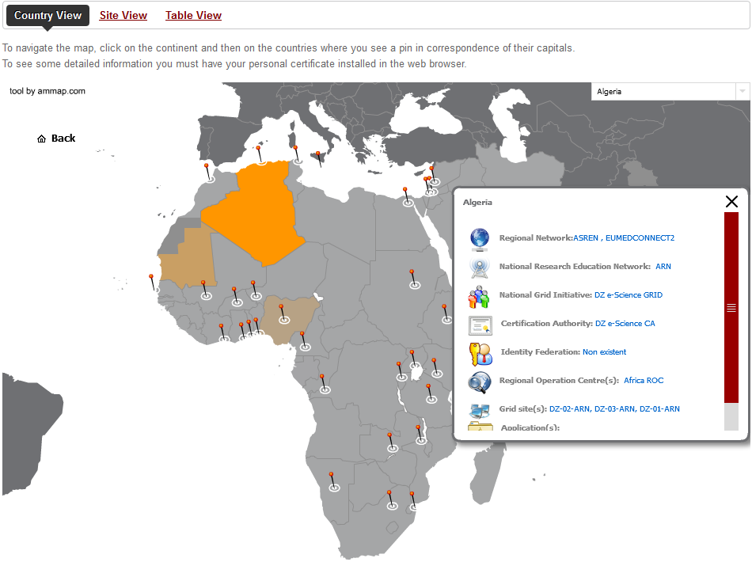
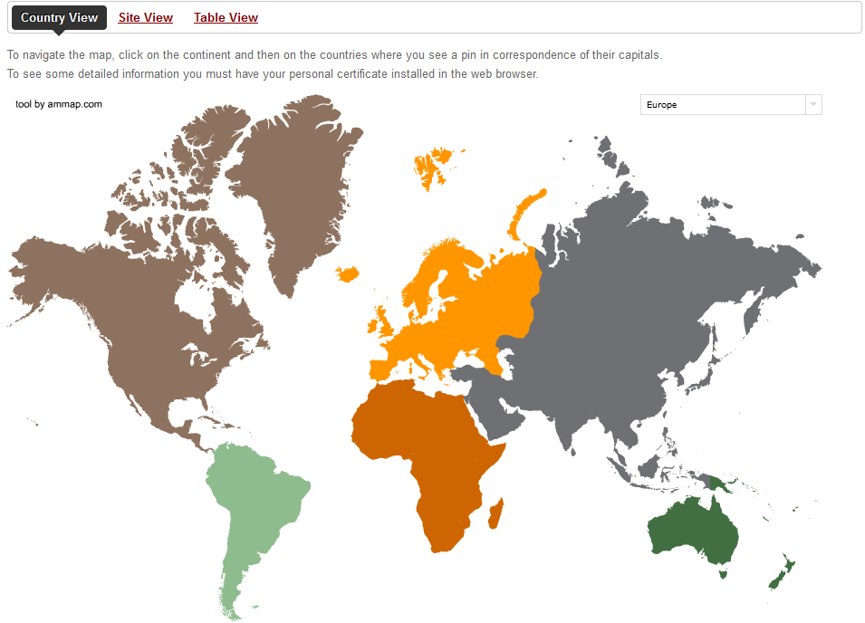
Knowledge Base: Infrastructures
Extend the CHAIN-REDS Knowledge Base (BS) with Data Infrastructures http://www.chain-project.eu/knowledge-base
RREN(s)
NREN
NGI
CA(s)
Ident. Fed(s)
ROC(s)
Grid site(s)
Application(s)

Slide 15
Knowledge Base:
Document / Data repositories
An investigation on the available (Open Access) Data Repositories has been performed
  Information has been collected in Africa, Asia, Europe, Latin America and the Middle East
  New ones have been incorporated into the Knowledge Base
  These new repositories range from databases owned by a single group to huge continental collaborations

Slide 16


Knowledge Base:
Document / Data repositories
LA Referencia is the Latin America Federated Network of Institutional Repositories of Open Access Scientific Publications
  http://http://lareferencia.redclara.net
It has been integrated into the CHAIN-REDS Knowledge Base making thousands of documents widely visible

Slide 17
Knowledge Base:
Document / Data repositories
A big challenge for LA Referencia was to collect information from repositories with different formats, making necessary the data standardization to comply with established international protocols
The integrations has been possible by the collaboration between RedCLARA, CHAIN-REDS and
  9 countries (Argentina, Brazil, Chile, Colombia, Ecuador, El Salvador, Mexico, Peru and Venezuela)
  18 institutions
  A team of more than 40 engineers and managers

Slide 18
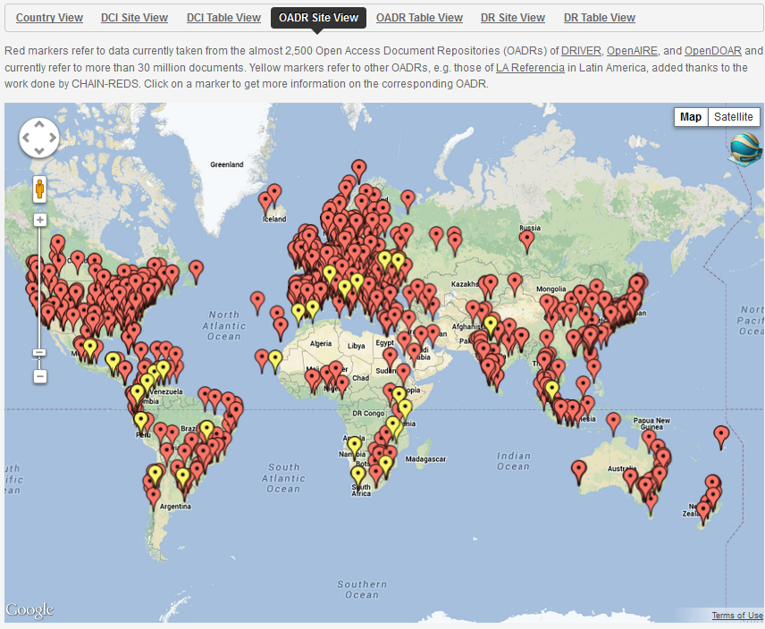
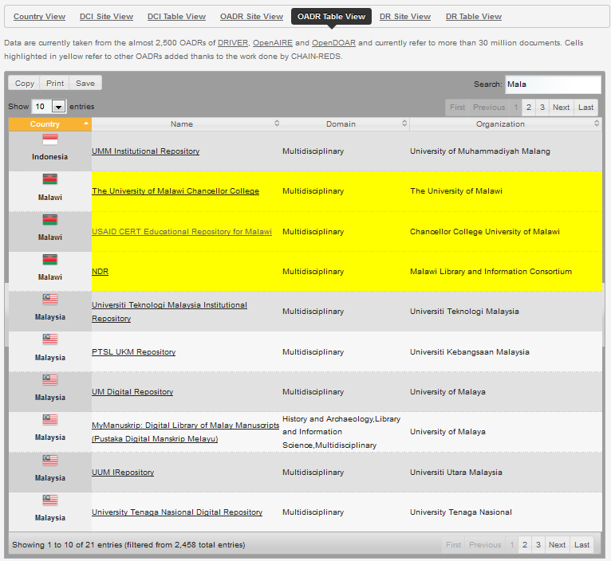




Knowledge Base:
Document / Data repositories
∼2,500 repos
>33 M docs

Slide 19


Standards
About Open Access Data Repositories, standards are being promoted
  OAI-PMH for metadata retrieval
  Dublin Core as metadata schema
  SPARQL for semantic web search
  VOTable (XML) as potential standard for the interchange of data represented as a set of tables
All of them are implemented in the CHAIN-REDS KB
  It presents both Site and Table views

Slide 20
OADR
Current developments on Open Access Document Repositories are expected
  A semantic web enrichment
  A semantic search engine
A first version of the search engine on CHAIN-REDS linked data is available
  Allows searching among the semantically-enriched metadata coming from the OADRs and DRs included in the CHAIN KB
  Visitors can either enter a keyword in the search window or select a language and get the list of available subjects in that language
  http://www.chain-project.eu/linked-data

Slide 21












Multi-layer architecture
Linked-data search engine
Semantic-web enrichment
Harvester
(running on
grid/cloud)
Harvester
(running on
grid/cloud)
OAI-PMH
End-points
OAI-PMH
OADRs
Data Repos.

Slide 22

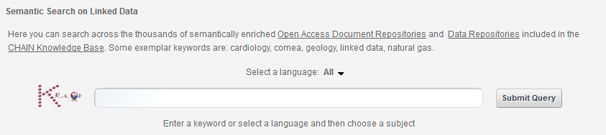
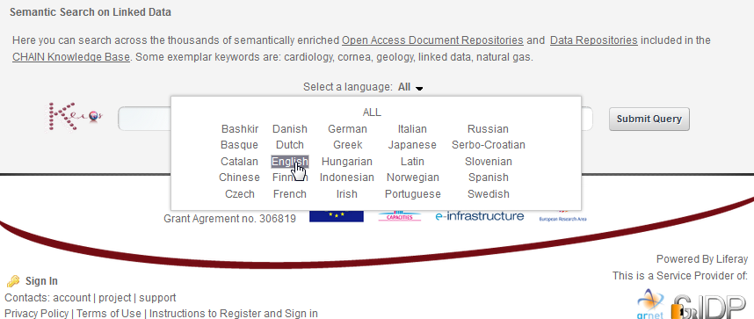
Linked data semantic search

Slide 23
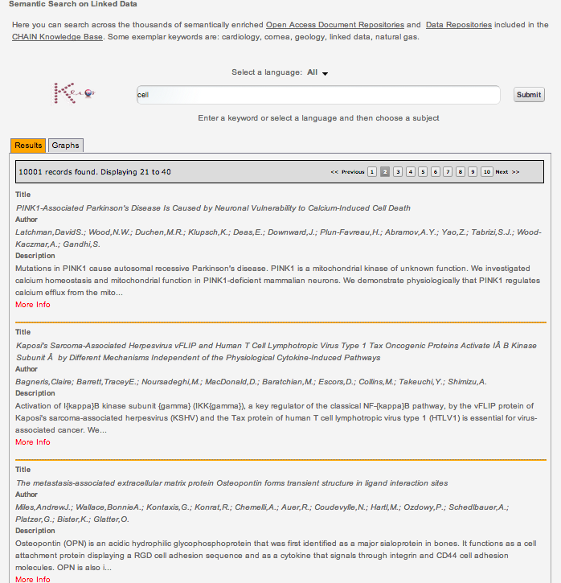
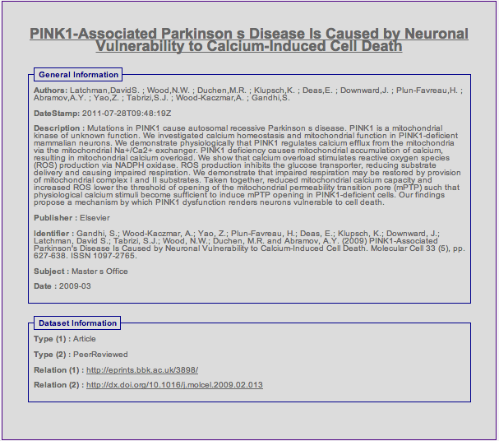
Linked data semantic search

Slide 24
Coming actions
Future developments on
  A tool for extracting the data associated to OADRs
  The execution of distributed jobs in the Science Gateway
  Big Data analytics with Rasdaman (EarthServer project)
There are interesting related presentations in this EGI TF
  “Standard-based Interoperability amongst HPC, Grid and Cloud Resources Distributed Worldwide with Catania Science Gateways” by Prof. R. Barbera (Science Gateways Frameworks, Sep 17th)
  “Managing and using interoperable DCIs through a standard-based Science Gateway” Demo, Sep 18th
    http://science-gateway.chain-project.eu/demo-status

Slide 25
Conclusions
CHAIN-REDS has identified in a first phase several fields with interests in the different regions
  Agriculture
  e-Government
  Earth Science
  Astronomy and Astrophysics
Potential collaborations with initiatives and projects working on these areas are being carried out
Other fields are not restricted!!!

Slide 26
Conclusions
Data developments have been carried out in the Regions of interest to CHAIN-REDS
Semantic engine and web-enrichment are powerful tools to link data and retrieve information
CHAIN-REDS is also looking forward to receiving feedbacks from all interested organizations on the Knowledge Base and the semantic search service

Slide 27
Thank you !
www.chain-project.eu
proj-office@chain-project.eu

