Slide 1
THE CMMST VT: TOWARDS A VIRTUAL RESEARCH COMMUNITY FOR CHEMISTRY, MOLECULAR AND MATERIALS SCIENCES AND TECHNOLOGIES
Antonio Laganà, University of Perugia
Daniele Cesini, CNAF, Bologna
Alessandro Costantini, CNAF, Bologna

Slide 2
Multiscale modeling: ENERGY STORAGE

Slide 3
THE SIMULATOR WORKFLOW
NO
Are ab initio
calculations
available?
NO
Are ab initio
calculations
feasible?
NO
INTERACTION
Is there
a suitable PES?
YES
YES
YES
SUPSIM
Are
dynamics
calculations
direct?
NO
Take Force fields from databases
FITTING
Import the
PES routine
YES
YES
DYNAMICS
Exact
quantum
calculations?
NO
Approximate
quantum
calculations?
NO
NO
Semiclassical
calculations?
YES
YES
YES
QDYN
TD / TI
APPROXIMATE
QDYN
SEMICLASSICAL
SC_IVR
QUASI-
CLASSICAL
OBSERVABLES
NO
Fixed
Energy
NO
Fixed
Temperature
NO
Fixed J and Energy
YES
YES
YES
Scalar and vector correlations
Cross-sections
Thermal
Rate coefficients
Thermodynamic properties

Slide 4
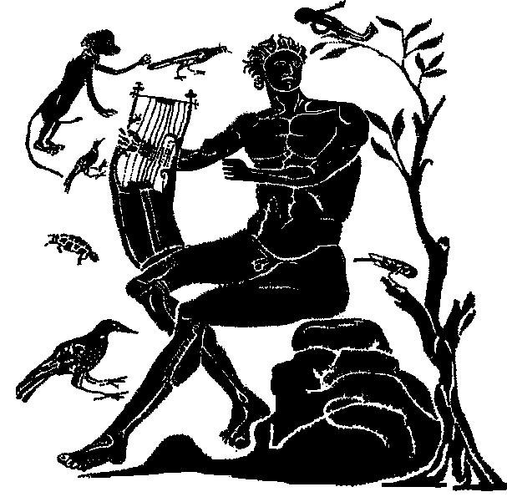
DATA FORMATS
System input
Q5Cost
Interaction
D5Cost
Dynamics
various
Statistics
Virtual Monitors
Notes:
4

Slide 5
AB INITIO PACKAGES
CADPAC Acad Fortran GTO
COLUMBUS Acad Fortran GTO
CRYSTAL Acad Fortran GTO
DALTON Acad Fortran GTO
DFT++ GPL C++ PW/Wavelet
DIRAC Acad F77, 90, C GTO
GAMESS Acad/Comm Fortran GTO
GAUSSIAN Comm Fortran GTO
MOLCAS Comm Fortran GTO
MOLPRO Comm Fortran GTO
NWChem ECLv2 F77/C GTO, PW
TERACHEM Comm C/CUDA GTO

Slide 6
DATA FORMATS
QC: FIXED GEOMETRY MULTI STATE
- SD (Small data) input, parameters, properties -> formatted human readable like XML
- LD (Large data) binary working quantities like 4 index integrals IJKL ➔
•OPEN BABEL: open, collaborative project allowing search, conversion, analysis, or data storing in CMMST
•CML: A XML-based format for chemistry
•HDF5: a hierarchical data model

Slide 7
HDF5
° CONTAINERS (groups) domains of quantities defined by common basis functions (AO atomic orbitals, MO molecular orbitals, WF Wave functions, ..)
° METADATA (attributes) simple and small sets of data describing a set of data
° DATA (data ses) large set of binary quantities referring to wavefunction integrals storing in matrices with an arbitrary number of indices
° LIBRARIES (Utilities and tools)
Q5dump reports the content of Q5cost files
Q5edit python based program text editor

Slide 8
Q5 EXTENSION TO D5
Ctime (s)
Atime (s)
Q5version (s)
Basis
Coord system
Atom
Angular number
Magnetic number Coeff/exp
Num of contracted
Num of primitives
System
overlap
Index/value
Title
Electrons /α,β
oneint
Index/value
AO
twoint
Index/value
Symmetry:
- num_sym
- labels
Name
Num_orb_sym
Num_orb_tot Labels
Transformation
densities
Index/value
prop
Index/value
Geometry:
- charges
- coordinates
- labels
- nuclear_energy
- num_atom
- atomic_number
Name
Description
Rank
Symmetry
Real/Complex
MO
oneint
Index/value
AO_pointer
Name
Num_orb_sym
Num_orb_tot Labels Orbitals SCF_energy
Classification
Occ_num
Symmetry
twoint
Index/value
densities
Index/value
prop
Index/value
WF
DetCoeff
Determinants/ coefficients
MO_pointer
Name
Energy
Core Energy
Num_dets
Energy derivatives
Non adiabatic coupling

Slide 9
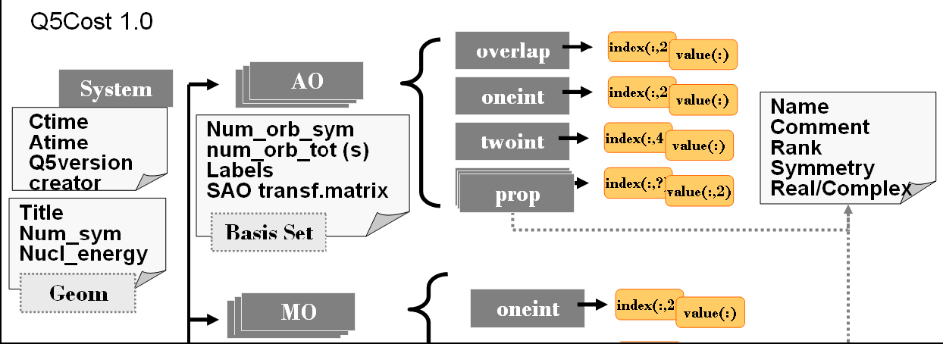
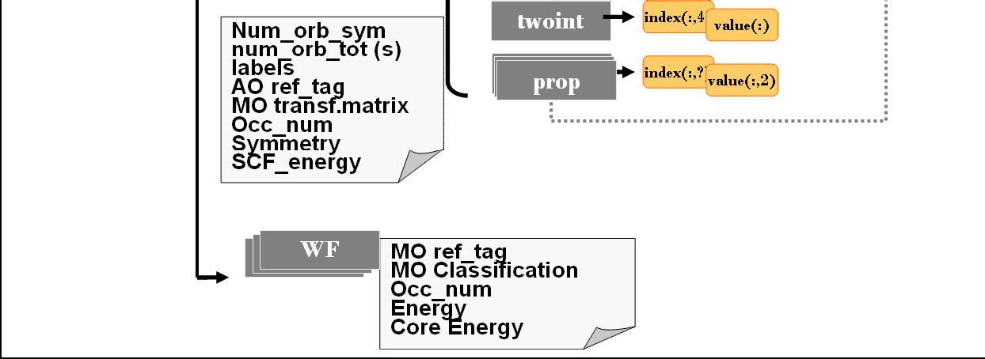
AbInitio
Interaction
AbInitio
AbInitio
Fitting
Fitting
Fitting
ForceField
ForceField
ForceField
System
Dynamics
SMatrix
SMatrix
SMatrix
q5 “file system” +
energy derivatives +
non-ad. coupling els. –
system general info
QuantumFunction
QuantumFunction
QuantumFunction
Trajectories
Trajectories
Trajectories
Spectra
Spectra
Observables
Spectra
CrossSection
CrossSection
CrossSection
RateCoeffs
RateCoeffs
RateCoeffs

Slide 10
QUANTUM DYNAMICS PACKAGES
ABC
RWAVEPR
FLUSS
MCTDH

Slide 11
CLASSICAL DYNAMICS PACKAGES (LARGE SYSTEMS)
VENUS
AMBER
CHARMM
DL_POLY
GROMACS
MOLDY
TINKER
YASARA

Slide 12
THE COMMUNITY SERVICE ORIENTED APPROACH
Register, access, move and store data
Repository of tools, applications and services
Find and select the computer platform
Compose competences and packages
Evaluate and reward themembers’ contribution to the activities of the community
C. Manuali, A. Lagana’
GRIF: A New Collaborative Framework for a Web Service Approach to Grid Empowered Calculations, Future Generation of Computer Systems, 27(3), 315-318 (2011) DOI 10.1016/j.future.2010.08.006

Slide 13
The VT for preparing the VRC
VT submitted for approval in October 2012
Approved by EGI in January 20123
Call for interest for NGIs and partners started at the beginning of February
Official starting date: February 4th 2013
Official closing date: August 5th 2013
CMMST-VT mailing list:
vt-cmmst-vrc@mailman.egi.eu
Wiki page:
https://wiki.egi.eu/wiki/Towards_a_CMMST_VRC

Slide 14
Tasks of the CMMST VT
N | Topic | Task
1 | How to exploit the capabilities of the existing EGI tools in building distributed workflows and “workflows of workflows” from various software packages | Task 1
2 | How to exploit the capabilities of the existing EGI tools for distributing runs of CMMST applications on EGI and PRACE platforms | Task 2
3 | How to attract more CMMST users into a common endeavour offering the possibility of assembling higher level of complexity applications and services | Task 3
4 | How to utilize a credit system to encourage CMMST users to cooperate in developing higher level of complexity applications | Task 4
5 | How to develop a coordinated management body for such endeavours and configure a Virtual Research Community (VRC). | Task 5
6 | How to operate the EGI VRC in a sustainable way | Task 6

Slide 15
Milestones of the VT
 | Outcome | Means of delivery | Time of delivery (after VT start) | Task Leader
M 1 | The list of technical and non-technical topics that the project should investigate. Each topic is allocated to an individual or to a team with a leader from the VT. | Investigation planning document | 1 month | Each topic is allocated to an individual or to a team with a leader from the VT.
M 2 | Outcome of the technical and non-technical investigations are integrated into the first draft of the VRC plan | VRC proposal document (draft version) | 4 months | The draft is restricted to the project leader

Slide 16
Milestones of the VT
 | Outcome | Means of delivery | Time of delivery (after VT start) | Task Leader
M 3 M 4 | Integrated draft reviewed and commented | VRC proposal document (draft version) | 4.5 – 5.5 months | VT leader
M 5 | Final draft – a proposal for the setup of a CMMST VRC in EGI | VRC proposal document (public version) | 6 months | VT leader

Slide 17
Proposed meetings (Tuesday 11-13)
T | February |  |  | March |  |  | April |  |  | May |  |  | June |  |  | July |  |  | August
 | 12 | 19 | 26 | 12 | 19 | 26 | 16 | 23 | 30 | 14 | 21 | 28 | 11 | 18 | 25 | 16 | 23 | 30 | 2 | 9
M |  | W |  |  | W |  |  | W |  |  | W |  |  | W |  |  | W |  | W
M1
M2
M3
M4
M5
W | WebEx conference

Slide 18
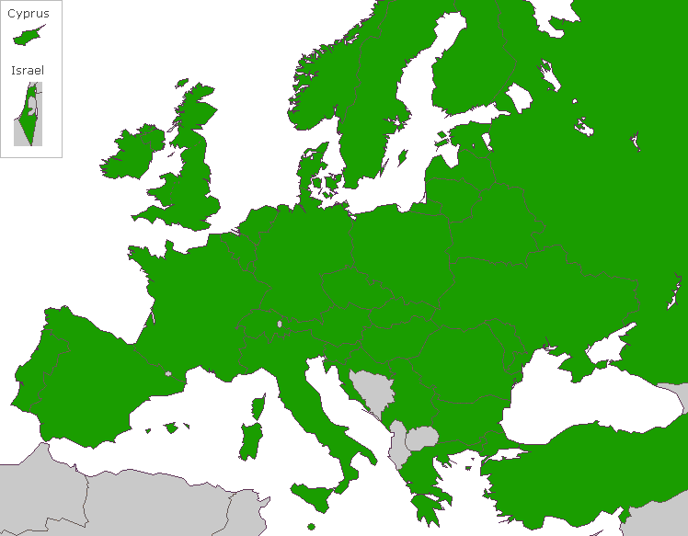
GriF: a grid framework
Make grid applications user friendly, black box like and optimize automatically the distribution of tasks over the grid.
Adopt a collaborative JAVA Service Oriented Architecture (SOA) framework articulated as a set of grid services
Provide users with standard operational modalities based on friendly user driven services allowing the composition of one or more services transparently to their implementation details.
Conveniently direct the jobs to the appropriate machine

Slide 19
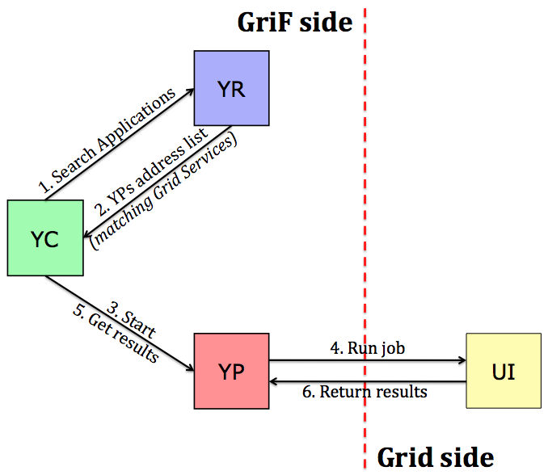
Architecture of GriF
Scientific Linux Distribution
Service Oriented Architecture
(UDDI, WSDL, SOAP)
UDDI4J, WSDL4J, AXIS
Java Web Services
(JWS)
Tomcat Web Server
MySQL DBMS
Java Swing/AWT
(platform-independent client)

Slide 20
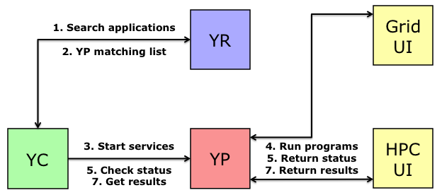
GriF to bridge HTC & HPC
HPC: GriF has been extended to offer to the Grid users the possibility of running their Grid applications (serial, parallel: MPI/OpenMP) on some HPC platforms by bridging the corresponding HPC facilities directly.

Slide 21
THE STUDY CASES
In particular, Grid Applications can be run from GriF to HPC either under the form of ‘Service’ (programs already made available by GriF for running on HPC) or, more in general, by uploading user customized binaries.
Serial:
a) ABC. Implemented as a COMPCHEM Service.
Parallel (supporting MPI & OpenMP libraries):
a) GAMESS-US. Implemented as a HPC Service (MPI);
Therefore, by GriF one can manage the corresponding generated HPC jobs (e.g. status checking, deletion) retrieving related results (under the form of a compressed zip package).

Slide 22
HTPC Skeletons
0
HTPC2
0
HTPC2
Inverse
HTPC1
HPC run
Scalar run
A feasibility study on running real life use cases based on HTC + HPC (HTPC) skeletons by exploiting the two infrastructures
in an automatedway by minimizing the human intervention
developing prototypical tools able to handle the skeletons (in both the computing and data management parts).

Slide 23
General Capabilities (1/2)
Provides Single Sign-On for all the Grid-related operations (users only need to be registered in GriF)
No need for managing Grid Certificates, Jobs Id nor the command-line
Application runs offered as Grid Services efficiently
Supports Multiple Input and Output for all the Grid executions
Supports Single and Parameter Study running modalities as well as Parametrized Workflows
Provides jobs description and advanced management (e.g. subjobs re-scheduling)

Slide 24
General Capabilities (2/2)
7. Optimizes results gathering (in terms of time, space)
Supports Mobile Devices (Google Android, Apple iOS)
Provides automatic notifications for ‘done’ jobs and user feedbacks
Provides Computing Element Queues Ranking
Supports a Quality Credits/Costs Schema (by providing data for the so called Quality of Service (QoS) and Quality of User (QoU) global evaluation parameters developed by the COMPCHEM VO for estimating its activities)

Slide 25
CONCLUSIONS
GRID PLATFORMS OFFER AN ALTERNATIVE SCHEME FOR ON DEMAND COMPUTING (RESOURCES (HPC+HTC) AND TOOLS SHARING) FOR THE CMMST COMMUNITY
VIRTUAL RESEARCH COMMUNITIES OFFER A SOLID GROUND TO COLLABORATIVE COMPUTING METRICS (QUALITY EVALUATION) AND TOOLS DEVELOPMENT
VIRTUAL TEAMS ARE THE PLACE TO DESIGN THE WAY TO VIRTUAL RESEARCH COMMUNITIES

Slide 26
VT MEMBERS
Antonio Laganà, Carlo Manuali, Perugia, IT
Gergely Sipos, Richard McLennan, Jelena Tamuliene, EGI.eu
Alessandro Costantini, Daniele Cesini IGI-CNAF, Bologna, IT Fermin Huarte, Barcelona, Ernesto Garcia, Vittoria, ES
Peter Annousek, CZ, Remco Havenit, Groningen, NL
Alan Sill, Bill Hase, Lubbock, USA
Stavros Farantos, Heraklion, GR
Michele Ceotto, Milano, IT,
Akos Benksura, Gyorgy Lendvay, Budapest, HU
Mariusz Sterzel, Krakow, PL
Sergio Maffioletti, Zurich, CH
Peter Oliver UK, Marco Verdicchio FR,

Slide 27
TOPICS AND LEADERS
The consistency of the present patrimony of applications available to the community and the way of evolving to higher complexity applications (JT,SF,AC,AL)
The present ways of accessing compute resources and the EGI technologies, resources and services (already exist within EGI) that could be used to satisfy the requirements of the CMMST community and in particular to build workflows and workflows of workflows for the existing applications (GS,RM)

Slide 28
TOPICS AND LEADERS
The possibility of a distributed execution of CMMST applications requiring both HTC and HPC on EGI and PRACE (AS,RM)
The use of Quality of User (QoU) and Quality of Service (QoS) parameters to build a credit system fostering collaboration (AL,AC,CM)
The extension of CMMST applications to use in research based education (EV)

Slide 29
TOPICS AND LEADERS
the structure of the VRC and the develop-ment of a coordinated management body (national representatives?)
the attraction and training of more CMMST users (all or champions)
the sustainability of the CMMST VRC (GC,RM)

