Slide 1
New RT queues and workflow for OTAG requirements
Daniele Cesini IGI / INFN
OTAG-06 f2f meeting
January 25th 2011
Amsterdam EGI.eu

Slide 2
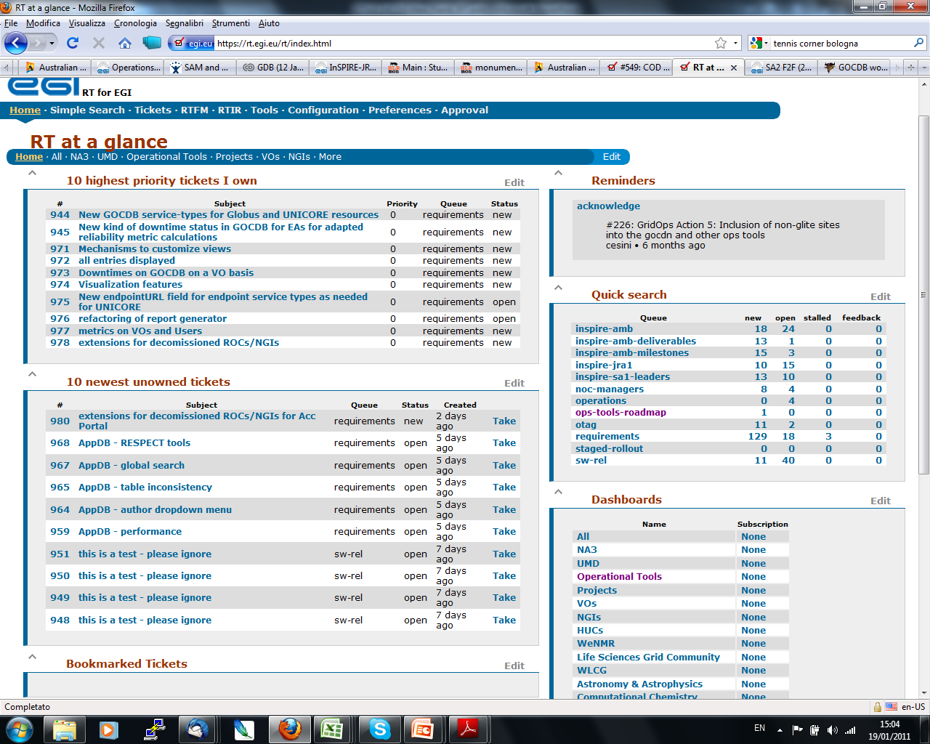
New “Requirements” RT queue

Slide 3
New “Requirements” RT queue
Replace the OTAG queue to track requirements
Is a project wide queue - not only ops tools
Old OTAG queue will be used to track actions opened during the meetings
Allows to search per tool
and per any field available in the ticket
i.e. Requestor
No need to put the impacted tool on the subject

Slide 4
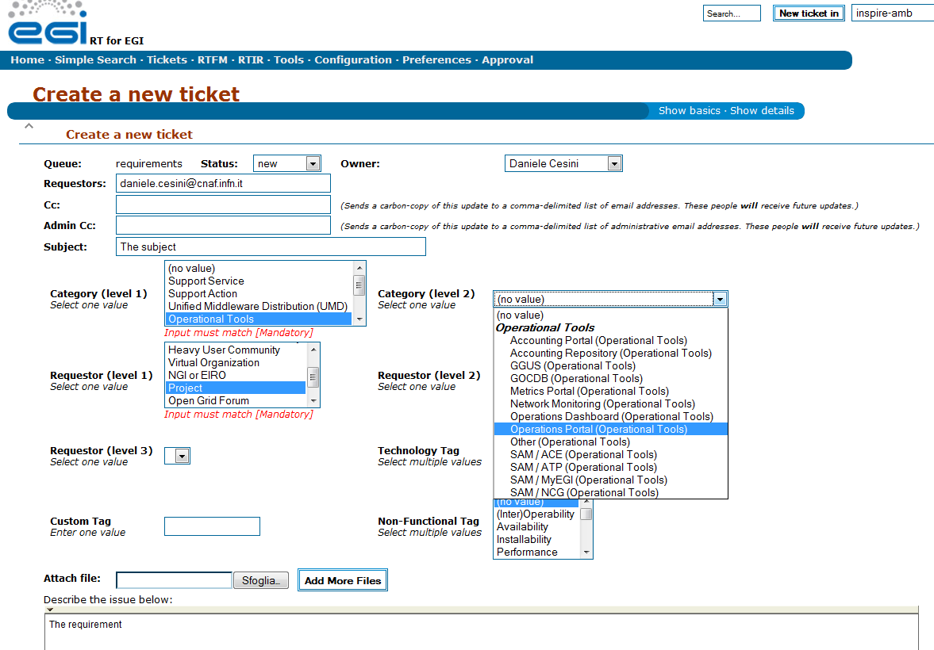
Opening a requirement ticket
Developers are not into this list
Split into components
Split into components

Slide 5
The multiple impacted tools case
A requirement can impact on multiple tools
i.e. The “virtual sites” requirement discussed in OTAG-04 (https://rt.egi.eu/rt/Ticket/Display.html?id=502 and connected tickets)
Leave the category “Category (level 2) field” blank
JRA1 will create one ticket for each impacted tool setting references to the original one

Slide 6
Priority
It can be set in “basic” section after the ticked is opened
Priority 4 - Immediate: the requirement needs to be addressed as soon as possible
Priority 3 - High: the requirement can be addressed in a next release of the affected component
Priority 2 - Medium: the requirement can be addressed in a future major release of the affected component
Priority 1 - Low: there is no specific release date for addressing the requirement.
Can be changed after discussion to “Final Priority”

Slide 7
Searching tickets
Operation tools Dashboard from “RT Home” lists all the ops-tools-requirements
To refine search (i.e. ask for just one tool):
Go to the “Requirements” queue using “quick search” from “RT Home”
Use the “edit search” tool to customize, save or load a requirement query

Slide 8
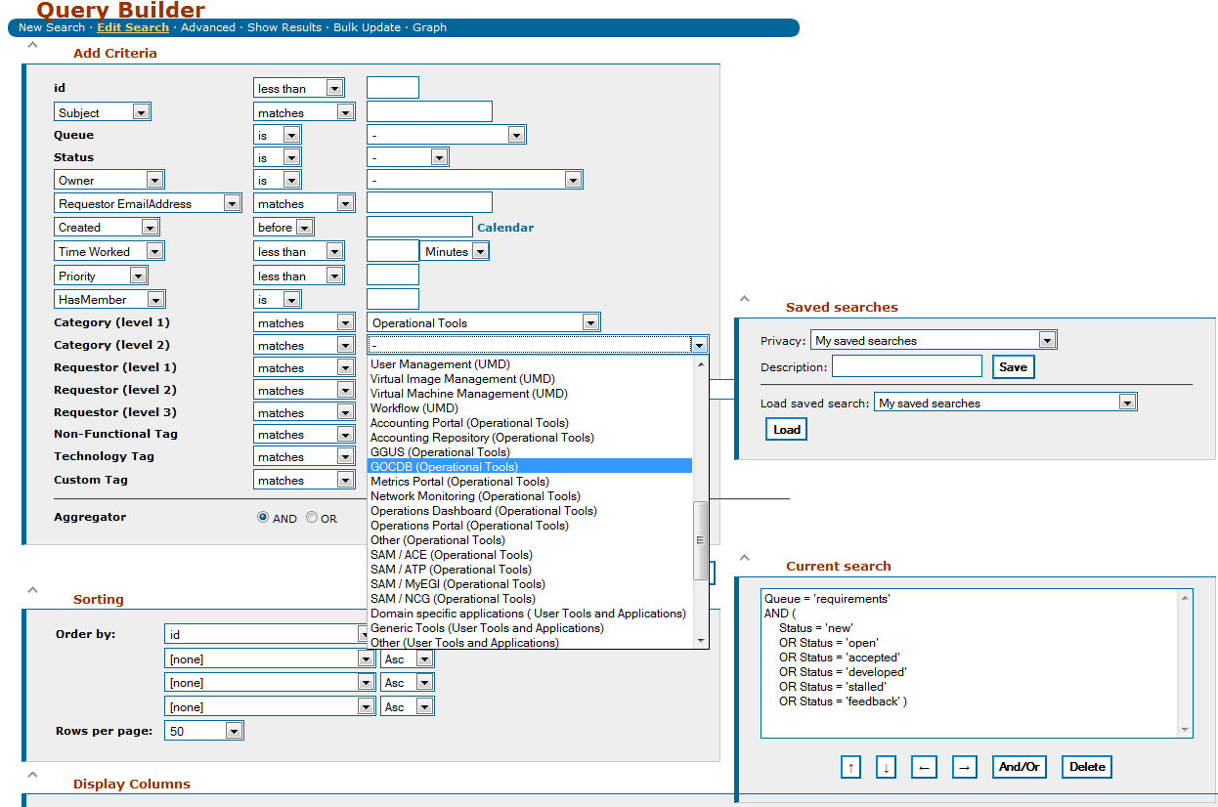
Refining a search

Slide 9
Loading a search query
Search queries for Ops portal and SAM should be available under OTAG’s saved searches
They have more complex queries than the other because are split into components

Slide 10
New “Roadmap” RT queue
Should be the single aggregation point for the JRA1 release plans (requested by many – currently this information is split in various pages)
Keeps track of the future releases per tool with timelines
Keeps track of requirements addressed by each release

Slide 11
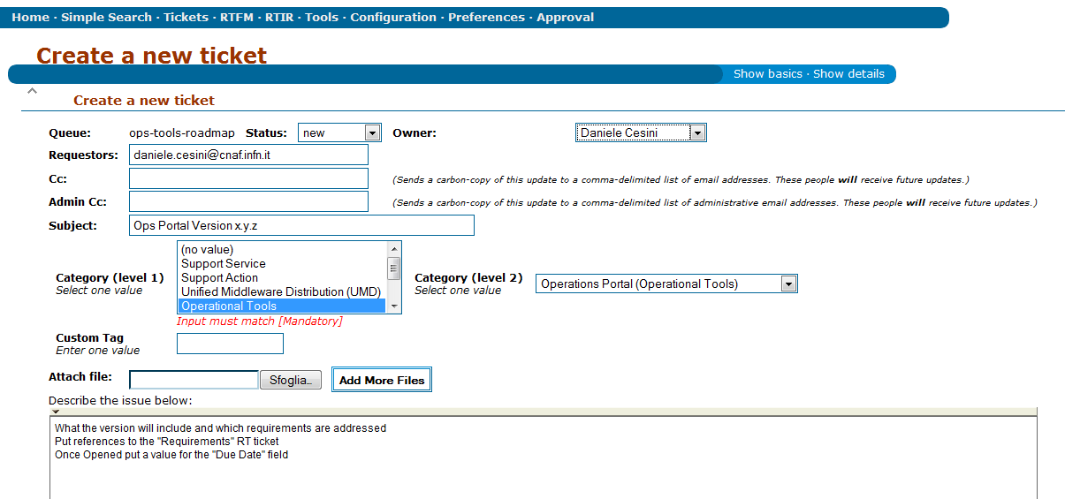
Opening a Roadmap ticket
Will be done by JRA1
In the body Include a quick changelog, possibly a reference to documentation and the list of requirements addressed
Once opened:
Set references to the "Requirements" RT tickets
Set a value into the "Due Date" field

Slide 12
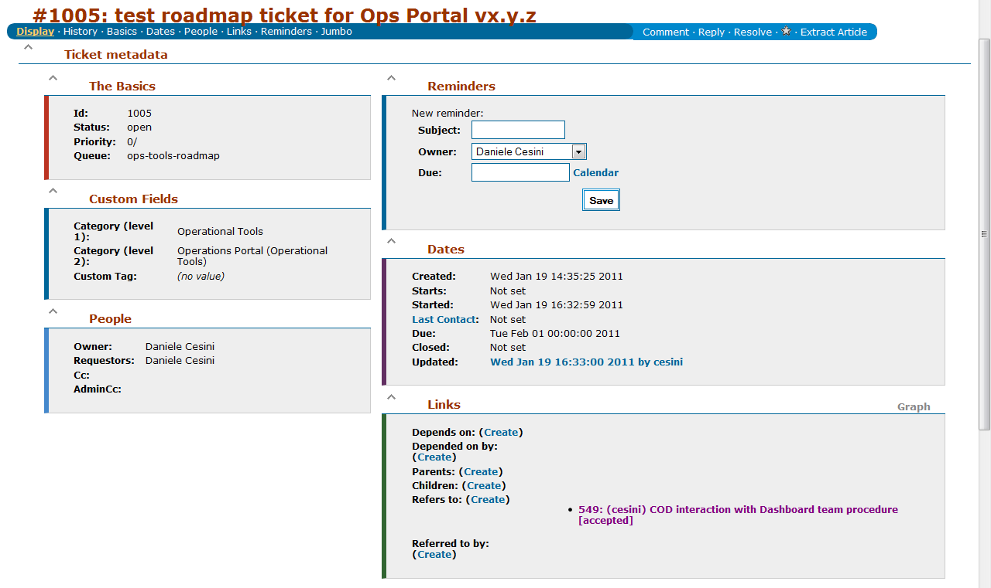
Roadmap tickets

Slide 13
Project Requirements
Ops tools take requirements from other sources:
VOs
Project Management

Slide 14
Ops Tools Requirements Workflow
Req from NGIs
Req from NA3
Req from EGI.eu
Req from any source
RT Tickets in Requirements queue
No impact on roadmap or clients
JRA1 Review
Has impact, needs priority or clarification
Development
RT Ticket in Roadmap queue
Propose to reject
OTAG Discussion
Give Priority
Accept!
Reject!

Slide 15
Ops Tools Requirements Workflow
Requirement tickets can be submitted at any time
Periodic surveys will be probably sent to boost the activity
JRA1 will review the new items at least every 2 months:
Accepting those that do not need discussion because development effort does not impact the tool roadmaps or tools clients
Labelling as “to be discussed” those that need OTAG attention for prioritization or rejection
Old items will be updated when needed
Accepted “Requirements” tickets will be included in the development plan and referred by a “Roadmap” ticket where timelines for implementation are available

Slide 16
Issues
GGUS requirements prioritization can be difficult
Clients outside the project (EMI, WLCG…)
OMB vs OTAG conflicts
OTAG and OMB can have different views on the same problem:
i.e. ticket #492: APEL-pub check alarms

