Slide 1
Etienne Dublé

Slide 2
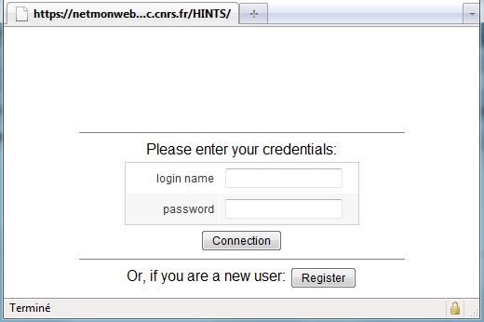
HINTS project
A French NGI project, unfunded project
The same general concept of PerfSONAR-Lite TSS
In order to be used more widely, the software should be able to be used in other contexts, apart from the one of EGI:
other projects, any kind of NOC, NRENs, institute, private company
Consequently, we have to modify deeply the database model

Slide 3
Hints concept
Launch test on demand from one site under the control of the central server: ping, traceroute, DNS lookup, nmap and bandwith measurements
2 →Authentication Authorization Process
Login/passwd or certificate
2
1
TOC
NOC / ROCs members site administrator / troubleshooter
7
3
Mutual authentication
6
4
5
Security based on IP address BWCTL port open on demand
Grid site A
Grid site B
Local site light probe
Central web monitoring server

Slide 4
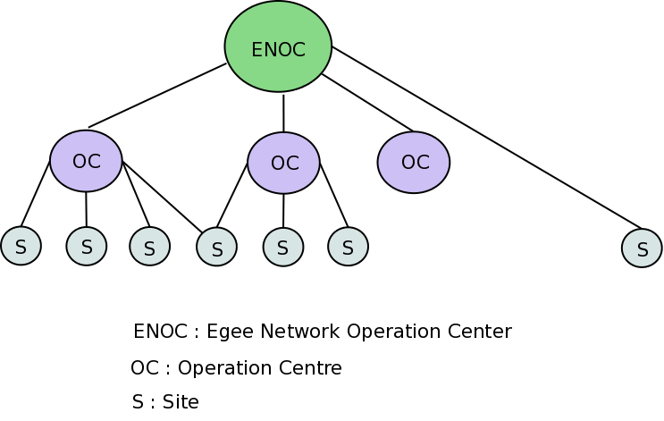
New hierarchy
TOC
TOC = Top Level Operation Center (in EGI context it should be EGI NOC at GARR)
OC = Operation Center (NOC, in EGI context it should be NGIs))
S = Site
This organization is more flexible
a site can be included in several operation centers
operation center can be created easily

Slide 5
Development choice
As the database schema has to be changed deeply, we rewrote completely the web server part
But the probe software part has not be modified (or very slightly) : OPPD, BWCTLD
Use a Java framework technology ZK http://www.zkoss.org/
More efficient development
The work has been done by Etienne Dublé

Slide 6
Site’s probe
Site’s probe
ping
ping
traceroute
traceroute
OPPD/ perfSONAR
OPPD/ perfsonar
DNS lookup
DNS lookup
IPC / command
Port Scan
Port Scan
BWCTLD
BWCTLD
OPPD is developed by GEANT within perfSONAR context suite
BWCTLD is developed by Internet2
Soap message
HINTS
AA
Web server Apache, mod_jk
Tomcat
Local DB
Users :
TOC
OC / ROCs members
site administrator / troubleshooter
Central server
Software architecture

Slide 7
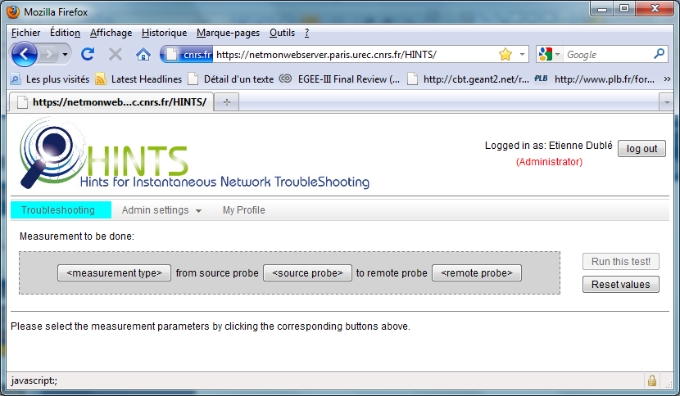
Tour of HINTS Management of OC

Slide 8
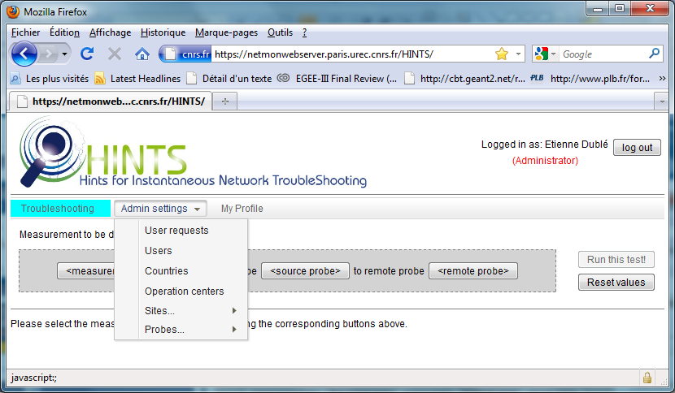
Tour of HINTS Management of OC

Slide 9
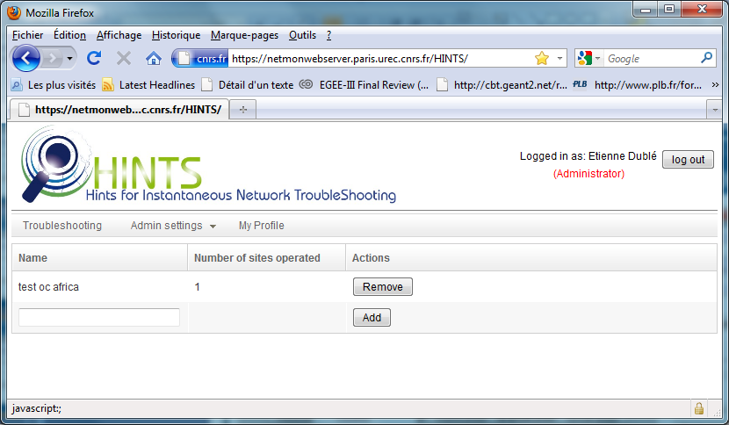
Tour of HINTS Management of OC

Slide 10
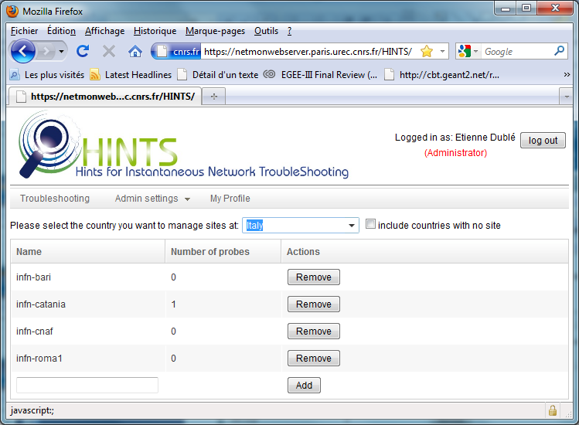
Tour of HINTS Management of sites

Slide 11
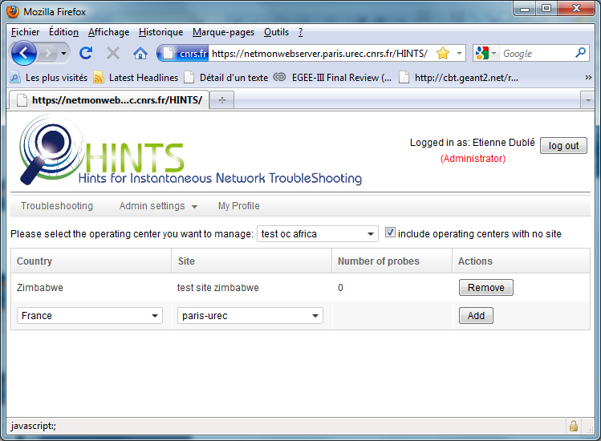
Tour of HINTS Management of sites

Slide 12
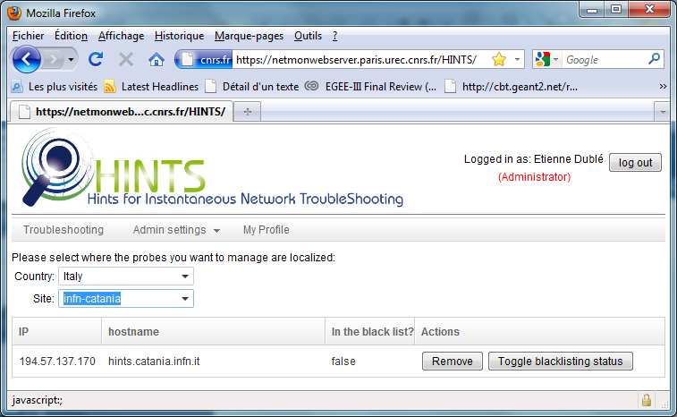
Tour of HINTS Management of probes

Slide 13
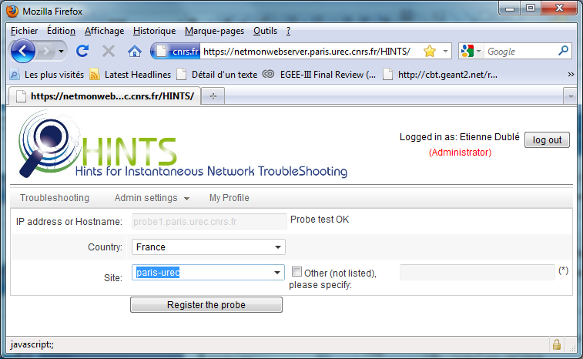
Tour of HINTS Register probes

Slide 14
Tour of test features

Slide 15
Status of our initial roadmap
Become a non specialized software rather than a dedicated software
Used by any kind of operating centers
Improve security
Probe should be accessible for bandwidth control test only by the source site
Accept both login/password & certificate authentication
Improve the general design of web forms that were not user friendly
Maintain continuously a list of active probes for the end user
To be done
50% : probe is tested during registration

Slide 16
Status of our initial roadmap
All essential features are now available
Network troubleshooting tests
Standard users can register a probe and manage them, request additional access rights and transmit these rights to other users
Super-admins can manage user, standard user requests , sites, operating centers, countries, probes
GOC-DB data importation and synchronization
SSL between web server and the probe
Automate probe installation
canceled
To be done
To be done

Slide 17
Status of french team and next step
The network French NGI will be certainly soon disbanded and leave the project
We plan to deliver and help installing a first version at GARR very soon
We plan to assume the maintenance of the software at least until end of March (to be confirmed)
The maintenance and any further improvements of the software should be handled by another team

