Slide 1
Operations Architecture D4.1
Tiziana Ferrari
https://documents.egi.eu/document/218
OMB Meeting, 24 January 2010

Slide 2
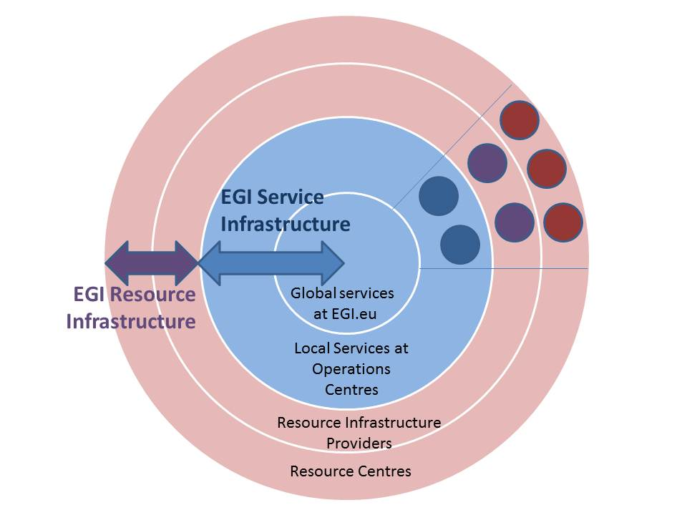
EGI Infrastructure
Resource Infrastructure
Service Infrastructure

Slide 3
Resource Infrastructure 1/2
Resource Centre (RC)
The Resource Centre is the smallest resource administration domain in EGI. It can be either localized or geographically distributed. A Resource Centre is also known as a “site”. It provides local resources and the Grid services necessary to make those resources accessible to authorized users.
Resource Infrastructure Provider (e.g. NGI/EIRO)
The Resource Infrastructure Provider federates RCs, peers locally with the respective RCs, and globally with other Resource Infrastructure Providers that are part of EGI, and EGI.eu
The Resource Infrastructure Provider is a legal organisation that is responsible of establishing, managing and of operating directly or indirectly the operational services to an agreed level of quality.

Slide 4
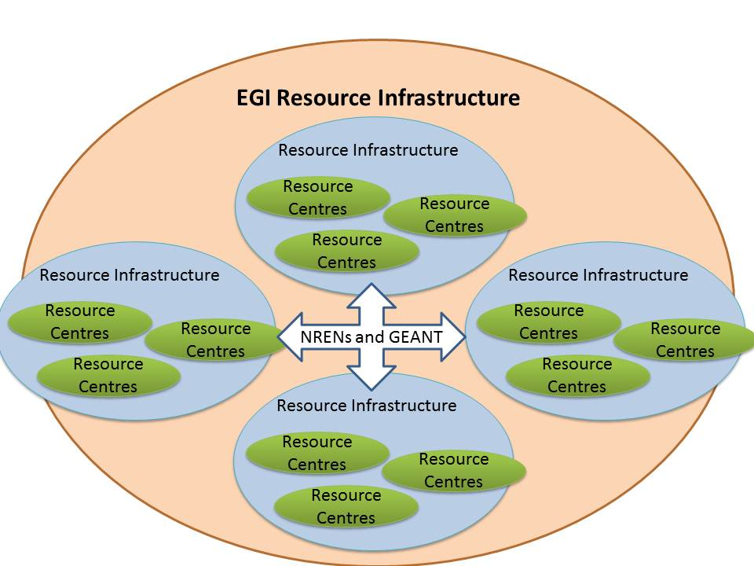
Resource Infrastructure 2/2

Slide 5
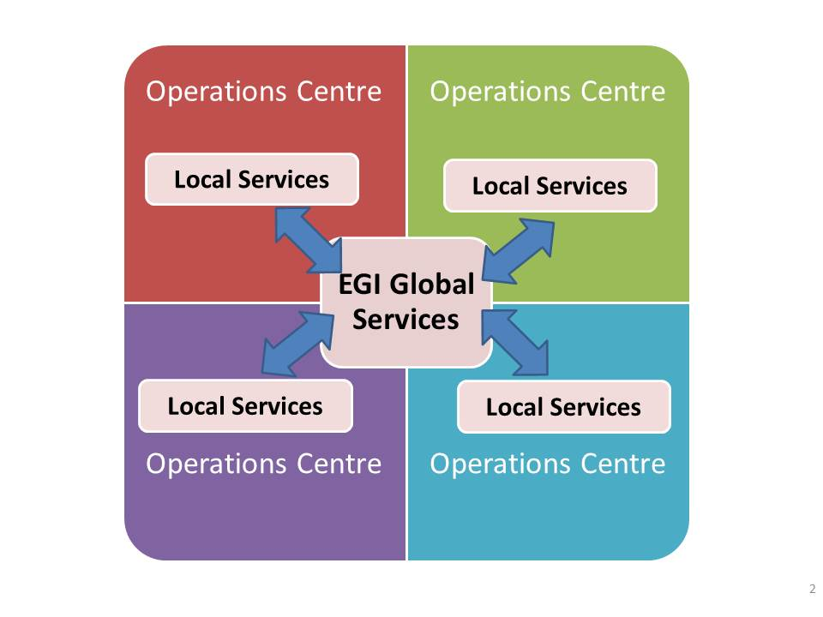
Service Infrastructure
Global Services
EGI.eu
Local Services
Operations Centres (can be federated)

Slide 6
Operations Management Board

Slide 7
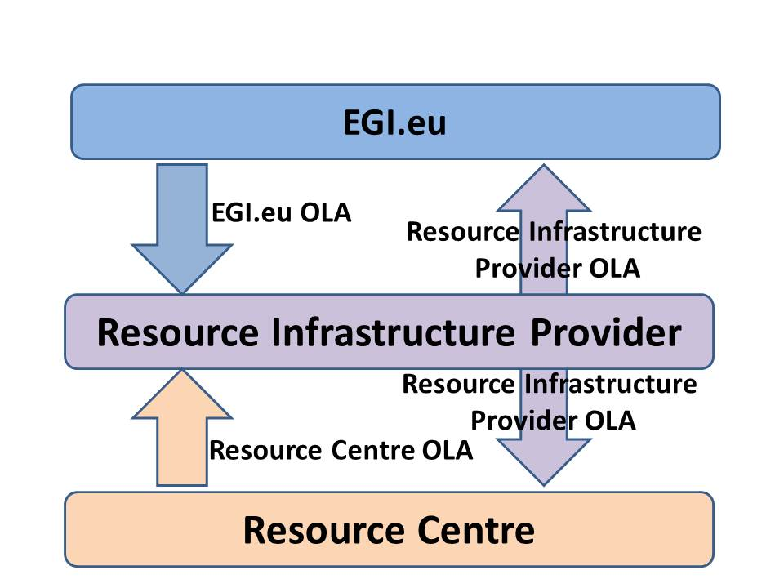
Operational Level Agreements
The OLA is the mechanism adopted in EGI to integrate resource providers into the pan-European production infrastructure while ensuring interoperation, QoS, a common set of policies and procedures.
EGI OLA:
RC OLA
Resource Infrastructure Provider OLA
EGI.eu OLA

Slide 8
Requirements

Slide 9
Summary
EGI = Resource + Service Infrastructure
Resource Infrastructure
Resource Infrastructure Provider
Resource Centre and Resource Centre Ops Manager
Service Infrastructure
EGI.eu → Global Services
Operations Centres → Local Services

