Slide 1
Evaluation of Liferay modules EGI-InSPIRE mini-project
Gergely Sipos
EGI.eu
Technical Outreach Manager
User Community Support Team coordinator
gergely.sipos@egi.eu
EGI Community Forum, Manchester
8-12/April/2013

Slide 2
Outline
Motivation
Liferay Social Office & Liferay Sync
WIIF EGI
Mini-project
goals, partners, tasks, timeline, ...

Slide 3
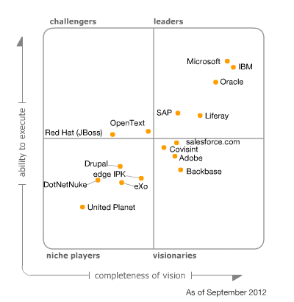
Portals in EGI
Increasing number of portals in EGI
Currently 39 are registered in AppDB http://appdb.egi.eu → Science Gateways
Includes reusable portal frameworks!
Recent Virtual Team project wrote a Primer https://wiki.egi.eu/wiki/VT_Science_Gateway_Primer
In final editing, feedback is welcome!
Workshops with EGI’s support International Workshop on Science Gateways: http://iwsg2013.org/, Zurich 3-5 June
Liferay is the prime choice for EGI portals
Scientific portals: e.g. (WS)P-GRADE, SCI-BUS, IGI portal, Catania Science Gateway
Project portals: e.g. EMI project site
Gartner Magic Quadrant for Horizontal Portals
http://www.liferay.com/about-us/awards

Slide 4
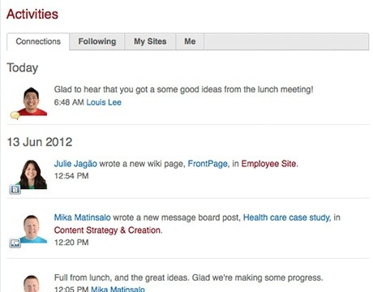
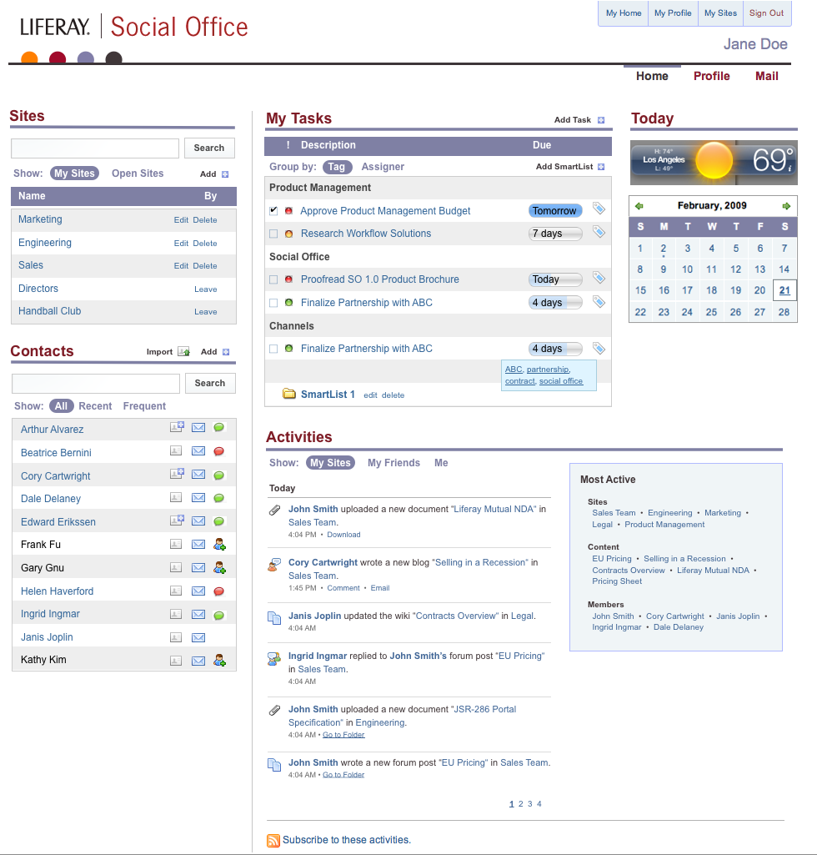
Liferay Social Office http://www.liferay.com/products/liferay-social-office
An extension for Liferay portal 6.1+
For complex & distributed communities
To
Enhance personal workflow with social tools
Keep teams up-to-date
Find the right people with the right knowledge
Turn collective knowledge into collective action
Preserve knowledge for the future
V2.0 released in late 2012

Slide 5
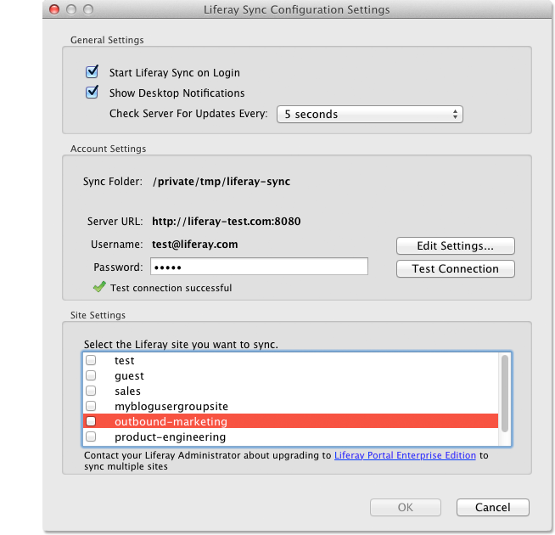
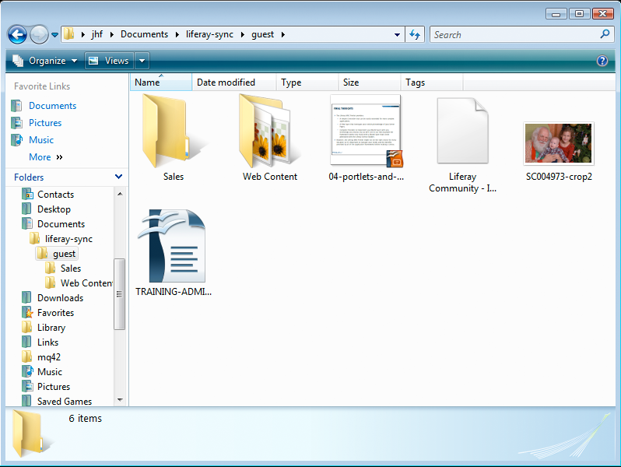
Liferay Sync http://www.liferay.com/products/liferay-sync
Transforms Liferay into an easy-to-use document sharing service
Share files with a simple drag-and-drop – in real-time
Synchronizes content and documents to desktop and mobile environments (Windows, Mac OS, iOS, Android)
Versioning and revision tracking

Slide 6
WIIF EGI
New capabilities
Enhance existing Liferay portals/portlets with collaboration capabilities
Increase integration and collaboration across countries, across groups, accross tools
Provide fully customisable and extendable websites and group management systems for EGI stakeholders (projects, VOs, VRCs, task forces, pilots, etc.)
Lower costs of operation & maint.
A hosting environment for (some of) the services of the EGI Collaboration Platform?
Alternative for some of the services that the community already uses for collaboration (e.g Wiki, Document database, Single Sign On)
Making collaborative work in EGI simpler and more fun!

Slide 7
The mini-project
A systematic evaluation of Liferay Social Office and Sync
April 2013 → September 2013
Outcomes
Best practices and recommendations for the EGI community (particularly for portal-community@mailman.egi.eu)
Broader uptake of Liferay within EGI: NGIs, projects, institutes, ...
Updated EGI portals (by mini-project members)
Members:
EGI.eu: coordinator
CESNET: EGI central IT services
SZTAKI: SCI-BUS/SHIWA portal developers
INFN: IGI portal developers

Slide 8
Project timeline
TASK CODE | TASK NAME | EFFORT (in PM) | START | END | COMMENT
T1 | Project coordination | 1.00 | M1 (April) | M6 (Sept) | Including coordination of writing the final deliverable.
T2 | Setup of local Social Office and Sync installations | 1.00 | M1 (April) | M1 (April) | Milestone: One installation for each site. CESNET provides an installation for EGI.eu.
T3 | Refine software evaluation aspects and scenarios (both individual and integrated) | 1.00 | M1 (April) | M2 (May) | Milestone: Aspects and scenarios for evaluation. See the initial list of aspects in another table.
T4 | Perform evaluations, document initial findings | 3.75 | M2 (May) | M4 (July) | Distributed activity at each site. Milestone: Documented findings and recommendations at each site.
T5 | F2F meeting in Amsterdam | 1.50 | M4 (Around mid July) |  | To inform the consortium about the findings; to agree on integrated tests; to agree on overall documentation. 2 person/partner for 3 days including travel time.
T6 | Integrated evaluations & overall documentation | 2.00 | M5 (Aug) | M6 (Sept) | Milestone: Integrated documentation of all evaluation results, together with plans and recommendations for uptake.
 | TOTAL | 10.25

Slide 9
List of evaluation scenarios
 | PERSPECTIVE FOR EVALUATION | EFFORT | WHO DOES IT
1 | Solution for VRC, VO, NGI, project websites? | 0.25 | EGI.eu
2 | Interoperability with EGI SSO? | 0.25 | CESNET
3 | Interoperability with AAI solutions? (e.g. eduGAIN, IDEM-GARR, Umbrella) | 0.25 | INFN
4 | Interoperability with portlets from the community? (SCI-BUS and SHIWA portlets) | 1.00 | MTA SZTAKI
5 | Interoperability with portlets from the community? (IGI portlets) | 0.50 | INFN
6 | Interoperability and alternative to EGI Helpdesk? | 0.25 | CESNET
7 | Interoperability and alternative for AppDB? | 0.25 | EGI.eu
8 | Interoperability and alternative for Indico? | 0.25 | CESNET
9 | Interoperability and alternative for Wiki? | 0.25 | CESNET
10 | Interoperability and alternative for DocDB? (Liferay Sync module) | 0.25 | CESNET
11 | Interoperability and alternative for EGI Blog? | 0.25 | CESNET
 | TOTAL (effort in T4) | 3.75
Notes:
Possiblility to add:
Liferay supports the setup of personal profiles. This could help us finding persons with specific skills/expertise for certain tasks.

Slide 10
Project administration
EGI-InSPIRE mini-projects website:
https://wiki.egi.eu/wiki/Overview_of_Funded_Virtual_Team_projects
New Work package in EGI-InSPIRE (SA4)
This project: TSA4.3: Evaluation of Liferay modules → https://wiki.egi.eu/wiki/VT_Liferay
WP leader: Michel Drescher (EGI.eu)
Short (few lines!) project report every Tuesday to vt-funded-leaders@mailman.egi.eu
Project members to record effort in PPT

Slide 11
Next steps
Setup of local Social Office and Sync installations
Refine software evaluation aspects and scenarios (both individual and integrated)
Short document
Elect leader

Slide 12
Questions
Email
Gergely.sipos@egi.eu

