Slide 1
Bringing Scientific Workflow to the Masses via Pegasus and HUBzero
Michael McLennan*, Steven Clark*, Ewa Deelman♱, Mats Rynge♱, Frank McKenna⧲, Derrick Kearney* and Carol Song*
*Purdue University, ♱USC Information Sciences Institute, ⧲University of California, Berkeley

Slide 2
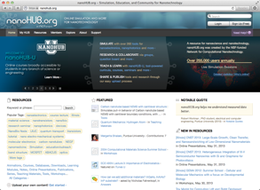
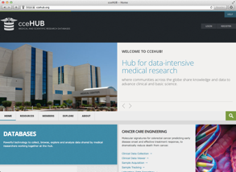
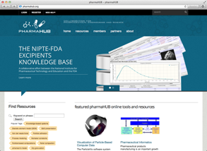
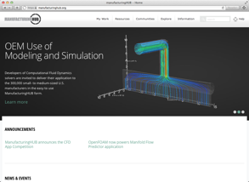
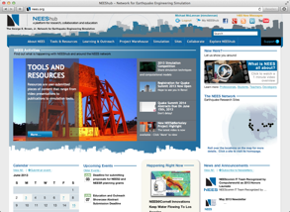
What is HUBzero?
HUBzero
Open source software platform
used to build…
“hubs”
“Science Gateways” or
“Collaboratories” for
Research, Education,
and Collaboration
License LGPL-3.0
Linux/Apache/MySQL/PHP
http://hubzero.org/download

Slide 3
40+ Hubs for many disciplines
visitors users
540,063 258,791 nanoHUB.org
230,698 59,175 nees.org
59,659 29,965 GlobalHUB.org
32,700 22,651 pharmaHUB.org
32,314 11,199 vhub.org
37,414 3,132 HABRIcentral.org
15,898 3,933 cceHUB.org 14,977 5,797 ciHUB.org
12,304 3,510 StemEdHub.org
11,754 1,907 iemhub.org
10,995 1,863 C3Bio.org 7,317 1,246 cleerHUB.org
~1,000,000 visitors per year

Slide 4
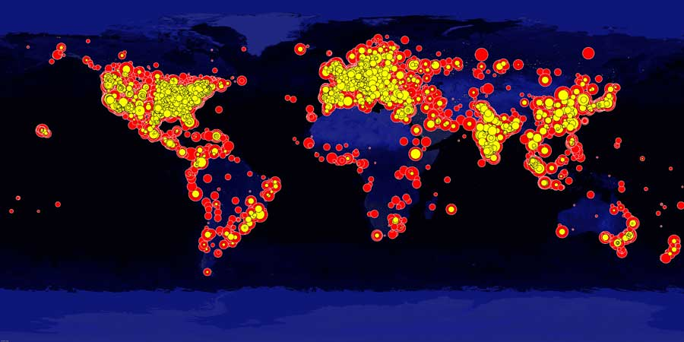
Where are the users?
= Browsing
= Simulation
1,000,000 visitors total for all hubs each year

Slide 5
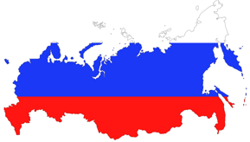
Global community
27
Non-profit organization
Independent owner of HUBzero code
Promotes dissemination and outreach
Sponsors HUBbub Conference
Coordinates software contributions
Foundation, LLC

Slide 6
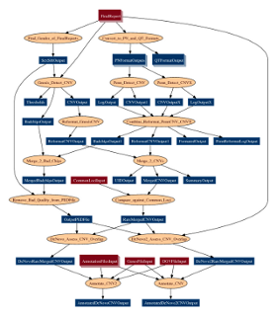
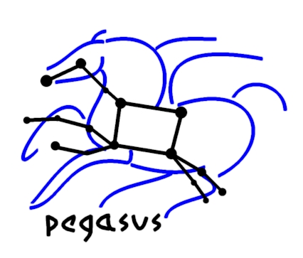
What is Pegasus?
Pegasus Workflow Management System (est. 2001)
Ewa Deelman USC Information Sciences Institute
Development Team:
Gideon Juve, Rajiv Mayani,
Mats Rynge, Karan Vahi
http://pegasus.isi.edu

Slide 7
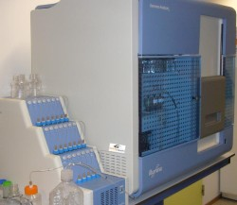
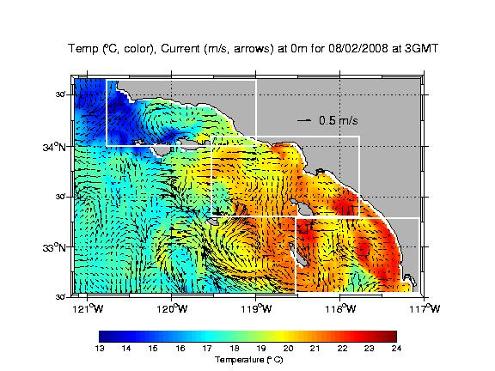
Advantages of Pegasus
A collaboration with U Wisconsin Madison / HTCondor
Used by a number of applications in a variety of domains
Provides reliability—can retry computations from the point of failure
Provides scalability—can handle large data and many computations (kbytes-TB of data, 1-10⁶ tasks)
Optimizes workflows for performance
Automatically captures provenance information
Runs workflows on distributed resources: laptop, campus cluster, Grids (DiaGrid, OSG, XSEDE), Clouds (FutureGrid, EC2, etc..)

Slide 8
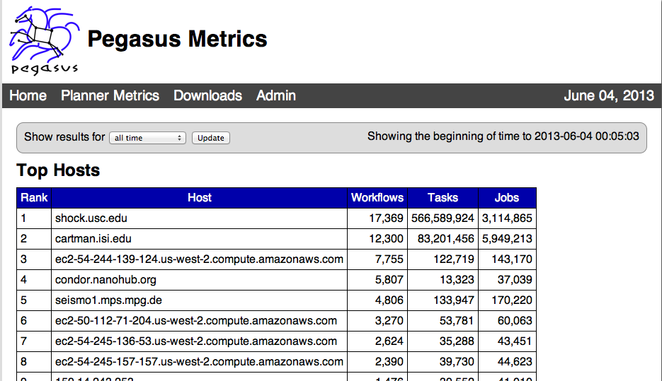
Industrial Strength
Since Jan 2013

Slide 9
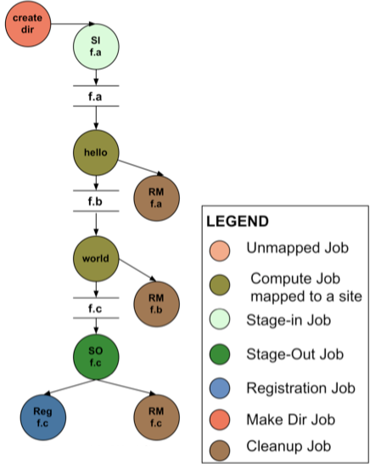
How does Pegasus work?
APIs for
workflow
specification
DAX
=
DAG in XML
Executable Workflow
(After Pegasus Planning)
Workflow
Spec

Slide 10
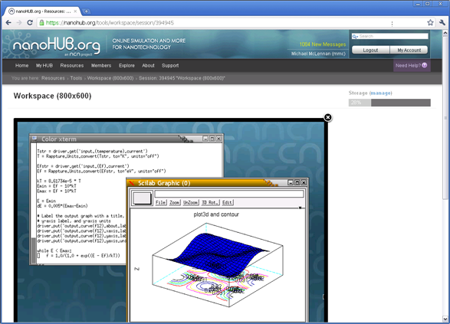
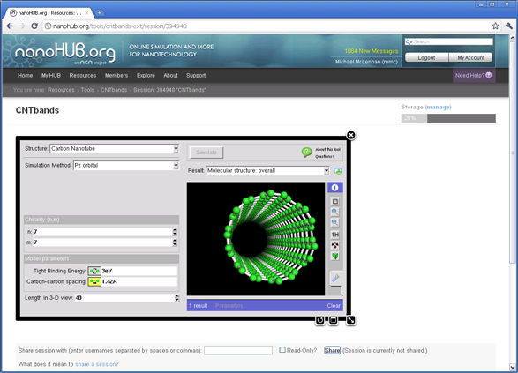
Two Audiences
Researchers
Casual Users
Use “workspace” (remote desktop)
Launch simulation jobs on grid/cloud
Share desktops
Build and deploy tools
Use “tools” (app store)
Simple, intuitive interfaces
Share tools

Slide 11
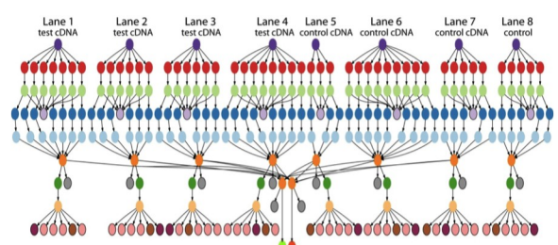
Submitting Your Pegasus Workflow
submit pegasus-plan --dax myworkflow.dax
Hub Web Server
Execution Host 1
Execution Host 2
. . .
Pegasus “DAX”
Workflow

Slide 12
Submit: Parameter Sweeps
If you normally run a command like this…
spice3 –b circuit
Submit to remote resources like this…
submit –v DiaGrid spice3 –b circuit
submit –p @@res=100,1k,10k spice3 –b @:circuit
* common collector amplifier: mid- and low-frequency analysis
.model m1 npn bf=350
.width in=80 out=80
*
* dc bias circuit
r1 2 4 @@res
r2 2 0 25k
vcc 4 0 dc 15
Automatically builds a Pegasus Workflow to
manage these jobs

Slide 13
Submit: Parameter Sweeps
If you normally run a command like this…
spice3 –b circuit
Submit to remote resources like this…
submit –v DiaGrid spice3 –b circuit
submit –p @@res=100,1k,10k spice3 –b @:circuit
submit –p @@res=100,1k,10k –p @@cap=1u,10u,100u spice3 –b @:circuit
submit –d indata.csv spice3 –b @:circuit
submit –p @@num=1:100 spice3 –b circuit@@num
submit –p @@file=glob:circuit* spice3 –b @@file

Slide 14
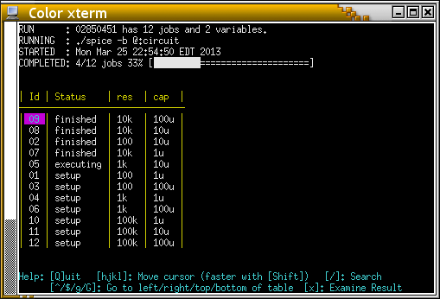
Submit: Parameter Sweeps
If you normally run a command like this…
spice3 –b circuit
Submit to remote resources like this…
submit –v DiaGrid spice3 –b circuit
submit –p @@res=100,1k,10k spice3 –b @:circuit
submit –p @@res=100,1k,10k –p @@cap=1u,10u,100u spice3 –b @:circuit
submit –d indata.csv spice3 –b @:circuit
submit –p @@num=1:100 spice3 –b circuit@@num
submit –p @@file=glob:circuit* spice3 –b @@file

Slide 15
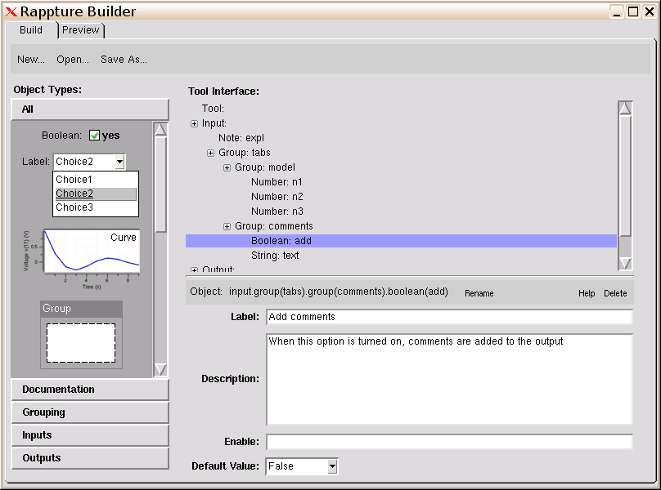
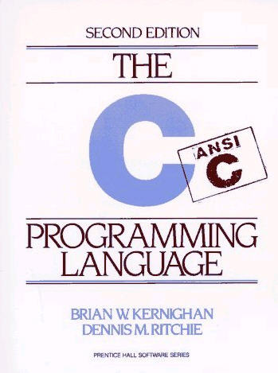
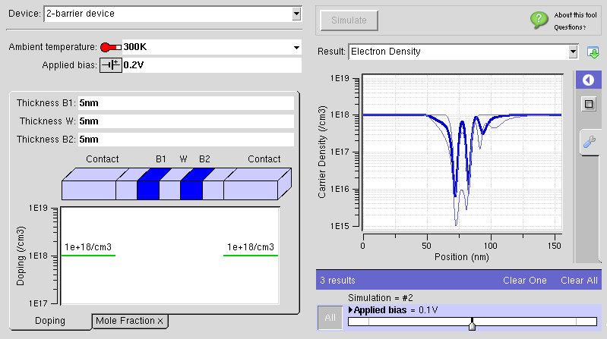
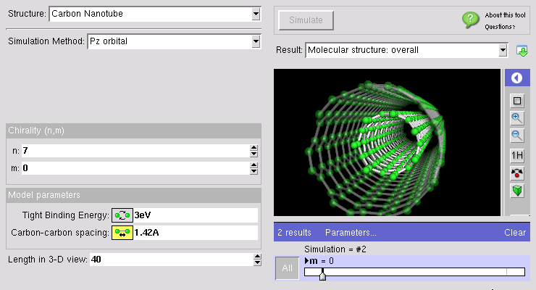
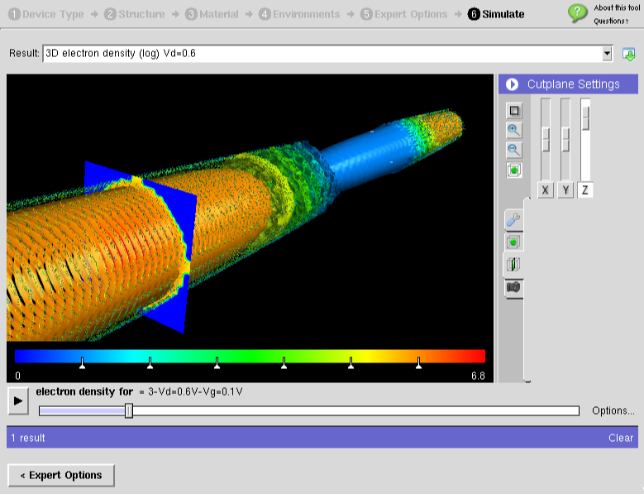
Rappture Toolkit
Your Code
Rappture Builder

Slide 16
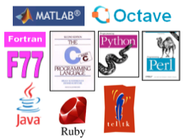
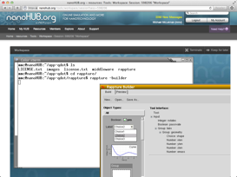
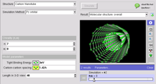
Publishing Simulation Tools
Rappture
Fingertip access to latest tools
Tools run in the Cloud
Leverage HPC resources
Hub reports impact metrics

Slide 17
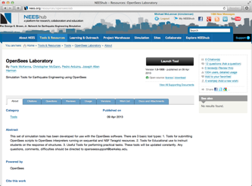
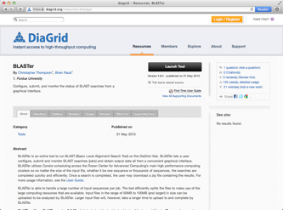
Tools leveraging Pegasus
OpenSees Laboratory
NEES.org
BLASTer
DiaGrid.org

Slide 18
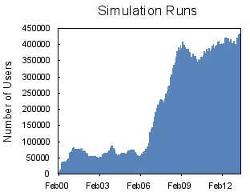
Integration Challenges
Dynamic mapping to resources
Staging files in and out
Reporting job status
Reporting usage and metrics
http://metrics.pegasus.isi.edu/metrics
Shared HPC Filesystem
Hub Web Server
Execution Host 1
“submit” server
head
node
Execution Host 2
. . .
Condor IO
GridFTP
pegasus-status
pegasus-statistics
pegasus-analyzer
Pegasus 4.0

Slide 19
More information
Michael McLennan
Director, HUBzero® Project
mmclennan@purdue.edu
http://hubzero.org/pressroom
Ewa Deelman
Assistant Director Science Automation Technologies
deelman@isi.edu
http://pegasus.isi.edu

