Slide 1
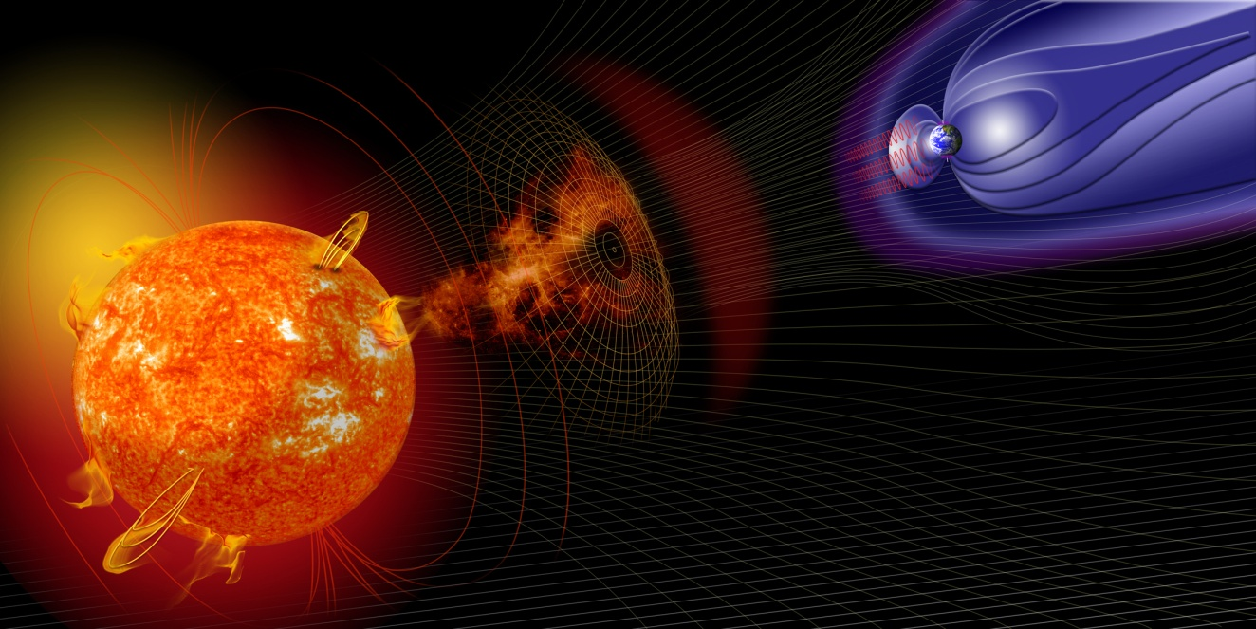
HELIOGate
Dr. Gabriele Pierantoni
Dr. David Perez Suarez
Notes:
This is a template. The following slides can be interspersed with other slides of course and there can be introductory slides.
The template slides should be answered and expanded on if possible.

Slide 2
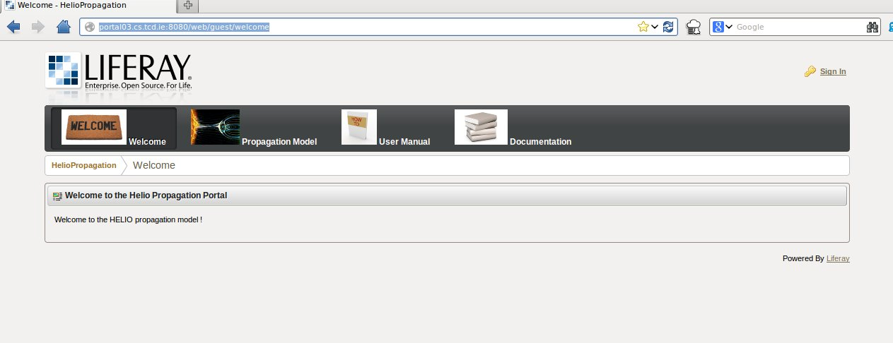
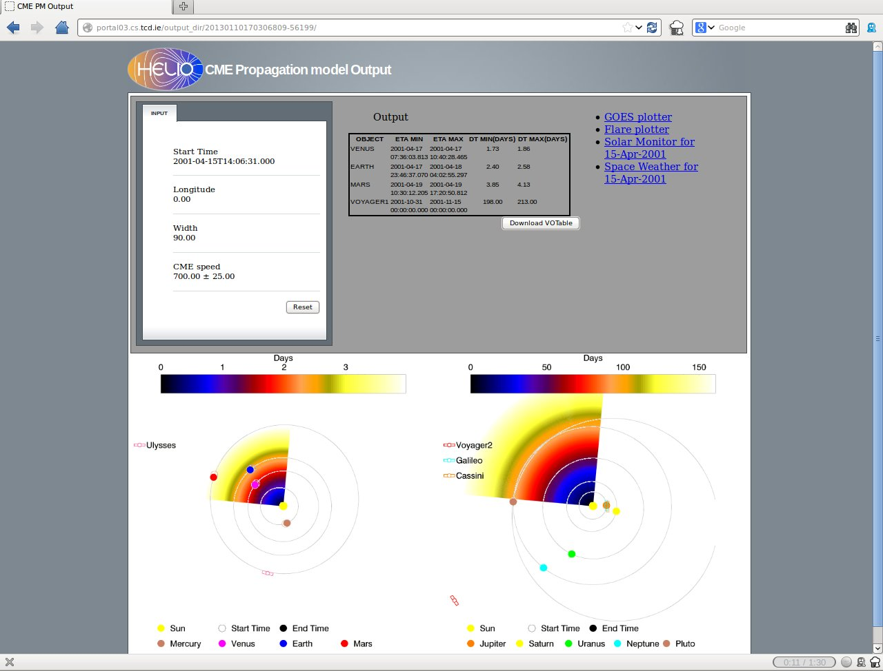
The HELIO Gate Portal
The HELIO Gate portal offers to the Heliophysics community an easy and intuitive way of performing repetitive and time-consuming actions.

Slide 3
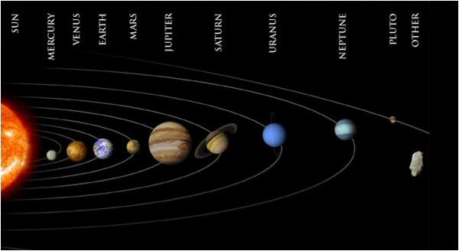
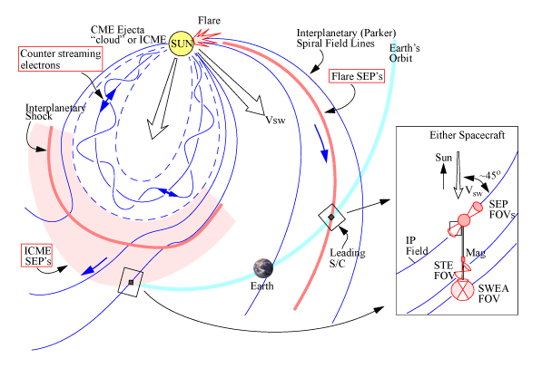
Heliophysics
Heliophysics is the study of the system composed of the Sun’s heliosphere and the objects that interact with it.
Effects depend on type of emission
Propagation is influenced by the interplanetary magnetic field for particles
Propagation models are fundamental !

Slide 4
How an Heliophysicist works
Find what is interesting: During this step, the scientist browses catalogues of events that were observed throughout the solar system and catalogues of features that were observed on the Sun’s surface to establish what is worth investigating
Find which observations are available: During this step the scientists browses catalogues of instruments capabilities and locations to understand which observations are available to investigate the events or features of interest.
Find the data: During this step the scientists find and access the data sets that are available and relevant to study the events and features.
Analyse the data: During this step the scientists analyse the retrieved data sets.

Slide 5
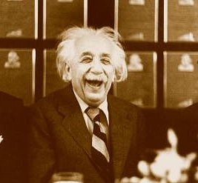
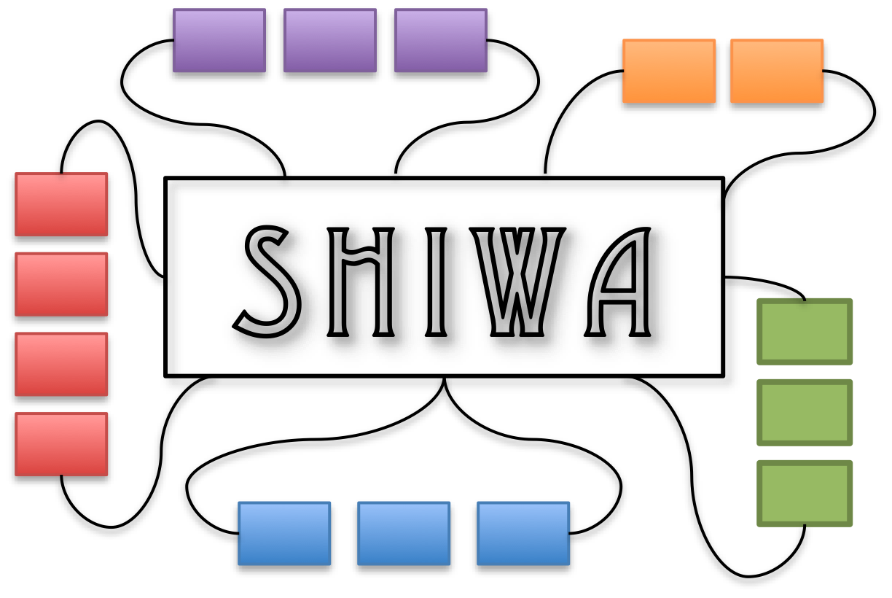
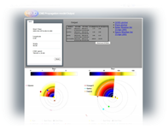
Heliophysicists and workflows
Repositories
Portals

Slide 6
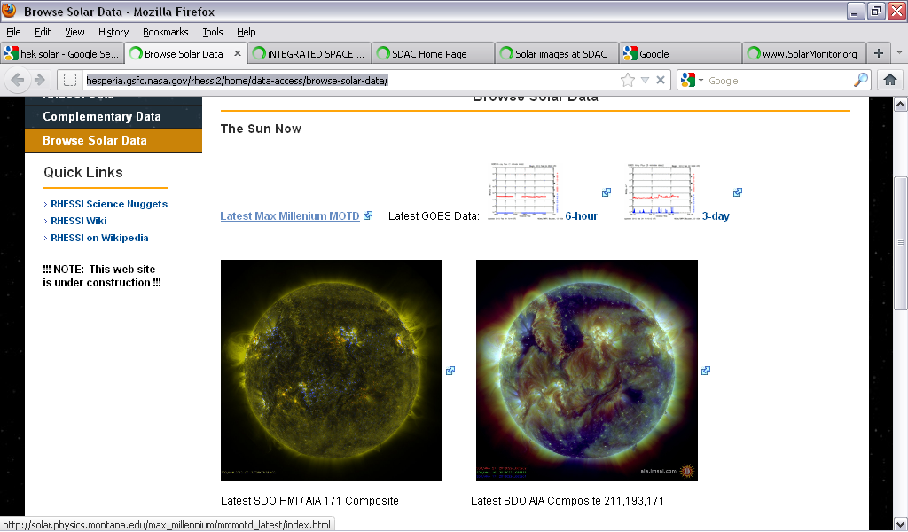
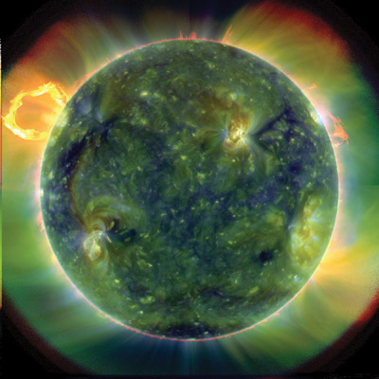
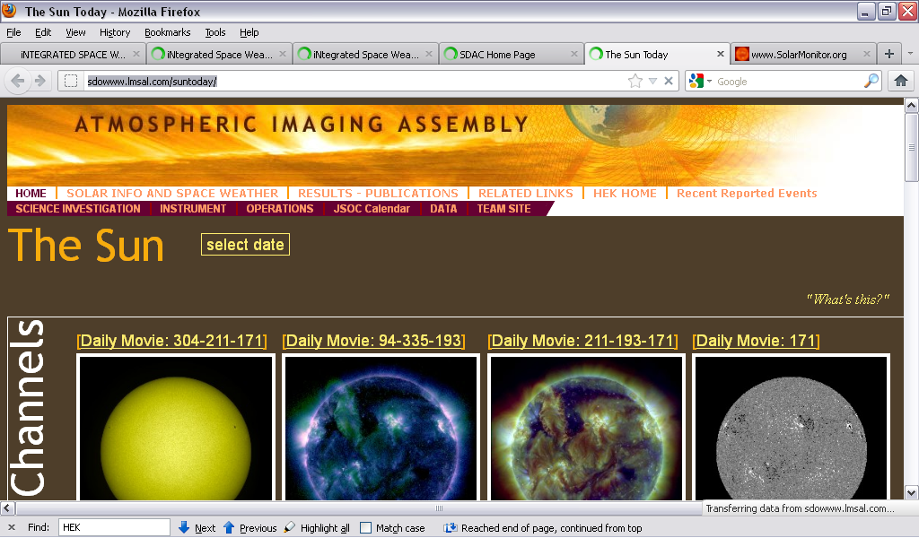
Heliophysics, the old way….

Slide 7
Available Services
Web Services
Workflow
Engine
(Desktop)
Resources
GUI
API
Web Services
Data
Workflow
Engine
(Server)
Web Services
Catalogues

Slide 8
Heliophysics, the new way
SCI-BUS
WS-Pgrade
Services
Resources
Taverna
Data
SCI-BUS
SHIWA
Catalogues

Slide 9
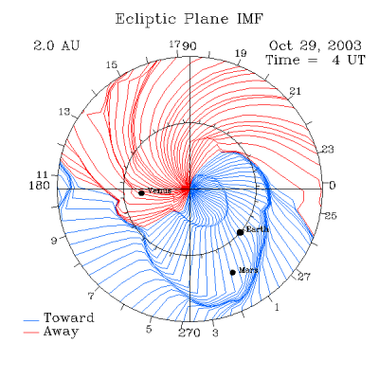
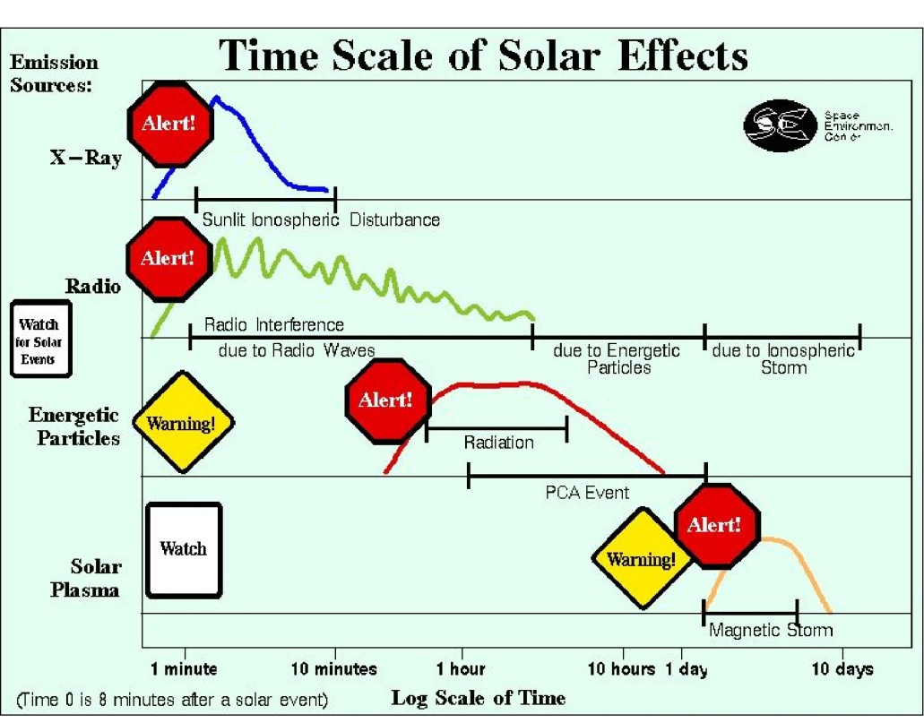
Propagation Models
A propagation model is used to help determine which observations, where and when may be of interest in order to satisfy the user's search criteria.

Slide 10
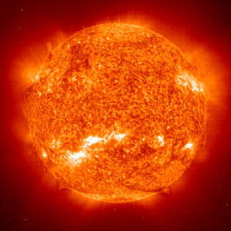
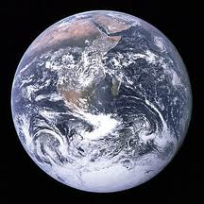
Advanced Propagation Model
Origin
Target
t
P = P_{max}
t
ETA
Range
E
P = P_{OK}
Period of interest
E
P = P_{min}
E

Slide 11
Advanced Propagation Model
Origin
Target
t
P = P_{max}
t
ETA
Range
E
P = P_{OK}
Period of interest
E
P = P_{min}
E

Slide 12
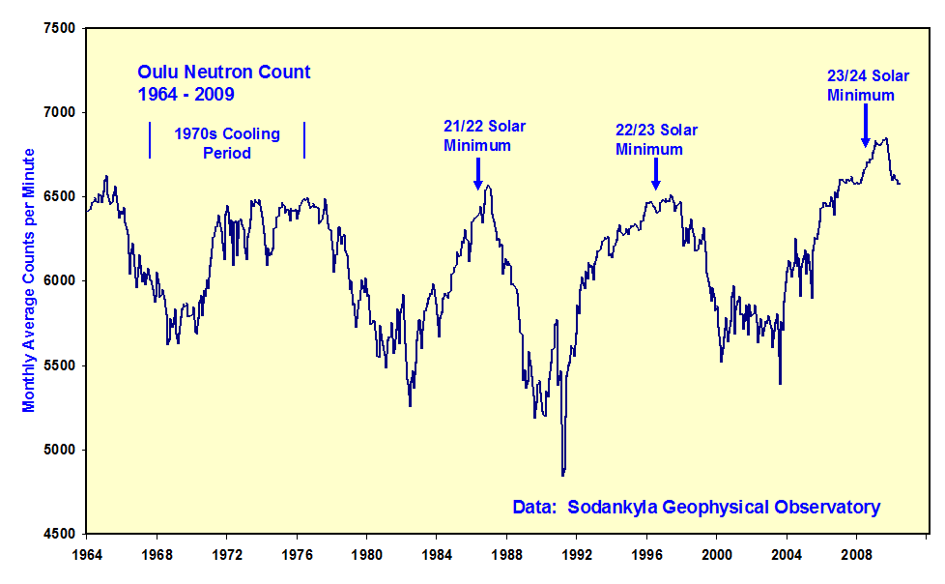
Events Count

Slide 13
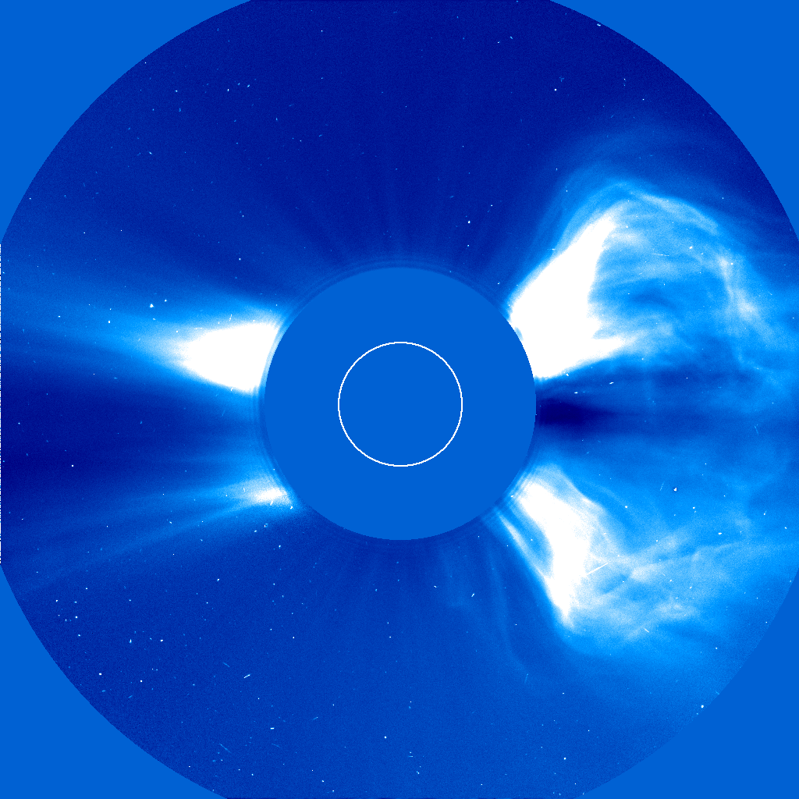
Fastest CMEs Propagation
This workflow is used to investigate one of the most relevant events in HELIOphysics; Coronal Mass Ejections. The propagation of these events is studied throughout the Solar System by the means of the execution of the SHEBA propagation model on the HELIO Processing Service.

Slide 14
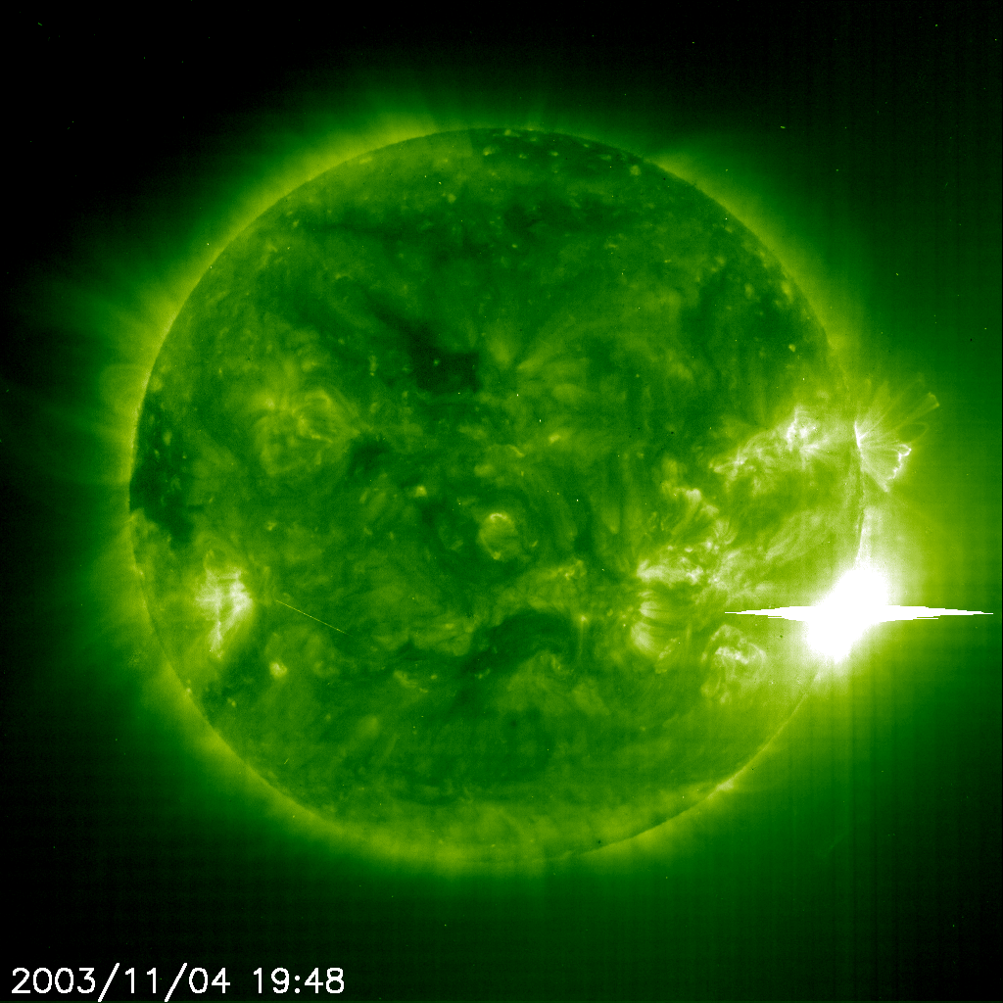
High Energy Flares
Given a time range, this workflow looks for flares within the specified energy range and provides the observations for such time range for the list of instruments asked. It also provides the table of flares with its properties.

Slide 15
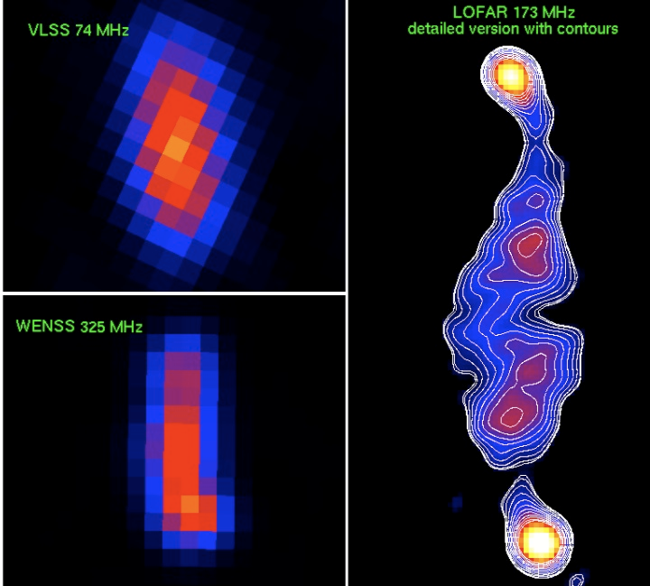
LO-FAR
LOFAR is a real-time multiple sensor array.
Very different sensors can be placed along a common infrastructure and make use of it the same time.
Analysis of raw frequency data requires significant storage and computation resources.
We are developing a standardizes processing and storage workflow to the community to be easily configured

Slide 16
Fastest CMEs Propagation
This workflow is used to investigate one of the most relevant events in HELIOphysics; Coronal Mass Ejections. The propagation of these events is studied throughout the Solar System by the means of the execution of the SHEBA propagation model on the HELIO Processing Service.

Slide 17
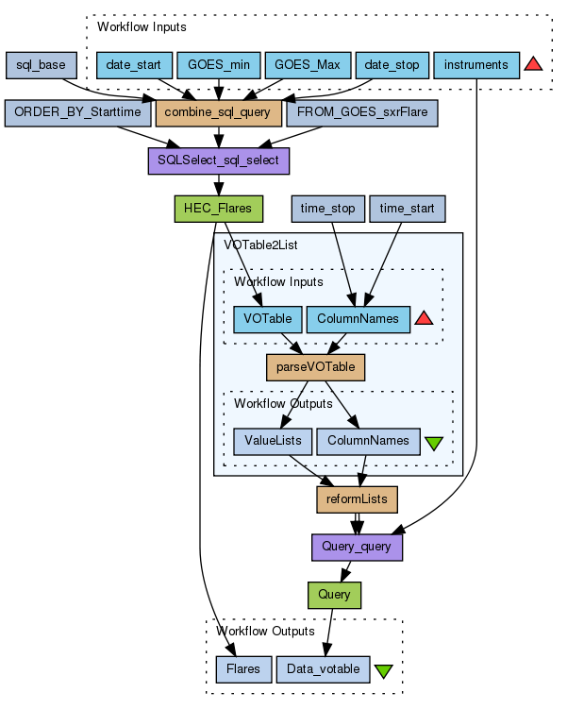
High Energy Flares
Given a time range, this workflow looks for flares within the specified energy range (GOES x-ray flare class), and provides the observations for such time range for the list of instruments asked. It also provides the table of flares with its properties.

Slide 18
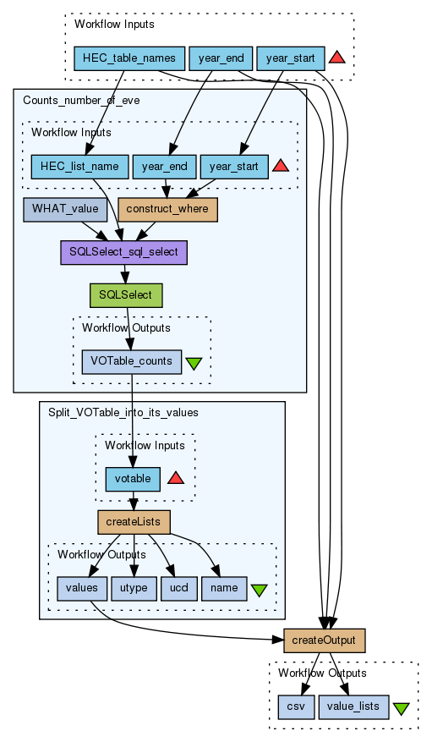
Events Count
Counts the number of events for a period.

