Slide 1
Gateway Challenges and Evolution: Current Trends and Practices in US Science Gateways
Mark A. Miller
San Diego Supercomputer Center

Slide 2
Talk overview
Part 1. Overview of US Gateway development efforts
Part 2. Overview of Issues faced by a growing Gateway

Slide 3
Talk overview
Part 1. Overview of US Gateway development efforts
Part 2. Overview of Issues faced by a growing Gateway

Slide 4
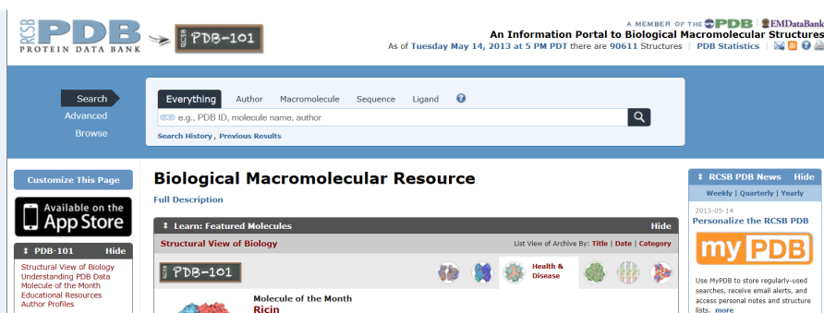
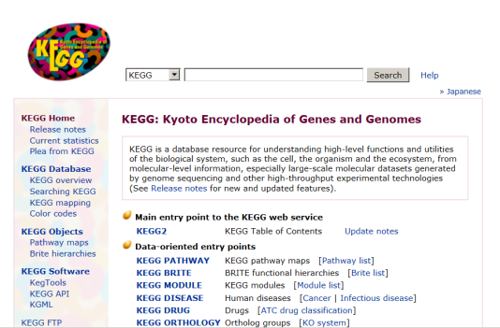
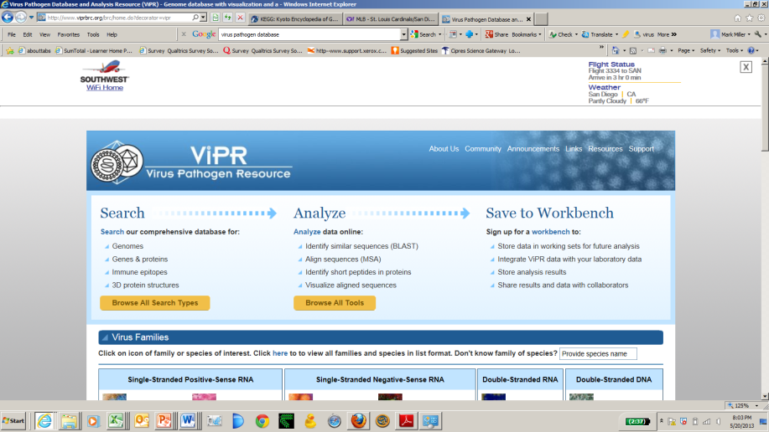
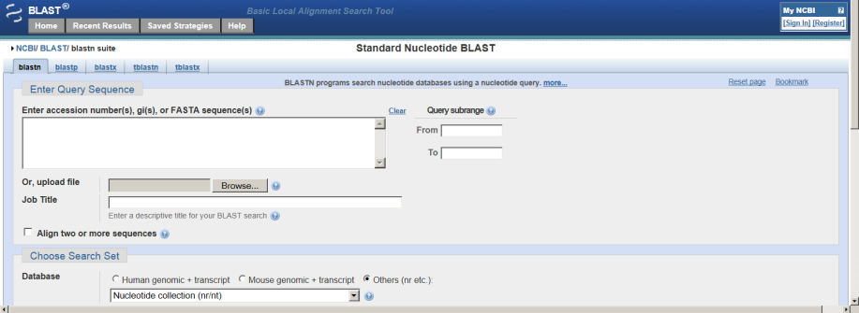
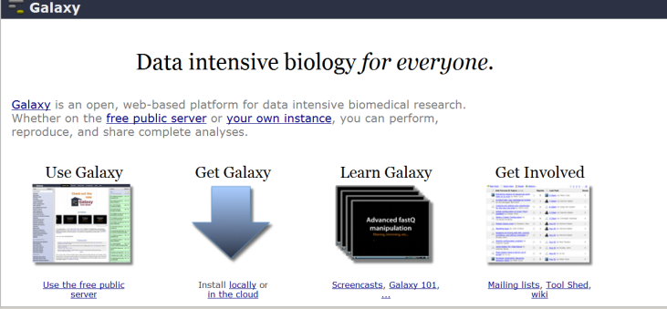
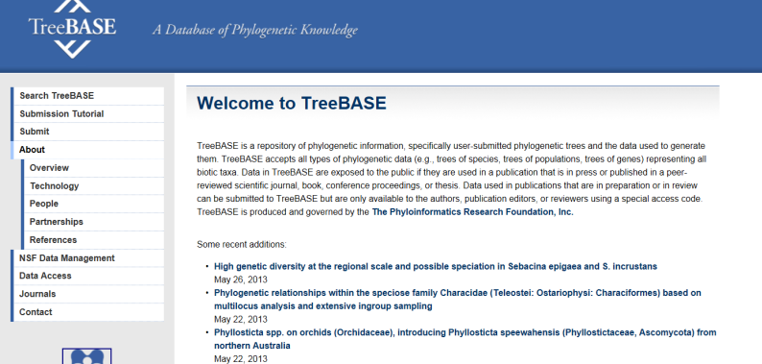
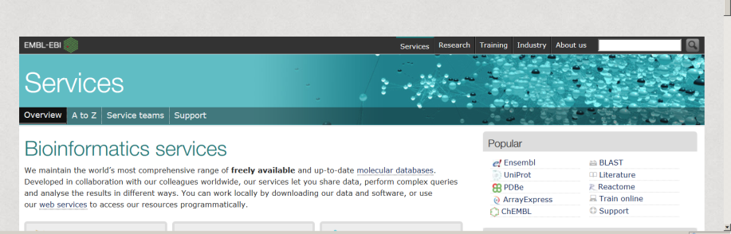
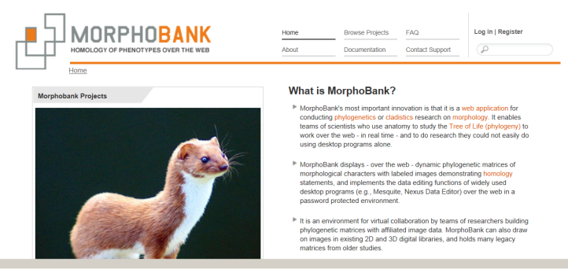
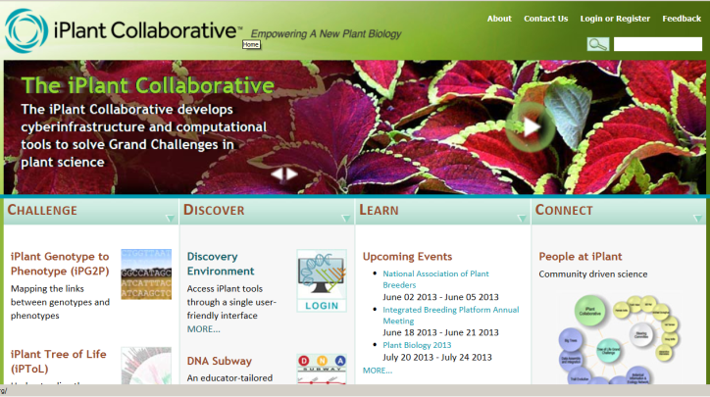
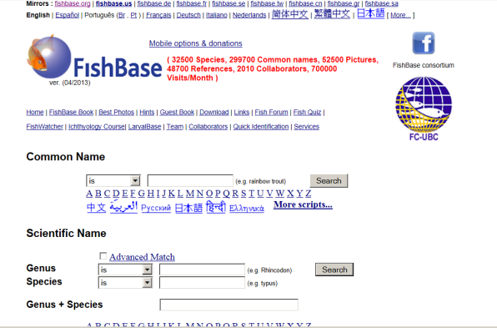
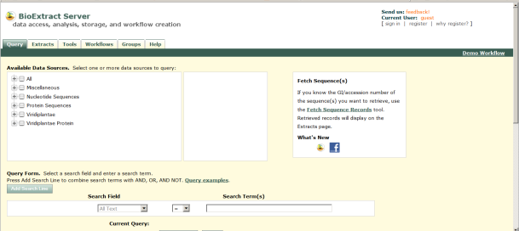
The Set of Functional Science Gateways is really, really large

Slide 5
The Set of Functional Science Gateways is really, really large
The Nucleic Acids Research Bioinformatics Links Directory now contains :
134 resources
455 databases
1205 web server tools

Slide 6
The Set of Functional Science Gateways is really, really large
The Nucleic Acids Research Bioinformatics Links Directory now contains :
134 resources
455 databases
1205 web server tools
And criteria for inclusion in that list are quite
restrictive!

Slide 7
The Set of US projects that explicitly call themselves Science Gateways is almost managable.
8 Science Gateways sponsored by the National Energy Research Scientific Computing Center, US Dept of Energy
name | link | subject | data | computation
Deep Sky | http://deepskyproject.org/ | image querying, telescope data | X
The Materials Project | http://materialsproject.org/ | materials quuery | X
QCD | http://qcd.nersc.gov/ | lattice guage theory | X
CXIDB | http://cxidb.org/ | coherent xray imaging data bank | X
20th Century Reanalysis | http://portal.nersc.gov/project/20C_Reanalysis/ | global weather trends | X
Daya Bay | http://portal.nersc.gov/project/dayabay/ | Dayabay Neutrino Detector Gateway | X
Earth System Grid Configuration | http://esg.nersc.gov/esgf-web-fe/ | Earth System Grid Climate Gateway and Data-node | X
NOVA | https://portal-auth.nersc.gov/nova/login/?next=/nova/ | NERSC online (Vienna ab initio Simulation Package jobs |  | X

Slide 8
35 or so XSEDE Science Gateways, sponsored by the US National Science Foundation
Current ProjectComputational Poertalt
Computational Resource Access
Asteroseismic Modeling Portal | Stellar Astronomy and Astrophysics
Center for Multiscale Modeling of Atmospheric Processes | Atmospheric Sciences
CIG Science Gateway for the Geodynamics Community | Geophysics
CIPRES Portal for inference of large phylogenetic trees | Systematic and Population Biology
Community Climate System Model (CCSM) TeraGrid Gateway | Atmospheric Sciences
Computational Chemistry Grid | Chemistry
CyberGIS Gateway | Geosciences
Cyberinfrastructure for End-to-End Environmental Exploration Portal | Earth Sciences
Developing Social Informatics Data Grid (SIDGrid) | Language, Cognition, and Social Behavior
EPSCoR Desktop to TeraGrid EcoSystem | Systematic and Population Biology
High-Resolution Modeling of Hydrodynamic Experiments with UltraScan | Biophysics
Iplant Agave Foundation API | Integrative Biology and Neuroscience
National Biomedical Computation Resource | Integrative Biology and Neuroscience
Network for Computational Nanotechnology and nanoHUB | Emerging Technologies Initiation
Network for Earthquake Engineering Simulation | Earthquake Hazard Mitigation
Neuroscience Gateway | Neurosciences

Slide 9
Neutron Science TeraGrid Gateway | Materials Research
OGCE Science Gateway Portal | Information Technology and Organizations
ROBETTA: Automated Prediction of Protein Structure and Interactions | Molecular Biosciences
SCEC Earthworks Project Tera 3D) | Seismology
Social Science Gateway | Social and Economic Science
TeraGrid Geographic Information Science Gateway | Geography and Regional Science
VLab - Virtual Laboratory for Earth and Planetary Materials | Materials Research
Data Portals
Indiana University Centralized Life Sciences Data | Genetics and Nucleic Acids
Dark Energy Survey Data Management | Extragalactic Astronomy and Cosmology
Biodrugscore: A portal for customized scoring and ranking of molecules docked to the human proteome | Biochemistry and Molecular Structure and Function
Globus Online | Engineering Infrastructure Development
High Resolution Daily Temperature and Precipitation Data for the Northeast United States | Atmospheric Sciences
Isoscapes modeling, analysis and prediction (IsoMAP) | Environmental Biology
Linked Environments for Atmospheric Discovery | Atmospheric Sciences
Massive Pulsar Surveys using the Arecibo L-band Feed Array (ALFA) | Astronomical Sciences
Purdue Environmental Data Portal | Earth Sciences
QuakeSim | Geophysics
Science Gateway for Diffraction Facilities, Data and Methods | Chemistry
The Earth System Grid | Global Atmospheric Research

Slide 10
The set of US Science Gateway efforts that:
attempt to advance the architecture and methodology of Gateway creation
attempt to advance practices in Gateway scalability
is a set we can hope to cover in the context of this talk

Slide 11
  Generation 1 Gateway software:
  The archetypal Generation 1 Gateway is a three tiered web application. It has a HTML/jsp front end, uses Globus for submission.
  (early examples: GridSpeed, GPDK)

Slide 12
  Generation 1 Gateways:
  Many highly successful Science Gateways in the US today evolved from the Gen 1 concept.

Slide 13
  Generation 1 Gateways:
  Important evolutionary adaptations:
  Addition of Content Management Systems
  Provide Descriptions of a Command Line tool’s interface and workflow (JSON, XML, Rappture) so users can contribute new interfaces/tools
  Add support for data sharing
  Provide for Social Networking
  Deploy pluggable job submission tools allow many choices for submission

Slide 14
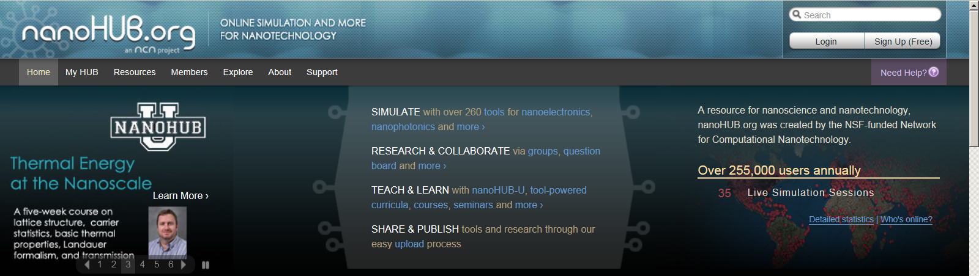
  Generation 1 Gateways:
Platform: HubZero
Highly developed tools for sharing and collaborating
Joomla! CMS
Provides user with a VM instance, provides lots of flexibility in interaction.
Rappture toolkit allows user creation of tools with fluid, interactive interfaces
Emphasis on modelling and demonstrations
Relatively lightweight computing within the VM
Some groups have connected the VM to NFS/job submission tools

Slide 15
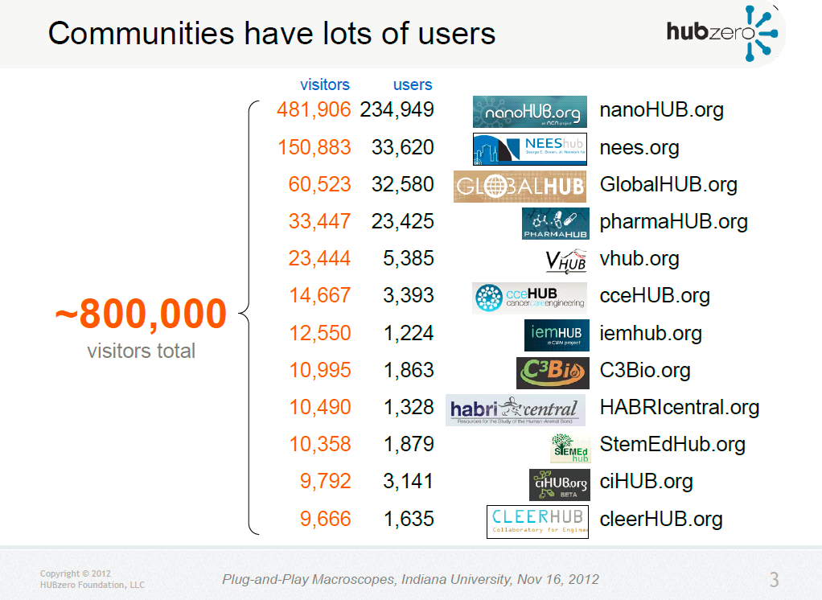
481.906
234.949
234.949
234.949
150.883
33,620
33,620
60.523
32.580
32.580
33.447
23.425
23.425
23.444
5.385
~ 800.000
14.667
3.393
12.550
1.224
10.995
1.863
10.490
1.328
10.358
1.879
1.879
9.792
3.141
9.666
1.635
M. McLennan

Slide 16
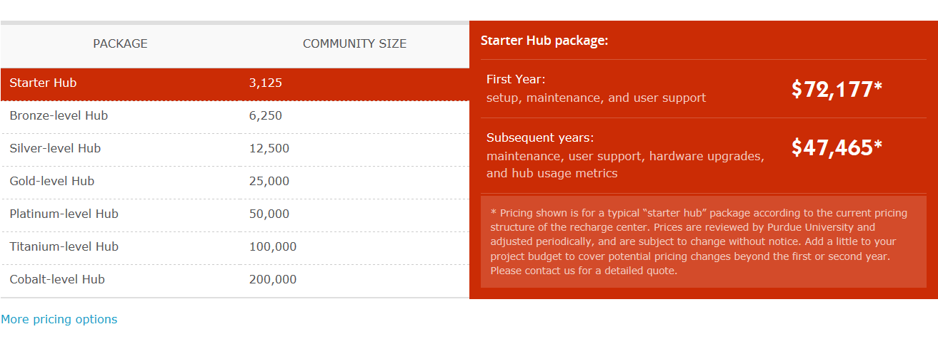
  Hubzero instances can be purchased:

Slide 17
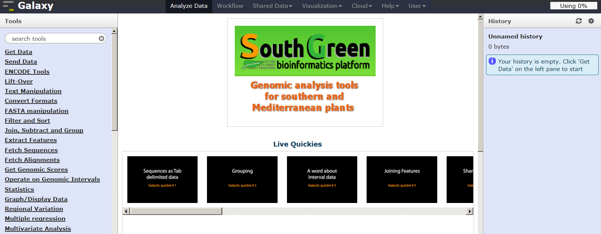
  Generation 1 Gateways:
Platform: Galaxy
Project historically encourages interaction between developers and users.
Distributable Galaxy package not originally designed for submission to remote resources, but this capability has been developed. Cloud instances available.
Supports flexible addition of command line tools.
Main server has 30.000 registered users/ 160.000 jobs per month.
Many, many local Galaxy installations around the world.
Galaxy is highly customizable, but is presented only as a Genomics Application

Slide 18
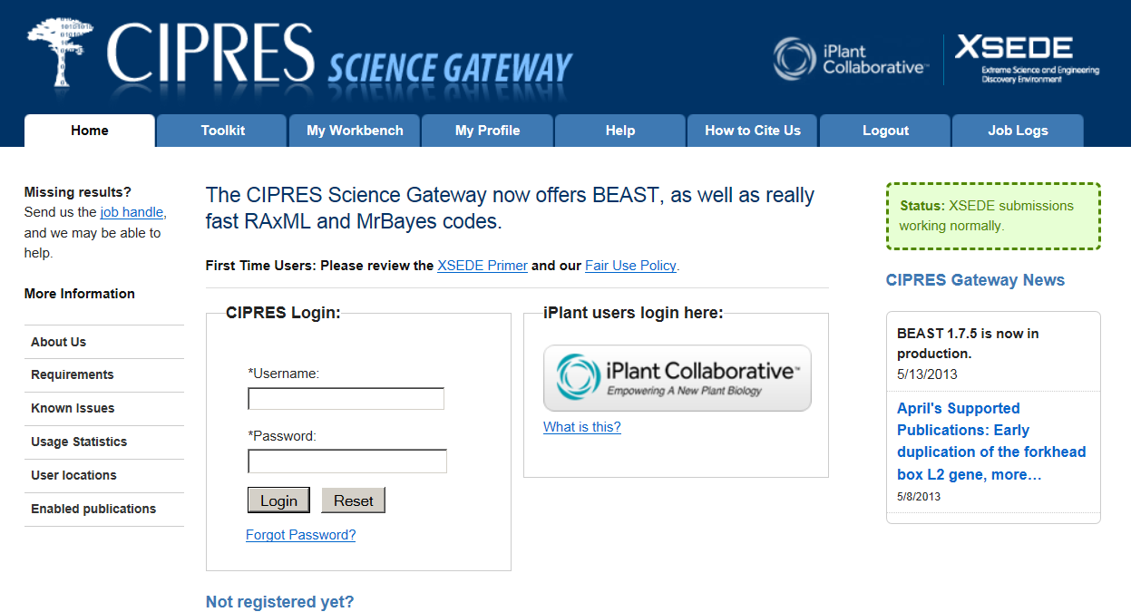
  Generation 1 Gateways:
Platform: Workbench Framework
Emphasis on submission of long running command line jobs to remote HPC resources.
Supports flexible addition of command line tools.
Main server has 6.000 registered users/8.000 jobs per month/supported 600+ publications.
Brings 29% of all XSEDE users each quarter, who use 0.7% of all XSEDE
resources.
3 other Gateways now use the Workbench Framework.

Slide 19
  Generation 2 Gateway software:
  The archetypal Generation 2 Gateway:
  distributable portlet container
  provides the essential login/user management functions via portlets “out of the box.”
  new portlets can be added scalably and can be shared between Gateways
  flexible methods for job submission
  the GUI appearance is customizable by the user
  (early examples: GridSphere; JetSpeed, IBM WebSphere)

Slide 20
  Generation 2 Gateways:
  Many US Science Gateways were built from the Gen 2 concept using Gridsphere.
  These include:
  LEAD, NCBR, TGIS, VLab, IsoMAP, QuakeSIM, PEDP, CCSM.
  Gridsphere project has ended, but some of these Gateways are still functioning

Slide 21
  Generation 2 Gateways:
  Important evolutionary events:
  The Open Grid Computing Environment software (OGCE) implements access to infrastructure Web services via portlets.
  The goal is to make it possible to centralize infrastructure web services.
  OGCE established a repository of web service Portlets.

Slide 22
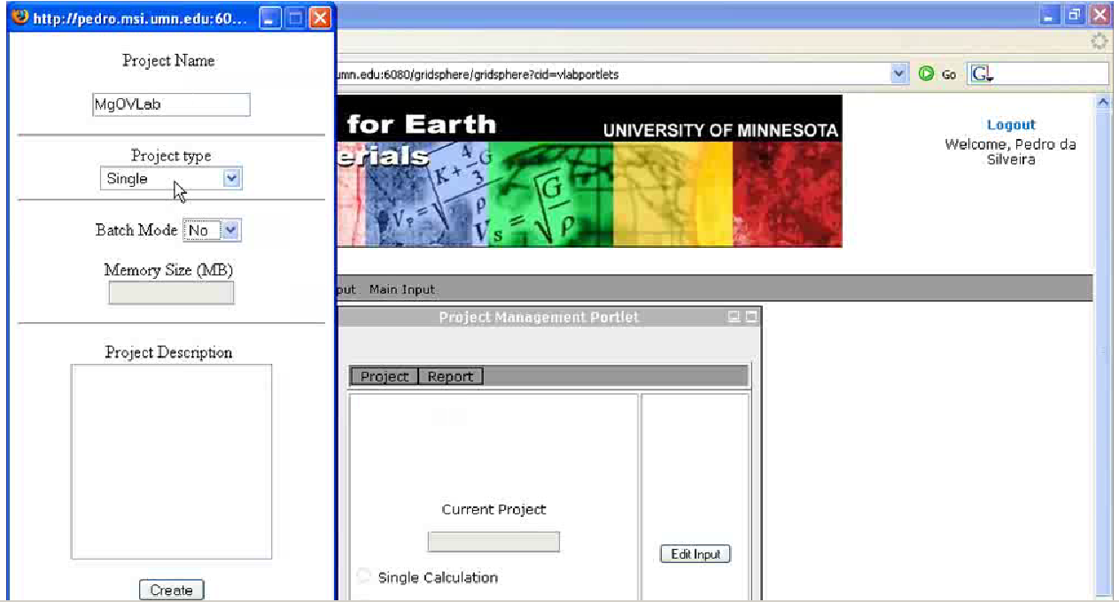
  Generation 2 Gateways:
The VLAB portal, built on Gridsphere

Slide 23
  Generation 3 Gateway software:
  The archetypal Generation 3 Gateway uses a GUI/presentation layer created by the Gateway developer to consume infrastructure services made available via public API.
  (current examples: OGCE; iPlant Foundational API; NEWT)

Slide 24
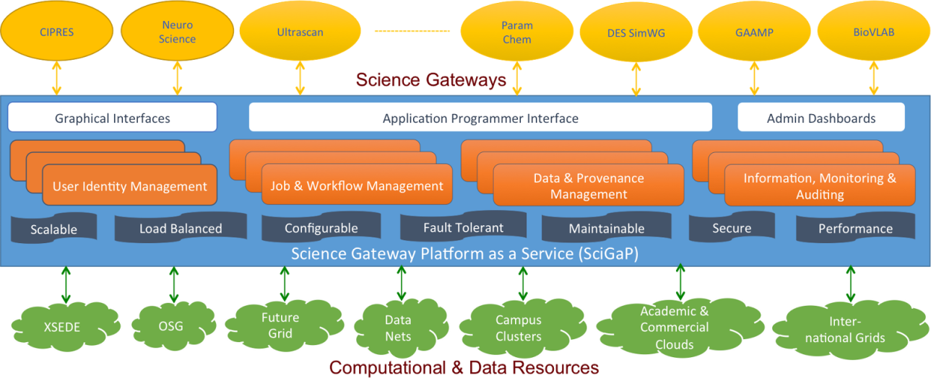
Domain
Gateway
Domain
Gateway
Domain
Gateway
Domain
Gateway
Domain
Gateway
Domain
Gateway
Domain
Gateway
Browser
Interface
Web
Server
Application
Manager

Slide 25
Domain
Gateway
Domain
Gateway
Domain
Gateway
Domain
Gateway
Domain
Gateway
Domain
Gateway
Domain
Gateway
Browser
Interface
Web
Server
Application
Manager
All middleware service provided from a single production
location

Slide 26

  Generation 3 Gateways:
Platform: OCGE
Tools for creating portals using centralized infrastructure web services
OCGE Services currently support several production Gateways.
OCGE Project has committed to open governance:
  Apache RAVE for Interface
  Apache Airavata for middleware
Home page: http://www.collab-ogce.org/ogce/index.php/Main_Page

Slide 27
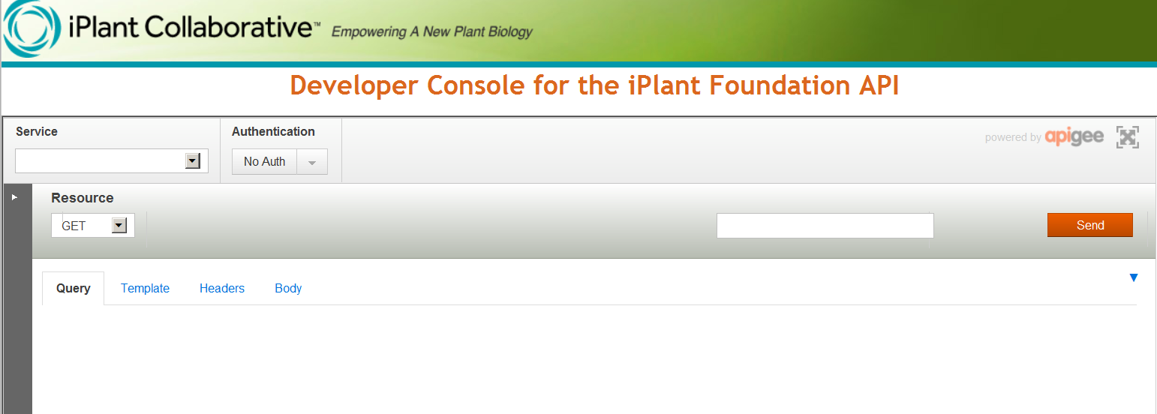
  Generation 3 Gateways:
Platform: iPlant AGAVE Foundational API
Provides centralized public web services for access to XSEDE data and compute resources
https://foundation.iplantcollaborative.org/

Slide 28
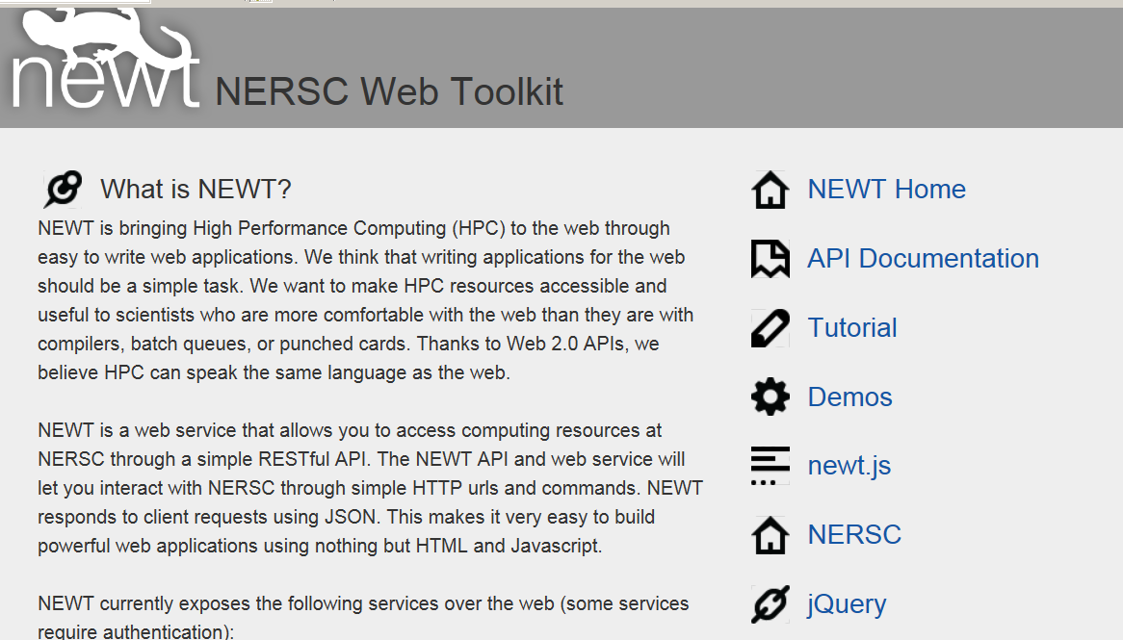
  Generation 3 Gateways:
Platform: NERSC Web Toolkit (NEWT)
Provides centralized public web services for access to NERSC data and compute resources
https://newt.nersc.gov/

Slide 29
  Generation 3 Gateways:
  The Gen 3 concept is still in rapid evolution, with results to be determined.

Slide 30

Another Important Project….
Are you building websites that serve your science discipline?
Do you wish you could connect with and learn from others who are doing the same thing?
We are building an institute to serve you—and others like you—with resources, services, experts, and ideas for creating and sustaining science gateways. Sign up to join the conversation: http://sciencegateways.org/volunteer/
science gateway /sī′ əns gāt′ wā′/ n.
1. an online community space for science and engineering research and education.
2. a Web-based resource for accessing data, software, computing services, and equipment specific to the needs of a science or engineering discipline.

Slide 31
Another Important Project….
Folks from the OGCE, iPlant, and Hubzero projects have partnered with Nancy Wilkins-Diehr of SDSC to create a Science Gateways Institute.
They have received preliminary funding to prepare a proposal for submission in 2014.

Slide 32
Assist with the entire lifecycle of a gateway:
Business plan development and review
Development environment, consulting, documentation and software recommendations
Software repositories
Software engineering facilities
Software assessment services
  like Open Source Software Advisory Service, Apache assessment service, Software Sustainability Institute (UK)
Build-and-test facilities
Hosting service
Offering gateways expertise in the following areas:
  Usability assessment
  Licensing
  Sustainability
  Project management
  Security

Slide 33
  Summary:
The most successful US Gateways in production today are evolved versions of Gen 1 architectures.
The Gen 2 concept of the portlet container did not get sufficient traction in the US. It was hampered by high overhead and unmet expectations leading to low adoption.
The Gen 3 concept is still evolving rapidly in several projects. Centralized infrastructure web services are used by several production Gateways, though this is not yet a generic solution.
Success of the Gen 3 concept will depend on its rate of adoption and the ability to recruit/engage a critical mass of developers.
The ScienceGateways.org project may help bring focus to gateway development and sustainability efforts.

Slide 34
Talk overview
Part 1. Overview of US Gateway development efforts
Part 2. Overview of Issues faced by a growing Gateway

Slide 35


Phylogenetics is the study of diversification of life on the planet Earth, both past and present, and the relationships among living things through time
?

Slide 36
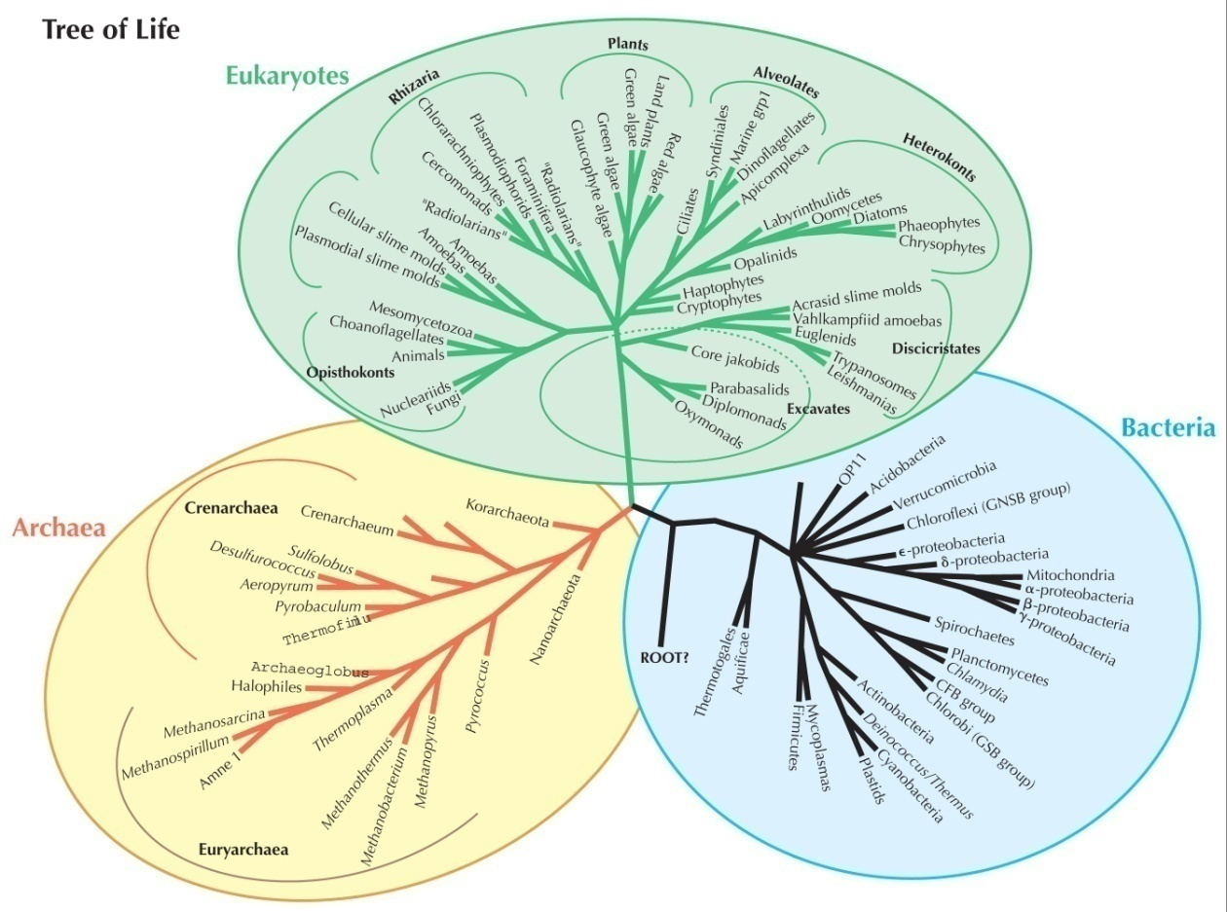
Evolutionary relationships can (for the most part) be represented as a directed acyclic graph.

Slide 37
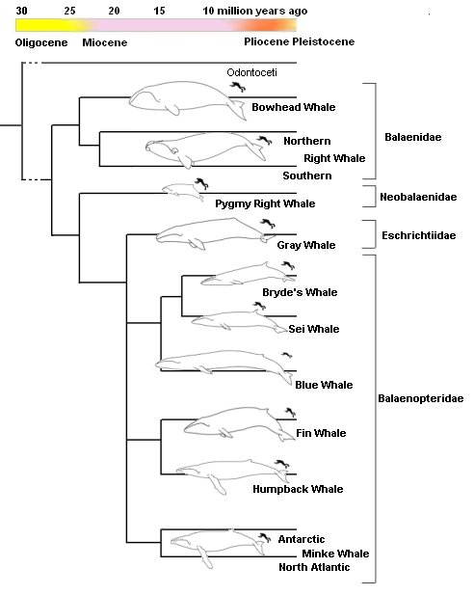
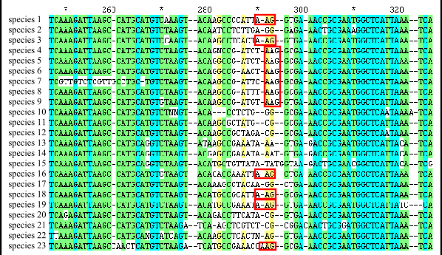
Evolutionary relationships can be inferred from DNA sequence comparisons:
Align sequences to determine evolutionary equivalence:
Infer evolutionary relationships based on some set of assumptions:

Slide 38
Evolutionary relationships can be inferred from DNA sequence comparisons:
Align sequences to determine evolutionary equivalence:
Infer evolutionary relationships based on some set of assumptions:
Tree inference is NP hard, even with heuristics, the codes are compute-intense; desktop computing is no longer adequate….

Slide 39
Workflow for the CIPRES Gateway:
CIPRES Gateway
Assemble Sequences
Upload to
Portal
Run Alignment
Store
Run Tree
Inference
Post-Tree
Analysis
Download

Slide 40
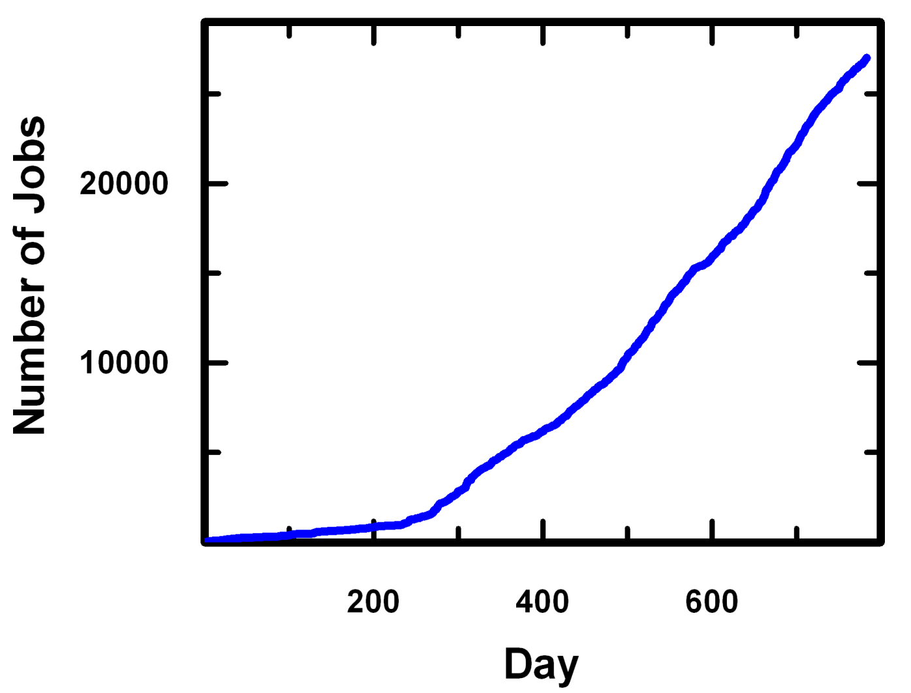

Slide 41
Make all command line options available

Slide 42
Make parallel codes available

Slide 43
  What if you build it and too many people come?
?!?
Core hours (thousands)
Initial allocation

Slide 44
To optimize resource use:
Ensure resource use is as efficient as possible
Make sure resources are used effectively

Slide 45
To optimize resource use:
Ensure resource use is as efficient as possible
Make sure resources are used effectively

Slide 46
Efficiency of resource use:
All codes are benchmarked and configured for good efficiency automatically, based on user input
Make the system robust to system outages, so running jobs are not lost when communication between the server and the compute resource are severed. (saved 7% of long jobs)
Monitor resource use for anomalous spikes in resource consumption per job (e.g. identify and eliminate file system incompatibilities with code).

Slide 47
To optimize resource use:
Ensure resource use is as efficient as possible
Make sure resources are used effectively

Slide 48
Monitor resource distribution:
Identify usage patterns

Slide 49
Usage In the Reporting Period Sept, 2010 – May, 2011
Core hours used | % of Users | % total SU
0 – 30 K | 97 | 45
30 K – 300,000 K | 3 | 55

Slide 50
Usage In the Reporting Period Sept, 2010 – May, 2011
Core hours used | % of Users | % total SU
0 – 30 K | 97 | 45
30 K – 300,000 K | 3 | 55
We need to monitor individual users, because we want all XSEDE users to be subject to the same level of peer review.

Slide 51
Monitor resource distribution:
Identify usage patterns
Establish a Fair Use policy

Slide 52
Establish a Fair Use Policy
Users in the US are permitted to use 50,000 core hours from the community allocation annually.
Users at non-US institutions can use up to 30,000 core hours annually.
Users at US institutions can apply for a personal XSEDE allocation if they require more core hours.

Slide 53
Monitor resource distribution:
Identify usage patterns
Establish a Fair Use policy
Create tools to Enforce Fair Use Policy

Slide 54
Monitor resource distribution:
Identify usage patterns
Establish a Fair Use policy
Create tools to Enforce Fair Use Policy
  Tools to track usage by each user
  Tools to disable submission from over-active accounts
  Tools to notify users when they reach thresholds of use

Slide 55
Monitor resource distribution:
Identify usage patterns
Establish a Fair Use policy
Create tools to Enforce Fair Use Policy
Engage Users in Monitoring their own usage

Slide 56
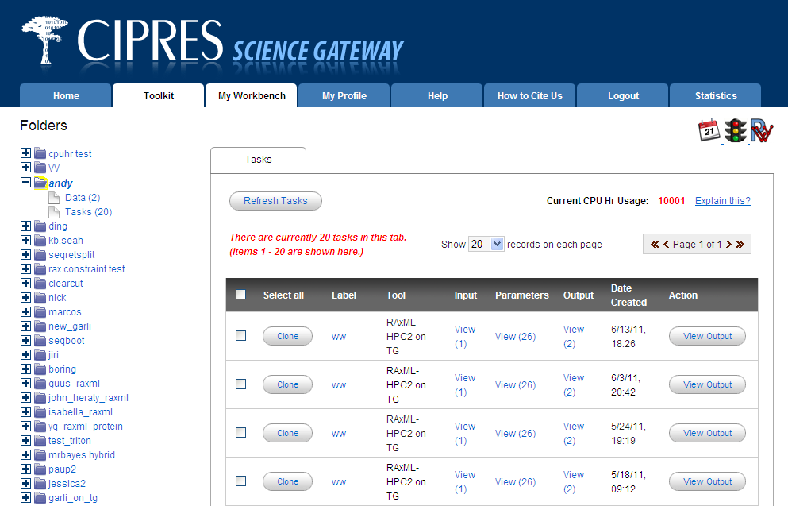
Help users track their resource consumption:
Notify users of their
usage level

Slide 57
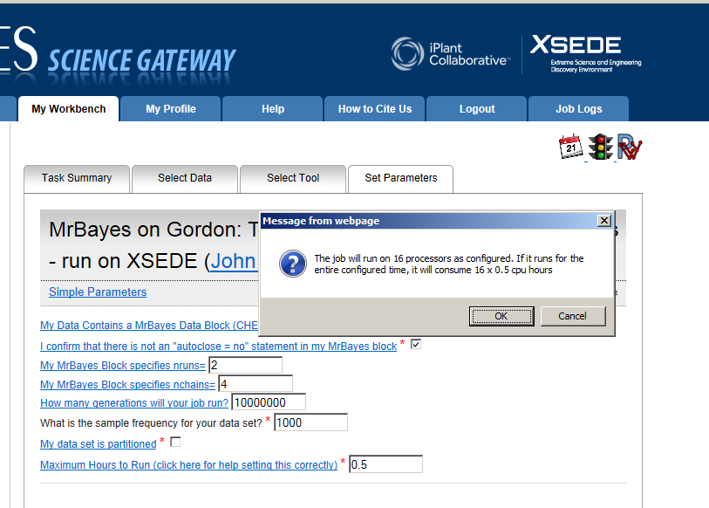
Create a conditional “warning” element in the interface XML

Slide 58
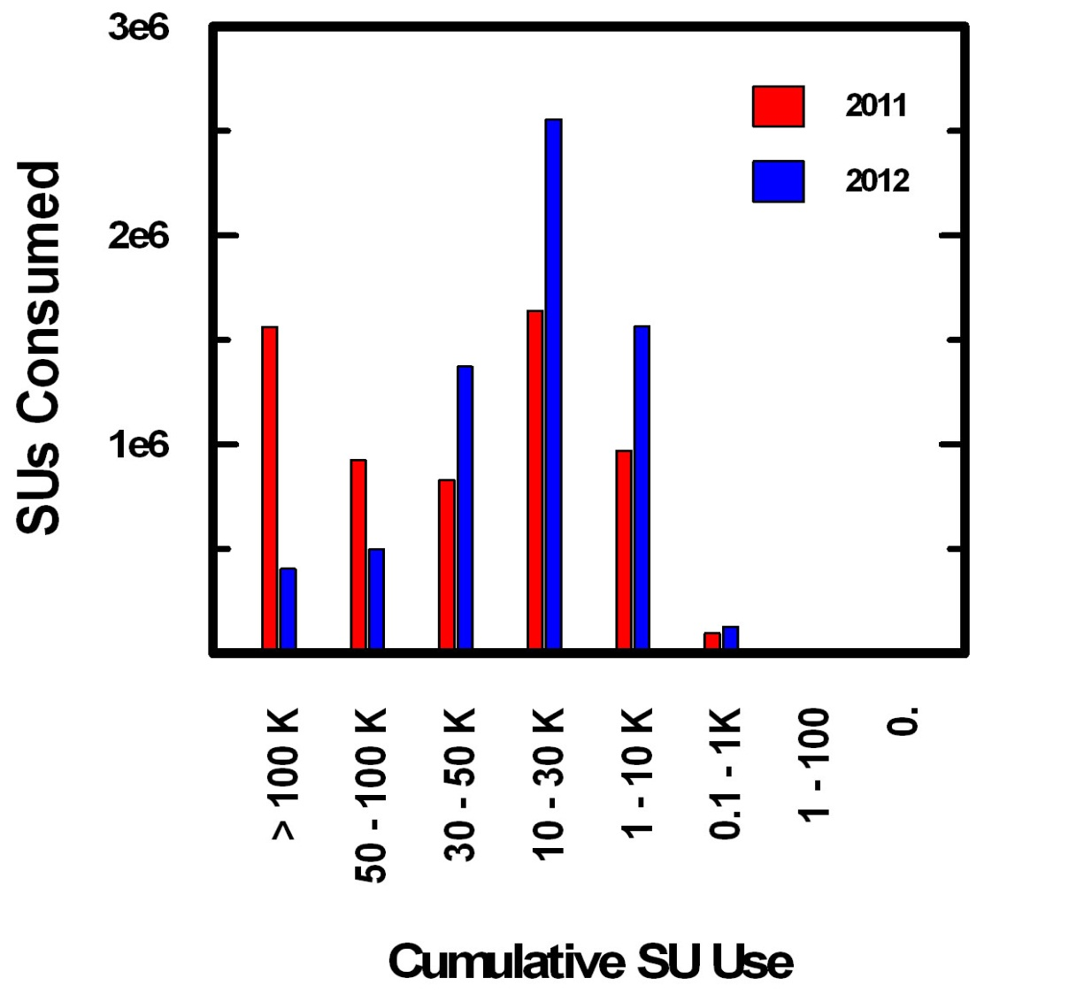
Impact of new policies/tools on user demographics:
2010/11
2011/12
Core Hours Consumed
Cumulative Core Hours

Slide 59
Impact of New Policies/tools on Usage Dec 2009 – Feb 2013
users submit 160 more jobs each month
29,000 more core hours requested each month.
Projected use for 2013 - 2014 is
20 million core hours

Slide 60
Impact of Policy on Usage Dec 2009 – Feb 2013
800
Total Users
600
Users/Month
Repeat Users
400
200
New Users
2010
2011
2012
2013
Year
12
24
36

Slide 61
Impact of Policy on Usage Dec 2009 – Feb 2013
Growth in resource usage is driven primarily by new users, not by waste or high use by a few users….
800
Total Users
600
Users/Month
Repeat Users
400
200
New Users
2010
2011
2012
2013
Year
12
24
36

Slide 62
  What if you build it and too many people come?
?!?
Core hours (thousands)
Initial allocation

Slide 63
  What if you build it and too many people come?
At 14 million core hours/year, the 2012/2013 CSG brings 29% of all XSEDE users, and consumes only about 0.7% of allocatable XSEDE resources.
BUT……..

Slide 64
The CIPRES use case is different from the typical XSEDE resource request:
Most tree inference codes scale to no more than 64 cores.
20% of CSG users are students in classes, so queue time matters
88% of CSG jobs complete within 12 hours, so queue time matters
3% of CSG jobs run for more then 1 week and most codes have no restart capability, so run times of up to 334 hours are required.
These jobs are not a good fit for the intent of the large XSEDE machines

Slide 65
Important Policy Moment:
Based (in part) on our use case, the US NSF created the Trestles cluster to provide “On demand” computing (Thanks, NSF!):
Trestles is managed and allocated to keep queue depth near zero
Administrators allow CSG to run jobs for 334 hours
The machine is significant in size, but small jobs (64 cores or less) are welcomed

Slide 66
Important Policy Moment:
Based (in part) on our use case, the US NSF created the Trestles cluster to provide “On demand” computing (Thanks, NSF!):
Trestles is managed and allocated to keep queue depth near zero
Administrators allow CSG to run jobs for 334 hours
The machine is significant in size, but small jobs (64 cores or less) are welcomed
CIPRES usage now amounts to 21% of the entire allocatable Trestles machine….what if there were 4 Gateways as successful as CIPRES? or for that matter, what about CIPRES in 2017?

Slide 67
If Gateways are valued, we will need supportive policy decisions at the National / International Level about HPC resource allocation.
  More investment by US in “on demand HPC computing”?
  Accommodation of jobs that scale to a small number of cores
  Investment by other countries in “on demand” HPC as a fraction of their total HPC resources, perhaps as a consortium?
  Otherwise:
  Decrease user base by eliminating non- US users? (about half of the total user base)
  Require fee-for-service for non-US users, high-end users, all users?

Slide 68
How to keep the CIPRES Gateway operating?
Annual operating budget
~ $200,000 per year to keep the server functioning
20 million cores hours of compute time for 2013-2014
(generously provided by NSF)
Served 2,800+ scientists in 2012/2013 allocation year
250+ publications enabled in 2012/2013
58+ instructors supported in 2012/2013

Slide 69
There is a strong dynamic tension between innovation and infrastructure
“I think what your Gateway has accomplished is impressive, but unless your proposal describes a plan to create new capabilities that do not exist anywhere, you will not get the scores required to win an award”
Project Officer, US NSF Division of Biological Infrastructure

Slide 70
There is a strong dynamic tension between innovation and infrastructure
“I think what your Gateway has accomplished is impressive, but unless your proposal describes a plan to create new capabilities that do not exist anywhere, you will not get the scores required to win an award”
In other words, we’re having big impact, but NSF isn’t going to pay us to make the CIPRES software better for users (or even to continue operations)…….now what?
Project Officer, US NSF Division of Biological Infrastructure

Slide 71
Survival Strategy 1.
Innovate!

Slide 72
Workflow for the CIPRES Gateway:
CIPRES Gateway
Assemble Sequences
Upload to
Portal
Run Alignment
Store
Run Tree
Inference
Post-Tree
Analysis
Download

Slide 73



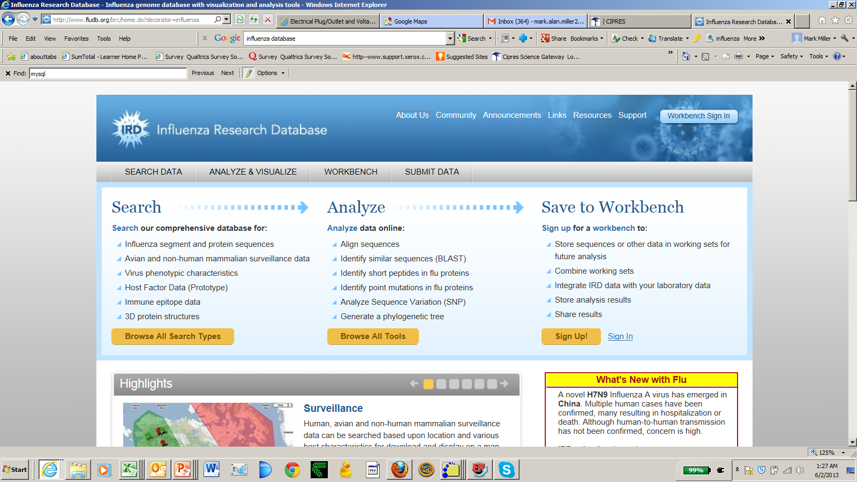
These are highly-evolved desktop/browser applications
That have no tree inference tools or are under powered:
raxmlGUI
Influenza DB

Slide 74
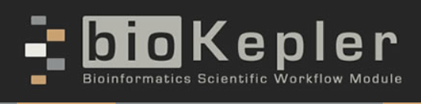
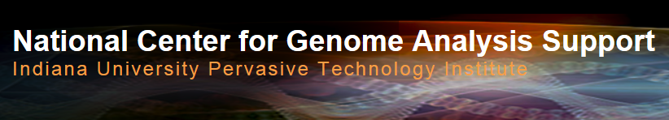

These projects offer powerful and distinct user experiences, and are interested in incorporating powerful tree inference tools into an existing application:

Slide 75
RESTful Services will put CIPRES in many environments
XSEDE
CSG
Parallel codes
raxmlGUI

Slide 76
RESTful Services will put CIPRES in many environments
XSEDE
CSG
Parallel codes
raxmlGUI
With a variety of new user interfaces!

Slide 77
We will be adding complexity, with significant risk, and significant potential benefit.
Stay tuned……

Slide 78
There is a strong dynamic tension between innovation and infrastructure
“Developers may address new research topics in the course of gateway design in order to further their academic goals. Resulting gateways may be more complex than necessary, less reliable, and may not meet the goals of the domain science community for whom they were designed. Focus group participants noted that sometimes simple tools are all that is needed to enable cutting edge science, but [Gateway developers] ‘make the easy things hard.’”
Wilkins-Diehr, N., and Lawrence, K. A. (2010) in Gateway Computing Environments Workshop (GCE), 2010

Slide 79
There is a strong dynamic tension between innovation and infrastructure
To stay federally funded we must continually innovate.
This is not necessarily what users want or need.
Wilkins-Diehr, N., and Lawrence, K. A. (2010) in Gateway Computing Environments Workshop (GCE), 2010

Slide 80
Survival Strategy 2.
Identify new funding models

Slide 81
Let’s start by clarifying the value proposition:
Random user feedback:
“It is hard for me to imagine how I could work at a reasonable pace
without this resource, especially when things like MS or grant submission deadlines loom….”
Gateways add value to Universities by making their professors more competitive

Slide 82
Random user feedback:
“It is an easy-to-use cluster to run BEAST analyses in a short time. This allows students to run analyses that actually converge in a single class.”
“I found it is important to be able to let the student explore the analysis 'all the way', i.e. not just show the principle but actually let them run an entire Markov chain and let them evaluate the results. For that I found that having access to the CIPRES Science Gateway to be crucial.”
Gateways add value to Universities by making their classroom instruction better

Slide 83
The CSG has supported researchers funded by awards from:
In the US:
14 governmental agencies
26 non-governmental organizations
25 Universities
On 5 other continents:
63 governmental agencies
10 non-governmental organizations
30 Universities
Gateways add value to many other organizations as well….

Slide 84
To preserve the spirit of Science Gateways, we must find a way to pitch the value proposition above the level of individual investigators….
Above-campus models have been used successfully by others:
See the Kuahli foundation (http://www.kuali.org/)
as an example.
Can such models be crafted for Gateways?

Slide 85
To be continued….

Slide 86
Acknowledgements:
CIPRES Science Gateway Terri Schwartz
Hybrid Code Development Wayne Pfeiffer
Alexandros Stamatakis
XSEDE Implementation Support Nancy Wilkins-Diehr
Doru Marcusiu
Leo Carson
Mahidhar Tatineni
Workbench Framework: ` Terri Schwartz
Paul Hoover
Lucie Chan
Jeremy Carver

