Slide 1
Improving the Swiss Grid Proteomics Portal
Peter Kunszt, Lorenz Blum, Béla Hullár, Emanuel Schmid, Adam Srebniak, Witold Wolski, Bernd Rinn, Franz-Josef Elmer, Chandrasekhar Ramakrishnan, Andreas Quandt and Lars Malmström
Notes:
Intro
Requirements
1 single user
2 non customize for end-user
3 error trace through steps difficult
4 rescuing wf not user-friendly
5 grid certificates
6 difficult input dataset selection (old bidb table)
7 newcomers need same portal/infrastructure to develop
===========================================
High-level Requirements
1-1 local user
1-2 configurable
1-3 input output error background
1-4 GUI improve
1-5 bg gridcert
1-6 uniprot + sprot + self easy managing
1-7 outside users ruffus
Implementation
A cluster auth 1
B gridcert 5
C GUI submission 2+4
D GUI monitoring errortrace rescuing 4
E wrap a lot 3
F BioDB 6
G Ruffus

Slide 2
Introduction
Life Sciences have become data intensive
  Systems Biology has to deal with large amounts of mass spectrometry data
SyBIT (part of SystemsX.ch initiative) provides data management support for laboratories
  Build a web-based science gateway for data analysis at the Institute of Systems Biology (IMSB) at ETHZ.

Slide 3
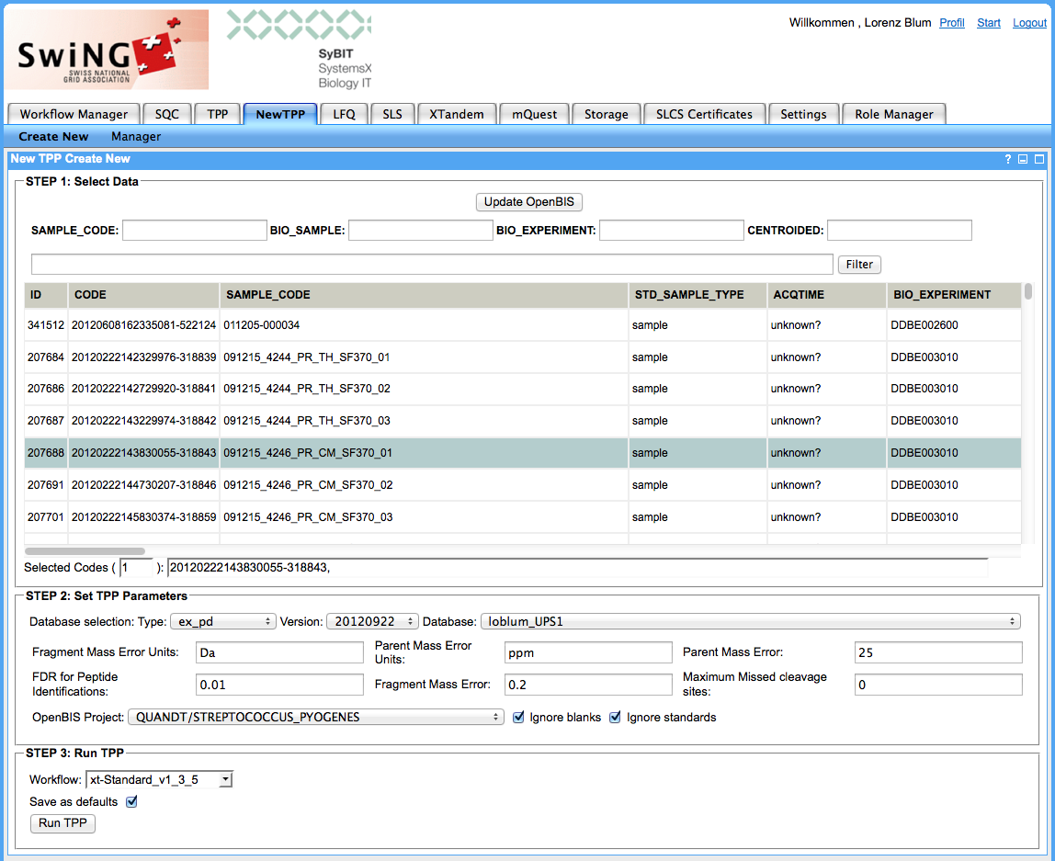
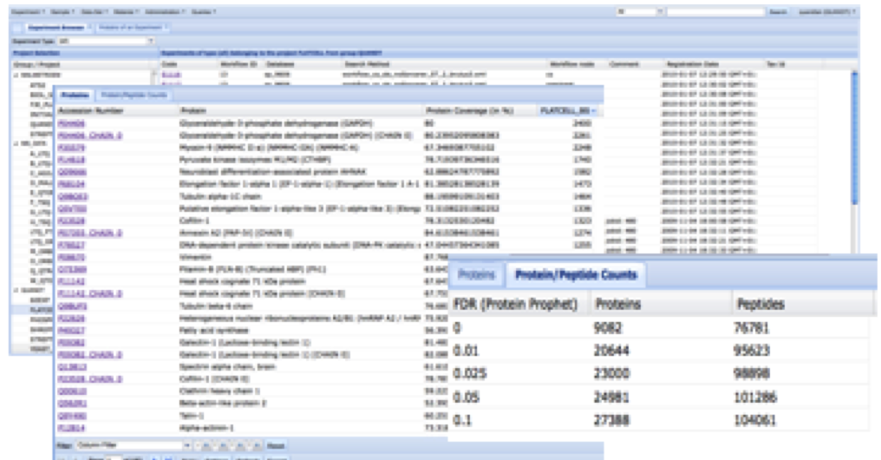
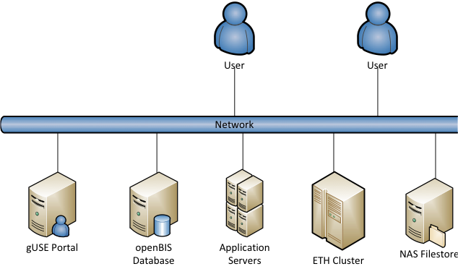
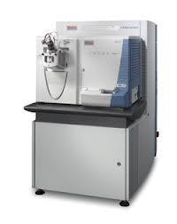
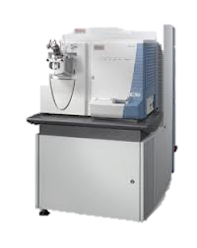
System Setup
openBIS WebUI
Proteomics Portal
Mass Spectrometry Instruments
openBIS
Data Storage Server
ETH Cluster

Slide 4
What happened so far…
Built Swiss Grid Proteomics Portal in 2010, based on
P-GRADE
After initial phase feedback was collected
Assembled requirements
for next version

Slide 5
Problems/Requirements
Grid accessibility
  All jobs were submitted with the same credentials
  Setup of Grid certificates too complex

Slide 6
Problems/Requirements
Portal User Interface
  Not intuitive enough (one large page)
  Not flexible enough (parameters / parameter sets)
  Lack of reference dataset management

Slide 7
Problems/Requirements
Workflow development
  Input/output handling, logging different for each tool
  No simple way to prototype workflows outside
  P-GRADE infrastructure

Slide 8
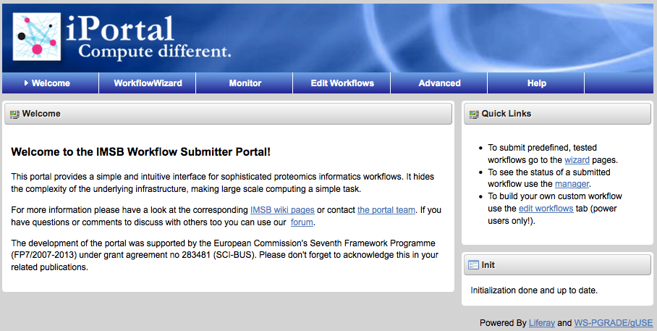
2nd edition: iPortal

Slide 9
Grid Acessibility
new P-GRADE version (gUSE/WS-PGRADE)
+ first-time login popup
to set up cluster resources
Grid certificate handling still not solved

Slide 10
Portal UI
  gUSE is Liferay based -> simpler web development
Workflow wizard
  Better guidance, simplified UI
  Simple to add more configuration options (number, text, selection)
Workflow monitor
  Compact UI
  Simple "rescue" button

Slide 11
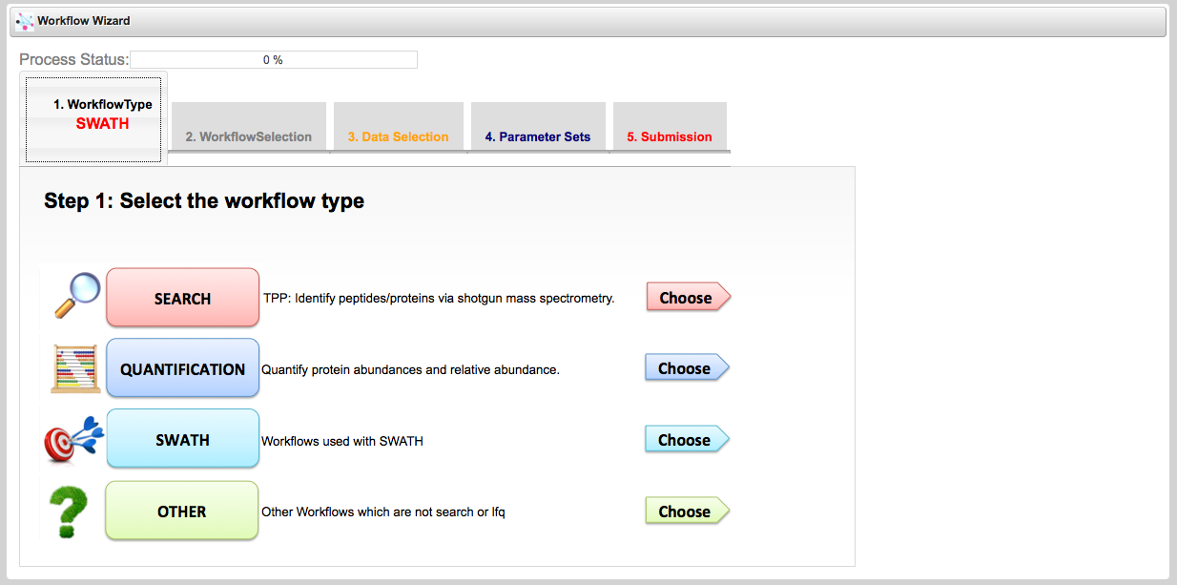
Workflow Wizard

Slide 12
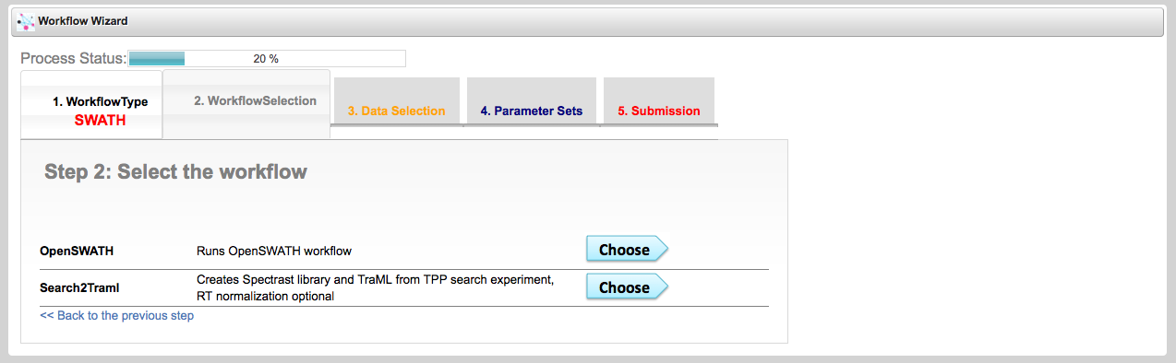
Workflow Wizard

Slide 13
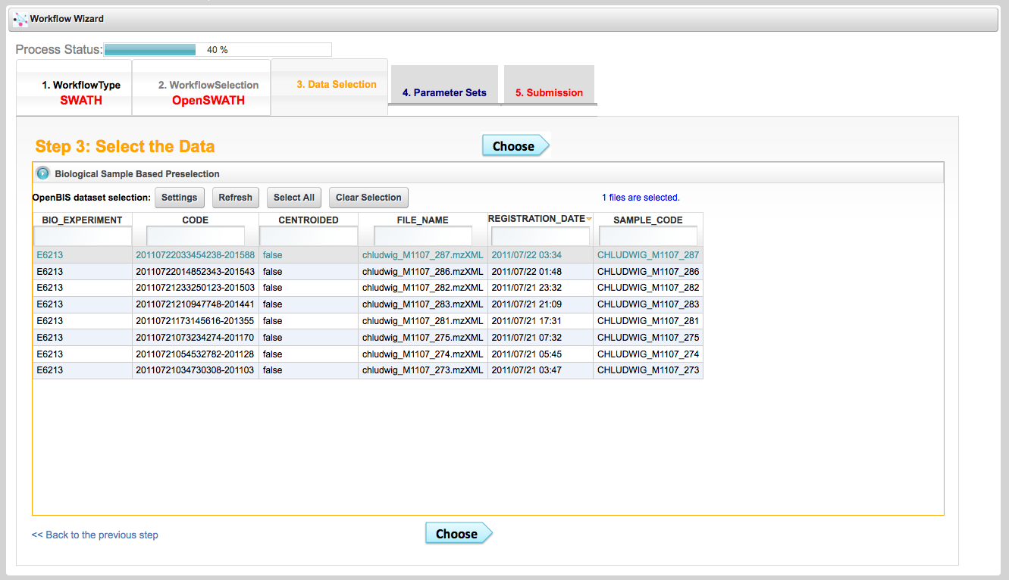
Workflow Wizard
openBIS

Slide 14
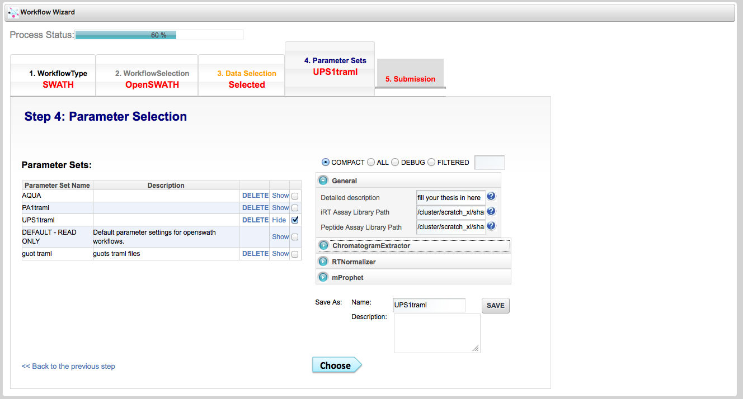
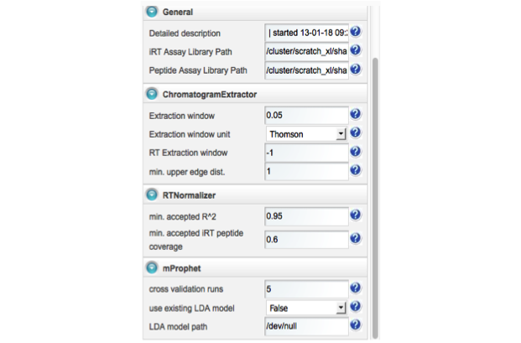
Workflow Wizard

Slide 15
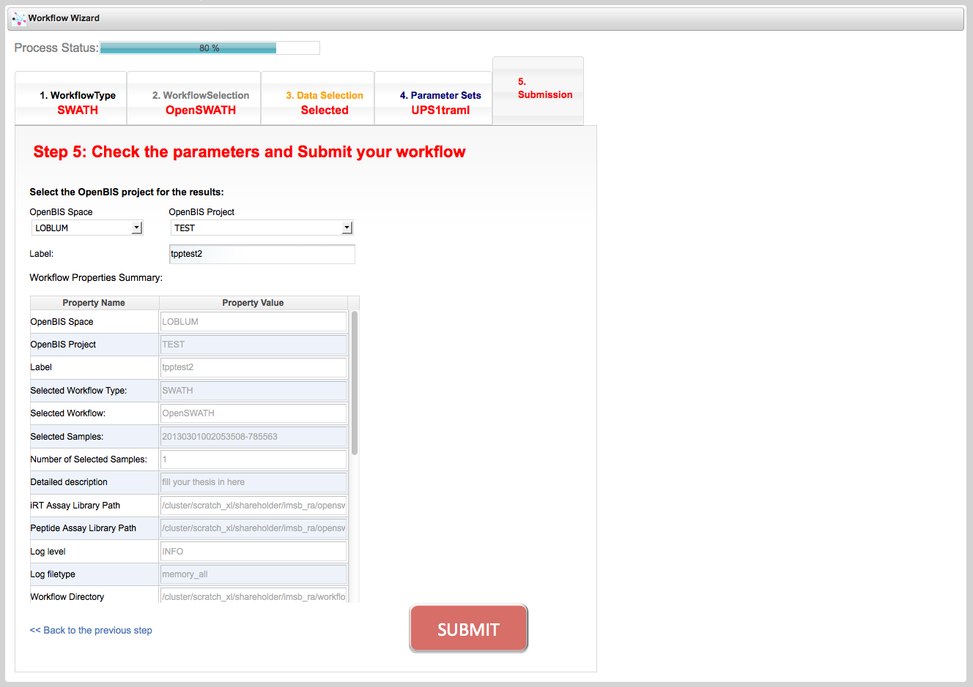
Workflow Wizard
ETH Cluster

Slide 16
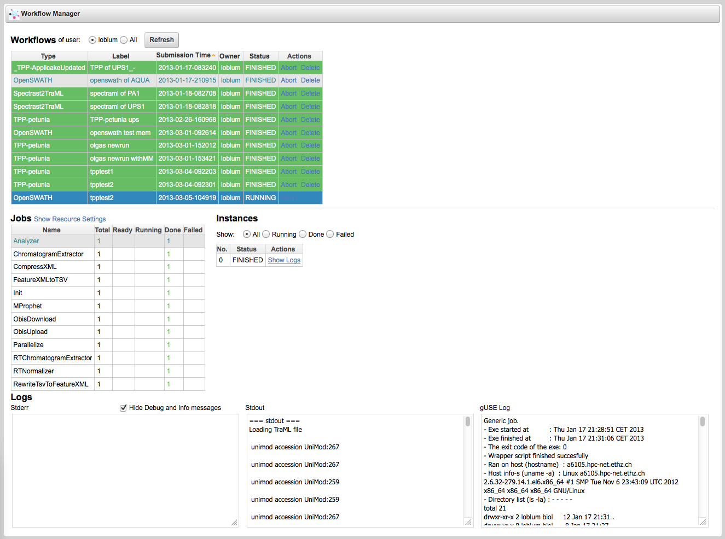
Workflow Monitor

Slide 17
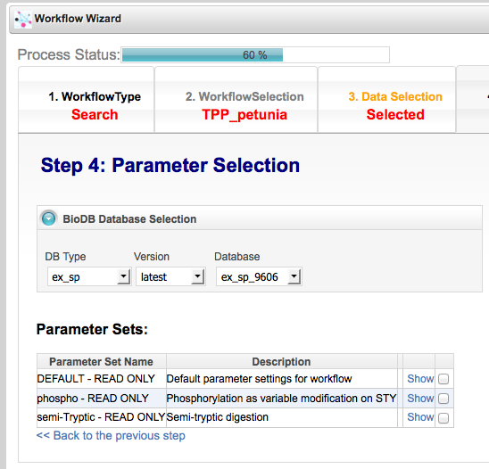
BioDB
  "The BioDB project is about providing a synchronized distribution mechanism for public and secondary (derived) datasets all across Switzerland. "
  Automatical update and distribution of reference databases like Swiss-Prot, SGD
https://wiki.systemsx.ch/display/BIODB
BioDB Server

Slide 18
Workflow Development
applicake
  Each node
    gets one input parameter file
    executes a program
    validates the run
    creates one output parameter file, which is passed to the next node
  Errors and log messages are standardized
http://www.sybit.net/projects/1342100-applicake

Slide 19

Workflow Development
Ruffus
  Lightweight workflow engine
    Manages dependencies
    Parallel jobs
    Rescuing of failed workflows
  Works well with applicake nodes
  Simple DRMAA extension allows to use cluster
http://www.ruffus.org.uk/

Slide 20
Summary
New P-GRADE version for better cluster support
Workflow Wizard & Monitor are (more) easy to use user interfaces
BioDB for reference database handling
Applicake to wrap execution of tools
Ruffus to prototype workflows w/o portal

Slide 21
Outlook
BioDB: Extend with personal databases
Access to further infrastructure
  Grid certificates
  Public cloud access
New workflows

Slide 22
Acknowledgements
SyBIT @ IMSB: Peter Kunszt, Béla Hullár, Emanuel Schmid, Adam Srebniak, Witold Wolski
CISD: Bernd Rinn, Franz-Josef Elmer, Chandrasekhar Ramakrishnan
IMSB: Andreas Quandt and Lars Malmström
…you for your attention

