Slide 1
Scaling bio-analyses from computational clusters to grids
1
George Byelas
University Medical Centre Groningen, the Netherlands
IWSG-2013, Zürich, Switzerland, June 3rd, 2013

Slide 2
Content
Bio-workflows
Workflow
  Modeling
  Job Generation
  Tool deployment
  Data management
  Workflow execution
  Implementation detail
  Recent developments
Conclusion and further steps

Slide 3
Bio-workflows

Slide 4
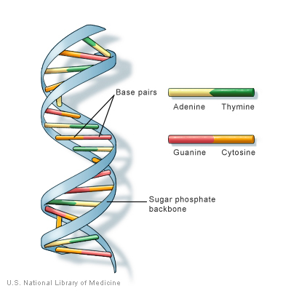
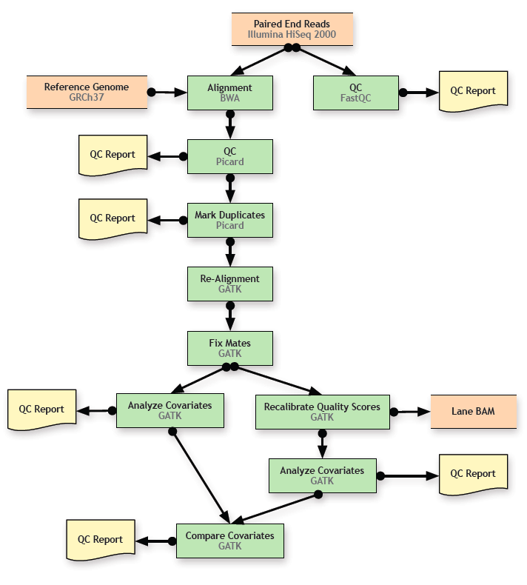
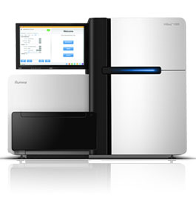
Example: NGS alignment workflow
Per Project:
Aligned reads
QC-reports
SNP lists
HiSeq
alignment
workflow
Raw data
Result data
10-100 samples
20 – 200 days
80 – 800 GB

Slide 5
Alignment & SNP calling workflow
31 steps, ≥ 2 days per sample
Input
  Analysis protocols
  Sample DNA data
  Reference DNA data
Analysis
  Scripts are generated and executed
Output
  Aligned DNA and QC reports

Slide 6
An analysis job (script) generated from a protocol
#!/bin/bash
#PBS -q test
#PBS -l nodes=1:ppn=4
#PBS -l walltime=08:00:00
#PBS -l mem=6gb
#PBS -e $GCC/test_compute/projects/batch4/intermediate/test1/err/err_test1_BwaElement1A102a_FC81D90ABXX_L7.err
#PBS -o $GCC/test_compute/projects/batch4/intermediate/test1/out/out_test1_BwaElement1A102a_FC81D90ABXX_L7.out
mkdir -p $GCC/test_compute/projects/batch4/intermediate/test1/err
mkdir -p $GCC/test_compute/projects/batch4/intermediate/test1/out
printf "test1_BwaElement1A102a_FC81D90ABXX_L7_started " >>$GCC/test_compute/projects/batch4/intermediate/test1/log_test1.txt
date "+DATE: %m/%d/%y%tTIME: %H:%M:%S" >>$GCC/test_compute/projects/batch4/intermediate/test1/log_test1.txt
date "+start time: %m/%d/%y%t %H:%M:%S" >>$GCC/test_compute/projects/batch4/intermediate/test1/test1_BwaElement1A102a_FC81D90ABXX_L7.txt
echo running on node: `hostname` >>$GCC/test_compute/projects/batch4/intermediate/test1/test1_BwaElement1A102a_FC81D90ABXX_L7.txt
/target/gpfs2/gcc/tools//bwa-0.5.8c_patched/bwa aln \
/target/gpfs2/gcc/resources/hg19/indices/human_g1k_v37.fa \
$GCC/test_compute/projects/batch4/rawdata/110121_I288_FC81D90ABXX_L7_HUMrutRGADIAAPE_1.fq.gz \
-t 4 \
-f $GCC/test_compute/projects/batch4/intermediate/A102a_110121_I288_FC81D90ABXX_L7_HUMrutRGADIAAPE_1.fq.gz.sai
printf "test1_BwaElement1A102a_FC81D90ABXX_L7_finished " >>$GCC/test_compute/projects/batch4/intermediate/test1/log_test1.txt
date "+finish time: %m/%d/%y%t %H:%M:%S" >>$GCC/test_compute/projects/batch4/intermediate/test1/test1_BwaElement1A102a_FC81D90ABXX_L7.txt
date "+DATE: %m/%d/%y%tTIME: %H:%M:%S" >>$GCC/test_compute/projects/batch4/intermediate/test1/log_test1.txt
backend specific
analysis specific

Slide 7
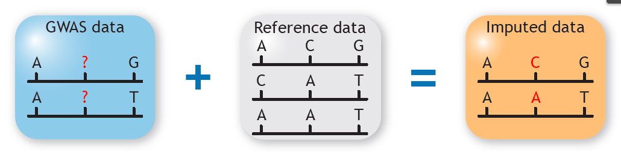


Imputation workflow
Imputation:
Number of jobs
One run:

Slide 8
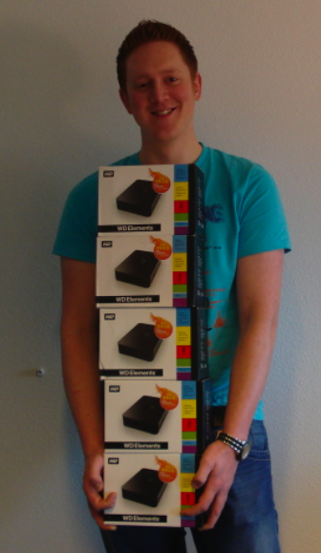
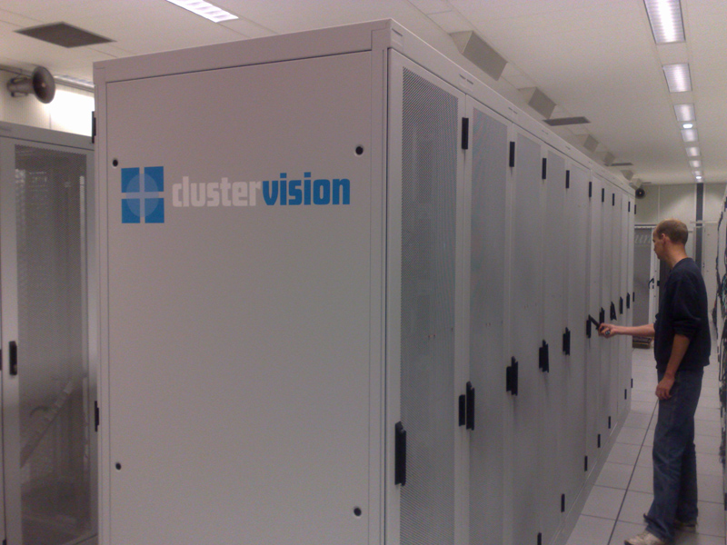
Bio-workflow complexity
Many analysis steps
  Many analysis jobs
  Different analysis tools and their dependencies
Large various data involved
Heterogeneous resources

Slide 9
Workflow design and generation

Slide 10
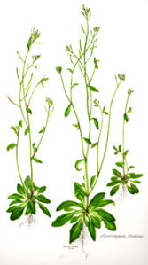



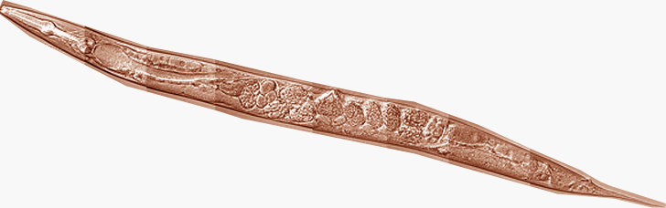
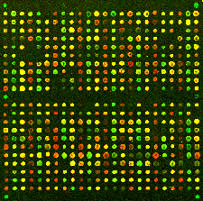



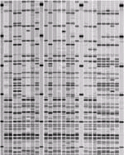

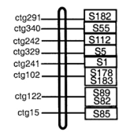



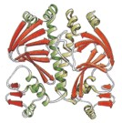

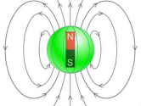



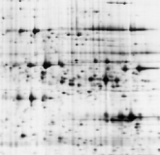



MOLGENIS approach
Model
Generate
Use
Species...
Analyses...
Projects ...

Slide 11
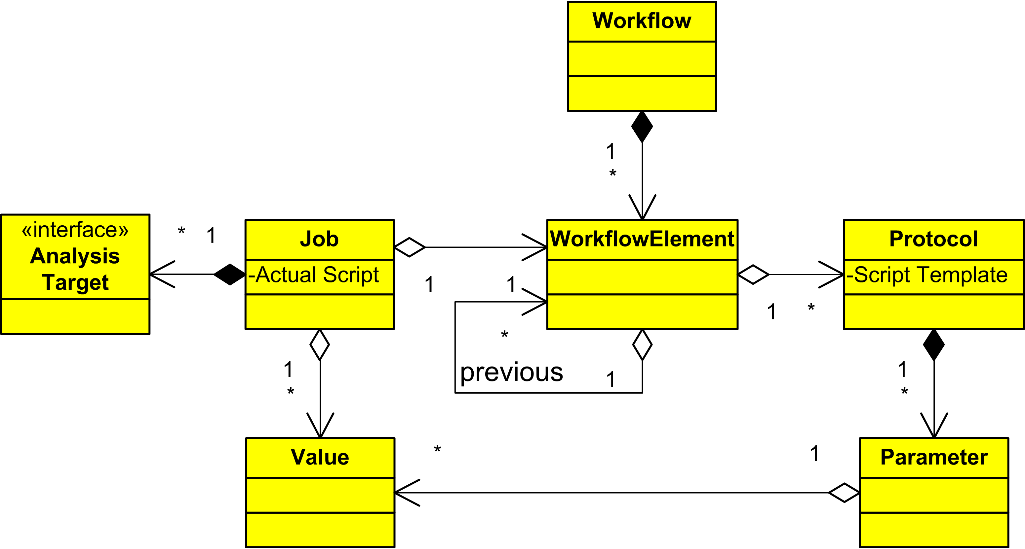
Workflow design
Jobs are generated from the model
Every job has an analysis target (e.g. Genome region)

Slide 12
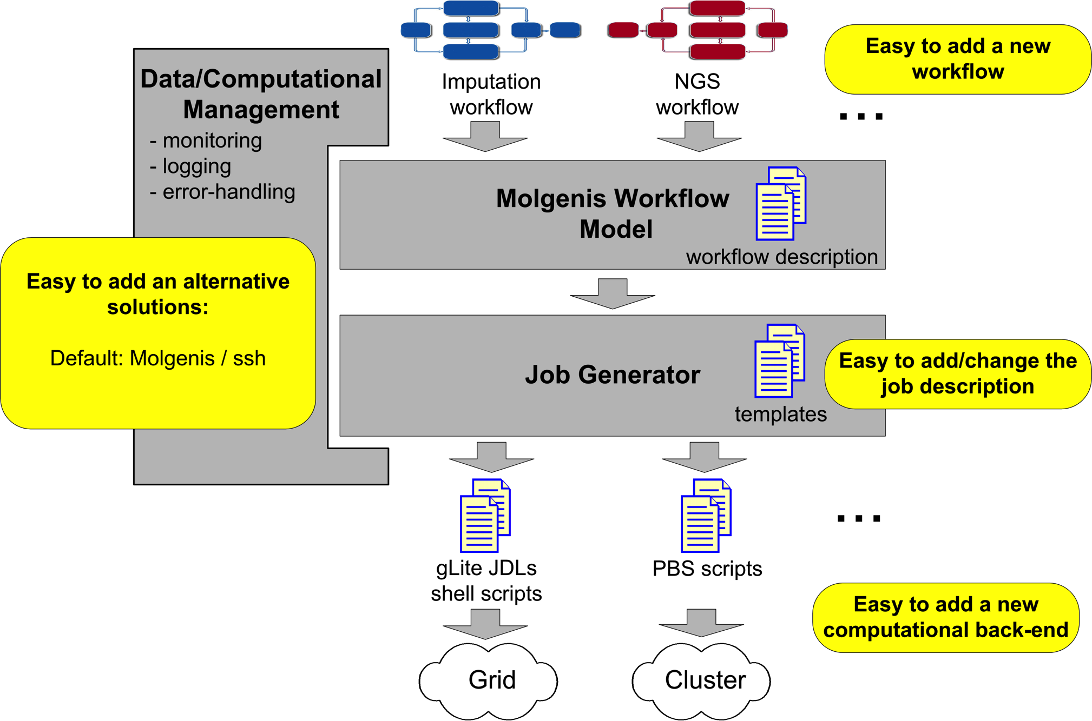
Command-line generator ( Demo @ IWSG-2012)
Generates jobs (scripts) from model described in files
Suitable for workflows (PBS cluster) and single jobs (gLite grid)

Slide 13
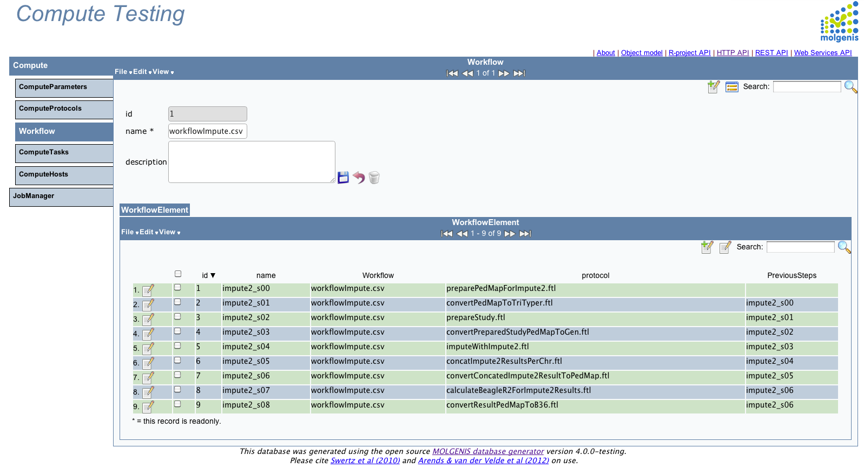
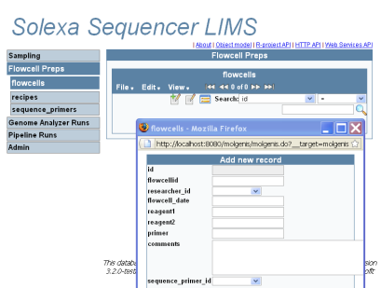



Database solution with MOLGENIS software toolkit (1)
Model (xml)
Use (web)
Molgenis/compute
Workflow
Generator (java)
NextGenSeq
Animal Observatory
Model organisms

Slide 14
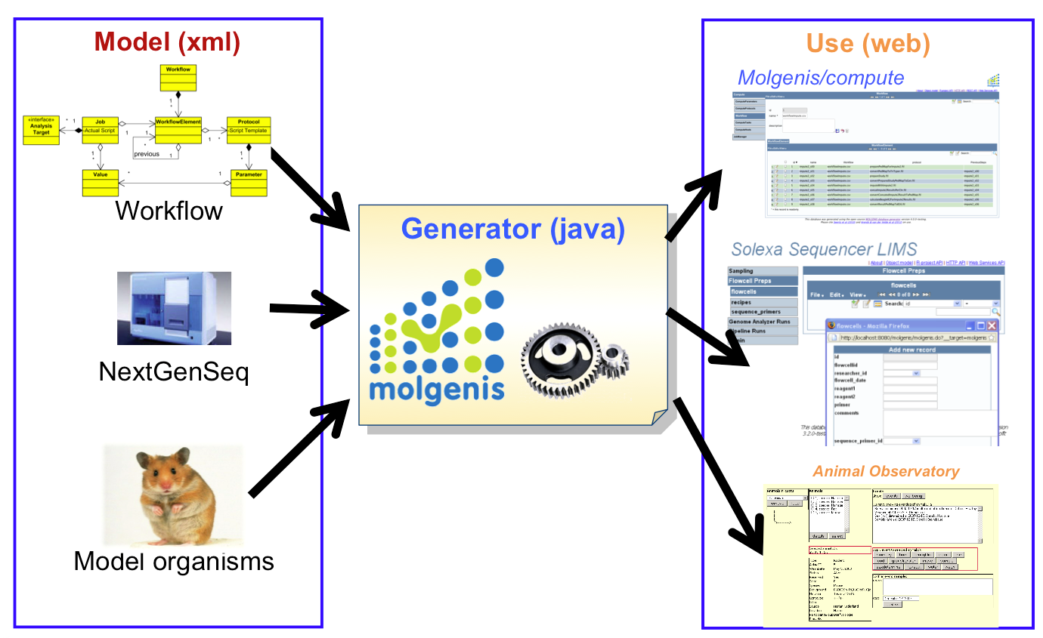
Database solution with MOLGENIS software toolkit (2)
Model
  workflow.xml / 100 loc
  ui.xml / 25 loc
Generate
  *.sql / 1722 loc
  *.java / 46639 loc
1 : 400!

Slide 15
Workflow design view in the generated Molgenis web-UI
workflow
step
analysis
protocol
previous steps

Slide 16
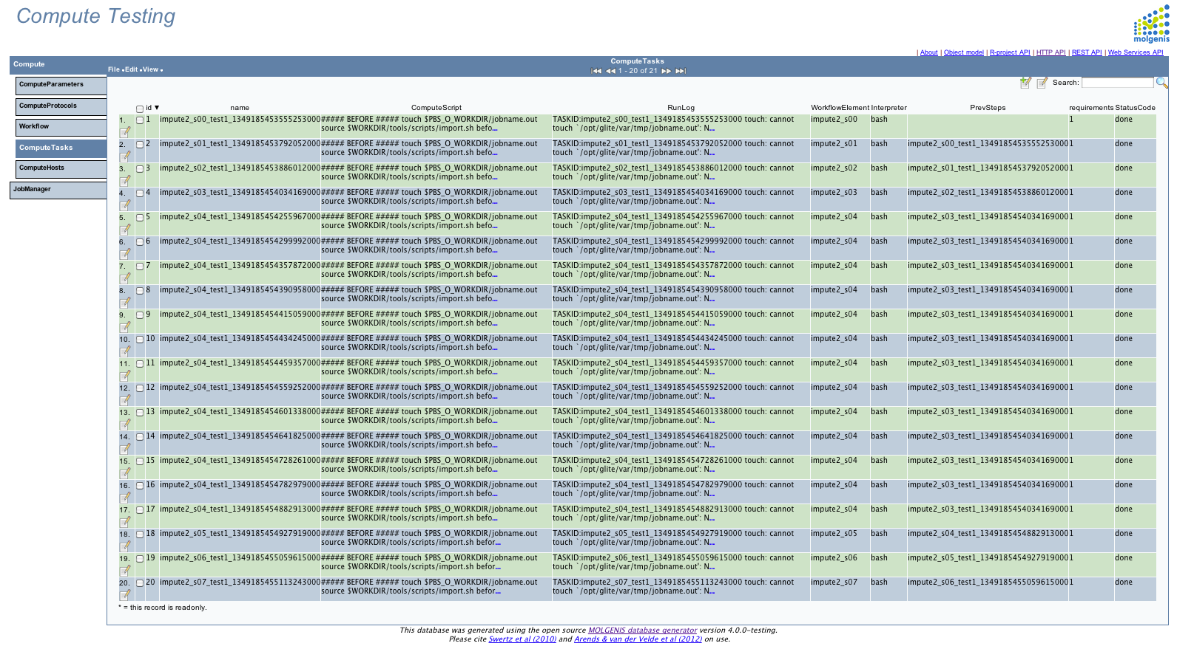
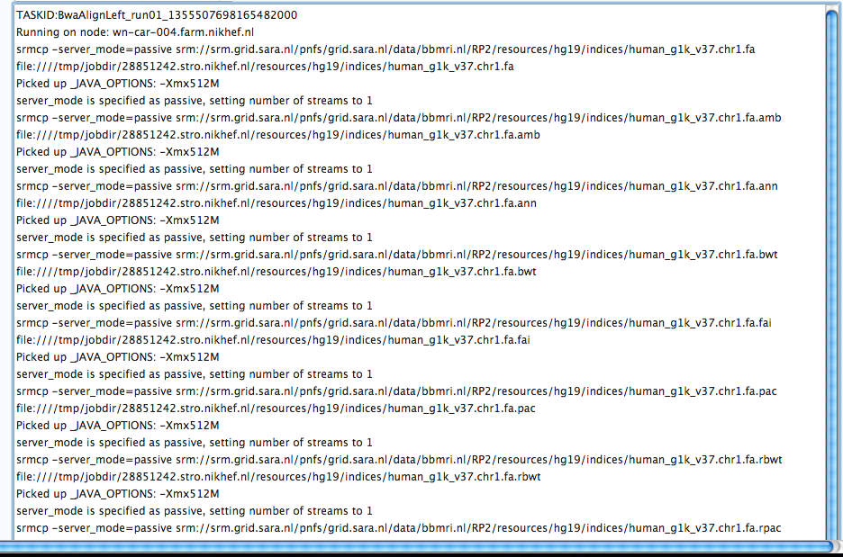
Workflow run-time view (analysis jobs)

Slide 17

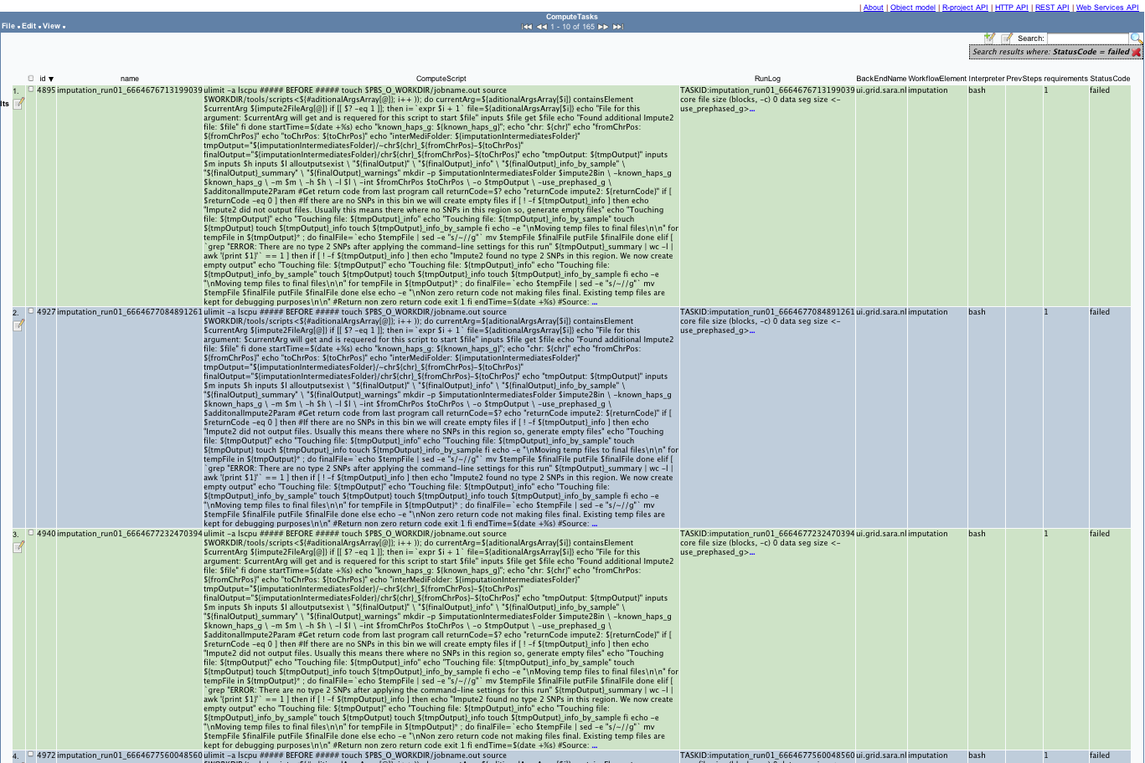
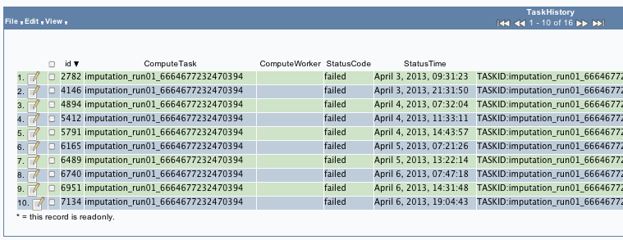
Failed jobs overview
chr: 4 from: 185000001 to: 190000001
Running on node: v33-45.gina.sara.nl
Error: terminate called after throwing an instance of 'std::bad_alloc'
what(): St9bad_alloc
How much memory:
virtual memory (kbytes, -v) 4194304

Slide 18
Workflow deployment

Slide 19
Computational environments
(Inter)national
grid
Cluster compute
Tool
environment
Local compute/cloud
ease of use vs. redundancy & scale
Distributed grid
storages
Local storage/cloud
Cluster
storage
Data
environment

Slide 20
“Harmonized” tool management
Tool in input sandbox
“getFile(‘tool.zip’)”
Tool deployed as
“load module”
In $WORKDIR
Download
In $VO_BBMRI_NL_SW_DIR
Download
Build
Configure
Simple download vs. On-site build deployment

Slide 21
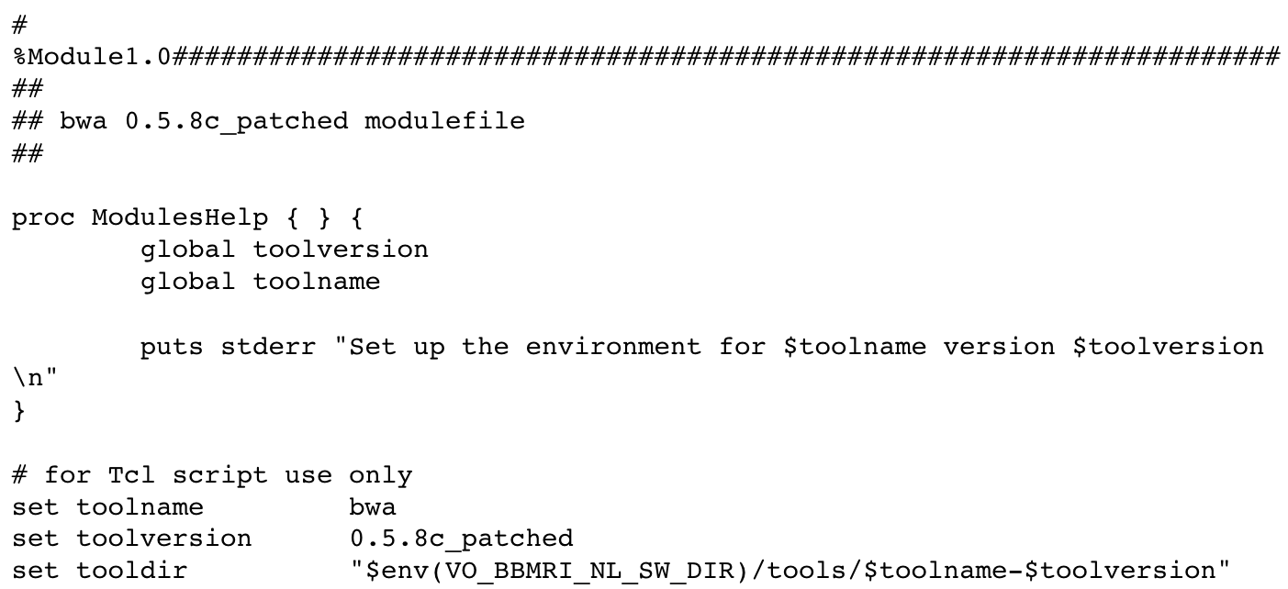
‘Harmonized’ tool management: modules
Build using standard ‘modulecmd’ tool
Software should be deployed at all grid sites
Module file should be added to all sites
http://www.bbmriwiki.nl/svn/ebiogrid/modules/

Slide 22
Workflow execution

Slide 23
Execution topology
Started pilot jobs retrieve analysis jobs from
Molgenis server

Slide 24
Workflow execution with pilots (1)
glite-wms-job-submit \
-d $USER … $HOME/maverick.jdl
curl … -F status=started \
-F backend=ui.grid.sara.nl \
http://$SERVER:8080/api/pilot > script.sh

Slide 25
Workflow execution with pilots (2)
bash -l script.sh 2>&1 \
| tee -a log.log &
curl … -F status=done \
-F log_file=@done.log \
http://$SERVER:8080/api/pilot

Slide 26
Workflow execution with pilots (3)
while [ 1 ] ; do
…
check_process "script.sh”
CHECK_RET=$?
if [ $CHECK_RET -eq 0 ];
then
…
curl … -F status=nopulse \
-F log_file=@inter.log …
…
elif
…
curl … -F status=pulse \
-F log_file=@inter.log …
…

Slide 27
Back-end independent analysis templates

Slide 28
Template structure
//header
#MOLGENIS walltime=15:00 nodes=1 cores=4 mem=6
//tool management
module load bwa/${bwaVersion}
//data management
getFile ${indexfile}
getFile ${leftbarcodefqgz}
//template of the actual analysis
bwa aln \
${indexfile} ${leftbarcodefqgz} \
-t ${bwaaligncores} -f ${leftbwaout}
//data management
putFile ${leftbwaout}

Slide 29
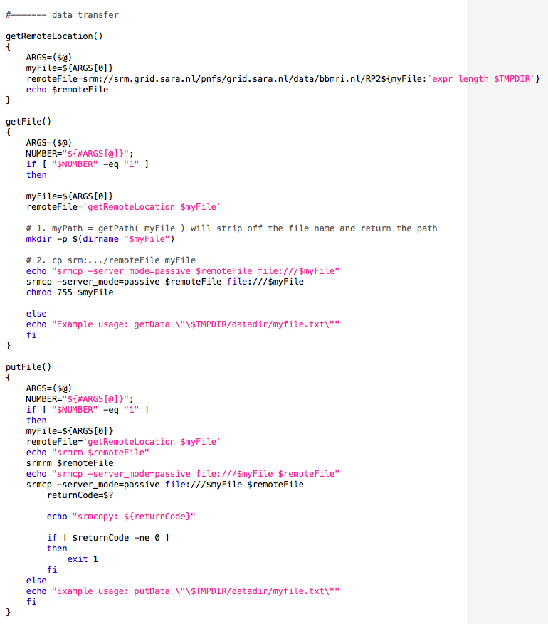
Data transfer
getFile and putFile
  are back-end specific
  now, we
    check if the files are present (cluster or localhost)
    do srm/lfn file transfer (grid)
Input
Generated output
getFile ${studyInputPedMapChr}.map
getFile $WORKDIR/groups/gonl/projects/imputationBenchmarking/eQtl/hapmap2r24ceu/chr20.map

Slide 30
Generated back-end independent script
//header
#MOLGENIS walltime=15:00 nodes=1 cores=4 mem=6
//tool management
module load bwa/0.5.8c_patched
//data management
getFile $WORKDIR/resources/hg19/indices/human_g1k_v37.fa
getFile $WORKDIR/groups/gcc/projects/cardio/run01/rawdata/121128_SN163_0484_AC1D3HACXX_L8_CAACCT_1.fq.gz
//template of the actual analysis
bwa aln \
human_g1k_v37.fa 121128_SN163_0484_AC1D3HACXX_L8_CAACCT_1.fq.gz -t 4 \
-f 121128_SN163_0484_AC1D3HACXX_L8_CAACCT_1.bwa_align.human_g1k_v37.sai
//data management
putFile $WORKDIR/groups/gcc/projects/cardio/run01/results/121128_SN163_0484_AC1D3HACXX_L8_CAACCT_1.bwa_align.human_g1k_v37.sai

Slide 31
Current developments

Slide 32
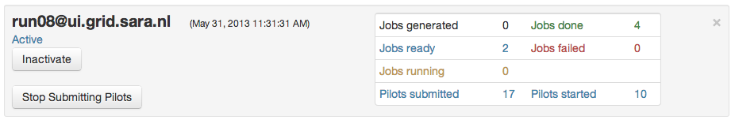
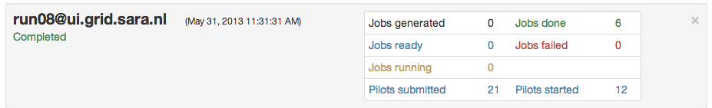
Pilots Dashboard
During execution
Workflow is completed

Slide 33
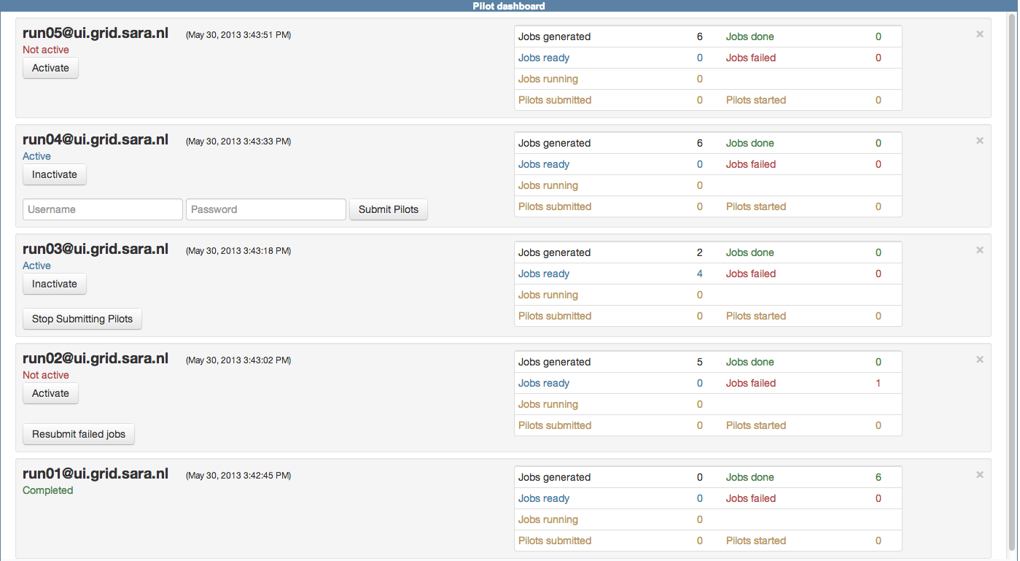
Dash-board for jobs monitoring (work-in-progress)

Slide 34
Enhancements and further steps
What if not all parameters are known at the generation time
  Run-time parameters passing to DB from previous steps (implemented)
Advanced pilot management
  Pilots re-using
Better workflow visualization
  Showing workflow elements and their properties
  H. Byelas and M. Swertz, “Visualization of bioinformatics workflows for ease of understanding and design activities,” Proceedings of the BIOSTEC BIOINFORMATICS-2013 conference, pp. 117–123, 2013.

Slide 35
Conclusion

Slide 36
Conclusion
One protocol template style that is suitable for different back-ends
Workflow tools deployment using module system
Hidden in scripts data management
Workflow execution using pilot jobs

Slide 37

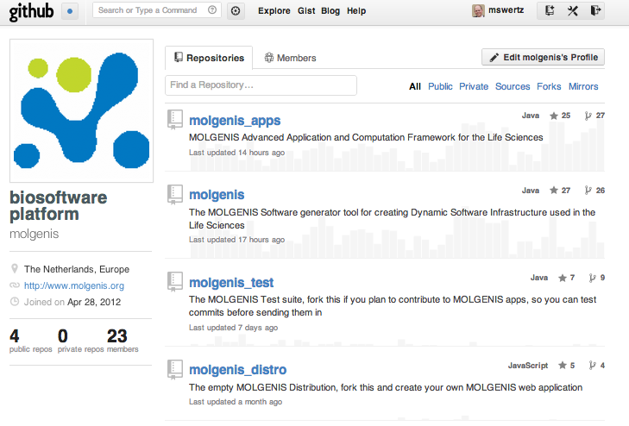
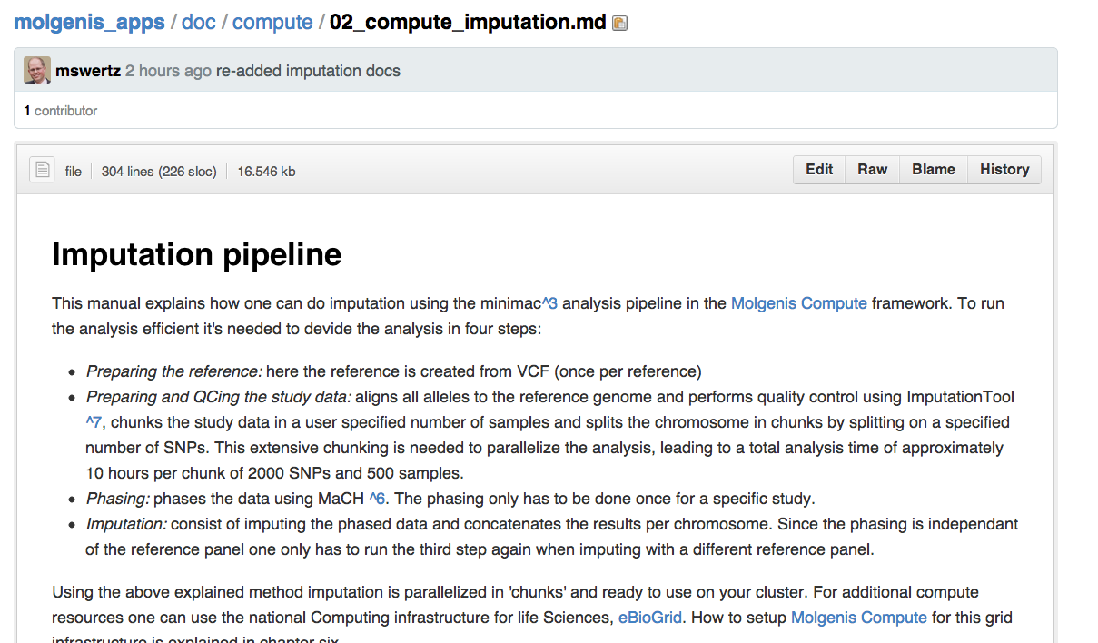
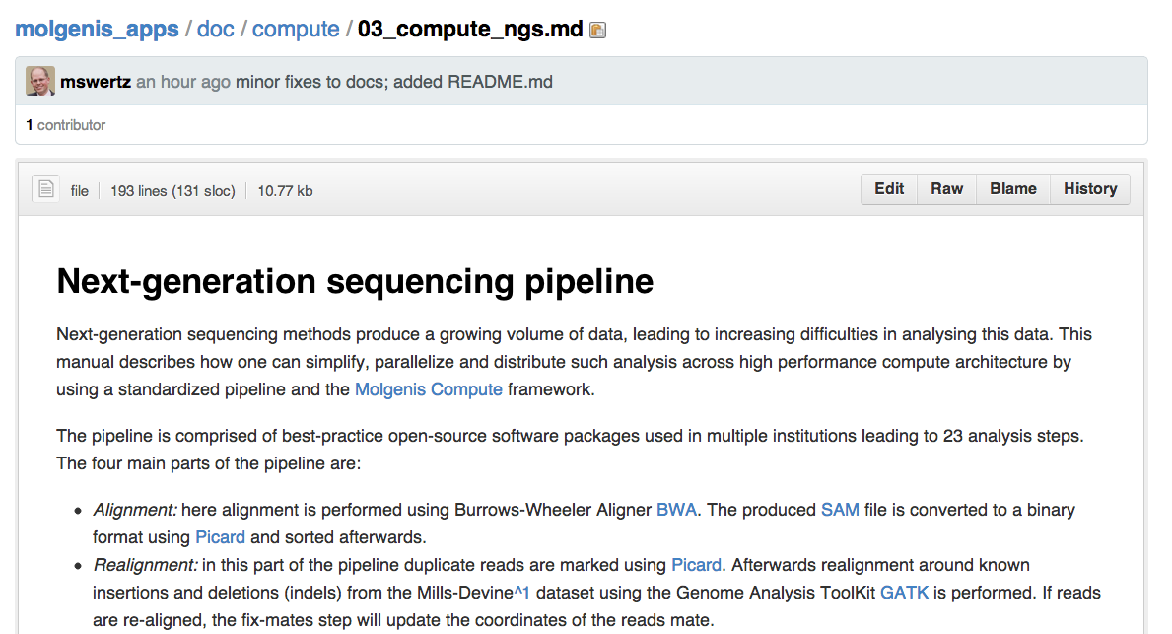
All available as open source
http://www.molgenis.org
http://www.molgenis.org/wiki/ComputeStart
h.v.byelas@gmail.com m.a.swertz@gmail.com
Thank you!
Questions?

