Slide 1


A GEANT4 Web-based Application to Support Intra-Operative Electron
Radio-Therapy using the European Grid Infrastructure
C. Casarino¹, G. Russo¹, G. Candiano¹ , G. La Rocca², R. Barbera^{2,3},
G. Borasi^{1,4}, C. Messa^{1,4,5}, G. Passaro⁷ and M. C. Gilardi^{1,4,6}
¹ IBFM-CNR – LATO s.c.r.l, contrada Pietro Pollastra-Pisciotto, Cefalu’ (Palermo), Italy
² Italian National Institute of Nuclear Physics, Division of Catania, Via S. Sofia 64, Italy
³ Department of Physics and Astronomy of the University of Catania, Viale A. Doria, 6, Italy
⁴ University of Milano-Bicocca, Milan, Italy
⁵ San Gregorio Hospital, Monza, Italy
⁶ San Raffaele Scientific Institute, Milan, Italy
⁷ Consortium COMETA, Via S. Sofia 64, c/o Cittadella Universitaria, Catania, Italy
IWSG 2013 – ETH Zürich
Zürich – Switzerland, 3-5 June 2013

Slide 2
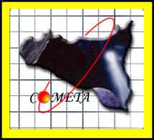



Topics
The IBFM CNR - LATO (LAboratorio di Tecnologie Oncologiche)
@ HSR
  Clinical and Research Activities
The Intra-Operative Electron Radio Therapy (IOERT)
technique in a nutshell
Overview of iort_therapy, a Monte Carlo application based on the GEANT4 toolkit
The role of advanced R&E networking and computing infrastructures:
  Consorzio COMETA
  The Italian Grid Infrastructure
The Catania Science Gateway components;
  Architecture
  The iort_therapy application on the Science Gateway
Summary and Conclusions

Slide 3
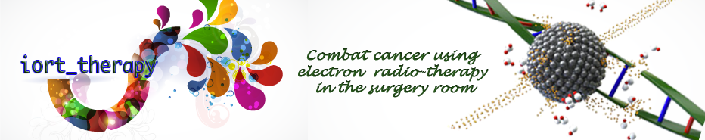
IBFM CNR - LATO (LAboratorio di Tecnologie Oncologiche)
@ HSR Giglio
  Clinical and Research Activities
The Intra-Operative Electron Radio-Therapy (IOERT) technique in a nutshell
Overview of iort_therapy, a Monte Carlo application based on the GEANT4 toolkit

Slide 4

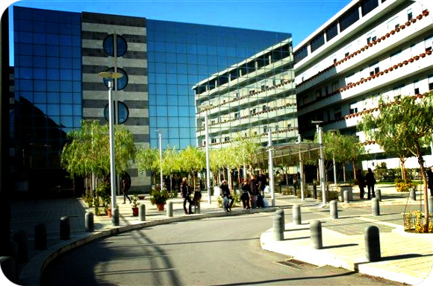

IBFM CNR – Laboratorio di Tecnologie Oncologiche (LATO)
IBFM CNR – LATO (LAboratorio di Tecnologie Oncologiche)
@ HSR Giglio – Fondazione Istituto San Raffaele G. Giglio in Cefalù, Italy
Clinical and Research Activities:
Proteomic and Genomic
Morbid Anatomy
Magnetic Resonance
Nuclear Medicine
Clinic Informatics
Magnetic Resonance guided Focused Ultrasound Surgery (MRgFUS)
Intra-Operative Electron Radio-Therapy (IOERT)

Slide 5
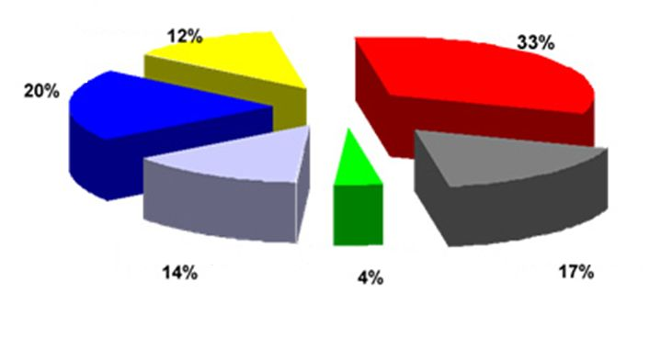
Cancer and Radiotherapy
Multimodal approach
Not treatable
Surgery
Radiotherapy
Chemotherapy
Local recurrence
At present, globally about 70% of cancers are treatable
14% of patients are cured by radiotherapy only
12% uses a multimodal approach in which radiotherapy is an integral part
The Radiotherapy plays an important role in cancer treatment!

Slide 6
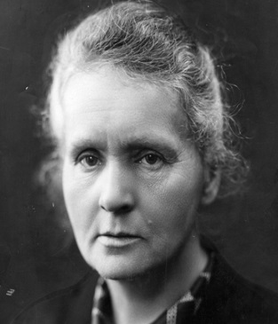
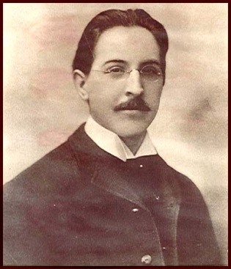
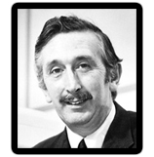
The Radio-Therapy technique: a bit of history …
Medicine has used radiation therapy as a treatment for cancer for more than 100 years
Marie Curie (1867 – 1934), physicist and chemist
  Nobel Prize in Physics in 1903 (polonium and radium)
  Nobel Prize in Chemist in 1911
Emil Herman Grubbe (1875 – 1960), physician
  First American to use x-rays in the treatment of cancer (1896)
Godfrey Hounsfield (1919 – 2004), engineer
  Nobel Prize in Medicine in 1971 (Computed Tomography)

Slide 7
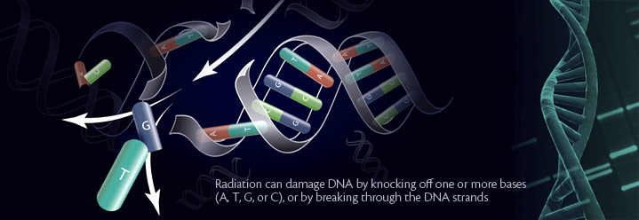
The Intra-Operative Electron Radio-Therapy (IOERT) technique in a nutshell
Intra-Operative Electron Radiotherapy (IOERT) is an advanced radiation therapy technique that allows treatment of tumors, directly in the surgery room, after the removing of tumor tissues
This technique consists of delivering Ionizing Radiations (dose for short) inside cancerous tissues to damage cell DNA content
Possible Ionizing Radiations: γ- and X-rays, photons, electrons, protons, etc

Slide 8
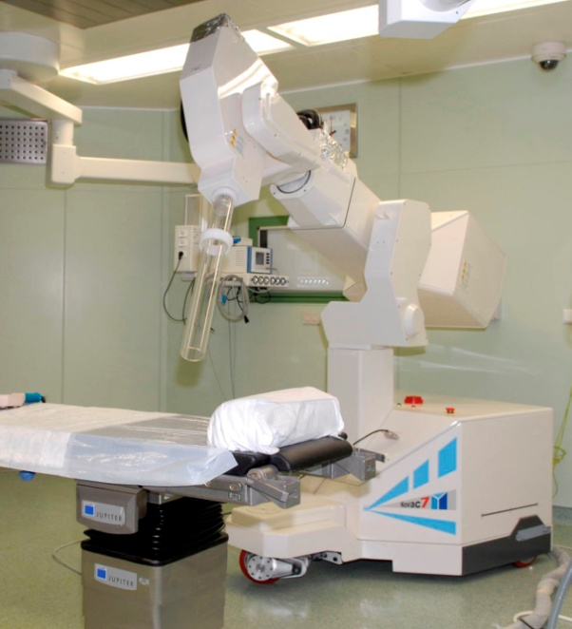
The Intra-Operative Electron Radio-Therapy (IOERT) technique in a nutshell
The electron beam is produced through dedicated and mobile accelerators, such as:
  NOVAC7 (NRT, Aprilia, Italy)
  LYAC
  MOBETRON (California)
  NOVAC7 Specifications
  Electron beams of 4, 6, 8 e 10 MeV
  Different diameters (from 3 to 10 cm)
  Slant angles collimators (0°, 15°, 22.5°,
  30° and 45°)

Slide 9
IOERT Simulation Activities
Clinicians & Medical Physics Requested Times : ≤ 24 hours
Clinicians & Medical Physics Requested Times : ≤ 1 month
Clinical
OPTIMIZATION
NOVAC7
Commissioning
Therapeutic Dose
Patient Radio-Protection
No commercial software available
Commercial software available. Fast but imprecise Treatment Planning System (TPS)

Slide 10
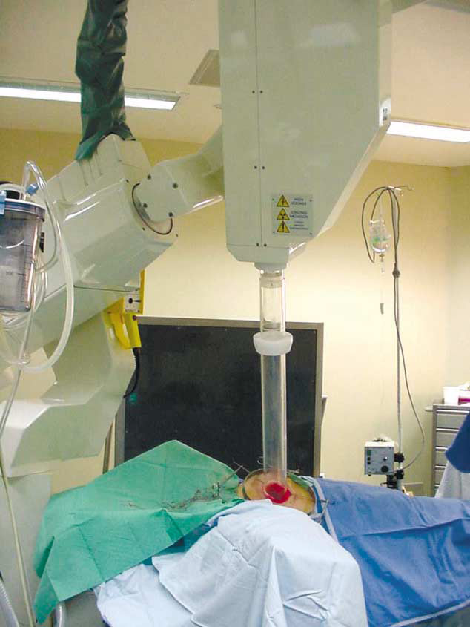
A typical scenario: the Intra-Operative Electron Radio-Therapy (IOERT) technique for breast treatment
One of the most relevant risks in intra-operative electron radiotherapy is the incorrect positioning or misalignment of the shielding disc which are mandatory in high-dose IORT
Releasing of the “dose” to the target
Electron
beam
Treatment
Zone
Healthy
Tissues
Placing a metal disc to protect healthy tissue

Slide 11
IOERT Simulation Activities
Technology
Company Requested Times : 1 - 6 months
Research Community Requested Times : 6 - 12 months
Design & Studies
beam collimation systems
Patient and worker radioprotection
No commercial software available

Slide 12
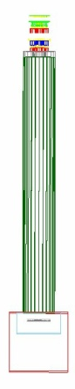
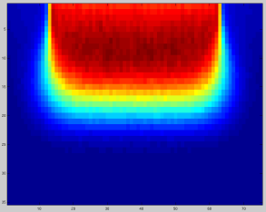
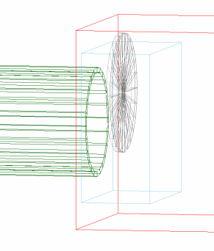
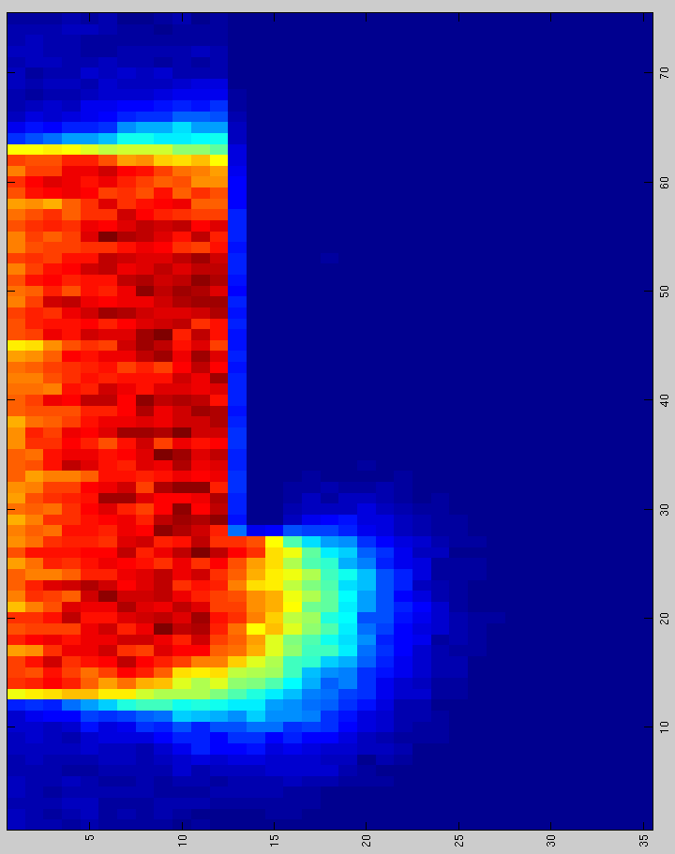
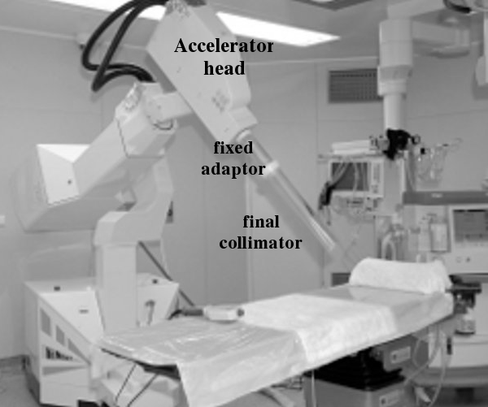
iort_therapy: a Monte Carlo application based on the GEANT4 toolkit
A web-based application called iort_therapy has been implemented to simulates the electron beam and the collimation system of the NOVAC7 and it can be used for:
The optimization of the therapeutic dose distribution
The study of radioprotection aspects
The development of procedures for the verification of the NOVAC7 specifications (Commissioning)
The design and the optimization of the collimation system, etc

Slide 13
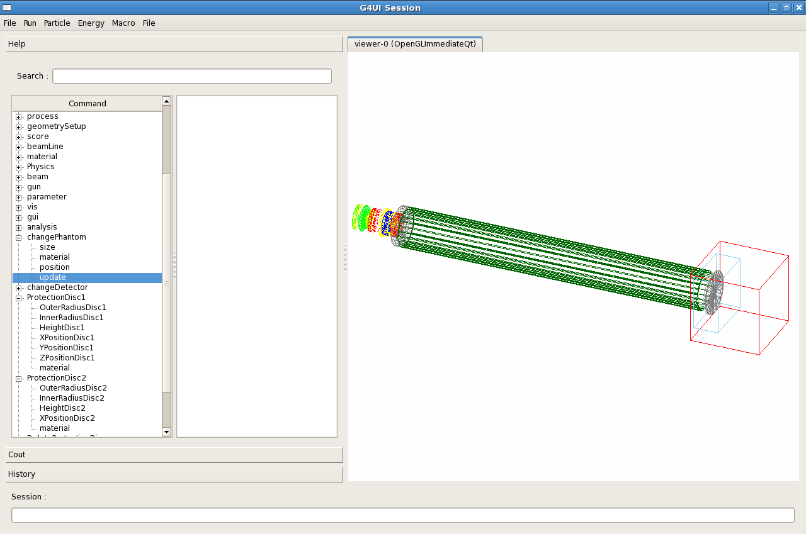
iort_therapy graphical interface
Authors:
G.Russo^{(a,b,c)}, C.Casarino^{*(c)},
G.C. Candiano^{(c)}, G.A.P. Cirrone^{(d)}, F.Romano^{(d)} and S.Guatelli^{(e)}
^{(a)} Fondazione Istituto San Raffaele G.Giglio, Cefalù, Italy
^{(b)} IBFM-CNR , UOS of Cefalù, Italy
^{(c)} LATO (Laboratorio di Tecnologie Oncologiche), Cefalù, Italy
^{(d)} Laboratori Nazionali del Sud of the INFN, Catania, Italy
^{(e)} University of Wallongong, Australia
*Corresponding Author

Slide 14
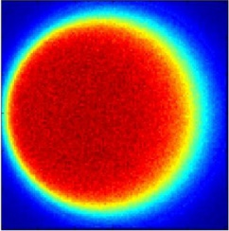
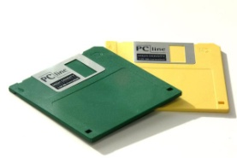
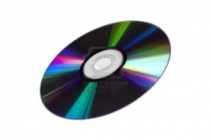
iort_therapy: a Monte Carlo application based on the GEANT4 toolkit
Starting from release 9.5 iort_therapy is officially supported by the GEANT4 collaboration (http://geant4.web.cern.ch/geant4/)
By default, the application needs a full installation of GEANT4 toolkit and of some additional libraries (2.2 GB)
Before starting to use the distributed computing resources, the iort_therapy application has been re-compiled as a stand-alone executable (67 MB of size)
typical results: a dose distribution in a volume of 300 x 300 x 140 voxels
application mode: batch or graphical mode (QT4 libraries)
size output files (per simulation): from few MBs to tens of GBs

Slide 15
The role of advanced R&E Networking and Computing infrastructures
The Catania Science Gateway components
The iort_therapy application on the Science Gateway
iort_therapy’s results
Summary & Conclusions

Slide 16




The role of advanced R&E Networking and Computing Infrastructures
Monte Carlo simulation tools offer the best software tool, but require large computing power …
  To achieve a correct statistical uncertainty in dose distribution values the number of histories may increase up to 10⁸ per simulations
  Clinical and Research studies usually demand tens of dose distribution
  On a single 3 GHz CPU core, it would require about 200 full days to produce the dose distribution with the required precision and just 10 CPU hours on the e-Infrastructure

Slide 17


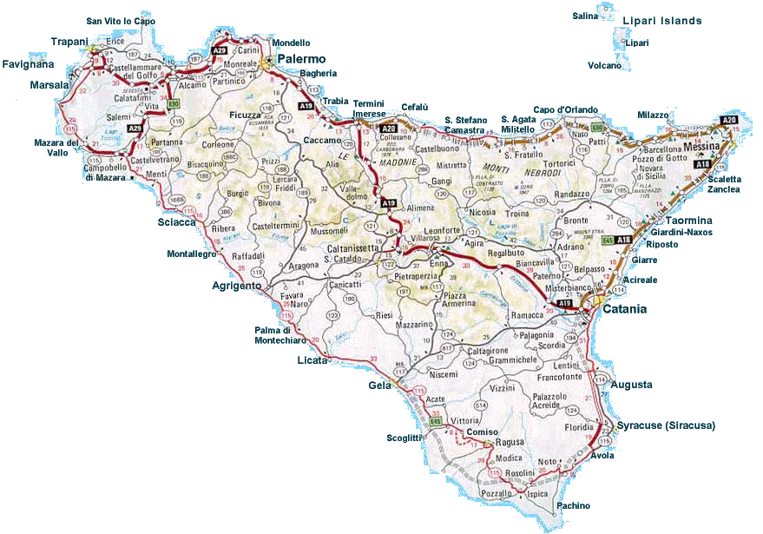

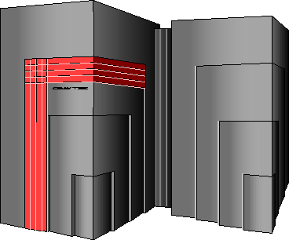




The Consorzio COMETA
(http://www.consorzio-cometa.it)
~2000 cores AMD Opteron 2218
2 GB of RAM per core
LSF as LRMS everywhere
Infiniband-4X at all sites
200+ TB of raw disk storage
Distributed/parallel GPFS file system

Slide 18

The Italian Grid Infrastructure
(http://www.italiangrid.it)
The Italian Grid Initiative (IGI) is a Joint Research Unit supported by the Italian Ministry of University and Research (MIUR) and recognized by the EU Commission
IGI provides the Italian Grid Infrastructure for supporting common services for e-Research
IGI in numbers
58 sites
25000 CPU cores, 8000 CPUs
28 PB of disk storage
5 PB of tape storage
50 VOs
30M job/year
10 Application Domains

Slide 19
The Catania Science Gateway components
The primary requirements that drove us in the design and implementation of the Science Gateway were:
  Use of standards
  Simplicity
  Easiness of use
  Re-usability
For the development of the basic elements of the Science Gateway we decided to adopt the JSR 286 standard and Liferay as portlet container
Identity Federations based on the SAML 2.0 standard and on its implementation based on Shibboleth
To access the computing resources we use SAGA and its JSAGA implementation
For all grid transactions we rely on robot X.509 certificates and on the following standards: JAX-RS and PKCS#11
We comply with the EGI VO Portal Policy and the EGI Grid
Security Traceability and Logging Policy !!

Slide 20


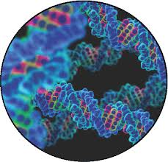
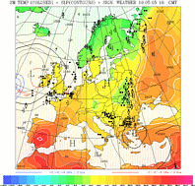
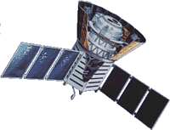








The Catania Science Gateway model
Science
Gateway
Administrator
Power User
Basic User
Standard-based (SAGA)
middleware-independent Grid Engine
Users from different organizations having different roles and privileges
Notes:
Figure da aggiornare….vedi ppt JSAGA
Liferay portlet conteiner
Middleware differenti che offrono altre CPU e altri softaware e vicersa

Slide 21
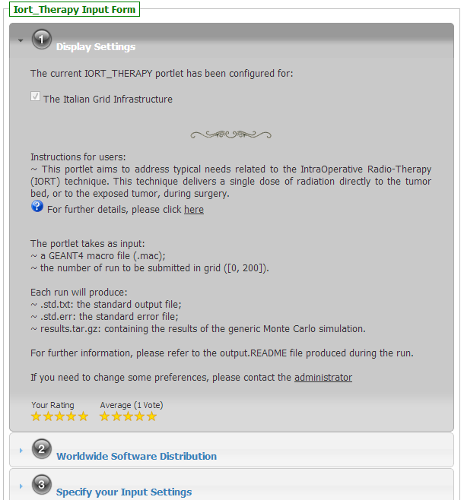



The iort_therapy application on the Science Gateway
running on sgw.garr.it
It shows the list of enabled infrastructures
It provides instructions for user
Follow us on:

Slide 22
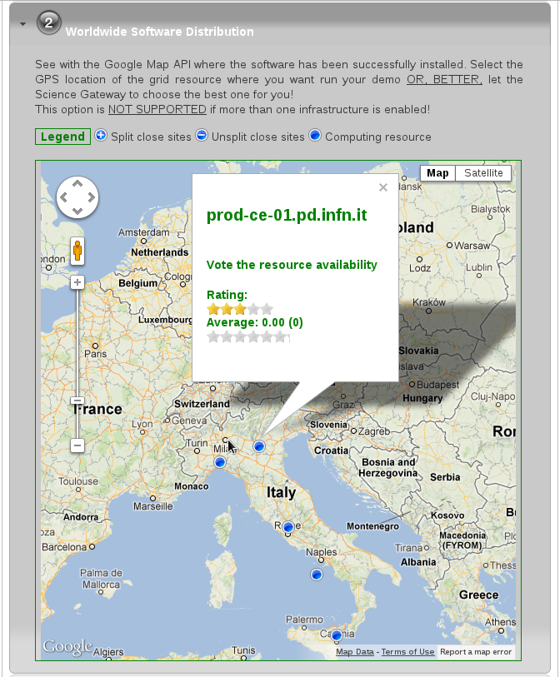

The iort_therapy application on the Science Gateway
running on sgw.garr.it
It is possible to rank the generic computing resource
It shows the computing resources where GEANT4 has been successfully deployed

Slide 23
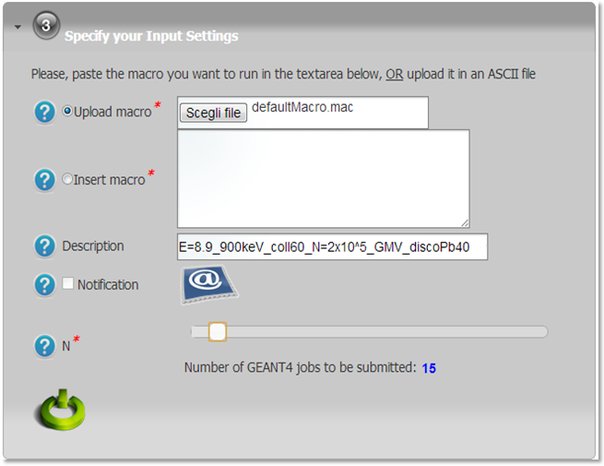

The iort_therapy application on the Science Gateway
running on sgw.garr.it
Uploading a GEANT4 macro as ASCII file or use the text-area
Job description
Enable e-mail notification
# of Monte Carlo jobs submitted

Slide 24
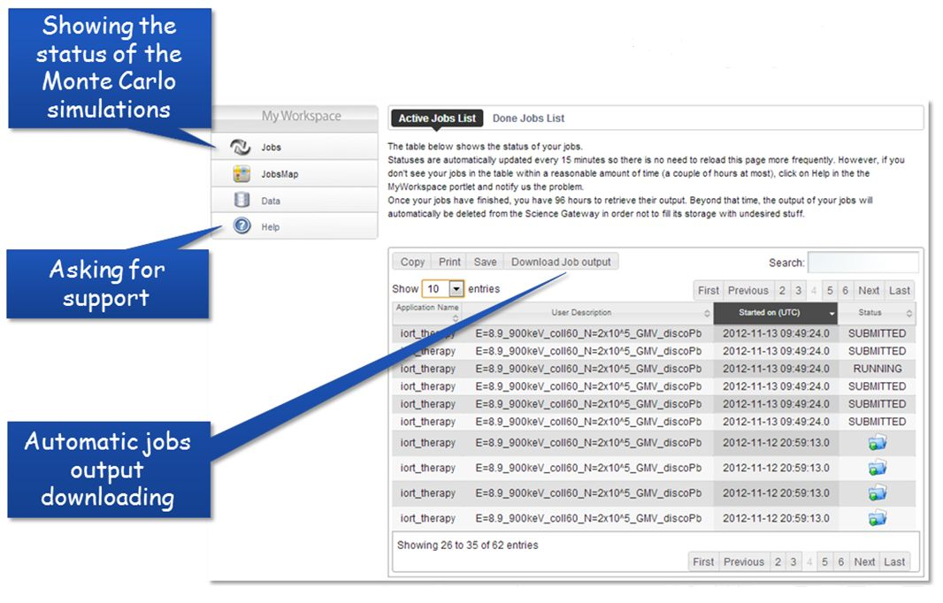
The iort_therapy application on the Science Gateway
running on sgw.garr.it

Slide 25
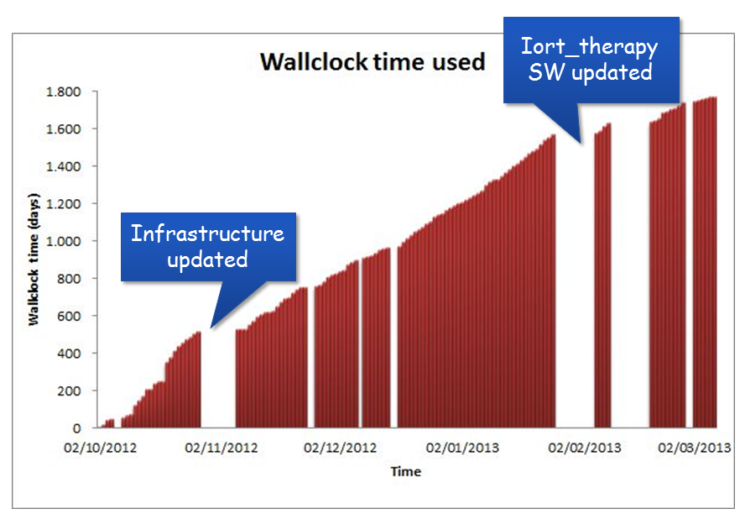
iort_therapy’s results
43598 h WallClock Time used
5436 jobs submitted
85,2 GB raw data produced
The average data rate produced from the computing infrastructure:
  partially address the IOERT Clinical requirements
    The NOVAC7 commissioning could be done in 1 week
  fully address the IOERT Technical requirements
    The computing infrastructure helps to fulfill Company and
    Research’s requirements

Slide 26
Summary & Conclusions
Thanks to the advanced R&E Networking and the Computing Infrastructures the LAboratorio di Tecnologie Oncologiche can then:
  Sustain a research project to validate and improve commercial IOERT Treatment Planning System (TPS)
  Collaborate with New Radiant Technology NRT S.p.a. company to optimize patient radio-protection and the design of the NOVAC collimation system
  Promote the use and the distribution of the iort_therapy application in hospitals

Slide 27
References
Russo G, CASARINO C, Arnetta G Candiano, A Stefano. F Alongi, G Borasi,
C Messa, MC Gilardi (2012). Dose distribution changes with shielding disc misalignments and wrong orientations in breast IOERT: a Monte Carlo – GEANT4 and experimental study. J. Appl. Clin. Med. Phys. 5 , 74 - 92
G Russo, CASARINO C., G Candiano, G Borasi, C Messa, MC Gilardi (2012). A GEANT4 application for the simulation of the NOVAC7: a support to optimize the clinical setup in IOERT treatment. In: 3rd European Workshop on Monte Carlo Treatment Planning. Sevilla, Spain, 15-18 May 2012
I Fazio, G Russo, CASARINO C., G Candiano, G Borasi, C Messa, MC Gilardi (2012). DOSE DISTRIBUTION CHANGES WITH SHIELDING DISC MISALIGNMENTS AND WRONG ORIENTATIONS IN BREAST IOERT: A MONTE CARLO – GEANT4 STUDY. In: ISIORT 7th International Conference of the International Society for Intraoperative Radiation Therapy (ISIORT). Baveno, Italy, June 22-24, 2012
V. Ardizzone, R. Barbera, A. Calanducci, M. Fargetta, E. Ingrà, I. Porro, G. La Rocca, S. Monforte, R. Ricceri, R. Rotondo, D. Scardaci, A. Schenone – 2012, The DECIDE Science Gateway, Journal of Grid Computing – Special Issue: Science Gateway, ISSN 1570-7873, 2012

Slide 28









Contacts
Any questions, comments or remarks are very welcome.
Contacts: carlo.casarino@polooncologicocefalu.it
giuseppe.larocca@ct.infn.it

