Slide 1
Open Data and Cloud Computing e-Infrastructure for Biodiversity
Daniele Lezzi
Barcelona Supercomputing Center
International Workshop on Science Gateways 2013

Slide 2
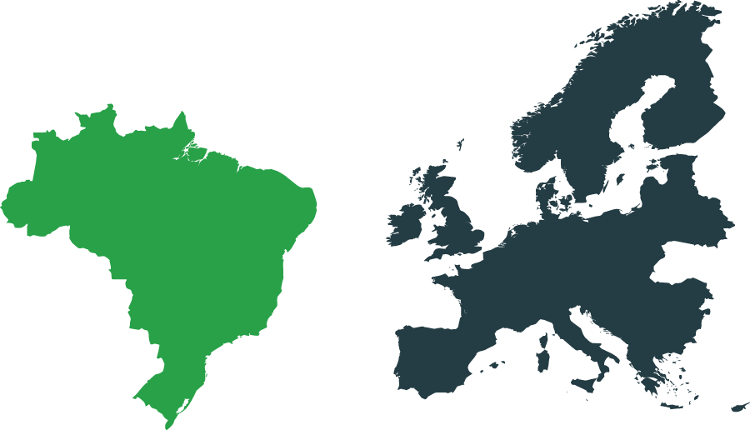




EU-Brazil OpenBio
EU-Brazil Open Data and Cloud Computing e-Infrastructure for Biodiversity
Combining Biodiversity Science and the Open Access Movement to deploy a joint European and Brazilian e-Infrastructure of open access resources supporting the needs of the
biodiversity scientific community.
Two biodiversity use cases
Who will benefit from
EUBrazilOpenBio?
Computing resources
& SW platforms
EU & Brazilian biodiversity scientific communities
Data and resource managers & Open Access community
European & Brazilian policy and funding bodies
Further EU-Brazil collaboration in support of the biodiversity area & infrastructures
Notes:
Reduce text -> enlarge font

Slide 3









The Partnership
A well-balanced effort of
European and Brazilian organisations
BSC,
Spain
CRIA, SP
CNR-ISTI, Italy
UFF, RJ
UPVLC, Spain
CESAR, PE
SP2000, UK
RNP, RJ
Trust-IT, UK
Notes:
CRIA: Coordinator, application provider - openmodeller
UFF – technology provider – easygrid, condor, infrastructure provider
CESAR: technology provider
RNP: infrastructure provider
BSC – Coordinator, technology provider, infrastructure provider
CNR – technology provider, infrastructure provider
UPVLC – technology provider, use cases coordinator
Species 2000 – application provider
Trust-it – communication, policy oriented activities

Slide 4
The Technological Challenges
Nowadays science is posing “systems” engineers with challenging tasks:
  highly-evolving requirements;
  large scale resource & player distribution;
  heterogeneity;
This makes standard development approaches often too expensive and
  “from-scratch” development of ad-hoc solutions
  HW investment (even if intermittently needed)
… do not result in sustainable infrastructures …

Slide 5
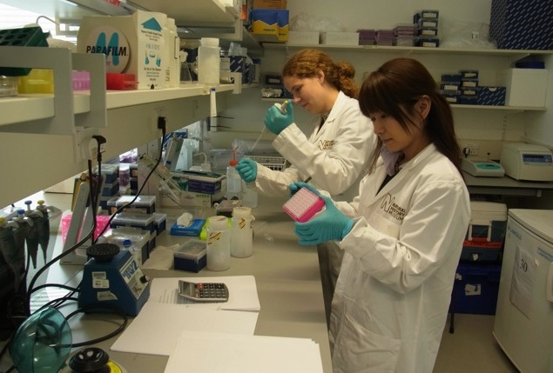
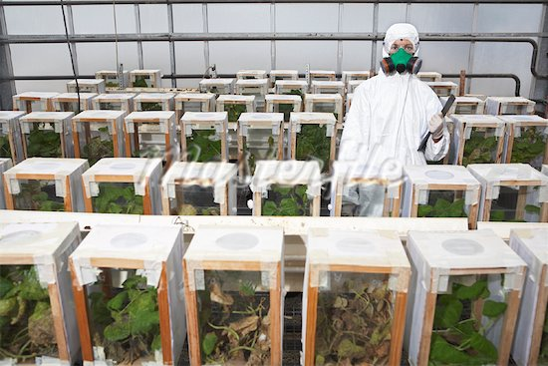
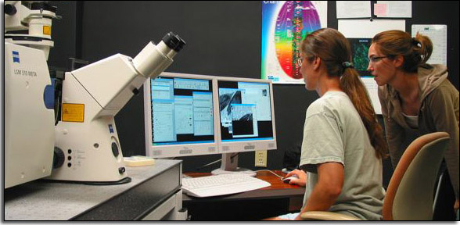
Infrastructure vs e-Infrastructure
Science has been traditionally based on infrastructures
E-infrastructures are becoming increasingly important tools for
  addressing the complexities and challenges of scientific discovery
  enabling researchers across the world to collaborate on scientific initiatives by sharing access to unique or distributed scientific facilities (including data, instruments, applications, computing and communications) through user-friendly interfaces.

Slide 6
Supporting
Virtual Research Environments
A Virtual Research Environment is a complete “system” consisting of hardware, data, and applications deployed to support the needs of a user community and promoting effective and fruitful collaborations

Slide 7
The EUBRAZILOPENBIO Infrastructure

Slide 8
An Hybrid Infrastructure
Integrating different technologies to make a large variety of services available for managing, manipulating and processing data and metadata within an autonomously-managed infrastructure: gCube system, openModeller, COMPSs, EasyGrid AMS, VENUS-C, HTCondor, u.store
Leveraging on existing European, Brazilian and global data sources ranging from species data - species names, synonyms, taxonomical classifications - to literature, occurrence maps and images: Catalogue of Life, List of Species of the Brazilian Flora, speciesLink, Biodiversity Heritage Library, Bioline International, Global Biodiversity Information Facility (GBIF).
Two use cases: Taxonomy Management and Ecological Niche Modelling
User communities
User communities
User communities
Application #1
Application #2
Application #N
Application #1
Application #2
Application #N
Application #1
Application #2
Application #N
Services
Services
Services
Data Services
Computing Services
Management Services
Data Services
Computing Services
Management Services
Data Services
Computing Services
Management Services
gCube storage
Usto.re
VENUS-C
HTCondor
COMPSs
EasyGrid AMS
gCube storage
Usto.re
VENUS-C
HTCondor
COMPSs
EasyGrid AMS
Biodiversity VRE
gCube storage
Usto.re
VENUS-C
HTCondor
COMPSs
EasyGrid AMS
Biodiversity VRE
Biodiversity VRE
Existing Infrastructures
Existing Infrastructures
Existing Infrastructures
Data Sources
Grids
Clouds
Clusters
Data Sources
gHNs
Data Sources
Grids
Clouds
Clusters
CoL
GBIF
gHNs
Grids
Clouds
Clusters
CoL
GBIF
gHNs
CoL
GBIF
Notes:
CRIA: Coordinator, application provider - openmodeller
UFF – technology provider – easygrid, condor, infrastructure provider
CESAR: technology provider
RNP: infrastructure provider
BSC – Coordinator, technology provider, infrastructure provider
CNR – technology provider, infrastructure provider
UPVLC – technology provider, use cases coordinator
Species 2000 – application provider
Trust-it – communication, policy oriented activities

Slide 9
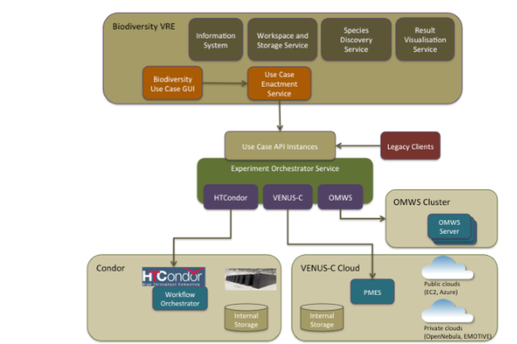
Insight of EUBrazilOpenBio infrastructure
EUBrazil OpenBio have implemented new services and components to ease the development of applications
  Data Access services
    gCube Storage.
    Storage connectors.
  Execution Services
    COMPS+PMES execution.
    OMWS2 Execution Services
      Orchestrator Service.
  Developing portlets
    High-end services
      Species Discovery Service.
    ENM and XMAP service.

Slide 10
Accessing the infrastructure
A GUI developed using Google Web Toolkit (GWT) and Java.
Integrated with a several number of gCube applications, such as:
  The workspace. Users will be able to store taxonomic checklists and the results of the cross-maps on their own storage space.
  The Species Discovery Service, a gCube portlet that enables obtaining taxonomic checklist and occurrences from different providers.
  The gCube Information System, that enables the GUI to obtain the endpoint of the cross-map and ENM web services that will execute the algorithm of the cross-map and ENM.

Slide 11
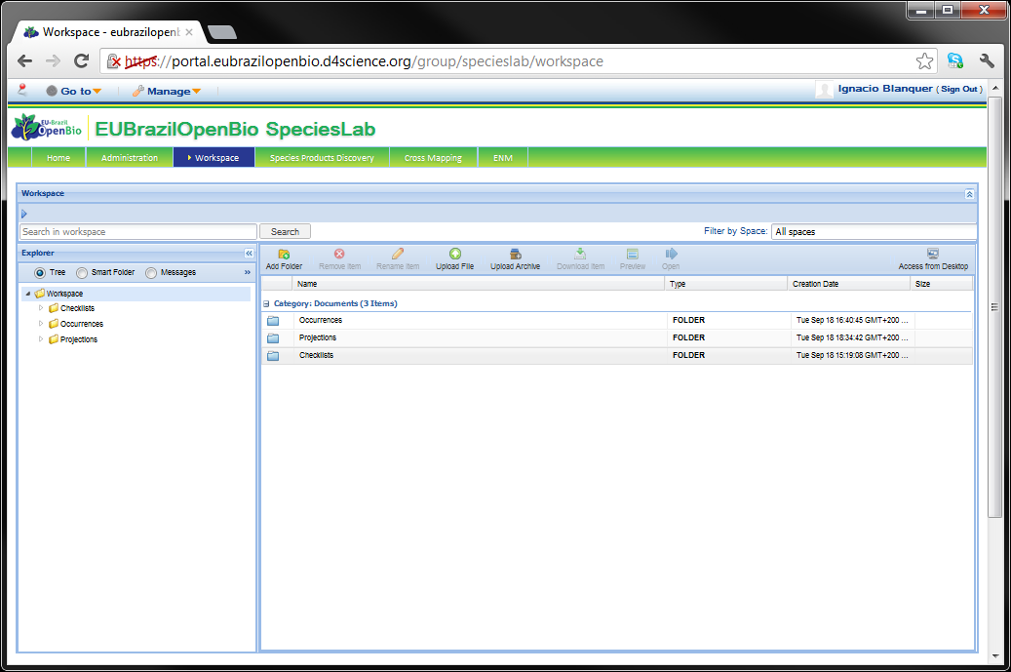
General Services - The workspace
The workspace is a virtual drive in which you can upload and download the files needed for the services and the results.
Files can be organized
into folders.
Several file types
can be directly
displayed
  Bitmaps, text,
  GIS data, etc.

Slide 12
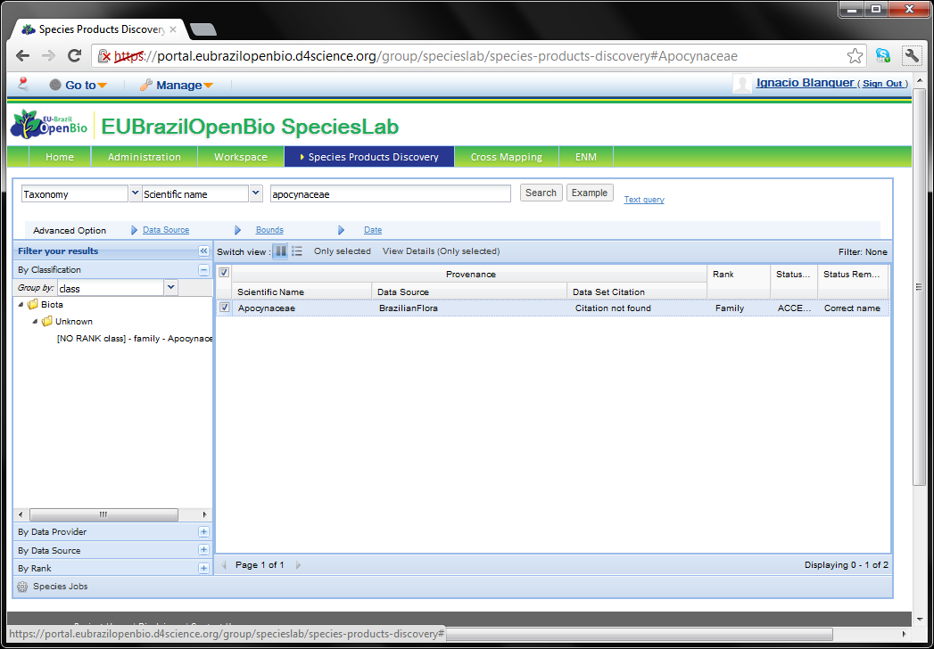
General Services - Species products discovery
The Species product discovery enables retrieving taxons and occurrence points from a number of providers & data sources in a
seamless way.
Search on taxons
or occurrence
points is selected
from the first box.
Resulting files
can be stored in
the workspace
and used further.

Slide 13
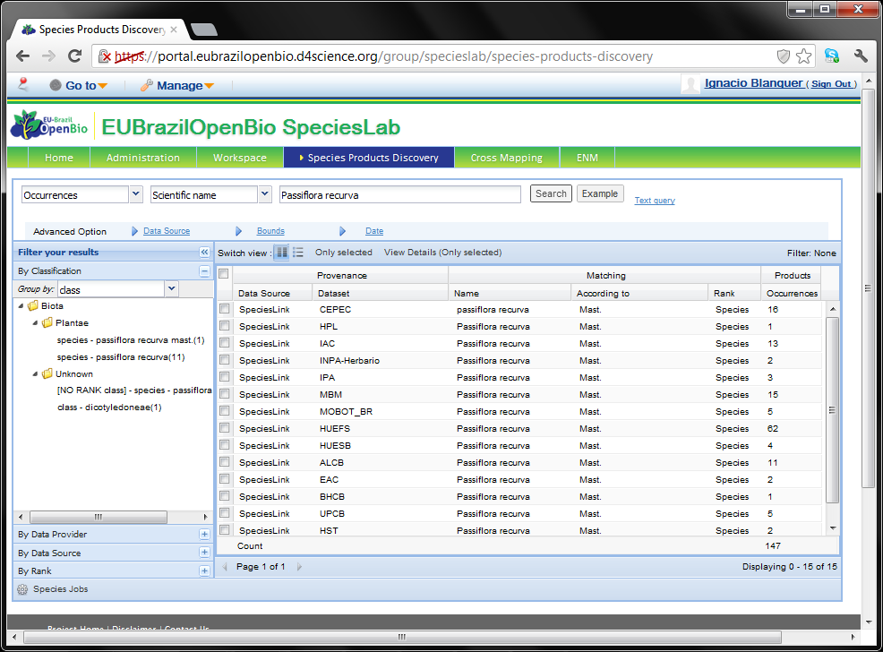
General Services - Species products discovery
Occurrence points
Service products discovery can also be used to browse occurrence points.
Scientific or common names can be used.
Data from the different databases is presented in the list.
Downloading may take long.

Slide 14
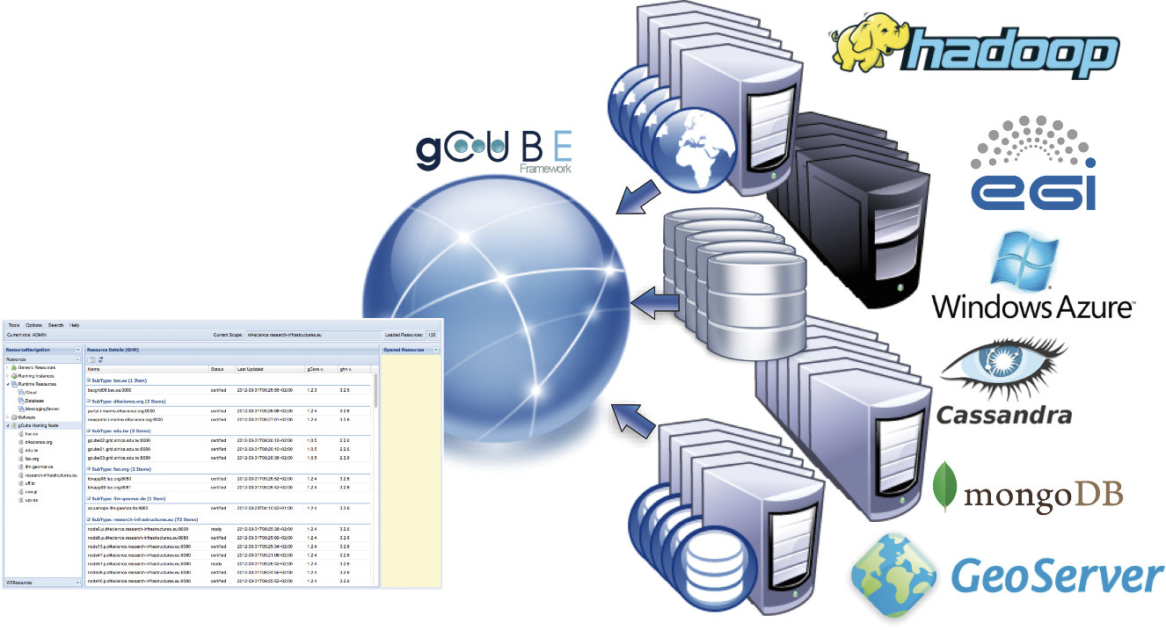

Data Services:gCube
gCube is a service-oriented framework enabling for the creation and interconnection of e-Infrastructures in a controlled and highly configurable manner.
Computing, storage, data and software are made accessible by the infrastructure and are exploited by users
using a thin client

Slide 15
Use case I: Integration of Taxonomies

Slide 16
Use case I - Integration of Taxonomies:
The problem
Given 2 taxonomic checklists in Darwin code (dwca) format, the objective is to obtain the relationships present between the taxa in one checklist with taxa in the other checklist.
The specific steps of the use case are:
  Obtain the dwca files of the checklist to compare.
  Import the checklist into the web service.
  Run the cross-map.
  Save the results.

Slide 17
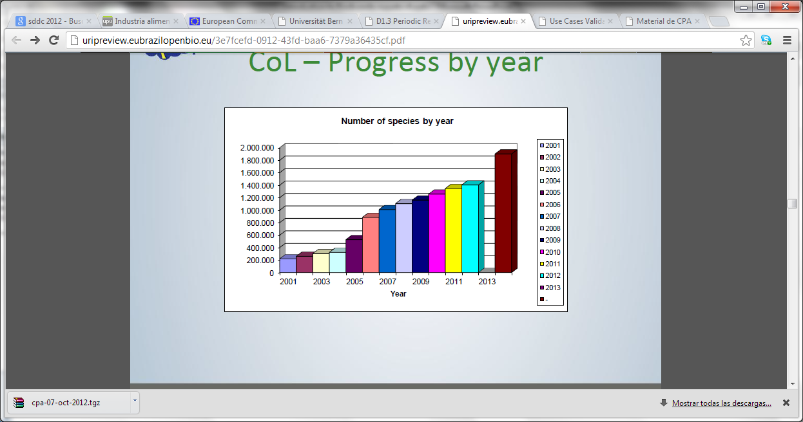
Use case I - Integration of Taxonomies:
Bottlenecks
Currently 46 members
There are now 100 participating databases
Estimated 150 databases
and partners
Aim is to increase
number of members
and databases
Increasing access to
the data
  Problems with the quality of service

Slide 18
Use CASE II: Ecological Niche modelling

Slide 19
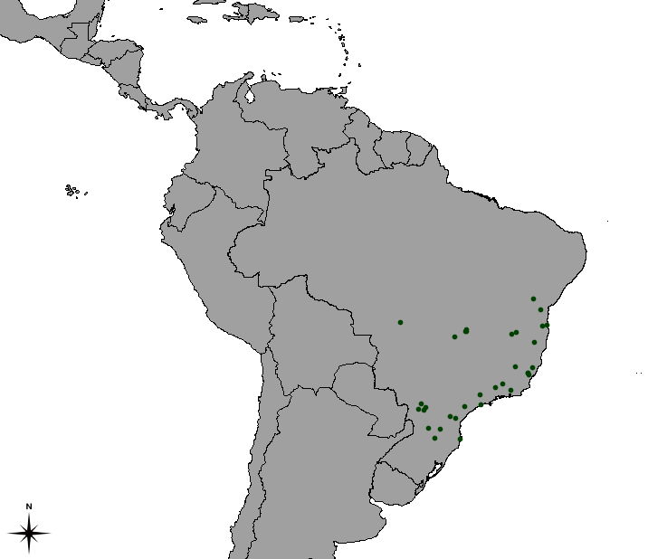
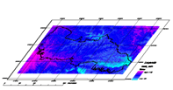
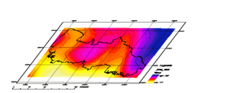
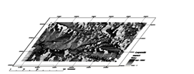
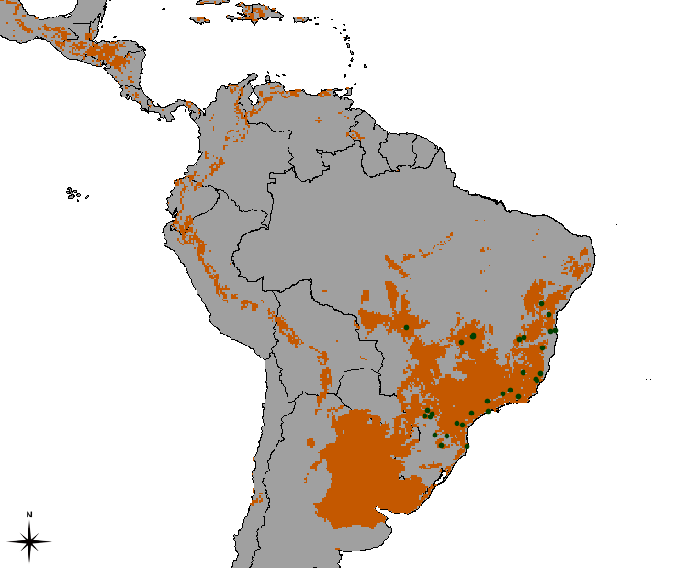
Ecological Niche Modelling
Ecological niche:
Set of ecological requirements for a species to survive and maintain viable populations over the time.
(Grinnel, 1917)
Species occurrence points
Environmental variables
Modellingalgorithm
Projected niche model

Slide 20


Approach before OpenBio
(Brazilian Virtual Herbarium)
request
openModeller
Web Service
response
(single machine)
~50min for a single species
(until the final model is generated)

Slide 21




EU-Brazil OpenBio strategy
Virtual Research Environment
Cloud-based
backends:
Advanced Web
interface for niche
Modelling (OMWS+)
Enhanced niche
modelling
Web Service
(virtualized Condor)
Other applications
(Brazilian Virtual Herbarium)
Additional improvements:
COMP Superscalar
EasyGrid AMS
U.Store

Slide 22
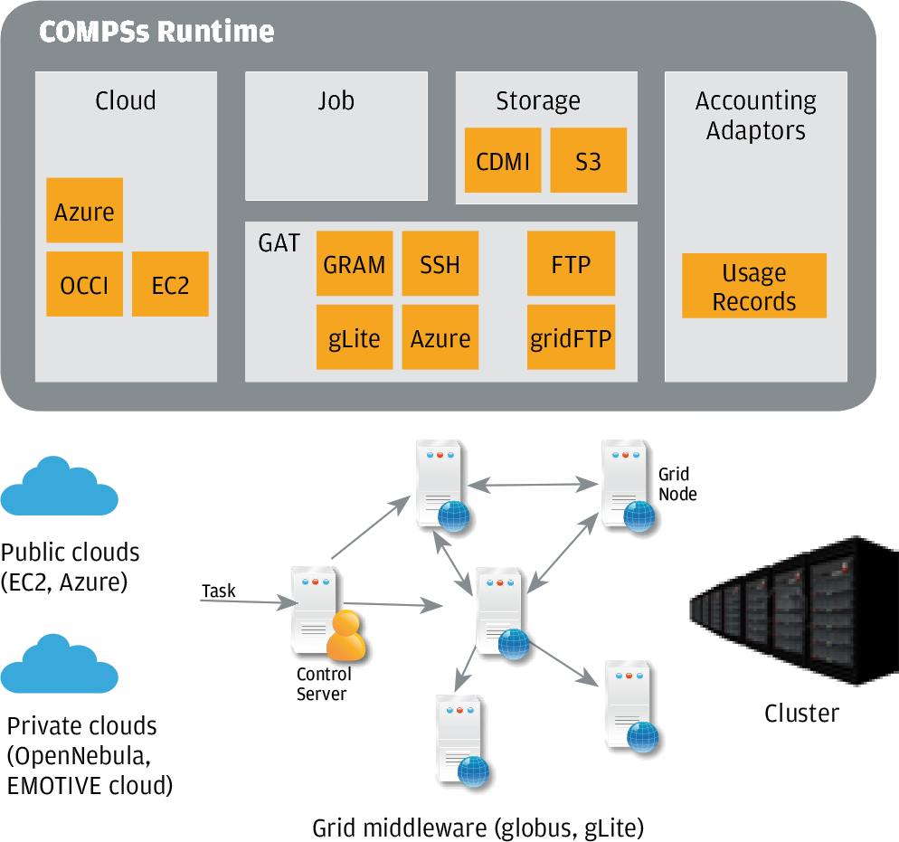
The COMPSs programming framework
    Platform unaware programming model that simplifies the development of applications in distributed environments
    Low user intervention for application development
    Transparent data management, task execution
    Parallelization at task level

Slide 23
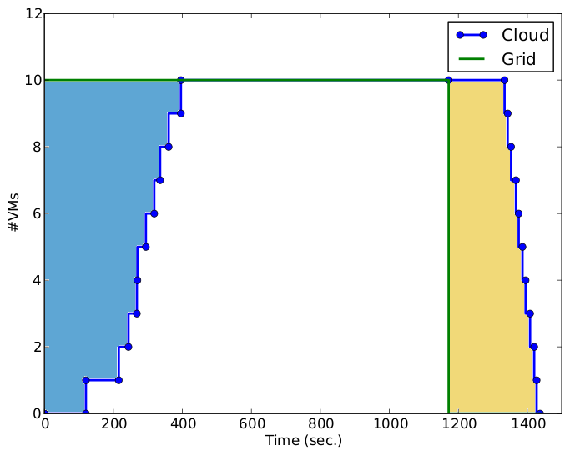
Validation of the ENM workflow
#VMs | #Cores | Cloud Time Speedup
1 | 4 | 02:00:21 | 1.00
2 | 8 | 01:00:47 | 1.98
4 | 16 | 00:33:52 | 3.55
8 | 32 | 00:25:16 | 4.76
10 | 40 | 00:23:57 | 5.02

Slide 24
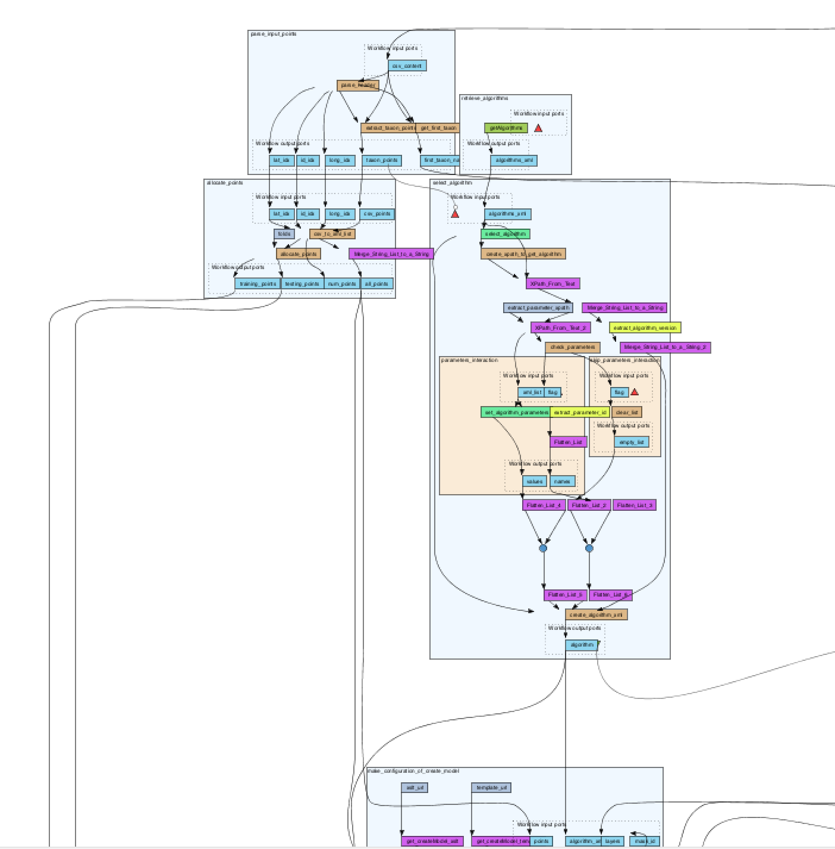
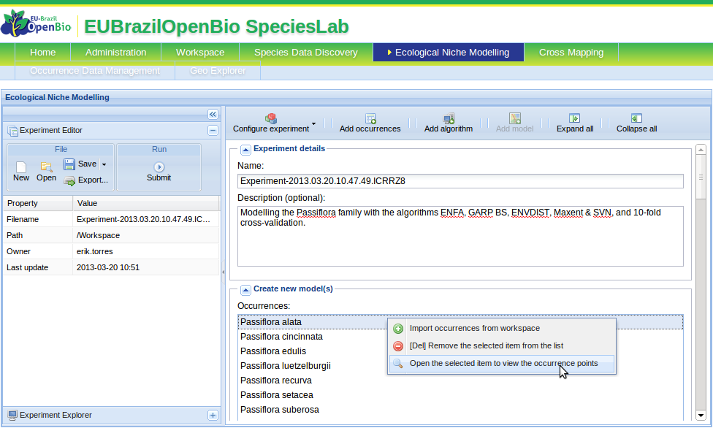

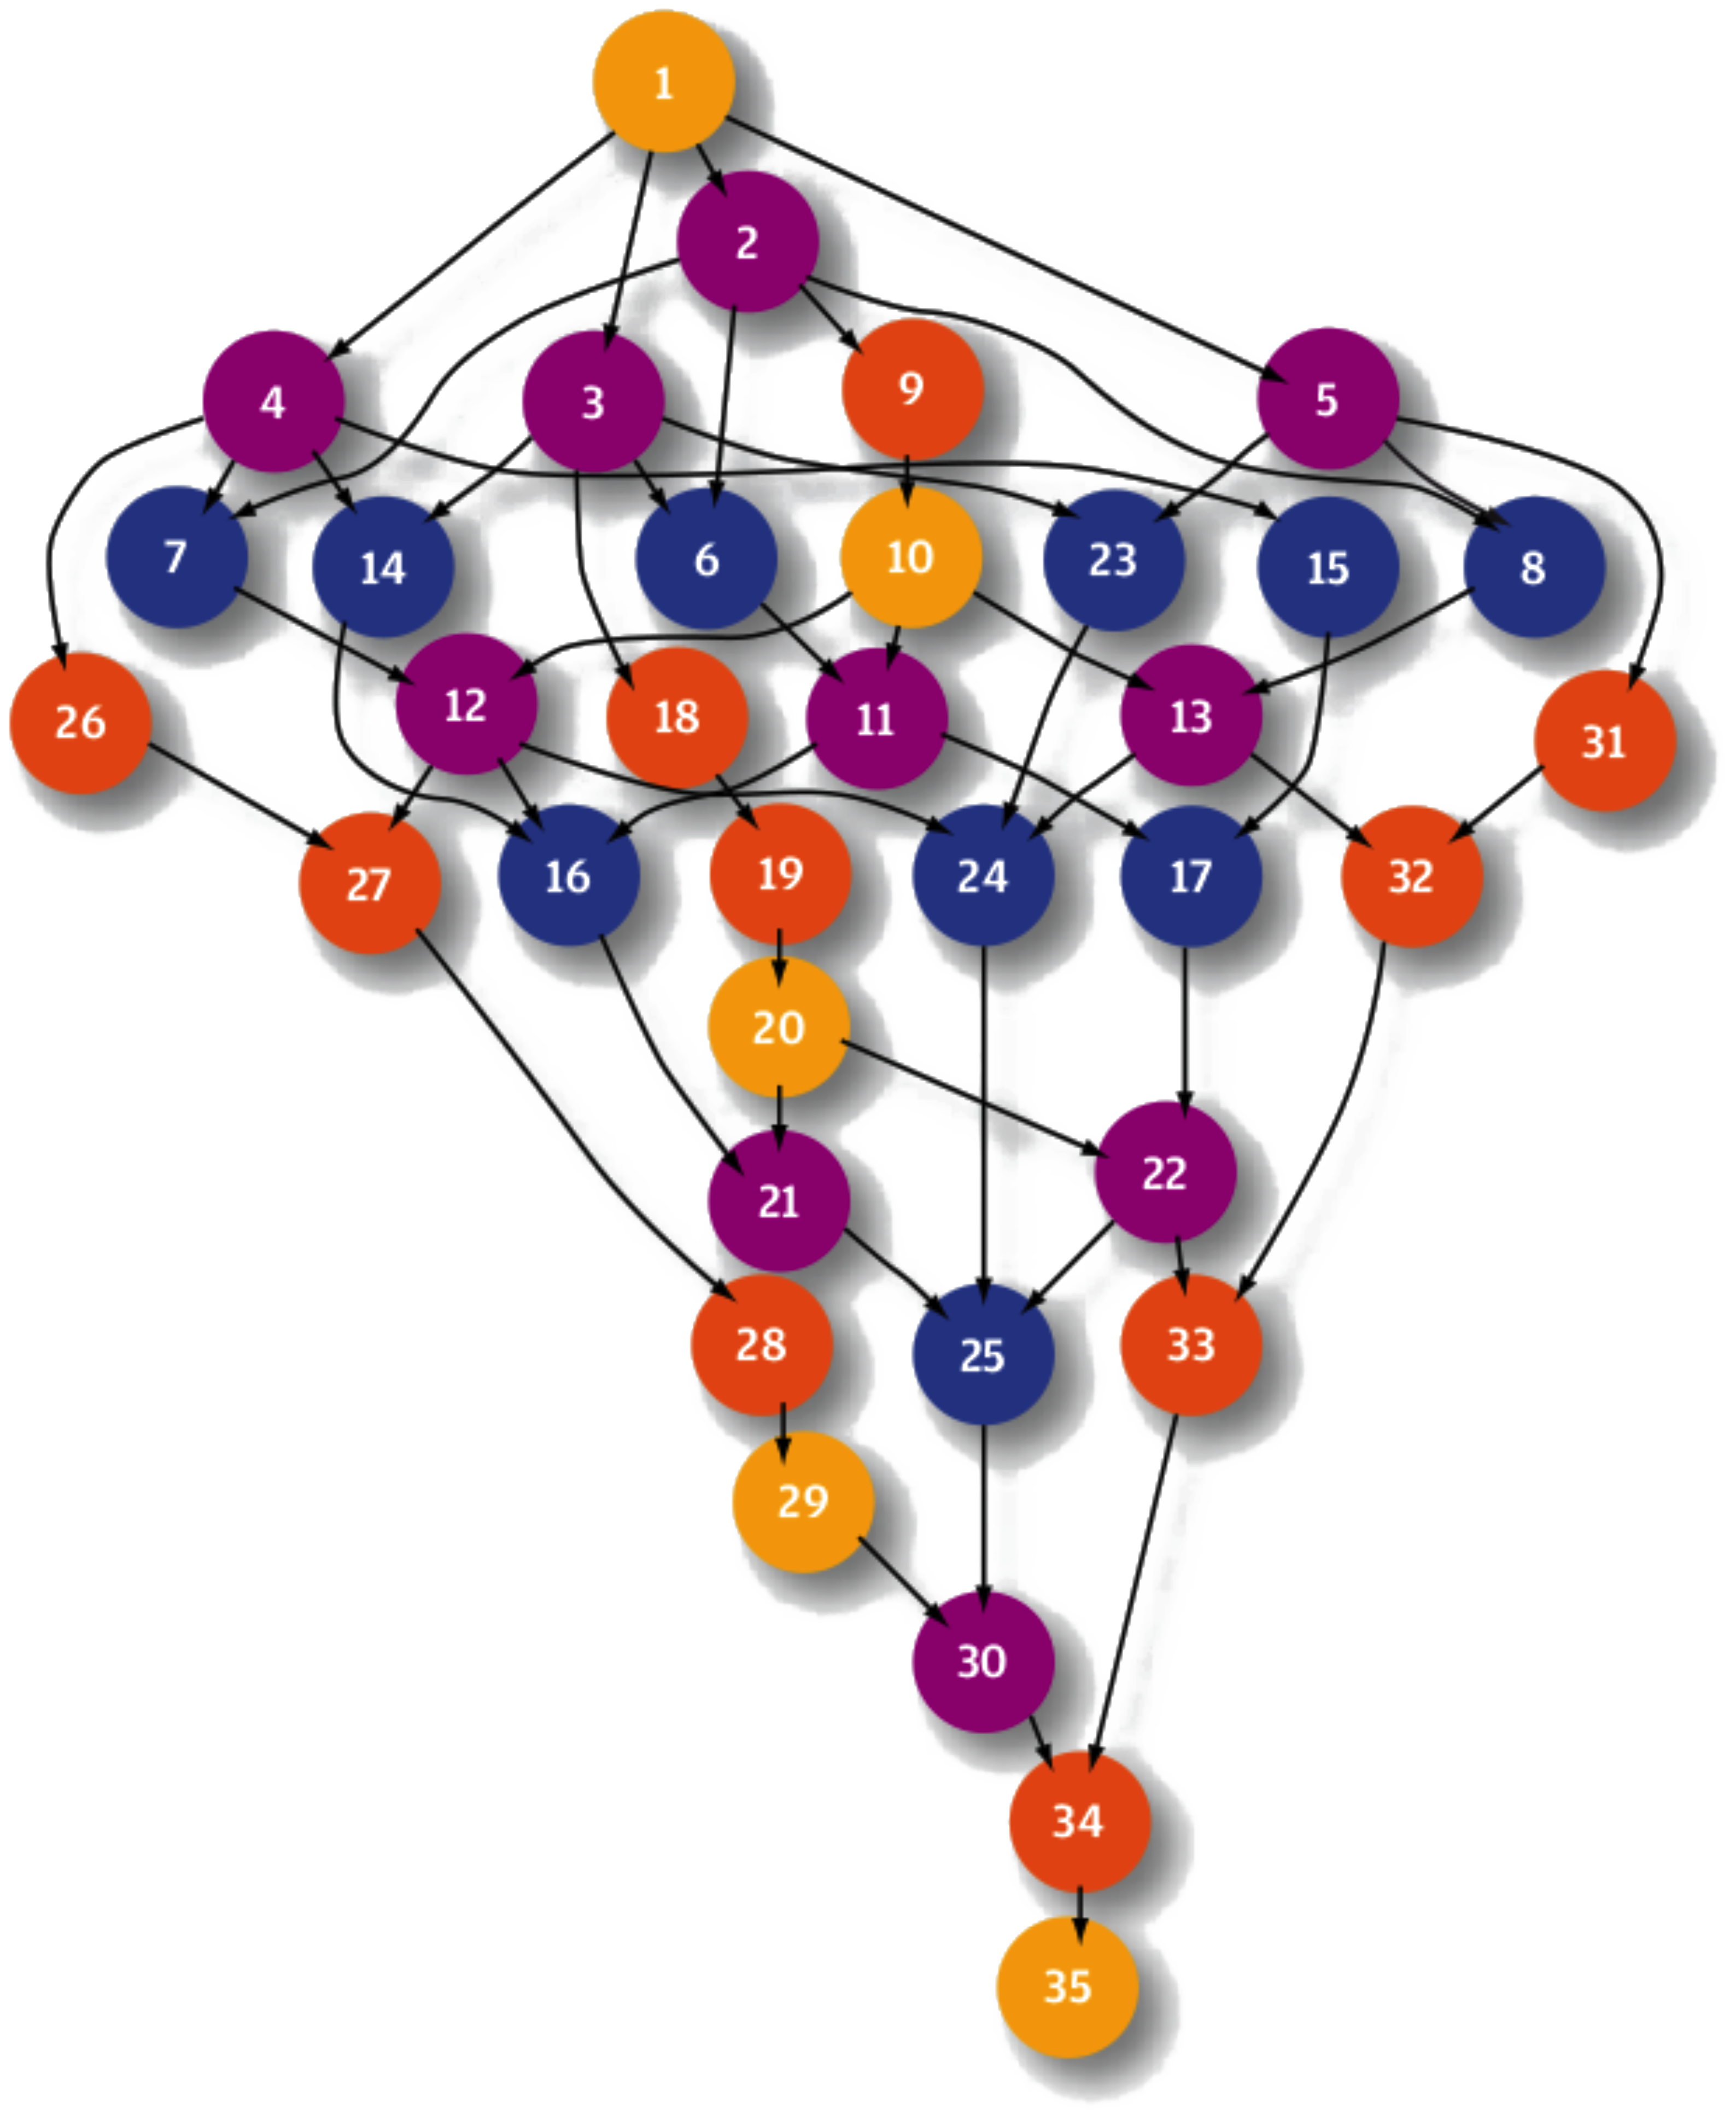


Collaborations
    Provision of the OMWS+ to BioVel community to access the EGI Federated Cloud
    VENUS-C/COMPSs enables the execution of Taverna workflows thanks to interoperability features
    OMWS+ protocol officially integrated in the main release
OMWS+
Experiment Orchestrator Service
VENUS-C Connector
VENUS-C Cloud Middleware
COMPSs Workflow Orchestrator
OCCI
CDMI
EGI Federated Cloud
OMWS+
Experiment Orchestrator Service
VENUS-C Connector
VENUS-C Cloud Middleware
COMPSs Workflow Orchestrator
OCCI
CDMI
EGI Federated Cloud

Slide 25
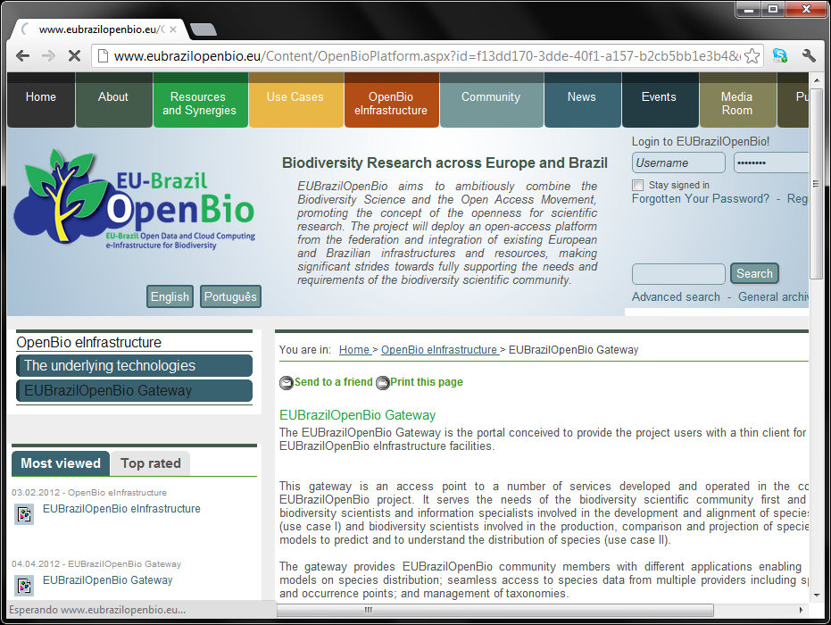
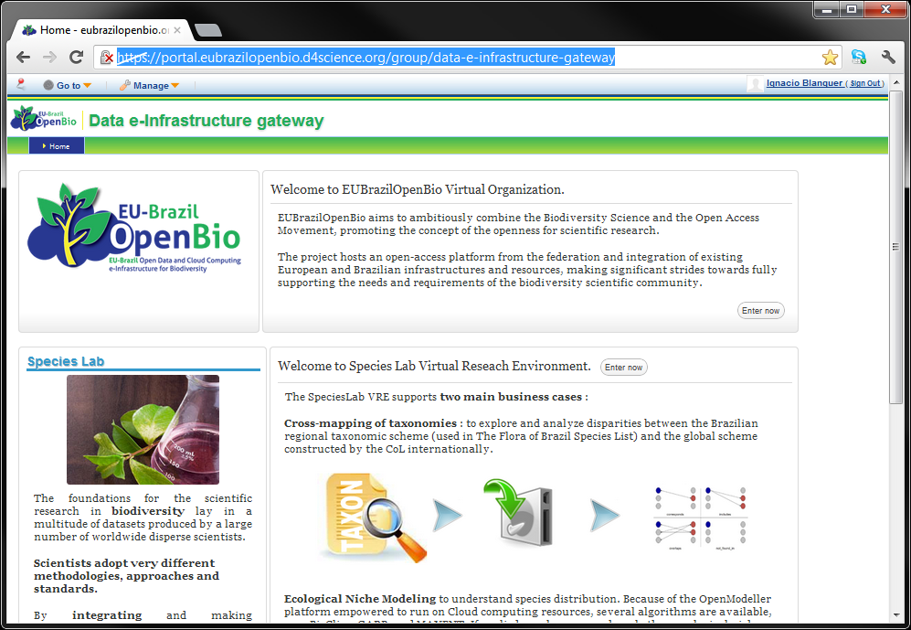
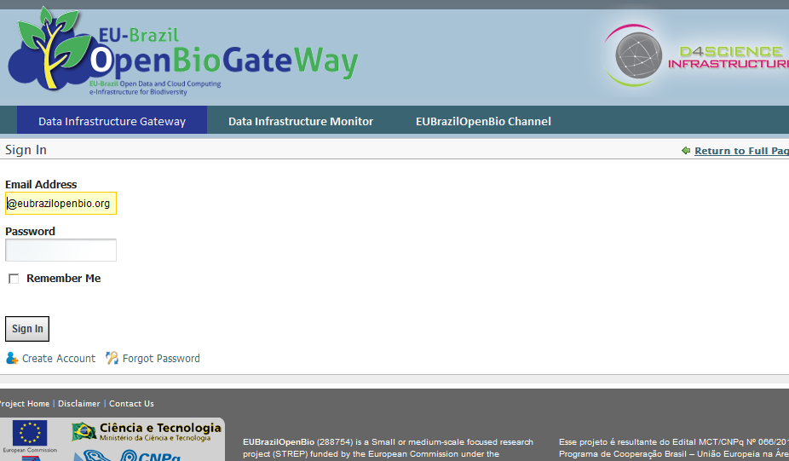
Accessing the infrastructure
The infrastructure is available at
  https://portal.eubrazilopenbio.d4science.org/group/data-e-infrastructure-gateway
You can access from the
main portal of
EUBrazilOpenBio
  www.eubrazilopenbio.eu
A registration is needed.

Slide 26

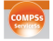


Inventory of components
EUBrazilOpenBio has developed a set of components on top of different technologies to make available a large variety of services for managing, manipulating and processing data and metadata within an autonomously-managed infrastructure
More information can be found at the reference pages
  gCube Framework, https://gcube.wiki.gcube-system.org/gcube/
  COMPSs and VENUS-C PMES, http://wiki.eubrazilopenbio.eu/index.php/COMPSs
  openModeller, http://openmodeller.sf.net/
  EasyGrid AMS, http://wiki.eubrazilopenbio.eu/index.php/EasyGrid_AMS
  u.store, http://usto.re/

Slide 27
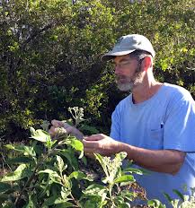
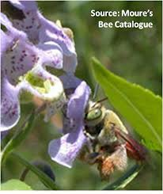

Sustainability plans
Socio-economic Analysis
Promoting benefits for biodiversity researchers and next-generation of researchers
  Modelling important for sustainable development: conservation planning, geographic & ecological aspects of disease transmission, guiding biodiversity field surveys.
  Benefits for developers & integrators.
  Citizen scientists – raising awareness of the value of biodiversity. Sharing a passion for nature.
  Promotion of tangible assets to target audiences: integrated services, resources, use cases, eTraining Programme and hands-on tutorials.
  Detailed partner exploitation plans to exploit assets and synergies to broaden the user base, e.g.
    EGI Federated Cloud Use case for Ecology in synergy with BioVEL
  EUBrazilOpenBio Joint Action Plan for policy makers & funding agencies
    Horizon 2020: from e-infrastructure prototypes to sustainable services
    Analysis of the EU & Brazil policy and biodiversity landscape
    Identify actions to evolve the e-infrastructure & address biodiversity challenges for sustainable development
    Identify opportunities for enterprise participation in collaborative initiatives and new public-private partnerships
OMWS+
Experiment Orchestrator Service
VENUS-C Connector
VENUS-C Cloud Middleware
COMPSs Workflow Orchestrator
OCCI
CDMI
EGI Federated Cloud

Slide 28


Join the EUBrazilOpenBio Online Community!
Engage in the eTraining Programme
www.eubrazilopenbio.eu
Thanks for your attention
www.eubrazilopenbio.eu
OMWS+
Experiment Orchestrator Service
VENUS-C Connector
VENUS-C Cloud Middleware
COMPSs Workflow Orchestrator
OCCI
CDMI
EGI Federated Cloud

