Slide 1
MISRAM - A Model-based Information Security Risk Assessment Method for Science Gateways
Evert Mouw, Guido van ’t Noordende,
Baas Louter, Silvia Delgado Olabarriaga
University of Amsterdam
Presentation of the paper at the IWSG 2013, Zurich.
Contact: Evert <post@evert.net>

Slide 2
Motivation / Problem
Much data that passes our Gateway is of sentitive nature (DNA → genetic).
We want to offer a safe and secure platform.
Also we became aware of legal requirements, see E. Mouw, G. van ’t Noordende, A. H. van Kampen, B. Louter, M. Santcroos, and S. D. Olabarriaga, “Legal constraints on genetic data processing in European grids,” in HealthGrid Applications and Technologies Meet Science Gateways for Life Sciences, 2012
So first… how risky is what we do?

Slide 3
Basics
For more details, see the paper.

Slide 4
Risk
Many definitions.
ISO 31000:2009 defines risk as effect of uncertainty on objectives. (Still vague.)
Objectives → what you do. Like, running experiments on your Science Gateway.
Risk is likelihood multiplied with impact costs (damage). YOU NEED BOTH.

Slide 5
Information Security / Assets
Risk for information systems: your objectives deal with information assets.
UK National Archives sais information assets have two properties: - (Business) value - Confidentiality
THINK A MOMENT: How could information assets be damaged or compromised? (risk)

Slide 6
Looking for Risk Assessment methods
We made an inventory of current Risk Assessment methods / approaches.
Most of them are a question lists of some sort.
Only a recent few take into account the information / IT architecture (and the links between the components).
We liked the Distributed Confidentiality Risk Assessment (DCRA) by Morali (2008).

Slide 7
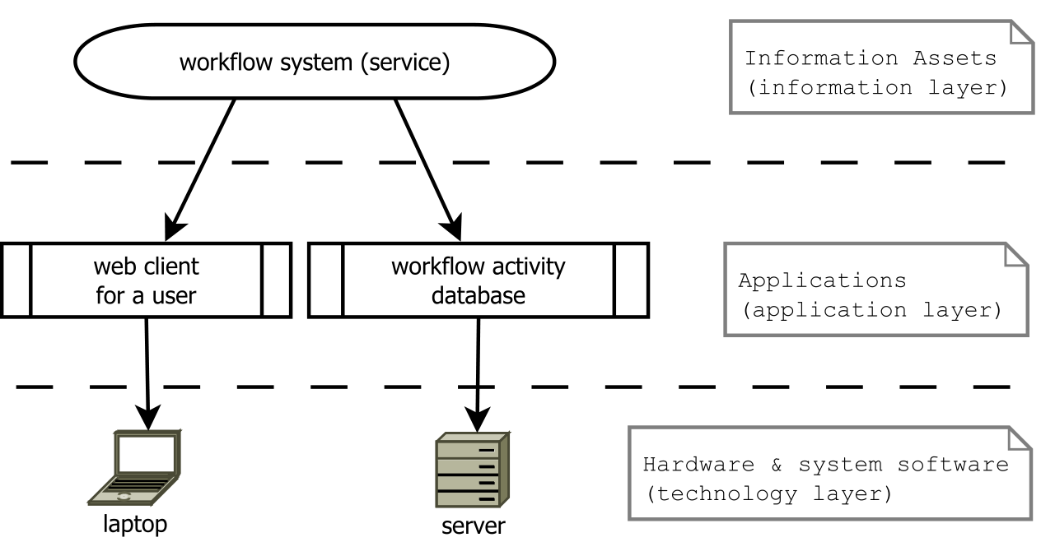
DCRA uses “ArchiMate” layers
operations

Slide 8
Question to Audience
If the data you process is not confidential at all, and if the server you use is placed in an unsecured location and has no firewall, do you then have a confidentiality risk?
In the same situation, do you have a (business) value risk?

Slide 9
Our way
For more details, see the paper.

Slide 10
Two problems with DCRA
DCRA is a bit complicated. The model is mathematically sound but it’s not easy to fill in the numbers and to make quick calculations. → We simplified the model a bit (at a cost).
DCRA mostly describes the calculations, not the whole process. It needs to fit within a whole “workflow” or process model. → We made such a “workflow”.

Slide 11
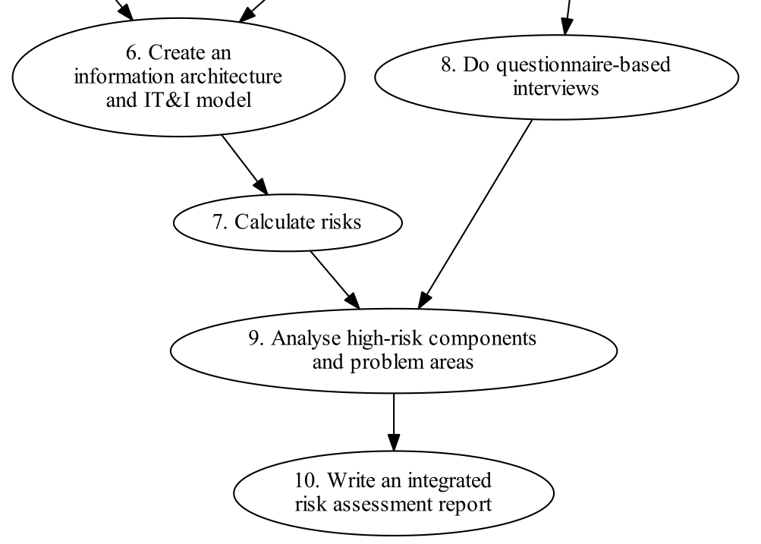
MISRAM workflow (2/2)

Slide 12
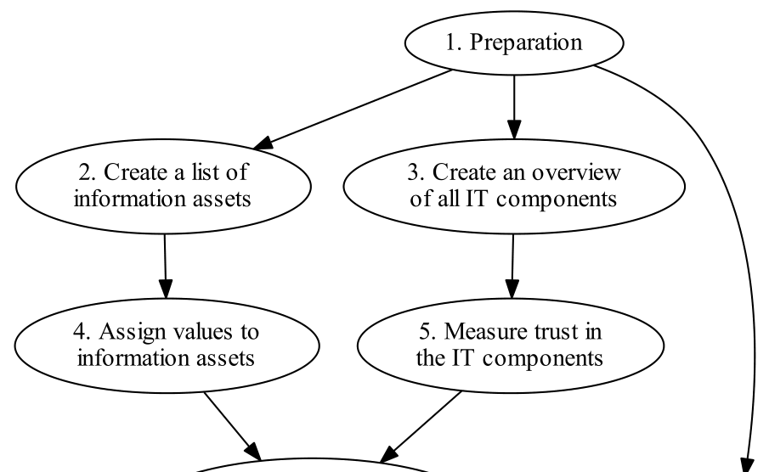
MISRAM workflow (1/2)

Slide 13
Nice for Science Gateways
Gateways typically live between layers: between user systems, and grid or cloud. This model-based or architecture-based method fits in well.
Science Gateways: who can determine the code quality, the inner security, the usage? Who is the expert? Isn’t that the dev/admin group itself?

Slide 14
A few practical hints
More are given in the paper.

Slide 15
(getting the expert opinion) surveying tips
Likert scale, 5 points: none, low, moderate, high, very high, no answer
keep it short (and simple →KISS) - better participation - less selection bias
allow free-text comments

Slide 16
(getting the expert opinion) defeat outliers with a trimmed mean
Outliers have much effect when the number of respondents is mall.
Still, the mean is better than the median to get the average from a small group, e.g. when six of the respondents assign value ‘3’, and the seven others assign ‘4’.
Another solution: use a trimmed mean. Leave out x% of the highest and the lowest values.

Slide 17
Include a classic questionnaire
The non-model risk assessment methods use questions that do detects vulnerabilities and risks that are not catched by our model-based approach alone.
Use a short questionnaire that includes questions that are obligatory for your legal domain. For the Netherlands, in healthcare, that is NEN 7510.

Slide 18
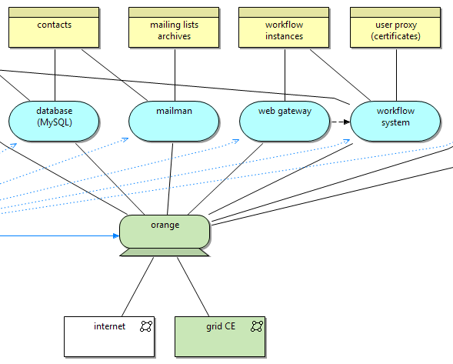
Creating an IT&I diagram
You can do it with Graphviz, Visio, Dia, or whatever you like.
I like Archi. It creates ArchiMate diagrams. IT&I was derived from ArchiMate.
http://archi.cetis.ac.uk/

Slide 19
The integrated report is for others too
The end-result is an integrated report.
It should be readable by outsiders.
It should give an overview of risks.
It should contain suggestions for actions.

Slide 20
Calculation example
For more details, see the paper.

Slide 21
Remember: two properties
UK National Archives sais information assets have two properties: - (Business) value - Confidentiality
Risk must be calculated separately for both properties.

Slide 22
Example of calculation (1/2)

Slide 23
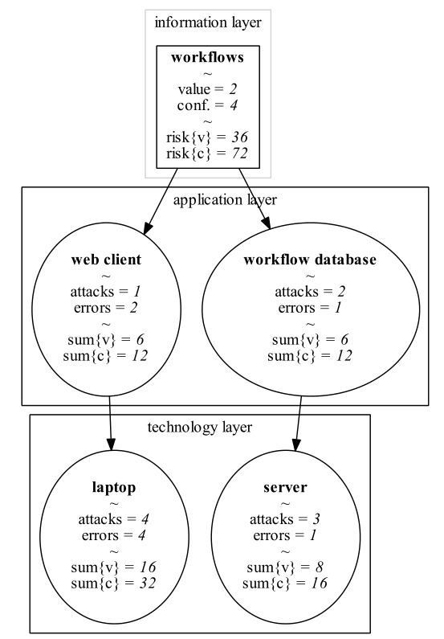
Example of calculation (2/2)
risk{v} = risk for business value
risk{c} = risk for confidentiality
vulnerability score Θ =
vulnerability to intentional attacks
+ vulnerability to unintended errors
e.g. Θ_{server} = 3 + 1 = 4
risk{v}_{workflows} =
= value · sum of vulnerabilities
= 2 · (Θ_{webclient}+ Θ_{laptop}+ Θ_{db}+ Θ_{server})
= 2 · ((1 + 2) + (4 + 4) + (2 + 1) + (3 + 1))
= 36

Slide 24
Note: you can go further…
You might want to consider the more complex, more complete original DCRA calculation model.
The calculations are used by MISRAM. The rest of the workflow doesn’t depend too much on the exact calculation method used.

Slide 25
Two kind of results
Which information assets are most at risk? MISRAM delivers… an ordered list with relative risks.
Which IT components cause the most risk? MISRAM delivers… an ordered list with relative risks.

Slide 26
Classify risk
The calculation gives a relative number.
Map it to risk: high, moderate, low, none.
Even the largest risk value from the calculation might be considered at “low risk”.
This might be subjective. Use a group meeting. Discuss. Consider consequences of s**t happening.

Slide 27
MISRAM again
Model-based Information Security Risk Assessment Method for Science Gateways

Slide 28
MISRAM workflow (1/2)

Slide 29
MISRAM workflow (2/2)

Slide 30
Discussion
More in the “Discussion” section in the paper.

Slide 31
Connectivity
Hey! My much-connected server is always causing the most risk!
Does MISRAM measure connectivity, or risk?
Are connectivity and risk related?
Compensate for connectivity?

Slide 32
Expert on what?
Are Science Gateway developers really experts on security as well?
Consider SQL injection attacks, or other specific attack vectors.
Unintentional errors are better grasped by developers than intentional attacks.

Slide 33
Who is at risk?
MISRAM detects risk for the group or organization administering the Science Gateway.
But the users?
We think: risk for users ≈ risk for group.

Slide 34
Does it work?

Slide 35
AMC case
We used this risk assessment method in the e-BioScience group at the Academic Medical Center (AMC), University of Amsterdam. http://www.bioinformaticslaboratory.nl
In meeting afterwards, group members voiced their trust in the method used.
Actionable measures were proposed.
Also a generic discussion on information security started within the group.

Slide 36
Going further

Slide 37
Future research
Connectivity vs risk problem.
Can one compare organizations with MISRAM?
Is it useful for everyone?

Slide 38
YOU!
You might be at risk without knowing it.
Discovering risk too late is, in general, not a good thing.
Start doing your risk assessment today.
Thank You!

