Slide 1
EGI – EISCAT_3D collaboration opportunities
European Grid Infrastructure
Gergely Sipos
EGI.eu
Technical Outreach Manager
gergely.sipos@egi.eu
EGI – EISCAT_3D teleconferece
17/May/2013

Slide 2
ENVRI study case
Project in ENVRI to
  Identify existing services and solutions from EGI that could address the data pre-processing, post-processing, publishing needs of Euro-Argo and EISCAT_3D
Project leader:
  Malgorzata Krakowian (malgorzata.krakowian@egi.eu)
Further information:
  https://wiki.egi.eu/wiki/EGI_ENVRI

Slide 3
Next steps
EISCAT_3D - EGI
Agree on scope of study case
  Goals, tasks, milestones, deliverable
Membership (which NGIs and projects?)
Next steps & frequency of meetings

Slide 4
Outline
EGI overview
  Contributors
EGI services for research communities
  Individual researchers ←→ Research infrastructures
EISCAT3D and EGI: Possible collaborations

Slide 5
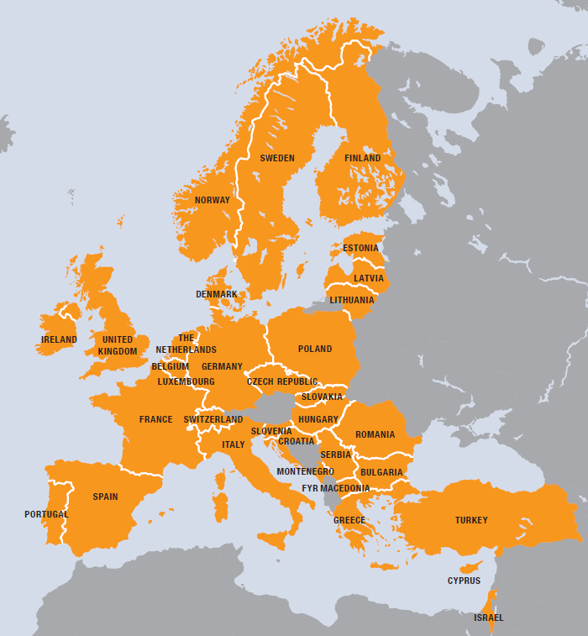
European Grid Infrastructure
European
  Over 35 countries
Grid
  Secure sharing of
  IT resources
Infrastructure
  Computers (clusters)
  Data
  Applications
  …. and beyond!!

Slide 6

EGI contributors
EGI-InSPIRE
Grid and cloud technologies:
EMI,
IGE,
EDGI,
...
EGI.eu
High level technologies:
SCI-BUS,
SHIWA,
MAPPER,
...
National Grid Infrastructures (NGIs)
Projects
Legal entities
Software + services
MoUs, SLAs
European Intergovernmental Research Organisations (EIROs)
Science domain specific:
wLCG,
WeNMR,
ScalaLife
HMRC,
...
Linking
infrastructures:
CHAIN
EUDAT
...
Notes:
MoU: Memorandum of Understanding
SLA: Service Level Agreement

Slide 7
EGI’s strategic focus areas
Virtual Research Environments
Community
& Coordination
Integration & operation of scientific environments
Operational Infrastructure
Governance
Communication
(inreach, outreach)
  Operate a European wide grid infrastructure
  Build a federated cloud infrastructure
Notes:
For further information, please refer to:
EGI Strategic Plan – Seeking New Horizons: EGI’s Role in 2020. Availabile online at https://documents.egi.eu/document/1098.

Slide 8













EGI services for research communities
Use
services
Individual researchers
1.
Scientific applications
Create
services
2 .
Capacity (grid/cloud)
3.
Application porting / hosting tools
Research collaborations
Operate
services
4.
Collab. & communic. services
Research infrastructures
5.
Operation tools, dashboards
...
Research infrastructure clusters

Slide 9
EGI services for research communities
Use
services
Individual researchers
What does the EISCAT_3Dcommunity want to achieve with EGI?
How is the EISCAT_3D community structured?
1.
Scientific applications
Create
services
2 .
Capacity (grid/cloud)
3.
Application porting / hosting tools
Research collaborations
Operate
services
4.
Collab. & communic. services
Research infrastructures
5.
Operation tools, dashboards
...
Research infrastructure clusters

Slide 10
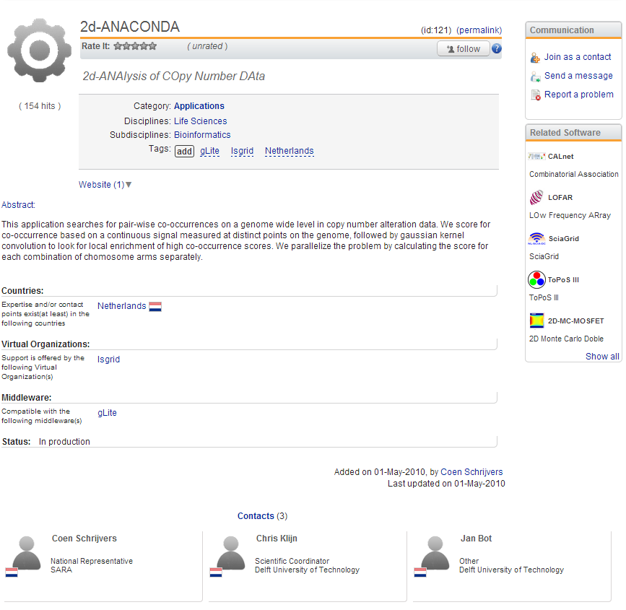
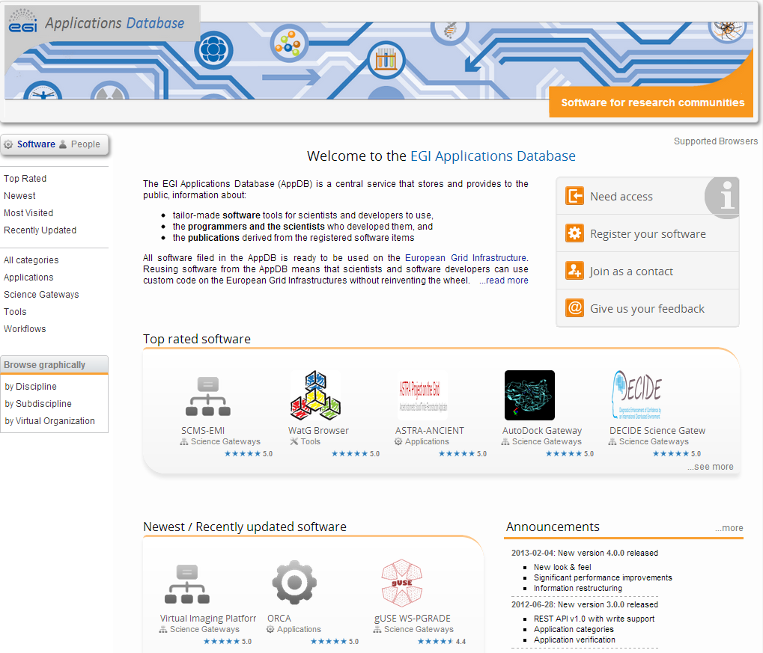
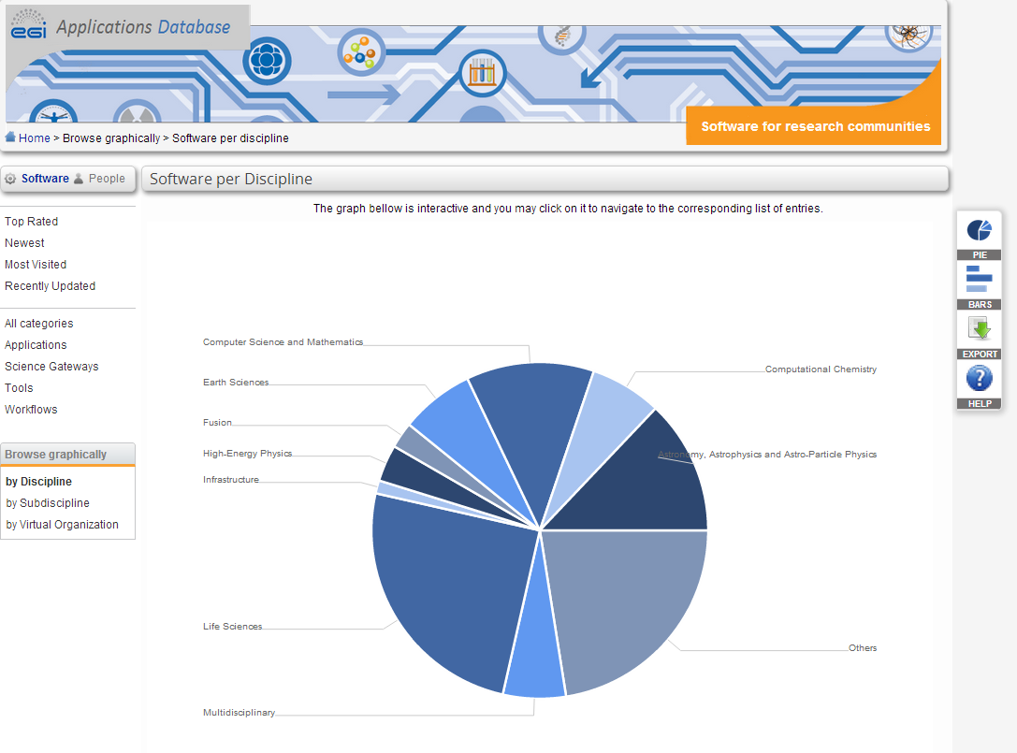
1. Scientific applications
Registered in EGI AppDB: http://appdb.egi.eu
  Browse by scientific discipline
  Browse by Virtual Organisation
Application access varies:
  Public access
  Via portal (username/pwd)
  Register in VO (X.509 cert)
Interact!
  Follow
  Rate
  Comment
  Contact
Applications

Slide 11
2/1. Capacity - Grid access
Join an existing Virtual Organisation:
  http://operations-portal.egi.eu/vo
  200-220 Virtual Organisations
    8 science discipline specific VO groups
    1 VO group for other disciplines
    1 group for Multi-disciplinary Vos
OR
Setup a new Virtual Organisation:
  http://operations-portal.egi.eu/vo/registrationWelcome
  Request to support the VO is sent to site managers
  Connect your own resources
Get help from NGI Support Teams
Domain specific applications, workflows, databases, etc.
Grid middleware: UMD
Unified Middleware Distribution
(gLite, ARC, Unicore, dCache, SAGA, Desktop Grid)
Linux OS
Linux OS
Grid sites at ~350 sites

Slide 12
EGI Grid use case example 1: batch processing
User environment
Broker service
Information System
Create job definition
Submit job
(batch executable + <20 MB inputs)
query
Login to your VO
(With X509 cert)
Retrieve status
&
(small) output files
Submit job
publish
state
Retrieve
output
EGI Virtual Organisation
Job status
Logging
Site X of YOUR VO
Computing service
Storage Service
Job status
job
Read/write files
job
Your files
VO Management Service
(VOMS)
job
Logging and bookkeeping service

Slide 13
Implementation: Auger VO
Serving the Pierre Auger Collaboration
Central services for the VO are in Czech Republic (by CESNET)
User environment
Broker service
Information System
Create job definition
Submit job
(batch executable + <20 MB inputs)
query
Login to your VO
(With X509 cert)
Retrieve status
&
(small) output files
Processing software is distributed to consortium members
Copied from Colorado (USA), Malargüe (Arg) to grid storage Lyon (Fr) (CCIN2P3)
Submit job
publish
state
Retrieve
output
Auger Virtual Organisation on EGI
Job status
Logging
CPU intensive simulations done at various sites and
results copied back to Lyon
Site of AugerVO
Computing service
Storage Service
Job status
job
Read/write files
job
Cosmic ray files
VO Management Service
(VOMS)
job
Logging and bookkeeping service

Slide 14
EGI grid use case example 2: data & meta-data management
User environment
Information System
Query
Login to your VO
(With X509 cert)
Register file
Lookup file
Upload file
Download file
publish
state
File content
EGI Virtual Organisation
Site X of YOUR VO
Computing service
Storage service
File Catalog and/or
Metadata catalog
Your files
VO Management Service
(VOMS)
Metadata

Slide 15
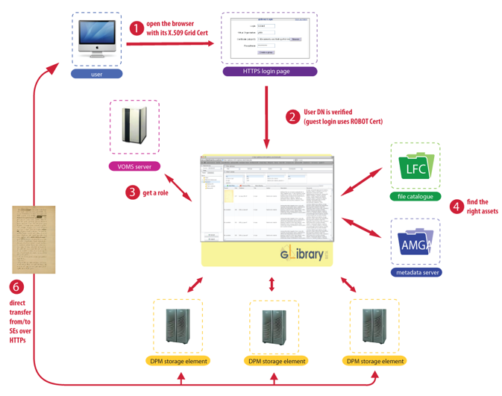
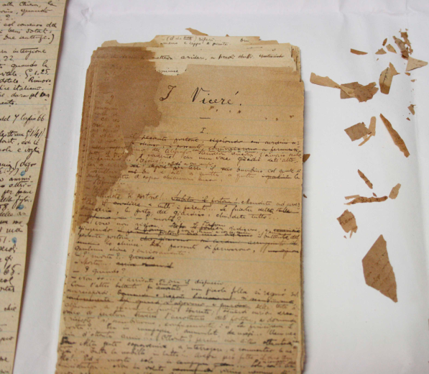
Implementation: gLibrary http://glibrary.ct.infn.it
De Roberto, an Italian writer of the XIX/XX century, born in Naples, but spending his life in Catania
(4) Browse
(1) Digitalise
(3) Catalogue
+
Meta-data
3TByte in total
TIFF (100MB/A3 page)
PDF (40-400MB/work)
(2) Store

Slide 16
2/2 Capacity - Cloud access:
EGI Federated Cloud
Any service, not only “batch processing” and “file based data management”
Domain specific services in Virtual Machine Images
OCCI: VM Image management
BDII: Information system
X509: Authentication
VOMS: Authorization
APEL: Accounting
EGI FedCloud interfaces
Local hypervisors
OS
OS
OS
OS
OS
OpenStack
OpenNebula
EmotiveCloud (Spain)
Okeanos (OpenStack impl. in GR)
WNoDeS (Italy)
Cloud resources at
~10 EGI sites

Slide 17
EGI Federated Cloud roadmap http://go.egi.eu/cloud
Sept 2011 – March 2013: Federated Cloud Task Force
  Identify open source technologies (OpenStack, OpenNebula,...) and open standard (OCCI, CDMI, GLUE2,...)
  Deploy a testbed
  Write blueprint for resource centres
  Identify issues from non-technical areas (policy, dissemination)
August 2012 – March 2013: Pilot use cases
  Support early adopters
  Collect and feedback requirements
April 2013 (EGI Community Forum): Start of pre-production phase
  Establish user facing services (e.g. Portal environments)
  ‘Blueprint’ for resource providers who wish to join
  Reach routine operation by October 2013

Slide 18
3. Application porting / hosting tools
To create custom environments for scientists...
Domain specific services
Domain specific services
EGI Applications Database stores
  Ready-to-use solutions on EGI
  Reusable frameworks
  Grouped in various categories (see below)
Categories (numbers in February 2013):
  70 developer tool/framework/toolkit
  46 science gateway & gateway framework
  26 workflow system & workflow
http://appdb.egi.eu
Service access
Science gateways (Portals)
Service orchestration
Workflow systems
Science domain specific services
Scientific algorithms, applications, workflows, databases
Off-the-shelf and custom
VM images
Scientific applications and algorithms
Very often only
this part is unique
Data bases and repositories
Grid
Cloud

Slide 19
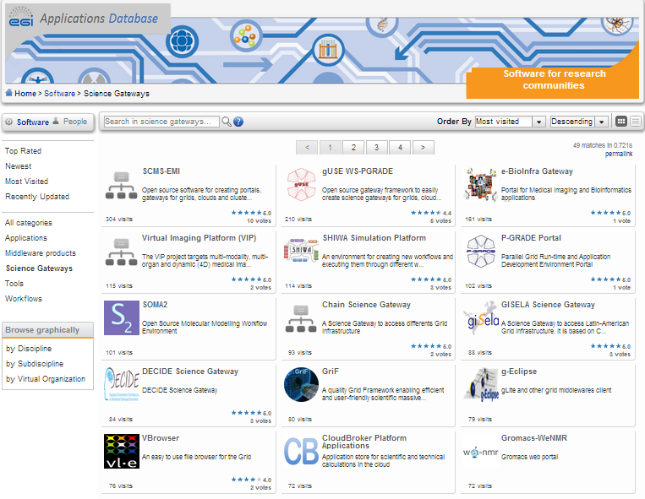
Science gateways http://appdb.egi.eu
…are community-specific sets of tools, applications, and data collections that are integrated together via a web portal (or a desktop application)
Main drivers:
  Simplify grid/cloud access for users
  Modularity & reuse
Gateways are domain/community specific, but the enabling technologies are typically not
Science gateway frameworks:
  gUSE WS-PGRADE → MoSGrid, e-Bioinfra, DBrain, HellasGrid,...
    21 in total - https://www.sci-bus.eu/science-gateways
  Catania Science Gateway Framework → CHAIN, GARR, AgINFRA,...
    19 in total - https://gridp.garr.it/service-providers.html

Slide 20
Anatomy of a science gateway
Science gateway
Authentiation
&
Authorization
Administrator
Power User
Basic User
Embedded applications
App. 1
App. 2
...
App. N
Users with different roles and privileges
Job submission engine
Data transfer engine
Local data (logs, authz, tmp, cache,...)
Grids, clouds, HPC, databases, etc.

Slide 21
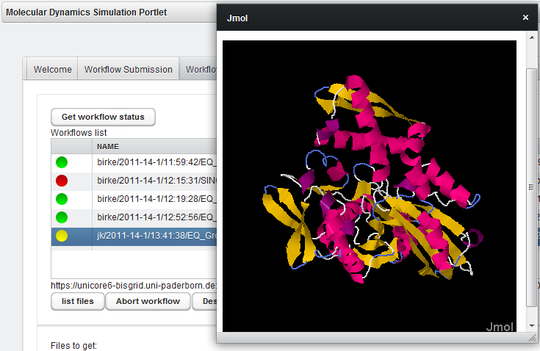
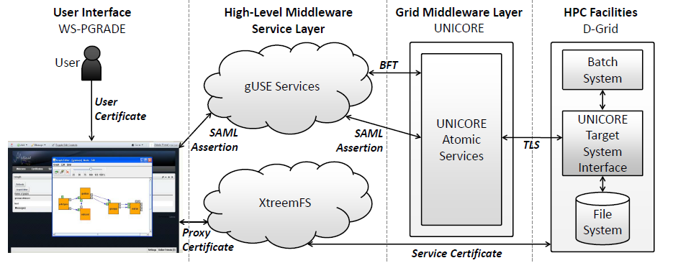
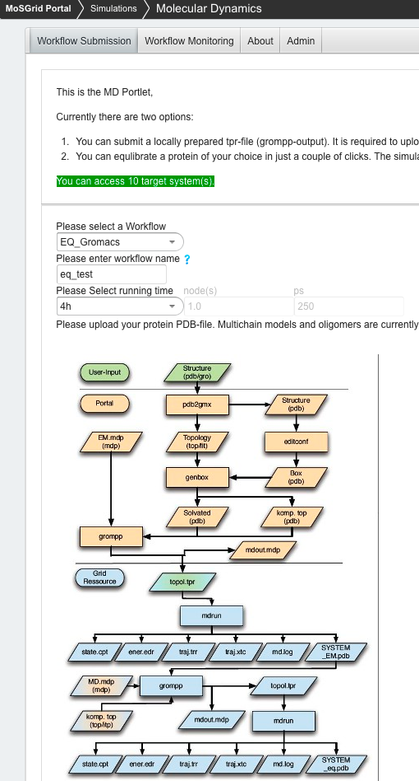
Example: MosGrid portal https://mosgrid.de/portal
Authentication
Job submission engine
Data transfer engine
HPC access with UNICORE
Quantum Chemical Calculations
  based on approximated solutions of the Schrödinger equation
  Average scalability
  Gaussian, NWChem, Turbomole, …
Molecular Dynamics
  based on forcefields describing molecular interactions
  Good scalability
  Gromacs, NWChem, Amber, …
Docking
  Based on simplified forcefields
  Excellent scalability
  CADDSuite, FlexX, …

Slide 22
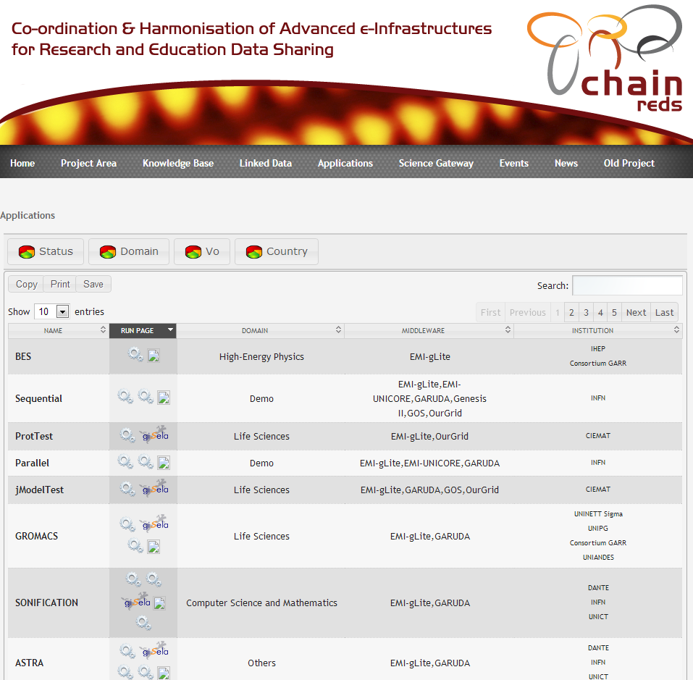
Example: CHAIN science gateway www.chain-project.eu/applications
Choose a science gateway
Sign in from an identity federation (user & psw)
Register in the gateway
Run pre-defined apps with your own data

Slide 23
4. Collaboration and communication services
To facilitate information exchange & knowledge integration in the community...
What we can provide for the VRC:
Software services
  Email list(s)
  Single Sign On service: http://www.egi.eu/sso
  Document repository: http://documents.egi.eu
  Training Marketplace: http://training.egi.eu
  Applications Database: http://appdb.egi.eu
  Requirements Tracker: http://go.egi.eu/requirements
Creation of content/materials
  Case studies, news stories, newsletters, articles, prints, designs, blog posts, videos, leaflets, social network content, etc.
Events
  EGI annual meetings
  F2f trainings and Webinars
Outreach
  (International Science Grid This Week, HPCwire, HPCinthecloud and Datanami, etc.
  Coordinated outreach (to ESFRIs) via the network of ‘NGI International Liaisons’
  EGI Champions: http://www.egi.eu/community/egi_champions/
In the pipeline:
EGI Webinar Programme
  https://wiki.egi.eu/wiki/EGI_Webinar_Programme
  Catania Science Gateway Framework
  (15 May)
  AMGA Metradata catalogue
International Workshop on Science Gateways:
  http://iwsg2013.org/, Zurich 3-5 June
EGI Technical Forum:
  http://tf2013.egi.eu/, Madrid 16-20 September

Slide 24

5. Operation Tools & dashboards
Services to operate a multi-site, multi-national Research Infrastructure...
EGI’s services:
Service registry (GOCDB)
  Repository to maintain topology and other type of basic information about distributed services
Accounting infrastructure
  To gather, process and visualise usage of distributed services
Service Availability Monitor (SAM)
  To gather, process and visualise availability and reliability information about distributed services
Service discovery capability
(GLUE and LDAP)
  To store detailed and dynamic information about services. To discover services by features.
Helpdesk (GGUS, xGUS)
  To troubleshoot problems or provide guidance about products and services.
Research infrastructure
Scientific
services
Service
Service
Community portals
Service
Service
Registry
Accounting
Monitoring
Heldesk
Operation portals
Local NGIs
Infrastructure
services

Slide 25
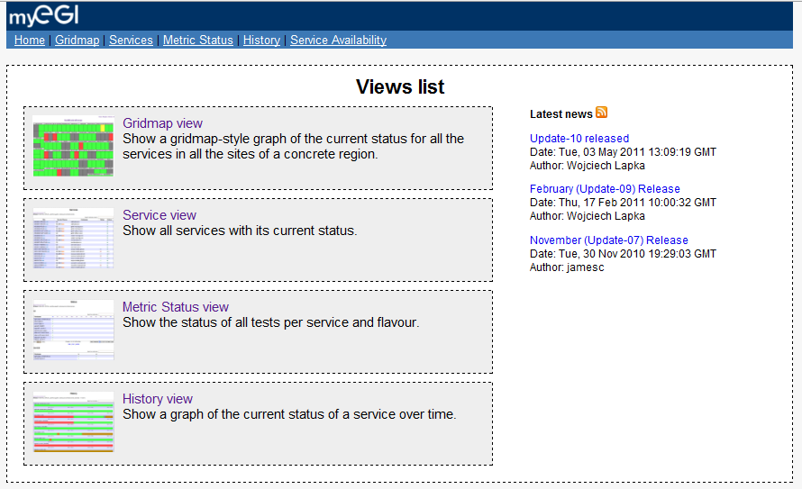
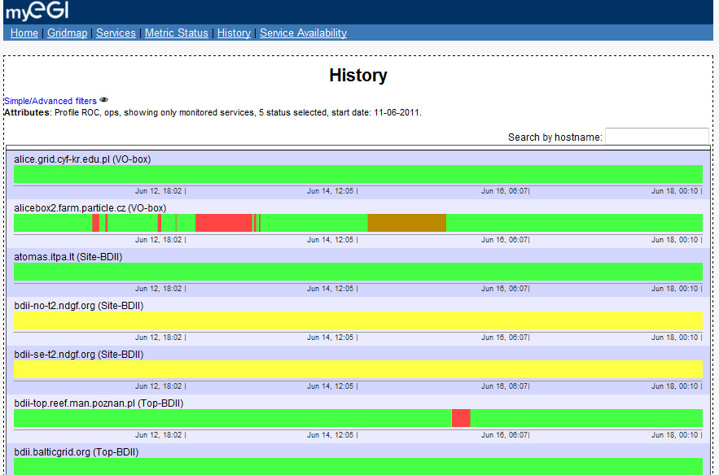
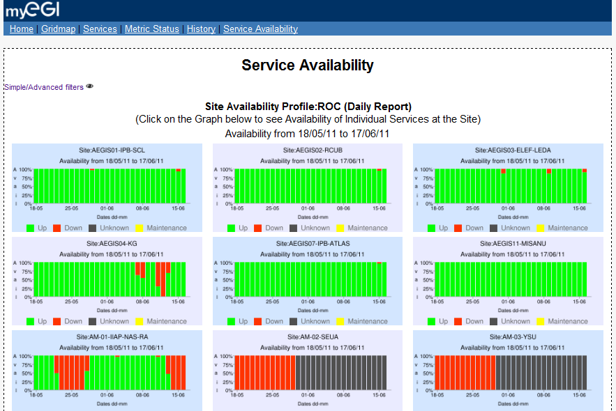
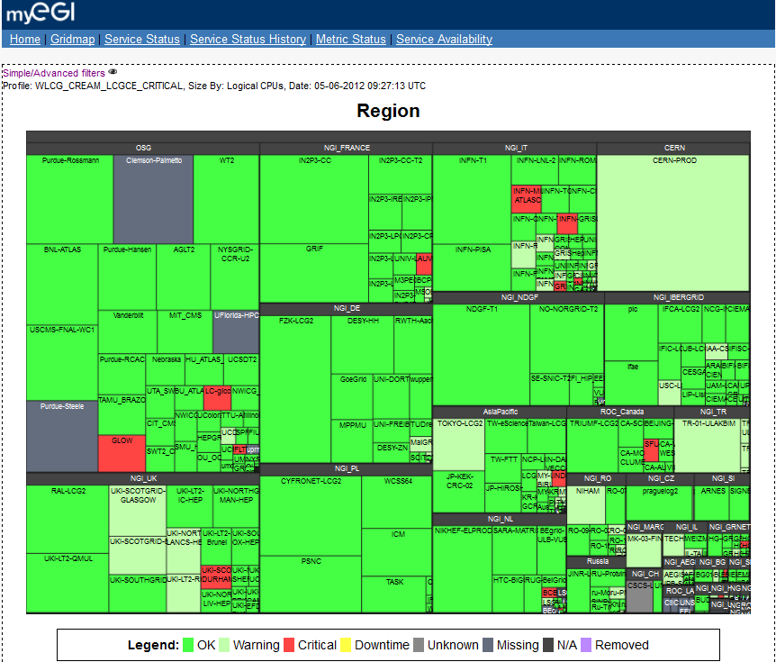
Example:
Service Availability Monitoring (SAM)
Framework for resource centres and service operators
Based on Nagios
Service-specific probes
Database to store service topology
Connected to a messaging network
Aggregate and browse results:
  Operations Dashboard, MyEGI, etc.

Slide 26
New project: HPC-HTC integration: https://wiki.egi.eu/wiki/EGI_EUDAT_PRACE_collaboration
Objectives:
  identify common data access and transfer tools and protocols
  demonstrate real benefit for the involved communities
  identify technology and/or organisational gaps and suggest measures for improvements
Pilot 1:
  Data sharing and uniform data access
Pilot 2:.
  Monitoring and resource discovery
Conclusions expected
  by mid August
Communities
Mapper
Virtual Physiological Human
VERCE (Earthquake and seismology)
Tools
Globus Online
File Transfer Service 3
EUDAT Data Staging
UberFTP
Globus-url-copy
QCG-Icon
Protocols
SRM
gsiftp/ftp
http/webdav
XROOT (rfio)
dCache (dcap)
Middleware
QosCosGrid
DPM
dCache
XROOT
iRODS/Griffin
E-infrastructures
EGI
EUDAT
PRACE

Slide 27
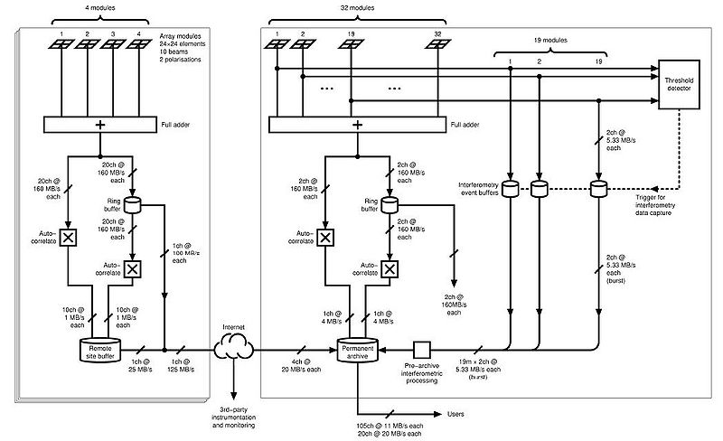
EISCAT3D and EGI:
Possible connections
Operation tools, Dashboards
File transfer services
Scientific applications, science gateways
Tools & support for application integration
Grid and/or Cloud?
Grid & cloud Virtual Organisation (capacity, technology, support)

Slide 28
Conclusions
EGI is based on a federated model
  NGIs - national resource and service providers
Established grid, emerging cloud infrastructure
EGI is not just computing and storage
  Scientific applications
  Application developer tools & support
  Infrastructure operation tools and dashboards
  Collaboration and communication services
Various possibilities to use EGI services in EISCAT3D

Slide 29
Thank you

Slide 30
Extra slides

Slide 31
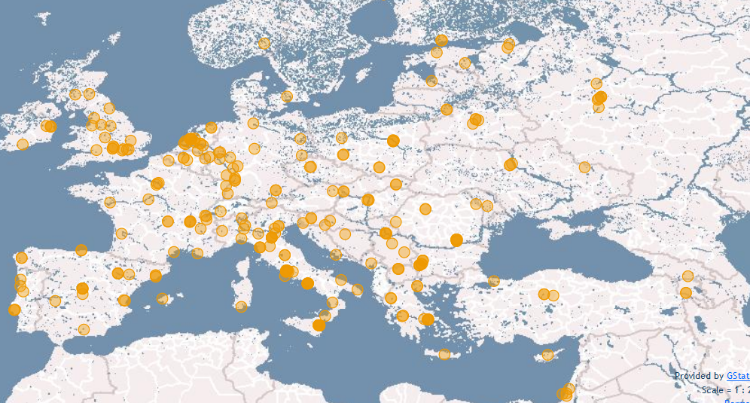
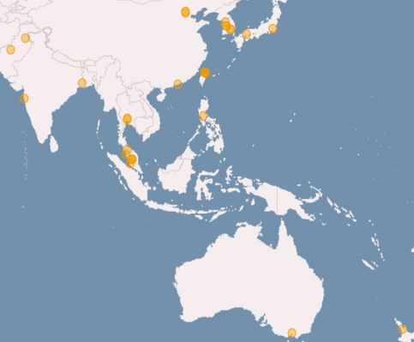
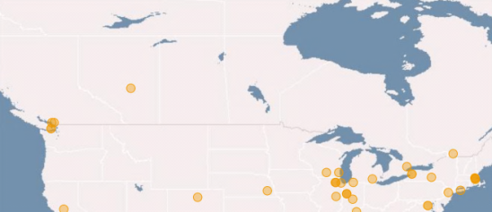
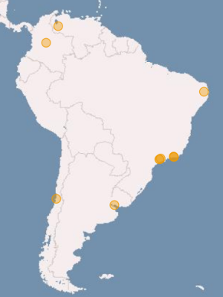
Key resource providers in EGI:
National Grid Infrastructures
Metric | Value (March 2013)
Sites | 315
Nb. of CPU cores | 372,612
Disk (PB) | 180 PB
Tape (PB) | 167 PB
Notes:
Statistics were taken from the EGI Metrics Portal:
http://metrics.egi.eu/

Slide 32
A multi-disciplinary e-infrastructure http://www.egi.eu/community/
Virtual Research Community
Virtual Research Community
Current VRCs:
wLCG - High Energy Physics
WeNMR – Structural biology
LSGC – Life sciences
(HMRC – Hydro-Meteorology)
(CLARIN – Humanities)
Research
communities
Cloud
Grid
Most active VO groups:
High Energy Physics (wLCG)
Astronomy & Astrophysics
Life Sciences (LSGC)
Earth Sciences
Computational Chemistry
Fusion
…
VO
VO
VO
VO
Virtual
Organisations
User
User
User
Members
User
User
User
Sites
Sites
Sites
Sites
Sites
~22.000 users, ~230 Registered VOs:
http://operations-portal.egi.eu/vo
Notes:
32

Slide 33
EGI, EGI.eu, EGI-InSPIRE
EGI – A collaboration. An ecosystem.
  Operates the infrastructure – and does other things too! (see later)
  Aim: Support the digital European Research Area through a
  pan-European research infrastructure based on services federed from the NGIs
EGI.eu – A Dutch fundation owned by the NGIs
  To coordinate the work of EGI (operations, technology, user support, policy, community & communications, administration)
  Sustainable, small organisation
EGI-InSPIRE – An FP7 project
  Supports EGI.eu and EGI to transition to sustainable operational model
  May 2010 – April 2014

Slide 34
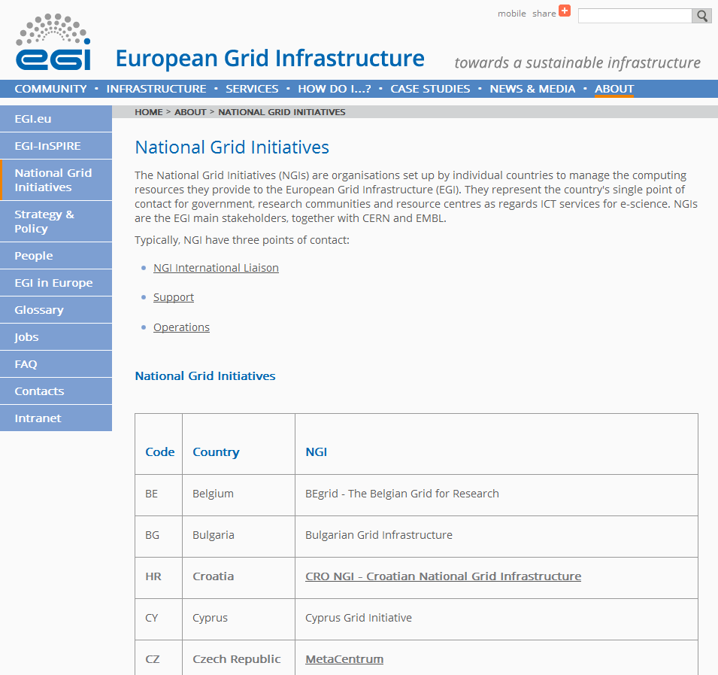
What is an NGI? http://www.egi.eu/about/ngis/
The country's single point of contact for government, research communities and resource centres as regards ICT services for e-science.
Manage the computing resources and support services they provide to the European Grid Infrastructure.
Has named contact for:
  International liaison (NILs)
  User support
  Infrastructure Operation

Slide 35
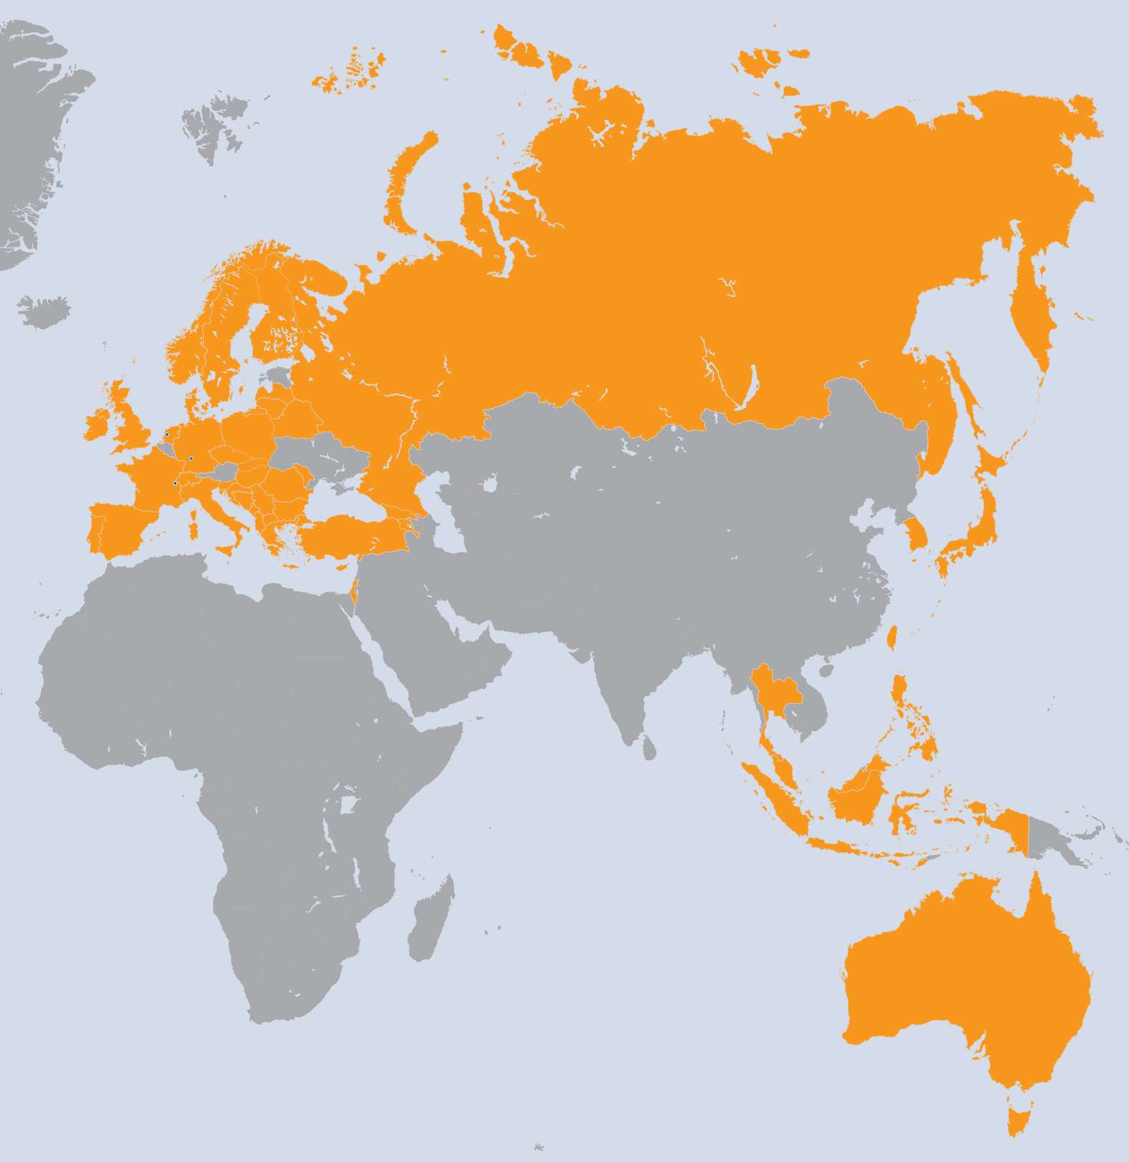
EGI-InSPIRE Project
Integrated Sustainable Pan-European Infrastructure for Researchers in Europe
A 4 year project with €25M EC
contribution
  Project cost €72M
  Total Effort ~€330M
  Effort: 9261PMs (192 FTE)
Project Partners (50)
EGI.eu (coordinator)
38 NGIs, 2 EIROs
Asia Pacific (9 partners)

Slide 36
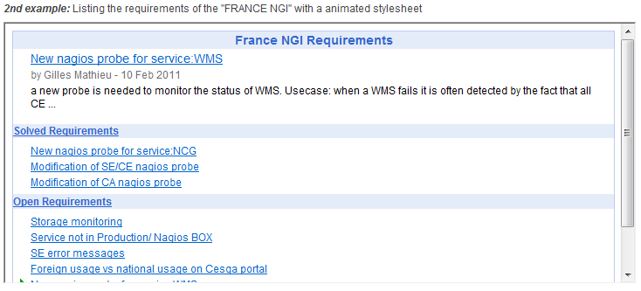
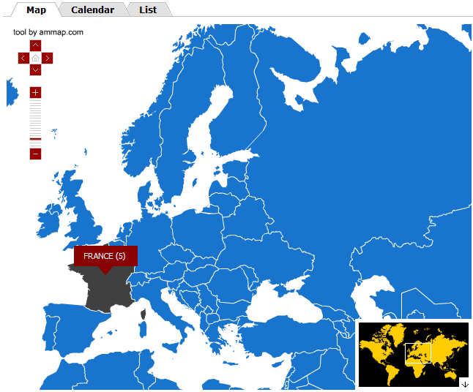
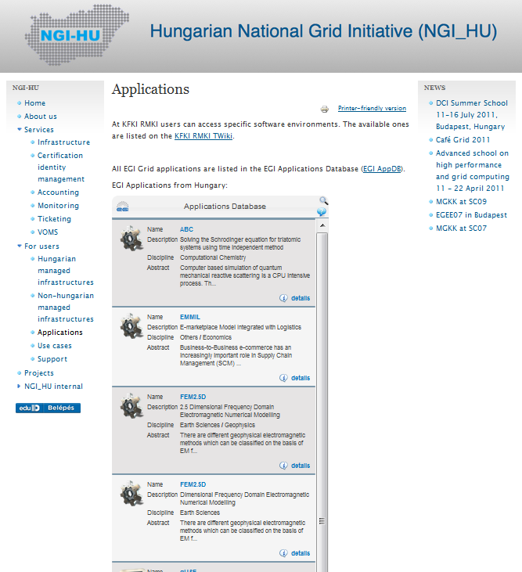
Web Gadgets:
Embed EGI collaboration services into Websites!
The simplest way to reuse EGI services: embed EGI gadgets into your website
Benefits
  Customisability
  Reusability
  Compatibility
Existing gadgets:
  Application Database
  Training Marketplace
  Requirement Tracker
  Grid Relational DBs Catalogue
Use and develop gadgets & share them through EGI:
www.egi.eu/user-support/gadgets

Slide 37
EGI Infrastructure:
The platform model
Collaboration Platform
(AppDB, Training Marketplace, DocDB,...)
Virtual Research Communities
EGI Collaboration platform
Community Platform
(UMD)
Community Platform
wLCG Community Platform
EGI Cloud Infrastructure
Platform
(FedCloud)
VM
EGI Core Infrastructure
Platform
(Operation tools)
VM
VM
EGI resources (cores & storage)

Slide 38
The current community platform:
Unified Middleware Distribution (UMD)
    External technology providers: EMI (ARC, gLite, UNICORE, dCACHE), IGE (Globus), EDGI (desktop grids), SAGA, …
    UMD capabilities captured in UMD roadmap
    (last version 2012 May: https://documents.egi.eu/document/612)
By EGI user communities and other stakeholders
External Technology Providers
Core infrastructure platform
Requirements
Software
Operations
Criteria
Definition
Criteria
Verification
Staged
Rollout
Production
Deployed Software
Helpdesk unit
Provisioning Infrastructure

Slide 39





Some of the EGI FedCloud pilot use cases
Structural biology – We-NMR project:
Gromacs training environments
Ecology – BioVel project:
Remote hosting of OpenModeller service
Linguistics – CLARIN project:
Scalable ‘British National Corpus’ service (BNCWeb)
Software development – SCI-BUS project:
Simulated environments for portal testing
Space science – ASTRA-GAIA project:
Data integration with scalable workflows
Join as pilot use case, or as provider of high level service on top of the EGI Cloud!
http://go.egi.eu/cloud

