Slide 1
CTA science gateway and single sign-on requirements
European Grid Infrastructure
Summary
Gergely Sipos
EGI.eu
Technical Outreach Manager
gergely.sipos@egi.eu
CTA Technology Study Virtual Team Project Webinar workshop: 21/06/2013 https://documents.egi.eu/public/ShowDocument?docid=1796

Slide 2
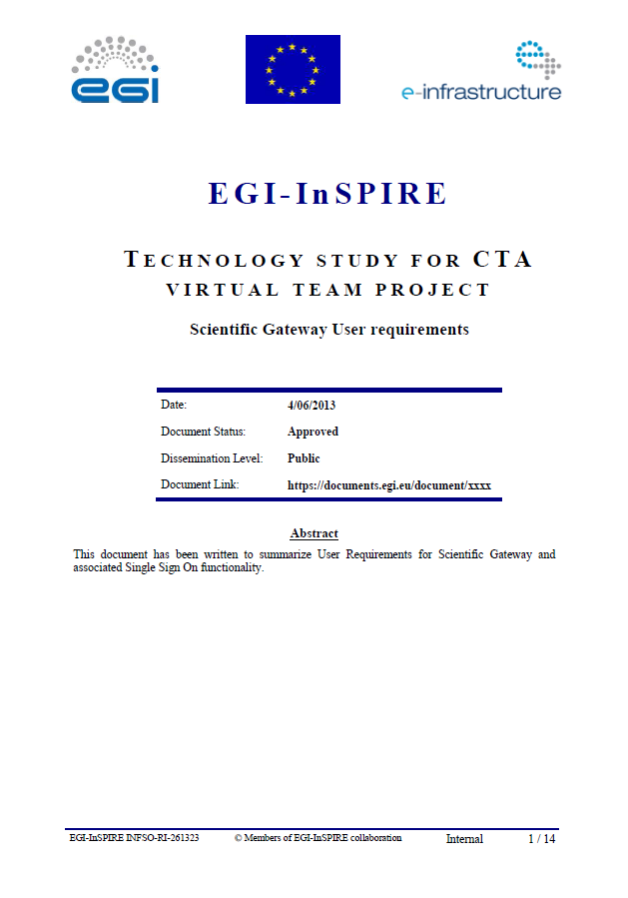
Sources
https://documents.egi.eu/document/1796

Slide 3
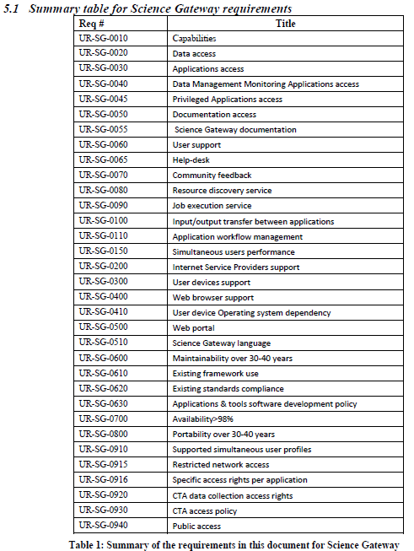
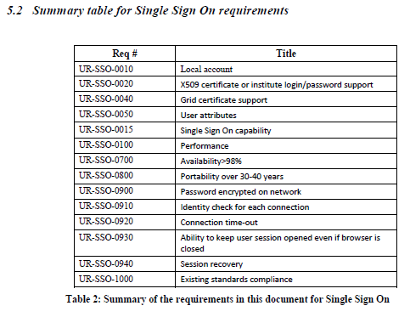
Requirements

Slide 4
An EGI science gateway
Science gateway (framework)
App. porting tools
Scientific applications
Authentiation
&
Authorization
Administrator
Power User
Basic User …
App. 1
App. 2
...
Job / service management engine
Data transfer engine
Local data (logs, authz, tmp, cache,...)
EGI Grid | EGI Federated Cloud | Other infrastructures

Slide 5
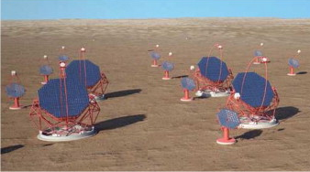
Envisaged CTA science gateway
One or more gateway instances based on a single technology (possibly technology integration)
CTA Science Gateway
Data
Users
Computation & data
Resources of CTA members
EGI resources (from NGIs)

Slide 6
What the users should see
CTA Science Gateway
Archived data sets (protected on CTA sites, public on NGI and other sites)
Is entitled to access
Applications
CTA Observatory performance inspectors
Observation oriented
Scientific:
Related to observatory access requests (forms, reviews, evaluations)
Analysis tools (Monte Carlo pipelines & pipeline builders)
Is entitled to use
Monte Carlo simulation results
Is entitled to access
Forums, helpdesk, support materials (manuals & FAQ), resource discovery service

Slide 7
Gateway and single sign-on
Home organisations
Certification Authority
Trusted by CTA and EGI
Approved by local HR
User identity (SAML)
User identity (X509 personal certificate)
User role (based on group, project, etc)
User roles:
Guest observer
With a successful proposal
Priviliged user
Special access
Archive user
Access to ‘public data’ withoth any proposal
Entries in CTA LDAP (or other registry?)
CTA Science Gateway
Web login
User identity (for the ‘homeless’)
Approved by the CTA Observatory
Local accounts in the science gateway
Approved by the CTA Observatory

Slide 8
Linking two worlds: eduGAIN and CAs
Import certificate proxy
CTA Science Gateway
X509 Certificate store
X509 personal certificate
Power user
Run user’s own binaries & pipelines
European Grid Infrastructure and CTA sites
X509 robot certificate
Run pre-defined and validated binaries & pipelines
Basic user
Prepared by power users

Slide 9
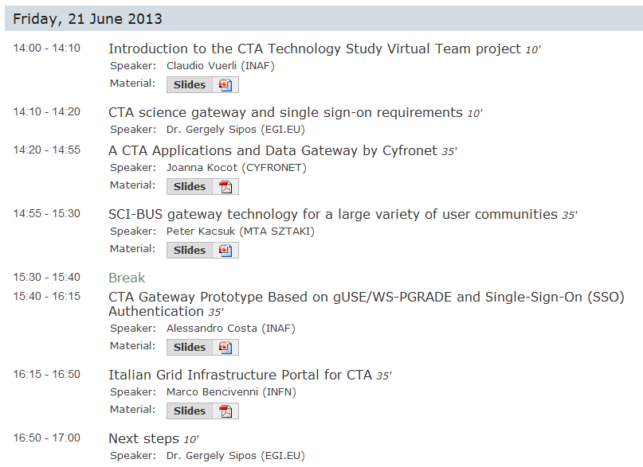
Programme today

Slide 10
What we want to achieve today
Identify potential technologies for CTA science gateway
Based on the requirements
Clarify and extend requirements (e.g. applications, data, certificates)
Capture recomendations for the VT
To implement, or to pass on to CTA

Slide 11
Thank you
gergely.sipos@egi.eu

