Slide 1
CTA Gateway Prototype
Based on gUSE/WS-PGRADE
and Single-Sign-On (SSO) Authentication
http://cta-sg.oact.inaf.it/
A. Costa, P. Massimino,
C. Vuerli, U. Becciani
INAF

Slide 2


Communities and
Information Technology
Knowledge Providers
SCI-BUS
ER-Flow
Different scientific communities are involved in the ER-flow activities.
INAF in the first project year is providing application support for these communities:
INAF Astrophysical Observatory of Catania (OACT).
INAF Astronomical Observatory of Trieste (OATS)
INAF Astronomical Observatory of Teramo (OATE)
University of Portsmouth (UoP)
Slovak Academy of Sciences (SAS)

Slide 3





STAR^{net} Gateway Federation
Scientific Communty support ➔ New Science Gateways
INAF
  Astrophysical Obs. of Catania - VisIVO SG
  Astronomical Obs. of Trieste – Plank Mission
  Astronomical Obs. of Teramo – Franec/Basti
University of Portsmouth (UoP)
  Cosmological Support (ICG)
  Teaching and Learning Tools (CCI)
Slovak Academy of Sciences
http://www.oact.inaf.it/STARnet/pages/members.htm

Slide 4
STAR^{net} Gateway Federation
Definition
- Technology.
  Liferay/WS-PGRADE, gUse, SHIWA Repository
  Local and distributed DCIs
- Maintenance.
  FrontEnd/BackEnd Virtual Machines
  Master Virtual Machines with Local Customization included (configuration file Enab/Disab. Portlets and services)
  Master maintenance/update ➔ INAF (OACT)
- Shared Services
  Single Sign On (SSO)
  Workflows Sharing (SHIWA repository)
  Cloud Data
- Local account
  Data will be preserved: each Federate SG mounts external DB exported by the physical machine (e.g. /mnt/STARnet)
Notes:
STAR^{net} Gateway Federation schema

Slide 5

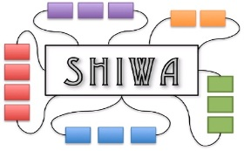
Virtual Machine
Virtual Machine
Virtual Machine
WSPGrade/gUSE
WSPGrade/gUSE
WSPGrade/gUSE
Liferay
Liferay
Liferay
Local DCIs
Local DCIs
Local DCIs
Local DB
Local Storage
Local DB
Local Storage
Local DB
Local Storage
Local WF Repository
Local WF Repository
Local WF Repository
Shared
Storage
Shared DCIs
Shared WF Repository

Slide 6
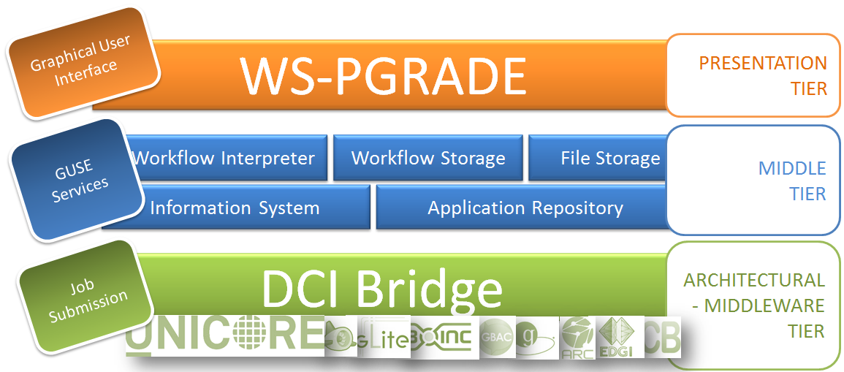
A CTA gateway based on ws-pgrade gUSE: Portal Architecture
http://cta-sg.oact.inaf.it/
Notes:
UR-SG-0090 The Science Gateway must provide a job execution service able to use distributed resources (see above) for application processing and selected data storage.
UR-SG-0610 The Science Gateway must be developed using existing frameworks to minimize the number of specific developments.

Slide 7

CTA users and SSO authentication the CTA IdP
WAYF Service
CTA Science Gateway
Users:
Guest observer
Priviliged user
(incl. principal investigators,
archive managers, etc.)
Archive user
Privileged users will use CTA IdP
Guest observers will use
A federated IdP
Web SSO
‘Homeless users’
Local accounts in the science gateway
Federation
Notes:
The goal of a "Where Are You From" (WAYF) service is to guide a user to his or her Identity Provider

Slide 8
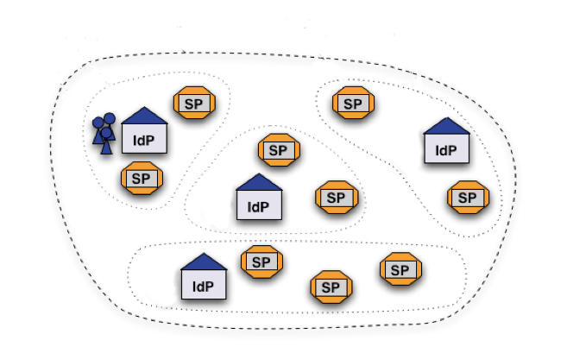
Federation
CTA IdP
Connected to the the CTA LDAP
Notes:
A federation is a collection of organizations that agree to interoperate under a certain rule set. Federations will usually define trusted roots, authorities and attributes, along with distribution of metadata representing this information.

Slide 9
Currently implemented components at INAF
WAYF Service
CTA Science Gateway
A CTA SG prototype based on WS-PGRADE-gUSE
CTA IdP
A CTA SP
Notes:
A federation is a collection of organizations that agree to interoperate under a certain rule set. Federations will usually define trusted roots, authorities and attributes, along with distribution of metadata representing this information.

Slide 10
INAF CTA SG:
SAML Based SSO Model
CTA Gateway
CTA Identity Provider
Trust
Service Provider
SAML Request
SAML Response

Slide 11
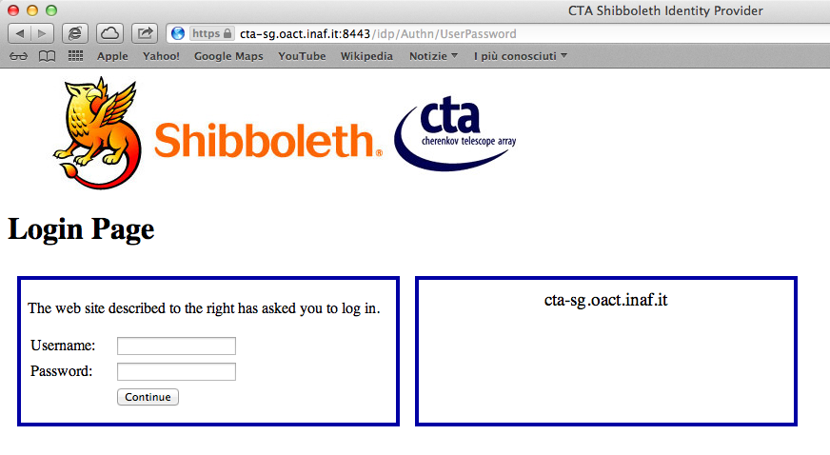
INAF CTA SG: Login Page
The portal user is presented with the CTA IdP login page
Notes:
The Shibboleth environment can be customized in order to filter and manage any attribute provided by LDAP.
Currently we are using an LDAP server at INAF CATANIA.
The Identity Provider can be connected to the CTA LDAP server.
This Authentication environment meets the following requirements:
UR-SSO-0010: A Guest Observer that cannot be identified by a scientific community must be able to create a local account protected by login/password. The CTAO produces identification credentials for such a user.
UR-SSO-0030 A CTA internal user will be identified using his CTA login/password
UR-SSO-0900 All passwords must be encrypted on network.
UR-SSO-0910 The identity of users must be checked for each connection request.
The Shibboleth 2 standard implements an inactivity timeout that is reset any time the user is authenticated to a service provider.

Slide 12
INAF CTA SG Standards
The usage of standards increase
  the long term sustainability
  Modularity
  Easiness of use
Java Portlet Specification (JSR-168)
Security Assertion Markup Language 2.0 (SAML 2.0)
  Shibboleth implementation
Open LDAP
Usage of X509 certificates
Notes:
The implemented solution meets the following requirements:
UR-SG-0620 The Science Gateway framework used must follow existing standards.

Slide 13
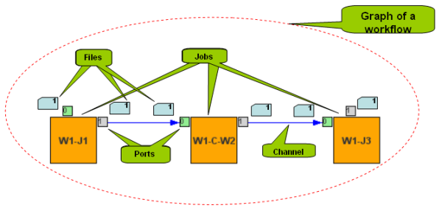
Workflows
The skeleton of a workflow is represented by a Graph.
Jobs denote the activities, which envelop insulated computations
Channels are directed edges of a graph, directed from the output ports towards the input ports.

Slide 14
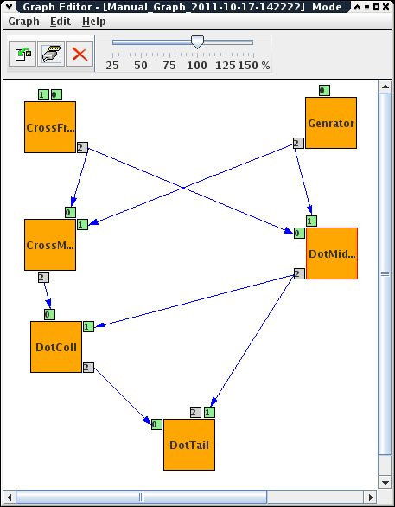
Workflows
UR-SG-0110: CTA gUSE/WS-PGRADE portal provides a workflow management system: “graph editor”.
We can rely on a local and a public workflow repository .

Slide 15
Workflows
Graph creation
Concrete workflow creation
Concrete workflow configuration
  Job types and corresponding properties
  Port properties
Certificate handling
Submission
  Log examination
Submitted instance management
Result evaluation
Repository handling (export/import)

Slide 16
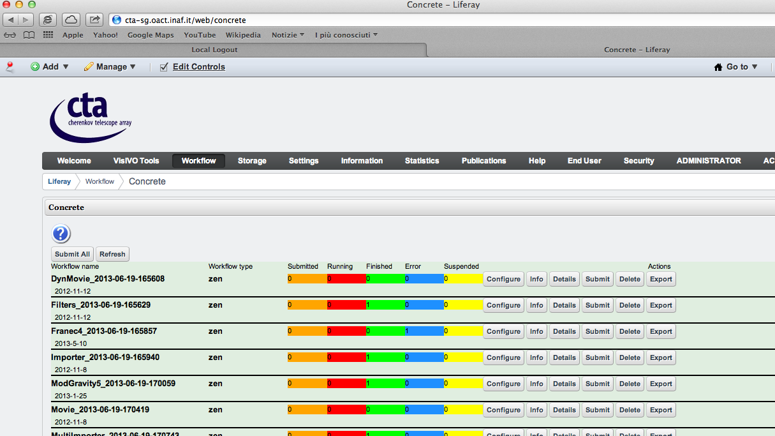
CTA Gateway
Workflows instances

Slide 17
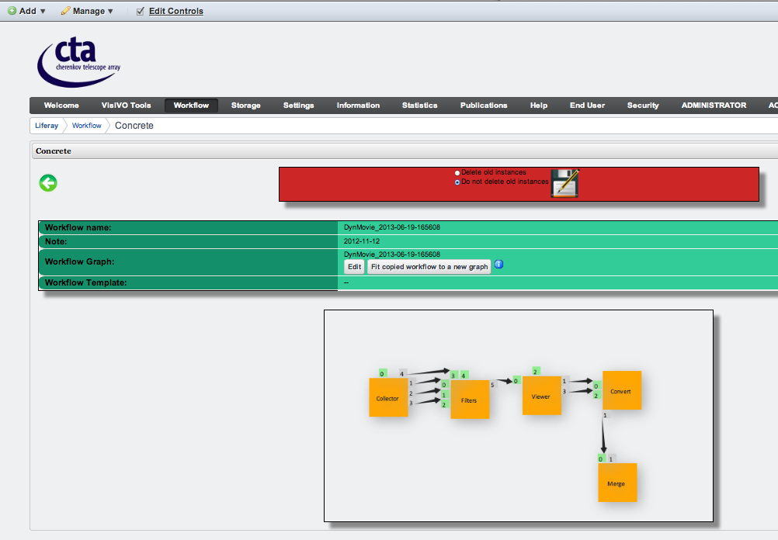
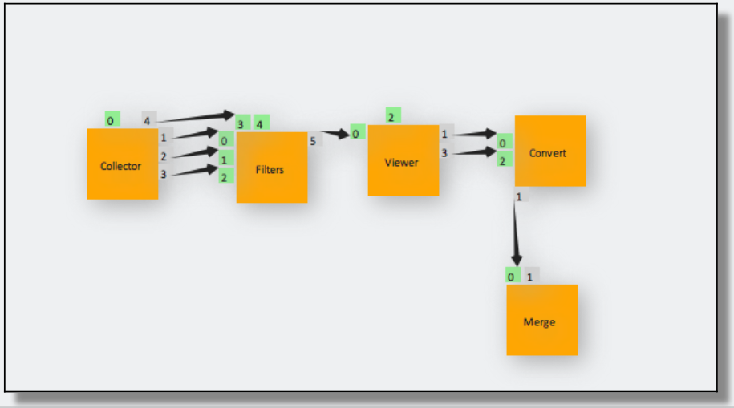
CTA Gateway
Workflows instances
Notes:
This Workflow is a parameter sweep workflow

Slide 18
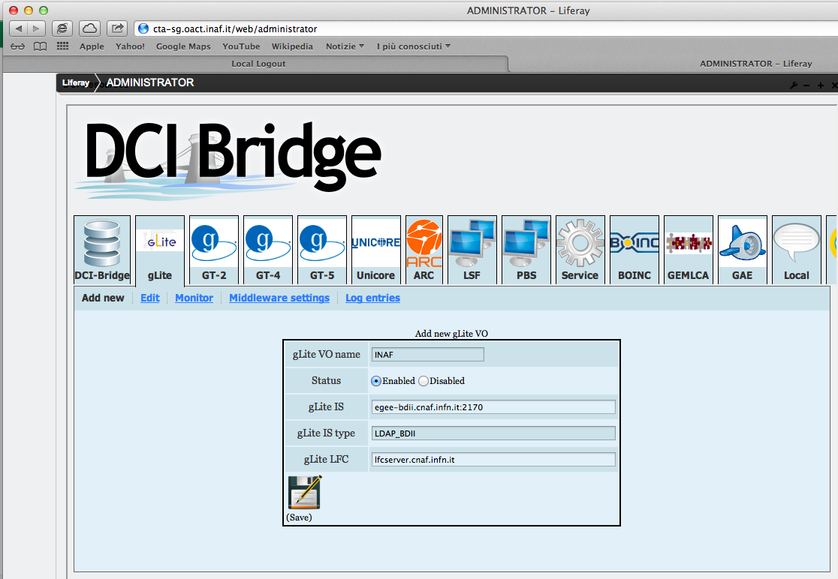
CTA Gateway:
Adding a DCI to the portal

Slide 19

CTA Gateway
Application and DATA in Cloud: ACID
ACID (Astronomical & Physics Cloud Interactive Desktop)
Is the cloud environment provided by our
CTA gUSE/WS-PGRADE portal.
It allows you to use many complex astrophysical software packages
ACID can be used as a remote DCI (workflows) or interactively by a GUI.
We use ownCloud
It is possible to sync and share data seamlessly directly from the user Desktop.
Notes:
ACID has more than 140 specific applications http://acid.oact.inaf.it/ACID/Included_packages.html
The astronomical and physics software suites available in ACID are Heasoft (High Energy Astrophysics Science Archive Research Center) that contains more than 100 subprograms like FV and others, Xanadu (Data Analysis for X-Ray Astronomy), Xspec (X-Ray Spectral Fitting Package), Xronos (Timing Analysis Software Package), Ximage (X-Ray Image Package), DS9 (Astronomical imaging and data visualization application), Sextractor (builds catalogue of objects from an astronomical image), Tempo2 (Pulsar timing package), IRAF (Image Reduction and Analysis Facility) and IRAF Ximtool (X11IRAF Tools), Topcat (Tool for Operations on Catalogue and Tables), Aladin (Interactive software for sky atlas), ROOT (Set di OO frameworks to handle and analyse large amounts of data), EUTelescope (Generic Pixel Telescope Data Analysis Framework), Geant4 (Toolkit for simulation of the passage of particles through matter), VisIVO (Tools for image and movie generation from large amounts of data). All packages are correctly installed on ACID server and they work without problems.
The user has own ACID account where he can transfer (upload and download) any type of data by using SCP or HTTP protocols. Moreover it is possible to use Owncloud, component of ACID packages, to share easily data between the personal desktop and the ACID server.

Slide 20
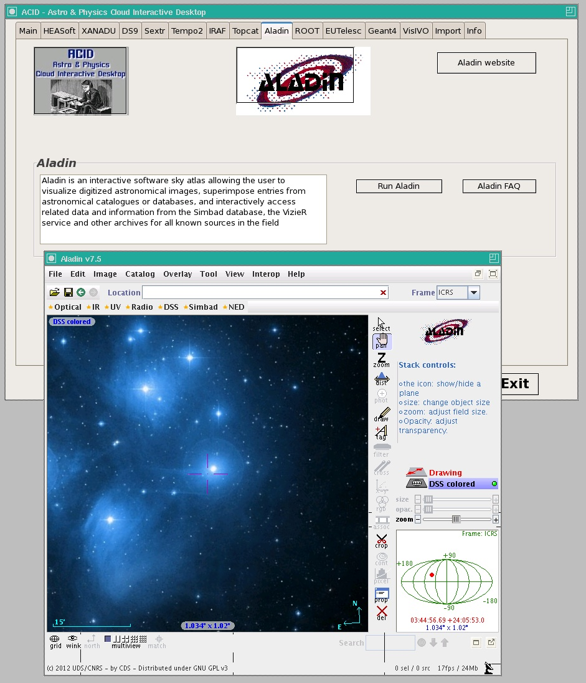
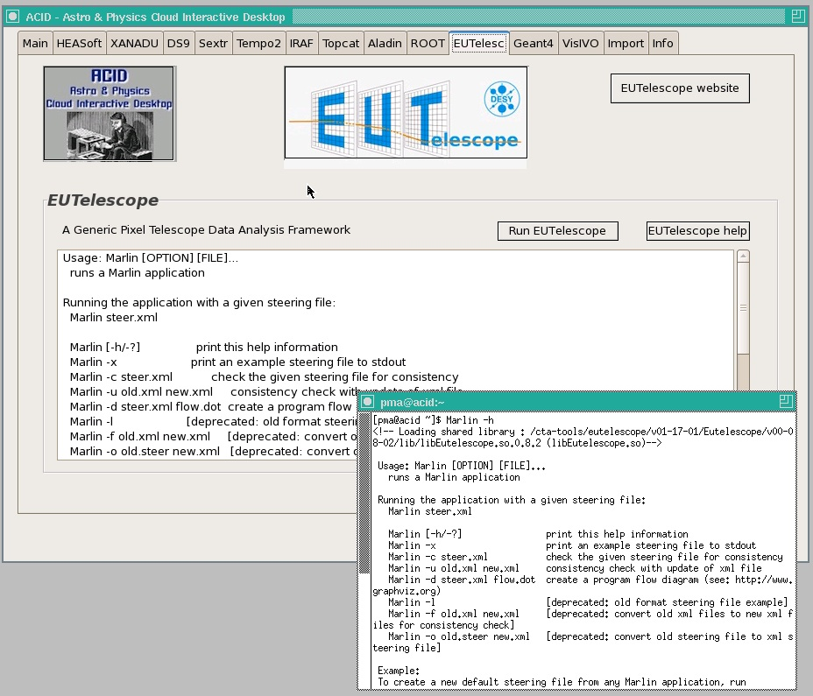
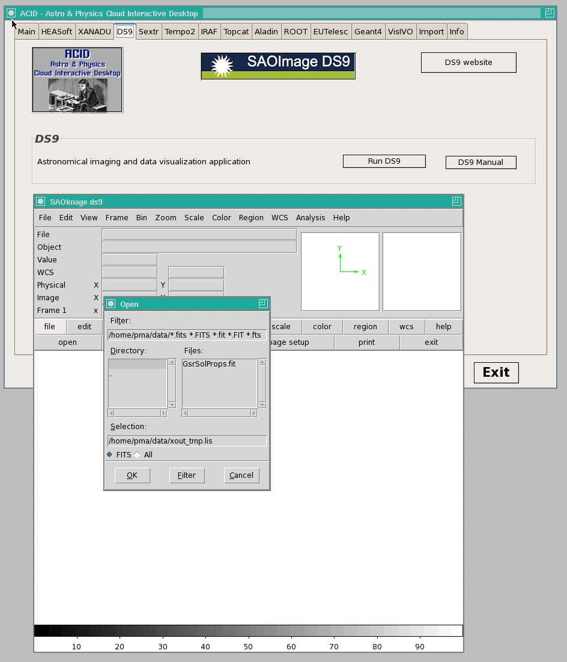
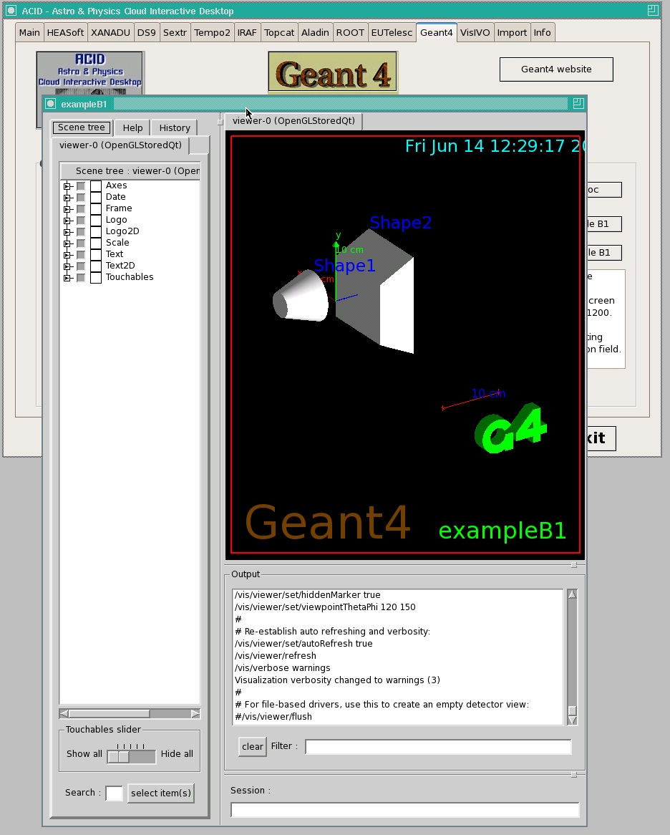
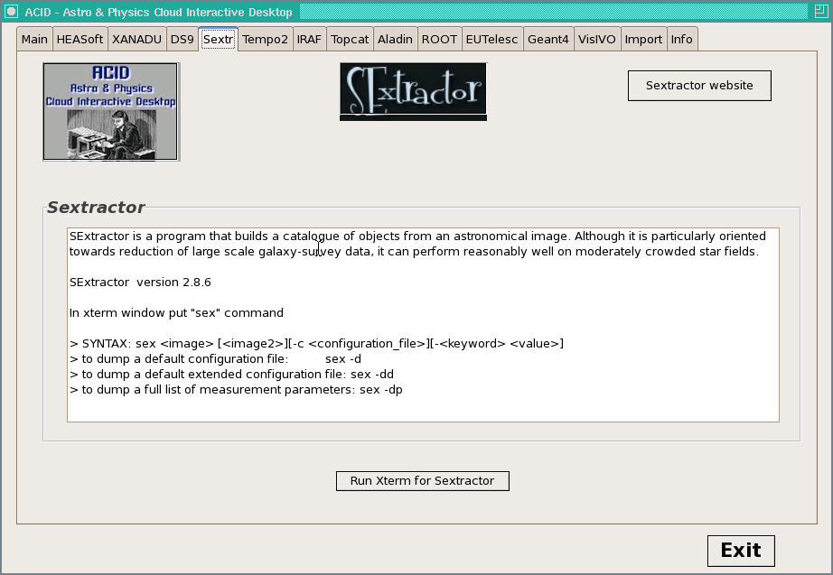
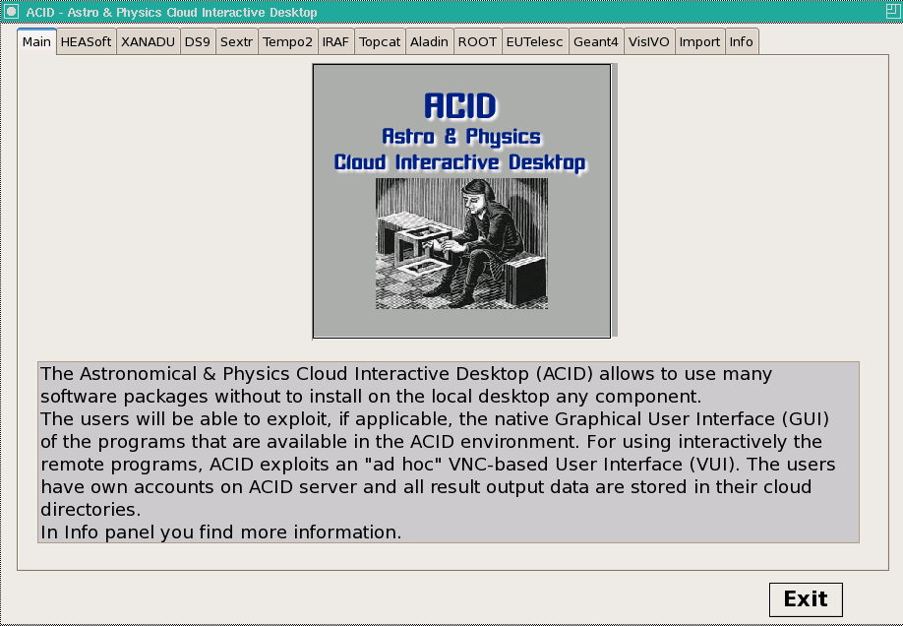
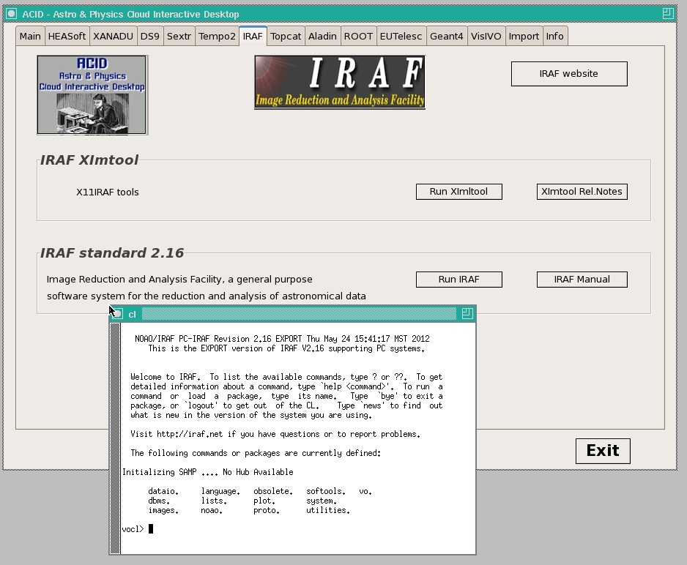
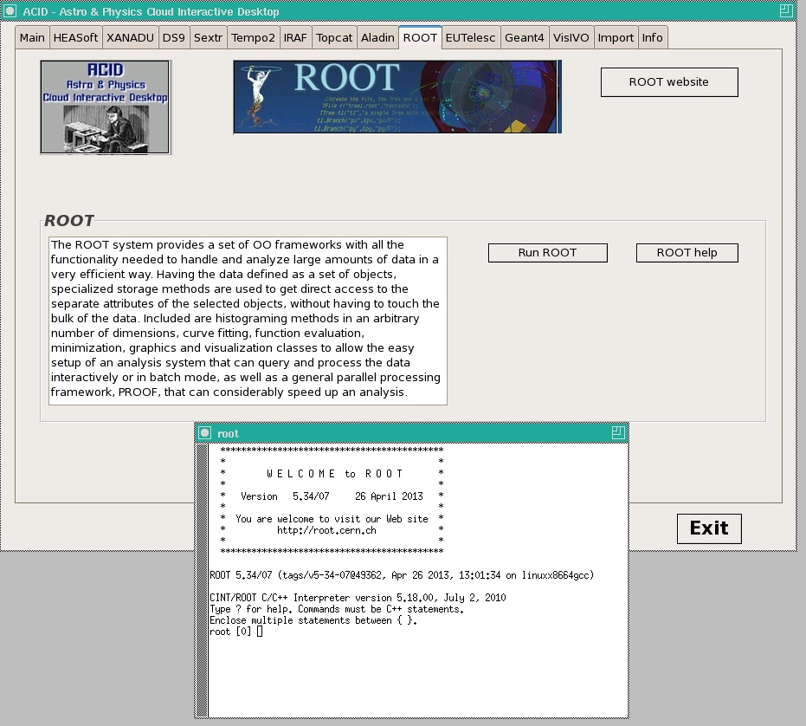
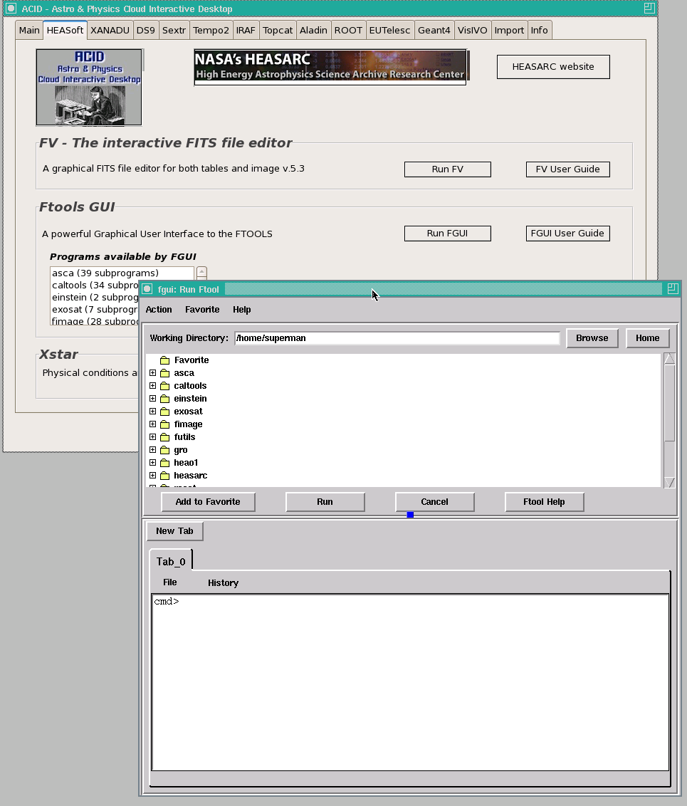
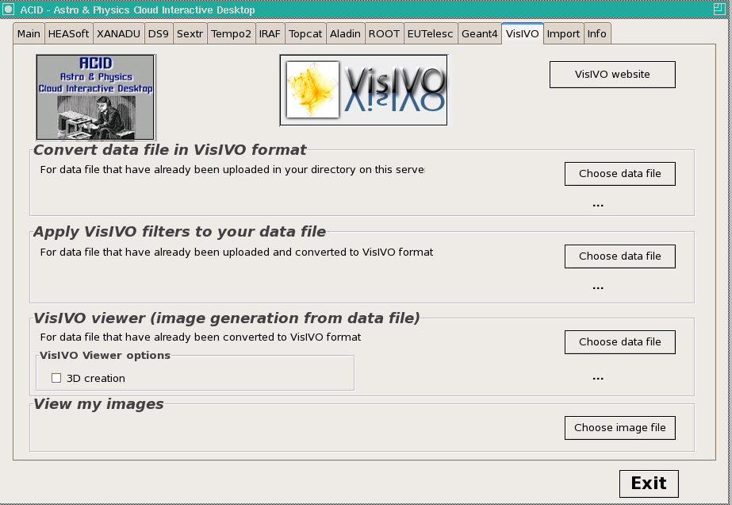
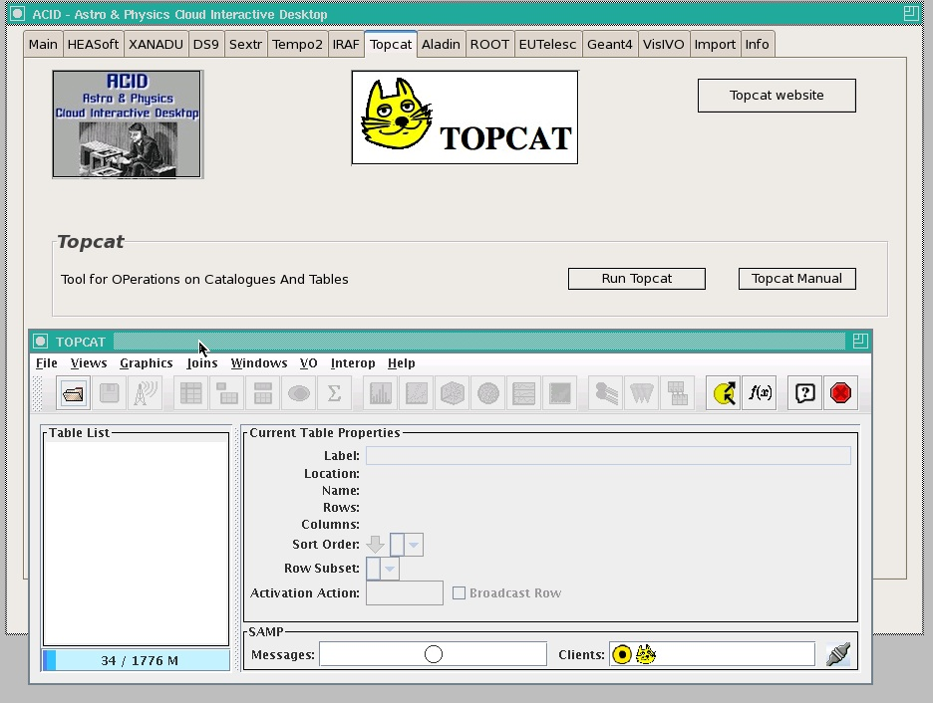
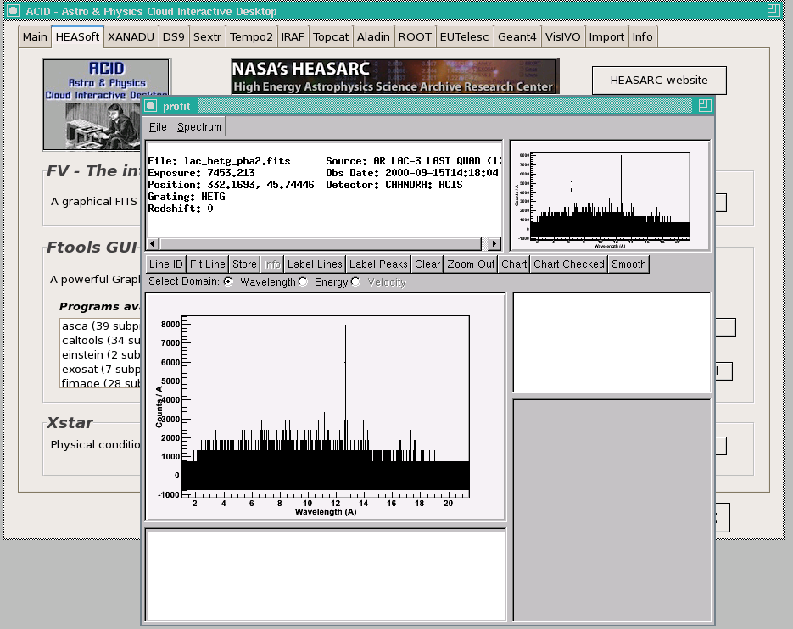
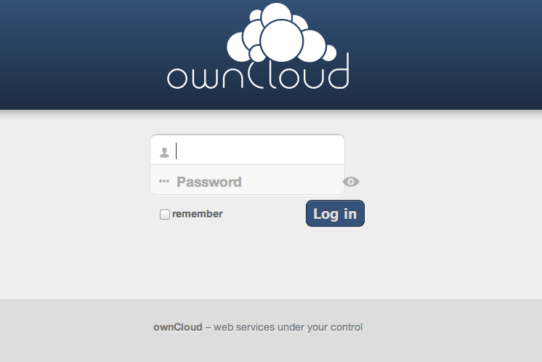
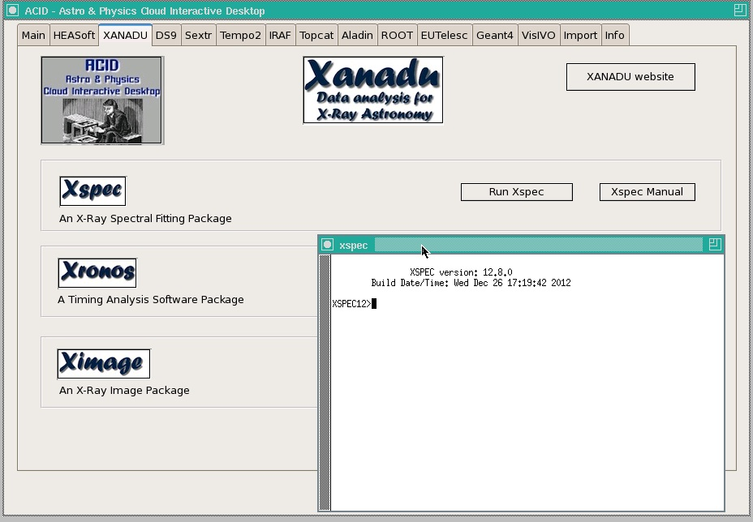
Application in Cloud: ACID

Slide 21
Thanks for your attention
CTA Gateway Prototype
Based on gUSE/WS-PGRADE
and Single-Sign-On (SSO) Authentication
Costa, P. Massimino, U. Becciani, C. Vuerli
INAF
References: TECHNOLOGY STUDY FOR CTA VIRTUAL TEAM PROJECT
Scientific Gateway User requirements

