Slide 1
NA1: Project Management, Administration & Finances
Catherine Gater
Deputy Director, EGI.eu

Slide 2
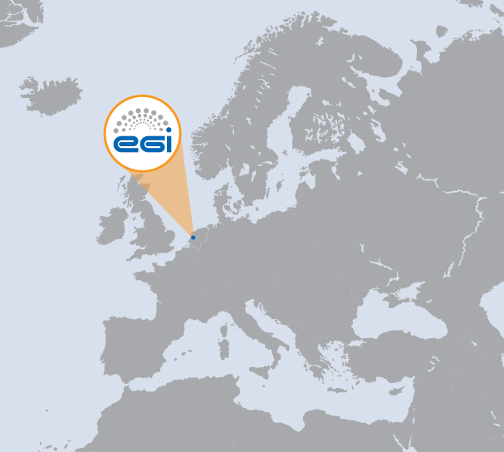
NA1 Overview
WP | Task | Beneficiary | Effort (PM)
WP1-M | TNA1.1 | EGI.eu | 24
WP1-E | TNA1.2E | EGI.eu | 149
WP1-M | TNA1.2M | EGI.eu | 95
WP1-M | TNA1.3 | EGI.eu | 36
WP1-M | TNA1.4 | EGI.eu | 24
1 International organisation
1 Beneficiary
Total project 328 PMs
Total project 27 FTEs
NA1 Effort

Slide 3
Contents
Consortium and management structure
Deliverables and milestones
Provisional financial status and effort
Quality assurance
NA1 achievements
NA1 issues
Summary

Slide 4
Consortium and Management Structure

Slide 5
Project Activities PY3
Networking
NA1: Project management (WP1)
NA2: Community Engagement (WP2)
NA3: PMs used from PM1-18
Services
SA1: Operation of the production infrastructure (WP4)
SA2: Provisioning the software infrastructure (WP5)
SA3: Support for Heavy User Communities (WP6: PY1-PY3 only)
Joint Research
JRA1: Support for operational tools (WP7)
Total Effort by Activity

Slide 6
Relationship Between WPs
NA2 Community Engagement
JRA1 Operational Tools
SA2 Provisioning the Software Infrastructure
SA3 Services for Heavy Users
SA1 Operations
NA1 Management

Slide 7
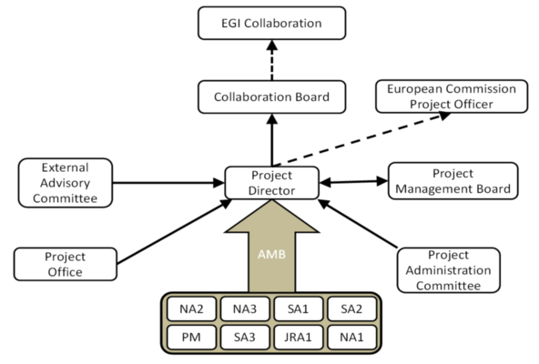
Project Governance
Group = regional grouping (IBERGRID, CE, UK.IE.NL, NBIS, SEE, IT-RU, FRRO, APGI, DACH)
1 rep per partner:
Met 2 times F2F
6 members: Met 2 times F2F
1 rep per group: Met 7 times (6 F2F)
EAC Members:
Alexandre Bonvin (WeNMR) Thomas Eickermann (PRACE)
Roger Jones (WLCG)
Wouter Los (EERI)
Ivan Maric (NREN PC)
Ruth Pordes (OSG)
1 rep per group: Met 3 times (twice F2F)
Activity leaders: Met bi-weekly by phone

Slide 8
EGI-InSPIRE & EGI
EGI COUNCIL STRUCTURE
EGI
Collaboration
EGI Council
Collaboration Board
Executive Board
PMB
Advisory Groups
Director
NGI / EIRO & Project Partner
EGI-InSPIRE PROJECT STRUCTURE
NGI / EIRO

Slide 9
Project Partners
Project Partners (50)
EGI.eu, 38 NGIs, 2 EIROs, Asia Pacific (9 partners)
38 NGIs
Albania
Armenia
Bosnia and Herzegovina
Bulgaria
Belarus
Croatia
Denmark
Switzerland
Cyprus
Czech Republic
Finland
France
Georgia
Germany
Greece
Hungary
Ireland (left end 2012)
Israel
Italy
Latvia
Lithuania
Moldova
Montenegro
FYR Macedonia
Netherlands
Norway
Poland
Portugal
Romania
Russian Federation
Serbia
Slovakia
Slovenia
Spain
Sweden
Switzerland
Turkey
United Kingdom
2 EIROs
CERN
EMBL

Slide 10
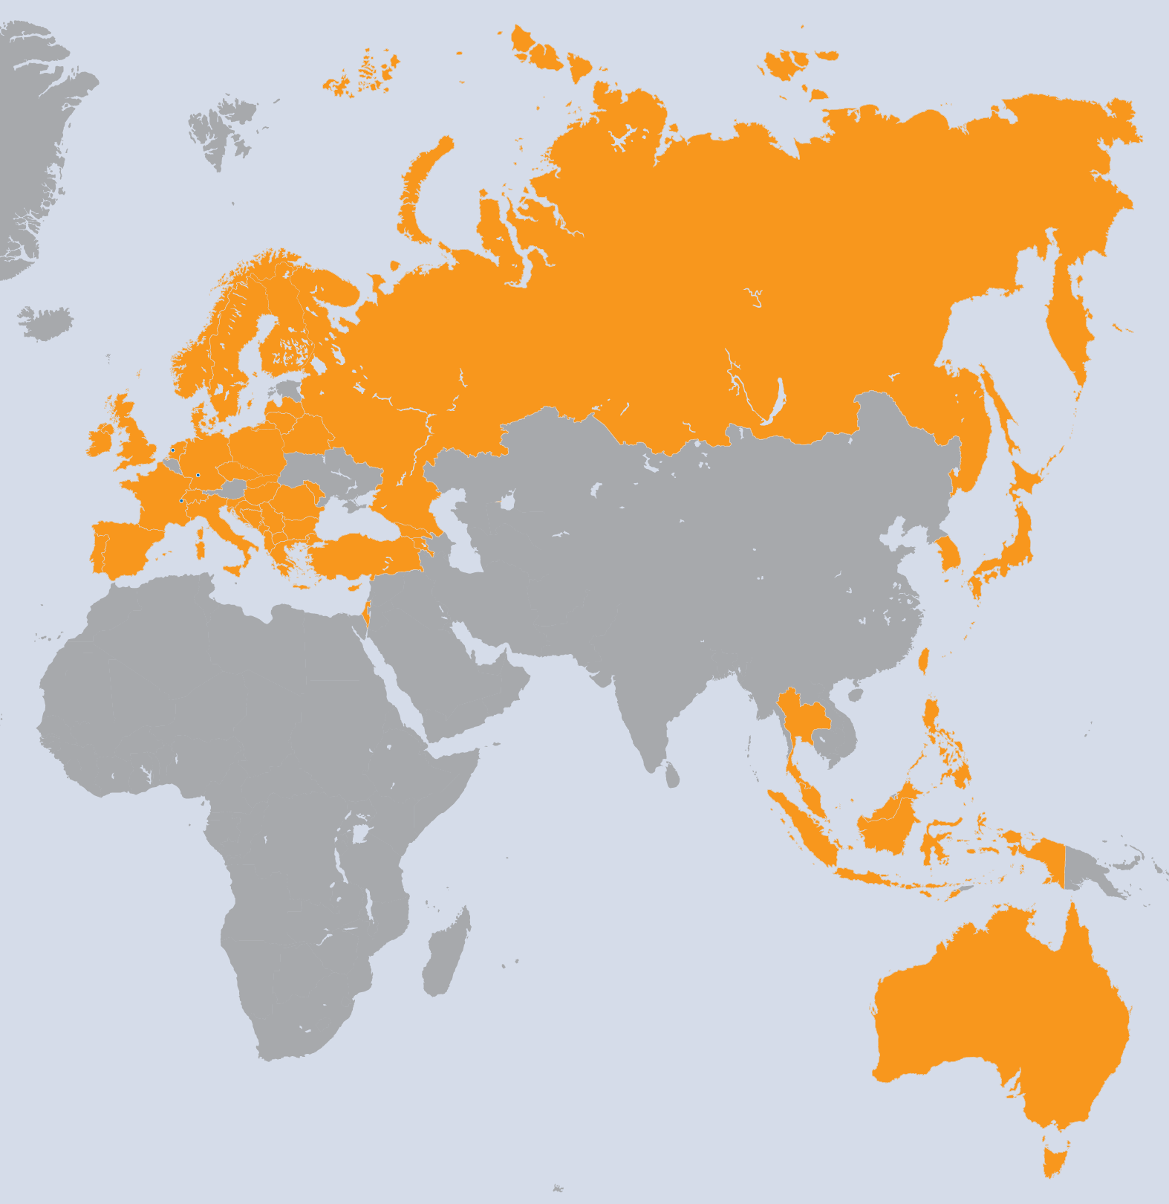
Project Partners
9 Asia Pacific (unfunded)
Australia
Indonesia
Japan
Malaysia
Philippines
Republic of Korea
Singapore
Taiwan
Thailand

Slide 11
NA1: Tasks and Objectives
TNA1.1 Activity management
Overall project management and reporting to the EC
TNA1.2 Project and consortium management
Establishment of a Project Office to support the very large project and consortium
Financial and effort management
TNA1.3 Technical management
Management of technical activities
TNA1.4 Quality assurance
Monitoring progress against defined metrics
Management of document review process

Slide 12
Deliverables and Milestones

Slide 13
PY3 Review Process
Table of Contents
INTERNAL
REVIEW
MODERATOR
Drafts
External Review
2 WEEKS
3 WEEKS
MANAGEMENT
SHEPHERD
AMB
Review
REVIEW
PMB
Review
2 WEEKS
1st of PM DUE
SUBMISSION TO EC

Slide 14
Deliverables & Milestones
18 Deliverables, 21 Milestones
At the end of PY1, ~ 6 weeks late on average
By the end of PY2, 33 days late on average
By the end of PY3, 36 days late on average
Time through review process is 33 days in PY3
Indicates that the initial draft is late but the review process is on time
Delivery time varies from 10 days early to 100 days late
Without MS520 FedCloud Blueprint, D2.20 EGI Sustainability Plan and D4.7 Sustainability of Operational Services, average is 32 days late

Slide 15
Provisional Financial Status and Effort

Slide 16
Provisional Financial Status
Total eligible costs = € 16.1M
93% of total budgeted costs for PY3 (€ 17.4M)
Total requested contribution = € 6M
86% of budgeted requested contribution (€ 7M)
Direct personnel (€ 9M) and travel costs (€ 500K) are 60% of the total
Other costs are overheads, audit costs (PY1, PY2) etc

Slide 17
Provisional Financial Status
EGI-InSPIRE Total Costs by Activity after Amendment #2 (excl unfunded partners)
PY3 Requested EC Contribution (Euros)

Slide 18
Provisional Financial Status
MAX PROJECT FUNDING

Slide 19
Project Use of Funding
Partners costs: Total budget vs used PY1-PY3 (%)
Partner | Country | % |  | Partner | Country | %
EGI.EU | EGI.eu | 71% |  | UOM | Montenegro | 54%
UPT | Albania | 0% |  | UKIM | Macedonia | 74%
IIAP NAS RA | Armenia | 25% |  | SURF | NL | 73%
UIIP NASB | Belarus | 76% |  | SIGMA | Norway | 57%
SWITCH | Switzerland | 85% |  | CYFRONET | Poland | 63%
UCY | Cyprus | 77% |  | LIP | Portugal | 52%
CESNET | Czech Republic | 51% |  | IPB | Serbia | 76%
KIT | Germany | 74% |  | ARNES | Slovenia | 54%
CSIC | Spain | 88% |  | UI SAV | Slovakia | 64%
CSC | Finland | 74% |  | TUBITAK | Turkey | 74%
CNRS | France | 55% |  | STFC | UK | 48%
GRENA | Georgia | 77% |  | CERN | CERN | 117%
GRNET | Greece | 65% |  | UCPH | Denmark | 47%
SRCE | Croatia | 66% |  | EMBL | EMBL | 1%
MTA SZTAKI | Hungary | 83% |  | UU-SNIC | Sweden | 60%
TCD | Ireland | 100% |  | IMCS-UL | Latvia | 25%
IUCC | Israel | 58% |  | JINR | Russia | 80%
INFN | Italy | 84% |  | ICI | Romania | 60%
VU | Lithuania | 77% |  | UNI BL | Bosnia and Herzegovina | 30%
RENAM | Moldova | 113% |  | IICT-BAS | Bulgaria | 78%
CNRS costs not provided; peak of activity in PY4 –WP8
CESNET: peak of activity in in PY4 – WP8
Small NGIs: limited with matching funding (Armenia, Bosnia, Montenegro, Latvia)
LIP: decrease of personnel salaries has impacted the costs; efforts are focused on E-tasks
UCPH: lack of personnel; funding will be cut off PY3-PY4
UK: 2 JRUs costs not provided
Underspending NGIs to watch: Israel, Norway
CERN: Main activity achieved; exchange rate impact ~ 400k

Slide 20
Consumed Effort Figures
Type | Work Package | Worked PM Funded | Committed PM | Achieved PM%
MGT | WP1 | 76 | 82 | 92%
COORD | WP2 | 336 | 419 | 80%
SUPPORT | WP4 | 1278 | 1194 | 107%
SUPPORT | WP5 | 125 | 141 | 88%
SUPPORT | WP6 | 219 | 240 | 91%
RTD | WP7 | 79 | 86 | 92%
 | Total | 2113 | 2162 | 98%
Consumed Effort PY3
Total Planned Effort by Activity PY3

Slide 21
PY1, PY2 and PY3 effort
(Excludes Asia Pacific partners)
Consumed Effort PY3
Consumed Effort PY1 + PY2 + PY3

Slide 22
PY3 Global Task effort
E-Tasks | Worked PM Funded | PMs planned | %
EGI.eu | 184 | 204 | 90%
CERN | 18 | 18 | 99%
CESNET | 25 | 39 | 66%
CSC | 0.3 | 2 | 15%
CSIC (+FCTSG) | 29 | 30 | 97%
INFN (+GARR) | 33 | 38 | 86%
SRCE | 18 | 13 | 141%
GRNET(Iasa) | 43 | 56 | 77%
CYFRONET | 4 | 6 | 64%
STFC (+UE) | 37 | 38 | 97%
LIP | 27 | 28 | 98%
FOM (+SARA) | 11 | 10 | 105%
KIT-G (+Juelich) | 34 | 37 | 92%
CNRS | 5 | 6 | 83%
Grand Total | 467 | 530 | 88%
SRCE:
no deviation in total costs
CSC:
overlap staff in several projects
CESNET:
underspending in TSA1.7.3E; overlapping with end of EMI project
CYFRONET:
underspending in TSA1.8 (Grid infrastructure)

Slide 23
PY3 effort consumed
Activity | Achieved PM %
WP1-E | 91%
WP1-M | 93%
WP2-E | 86%
WP2-N | 76%
WP4-E | 87%
WP4-N | 111%
WP5-E | 93%
WP5-N | 80%
WP6-G | 91%
WP7-E | 97%
WP7-G | 88%
TOTAL | 98%

Slide 24
Non-Reporting Beneficiaries
 |  | Project Period 3
Beneficiary | Country | Worked PM Funded | Committed PM | Achieved PM
2-UPT | Albania | 0 | 13.1 | 0%
37-EMBL | EIRO | 0 | 12.3 | 0%
IMPACT
Small amounts of PMs affected
EMBL effort reallocated – not participating in PY4

Slide 25
Effort Consumption
Total project PMs = 9,076 (adjusted from CA)
PY3 project PMs = 2,113 (funded)
PY3 FTE = 176
For under, over and non-reporting partners, small numbers of PMs are affected
Small partners report difficulties attracting matching funding
100 PMs fewer than last year due to reclaim costs/PMs of underspending partners; but budget is redistributed in full with SA4 task funding at 75%
Low level of travel in small partners as not all travel is refunded at 100% - addressed in DoW amendment
EMBL effort reallocated

Slide 26
Quality Assurance

Slide 27
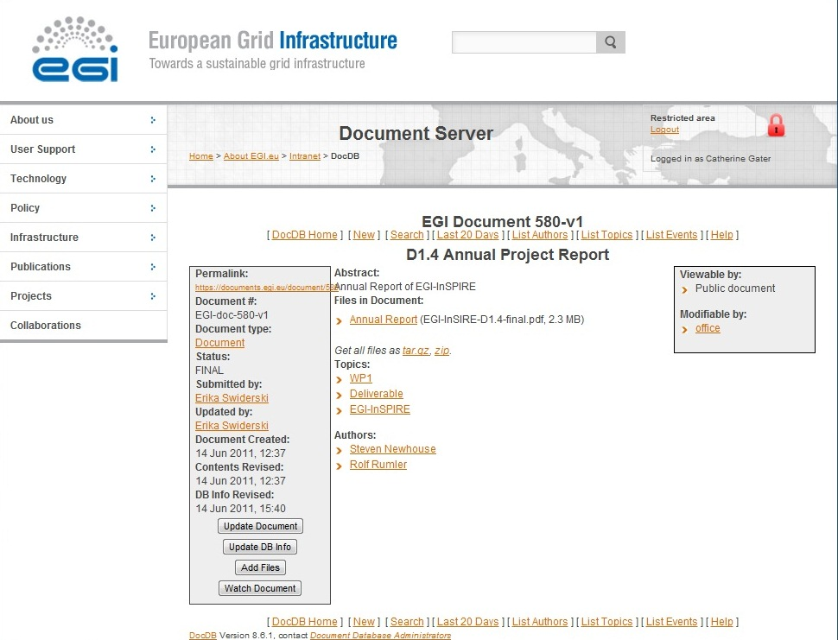
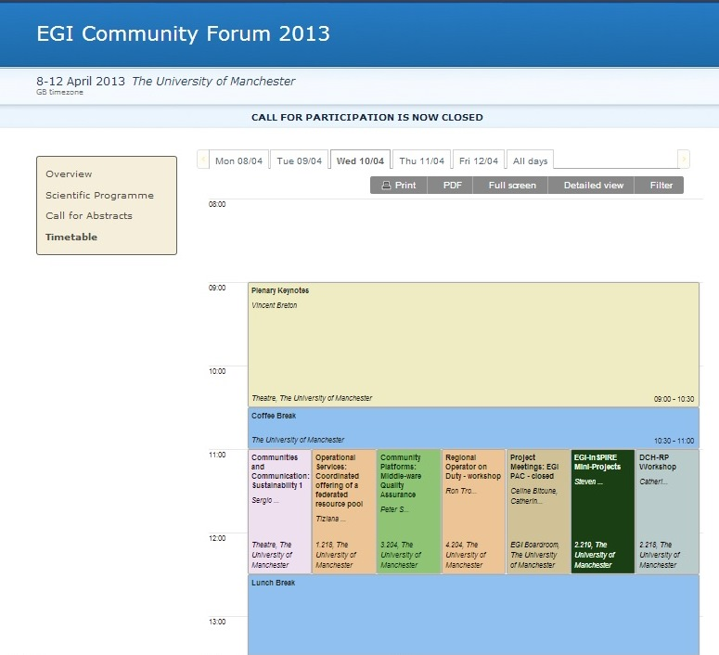
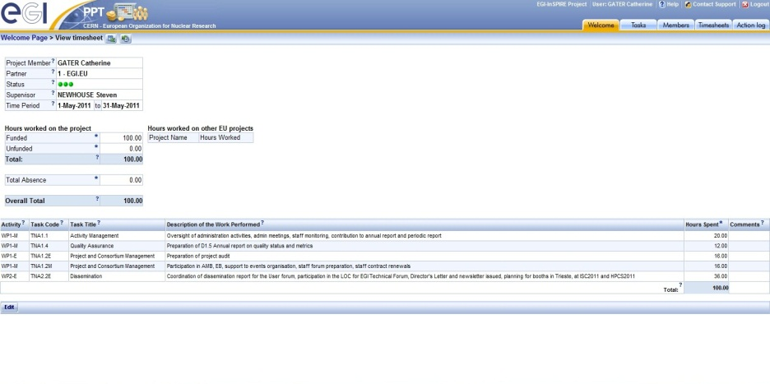
Quality Assurance
Quality assurance processes outlined in D1.9 & D1.13 Quality Plan in PQ8 & PQ12
Document management and review processes described
Tools for QA
DocDB repository
RT tickets tool
Indico meetings
Metrics portal
PPT

Slide 28
Project Level Objectives
PO1: Operate and expand today’s production infrastructure; transition to a governance model and operational infrastructure increasingly sustainable outside project funding.
PO2: Support researchers within Europe and international collaborators using the current production infrastructure.
PO3: Support current heavy users of the infrastructure in Earth Science, Astronomy & Astrophysics, Fusion, Computational Chemistry and Materials Science Technology, Life Sciences and High Energy Physics; move to sustainable models.
PO4: Interfaces that expand access to new user communities, including new potential heavy users of the infrastructure from the ESFRI projects.
PO5: Integrating existing infrastructure providers in Europe and around the world into the production infrastructure; transparent access to all authorised users.
PO6: Integrate new DCI technologies (e.g. clouds, volunteer desktop grids, etc.) and heterogeneous resources (e.g. HTC and HPC) into a seamless production infrastructure.

Slide 29
Metrics Collection
Types of metrics
Activity level metrics: activity level tracking
Project level metrics: progress against EGI-InSPIRE objectives
Strategy metrics: progress against EGI Strategy
Value of metrics
Project level metrics collection to continue quarterly for long term comparisons with EGEE and EGI-InSPIRE ie PY1-4
Strategy level metrics defined during PY2, collected during PY3 & PY4 (and beyond)
The EGI Compendium VT has worked to collect national statistics e.g. national funding

Slide 30
Targets for PY3
No | Objective Summary | Metrics | Target PY1 | Target PY2 | Target PY3
PO1 | Expansion of a nationally based production infrastructure | Number of resource centres in EGI-InSPIRE and integrated partners (M.SA1.Size.1) | 300 | 330 | 350 (355) (355)
 |  | Number of job slots available in EGI-InSPIRE and integrated partners (M.SA1.Size.2) | 200,000 | 250,000 | 300,000 (325,000) (333,000)
 |  | Reliability of resource centre functional services (M.SA1.Operation.5) | 90% | 91% | 95% (96%) (97%)
 |  | Reliability of NGI functional services (MSA1.Operations.4) |  |  | 97% (98.5%) (99%)
 |  | Reliability of critical operations tools (MSA1.Operations.6a) |  |  | 97% (98.5%) (99%)
PO2 | Support of European researchers and international collaborators through VRCs | Number of papers from EGI Users (M.NA2.5) | 50 | 60 | 70 (80) (90)
 |  | Number of jobs done a day (M.SA1.Usage.1) | 500,000 | 525000 | 1.2M (1.4M) (1.5M)
PO3 | Sustainable support for Heavy User Communities | Number of sites with MPI (M.SA1.Integration.2) | 50 | 100 | 120 (130) (140)
 |  | Number of users from HUC VOs (M.SA1.VO.6) | 5000 | 5500 | 12,000 (15,000) (17,000)
PO4 | Addition of new User Communities | Peak number of cores from desktop grids (M.SA1.Integration.3) | 0 | 0 | 1,000 (5,000) (7,500)
 |  | Number of users from non-HUC VOs (M.SA1.vo.5) | 500 | 1000 | 10,000 (12,000) (13,000)
 |  | Public events organised (attendee days) (M.NA2.6) | 1500 | 2000 | 15 000 (17 000) (19 000)
PO5 | Transparent integration of other infrastructures | MoUs with resource providers (M.NA2.10) | 3 | 5 | 4 (5) (5)
PO6 | Integration of new technologies and resources | Number of HPC resources (M.SA1.Integration.1) | 1 | 3 | 50 (50) (50)
 |  | Number of resource centres part of the EGI Federated Cloud (M.SA2.19) | 0 | 1 | 10 (15) (20)
Target – base
Target – stretch
Target – ideal

Slide 31
Achieved Targets for PY3
No | Objective Summary | Metrics | Target PY3 | Achieved PQ12
PO1 | Expansion of a nationally based production infrastructure | Number of resource centres in EGI-InSPIRE and integrated partners (M.SA1.Size.1) | 350 (355) (355) | 347
 |  | Number of job slots available in EGI-InSPIRE and integrated partners (M.SA1.Size.2A) | 300,000 (325,000) (333,000) | 361,287
 |  | Reliability of resource centre functional services (M.SA1.Operation.5) | 95% (96%) (97%) | 96.9%
 |  | Reliability of NGI functional services (MSA1.Operations.4) | 97% (98.5%) (99%) | 99.5%
 |  | Reliability of critical operations tools (MSA1.Operations.6a) | 97% (98.5%) (99%) | 99.9%
PO2 | Support of European researchers and international collaborators through VRCs | Number of papers from EGI Users (M.NA2.5) | 70 (80) (90) | 72
 |  | Number of jobs done a day (M.SA1.Usage.1) | 1.2M (1.4M) (1.5M) | 1.43
PO3 | Sustainable support for Heavy User Communities | Number of sites with MPI (M.SA1.Integration.2) | 120 (130) (140) | 77
 |  | Number of users from HUC VOs (M.SA1.VO.6) | 12,000 (15,000) (17,000) | 11,595
PO4 | Addition of new User Communities | Peak number of cores from desktop grids (M.SA1.Integration.3) | 1,000 (5,000) (7,500) | 6450
 |  | Number of users from non-HUC VOs (M.SA1.vo.5) | 10,000 (12,000) (13,000) | 10,602
 |  | Public events organised (attendee days) (M.NA2.6) | 15 000 (17 000) (19 000) | 8877
PO5 | Transparent integration of other infrastructures | MoUs with resource providers (M.NA2.10) | 4 (5) (5) | 3
PO6 | Integration of new technologies and resources | Number of HPC resources (M.SA1.Integration.1) | 50 (50) (50) | 44
 |  | Number of resource centres part of the EGI Federated Cloud (M.SA2.19) | 10 (15) (20) | 14

Slide 32
Achieved Targets for PY3
Non | Objective Summary | Metrics | Target PY3 | Achieved PQ12
PO1 | Expansion of a nationally based production infrastructure | Number of resource centres in EGI-InSPIRE and integrated partners (M.SA1.Size.1) | 350 (355) (355) | 347
 |  | Number of job slots available in EGI-InSPIRE and integrated partners (M.SA1.Size.2A) | 300,000 (325,000) (333,000) | 361,287
 |  | Reliability of resource centre functional services (M.SA1.Operation.5) | 95% (96%) (97%) | 96.9%
 |  | Reliability of NGI functional services (MSA1.Operations.4) | 97% (98.5%) (99%) | 99.5%
 |  | Reliability of critical operations tools (MSA1.Operations.6a) | 97% (98.5%) (99%) | 99.9%
PO2 | Support of European researchers and international collaborators through VRCs | Number of papers from EGI Users (M.NA2.5) | 70 (80) (90) | 72
 |  | Number of jobs done a day (M.SA1.Usage.1) | 1.2M (1.4M) (1.5M) | 1.43
PO3 | Sustainable support for Heavy User Communities | Number of sites with MPI (M.SA1.Integration.2) | 120 (130) (140) | 77
 |  | Number of users from HUC VOs (M.SA1.VO.6) | 12,000 (15,000) (17,000) | 11,595
PO4 | Addition of new User Communities | Peak number of cores from desktop grids (M.SA1.Integration.3) | 1,000 (5,000) (7,500) | 6450
 |  | Number of users from non-HUC VOs (M.SA1.vo.5) | 10,000 (12,000) (13,000) | 10,602
 |  | Public events organised (attendee days) (M.NA2.6) | 15 000 (17 000) (19 000) | 8877
PO5 | Transparent integration of other infrastructures | MoUs with resource providers (M.NA2.10) | 4 (5) (5) | 3
PO6 | Integration of new technologies and resources | Number of HPC resources (M.SA1.Integration.1) | 50 (50) (50) | 44
 |  | Number of resource centres part of the EGI Federated Cloud (M.SA2.19) | 10 (15) (20) | 14
Target – not met
Target – achieved
Target – exceeded
Increased in PY2, constant in PY3. New method for tracking in PY4. Some MPI sites decommissioned (Ireland, Latin America, Italy)
Not held and/or not reported
Reported manually by NGIs. Not a performance indicator in PY4
Notes:
No of sites with MPI (M.SA1.Usage.1) - 55 achieved vs 120 target baseline The number of Resource Centres supporting parallel computation has been steadily increasing in PY2, but this trend changed in PY3 as the number remained constant during the latest reporting period. In PY3 a new framework for the tracking of Resource Centres supporting MPI was devised and approved, and it will be rolled to production at the beginning of PY4. The new framework will allow for a more accurate estimation of this metric. In addition, a significant number of sites was decommissioned (Ireland, Latin America, Italy), this also affected the number, as many of these supported MPI even if in some cases contributing small capacity to the infrastructure. No of HPC resources (MSA1.Integration.1) - 44 achieved vs 50 target baseline
The total number of HPC systems is manually counted. The total is the sum of what reported by NGIs, the total could be thus affected by inaccuracies of NGI reports. As EGI has no control on the amount of HPC capacity (it depends on NGI policies), and unicore integration is completed, for PY4 the strategy of SA1 will be to facilitate the support of communities relying on MPI like those that are interested in coupled usage of EGI and PRACE resources. For PY4 the number of HPC systems is no longer a performance indicator.

Slide 33
Strategic Metrics
EGI Balance Scorecard relates the EGI Strategy to the metrics gathered
Based on linked performance measures from a range of perspectives:
Learning & growth – how EGI must develop as an organisation
Processes – where to excel to satisfy beneficiaries and funders
Direct beneficiaries – needs of the beneficiaries
Funders – return on investment
Income – effect of success on income

Slide 34
Strategy Perspectives
Learning & growth
Develop technical expertise
Strengthen strategic partnerships
Strengthen governance
Processes
Develop EGI as an open ICT ecosystem
Integrate new physical resources
Integrate new technologies
Improve technical outreach
Improve operational efficiency and effectiveness
Beneficiaries
Easy and reliable access to the services that meet the needs of researchers
Promote the sharing and re-use of innovation
Support the uniform operation of resource centres
Funders
Contribute to EU2020 priorities
Contribute to national priorities
Cost effective management
Incomes
Achieve continued European and National funding
Achieve community funding for continued operation

Slide 35
Strategy Metrics: Progress

Slide 36
Strategic Metrics: Analysis
Above ideal PY4 target – targets adjusted
6.1 Number of different operational service types in EGI as recorded in GOCDB
9.2 Number of scientific papers produced using NGI resources affiliated into EGI across different disciplines
10.4 Number of updates published per Community Platform
11.1 Number of resource centres that run services for international VOs
More than 10% below baseline
10.2 Number of relevant training materials and resources in the EGI Training Marketplace
13.1 Number of NGIs able to demonstrate strong engagement and integration with the ‘owner’ or funder of their national activities.
No values gathered
14.1 Cost (in Euro) of providing the operational tools and coordination needed to ensure the operation of EGI
15.1 Total national funding received for the operation and replacement of the physical resource infrastructure
15.2 Total national funding for the staff needed to operate and provide technical outreach.
15.3 Total national and European funding that is supporting technology innovation projects
16.1 The percentage of funds coming from inside the community that is needed to deliver the coordinated operation of the EGI Global services

Slide 37
NA1 Summary

Slide 38
NA1 Achievements
Consortium management
successfully coordinated the PY3 end of year project costs and global task costs through the PAC
PPT migration
updated PPT to new version, including new WP8
Second DoW amendment
amendment session submitted, including update to CA tables for the restructuring
EGI.eu organisational structure
Project Office and Secretariat support to Council, Boards and Committees
Finance
institutional and project audits completed, unqualified audit reports, small process refinements
Documentation
preparation and collection of project documents, including end of year deliverables and Periodic Report
Technical management
restructuring around SA2 and the new SA4
Metrics
automatic and manual metrics uploaded to the portal for PY3
stretch targets and strategic metrics tracked by the policy team
some metrics not yet gathered

Slide 39
NA1 Issues
Deliverable and Milestones delivery
Updated review process is now shorter, but documents are still late going into review
Mostly clustered at start and end of project year
Unresponsive partners in PY3
Russian JRU now able to distribute funds since PY2
EMBL effort reallocated
Most partners now responsive
Over/under reporting
Partners with known issues eg CNRS
Prioritisation
Consortium management, Project Office duties and events

Slide 40
NA1 Use of Resources
 |  | Project Period 3
Task | Partner | Worked PM Funded | Committed PM | Achieved PM %
TNA1.1 | EGI.EU | 5.7 | 6.0 | 95%
TNA1.2E | EGI.EU | 33.9 | 37.3 | 91%
TNA1.2M | EGI.EU | 27.1 | 23.8 | 114%
TNA1.3 | EGI.EU | 6.3 | 9.0 | 70%
TNA1.4 | EGI.EU | 2.4 | 6.0 | 40%
Total: |  | 75.4 | 82.1 | 92%

Slide 41
Plans for Next Year
Next steps
Finalisation of the Financial report, reallocation of resources unspent in PY3, third contract amendment (including proposed DoW changes) and release of PY3 costs
PPT upgrade
Tracking of usage of the new version of PPT and bug fixing
Financial profiling
Early foresight of partners and EGI.eu funds
Metrics
Tracking the new project level and strategic metrics
Upload of manual project metrics quarterly by the NGI International Liaisons
Virtual teams
Tracking of input of NGIs and NILs into the Virtual Teams

Slide 42
Summary
Participants: EGI.eu, 38 NGIs, 2 EIROs, Asia Pacific (9 partners), 95 beneficiaries
2 non-reporting JRUs in PY3
NA1 at 92% for PY3
All PY3 Deliverables and Milestones submitted, delays stabilised
Quality assurance processes ongoing
Metrics targets to be tracked for PY4, including strategic metrics

Slide 43
Additional Material

Slide 44
Vision
Support the digital ERA through a pan-European e-infrastructure based on an open federation of reliable services that provide uniform access to national computing, storage and data resources
Mission
Connect researchers from all disciplines with the reliable and innovative ICT services
they need to undertake their collaborative world-class research
Strategic Themes
Communication & Coordination
Operation Infrastructure
Virtual Research Environments
Income
Achieve continued European&national funding
Achieve community funding for continued operation
O1
Funders
Contribute to
EU2020 priorities
Contribute to national priorities
Cost effective management
Direct Beneficiaries
Easy and reliable access to the services that meet the needs of researchers
Promote the sharing and re-use of innovation
Support uniform operation of resource centers
O2
O3
O4
O1
O2
Processes
Develop EGI as
open ICT ecosystem
O6
O4
Integrate new physical
resources
Improve
technical outreach
Improve operational efficiency and effectiveness
Integrate new technologies
O1
O5
O4
O1
O2
O6
Learning & Growth
Strengthen governance
Strengthen strategic partnerships
Develop technical expertise
O1
O1
O6
O6
Core Values
Leadership
Openness
Reliability
Innovation

Slide 45
Strategy: Learning/growth
Objectives | Description | Performance measures | Strategic Themes | Targets
Develop technical expertise | Develop the human capital within the EGI ecosystem Enhance technical effectiveness and local support | Number of NGI supported training/tutorial attendee days undertaken at NGI events a year. Number of EGI.eu supported training/tutorial attendee days undertaken through EGI Forums and dedicated events a year. | C&C | 1000 (1500) (2000) 100 (200) (300)
Strengthen strategic partnerships | Develop strategic relationships with organisations and projects that can expand the EGI ecosystem Broaden technology offer, consulting on IT service management, engaging with developing regions | Number of entries in the EGI ‘Yellow Pages’ would provide a directory of skilled consultants, services, strategic partnerships, etc. | C&C | 50 (75) (100)
Strengthen governance | Increase the diversity of our stakeholders e.g. associate participants who are not resource providers | Number of associate participants in the EGI Council | C&C | 5 (6) (7)

Slide 46
Strategy: Processes
Objectives | Description | Performance measures | Strategic Themes | Targets
Develop EGI as an open ICT ecosystem | Improve accessibility of the EGI ecosystem Better defined roles, processes and interfaces Stimulating competition to allow new actors to enter the ecosystem | Number of service offerings in the ecosystem that have been identified and documented as being able to be fulfilled independently. | C&C | 5 (7) (8)
Integrate new physical resources | Expand the installed physical capacity of EGI | Total number of job slots (LCPUs) available in EGI Installed disk capacity (PB) in EGI Installed tape capacity (PB) in EGI | O.I. | 400,000 (425,000) (450,000) 270 (280) (290) 180 (190) (200)
Integrate new technologies | Integrate new functional services into EGI’s Operational Infrastructure Increase the attractiveness of EGI to new research communities | Number of different operational service types in EGI as recorded in GOCDB. Number of resource centres offering federated cloud services accessible to authorised users. (See M.SA2.19) | O.I. VREs | 90 (95) (100) 15 (20) (25)
Improve technical outreach | Strengthen local technical outreach to existing and new research communities | Number of recorded geographical contacts across the NGIs that can represent EGI locally to external requests Number of NGIs with established and active NILs | C&C | 100 (150) (200) 20 (25) (30)
Improve operational efficiency and effectiveness | Improve the reliability and the delivery of the operational infrastructure Improvements in the operational tools and processes | Number of EGI Global Services meeting published OLAs Number of resource centres meeting the Resource Centre OLA. | O.I. | 7 (10) (12) 320 (330) (340)

Slide 47
Strategy: Beneficiaries
Objectives | Description | Performance measures | Strategic Themes | Targets
Easy and reliable access to the services that meet the needs of researchers | Increase number of researchers and the diversity of research communities who rely on EGI Support data driven research | Number of researchers using EGI’s resources (either directly or through affiliated services – i.e. portals or integrated research infrastructures) Number of scientific papers produced using NGI resources affiliated into EGI across different disciplines. | VREs, | 23,000 (24,000) (25,000) 500 (700) (800)
Promote the sharing and re-use of innovation | Improve the reuse of innovation developed within the EGI ecosystem elsewhere | Number of relevant software items registered in the EGI AppDB Number of relevant training materials and resources in the EGI Training Marketplace Number of relevant appliances (i.e. virtual machines) available in the EGI Marketplace Number of community platforms in the UMD Number of agreements established with external research communities to use EGI’s operational tools to monitor their deployed services in their infrastructures | VREs, C&C | 450 (500) (550) 40 (50) (60) 5 (10) (20) 5 (6) (8) 0 (1) (2)
Support the uniform operation of resource centres | Resource centres providing uniform operation and consistent access to services | Number of resource centres that run services for international VOs. | O.I. | 200 (250) (275)

Slide 48
Strategy: Funders
Objectives | Description | Performance measures | Strategic Themes | Targets
Contribute to EU2020 priorities | EGI shows a clear impact on enabling the Digital ERA and other key EU strategic objectives for 2020 | Establish a measurement framework that will track the EGI contribute to EU2020 key flagship initiatives (IU and DAE) | C&C | N/A
Contribute to national priorities | NGIs, by collaborating with EGI, show a clear impact on contributing to their national priorities | Number of NGIs with national ministry/government as a stakeholder in their governance structure (i.e. management or advisory body) Number of NGIs that are recognised in their national e-Infrastructure strategies or plans. | C&C | 10 (13) (15) 5 (8) (10)
Cost effective management | Demonstrate the cost effective management of EGI and utilisation of its resources | Cost (in Euro) of providing the operational tools and coordination needed to ensure the operation of EGI Percentage utilisation through EGI provisioned services by EGI VOs of the job slots (LCPUs) capacity made available for their use | O.I. | N/A 84% (85%) (86%)

Slide 49
Strategy: Income
Objectives | Description | Performance measures | Strategic Themes | Targets
Achieve continued European & national funding | The EGI ecosystem is able to attract funding for continued operation, Investment in physical resources Innovation in the virtual research environments | Total national funding received for the operation and replacement of the physical resource infrastructure. Total national funding for the staff needed to operate and provide technical outreach. Total national and European funding that is supporting technology innovation projects recorded in the EGI Yellow Pages | C & C VREs | N/A N/A N/A
Achieve community funding for continued operation | EGI Global Services are supported by funds available from the NGIs | The percentage of funds coming from outside the community that is needed to deliver the coordinated operation of the EGI Global services | O.I. | N/A

