Slide 1
NA2: Community Engagement
Steven Newhouse
EGI.eu

Slide 2
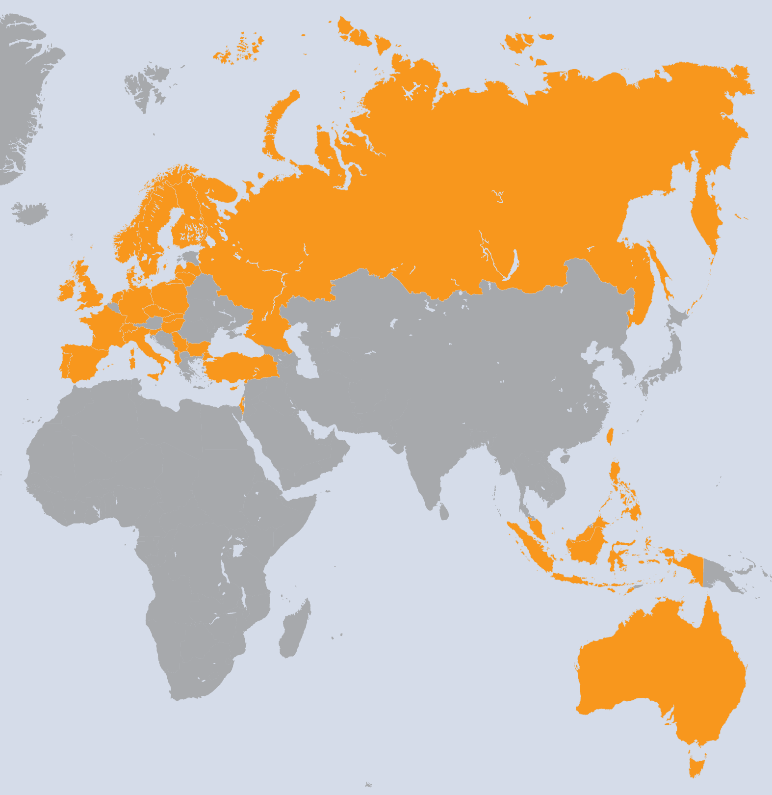
NA2 (PM25-36)
WP | Beneficiary | Total PMs
WP2-E | EGI.eu | 483
WP2-E | CSIC | 12
WP2-E | GRNET (IASA) | 47
WP2-E | FOM | 5
WP2-E | lip | 12
WP2-E | STFC | 42
WP2-N | UPT | 12
WP2-N | IIAP NAS RA | 6
WP2-N | IICT-BAS | 16
WP2-N | SWITCH | 19
WP2-N | UCY | 16
WP2-N | CESNET | 36
WP2-N | KIT-G | 73
WP2-N | CSIC | 62
WP2-N | CSC | 41
WP2-N | CNRS | 75
WP2-N | GRENA | 6
WP2-N | MTA KFKI | 36
WP2-N | TCD | 20
WP2-N | IUCC | 17
WP2-N | INFN | 60
WP2-N | VU | 13
WP | Beneficiary | Total PMs
WP2-N | RENAM | 9
WP2-N | FOM | 16
WP2-N | SIGMA | 27
WP2-N | CYFRONET | 51
WP2-N | LIP | 40
WP2-N | IPB | 28
WP2-N | ARNES | 47
WP2-N | UI SAV | 46
WP2-N | TUBITAK | 52
WP2-N | STFC | 52
WP2-N | UCPH | 18
WP2-N | UU | 4.7
WP2-N | IMCS-UL | 22
WP2-N | JINR | 21
WP2-N | ASGC | 169
WP2-N | ASTI | 240
WP2-N | ITB | 13
WP2-N | KISTI | 28
WP2-N | UNIMELB | 4
WP2-N | NUS | 44
WP2-N | UPM | 24
WP2-N | NECTEC | 4
Ireland
Turkey
Denmark
Cyprus
Slovakia
Albania
Sweden
Lithuania
Taiwan
Phillippines
Indonesia
Australia
Singapore
Malaysia
43 Countries
44 Beneficiaries
Total project:
(exc UNF)
- 1542 PMs
32 FTEs
(inc UNF)
2069 PMs
43 FTEs
The Netherlands
UK
Slovenia
Czech Republic
France
Finland
Spain
Poland
Russia
Bulgaria
Latvia
Italy
Serbia
Israel
Germany
Portugal
Hungary
Norway
Switzerland
NA2 Effort
 | Task | Leader/Partner | WP Effort %
TNA2.1 | NGI International Liaison | R. McLennan | 71%
TNA2.1E | Activity Management | S. Newhouse/EGI.eu | 1%
TNA2.2E | Communication and Marketing | C. Gater/EGI.eu | 5%
TNA2.3E | Strategic Planning and Policy Support | S. Andreozzi/EGI.eu | 8%
TNA2.4E | Community Outreach | G. Sipos | 3%
TNA2.5E | Technical Outreach to new Communities | G. Sipos | 13%

Slide 3
NA2 & Strategic Objectives
Develop & connect ‘technical’ expertise
Establish EGI as an open ecosystem
Strengthen governance
Develop & support strategic partnerships
Alignment to national and EC priorities
Promote sharing & re-use of innovation
Integrate new technologies & technical outreach
Easy and reliable access to services
Engagement within and outside the EGI Community across national operations and non-operations areas, research communities and technology providers

Slide 4
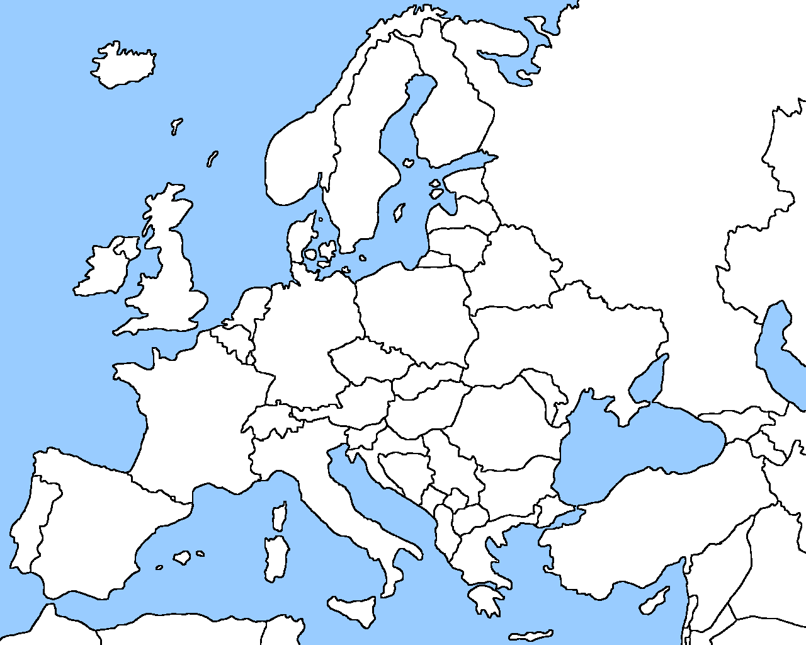
Community Engagement
Human Network
Marketing
Communications
European
Commission
Member States
ESFRI & EIROs
Research
Collaborations
Individual
Researchers
Press & Media
Projects
General Public
Geographical
(through NGIs)
Non-Operations
Operations
EGI
Community Outreach
Technical Outreach
Policy
Researchers
Technologists
Technology
Areas
Research
Disciplines

Slide 5
NA2 Effort Consumption
EGI Global Tasks
NGI International Tasks
NGI International Liaison & NGI Competency Centre
Worked: 194.1PM (Committed: 254.8PM, i.e. 76%)
Partner | Worked PM Funded | Committed PM | Achieved PM %
1-EGI.EU | 112.4 | 133.7 | 84%
12A-CSIC | 0 | 2.5 | 0%
16A-GRNET | 4.4 | 8.9 | 50%
16E-IASA | 6.5 | 2.6 | 250%
26A-FOM | 1.6 | 1.2 | 135%
29-LIP | 4.9 | 3.2 | 155%
34A-STFC | 12.1 | 12.4 | 98%
Total: | 141.9 | 164.4 | 86%

Slide 6
Relationship between tasks
TNA2.1N NGI International Liaisons
VTs
VTs
VTs
TNA2.4 Community Outreach
TNA2.2 Marketing & Communications
TNA2.3 Strategic Planning & Policy Support
TNA2.5 Technical Outreach
VTs
VTs
VTs
TNA2.6N NGI Distributed Competency Centre

Slide 7
Upcoming Presentations
Communications & Marketing
Including events
Strategic Planning and Policy Support
Technical Outreach to New Communities

