Slide 1
Introducing the EGI Solutions Portfolio
Sergio Andreozzi
Strategy and Policy Manager, EGI.eu

Slide 2
Service Providers vs. Consumers
EGI Partnership
Researchers
Service
Research Infrastructures
Resource Centres
Resource Provider
International Research Collaborations
Product/
Service
Technology Providers
NGIs/EIROs
National Research Collaborations
EGI.eu
Individual Researcher
… and what does EGI.eu do?
How can e-infrastructures help me solve my research problems?
What does EGI do?
What about NGIs and resource centres?

Slide 3
How are we improving EGI Service/Solution definition?
Defining a well-structured Services Portfolio for the key players of the EGI ecosystem
To answer: “What does X do?”
Defining a well-structured Solutions Portfolio for the EGI Partnership
To answer: “What problems EGI can solve and with what integrated service offering?”

Slide 4
From Process to Solution
EGI Solution
Portfolio
user
EGI.eu
Service
Portfolio
NGI/RP/RC
Service
Portfolios
solution
user-facing
services
supporting
services
process
document
record
EGI.eu
NGI/RP/RC

Slide 5
EGI.eu Service Portfolio
Coordination
Consulting and Support
Marketing and Outreach
Software and Services
Project and Programme Management
Operations Coordination
Technology Coordination
Security Coordination
Specialised Consultancy
Strategy and Policy Decision Support
Policy Development
Technical Consultancy and Support
Helpdesk Support
Marketing
Outreach
Federated Operations
Applications Database
Training Marketplace
Repository of Validated Software
http://www.egi.eu/services/

Slide 6
NGI/Resource Centre Service Portfolio
Core Platform
HTC Platform
Cloud Platform
Information Service
Grid Compute
Cloud Compute
VO Membership Management
Grid Storage
Data Management
Cloud Storage
Workflow Manager
Service Hosting
http://www.egi.eu/services/
work in progress

Slide 7
EGI Solutions Portfolio
Federated Infrastructure Operations
Federated High-Throughput Data Analysis
Federated Infrastructure as a Service Cloud
Community Networks and Support
Community Driven Innovations

Slide 8
How will each Solution be presented?
Target Group, Problem, Pain
Who is the target group?
What is it trying to accomplish?
What are the identified problems and associated pains?
EGI Solution
What is the proposed EGI solution?
What services from the EGI Service Portfolios help support this solution?
Value Proposition
What is the value delivered to the target group?
How problems are solved?
Strategic Impact and Sustainability
What is the strategic impact of providing this solution?
How this solution can be sustained?

Slide 9
Solution #1: Federated Infrastructure Operations
Tiziana Ferrari
EGI.eu Chief Operations Officer

Slide 10
Target Groups, Problems, Pains
Target Groups | Research Infrastructures Resource infrastructure Providers
Need | Services for the local operation of their own infrastructure Want to participate in a federated service provision Remote access by one or more research communities
Problems | Pains
Monitoring, accounting, technical support solutions from individual providers are not integrated | Lack of interoperation and harmonization requires substantial coordination effort and duplication of services
Small resource providers do not have enough expertise and effort to increase the quality of their service delivery | Lack of expertise and resources

Slide 11
EGI Solution
Technologies, processes and people for standard operation of heterogeneous infrastructures from multiple independent resource providers with lightweight central coordination
EGI Services needed to build the solution
EGI.eu | Operations Coordination, Technology Coordination, Security Coordination, Helpdesk Support, Technical consultancy and support, Federated operations
NGIs Resource Providers | Operations Coordination, Security Coordination, Helpdesk Support, Federated operations

Slide 12
Services for Federated Operations
Core Infrastructure Platform
Processes
Accounting, Monitoring, Configuration DB, Operations Portal, Security tools, Information discovery, Messaging
Operations and User community coord., Security coord., Integration coord., Service Management
Federated Operations
Documentation, policies, procedures, best practices, data (accounting, monitoring, service level reports)
Support, Training, Collaborative tools, working groups and task forces
Information
People

Slide 13
Value Proposition
Enabling cost efficient operations in a federated environment while retaining responsibility of local operations
Problems | Pain Relievers
Monitoring, accounting, technical support solutions from individual providers are not integrated | Core Infrastructure Platform based on standards, common interfaces and protocols, communication, planning and coordination
Small resource providers do not have enough expertise and effort to increase the quality of their service delivery | Provide federated service management best practices, cost-effective sharing of services (support, processes, policies, activities), community expertise & re-use of tools/output from public funded projects

Slide 14
Strategic Impact & Sustainability
What is the strategic impact of providing this solution?
EGI2020
Open uniform operation of a European scale infrastructure comprising locally deployed, domain specific services
Sharing of resources at local, national and European level
EU2020
Enabling the European Research Area
How this solution can be sustained?
Community funds: For operations, maintenance and infrastructure coordination
Projects: For technical innovation
In-kind contributions: Provide software consultancy
Notes:
European Union 10 year growth strategy – implementation of an open space for knowledge and growth by enabling integration and empowering international research collaboration

Slide 15
Solution #2: Federated High-Throughput Data Analysis
Peter Solagna
EGI.eu Operations Manager

Slide 16
Target Groups, Problems, Pains
Target Groups | Research Communities
Need | Analyse or produce a large datasets through the execution of large ensembles of (hundreds to thousands) loosely coupled computational tasks possibly combined with parallel ones
Problems | Pains
Researchers may have access to local resources, but they are not integrated with national, regional or international resources | Remote resources have different access interfaces It requires substantial effort and skill to integrate and use them together for their science
Managing a huge amount of data within a collaboration is time consuming and prone to error | Lack of capabilities and resources to manage data in a collaborative and distributed environment
Researchers do not have access to enough local capacity for their needs | Lack of resources to undertake their science

Slide 17
EGI Solution
Pan-European federated high-throughput data analysis infrastructure composed of independent resource centres
EGI Services needed to build the solution
EGI.eu | Operations coordination, technology coordination, security coordination, helpdesk support, technical consultancy and support, federated operations, repository of validated software
NGIs Resource Providers Resource Centres | Grid compute, grid storage, workflow management, VO membership management, information service, data management

Slide 18
Value Proposition
Easy access to shared computing and data services from independent resource providers where to provision owned resources or access unused ones in a uniform way and preventing single vendor lock-in while optimising utilisation
Problems | Pain Relievers
Researchers may have access to local resources, but they are not integrated with national, regional or international resources | Open standards based and open source middleware for uniform interfaces to heterogeneous resources Workflow management tools Virtual Research Environments
Managing a huge amount of data within a collaboration is time consuming and prone to error | Data management and transfer tools that support VO-based authentication and authorisation
Researchers do not have access to enough local capacity for their needs | Opportunistic access to unused capacity in a shared infrastructure

Slide 19
Strategic Impact & Sustainability
What is the strategic impact of providing this solution?
EGI2020
VREs: provides large scale high-throughput data analysis platform for research communities to build their own VREs upon
EU2020
Pooling of resources together across Member States
Enabling the European Research Area
How this solution can be sustained?
Coordination: Membership fees from resource providers
Resources: Research community contribution or publicly-funded
Software: In-kind contribution from technology providers or research communities, EC project funding for innovation
Notes:
European Union 10 year growth strategy – implementation of an open space for knowledge and growth by enabling integration and empowering international research collaboration

Slide 20
Solution #3: Federated Infrastructure as a Service Cloud
David Wallom
University of Oxford

Slide 21
Target Groups, Problems, Pains
Target Groups | Public and Private Sector Researchers with data analysis needs
Need | Deploy domain-specific IT services to manage access to research data and its analysis
Problems | Pains
Researchers do not want to learn how to use generic e-infrastructures to do their science but want to use their personalised services deployed by people within their own community who they trust | In current HTC-based Grid, it is not possible to delegate deployment and management of user-level services to research communities
Some communities application design models are not compatible with current e-infrastructures | The design of the current infrastructure can limit the configuration of different applications and therefore the communities that can be supported
Applications are released as virtual machine images to simplify maintenance and deployment | Cannot use traditional HTC-based Grids and leverage public investments on e-Infrastructures

Slide 22
EGI Solution
Standards based federation of IaaS clouds: A set of independent cloud services presented to prospective users as a coherent single system utilising a common standards profile allowing multiple provider services and capacity bursting
EGI Services needed to build the solution
EGI.eu | Operations coordination, technology coordination, security coordination, helpdesk support, technical consultancy and support, federated operations, repository of validated software
NGIs Resource Providers Resource Centres | Cloud compute, cloud storage, VO membership management, information service
Notes:
Solution Name (short, simple, understandable)
Description of the solution - what is it?
What services from the EGI Service Portfolio help support this solution?

Slide 23
Value Proposition
A single cloud system, providing resources targeted at the research community, able to scale to user requirements, and incorporating multiple different providers to give resilience and prevent single vendor lock-in
Problems | Pain Relievers
Researchers do not want to learn how to use generic e-infrastructures to do their science but want to use their personalised services deployed by people within their own community who they trust | Clouds isolate everyday users from the underlying infrastructure Allow community experts to provision and manage deployed resources
Some community’s application design models are not compatible with current e-infrastructures | The underlying use of virtualisation allows flexibility in the configuration of deployed services across and within providers
Applications are released as virtual machine images to simplify maintenance and deployment; compute models different than HTC | Provides a common cloud system where new and legacy applications deployed as virtual machines Virtual machines can be easily provisioned by user communities

Slide 24
Strategic Impact & Sustainability
What is the strategic impact of providing this solution?
EGI2020
Expands the resource provider to commercial of all sizes if they support open and recognized standards
Support broader communities beyond traditional users of distributed computing technologies
EU2020
Pooling of resources together across Member States
Enabling the European Research Area
Support the single digital market and cloud strategy
How this solution can be sustained?
Direct Charging: Providers add resources through the Federated Cloud making use of core services, thereby accessing new consumers markets
User Project: Pay per use model for provisioning of service instances targeted to communities connected to their resources
Notes:
European Union 10 year growth strategy – implementation of an open space for knowledge and growth by enabling integration and empowering international research collaboration

Slide 25
Solution #4: Community Networks and Support
Catherine Gater
EGI.eu Deputy Director

Slide 26
Target Groups, Problems, Pains
Target Groups | National and International Research Collaborations
Need | To find the best solution for their data-intensive compute requirements
Problems | Pains
User groups may potentially benefit from EGI, but are unaware of its existence | They are struggling with their work and would like to be informed/supported
EGI users span different countries and disciplines and are often unaware of each other’s activities | Difficult to find suitable peers or reusable solutions
Difficult to find proper channels for expressing requirements in a multi-domain infrastructure | Lack of clarity on communication channels

Slide 27
EGI Solution
Establish and manage thematic open community networks
EGI services needed to build the solution
EGI.eu | Technical Consultancy and Support, Marketing, Outreach, Application Database, Training Marketplace
NGIs Resource Providers Resource Centres | Marketing, Outreach
Notes:
Solution Name (short, simple, understandable)
Description of the solution - what is it?
What services from the EGI Service Portfolio help support this solution?

Slide 28
Value Proposition
Definitive, user-friendly and engaging support and information; establishing and building a network of contacts with those solving the same problems
Problems | Pain Relievers
User groups may potentially benefit from EGI, but are unaware of its existence | Champions program to spread knowledge through domain experts
EGI users span different countries and disciplines and are often unaware of each other’s activities | Easy access to relevant scientific publications Community events to network with people working in related areas
Difficult to find proper channels for expressing requirements in a multi-domain infrastructure | Defined channels and procedures to gather and prioritise requirements in a transparent way

Slide 29
Strategic Impact & Sustainability
What is the strategic impact of providing this solution?
EGI2020:
Community building and Coordination/NGI International Liaisons and Champions: build and strengthen a grassroots infrastructure for community engagement, technical outreach and communication.
Operations Infrastructure/Researchers and Champions: promote use cases of individual researchers and research communities accessing and analysing remote data, and community events where new requirements can be gathered.
Operations Infrastructure/NGI Operations and technical squads: sharing technical expertise.
Virtual Research Environments/Researchers and Champions: collect requirements and feedback from researchers through case studies, events and social media.
EC2020: Contribution to skills development and the free-flow of knowledge; open access to research outputs
How this solution can be sustained?
Community funding: Event organisation, Champions, Collaboration agreements, CRM
Project funding: Materials, copywriting, web content, events attendance
Notes:
European Union 10 year growth strategy – implementation of an open space for knowledge and growth by enabling integration and empowering international research collaboration

Slide 30
Solution #5: Community-driven Innovation
Richard McLennan
EGI.eu User Community Support Officer

Slide 31
Target Groups, Problems, Pains
Target Groups | Research Collaborations and their individuals
Need | Access the work of like minded specialists internationally Innovate their digital research workflow
Problems | Pains
Researchers have difficulty in defining the technical requirements for solutions that will support their research | Ideas on how to innovate their work through EGI, but lacking the skills to implement them
Short term collaborations to solve complex problems need easy access to knowledge and supporting processes and collaboration tools | High set up cost for the short-term collaborations slow down innovation
Technical solutions developed in isolation divert effort from research | Waste of resource when minimal effort could re-use other solutions

Slide 32
EGI Solution
Provide an EGI focal point through whom international teams and projects can be formed with relevant experts in order to develop technical solutions to support research
EGI services needed to build the solution
EGI.eu | Project and Programme Management (Project Management expertise, Collaboration tools) Technical Consultancy and Support (User Community Coordination, Requirements gathering and analysis, Coordination of application porting) Outreach (Coordination of events, Champions support, Collaboration)
NGIs Resource Providers Resource Centres | Consultancy and Support
Notes:
Solution Name (short, simple, understandable)
Description of the solution - what is it?
What services from the EGI Service Portfolio help support this solution?

Slide 33
Value Proposition
Facilitating innovation through on-demand access to experts supported by management tools provided centrally
Problems | Pain Relievers
Researchers have difficulty in defining the technical requirements for solutions that will support their research | Channel for accessing experts that can adapt existing tools and applications to meet specific needs
Short term collaborations to solve complex problems need easy access to knowledge and supporting processes and collaboration tools | Centrally-provided collaboration tools and streamlined best practices on how to set up and manage virtual teams, access to knowledge base
Technical solutions developed in isolation divert effort from research | Existing solutions can be adapted/re-used for the community by the community

Slide 34
Strategic Impact & Sustainability
What is the strategic impact of providing this solution?
EGI2020
Community and Coordination: Communities of researchers with shared needs emerge and solutions are relevant to larger groups (to enable more effective research)
Virtual Research Environments: Technical solutions support larger groups of researchers working in VREs.
How this solution can be sustained?
Innovation Funding: Funding to support innovation across the human networks within virtual teams & mini-projects
Coordination Funding: Provide the central support to facilitate productive short-term virtual teams or mini-projects
Notes:
European Union 10 year growth strategy – implementation of an open space for knowledge and growth by enabling integration and empowering international research collaboration

Slide 35
Researcher Profiles and EGI solutions
Gergely Sipos
Technical Outreach Manager EGI.eu

Slide 36
EGI Services for Research Communities
Services by our Community Networks
Individual researchers
Use services
Facility for HTC data analysis
Create services
Research collaborations
European-wide IaaS
Identifying and tackling Community Issues
Operate services
Research infrastructures
Federated Infrastructure Operations
...
Research infrastructure clusters

Slide 37
#1 Federated Infrastructure Operations for MAPPER
Community helpdesk
Users
EGI Helpdesk/GGUS
Specialized support
Technology provider
Virtual Research Environment support
User Community
Operations support
Resource infrastructure Provider (NGIs)
Specialized support
(Technology provider)
Specialized support
Technology provider
Specialized support
Technology provider
Specialized support
(Technology provider)
Specialized support
Technology provider
Specialized support
Technology provider

Slide 38
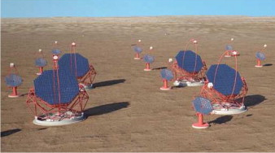
#2 EU High Throughput Data Analysis for CTA
CTA science gateway
App. porting tools
Applications
Authentiation,
Authorization
App. 1
App. 2
...
Support services
Computation
CTA resources
EGI HTC and data facilities

Slide 39
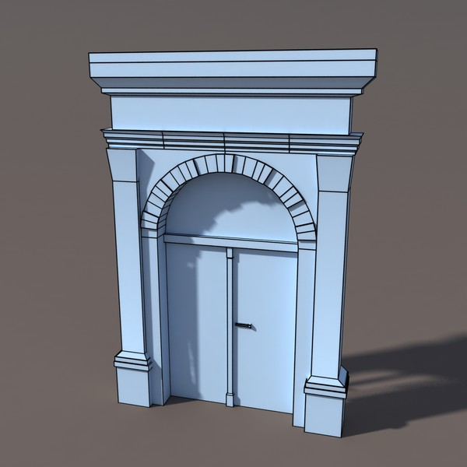
#3 EU Federated IaaS Cloud for CLARIN and BNCWeb
1st line infrastructure
2nd line Community support
Resource Discovery Service
Federated Cloud
SSO
Community Tools as Virtual Machines in Marketplace
Linguistic Datasets and corpa

Slide 40
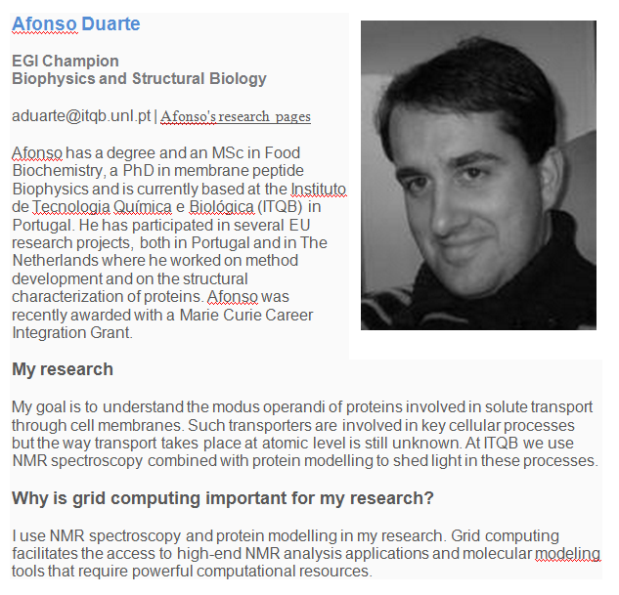
#4 Community Networks and Support The Champions Program
Feedback to EGI on application and services for biophysicsts
AppDB, brochure
Promote EGI at events
e.g. 9th European Biophysics Congress
Contribution to the EGI Massive Open Online Course mini-project
Liaison with Human Brain Project Flagship in Portugal

Slide 41
#5 Community-driven Innovation Virtual Team Projects - Examples
Activity | Discipline
EGI-EUDAT-PRACE pilots | Earthquake and seismology (VERCE); Life sciences (VPH)
EISCAT_3D and EURO-ARGO study cases | Environmental sciences (ESFRI cluster)
EGI-DRIHM collaboration | Hydrometeorology
NGI-ELIXIR collaboration | Life sciences (ESFRI)
Technology study for CTA | Astrophysics (ESFRI)
Towards a CMMST VRC | Chemistry, Molecular & Material Sciences
Speech on the Grid | Speech processing
Biodiversity and Environment (B & E) Community | Biodiversity and Environmental sciences
Fire and Smoke simulation | Fire and smoke simulation
MPI in EGI | Multi-disciplinary
GPGPU in EGI | Multi-disciplinary

Slide 42
Summary
Defined EGI Service Portfolio
Contributions from NGI, EGI.eu and projects
Services for researchers & communities
At various scale, scope & integration
Proven reliable and operational services
Demonstrated with heavy user communities
Collaborations enabled by a human network
Across EGI, by those who contribute and use it

