Slide 1
NA2.5 – Technical Outreach to New Communities
Gergely Sipos
Technical Outreach Manager EGI.eu

Slide 2
Outline
Objectives, partners
Areas of work
Outreach with technical focus
Joint activities with new communities
Support for Virtual Research Environments (VREs)
Providing Technical Services
Plans for PY4

Slide 3
Objectives
Coordination and support to enable research communities to evolve into routine EGI users:
Technical engagements → technical requirements
Identify and mobilise resources from EGI
Integrating applications with EGI platforms
Develop and deploy new services
Arrange training and consultancy
Support the development and deployment of innovative, collaborative VREs

Slide 4
NA2.5 Partners
EGI.eu ‘Technical Outreach to New Communities’ team (3 FTE)
Providers of technical services (2 FTE)
Applications Database
IASA (Greece 0.9 FTE)
Training Marketplace
STFC (UK 0.6 FTE)
Client Relationship Management system (from PM19)
Ibergrid (0.5 FTE) - CSIC (Spain 0.2 FTE) & LIP (Portugal 0.3 FTE)
NGI International Liaisons - NILs
Members of related Virtual Teams & other projects

Slide 5
Technical Outreach areas
Outreach with technical focus | Support for Virtual Research Environments
Joint activities with new communities | Providing technical services

Slide 6
Technical Outreach areas
Outreach with technical focus | Support for Virtual Research Environments
Joint activities with new communities | Providing technical services

Slide 7
Outreach with technical focus
Teleconferences with scientific projects
e.g. DRIHM, ELI, EISCAT_3D, Euro-Argo
Face-to-face presentations and discussions
Embedded into community events
Focus topics: Federated identity, workflows, science gateways, cloud technologies
EGI Webinar programme (go.egi.eu/webinars)
Service specific presentations
Introductory level
EGI.eu and guest speakers

Slide 8
Technical Outreach areas
Outreach with technical focus | Support for Virtual Research Environments
Joint activities with new communities | Providing technical services

Slide 9
Activities with new communities https://wiki.egi.eu/wiki → Projects
Activity | Discipline | Delivered output (so far)
EGI-EUDAT-PRACE pilots | Earthquake and seismology (VERCE); Life sciences (VPH) | Tools and best practices for complex workflows
EISCAT_3D and EURO-ARGO study cases | Environmental sciences (ESFRI cluster) | Architecture for a data systems based on EGI tools
EGI-DRIHM collaboration | Hydrometeorology | Architecture for a workflow portal based on EGI tools
NGI-ELIXIR collaboration | Life sciences (ESFRI) | Social network (Recommended next steps)
Technology study for CTA | Astrophysics (ESFRI) | Requirements from CTA to EGI
Towards a CMMST VRC | Chemistry, Molecular & Material Sciences | Identified EGI services and applications that could support the VRC
Speech on the Grid | Speech processing | Contacts to fragmented community
B & E community | Biodiversity and Environmental sciences | Feedback on CRM system
Fire and Smoke simulation | Fire and smoke simulation | Contacts to a small and fragmented community
V i r t u a l
T e a m
S
Notes:
Points to make:
We engage through VTs but also through other mechanisms (pilots, use cases, case studies)
We work with various new scientific disciplines
We work with many ESFRIs
Not all projects are successful - reason of failure in the three projects: Project were organised from inside EGI, with no/little representation of the scientific community.

Slide 10
Technical Outreach areas
Outreach with technical focus | Support for Virtual Research Environments
Joint activities with new communities | Providing technical services

Slide 11
Support for Virtual Research Environments
Categorise and promote software for VREs
Science gateway frameworks, workflow tools, middleware services (in AppDB)
Blog posts, articles, training slides (in TMP)
Support uptake of the EGI Federated Cloud
Entry page for new users (go.egi.eu/cloud)
Investigative work for federated cloud use cases
Support the setup of central services for EGI VOs
GlobusOnline.eu
Follow-up user community requirements (go.egi.eu/requirements)
Helpdesk (NGIs), projects, TCB
Solved 19, Endorsed but returned 8

Slide 12
Technical Outreach areas
Outreach with technical focus | Support for Virtual Research Environments
Joint activities with new communities | Providing technical services

Slide 13
Technical services
To facilitate information exchange among
NGI support and outreach teams
Community-specific support teams
Project-specific support teams
User communities and individual users
EGI.eu staff
Services from EGI-InSPIRE
Applications Database
Training Marketplace
Client Relationship Management system

Slide 14
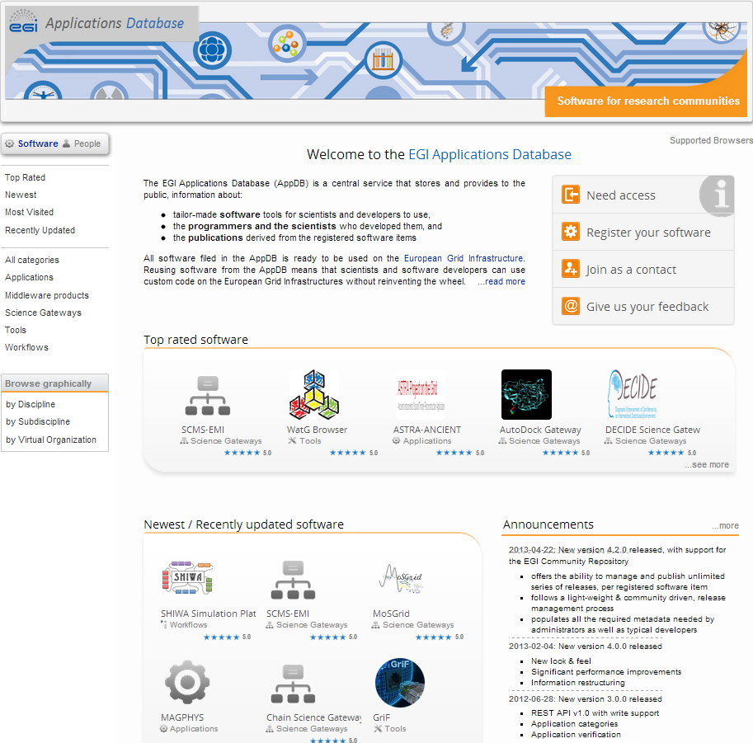
Technical services 1: Applications Database
Purpose:
Facilitate software reuse: Recognition to applications, tools and their developers
New features in PY3:
Content quality management
Broken link notification (~20/month)
Outdated entries notification (12 month)
New categories
Science gateways, Workflows, Middleware products
Repository features
Primarily for Community Technology Providers
Dissemination tool
Messaging groups of developers/users
Write API
Third party integration (+ gadget)
Redesigned front-end
Top, latest, recently updated, ...
http://appdb.egi.eu
By type
By discipline

Slide 15
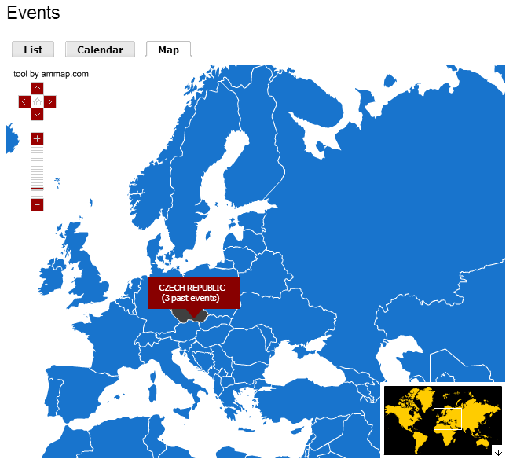
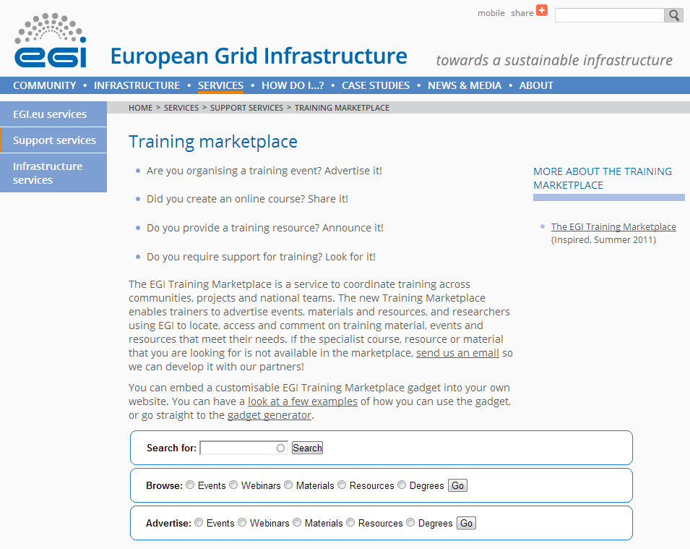
Technical Services 2: Training Marketplace
Purpose:
Recognition to training related activities and resources
New features in PY3:
Improved gadgets
Local events, auto-resize, look&feel
Usability improvements
Permalinks to events
Built-in descriptions
Spam protection
ReCAPTCHA module integrated
Promotion
‘As a service’ for external projects
A tool in EGI
Webinars
http://training.egi.eu

Slide 16
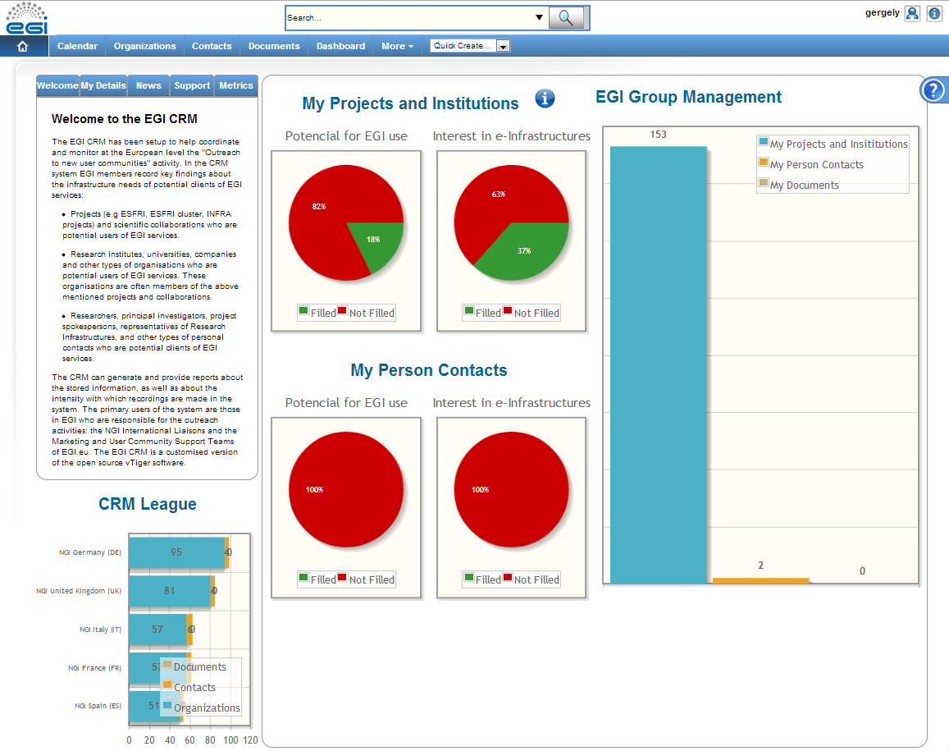
Technical Services 3: Client Relationship Management system
Purpose:
Database to capture interactions with and needs of potential user communities
Launched in PM19
New features in PY3:
Customisations
Data fields and associations
Pre-defined searches, ...
Metrics monitoring module
Leads and discussions per NGI
Projects without leads
Leads to be interviewed, ...
Promotion to NILs
http://crm.egi.eu

Slide 17
Uptake
Applications Database:
45 new software entries (~slightly less additions than in PY2)
Continuously growing and geographically dispersed visits
Further increase in the use expected
Repository and middleware support features (done)
Support for Virtualised software (planned)
Training Marketplace:
Events part is heavily used (more than in EGEE)
Client Relationship Management system:
Use so far only in a few NGIs → Still needs to demonstrate value at a European level

Slide 18
Community services Use of resources
 |  | Project Year 1 |  |  | Project Year 2 |  |  | Project Year 3 |  |  | Project Year 1-3
Service | Partner | Worked PM Funded | Committed PM | Achieved PM % | Worked PM Funded | Committed PM | Achieved PM % | Worked PM Funded | Committed PM | Achieved PM % | Worked PM Funded | Committed PM | Achieved PM %
Applications Database | IASA + GRNET | 14.6 | 11.8 | 124% | 8.4 | 11.8 | 71% | 10.6 | 11.5 | 92% | 33.6 | 35.1 | 96%
Training Marketplace | STFC | 5.6 | 5.8 | 107% | 3.9 | 3.6 | 107% | 7.7 | 7.3 | 105% | 17.2 | 16.7 | 103%
CRM | CSIC + LIP | 7.6 | 6.0 | 127% | 9.1 | 6.1 | 149% | 4.9 | 5.7 | 86% | 21.6 | 17.8 | 121%
Slight under reporting for IASA
Difference will be compensated in PY4
Slight over reporting for STFC
Difference will be compensated in PY4
Over reporting for CSIC
Maintenance and support will need less effort in PY4

Slide 19
Plans for next year
High priority activities at EGI.eu:
Joint activities with new communities
Enable community contributions in the EGI Collaboration Platform
Technical contributions to scientific events
Intense work with the NIL, Champion and Technologist networks
Technical services – functional features:
AppDB: Support for virtualised services
TMP: Rich filtering and customisation in all gadgets
CRM: Further promotion and focus on user support
Notes:
Software quality programme:
The programme will invite the developers and providers of user facing services from the EGI ecosystem to contribute to the EGI Collaboration Platform with services that meet the ‘5-star criteria’:
User-centric: The service is connected the EGI production infrastructure (core, cloud or community) and simplifies the use of the production infrastructure by scientific communities.
Generic: The service is discipline neutral, i.e. it can be used by scientists from any discipline.
Open: The service can be configured for any EGI Virtual Organisation (grid or cloud or both types of Virtual Organisations).
Online: At least one, centrally provided and production quality installation of the service exists for EGI.
Supported: Up to date information, support contacts and materials are available about the service through the EGI Applications Database.
The first ‘EGI 5-star services’ are expected to be Globus Online and some of the generic portal services, such as the SHIWA Simulation Platform, IGI Portal and DIRAC Portal. Because the EGI-InSPIRE project does not have budget to support the operation of 5-star services, these will have to be provided as external contributions.

Slide 20
Summary
Technical support for open, innovative, user-centric VREs:
Intense work with many new communities
These projects remain in the focus during PY4
Support for Virtual Research Environments
New programme will define ‘quality standards’ for contributed software
Outreach
Webinar programme & contributions to scientific events
Technical services
Continued growth in use
Development funding beyond EGI-InSPIRE still has to be secured

