Slide 1
SA1 and JRA1 Operations and Operational Tools
EGI-InSPIRE PY3 Review
25-26 June 2013
T. Ferrari, Chief Operations Officer/EGI.eu

Slide 2
Contents
Introduction to SA1 and JRA1
Infrastructure
Results
Analysis

Slide 3
PART I
Introduction to SA1 and JRA1
Resources
Partners
Objectives
Resource infrastructure
Service infrastructure
Analysis

Slide 4
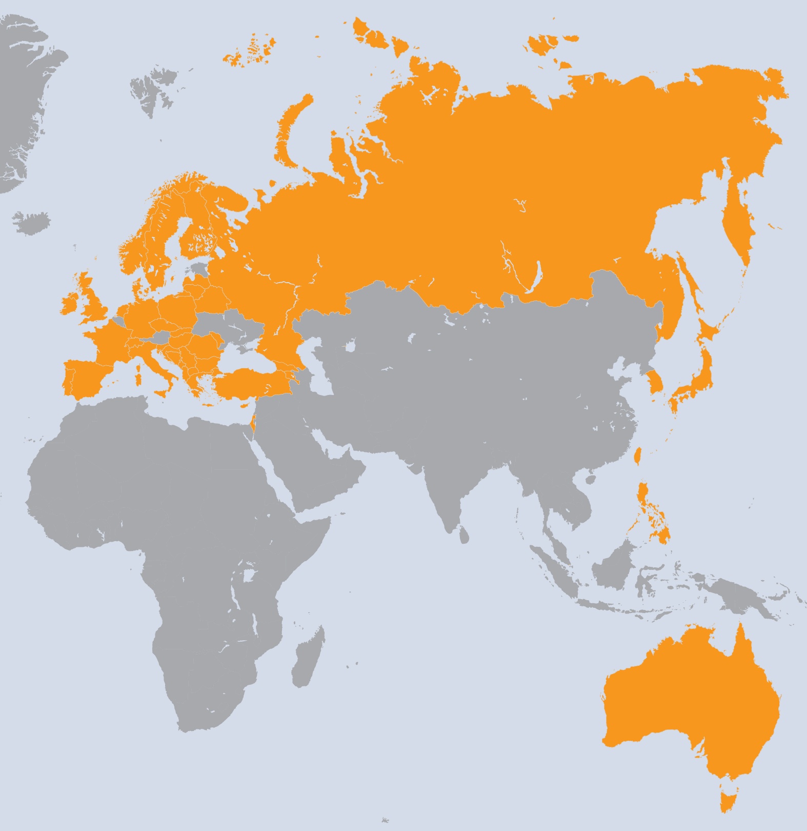
SA1 Overview
France
Finland
Spain
Poland
Greece
Italy
Germany
Portugal
Netherlands
Croatia
UK
Sweden
Slovenia
Czech Republic
Russia
Georgia
Romania
Bulgaria
Armenia
Latvia
Serbia
Israel
Hungary
Moldova
Norway
Switzerland
Ireland
Turkey
Denmark
Cyprus
Slovakia
Belarus
FYR Macedonia
Bosnia & Herzegovina
Montenegro
Albania
Lithuania
Taiwan
Philippines
Japan
Korea
Australia
Singapore
WP | Beneficiary | Total PM
WP4-E | EGI.EU | 79
WP4-E | CESNET | 42
WP4-E | KIT-G | 76
WP4-E | CSIC | 29
WP4-E | CSC | 8
WP4-E | CNRS | 12
WP4-E | GRNET | 70
WP4-E | SRCE | 39
WP4-E | INFN | 72
WP4-E | FOM | 35
WP4-E | CYFRONET | 23
WP4-E | LIP | 29
WP4-E | STFC | 73
WP4-E | CERN | 59
WP4-E | UU | 17
WP4-N | UPT | 15
WP4-N | IIAP NAS RA | 19
WP4-N | IICT-BAS | 58
WP4-N | UIIP NASB | 26
WP4-N | SWITCH | 83
WP4-N | UCY | 48
WP4-N | CESNET | 121
WP4-N | KIT-G | 263
WP4-N | UOBL ETF | 71
WP4-N | CSIC | 358
WP4-N | CSC | 63
WP4-N | CNRS | 302
WP4-N | GRENA | 19
WP4-N | GRNET | 176
WP4-N | SRCE | 72
WP | Beneficiary | Total PM
WP4-N | MTA KFKI | 106
WP4-N | TCD | 90
WP4-N | IUCC | 25
WP4-N | INFN | 364
WP4-N | VU | 8
WP4-N | RENAM | 16
WP4-N | UOM | 58
WP4-N | UKIM | 71
WP4-N | FOM | 149
WP4-N | SIGMA | 63
WP4-N | CYFRONET | 152
WP4-N | LIP | 103
WP4-N | IPB | 114
WP4-N | ARNES | 94
WP4-N | UI SAV | 92
WP4-N | TUBITAK | 126
WP4-N | STFC | 273
WP4-N | UCPH | 47
WP4-N | UU | 80
WP4-N | IMCS-UL | 48
WP4-N | JINR | 71
WP4-N | ICI | 54
WP4-N | ASGC | 193
WP4-N | ASTI | 156
WP4-N | KEK | 1
WP4-N | KISTI | 92
WP4-N | UNIMELB | 36
WP4-N | NUS | 14
57 Countries
58 Beneficiaries
PY3 effort (excluding unfunded partners)
1194 PMs
100 FTEs

Slide 5
SA1 tasks and resource distribution
I. Introduction
 | Task | Leader/Partner
TSA1.1 | Activity Management | T. Ferrari/EGI.eu
TSA1.2 | Secure Infrastructure | D. Kelsey/STFC
TSA1.3 | Service Deployment Validation | J. Pina/LIP
TSA1.4 | Infrastructure for Grid Management | E. Imamagic/ SRCE
TSA1.5 | Accounting | A. Packer/STFC
TSA1.6 | Helpdesk Infrastructure | G. Grein/KIT
TSA1.7 | Support Teams → extended to include software support (formerly SA2.5) | R. Trompert/SARA
TSA1.8 | Providing a Reliable Grid Infrastructure and core services | P. Korosoglou /AUTH

Slide 6
JRA1 Overview
7 Countries
8 Beneficiaries
PY3 effort:
86 PMs
7 FTEs
Italy
Germany
Spain
Greece
Croatia
CERN
France
UK
WP | Task | Beneficiary | Total PMs
WP7-E | TJRA1.1 | INFN | 24
WP7-E | TJRA1.2 | KIT-G | 47
WP7-E | TJRA1.2 | CSIC | 12
WP7-E | TJRA1.2 | CNRS | 12
WP7-E | TJRA1.2 | GRNET | 12
WP7-E | TJRA1.2 | SRCE | 12
WP7-E | TJRA1.2 | STFC | 24
WP7-E | TJRA1.2 | CERN | 12
WP7-G | TJRA1.3 | CSIC | 3
WP7-G | TJRA1.3 | CNRS | 3
WP7-G | TJRA1.3 | SRCE | 3
WP7-G | TJRA1.3 | STFC | 3
WP7-G | TJRA1.3 | CERN | 6
WP7-G | TJRA1.4 | KIT-G | 18
WP7-G | TJRA1.4 | CSIC | 18
WP7-G | TJRA1.4 | INFN | 26
WP7-G | TJRA1.4 | STFC | 27
WP7-G | TJRA1.5 | CNRS | 53

Slide 7
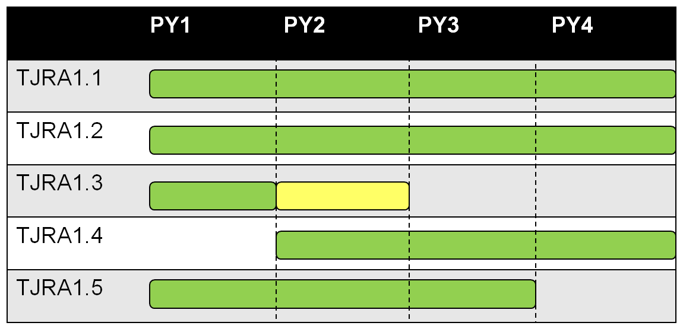
JRA1 tasks and resource distribution
I. Introduction
 | Task and Effort Distribution | Leader
TJRA1.1 | Activity Management (7%) | D. Scardaci/INFN
TJRA1.2 | Maintenance and development of the deployed operational tools (42%) | H. Dres/KIT
TJRA1.4 | Accounting for usage of different resource types (28%) Cloud, HPC, Desktop Grid, Storage/Data Usage Application Usage Billing system | A. Packer/SFTC
TJRA1.5 | Integrated Operations Portal (17%) Service Oriented model Porting to Symfony New DCI integration Support of mobile devices | C. L’Orphelin/CNRS

Slide 8
Objectives
I. Introduction
Operate a secure, reliable European-wide federated production grid infrastructure that is integrated and interoperates with other grids worldwide
 | Tasks | Task Objectives
O1 | TSA1.2 | Maintain a secure infrastructure
O2 | TSA1.3 | Validate new technology releases (tools and middleware)
O3 | TSA1.7 | Support end-users and Resource Centre administrators
O4 | TSA1.8 | Service Level Management, grid oversight, documentation and procedures
O5 | TSA1.4 TSA1.5 TSA1.6 | Operate tools, the accounting infrastructure and the EGI Helpdesk
O6 | JRA1.2 JRA1.3 JRA1.4 JRA1.5 | Evolve the operational tools used by the production infrastructure Maintenance, development and support of national deployment Accounting for the use of new resources Advancement of the Operations Portal

Slide 9
Contents
Introduction to SA1 and JRA1
Infrastructure
Results
Analysis

Slide 10
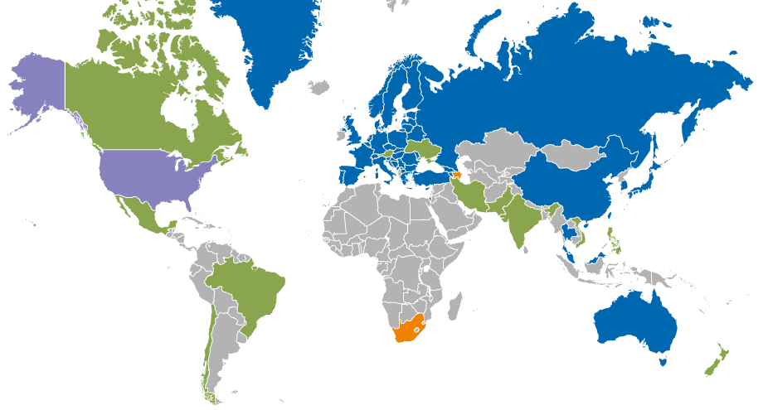
Resource infrastructure Providers
II. Resource infrastructure
Metrics (April 2013) |  | Value (yearly increase)
Countries | Including integrated RPs | 53 New: Iran & Vietnam Leaving: Ireland & Argentina
Operations Centres | Total (National, Federated, EIRO) | 34 (26, 7, 1)
 | New | Ukraine
 | Decommissioned | Ireland, Iniciativa de Grid de America Latina
Integrated EGI-InSPIRE Partners and
EGI Council Participants
Internal/External RPs being integrated
External RP
Peer RP

Slide 11
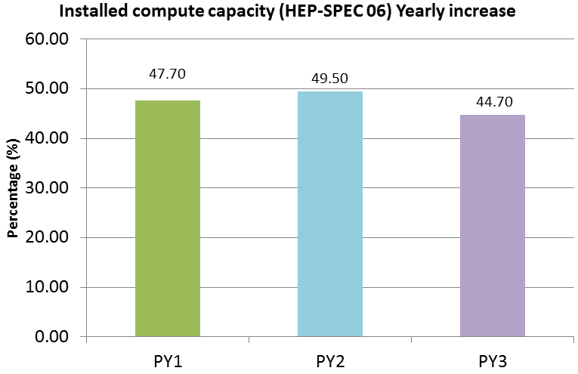
Installed Capacity
II. Resource infrastructure
Logical CPUs (April 2013) | Value (yearly increase)
EGI-InSPIRE and Council Participants | 333,400 (+23%) Stretch target: 330,000
Including integrated RPs | 361,300
Storage | Value (yearly increase)
Disk (PB) | 235 PB (+69%)
Tape (PB) | 176 PB (+32%)

Slide 12
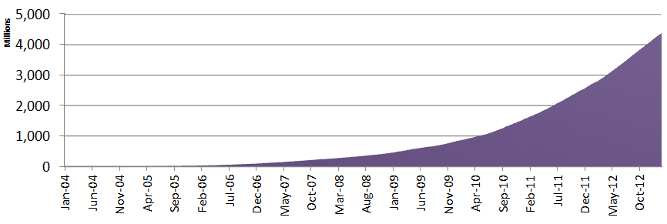
10 years in production
II. Resource infrastructure
Jan 2004 – April 2013 |  | Value
CPU wall time consumed (Jan 2004 – April 2013) | Billion hours | 5.0 (CPU wall time) 39.3 (normalized HEP-SPC06)
PY3 estimated utilization |  | 82%
HEP: 4.5 Billion hours
LS: 116.7 Million hours
EGI-InSPIRE
EGI-InSPIRE
AA: 110.3 Million hours
EGI-InSPIRE

Slide 13
Contents
Introduction to SA1 and JRA1
Resource infrastructure
Results
Continued operations
Technical advancement
Increased integration
Enhancement of service management
Analysis

Slide 14
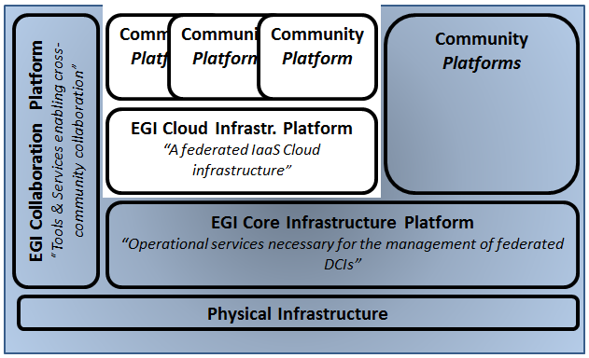
Continued operations
III. Results
PO1 The continued operation and expansion of today’s production infrastructure
Objectives
Adopt new software, technologies, standards
Security
Reliability
Notes:
Results
Continued coordination
Effective daily operations
New procedures and policies
Evolution of the infrastructure

Slide 15
Coordination
III. Results → Operations
Security Operations
EGI CSIRT
Software Vulnerability Group
Security Policy Group
Operations Coordination
Operations Management Board
User Community Board
GGUS Advisory Board
Technical coordination
Software deployment
Daily operations and Grid Oversight
Working groups and task forces
Effective daily running of the infrastructure
7 active working groups/task forces (3 new in PY3)
New board for helpdesk coordination

Slide 16
EGI CSIRT
III. Results → Operations → Security
Incident Prevention (security monitoring, security intelligence, assessment of known vulnerabilities with the support of SVG, preparation of advisories)
5 EGI CSRIT alerts and advisories (2 critical, 1 high risk)
12 Software Vulnerability Group advisories (1 critical, 3 high risk)
Incident Response and Vulnerability Handling (incident handling including investigation, heads up, coordination with site CSIRTs, forensics, technical support, advisories, reports)
Support tickets: 60 on critical vulnerabilities, 5 on security incidents
3 security incidents (2/PY1, 10/PY2) none related to middleware vulnerabilities, single site
Nodes deployed for denial of service attack, brute force attack via ssh

Slide 17
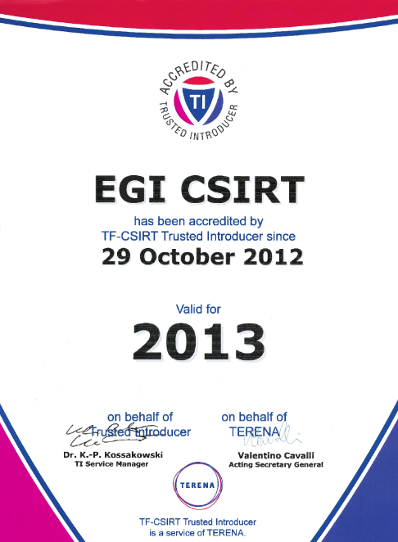
EGI CSIRT Collaborations
III. Results → Operations → Security
Oct 2012: Trusted Introducer accreditation
Member of Terena TF-CSIRT
EGI CSIRT is a listed team in the European database of CSIRTs
EGI-CSIRT collaborations
Public and non-public vetted networks
FIRST and NREN CERTS
Grid-SEC: coordinated response to cross-grid security incidents (vetted security representatives from WLCG, OSG, XSEDE, EGI)

Slide 18
Security Service Challenge
III. Results → Operations → Security
Purpose → Assessment of our incident response capabilities, test the incident response procedures, improving collaboration
How → Simulation of multi-site incidents (EGI/NGI level)
SSC6 involving EGI-CSIRT, WLCG and OSG resources in PY3 (40 sites)
Identified needs
Efficient infrastructure-wide user access management
Training on forensics, incident handling
More NGI readiness
Target → 10 NGIs running a SSC in PY4 (2 in PY3)

Slide 19
Security Threat Mitigations
III. Results → Operations → Security
Spreading of incidents, resources used for attacks to external parties
Policy, procedures, enforcement plan for central emergency user suspension and handling of compromised certificates
Training on forensics and incident response, defend real attacks (6 events, 94 participants)
Security operations support tools
Ability to quickly deploy custom sensors to meet emergent threats, security dashboard, evolution of SSC support framework
Policies and procedures for decommissioning of unsupported software
3 software upgrade campaigns (gLite 3.1, 3.2, EMI 1) supported by the with grid oversight team
Federated cloud security requirements, policies and operational activities (in progress)

Slide 20
Software Upgrades
III. Results → Operations → Core Infrastructure Platform
Operations Portal
3 releases: v. 2.9.4/.5/.6, new prototype under testing (v. 3.0.0)
Service configuration DB (GOCDB)
1 release (v. 4.4) and new (read-only) failover service instance
Service Availability Monitoring (SAM)
3 releases: Update 17, 19, 20
SAM instance for monitoring of EGI.eu and NGI operational tools
Nagios server for general infrastructure monitoring needs (e.g. monitoring progress of operational activities like unsupported software retirement, information validation, publishing required information in accounting records)
Messaging
New message broker network instance dedicated to testing, development of test suite to try software updates
Credential synchronization system for sharing of users/groups across all instances of a network, improved scalability and reliability of message delivery

Slide 21
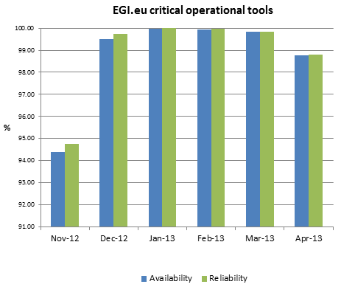
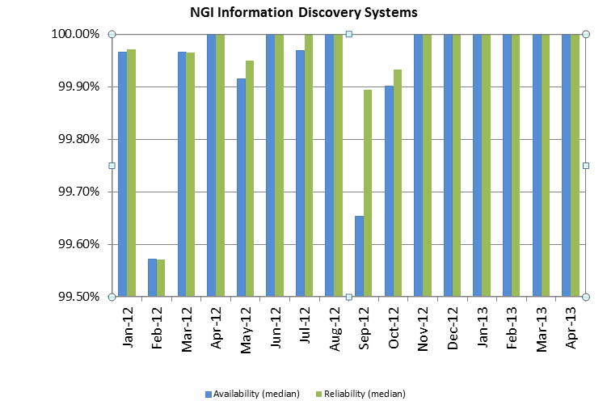
Service Levels/Core infrastructure
III. Results → Operations → Core Infrastructure Platform
PY3 Metrics |  | Availability/Reliability
Core Infrastructure Platform (Messaging, Monitoring, GGUS, Accounting DB, Operations Portal, Information System) | EGI.eu | 99.5%/99.5%
 | NGI | 97.5%/98.3%

Slide 22
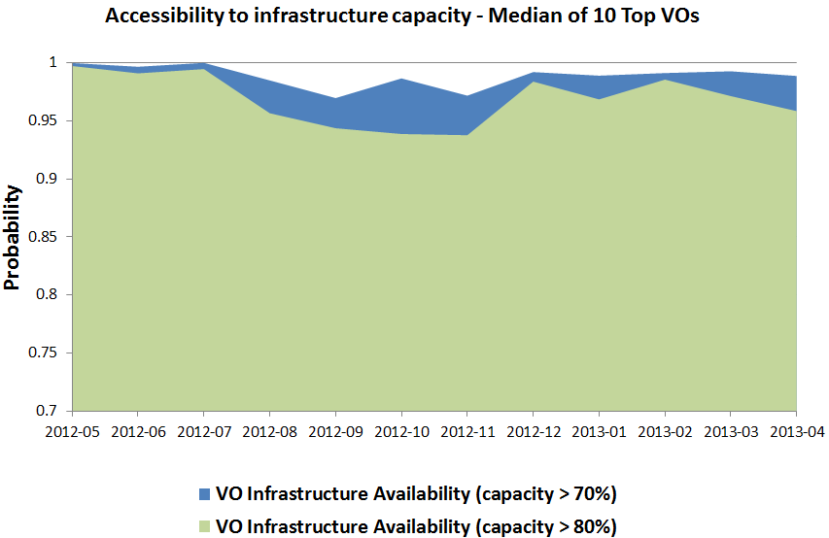
Service Levels/Community platforms
III. Results → Operations → Core Infrastructure Platform
PY3 Metrics |  | Yearly median of 10 top VOs
Monthly availability/reliability of services providing access to resources |  | 100.00%/100.00%
Monthly availability of infrastructure capacity | Capacity > 70% | Probability: 0.99
 | Capacity > 80% | Probability: 0.97

Slide 23
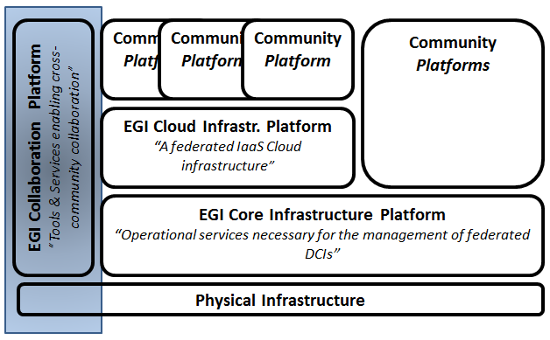
Evolution of operations and user support
III. Results
PO2 Continued support of researchers and operators
Objectives
Expansion of existing user communities
Continuous support
Evolve software support and helpdesk
Automate human ticket management

Slide 24
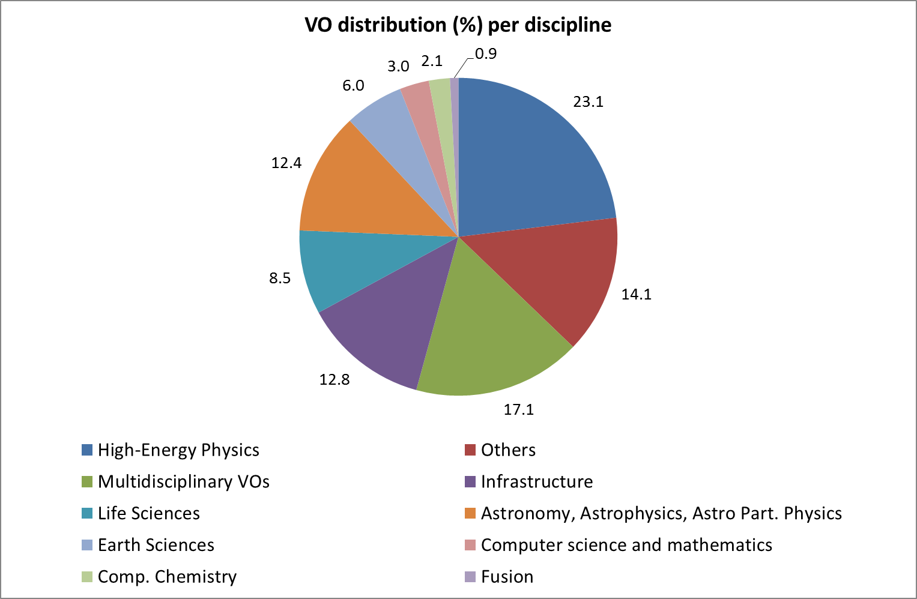
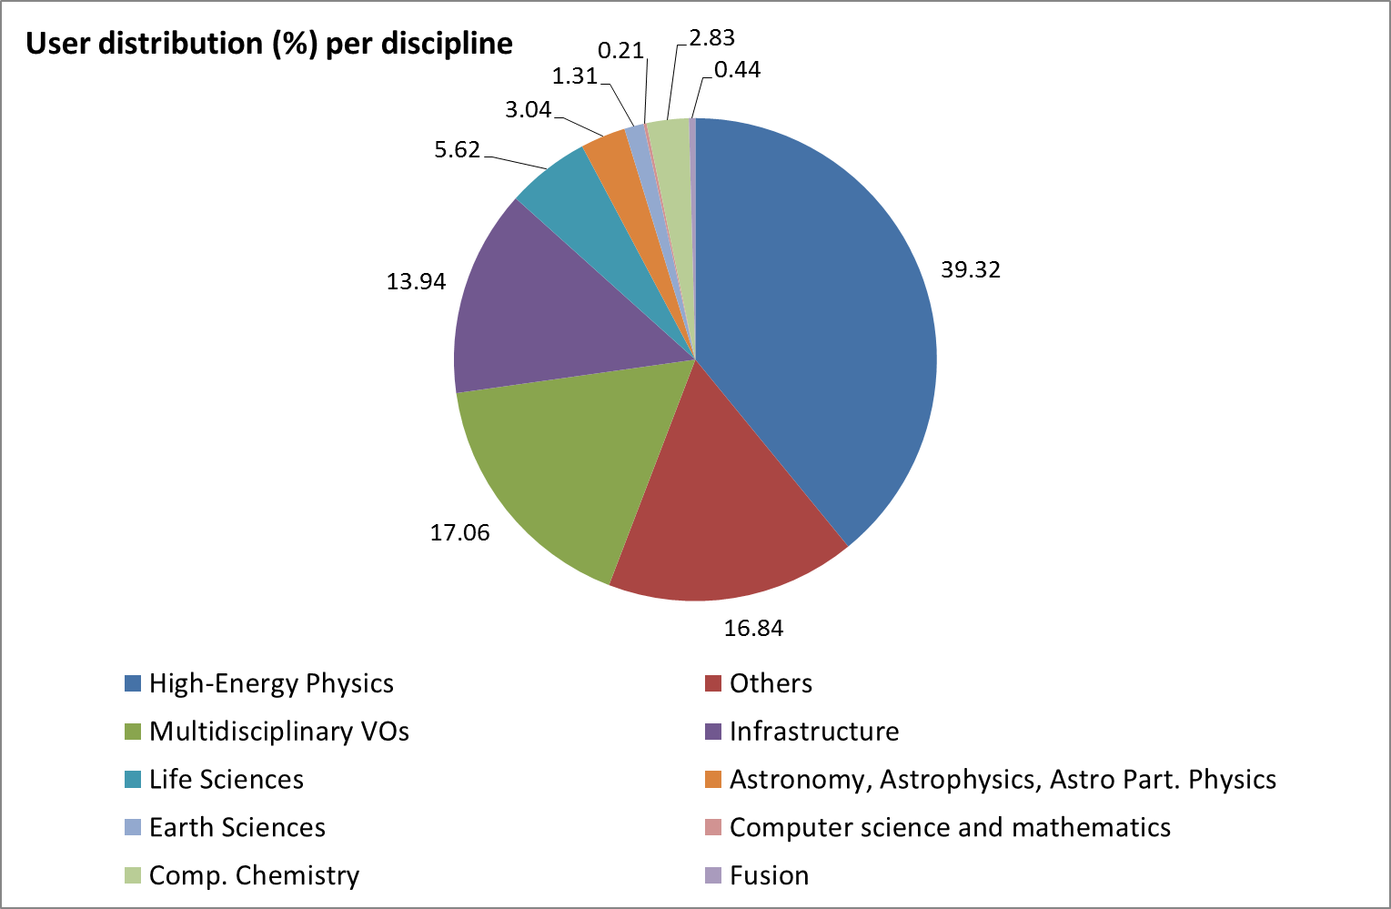
VO and User Statistics
III. Results → Support
PY3 Metrics | Values (April 2013) and yearly increase/decrease during PY3
Registered VOs | 237(+4.86%) - national (114) and international (123)
Registered users | 22,197 (+6.30%) Multidisc. (+18%), Astronomy (+9%), Life Science and HEP(+6%)
Active VOs | High: weekly workload (CPU time) > 1 Y Medium: weekly workload (CPU time) always ≤ 1 Y & > 1 Month Low: weekly workload (CPU time) always ≤ 1 Month | 74 ( +9%) 30 (-21%) 25 (-17%)
Notes:
Low activity VO: during the reference period for all weeks the CPU time collectively consumed is <= 1 Month/we
Medium activity VO: during the reference period for all weeks the CPU time collectively consumed is <= 1 Year/week
High activity VO: during the reference period for all weeks the CPU time collectively consumed is <= 1 Year/week

Slide 25
CPU Usage
III. Results → Support
PY3 Metrics |  | Value (yearly increase)
CPU wall clock time | Total norm. CPU wall clock time consumed – Grid jobs (Billion HEP-SPEC 06 hours) | 15.2, PY3: +44.7% PY2: +53%, PY1: +55.9%
Jobs | Grid job/year (Million) | 511.4, PY3: +6% PY2: +53%, PY1: +91.4%
 | Average Job/day (Million) | 1.44
% of total norm. CPU wall time consumed | High-Energy Physics | 93.78% (+40.97%)
 | Astronomy and Astrophysics | 2.82%
 | Life Sciences | 1.52%
Relative yearly increase | Other Sciences | +199.45%
 | Earth Science | +123.45%
 | Computational Chemistry | +78.31%
 | Astronomy and Astrophysics | +76.64%
 | Life Science | +65.12%
Notes:
Jobs
PY3: 511,420,740 +6.0%
PY2: 482,637,913 +52.9
PY1: 315,620,656 +91.4
PY0: 164,938,638

Slide 26
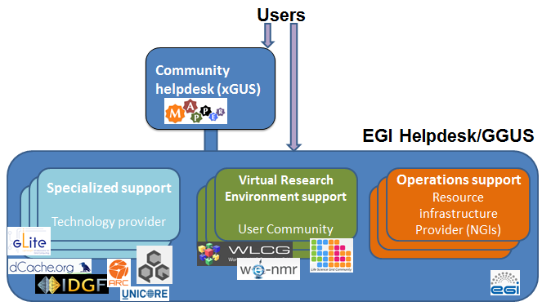
GGUS
III. Results → Support

Slide 27
GGUS
III. Results → Support
Report Generator
GGUS High Availability
New interfaces to NGI helpdesks
New automated ticket management workflows
Unresponsive submitters
Unresponsive supporters
Evolution of technology support helpdesk
Revision of all software support units
Quality of Service (Base, Medium, Advanced)
Feasibility study of EGI-PRACE helpdesk integration
PY3 Ticket metrics | Number of Tickets
Total number | 11,449
2nd level support Assigned/Solved | 701/195
3rd level support Assigned/Solved | 482/424

Slide 28
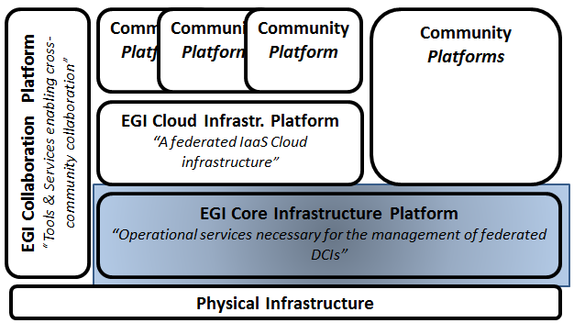
Technical Advancement
III. Results
PO1 The continued operation and expansion of today’s production infrastructure
Objectives
Extension of accounting to new resource types
Usability
Easy deployment
Robustness
Standard adoption for information publishing

Slide 29
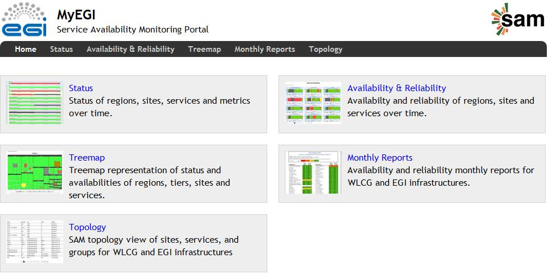
Monitoring 1/2
III. Results → Core Infrastructure Platform
SAM
Integration of new probes (EGI.eu operations tools, desktop grid, UNICORE, QCG, EMI as of Update 22)
New component for the management of monitoring profiles (POEM) - Update-17
describe existing monitoring metrics and group them
configure the way the availability and reliability is computed
allow notifications to messaging system
MyEGI
Improved usability
New Availability and Reliability
reporting module

Slide 30
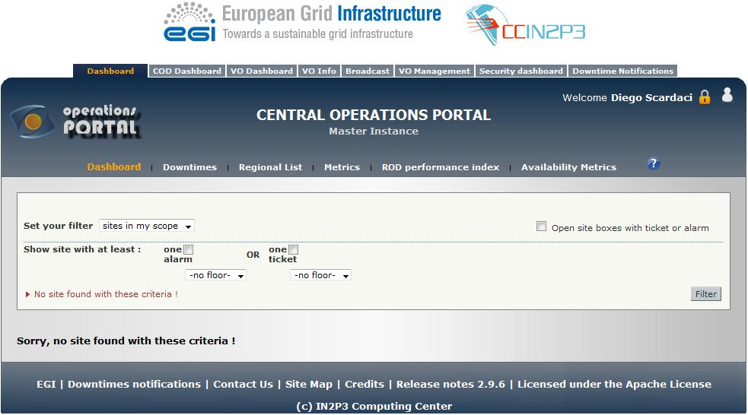
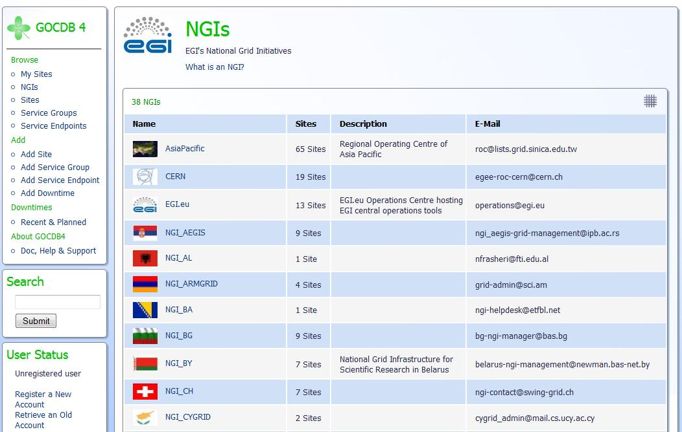
Operations Portal and GOCDB
III. Results → Core Infrastructure Platform
Operations Portal
Monitoring of resource centre performance and generation of alarms in case of service level target violations
Availability and reliability reporting module
Dashboards refactoring: new look and feel, improvement of efficiency and reactivity
GOCDB
V4.4: harmonization of front-end (read-only and read/write instances), improved search capabilities
V5 (in progress)
design and development of new data layer able to use different RDBMS platforms, services attributes
Scoping of services (Mini Project)

Slide 31
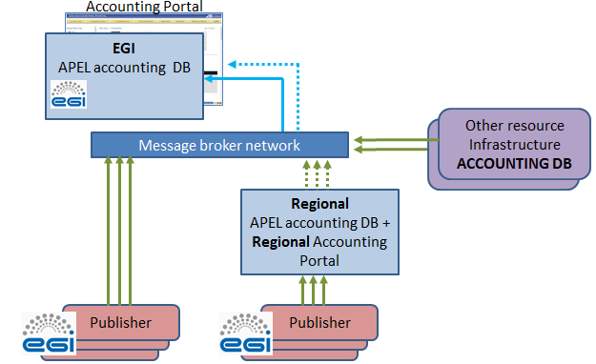
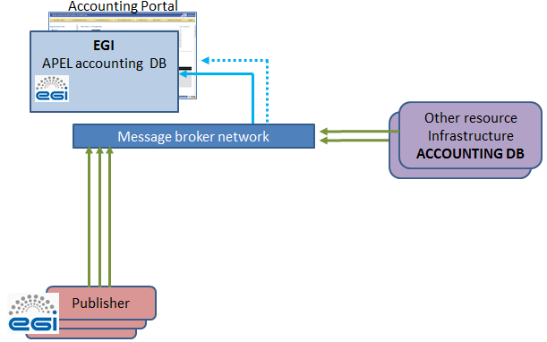
Accounting and regionalization
III. Results → Core Infrastructure Platform
Accounting DB
Usage Record 2.0/OGF (testing)
EMI CAR (Compute Accounting Record)/CPU and cloud
EMI StAR (Storage Accounting Record
EMI Secure STOMP Messenger
1.2 (June 2012)
2.0 (March 2013)
Regionalization
PY2
PY3
Accounting portal
New views
Inter-NGI accounting reports

Slide 32
Information Discovery Service
III. Results → Core Infrastructure Platform
Objective
flexible representation of resource and service properties
Results
publishing of information according to the latest OGF standard GLUE 2.0, more than 5000 service end-points
Definition of EGI GLUE 2 profile
Detailed semantics, extension to the schema definitions
Classification attributes by use case and importance
Information validation criteria
GOCDB GLUE 2 XML rendering of the EGI service registry and participation to OGF standardization activities

Slide 33
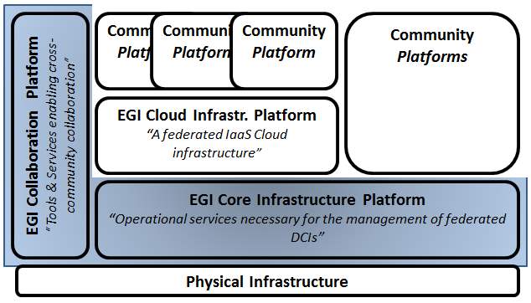
Integration
III. Results
PO4 Tool interfaces that expand access to new user communities ☺
PO6 Establish processes and procedures to allow the integration of new technologies ☺
PO5 Mechanisms to integrate existing infrastructure providers in Europe and around the world → In progress
Objectives
Service registry which can serve multiple infrastructure
CPU accounting for different software stacks
Monitoring of heterogeneous software
Support users accessing multiple RIs (EGI, EUDAT, PRACE, OSG and XSEDE)

Slide 34
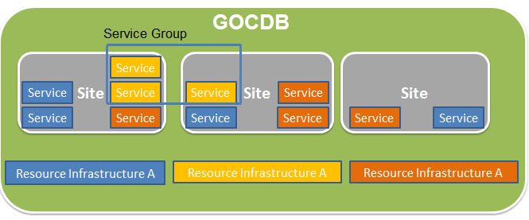
PO4: GOCDB
III. Results → Integration → Tools
Service grouping
Scoping of service end-points: allow them to be part of different arbitrary infrastructures (mini-project)
hosting multiple projects/infrastructures within a single GOCDB instance
Infrastructure-specific views
GOCDB for EUDAT

Slide 35
PO4: Accounting
III. Results → Integration → Tools
APEL Accounting DB
SSM v. 2.0 → Globus, QoSCoSGrid, Desktop Grid and UNICORE (in progress)
Accounting of usage of multiple resources types
PY1/PY2: Compute
PY3
Storage, Cloud, Parallel Jobs (testing)
Application accounting (under development)
Accounting Portal
XML endpoints generalization to be used to export accounting data to other infrastructures
Cloud accounting views being prototyped

Slide 36
PO4: SAM and Operations Portal
III. Results → Integration → Tools
Operations Portal
Operations Dashboard regional views
SAM
Any probe can be integrated to extend the framework
gLite, Globus, ARC and Desktop Grids
PY3: QosCosGrid, UNICORE, Federated cloud
Fully regionalized – 44 production instances
Set of probes can be customized
Users: VO SAM (11 service end-points)

Slide 37
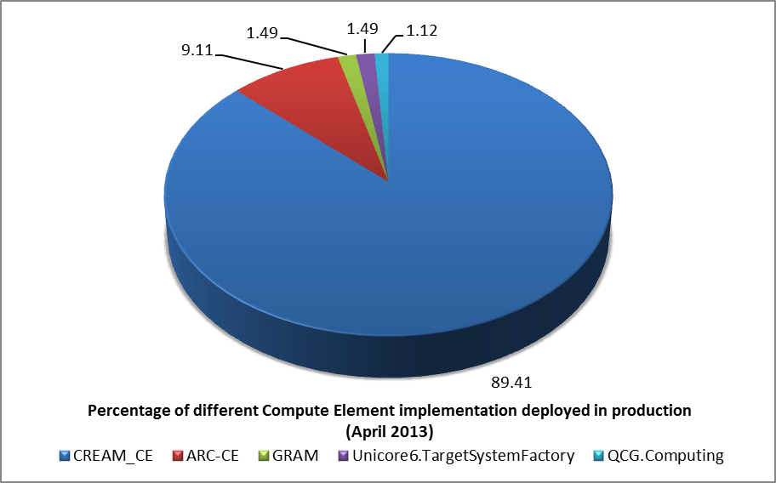
PO6: Software
III. Results → Integration
Core infrastructure platform interfaces and procedures allow the deployment and operation of heterogeneous software stacks
Completed integration of
ARC (9.11%),
UNICORE (1.49%),
Globus (1.49%),
QosCosGrid (1.12%)
Desktop Grids (6540 cores)

Slide 38
PO5: Infrastructure Providers 1/2
III. Results → Integration
Objective 1. Technical integration
Seamless authentication, data access, transfer, replication and processing across EGI, EUDAT and PRACE
Collaboration between user communities, Resource Infrastructures and Technology Providers
Seismology (VERCE)
Biomedical modelling and simulation of the human body (VPH)
European plate observation (EPOS)
Multi-scale simulation for nano-material science (MAPPER)
Hydro-meteorology (DRIHM)

Slide 39
PO5: Infrastructure Providers 2/2
III. Results → Integration
Objective 2. Operations integration for the exchange of support services, accounting and monitoring
Provisioning of operations technical services
Provisioning of tool software (e.g. GOCDB for EUDAT)
Common security operations, policies and incident response
Security for Collaboration among Infrastructures (SCI) – D. Kelsey/EGI (EGI, OSG, PRACE, WLCG, XSEDE)
MoU with Asia Pacific
Collaboration with OSG and XSEDE

Slide 40
Enhancing EGI’s Service Management
III. Results
PO1 The continued operation and expansion of today’s production infrastructure
Objectives
Improvement of service management processes (EGI.eu)
Advancement of
Service level management
Service reporting management

Slide 41
Operational Level Agreements (OLAs)
III. Results → Service Management
PY2
Resource Centre (RC) OLA
Local resource access services
Resource infrastructure Provider (RP) OLA
NGI/EIRO technical, support and coordination services
PY3
EGI.eu OLA
Centrally provisioned EGI.eu technical, support and coordination services

Slide 42
Service Management
III. Results → Service Management
Objective
Assess maturity of service management of EGI.eu core services and improvement plan
Phase 1: improve 3/14 service management processes
Service level management
Service reporting management
Incident & service request management
PY4 implementation of plan
14 Service Management Processes
64 Requirements
(2-8 per process)
192 capability level state descriptions
(3 per requirement)

Slide 43
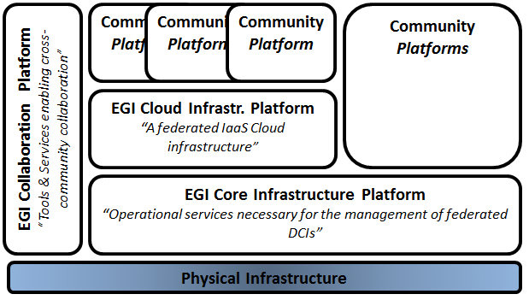
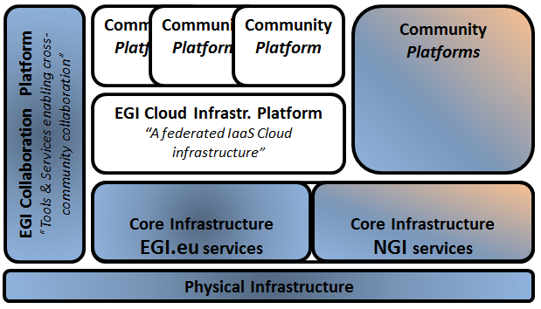
Service Level Management
III. Results → Service Management
Completed
In progress
PY2
PY3
Computation
SAM/Availability Computation Engine
Visualization
Not available
Computation
SAM/Availability Computation Engine
Operations Portal
Visualization
MyEGI and Operations Portal

Slide 44
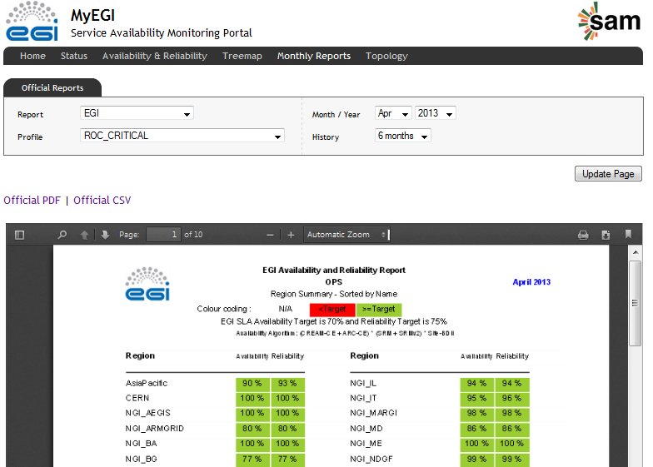
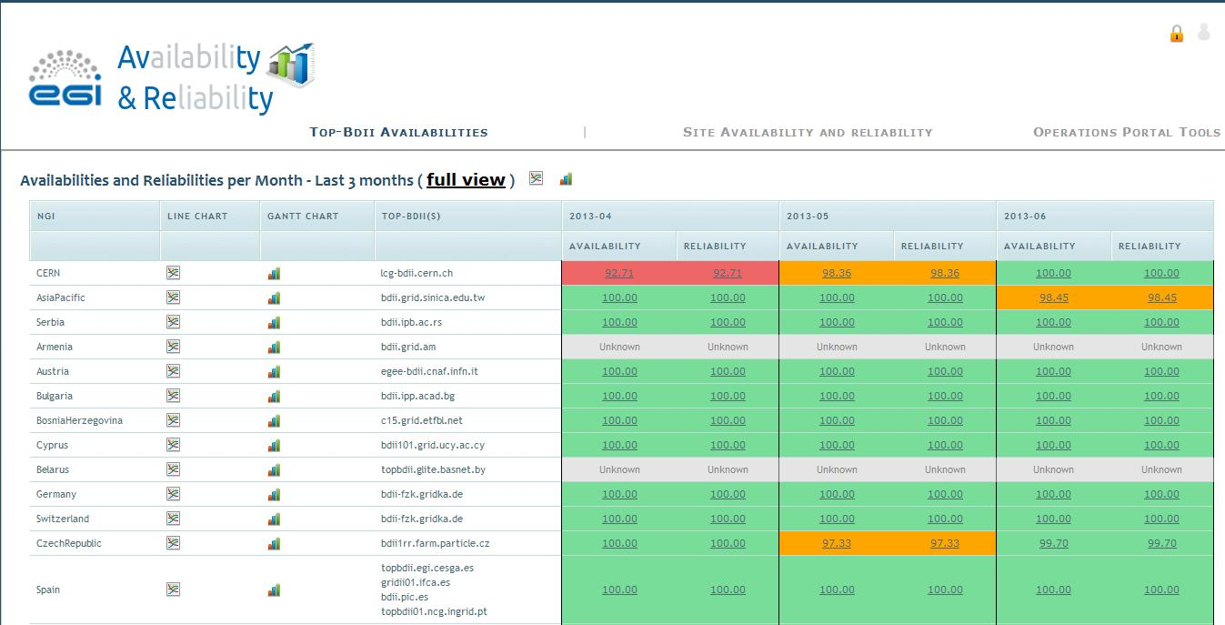
Service Reporting Management
III. Results → Service Management
PY4 Availability/Reliability computation mini project
Objectives
Regionalization
Customization of reports for NGIs and VOs

Slide 45
PART IV
Introduction to SA1 and JRA1
Resource infrastructure
Results
Analysis

Slide 46
PY4 Issues/SA1
IV. Analysis
NGI operations sustainability after EGI-InSPIRE
Jan 2013: no progress in securing funding to support national NGI operations activities (70.3%), negotiations still in progress, no national funding secured yet for the majority of the NGIs (85%)
PY4 mitigation
Central regional views of tools
Facilitate the exchange of operational services
NGI 3rd party service provisioning
Share services
Leverage on expertise
EGI.eu coordination of community platform services
Increase efficiency and reduce cost

Slide 47
PY4 Issues/JRA1
IV. Analysis
TJRA1.4: extension of the accounting system to support pay-for-use
Pay-per use model being experimented
Participation to the EGI Pay-for-Use pilot group to identify requirements
PY3 Mitigation: Effort allocated to the handling of accounting usage records for new resources (storage, cloud, local and parallel jobs)

Slide 48
Use of Resources/SA1
IV. Analysis
103% PMs achieved (aggregated)
EGI.eu Global Services → 92% PMs achieved
No PY2 deviations to be compensated
Operations coordination (TSA1.1) → 173% PMs achieved by EGI.eu, compensating PY1 (60%) and PY2 (70%)
Catch all services/availability (TSA1.8) → 27% PMs achieved, partner affected by hiring freeze and austerity measures in the public sector, but services successfully delivered. No compensation of PY2 deviation
NGI Services → 105% PMs achieved

Slide 49
IV. Analysis
Use of Resources/JRA1
92% PMs achieved (aggregated)
Coordination and maintenance (TJRA1.1, TJRA1.2) → 96% PMs achieved
General tasks (TJRA1.4, TJRA1.5) → 88% PMs achieved
TJRA1.4 → 68% PMs achieved, compensation expected in PY4 with ramping up of new implementation activities
TJRA1.5 (ended) → 99% PMs achieved over PY1, 2 and 3

Slide 50
SA1 Plans for PY4
IV. Analysis
Core infrastructure platform
Federated cloud integration
Secured messaging connections and messaging failover
Deployment of GOCDB v5, scoping
Accounting: regionalization; cloud, storage and parallel job accounting in production
Security
SHA-2 readiness, central emergency suspension enforcement, procedures and policies
Service management
Improvement of service management (EGI.eu core infrastructure platform)
New service level computing and reporting system (Operations Portal)
Technical integration
Use case-driven integration with EUDAT, PRACE, OSG and XSEDE
Preparation to post-EGI-InSPIRE
Global task transition, NGI service federation and coordinated community platform provisioning
Resource allocation

Slide 51
JRA1 Plans for PY4
IV. Analysis
Operations Portal
Consolidation of Availability/Reliability dashboard, integration of new module for resource allocation (Mini Project), automated testing of release updates
GOCDB
GOCDB v5, scoping, GLUE2 XML rendering
Accounting
Validation of accounting of new resource types (storage, clouds, parallel jobs)
Advancement of application accounting
Development of new accounting portal views
GGUS
Extended user authentication, Shibboleth
SAM
Release of Update 22 in production (new set of probes)
Use of messaging failover for dispatching of SAM results

Slide 52
Summary
SA1 and JRA1 contribute to meet the project objectives and support the EGI Strategy 2020
Leadership
with the expansion of the resource infrastructure and increasing usage
Openness
with a growing level of integration
Reliability
with continued operation and increasing performance
Innovation
by evolving the infrastructure, operational tools and service level management

