Slide 1
NA2.3 – Strategic Planning and Policy Support
Sergio Andreozzi
EGI-InSPIRE NA2.3 Task Leader
EGI.eu Strategy & Policy Manager

Slide 2
Outline
Partners
Objectives
  Strategic Planning
  Policy Development
  Building Strategic Collaborations
Achievements
Achievements of PY3
Plans for PY4

Slide 3
TNA2.3 Partners
EGI.eu, NL
  Strategy and Policy Team (40PM/Y3)
STFC*, UK
  Leading the Security Policy Group (5.1PM/Y3)
FOM*, NL
  Liaison with EUGridPMA/IGTF (1.2PM/Y3)
  * Activity reported in the context of SA1

Slide 4
Objectives and Achievements
Strategic Planning
  Assessment: EGI Compendium
  Execution: implementing the EGI Balanced Scorecard
  Governance: developing the ERIC opportunity
  Business Models: exploring EGI Pay-for-Use
  Service Strategy: EGI Service/Solution Portfolio(s)
Policy Development
  Scientific Impact: demonstrating and preparing for Open Access
  Scientific Discipline Classification: harmonisation
Building Strategic Collaborations
  Establish new collaborations

Slide 5
Strategy Planning :: Assessment
EGI Compendium
Body of information about NGIs/EIROs:
To increase transparency and clarity
To support strategic planning
To provide a coherent view
Build on similar experience from NRENs community (see TERENA Compendium)
Authored first edition (data about 2011) with 28 out 38 NGIs participating http://go.egi.eu/egi-compendium-2011
Authoring second edition (data about 2012, collection ended 26/05/13, publication for late summer)
125 questions to describe:
Identity and Contact
Strategy
Governance
Funding and staffing of the NGI/EIRO e-infrastructure
Funding of the NGI/EIRO e-Infrastructure
Cost of the NGI/EIRO e-Infrastructure
Policy
Outreach and Publications
Services
Users
Infrastructure
Technology

Slide 6
Strategy Planning :: Assessment
EGI Compendium
Strategy: vision(s)
Ops: yearly wall-clock time
Manpower
distribution
Government
relations

Slide 7
Strategy Planning :: Execution
Implementing EGI Balanced Scorecard
Implemented balanced scorecard
For each metric
Updated metric definitions
Defined a data dictionary item
Collected values for PY3
Scorecard data dictionary - Example

Slide 8
Strategic Planning :: Governance
Developing the ERIC Opportunity
Proposed a governance structure
  Based on the ERIC legal framework
  With a proposed Statute
  Overarching e-Infrastructures
  With better user representations
  With a preliminary implementation plan
Next steps
  Discussing with other e-Infrastructures
  Participating in e-IRG
  Proposed networking session at ICT2013

Slide 9
Strategic Planning :: Business Models
Exploring EGI Pay-for-Use
Opportunity
  Emerging on-demand, self-service, pay-as-you-go models
  Direct charge to users as additional revenue stream
Performed activities
  Authored a policy paper to explore possible models and actions
  Started a pilot group for small-scale experiment to identify available/missing technical capabilities (collaboration with JRA1 and SA1)
  Collaboration with e-FISCAL project to derive metrics for pricing models definition
Issues
  Legal barriers for some NGIs, liability, selection of broker model may require EGI.eu to change legal nature

Slide 10

Strategic Planning :: Service Strategy
EGI Service/Solution Portfolio(s)
Need
Making EGI service offerings description independent from projects
Improve clarity for potential new users
Solution
Introduce Service/Solution Portfolios
Defined a template for a service portfolio
Refactored EGI-InSPIRE Global tasks into EGI.eu Service Portfolio
Initial draft of NGI/Resource Provider/Resource Centre portfolio
Defined initial solutions portfolio
Plan for Y4
Transfer the experience to NGIs
thanks for support
http://www.egi.eu/services/

Slide 11
Objectives and Achievements
Strategic Planning
  Assessment: EGI Compendium
  Execution: implementing the EGI Balanced Scorecard
  Governance: developing the ERIC opportunity
  Business Models: exploring EGI Pay-for-Use
  Service Strategy: EGI Service/Solution Portfolio(s)
Policy Development
  Scientific Impact: demonstrating and preparing for Open Access
  Scientific Discipline Classification: harmonisation
Building Strategic Collaborations
  Establish new collaborations

Slide 12

Policy Development :: Scientific Impact
Demonstrating Excellent Science
EGI: distributed infrastructure, distributed communities, distributed resource allocation
Problem 1:
Difficult for research communities to “shop” for resources
Solution:
Introducing federated resource allocation process
  to be added to current one
  managed by EGI.eu
  allocation based on peer review from expert committee
  for resources that NGIs delegate to EGI.eu
Problem 2:
Difficult to track scientific output
Solution:
  Change of User AUP to mandate use of acknowledgment statements in research outputs
Extending OpenAIRE to allow:
  linking scientific publications to e-Infrastructures and virtual organisation
  Manual/automatic mining

Slide 13
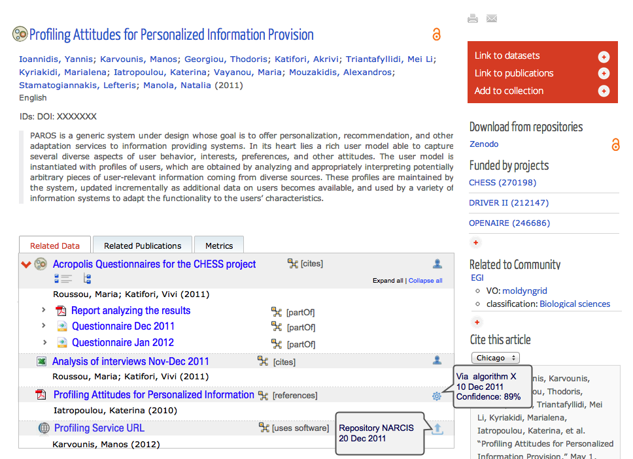
Policy Development :: Scientific Impact
Demonstrating Excellent Science
EGI: first case to collaborate with OpenAIRE on enriched metadata for linking research outputs to infrastructures
Preview of next OpenAIRE
To be rolled out in autumn
Prepare EGI for Open Access

Slide 14
Policy Development ::
Scientific Discipline Classification Harmonisation
Problem
  Many EGI tools map user-related information to scientific disciplines
  A legacy simple classification was inherited by EGEE (the “other” effect)
  Some new EGI tools adopted other classifications (e.g., CRM, AppDB)
  Inconsistent usage across tools make difficult to track impact by discipline and limit re-use of results
Solution
  Defined a new classification based on the Frascati Fields of Science (FOS)
  https://wiki.egi.eu/wiki/VT_Scientific_Discipline_Classification_Classification
  Validated through survey to VOs and public comment period
  Assessed cost for updating/aligning tools
Implementation
  Planned in PY4 (prioritisation to be confirmed)

Slide 15
Objectives and Achievements
Strategic Planning
  Assessment: EGI Compendium
  Execution: implementing the EGI Balanced Scorecard
  Governance: developing the ERIC opportunity
  Business Models: exploring EGI Pay-for-Use
  Service Strategy: EGI Service/Solution Portfolio(s)
Policy Development
  Scientific Impact: demonstrating and preparing for Open Access
  Scientific Discipline Classification: harmonisation
Building Strategic Collaborations
  Establish new collaborations

Slide 16
Collaborations :: New
Technology Providers
EMI, IGE, StratusLab, SAGA, UVACSE, PSNC
Resource Providers
Latin-America, South Africa, Ukraine, Asia-Pacific, OSG (US)*
Specialised Services and Support
MAPPER, GISELA, gSLM, e-ScienceTalk, DECIDE, CHAIN, EDGI, ScalaLife, SCI-BUS, SHIWA, SIENA, e-nventory, DANTE
VRCs
WLCG, WeNMR, HMRC, LSGC, VERCE*
LoI with DARIAH/CLARIN
Signed MoUs:
+7 (PY1)
+16 (PY2)
+4 (PY3)
Negotiate
Execute
Close
* Active negotiation
http://www.egi.eu/community/collaborations/

Slide 17
Other (Routine) Activities
Supported EGI policy groups
  Secretary support
  Policy development process
  Review of Terms of Reference (e.g. new TCB, URT)
Deliver messages on strategy/policy
  Blog posts, article in Inspired newsletter, e-IRG newsletter, other media
Monitor execution of strategic collaboration

Slide 18
Plans for Next Year
Strategic Planning
  Assessment: Publish EGI Compendium 2012, collect data for 2013
  Strategy Execution: review the EGI Balanced Scorecard
  Governance: develop discussion with e-IRG and key players for common ERIC to coordinate e-Infrastructures
  Business Models: complete EGI Pay-for-Use gap analysis
  Service Strategy: complete EGI Service/Solution Portfolio(s)
Policy Development
  Scientific Impact: complete federated allocation and OpenAIRE extensions
Building Strategic Collaborations
  Broaden collaborations, monitor execution

Slide 19
Summary
Strategic Planning
  Increased clarity in EGI.eu/EGI service offering/value
  Strengthened strategy execution monitoring
  Started EGI Pay-for-Use experiment
  Developed vision and plan for a common ERIC across e-Infra
Policy Development
  Defined process and governance for federated resource allocation
  Defined process and collaborated with OpenAIRE for better scientific publications tracking (preparing for Open Access)
  Harmonised scientific discipline classification
Building Strategic Collaborations
  Expanded network and streamlined monitoring

